Slide 1
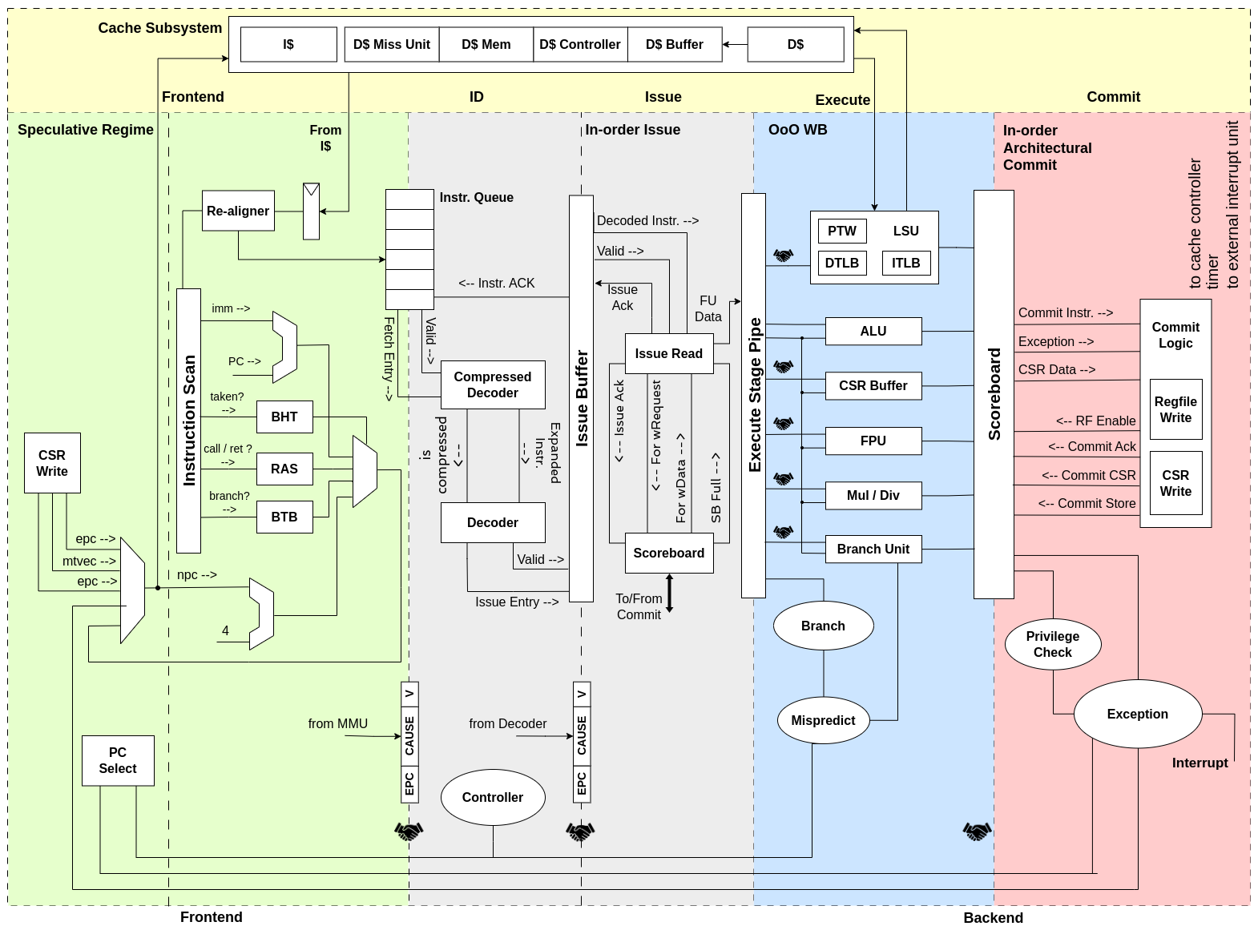
Shared L1 Data Cache

