Slide 1
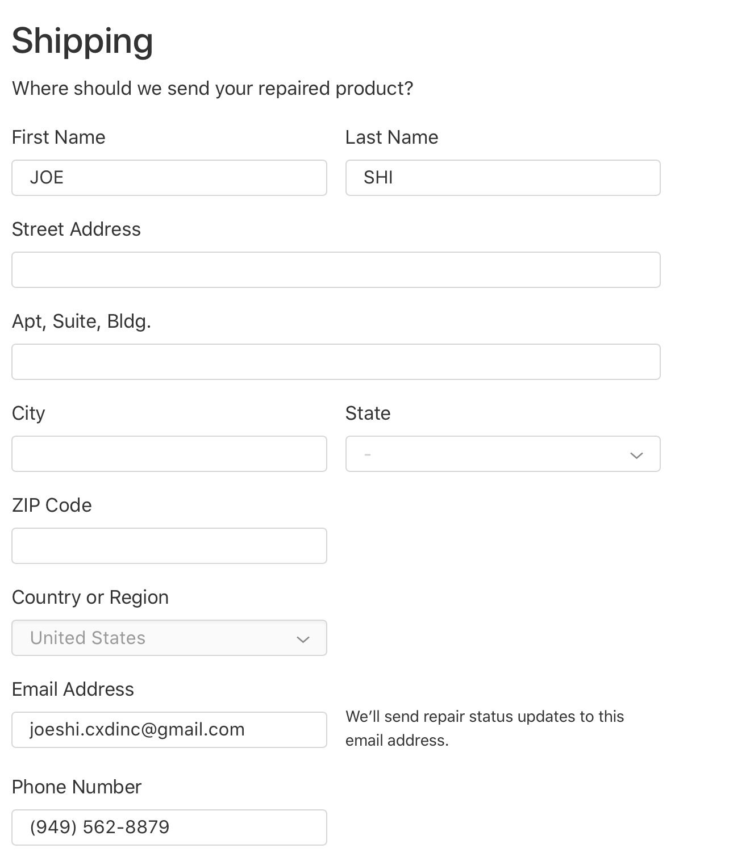

Menu
Where should we send your replacement product?

Slide 2
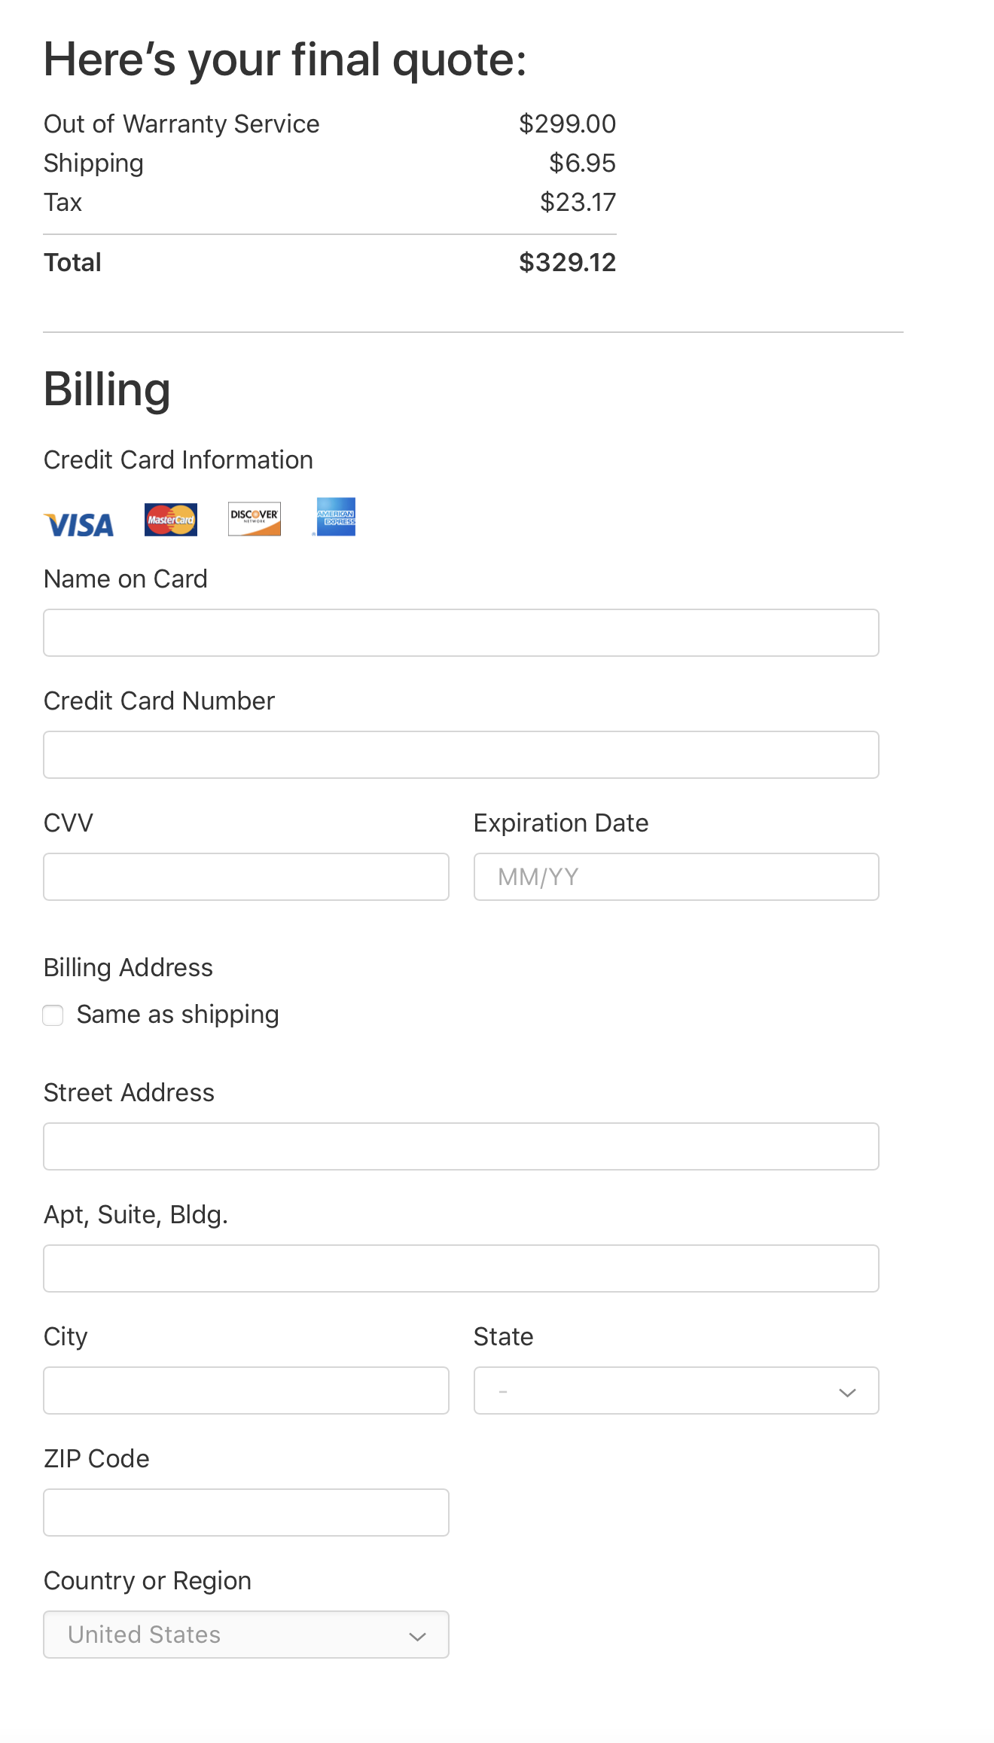
Menu
Here’s your estimated quote:

Slide 3
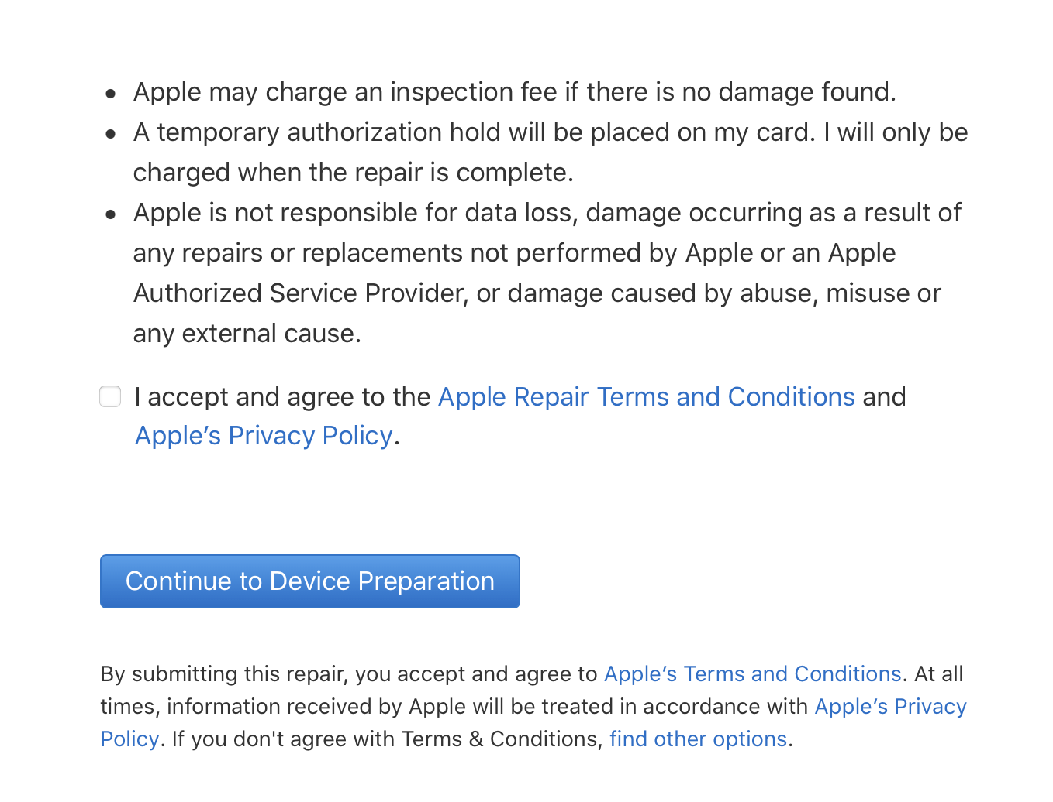
Menu
账单
You agree to return
InstantPods will inspect the product you returned and refund the replacement deposit once the inspection is completed.
If the product you returned was determined fake, physically damaged, has unauthorized modification, or you had never returned the product, the replacement deposit won’t be refunded. We will notify you in this case
I accept and agree to the InstantPods Repair Terms and Conditions.
Submit Repair
By submitting this repair, you accept InstantPods’s Terms and Conditions. If you don’t agree with Terms & Conditions, find other options.

Slide 4
Menu
We will replace your AirPods
We will replace both sides of your AirPods to ensure the quality of the repair and best customer experience.
Here’s your estimated quote:
Service Fee - AirPods, 1st Gen, Tier 1
$59.99
Replacement Deposit - AirPods, 1st Gen, RFB
$59.99
Shipping
$5.99
Tax
$5.99
Total
$131.96
We will charge a deposit of the product you are replacing so that we can send you the replacement first. Once we receive your returned faulty product, we will refund the replacement deposit.

Slide 5
Menu
We will replace your Charging Case
***
Here’s your estimated quote:
Service Fee - Charging Case, 1st Gen, Tier 1
$59.99
Replacement Deposit - Charging Case, 1st Gen, RFB
$59.99
Shipping
$5.99
Tax
$5.99
Total
$131.96
We will charge a deposit of the product you are replacing so that we can send you the replacement first. Once we receive your returned faulty product, we will refund the replacement deposit.

Slide 6
