Slide 1
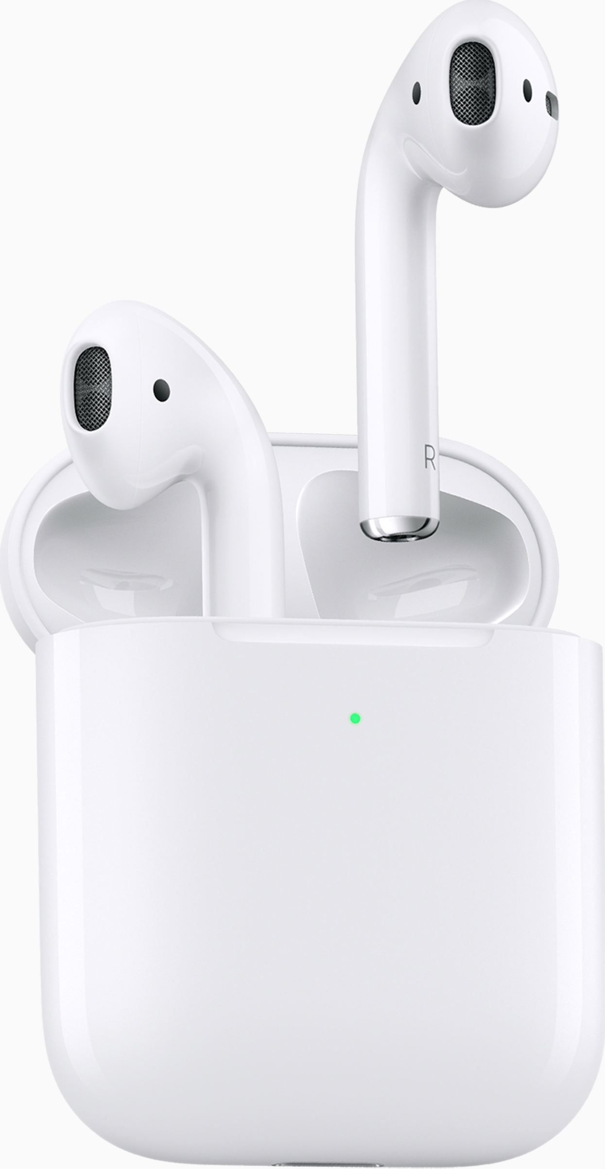


InstantPods
Menu
此图片侵权 需要被替换成动画
请开发者提供：
1.动画尺寸 像素
2.动画格式： 比如GIF
3.动画要求：比如透明底
Having your faulty AirPods instantly replaced. The ultimate repair experience is here.
How it works?

Slide 2
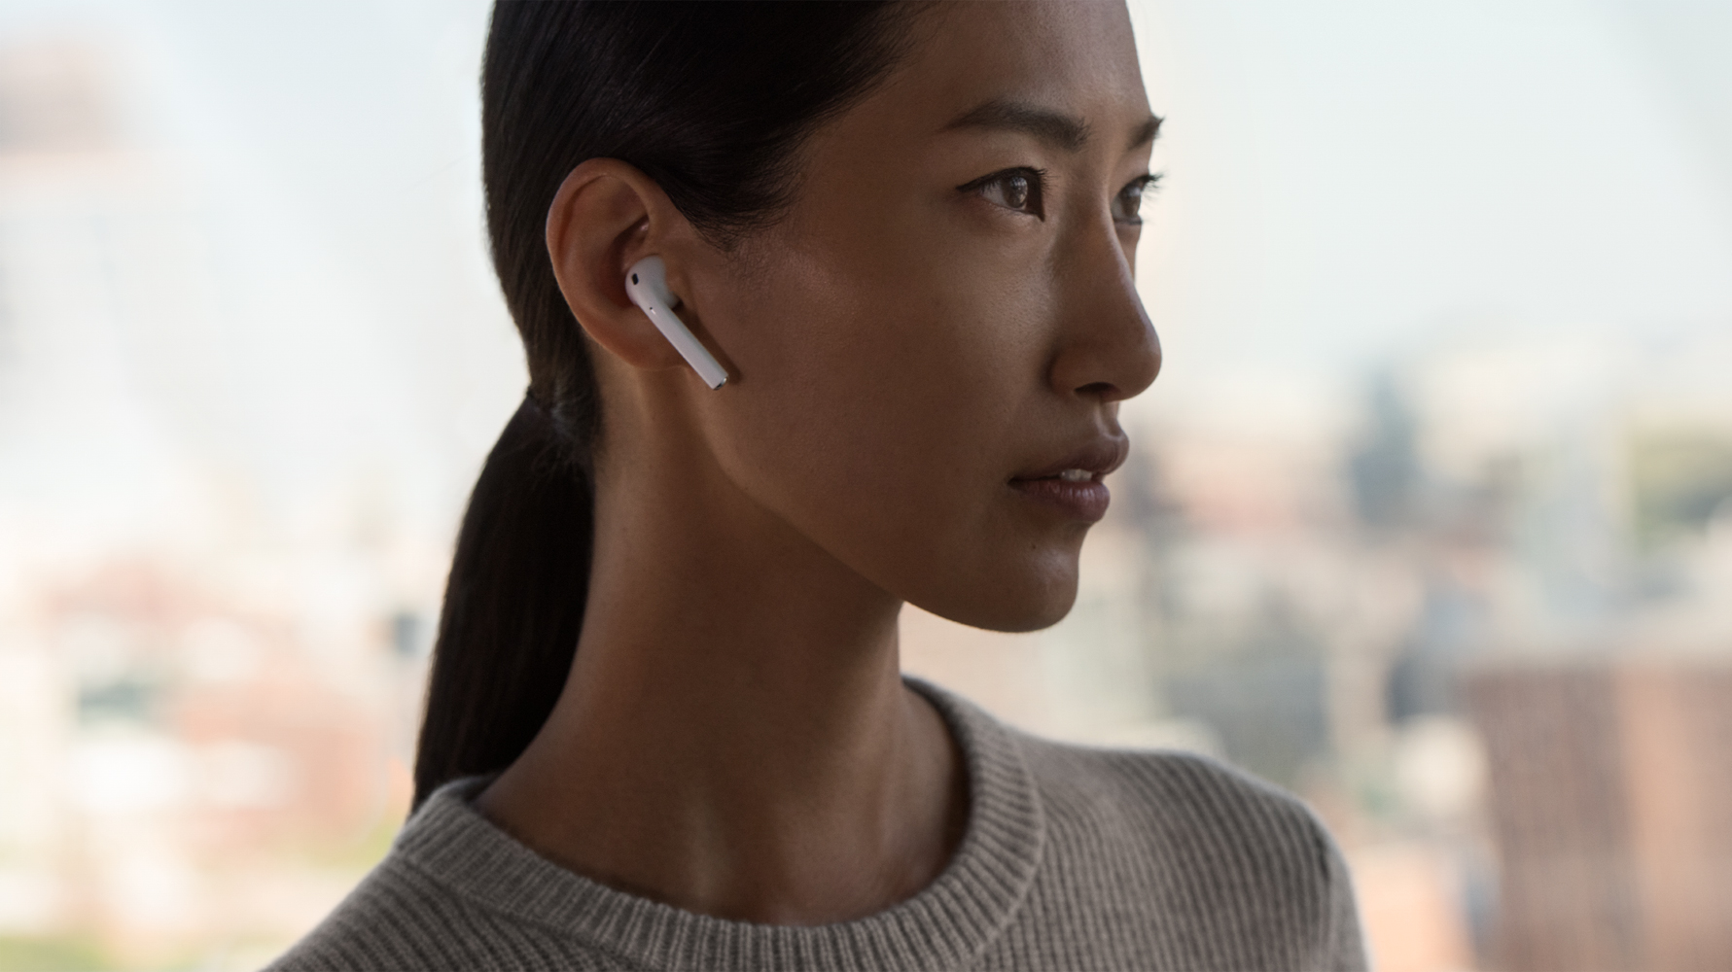


Menu
此图片侵权 需要被替换
Faulty battery? Nasty sound? AirPods keep disconnecting?
We are here to help. We will send you a replacement pair, and you return yours later
Charging Case Issue?
We take care of it. Start a repair request now and your replacement charging case will be on its way

Slide 3

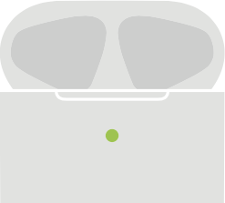
Menu
Accidental Damage?
AirPods stopped working due to water or physical damage? We can send you a replacement and our expert team will take care of the rest.
?
Bud Missing?
Missing bud or Charing Case? Request one now! We offer it at a competitive price.
How it works?

Slide 4




Menu
How it works?
Request your service online
*Deposit Required
*We will send you replacement first, but we need a deposit to make sure you will return your faulty AirPods. We will refund the deposit once we received your faulty part and it matches your request.
We will send out your replacement AirPods
Return your faulty AirPods with our pre-paid shipping label
We will diagnose your product with professional tools and finalize your service request
*Our replacements are refurbished by trusted experts who use genuine parts. The replacements you receive are equivalent to new products in performance and reliability

Slide 5
Menu
InstantPods
How it works
FAQs
Local Customer
Service Help
Shipping & Delivery
After Repair
Contact Us
92 Corporate Park, C388
Irvine, CA 92606
Hours: M-F 10am-5pm PST

Slide 6
Menu
FAQ
-How soon will I get my replacement?
We usually ship your replacement within two business days, and you should expect it with in the next three business days.
-How do I know that my AirPods has a faulty battery?
If you feel the battery is not as long-lasting as it was before, you battery is probably worn out.
-Are refurbished replacements the same as my current AirPods?
There are the same, but even better. Our replacements are refurbished by trusted experts who use genuine parts. The replacements you receive are equivalent to new products in performance and reliability
-How long does the service process take?
You should receive your replacement within 5 business days and we expect to finalize your service request within 2 business days once we received your returned product.
How long is the warranty period of the refurbished replacement?
We are confident with our refurbished replacements, and we cover it for 120 days, excludes accidental damages and unauthorized modifications.
-When will the replacement deposit be refunded?
We will inspect and diagnose your returned product once we receive it, and finalize your service order within 48 business hours. Refunds will be sent to the card-issuing bank within five business days of receipt of the returned item. Please contact the card-issuing bank with questions about when the credit will be posted to your account.
-What if I am not happy with my replacement?
Please reach out to us and we will try our best to fulfill your request.
What will happen to the faulty AirPods I returned?
Our trusted experts will repair, reuse and recycle every part of the products you returned to us.

Slide 7
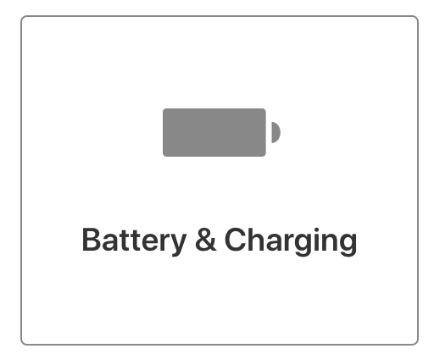

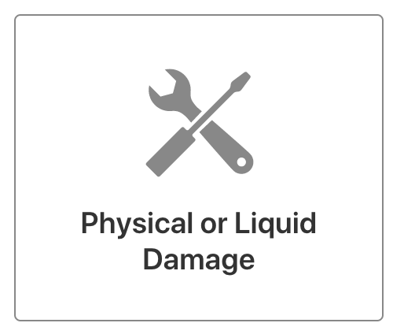
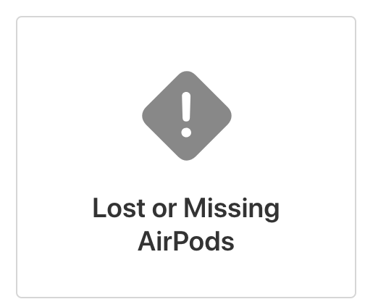
Menu
What’s happening with your AirPods?

Slide 8
