Slide 1
Menu
SKU列表
服务费
一代耳机 仅供H8TT
Service Fee - AirPods, 1st Gen, Left, T1 代码1GLT1
Service Fee - AirPods, 1st Gen, Left, T2 代码1GLT2
Service Fee - AirPods, 1st Gen, Left, T3 代码1GLT3
Service Fee - AirPods, 1st Gen, Right, T1 代码1GRT1
Service Fee - AirPods, 1st Gen, Right, T2 代码1GRT2
Service Fee - AirPods, 1st Gen, Right, T3 代码1GRT3
Service Fee - Charging Case, 1st Gen, T1 代码1GCT1
Service Fee - Charging Case, 1st Gen, T3 代码1GCT3
二代耳机 仅供LX2Y
Service Fee - AirPods, 2nd Gen, Left, T1 代码2GLT1
Service Fee - AirPods, 2nd Gen, Left, T2 代码2GLT2
Service Fee - AirPods, 2nd Gen, Left, T3 代码2GLT3
Service Fee - AirPods, 2nd Gen, Right, T1 代码2GRT1
Service Fee - AirPods, 2nd Gen, Right, T2 代码2GRT2
Service Fee - AirPods, 2nd Gen, Right, T3 代码2GRT3
Service Fee - Charging Case, 2nd Gen, T1 代码2GCT1
Service Fee - Charging Case, 2nd Gen, T3 代码2GCT3
二代无线充电仓版本 仅供JMMT
Service Fee - AirPods, 2nd Gen, Left, T1 代码2GLT1
Service Fee - AirPods, 2nd Gen, Left, T2 代码2GLT2
Service Fee - AirPods, 2nd Gen, Left, T3 代码2GLT3
Service Fee - AirPods, 2nd Gen, Right, T1 代码2GRT1
Service Fee - AirPods, 2nd Gen, Right, T2 代码2GRT2
Service Fee - AirPods, 2nd Gen, Right, T3 代码2GRT3
Service Fee - Wireless Charging Case, 2nd Gen, T1 代码2GWCT1
Service Fee - Wireless Charging Case, 2nd Gen, T3 代码2GWCT3
Pro耳机 仅供LKKT/0C6L
Service Fee - AirPods Pro, Left, T1 代码PROLT1
Service Fee - AirPods Pro, Left, T2 代码PROLT2
Service Fee - AirPods Pro, Left, T3 代码PROLT3
Service Fee - AirPods Pro, Right, T1 代码PRORT1
Service Fee - AirPods Pro, Right, T2 代码PRORT2
Service Fee - AirPods Pro, Right, T3 代码PRORT3
Service Fee - Charging Case, AirPods Pro, T1 代码2GWCT1
Service Fee - Charging Case, AirPods Pro, T3 代码2GWCT3
序列号后四位
1. H8TT=一代耳机
2. LX2Y=二代耳机
3. JMMT=无线充电二代耳机
2/3共享耳机头SKU，充电仓需要单独SKU
4. LKKT/0C6L=PRO耳机
维修难度评级和种类
-T1 容易，捆绑押金， ERS类别
-T2 深度，捆绑押金，ERS类别
-T3 报废 不捆绑押金 DR类别

Slide 2
Menu
SKU列表
序列号后四位
1. H8TT=一代耳机
2. LX2Y=二代耳机
3. JMMT=无线充电二代耳机
2/3共享耳机头SKU，充电仓需要单独SKU
4. LKKT/0C6L=PRO耳机
押金
一代耳机 仅供H8TT
Replacement Deposit - AirPods, 1st Gen, Left, RFB 代码1GLRFB
Replacement Deposit - AirPods, 1st Gen, Right, RFB 代码1GRRFB
Replacement Deposit - Charging Case, 1st Gen, RFB 代码1GCRFB
二代耳机 仅供LX2Y
Replacement Deposit - AirPods, 2nd Gen, Left, RFB 代码2GLRFB
Replacement Deposit - AirPods, 2nd Gen, Right, RFB 代码2GRRFB
Replacement Deposit - Charging Case, 2nd Gen, RFB 代码2GCRFB
二代无线充电仓版本 仅供JMMT
Replacement Deposit - AirPods, 2nd Gen, Left, RFB 代码2GLRFB
Replacement Deposit - AirPods, 2nd Gen, Right, RFB 代码2GRRFB
Replacement Deposit - Wireless Charging Case, 2nd Gen, RFB 代码2GCRFB
PRO耳机 仅供LKKT/0C6L
Replacement Deposit - AirPods Pro, Left, RFB 代码PROLRFB
Replacement Deposit - AirPods Pro, Right, RFB 代码PRORRFB
Replacement Deposit - Charging Case, AirPods Pro, RFB 代码PROCRFB
维修难度评级和种类
-T1 容易，捆绑押金， ERS类别
-T2 深度，捆绑押金，ERS类别
-T3 报废 不捆绑押金 DR类别

Slide 3
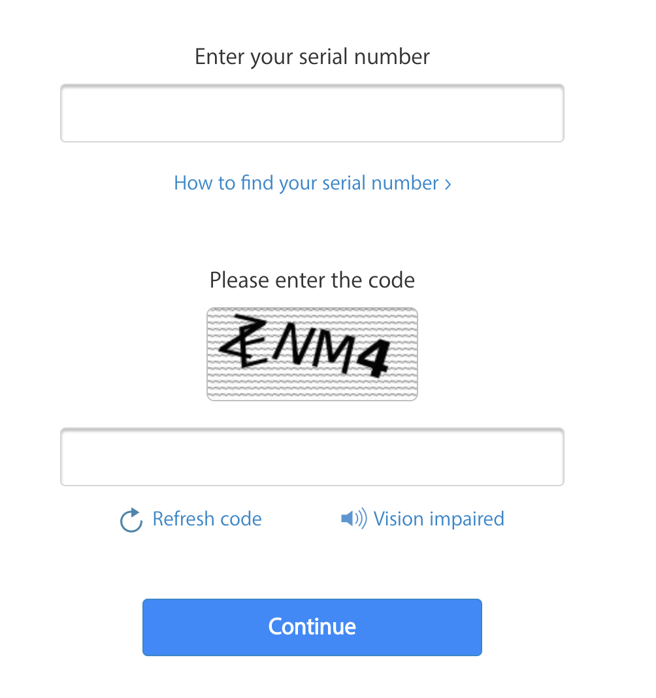
Menu
We need your serial number to get started.
-直接模仿样式：询问客户序列号
-本页的作用：询问序列号是帮助后续决定提供的产品SKU，因为序列号可以判断不同年份发布的产品，避免出现客户不知道自己的产品是什么年代的情况。
序列号判断逻辑：根据客户提供的序列号后四位甄别即
-输入要求：12位，英文字母和数字Olny，禁止特殊符号和语言
*此处可以考虑植入机器人检测避免攻击
序列号后四位
1. H8TT=一代耳机
2. LX2Y=二代耳机
3. JMMT=无线充电二代耳机
2/3共享耳机头SKU，充电需要单独仓SKU
4. LKKT/0C6L=PRO耳机

Slide 4
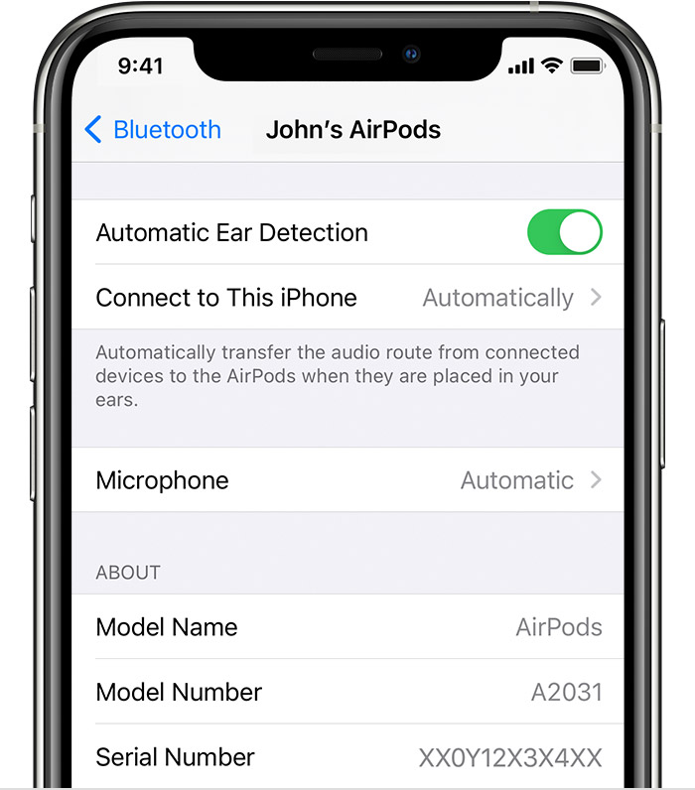
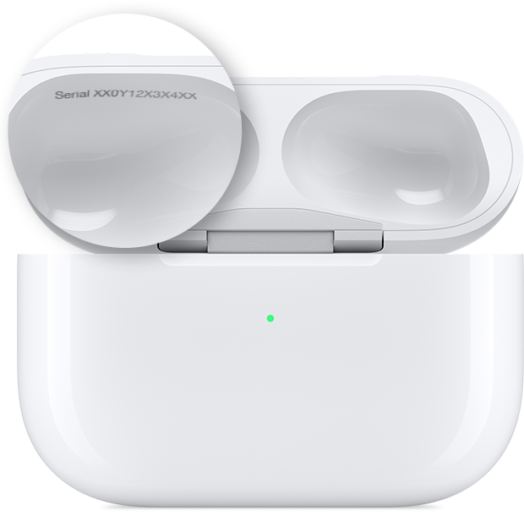
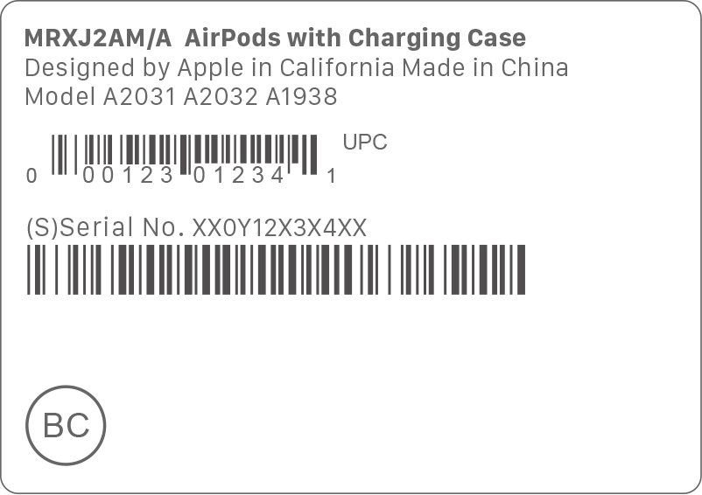
Menu
How to find your serial number
1. Go to Settings > Bluetooth.
2. Find your AirPods in the list.
3. Tap the Info button next to your AirPods, and you'll see the serial number.
You can find the serial number on the underside of the lid of your Charging Case or Wireless Charging Case.
If you have the original packaging, you can find the serial number next to the barcode.
-弹出这个辅助页面如果客户在上一页点击： how to find your serial number
-本页建议直接出现在上一页上弹出这个小说明书，右上角放一个X可以直接关闭

Slide 5
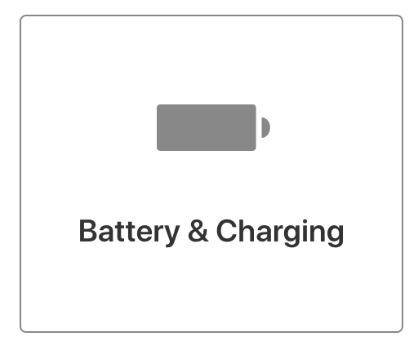
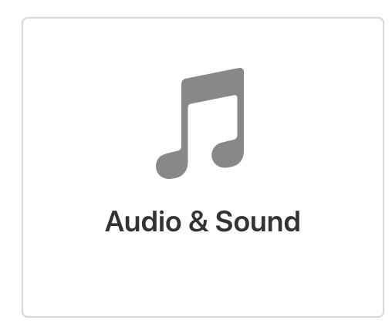
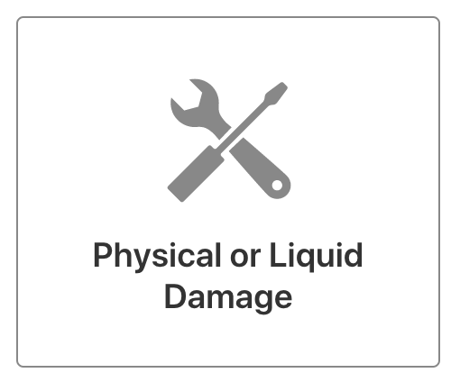
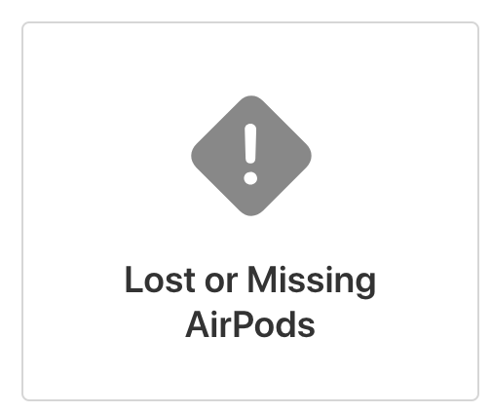
Menu
What’s happening with your AirPods?
Your Product: AirPods, 2nd Gen
-开始询问客户故障
-这四个大类

Slide 6
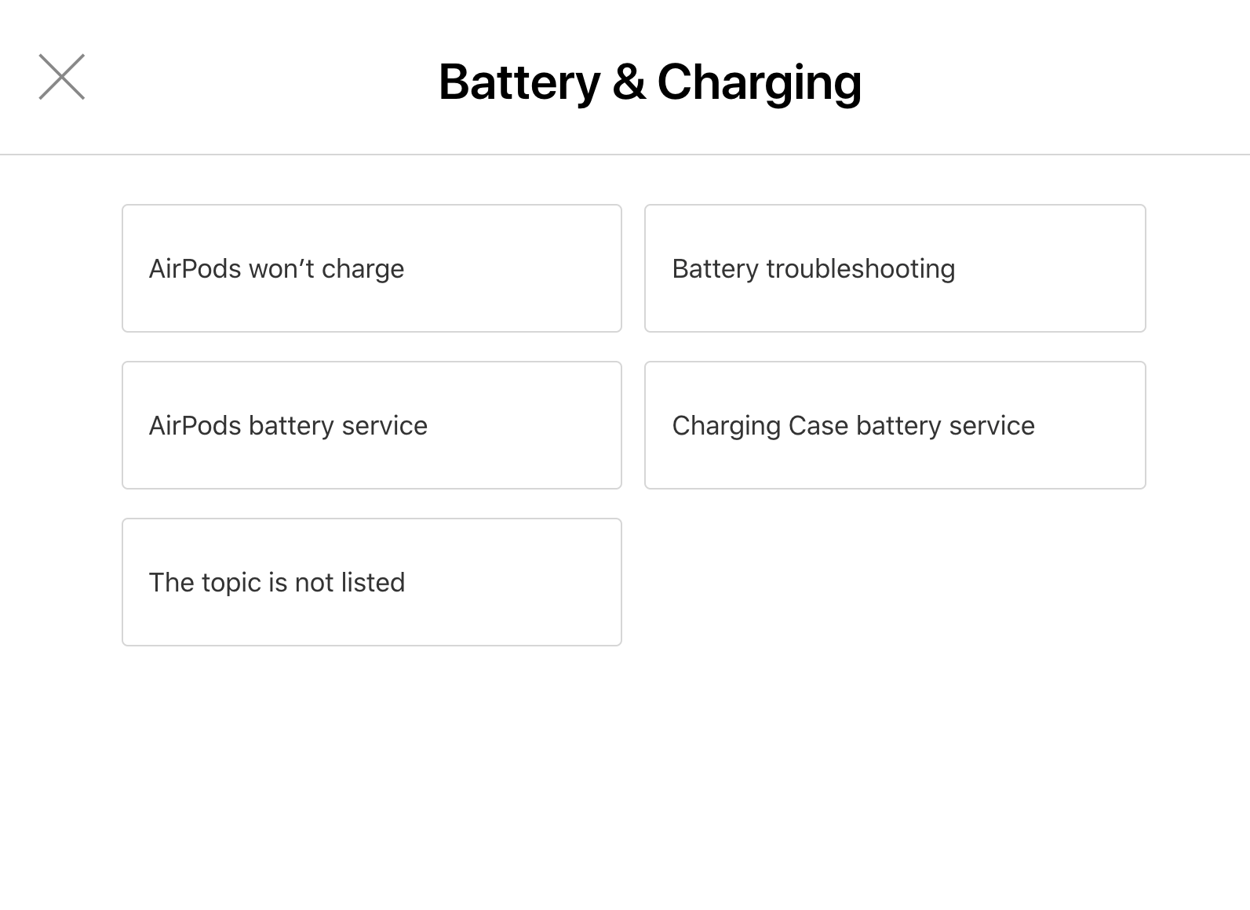
Menu
What’s happening with your AirPods?
-直接模仿样式：大类下面的子问题
-本页建议直接出现在上一页上弹出子页面，左上角放一个X可以直接关闭

Slide 7
Menu
What’s happening with your AirPods?
这个故障类别有四个子问题
第1个子问题
AirPods won’t charge
第2个子问题
Charging Case won’t charge
第3个子问题
AirPods Battery Service
第4个子问题
Charging Case Battery Service

Slide 8

Menu
What’s happening with your AirPods?
第1个子问题
AirPods won’t charge
Connect AirPods to known good power resource. Is the indictor light on the charging case on?
Yes
No
Is AirPods connecting to your phone?
You probably have a faulty charging case. Try to charge your AirPods again with a known good charging case.
Yes
No
如果回答NO，看下一页
Go Back
Which side of your AirPods needs to be replaced?
Left
Right
Both Sides
订购左耳
订购右耳
订购左耳+右耳
T1
T1
T1

Slide 9
Menu
What’s happening with your AirPods?
第1个子问题
AirPods won’t charge
Connect AirPods to known good power resource. Is the indictor light on the charging case on?
Yes
No
Is AirPods connecting to your phone?
You probably have a faulty charging case. Try to charge your AirPods again with a known good charging case.
No
Go Back 拒绝维修
Which side of your AirPods needs to be replaced?
Left
Right
Both Sides
订购左耳
订购右耳
订购左耳+右耳
T2
T2
T2

Slide 10
Menu
What’s happening with your AirPods?
第2个子问题
Charging Case won’t charge
Connect AirPods to known good power resource. Is the indictor light on the charging case on?
Yes
No
订购充电仓
订购充电仓
T1
T1

Slide 11
Menu
What’s happening with your AirPods?
第3个子问题
AirPods Battery Service
Is AirPods connecting to your phone?
Yes
No
如果回答NO，看下一页
Can you still hear sound from your AirPods?
Yes
No
Which side of your AirPods needs to be replaced?
Which side of your AirPods needs to be replaced?
Left
Right
Both Sides
Left
Right
Both Sides
订购右耳
订购左耳
订购左耳+右耳
订购左耳
T2
订购左耳+右耳
订购右耳
T2
T2
T1
T1
T1

Slide 12
Menu
What’s happening with your AirPods?
第3个子问题
AirPods Battery Service
Is AirPods connecting to your phone?
No
Which side of your AirPods needs to be replaced?
Left
Right
Both Sides
订购左耳
订购右耳
订购左耳+右耳
T2
T2
T2

Slide 13
Menu
What’s happening with your AirPods?
第4个子问题
Charging Case Battery Service
Connect AirPods to known good power resource. Is the indictor light on the charging case on?
Yes
No
订购充电仓
订购充电仓
T1
T1

Slide 14
Menu
What’s happening with your AirPods?
这个故障类别有六个子问题
AirPods won’t connect
T2
Unable to hear any sound
T2
AirPods keep disconnecting
T2
Microphone Issue
T2
Crackling, Static, or other sound issues
T2
Sensor Issues
T2
以上所有问题直接跳入下面这个问题
Which side of your AirPods needs to be replaced?
Left
Right
Both Sides
订购左耳
订购右耳
订购左耳+右耳
T2
T2
T2

Slide 15
Menu
What’s happening with your AirPods?
这个故障类别有4个子问题
AirPods physically damaged
T3不绑定押金
Charging Case physically damaged
T3不绑定押金
AirPods water damage
T3不绑定押金
Charging Case water damage
T3不绑定押金

Slide 16
Menu
What’s happening with your AirPods?
第1/3个子问题
AirPods physically damaged
AirPods water damage
Your product is non-repairable. We can offer you a replacement at a competitive price and you don’t have to return yours.
OK
Let me think about it
客户要考虑一下
问答结束
Which side of your AirPods needs to be replaced?
Left
Right
Both Sides
订购左耳
订购右耳
订购左耳+右耳
T3不绑定押金
T3不绑定押金
T3不绑定押金

Slide 17
Menu
What’s happening with your AirPods?
第2/4个子问题
Charging Case physically damaged
Charging Case water damage
Your product is non-repairable. We can offer you a replacement at a competitive price and you don’t have to return yours.
OK
Let me think about it
订购充电仓
客户要考虑一下
问答结束
T3

Slide 18
Menu
What’s happening with your AirPods?
AirPods Missing
T3不绑定押金
Charging Case Missing
T3不绑定押金

Slide 19
Menu
What’s happening with your AirPods?
第1个子问题
AirPods Missing
Which side of your AirPods needs to be replaced?
Left
Right
Both Sides
订购左耳
订购右耳
订购左耳+右耳
T3
T3
T3

Slide 20
Menu
What’s happening with your AirPods?
第2个子问题
Charging Case Missing
订购充电仓
T3

Slide 21
Menu
We will replace your AirPods
To ensure the best experiences possible, we will send you the replacement product first. We will charge your credit card to secure a deposit for the replacement product, and we will refund it once we receive your returned product.
I am comfortable with that.
I need to think about it.

Slide 22
Menu
We will replace your AirPods
Here’s your estimated quote:
Service Fee - AirPods, 1st Gen, Tier 1
$59.99
Replacement Deposit - AirPods, 1st Gen, RFB
$59.99
Shipping
$5.99
Tax
$5.99
Total
$131.96
We will charge a deposit of the product you are replacing so that we can send you the replacement first. Once we receive your returned faulty product, we will refund the replacement deposit.

Slide 23
Menu
We will replace your Charging Case
***
Here’s your estimated quote:
Service Fee - Charging Case, 1st Gen, Tier 1
$59.99
Replacement Deposit - Charging Case, 1st Gen, RFB
$59.99
Shipping
$5.99
Tax
$5.99
Total
$131.96
We will charge a deposit of the product you are replacing so that we can send you the replacement first. Once we receive your returned faulty product, we will refund the replacement deposit.

Slide 24
