Slide 1
Feature Generation by Convolutional Neural Network for Click-Through Rate Prediction
huangwei
20190704
Notes:
www 2019 是预测点击率的 我觉得可以借鉴的是他的特征工程不是手工提取的，用得是通过神经网络自动生成的 后面会仔细介绍

Slide 2
Introduction
In real scenarios, artificial features are able to improve the performance of deep models, but feature engineering is expensive and requires domain knowledge, making it impractical in different scenarios
Notes:
因此自动生成特征是很必要且有用的一件事情

Slide 3
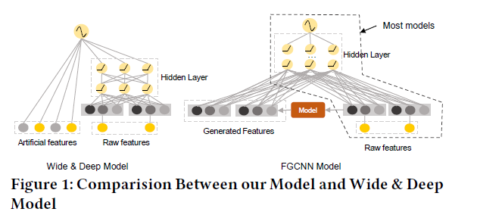
Introduction
Notes:
wide&deep模型主要分成两部分，wide部分就是传统的LR模型 要对原始特征做大量的特征工程才能取得比较好的泛化效果，deep部分就是DNN，少量的特征工程就可
通过一个红盒子 自动生成feature 那么问题来了 怎样的model 才能更好的生成新feature

Slide 4
Introduction
The key challenge for CTR prediction tasks is to effectively model feature interactions. However, due to that useful interactions are ususally sparse compared with the combination space of raw features, it is of great difficulties to learn them effectively from a large number of parameters
Notes:
特征之间的联系 相比原始feature 的组合

Slide 5
Introduction
The most straightforward way for automatical feature generation is to perform Multi-Layer Perceptron (MLP) and use the hidden neurons as the generated features
In CNN, the design of shared weights and pooling mechanism greatly reduces the number of parameters needed to find important local patterns and it will alleviate the optimization difficulties of later MLP structures.
Notes:
However, as mentioned above, due to that useful feature interactions are usually sparse [23], it is rather difficult for MLP to learn such interactions from a huge parameter space. For example, suppose we have four user features:
Name, Age, Height, Gender to predict whether a user will download an online game. Assume that the feature interaction between Age and Gender is the only signal that matters, so that an optimal model should identify this and only this feature interaction. When performing MLP with only one hidden layer, the optimal （最优的） weights associated to the embeddings of Name and Height should be all 0’s, which is fairly difficult to achieve.
Therefore, CNN provides a potentially good solution to realize our idea (identify the sparse but important feature interactions). However, applying CNN directly could result in unsatisfactory performance.
In CTR prediction, different arrange orders of original features do not have different meanings. For example, whether the arrangement order of features being (Name, Age, Height, Gender) or (Age, Name, Height, Gender) does not make any difference to describe the semantics of a sample, which is completely different from the case of images and sentences. although CNN can alleviates optimization difficulties of
MLP by reducing the number of paramters, it only generates neighbor
feature interactions which can lose many useful global feature
interactions.

Slide 6
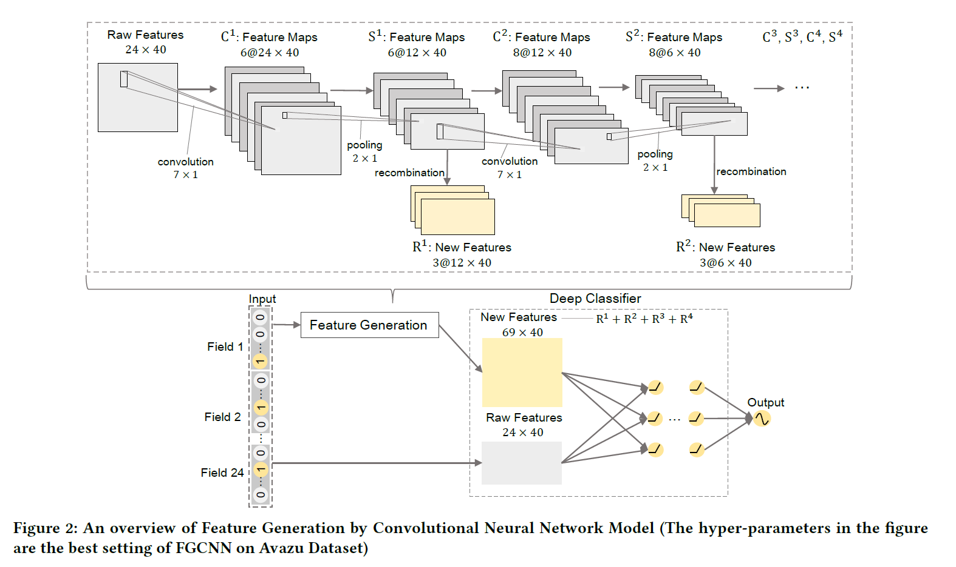
Model
Notes:
执行CNN以学习邻居特征交互，而应用MLP来重组它们以提取全局特征交互。 两部分 特征生成 做分类 CNN的公式我就不讲了 有兴趣的可以去论文看看
Raw features 是做了一层embedding 的 到低维向量
The pooling result of the i-th pooling layer will be the input for the
(i + 1)-th convolutional layer:

Slide 7
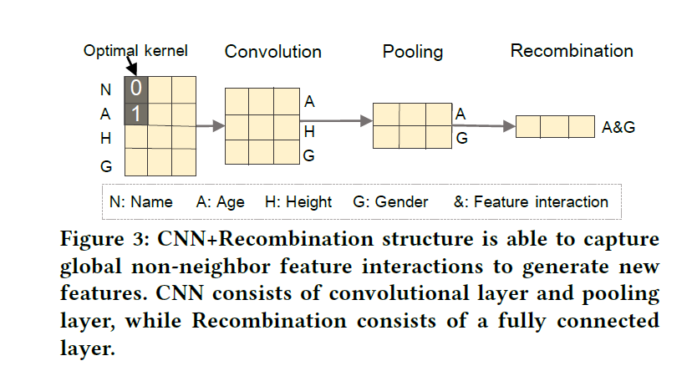
Feature generation
Convolutional Layer
Pooling Layer
Recombination Layer
Concatenation
Notes:
Concatenation 没体现出来 上一张ppt 没做一次recombination 就产生一个new feature

Slide 8
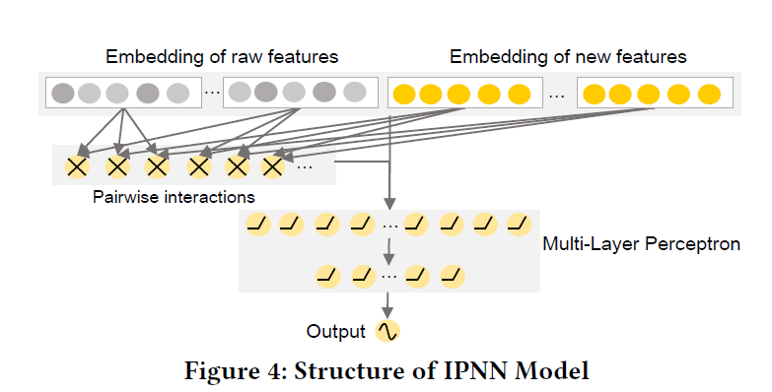
Deep classifier
Notes:
这里提到的模型都是已经被提出的 以 IPNN 为例
做内积 初始的新的所有两两相乘 最后其实是二分类 损失函数 交叉熵

