Slide 1
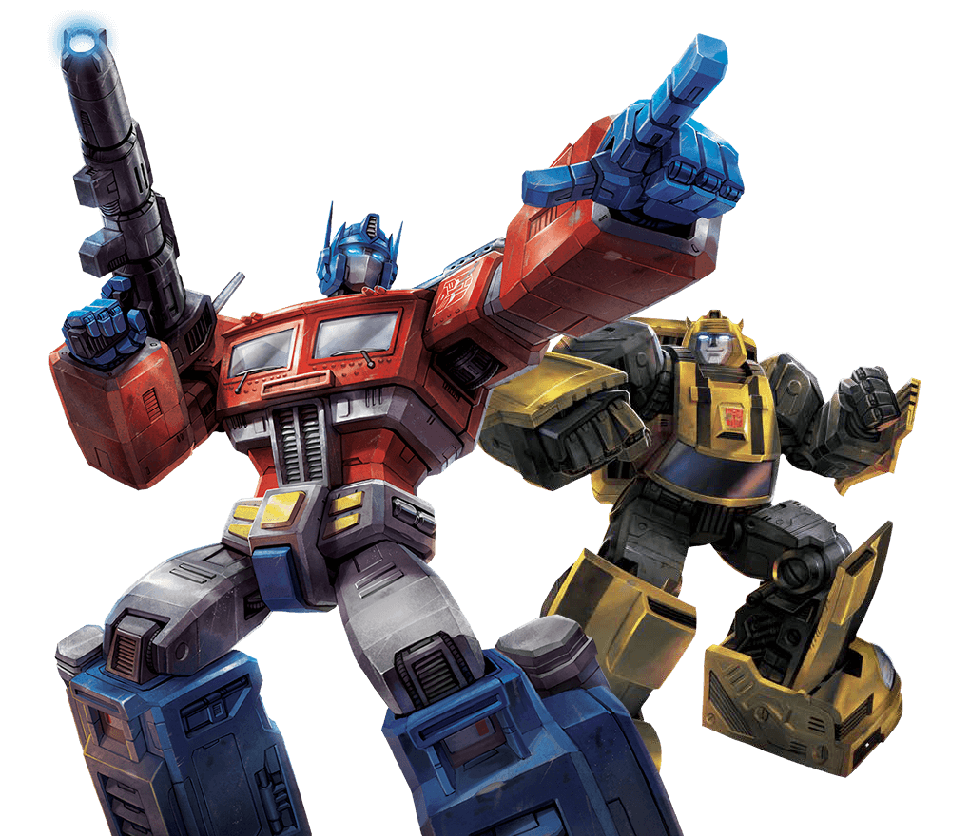

Transformer
BERT
张昊文
讨论会
PPT来自于李宏毅深度学习课程，仅做教学使用
Notes:
Question: scaling doc project???
https://voidism.github.io/note/2019/02/05/Transformer_Intro/
http://nlp.seas.harvard.edu/2018/04/03/attention.html
The best one: https://lilianweng.github.io/lil-log/2018/06/24/attention-attention.html
Also good: https://mchromiak.github.io/articles/2017/Sep/12/Transformer-Attention-is-all-you-need/#.XOoQfogzY2w
Matrix view: http://jalammar.github.io/illustrated-transformer/
https://github.com/jessevig/bertviz BERT vis
可以讀:
https://zhuanlan.zhihu.com/p/47470866
BERT: 這篇不錯 主要是分析 BERT
https://zhuanlan.zhihu.com/p/58430637

Slide 2
Transformer
Seq2seq model with “Self-attention”
Notes:
BERT: A transformer learned from lots of unannotated text

Slide 3












Sequence
Next layer
$$b^{1}$$
$$b^{2}$$
$$b^{3}$$
$$b^{4}$$
$$a^{1}$$
$$a^{2}$$
$$a^{3}$$
$$a^{4}$$
$$a^{1}$$
$$a^{2}$$
$$a^{3}$$
$$a^{4}$$
Previous layer
Using CNN to replace RNN
不可以并行计算！

Slide 4




Sequence
高层的卷积层可以考虑更多的上下文内容。但也有缺点 。
Next layer
$$b^{1}$$
$$b^{2}$$
$$b^{3}$$
$$b^{4}$$
$$b^{1}$$
$$b^{2}$$
$$b^{3}$$
$$b^{4}$$
……
……
……
……
$$a^{1}$$
$$a^{2}$$
$$a^{3}$$
$$a^{4}$$
$$a^{1}$$
$$a^{2}$$
$$a^{3}$$
$$a^{4}$$
Previous layer
Using CNN to replace RNN
不可以并行计算！
(CNN can parallel)

Slide 5


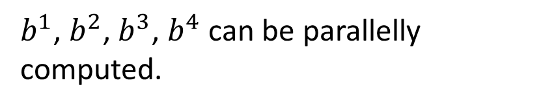







Self-Attention
每一个输出都会考虑所有单词的上下文关系
$b^{1}$, $b^{2}$, $b^{3}$, $b^{4}$ can be parallelly computed.
$$b^{1}$$
$$b^{2}$$
$$b^{3}$$
$$b^{4}$$
$$b^{1}$$
$$b^{2}$$
$$b^{3}$$
$$b^{4}$$
Self-Attention Layer
$$a^{1}$$
$$a^{2}$$
$$a^{3}$$
$$a^{4}$$
$$a^{1}$$
$$a^{2}$$
$$a^{3}$$
$$a^{4}$$
可以把任何RNN替换为self-attention

Slide 6
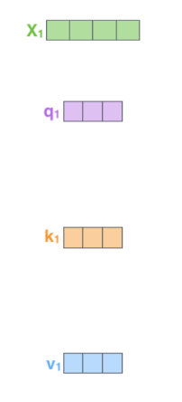
























Self-attention
q: 代表注意到别的词
https://arxiv.org/abs/1706.03762
$$q^{i}=W^{q}a^{i}$$
k:代表被注意到
$$k^{i}=W^{k}a^{i}$$
Attention is all you need.
v:代表有多少信息被提取
$$v^{i}=W^{v}a^{i}$$
$$q^{1}$$
$$k^{1}$$
$$v^{1}$$
$$q^{2}$$
$$k^{2}$$
$$v^{2}$$
$$q^{3}$$
$$k^{3}$$
$$v^{3}$$
$$q^{4}$$
$$k^{4}$$
$$v^{4}$$
$$a^{1}$$
$$a^{2}$$
$$a^{3}$$
$$a^{4}$$
$$a^{i}=Wx^{i}$$
$$x^{1}$$
$$x^{2}$$
$$x^{3}$$
$$x^{4}$$

Slide 7






Self-attention
d is the dim of $q$ and $k$
拿每个 query q 去对每个 key k 做 attention
Scaled Dot-Product Attention:
$$α_{1,i}=q^{1}∙k^{i}/\sqrt{d}$$
dot product
$$α_{1,1}$$
$$α_{1,2}$$
$$α_{1,3}$$
$$α_{1,4}$$
$$q^{1}$$
$$k^{1}$$
$$v^{1}$$
$$q^{2}$$
$$k^{2}$$
$$v^{2}$$
$$q^{3}$$
$$k^{3}$$
$$v^{3}$$
$$q^{4}$$
$$k^{4}$$
$$v^{4}$$
$$a^{1}$$
$$a^{2}$$
$$a^{3}$$
$$a^{4}$$
$$x^{1}$$
$$x^{2}$$
$$x^{3}$$
$$x^{4}$$

Slide 8
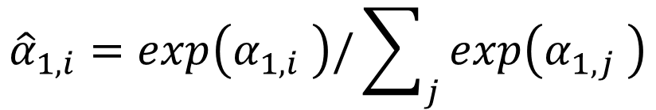




Self-attention
$${\hat{α}}_{1,i}=exp\left(α_{1,i} \right)/\sum_{j}{exp\left(α_{1,j} \right)}$$
$${\hat{α}}_{1,1}$$
$${\hat{α}}_{1,2}$$
$${\hat{α}}_{1,3}$$
$${\hat{α}}_{1,4}$$
Soft-max
$$α_{1,1}$$
$$α_{1,2}$$
$$α_{1,3}$$
$$α_{1,4}$$
$$q^{1}$$
$$k^{1}$$
$$v^{1}$$
$$q^{2}$$
$$k^{2}$$
$$v^{2}$$
$$q^{3}$$
$$k^{3}$$
$$v^{3}$$
$$q^{4}$$
$$k^{4}$$
$$v^{4}$$
$$a^{1}$$
$$a^{2}$$
$$a^{3}$$
$$a^{4}$$
$$x^{1}$$
$$x^{2}$$
$$x^{3}$$
$$x^{4}$$

Slide 9
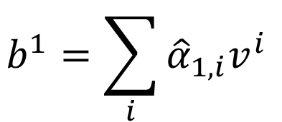





Self-attention
$$b^{1}=\sum_{i}{{\hat{α}}_{1,i}v^{i} }$$
b1 考虑了所有上下文
$$b^{1}$$
$${\hat{α}}_{1,1}$$
$${\hat{α}}_{1,2}$$
$${\hat{α}}_{1,3}$$
$${\hat{α}}_{1,4}$$
$$q^{1}$$
$$k^{1}$$
$$v^{1}$$
$$q^{2}$$
$$k^{2}$$
$$v^{2}$$
$$q^{3}$$
$$k^{3}$$
$$v^{3}$$
$$q^{4}$$
$$k^{4}$$
$$v^{4}$$
$$a^{1}$$
$$a^{2}$$
$$a^{3}$$
$$a^{4}$$
$$x^{1}$$
$$x^{2}$$
$$x^{3}$$
$$x^{4}$$
Notes:
Relation between attention and CNN
Global receptive field (compared to convolutional architectures)

Slide 10
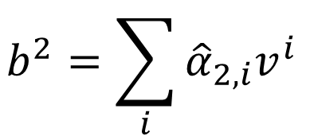





Self-attention
$$b^{2}=\sum_{i}{{\hat{α}}_{2,i}v^{i} }$$
拿每个 query q 去对每个 key k 做 attention
$$b^{2}$$
$${\hat{α}}_{2,1}$$
$${\hat{α}}_{2,2}$$
$${\hat{α}}_{2,3}$$
$${\hat{α}}_{2,4}$$
$$q^{1}$$
$$k^{1}$$
$$v^{1}$$
$$q^{2}$$
$$k^{2}$$
$$v^{2}$$
$$q^{3}$$
$$k^{3}$$
$$v^{3}$$
$$q^{4}$$
$$k^{4}$$
$$v^{4}$$
$$a^{1}$$
$$a^{2}$$
$$a^{3}$$
$$a^{4}$$
$$x^{1}$$
$$x^{2}$$
$$x^{3}$$
$$x^{4}$$
Notes:
Relation between attention and CNN
Global receptive field (compared to convolutional architectures)

Slide 11
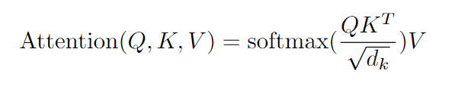

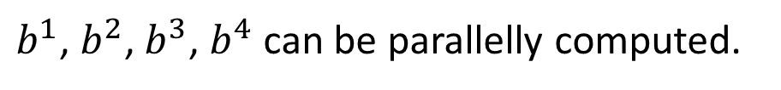



Self-attention
$b^{1}$, $b^{2}$, $b^{3}$, $b^{4}$ can be parallelly computed.
$$b^{1}$$
$$b^{2}$$
$$b^{3}$$
$$b^{4}$$
$$a^{1}$$
$$a^{2}$$
$$a^{3}$$
$$a^{4}$$
$$x^{1}$$
$$x^{2}$$
$$x^{3}$$
$$x^{4}$$
Notes:
Relation between attention and CNN
Global receptive field (compared to convolutional architectures)

Slide 12




































Self-attention
$$q^{1}$$
$$q^{2}$$
$$q^{3}$$
$$q^{4}$$
$$a^{1}$$
$$a^{2}$$
=
$$a^{3}$$
$$W^{q}$$
$$a^{4}$$
$$Q$$
$$I$$
$$a^{1}$$
$$a^{2}$$
$$k^{1}$$
$$a^{3}$$
$$k^{2}$$
$$a^{4}$$
$$k^{3}$$
$$q^{i}=W^{q}a^{i}$$
$$k^{4}$$
=
$$W^{k}$$
$$K$$
$$I$$
$$k^{i}=W^{k}a^{i}$$
$$a^{1}$$
$$a^{2}$$
$$a^{3}$$
$$v^{1}$$
$$a^{4}$$
$$v^{2}$$
$$v^{3}$$
$$v^{4}$$
=
$$W^{v}$$
$$v^{i}=W^{v}a^{i}$$
$$V$$
$$I$$
$$q^{1}$$
$$k^{1}$$
$$v^{1}$$
$$q^{2}$$
$$k^{2}$$
$$v^{2}$$
$$q^{3}$$
$$k^{3}$$
$$v^{3}$$
$$q^{4}$$
$$k^{4}$$
$$v^{4}$$
$$a^{1}$$
$$a^{2}$$
$$a^{3}$$
$$a^{4}$$
$$x^{1}$$
$$x^{2}$$
$$x^{3}$$
$$x^{4}$$

Slide 13



















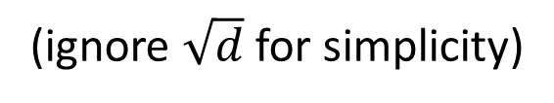



Self-attention
$$b^{1}$$
$${\hat{α}}_{1,1}$$
$${\hat{α}}_{1,2}$$
$${\hat{α}}_{1,3}$$
$${\hat{α}}_{1,4}$$
$$q^{1}$$
$$k^{1}$$
$$v^{1}$$
$$q^{2}$$
$$k^{2}$$
$$v^{2}$$
$$q^{3}$$
$$k^{3}$$
$$v^{3}$$
$$q^{4}$$
$$k^{4}$$
$$v^{4}$$
$$α_{1,1}=$$
$$k^{1}$$
$$q^{1}$$
$$α_{1,2}=$$
$$k^{2}$$
$$q^{1}$$
$$α_{1,1}$$
$$k^{1}$$
$$α_{1,2}$$
$$k^{2}$$
$$α_{1,3}=$$
$$k^{3}$$
$$q^{1}$$
$$α_{1,4}=$$
$$k^{4}$$
$$q^{1}$$
$$=$$
$$q^{1}$$
$$α_{1,3}$$
$$k^{3}$$
$$α_{1,4}$$
$$k^{4}$$
(ignore $\sqrt{d}$ for simplicity)
Notes:
Relation between attention and CNN
Global receptive field (compared to convolutional architectures)

Slide 14




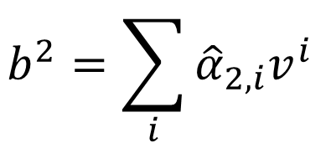









































Self-attention
$$b^{2}=\sum_{i}{{\hat{α}}_{2,i}v^{i} }$$
$$b^{2}$$
$${\hat{α}}_{2,1}$$
$${\hat{α}}_{2,2}$$
$${\hat{α}}_{2,3}$$
$${\hat{α}}_{2,4}$$
$$q^{1}$$
$$k^{1}$$
$$v^{1}$$
$$q^{2}$$
$$k^{2}$$
$$v^{2}$$
$$q^{3}$$
$$k^{3}$$
$$v^{3}$$
$$q^{4}$$
$$k^{4}$$
$$v^{4}$$
$${\hat{α}}_{1,1}$$
$${\hat{α}}_{2,1}$$
$${\hat{α}}_{3,1}$$
$${\hat{α}}_{4,1}$$
$$α_{1,1}$$
$$α_{2,1}$$
$$α_{3,1}$$
$$α_{4,1}$$
$$k^{1}$$
$${\hat{α}}_{1,2}$$
$${\hat{α}}_{2,2}$$
$${\hat{α}}_{3,2}$$
$${\hat{α}}_{4,2}$$
$$α_{1,2}$$
$$α_{2,2}$$
$$α_{3,2}$$
$$α_{4,2}$$
$$k^{2}$$
$${\hat{α}}_{1,3}$$
$${\hat{α}}_{2,3}$$
$${\hat{α}}_{3,3}$$
$$=$$
$$q^{1}$$
$$q^{2}$$
$$q^{3}$$
$$q^{4}$$
$${\hat{α}}_{4,3}$$
$$α_{1,3}$$
$$α_{2,3}$$
$$α_{3,3}$$
$$α_{4,3}$$
$$k^{3}$$
$${\hat{α}}_{1,4}$$
$${\hat{α}}_{2,4}$$
$${\hat{α}}_{3,4}$$
$${\hat{α}}_{4,4}$$
$$α_{1,4}$$
$$α_{2,4}$$
$$α_{3,4}$$
$$α_{4,4}$$
$$k^{4}$$
$$Q$$
$$\hat{A}$$
$$A$$
$$K^{T}$$
Notes:
Relation between attention and CNN
Global receptive field (compared to convolutional architectures)

Slide 15



























Self-attention
$$b^{2}=\sum_{i}{{\hat{α}}_{2,i}v^{i} }$$
$$b^{2}$$
$${\hat{α}}_{2,1}$$
$${\hat{α}}_{2,2}$$
$${\hat{α}}_{2,3}$$
$${\hat{α}}_{2,4}$$
$$q^{1}$$
$$k^{1}$$
$$v^{1}$$
$$q^{2}$$
$$k^{2}$$
$$v^{2}$$
$$q^{3}$$
$$k^{3}$$
$$v^{3}$$
$$q^{4}$$
$$k^{4}$$
$$v^{4}$$
$${\hat{α}}_{1,1}$$
$${\hat{α}}_{2,1}$$
$${\hat{α}}_{3,1}$$
$${\hat{α}}_{4,1}$$
$${\hat{α}}_{1,2}$$
$${\hat{α}}_{2,2}$$
$${\hat{α}}_{3,2}$$
$${\hat{α}}_{4,2}$$
$$b^{1}$$
=
$$b^{2}$$
$$b^{3}$$
$$b^{4}$$
$$v^{1}$$
$$v^{2}$$
$$v^{3}$$
$$v^{4}$$
$${\hat{α}}_{1,3}$$
$${\hat{α}}_{2,3}$$
$${\hat{α}}_{3,3}$$
$${\hat{α}}_{4,3}$$
$$O$$
$$V$$
$${\hat{α}}_{1,4}$$
$${\hat{α}}_{2,4}$$
$${\hat{α}}_{3,4}$$
$${\hat{α}}_{4,4}$$
$$\hat{A}$$
Notes:
Relation between attention and CNN
Global receptive field (compared to convolutional architectures)

Slide 16
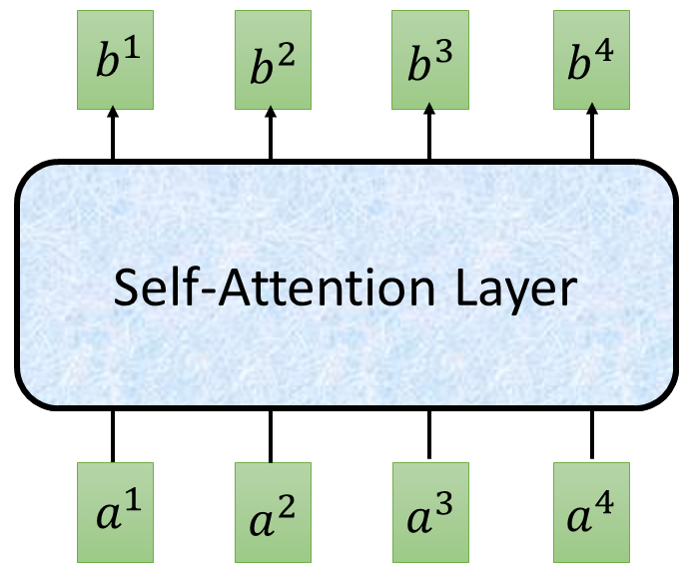


















Self-attention
$$O$$
$$Q$$
=
$$I$$
$$W^{q}$$
$$K$$
=
$$I$$
$$W^{k}$$
$$V$$
=
$$I$$
$$I$$
$$W^{v}$$
$$\hat{A}$$
$$A$$
=
$$Q$$
$$K^{T}$$
$$\hat{A}$$
$$O$$
=
$$V$$
反正就是一堆矩阵乘法，用 GPU 可以加速

Slide 17
























Multi-head Self-attention
(2 heads as example)
$$q^{i,1}=W^{q,1}q^{i}$$
$$b^{i,1}$$
$$q^{i,2}=W^{q,2}q^{i}$$
$$q^{i,1}$$
$$q^{i,2}$$
$$k^{i,1}$$
$$k^{i,2}$$
$$v^{i,1}$$
$$v^{i,2}$$
$$q^{j,1}$$
$$q^{j,2}$$
$$k^{j,1}$$
$$k^{j,2}$$
$$v^{j,1}$$
$$v^{j,2}$$
$$q^{i}$$
$$k^{i}$$
$$v^{i}$$
$$q^{j}$$
$$k^{j}$$
$$v^{j}$$
$$q^{i}=W^{q}a^{i}$$
$$a^{i}$$
$$a^{j}$$

Slide 18


Multi-head Self-attention
(2 heads as example)
$$q^{i,1}=W^{q,1}q^{i}$$
$$b^{i,1}$$
$$q^{i,2}=W^{q,2}q^{i}$$
$$b^{i,2}$$
$$q^{i,1}$$
$$q^{i,2}$$
$$k^{i,1}$$
$$k^{i,2}$$
$$v^{i,1}$$
$$v^{i,2}$$
$$q^{j,1}$$
$$q^{j,2}$$
$$k^{j,1}$$
$$k^{j,2}$$
$$v^{j,1}$$
$$v^{j,2}$$
$$q^{i}$$
$$k^{i}$$
$$v^{i}$$
$$q^{j}$$
$$k^{j}$$
$$v^{j}$$
$$q^{i}=W^{q}x^{i}$$
$$a^{i}$$
$$a^{j}$$

Slide 19
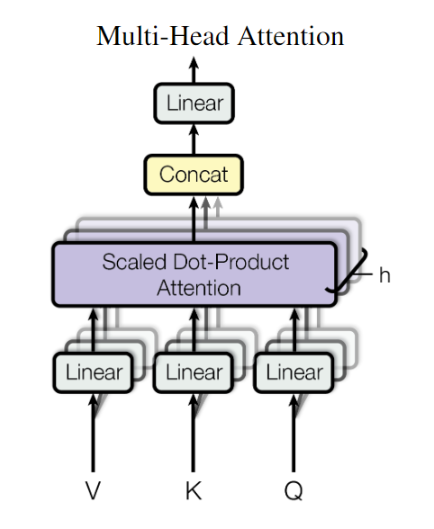
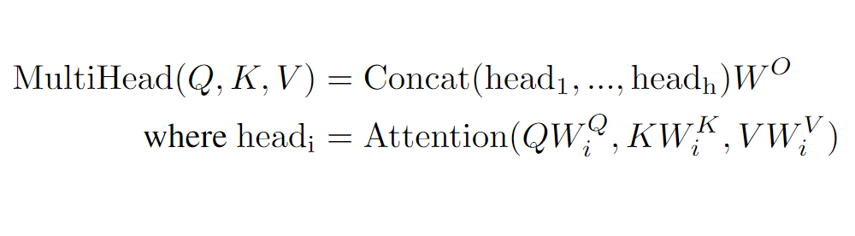





Multi-head Self-attention
(2 heads as example)
$$b^{i,1}$$
$$b^{i}$$
=
$$W^{O}$$
$$b^{i,2}$$
$$b^{i,1}$$
$$b^{i}$$
$$b^{i,2}$$

Slide 20
















Seq2seq with Attention
time
$$c^{1}$$
$$c^{2}$$
$$o^{1}$$
$$o^{2}$$
$$o^{3}$$
$$h^{1}$$
$$h^{2}$$
$$h^{3}$$
$$h^{4}$$
Self-Attention Layer
Self-Attention Layer
$$x^{1}$$
$$x^{2}$$
$$x^{3}$$
$$x^{4}$$
$$c^{1}$$
$$c^{2}$$
$$c^{3}$$
Encoder
Decoder

Slide 21
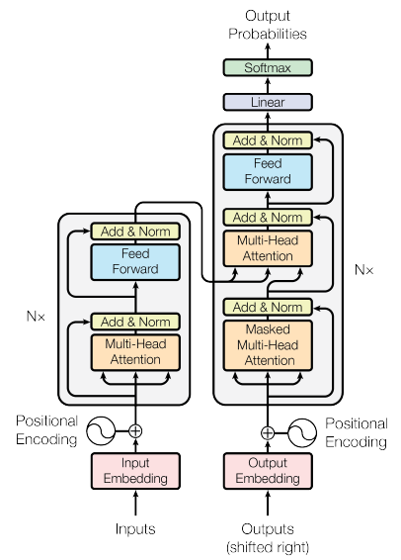
Transformer
machine
learning
Using Chinese to English translation as example
Encoder
Decoder
机器 学习
<BOS>
machine

Slide 22
Transformer
Feed
Forward
Mask
Multi-Head Attention
shifted right
Teacher Forcing
Positional encoding

Slide 23
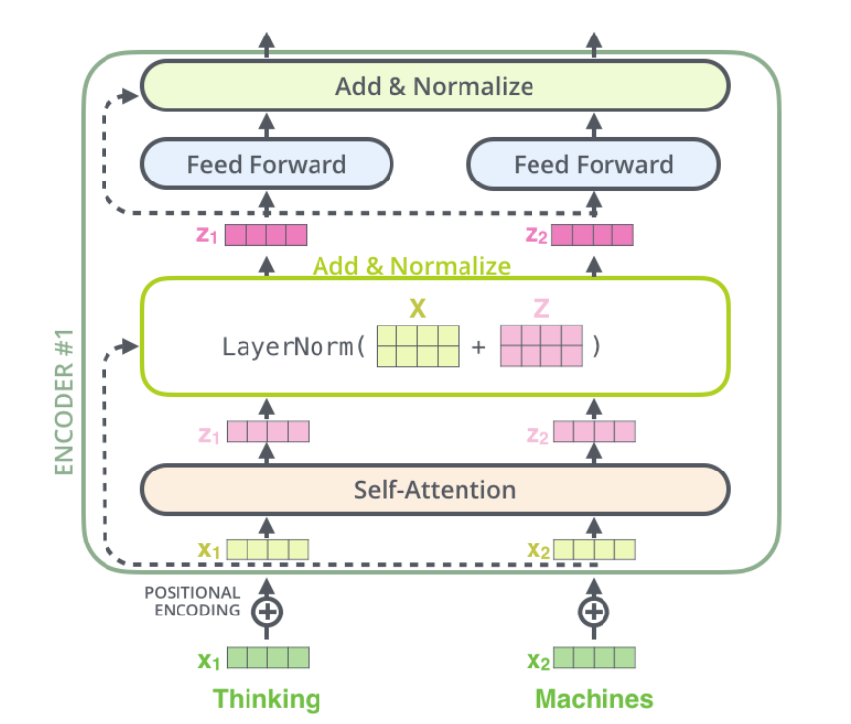
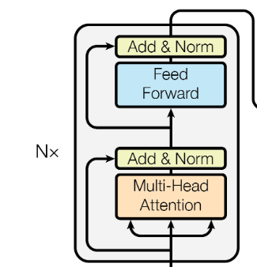
Transformer

Slide 24

Transformer
Feed Forward :
Layer
Normalization
Residual
connection
f(x)+x

Slide 25
Transformer
BN
Why LN?
LN
N×T
Batch Norm:
https://www.youtube.com/watch?v=BZh1ltr5Rkg
Layer Norm:
https://arxiv.org/abs/1607.06450

Slide 26
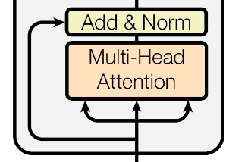
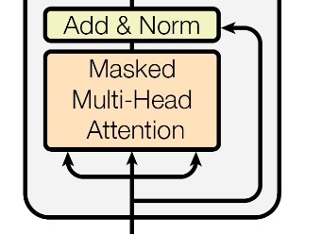
Transformer
Mask
padding mask
sequence mask
Notes:
(two layer2, with one relu)

Slide 27
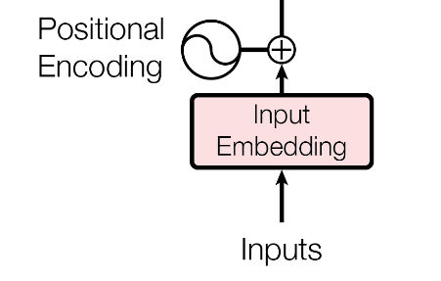
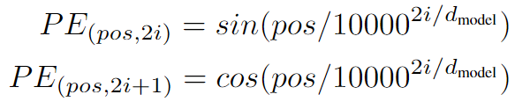
Positional Encoding
Transformer

Slide 28
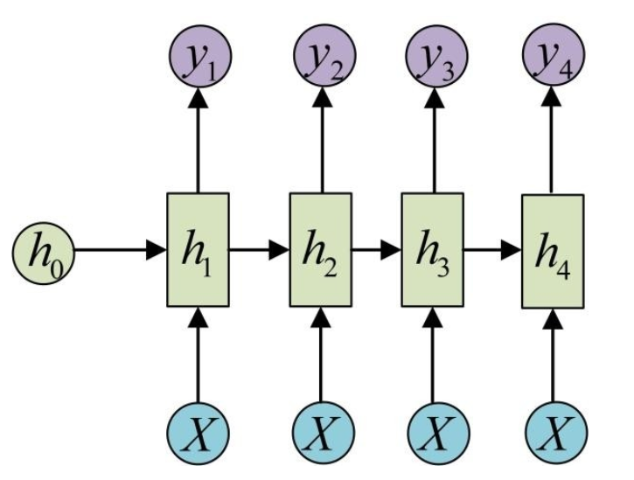
Transformer
output
shifted right
I am a handsome man
I am a handsome man
__ I am a handsome man
start I am a handsome man
input

Slide 29
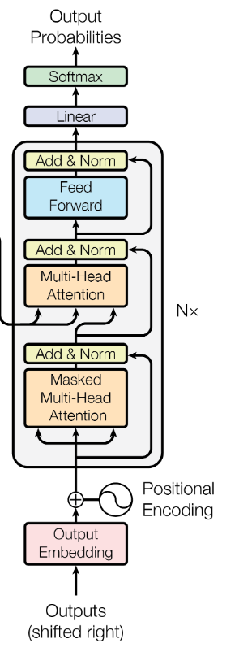
Transformer
Teacher Forcing
I am a handsome man
start
start NO
start NO you are ugly

Slide 30
Transformer
I am a handsome man
start
NO
start I
am
start I am a handsome man

Slide 31
BERT
BERT
张昊文
讨论会
PPT来自于李宏毅深度学习课程，仅做教学使用
Notes:
Question: scaling doc project???
https://voidism.github.io/note/2019/02/05/Transformer_Intro/
http://nlp.seas.harvard.edu/2018/04/03/attention.html
The best one: https://lilianweng.github.io/lil-log/2018/06/24/attention-attention.html
Also good: https://mchromiak.github.io/articles/2017/Sep/12/Transformer-Attention-is-all-you-need/#.XOoQfogzY2w
Matrix view: http://jalammar.github.io/illustrated-transformer/
https://github.com/jessevig/bertviz BERT vis
可以讀:
https://zhuanlan.zhihu.com/p/47470866
BERT: 這篇不錯 主要是分析 BERT
https://zhuanlan.zhihu.com/p/58430637

Slide 32

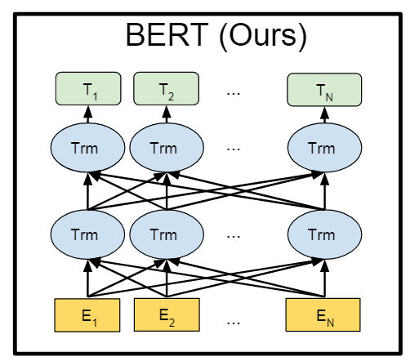
Bidirectional Encoder Representations from Transformers (BERT)
BERT = Encoder of Transformer
Learned from a large amount of text without annotation
Encoder
……
……

Slide 33
BERT
NLP
BERT
特定任务
特定模型
训练
预处理模型
训练
特定任务
模型微调

Slide 34
BERT
vocabulary size
feature-based
Predicting the word
fine-tuning
Linear Multi-class
Classifier
……
BERT
i
am
student
……
退了
a

Slide 35
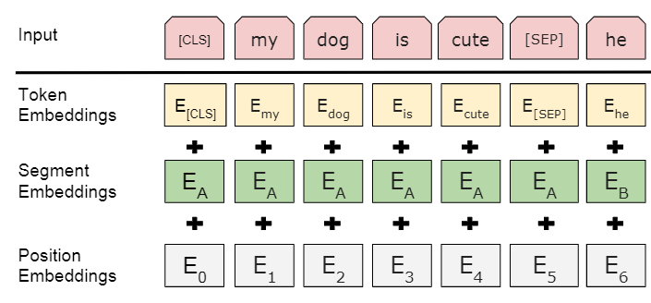
BERT
……
BERT
i
am
student
……
退了
a

Slide 36
Training of BERT
BERT
vocabulary size
Predicting the masked word
Approach 1:
Masked LM
Linear Multi-class
Classifier
整个序列会随机 Mask 掉 15% 的词
……
BERT
缺点：
收敛太慢
i
[MASK]
ironman
……
退了
am
Notes:
Can we compare BERT and ELMO??

Slide 37
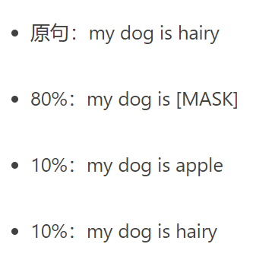
Training of BERT
BERT
vocabulary size
Predicting the masked word
Linear Multi-class
Classifier
……
BERT
i
[MASK]
ironman
……
退了
am
Notes:
Can we compare BERT and ELMO??

Slide 38
Training of BERT
Approach 2: Next Sentence Prediction
yes
[CLS]: the position that outputs classification results
Linear Binary
Classifier
[SEP]: the boundary of two sentences
Approaches 1 and 2 are used at the same time.
BERT
[CLS]
你
好
[SEP]
程
序
猿

Slide 39
How to use BERT – Case 1
class
Linear Classifier
从头开始训练
Input: single sentence,
output: class
Example:
情感分析,
文档分类
BERT
Fine-tune
[CLS]
w₁
w₂
w₃
sentence
Notes:
(https://arxiv.org/abs/1805.12471)

Slide 40
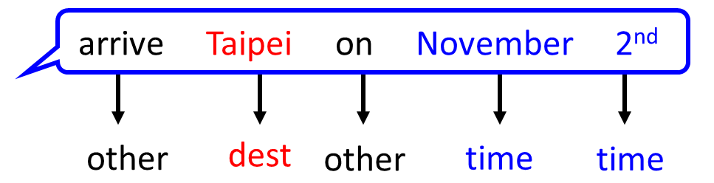
How to use BERT – Case 2
class
class
class
Linear Cls
Linear Cls
Linear Cls
Input: single sentence,
output: class of each word
Example: 词汇分类
BERT
[CLS]
w₁
w₂
w₃
sentence
Notes:
(https://arxiv.org/abs/1805.12471)

Slide 41
How to use BERT – Case 3
Class
Input: two sentences, output: class
Example: 自然语言推理
Linear Classifier
Given a “premise”, determining whether a “hypothesis” is T/F/ unknown.
BERT
[CLS]
w₁
w₂
[SEP]
w₃
w₄
w₅
Sentence 1
Sentence 2
Notes:
determining whether a “hypothesis” is true (entailment), false (contradiction), or undetermined (neutral) given a “premise”.

Slide 42
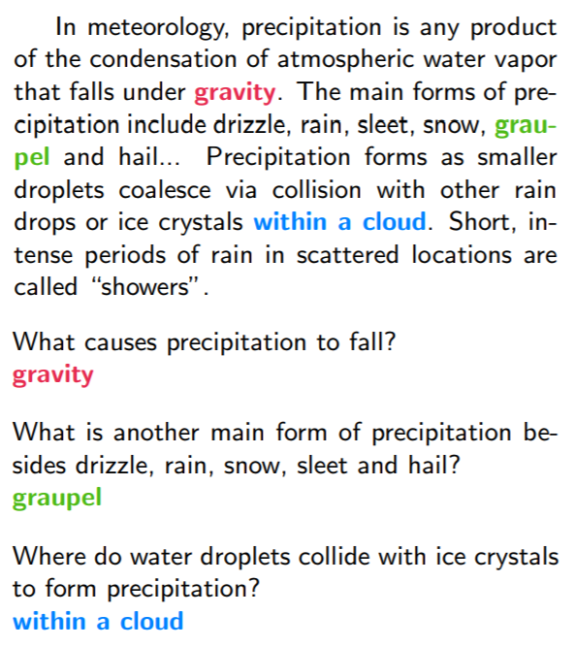





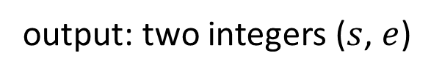




How to use BERT – Case 4
可提取问答 (QA) (E.g. SQuAD)
17
Document:
$$D=\left\{d_{1},d_{2},⋯,d_{N}\right\}$$
Query:
$$Q=\left\{q_{1},q_{2},⋯,q_{N}\right\}$$
77
79
$$D$$
QA
Model
$$s$$
$$e$$
$$s=17,e=17$$
$$Q$$
output: two integers ($s$, $e$)
Answer:
$$A=\left\{q_{s}, ⋯,q_{e}\right\}$$
$$s=77,e=79$$

Slide 43
How to use BERT – Case 4
Learned from scratch
0.3
0.5
0.2
s = 2, e = 3
Softmax
The answer is “d₂ d₃”.
dot product
BERT
[CLS]
q₁
q₂
[SEP]
d₁
d₂
d₃
question
document
Notes:
determining whether a “hypothesis” is true (entailment), false (contradiction), or undetermined (neutral) given a “premise”.

Slide 44
How to use BERT – Case 4
Learned from scratch
0.1
0.2
0.7
s = 2, e = 3
Softmax
The answer is “d₂ d₃”.
dot product
BERT
[CLS]
q₁
q₂
[SEP]
d₁
d₂
d₃
question
document
Notes:
determining whether a “hypothesis” is true (entailment), false (contradiction), or undetermined (neutral) given a “premise”.

Slide 45
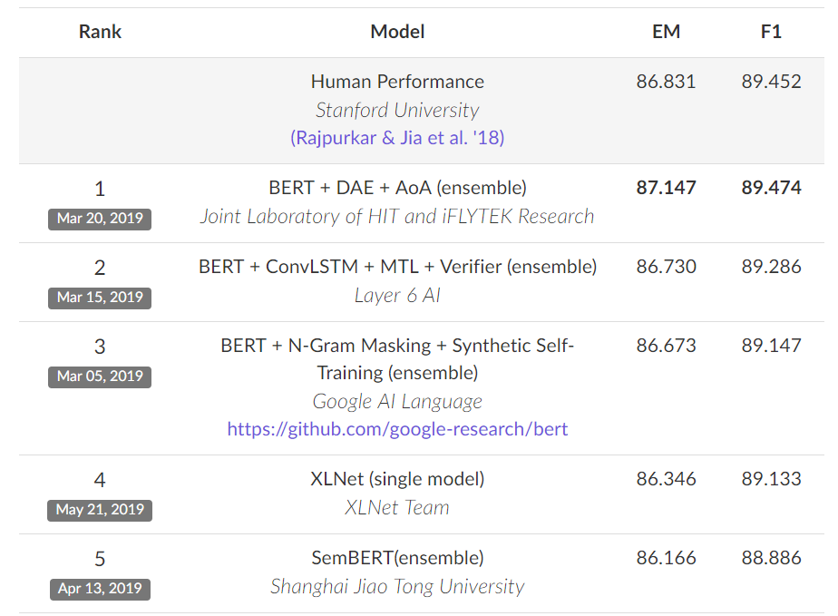
BERT 屠榜 ……
SQuAD 2.0
Notes:
屠榜

Slide 46
THANK YOU

