Slide 1
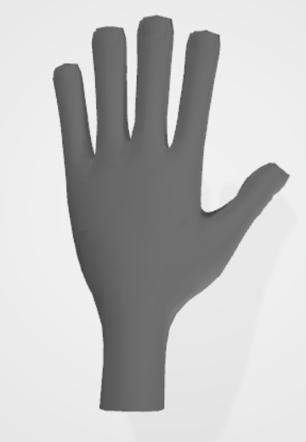
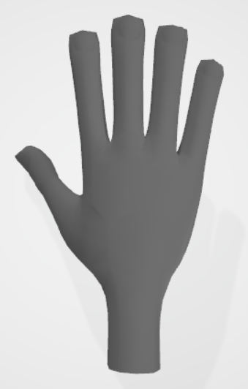
FIRST TASK – 1/1
Use WASD to move the left hand and Up/Down/Left/Right to move the right hand
Your hands can perform actions on objects. The left hand uses left-shift; the right hand uses right-control
Try to pick up a chicken leg from the bottom-right cooler

Slide 3
FIRST FRY – 1/2
Drop the chicken into the deep fryer in the middle of the table
[picture of deep fryer]
When the chicken has browned, pick up the fryer basket to remove it from the oil. Don't let it burn!

Slide 4
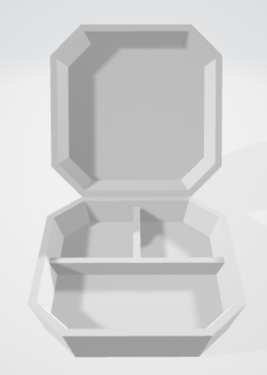
FIRST FRY – 2/2
Move the basket to the takeout containers in the back
perform an action to dump the chicken into the container

Slide 6
FULFILLING ORDERS – 1/3
Customer orders will appear at the top of the screen
[picture of order]

Slide 7
FULFILLING ORDERS – 2/3
Put all the items requested by the customer in a container, then deliver the container through the window
[picture of delivery through window]
Make sure to match the customer's request exactly, or the order will be rejected!

Slide 8
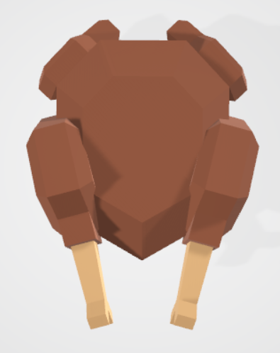
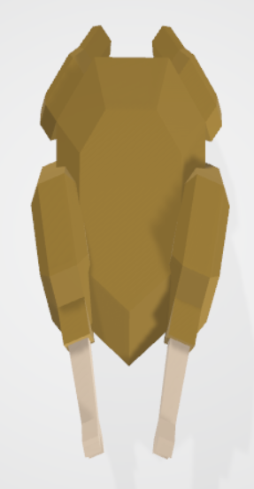
FULFILLING ORDERS – 3/3
Customers may request Fried Duck or Fried Turkey in addition to Fried Chicken
These can be found in the middle-right and upper-right coolers
Note that duck and turkey take longer to fry than chicken

Slide 10
ADDING TOPPINGS – 1/2
You can also make Breaded Chicken and Spicy Chicken by adding toppings
[pictures of new chickens]
Toppings can be applied to ducks and turkeys too
[pictures of new ducks / turkeys]

Slide 11
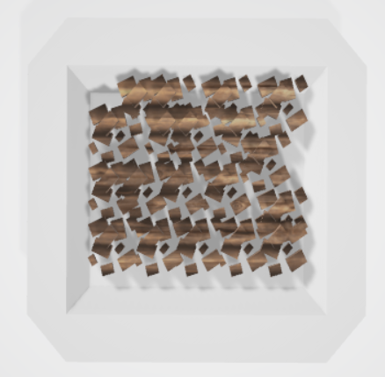
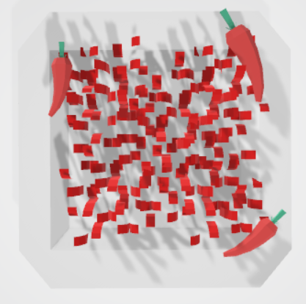
ADDING TOPPINGS – 2/2
Drop uncooked chicken on the lower plate to the right to add breading
Drop an uncooked breaded chicken on the upper plate to the right to add a spice rub
Toppings must be added before the chicken is fried!

Slide 13
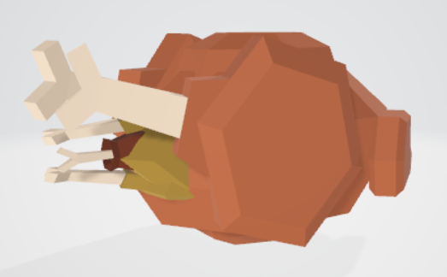
STUFFING BIRDS – 1/3
What's better than a combo meal of deep-fried chicken, deep-fried duck, and deep-fried turkey?
Deep-fried turducken - all three in one!

Slide 14
STUFFING BIRDS – 2/3
To stuff one bird inside another, hold one bird in each hand and mash the hands together
[picture of hands holding two birds]
Important: when stuffing a bird, the inner bird must be fried already, and the outer bird must be uncooked. The stuffed bird can then be fried for a double-deep-fry

Slide 15
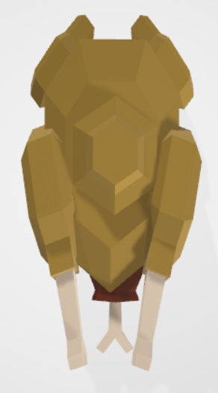
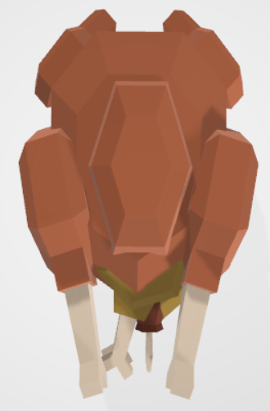
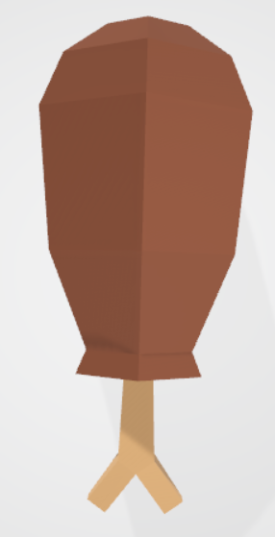
STUFFING BIRDS – 3/3
To make a Turducken:
stuff a fried chicken in a duck
fry the ducken
stuff the fried ducken in a turkey
fry the turducken
-> ->

