Slide 1
PS Core Performance Report
PS Network Performance
01 October 2026 – 12 October 2026
Karima DERRAS
Direction Ingénierie et Développement du Réseau
Sous-Direction Architecture Réseau

Slide 2
AGENDA
Introduction
Availability & Usage
Accessibility
Traffic
Conclusion

Slide 3
Introduction
The aim of this report is to show the performance of PS core nodes of MME, vMME, Cloud USN, EPG, vEPG and Cloud UGW

Slide 4
Availability & Usage
Attach&PDP Context
Max Attached Users and Max Active PDP Context by node
Node | SAU 2G | SAU 3G | SAU 4G | PDP 2G | PDP 3G | Bearer 4G | Total SAU | Total PDP/Bearer Context
BMR_CloudUSN | 206 526 | 596 760 | 2 269 273 | 59 599 | 309 116 | 2 300 932 | 3 072 559 | 2 669 647
ANB_CloudUSN | 200 385 | 651 441 | 2 399 962 | 65 820 | 337 076 | 2 433 780 | 3 251 788 | 2 836 676
OUG_CloudUSN | 158 933 | 609 387 | 2 349 025 | 55 685 | 322 039 | 2 384 184 | 3 117 345 | 2 761 908
MMEMUS1 | 142 241 | 349 020 | 1 627 728 | 60 164 | 166 751 | 1 636 000 | 2 118 988 | 1 862 915
MMEORN1 | 63 568 | 392 560 | 1 784 097 | 18 965 | 195 642 | 1 793 563 | 2 240 225 | 2 008 169
vMMEORN1 | 48 145 | 203 287 | 784 054 | 15 464 | 102 492 | 814 702 | 1 035 486 | 932 657
vMMEBMR1 | 63 470 | 192 543 | 629 918 | 13 539 | 78 568 | 646 261 | 885 931 | 738 368
Total | 883 267 | 2 994 997 | 11 844 058 | 289 236 | 1 511 683 | 12 009 421 | 15 722 322 | 13 810 340

Slide 5
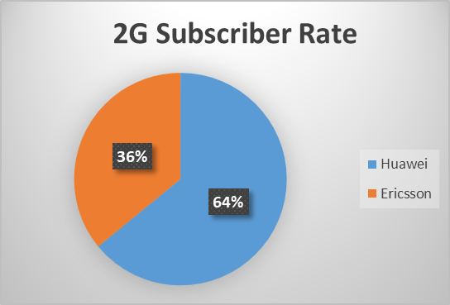
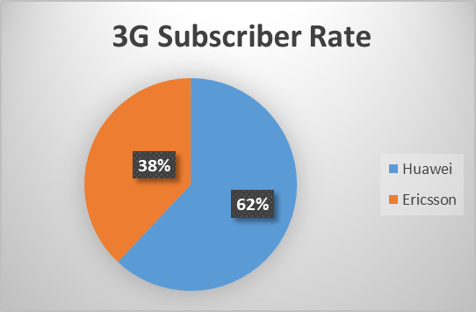
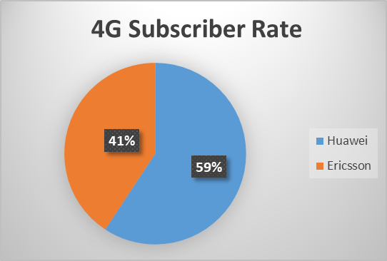
Dashboard Graph

Slide 6
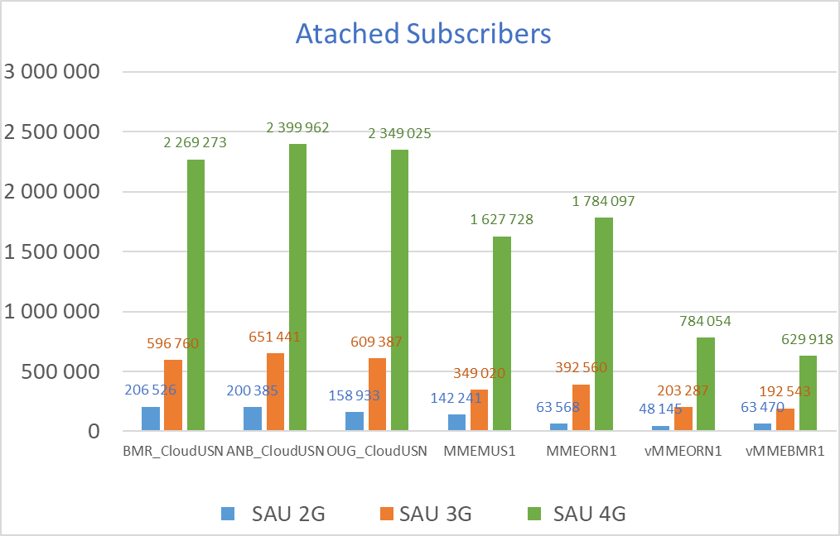
Accessibility
Attach
Attached Users per Node

Slide 7
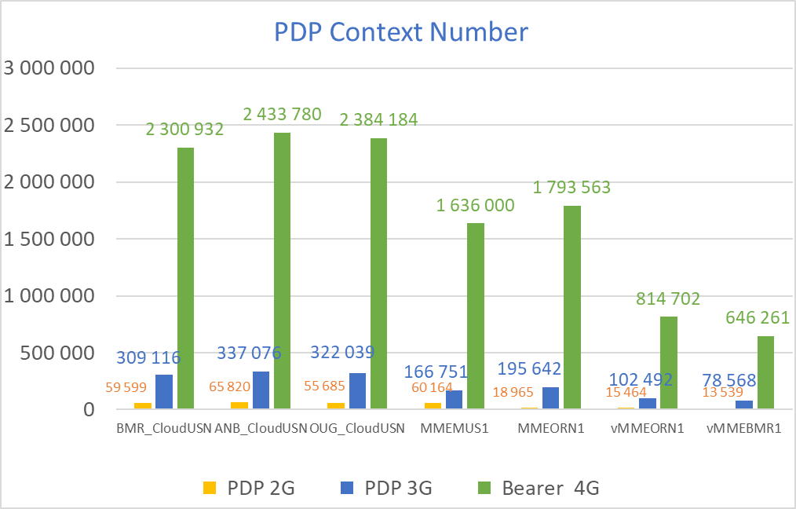
Accessibility
PDP Context
Active PDP Context per Node

Slide 8
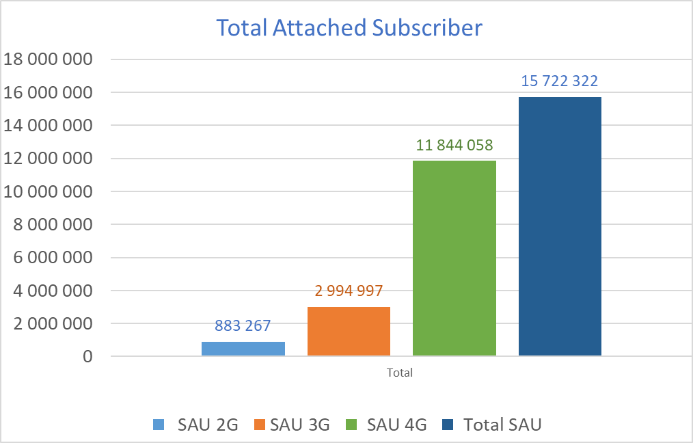
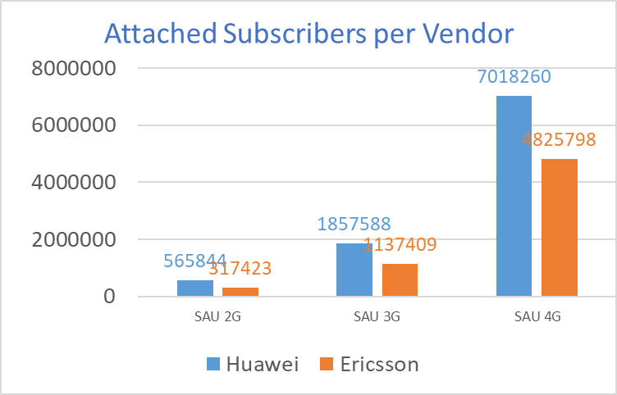
Accessibility
PDP Context
Total Attached Users

Slide 9

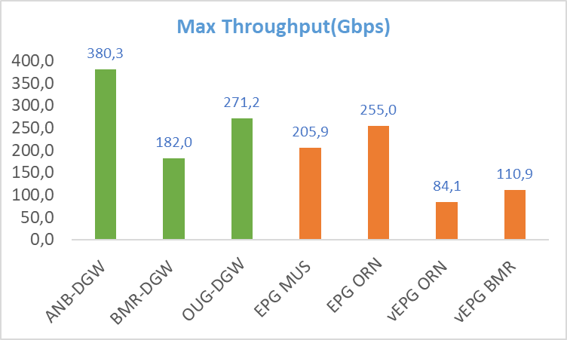
Traffic
Peak Throughput Per Node

Slide 10
Traffic
Network DL&UP Throughput in (Gbps)

Slide 11
Traffic
Huawei DL&UP Throughput in (Gbps)

Slide 12
Traffic
Ericsson DL&UP Throughput in (Gbps)

Slide 13
Traffic
Throughput per Pool in (Gbps)

Slide 14
Traffic
Throughput per Node_Huawei in (Gbps)

Slide 15
Traffic
Throughput per Node_Ericsson in (TB)

Slide 16
Traffic
Network DL&UP Traffic in (Gbps)

Slide 17
Traffic
Huawei DL&UP Traffic in (TB)

Slide 18
Traffic
Ericsson DL&UP Traffic in (TB)

Slide 19
Traffic
Traffic Per Pool in (TB)

Slide 20
Traffic
SGi(4G)_Gi(2G/3G) Network Traffic in (TB)

Slide 21
Traffic
SGi(4G)_Gi(2G/3G) Traffic per Pool in (TB)

Slide 22
Traffic
Daily SGi(4G)_Gi(2G/3G)_Network Traffic in (TB)

Slide 23
Traffic
Daily SGi(4G)_Gi(2G/3G) Traffic Per Vendor in (TB)

Slide 24
Conclusion
In general the major KPIs following normal trend during the period from 01 October to 12-Octoberber-2026,
The PS Core Network performance could be resumed in the bellow points :
Number of max attached subscribers: 2G: 883 267 3G: 2 994 997 4G: 11 844 058 Total: 289 236
Number of max active PDP context& bearer: 2G: 15 722 322 3G: 12 009 421 4G: 15 722 322 Total: 13 810 340
Throughput in BH (Gbps): 1494,83
SGi(4G) Throughput in BH(Gbps): 1361,70
Gi(2G/3G) Throughput in BH(Gbps): 133,13
Max Traffic Volume per Hour (TB): 730
Max SGI Traffic Volume per Hour (TB): 613
Max GI Traffic Volume per Hour (TB): 116
Max Daily Traffic (TB): 10310

