Slide 1

FitTrack
The project aims to make the fitness experience or a journey convenient for a user as it tries to bring together various components involved in this journey.

Slide 2
Team Members
Abhishek Ramchandani
Himanshu Walia
Raksha Israni
Sunayana Shivani
Vignesh Perumal

Slide 3

Let’s go through the features in the application
The applications comes with 4 major features
1. Exercises tutorial
2. Meal and workout plan generator
3. Progress Record Feature
4. Progress Tracker

Slide 4
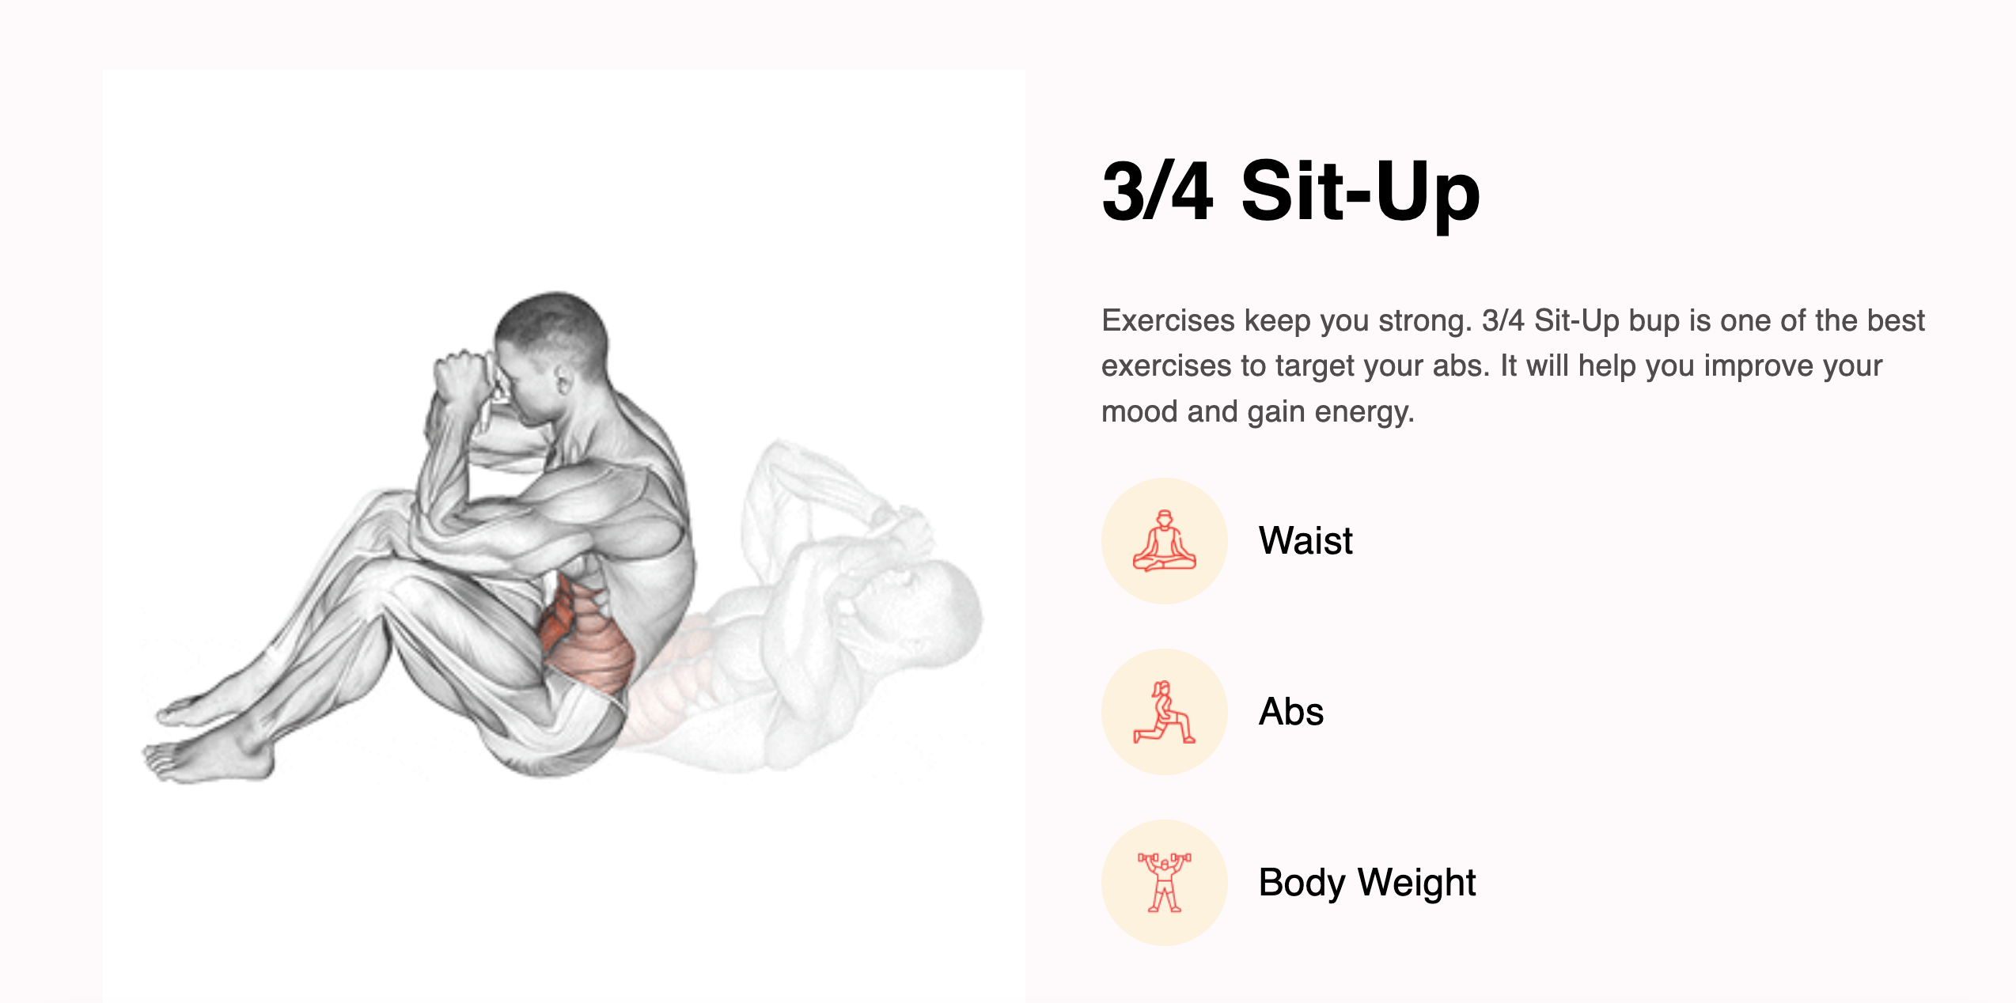
Exercises tutorial
This components enable user to learn basic exercises per muscle group by demonstrating the steps and posture for the exercises. It also helps user suggest you tube videos to learn more about a particular exercise

Slide 5
Meal and workout plan generator

Slide 6
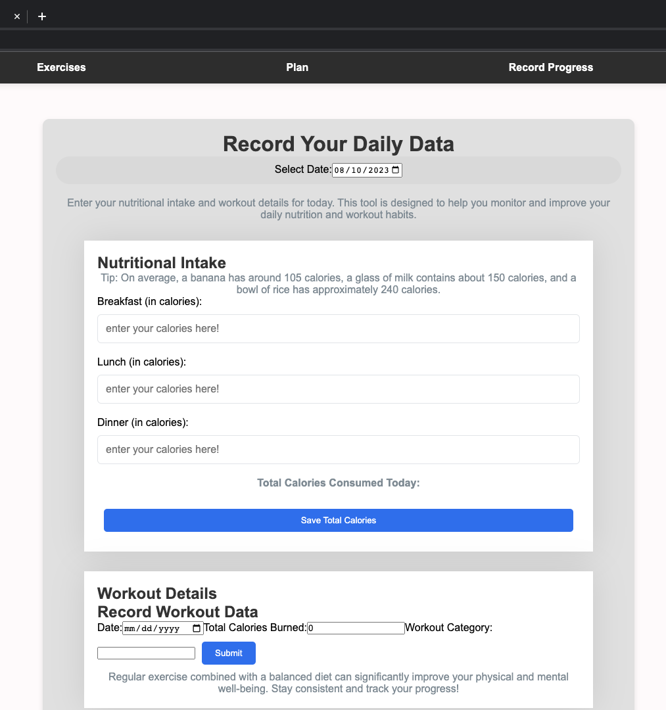
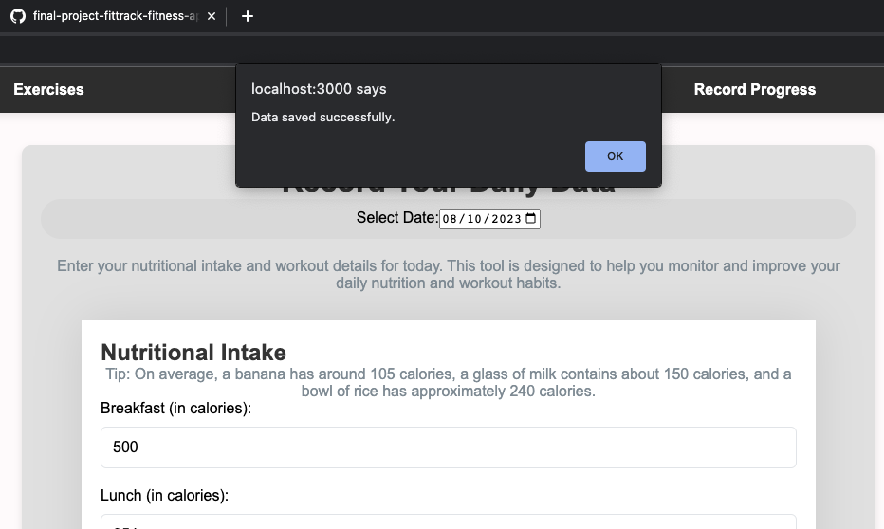
Progress Record Feature
This feature plays the most essential role for CRUD operations in our application. The Form is responsible to prompt the user daily to enter his nutritional as well his training details.
Makes use of state management to store Nutritional Values for Breakfast, Lunch, Dinner to be stored in state till the “Calculate Total Calories” button is clicked.
Future Scope : Add a carousel for Date and a visually pleasing variation of Workout Category menu.

Slide 7
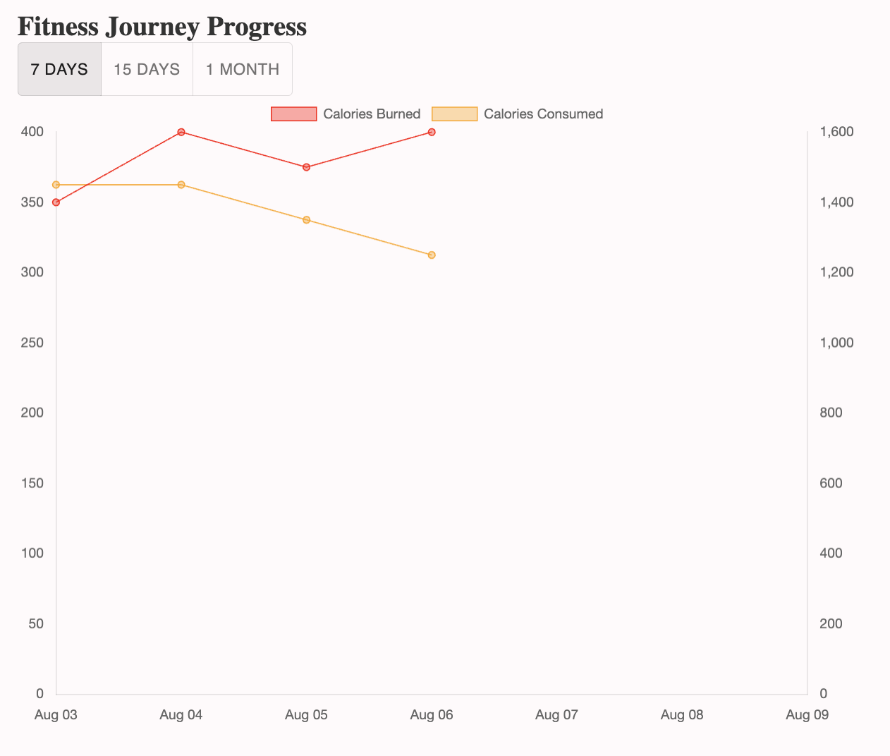
Progress Tracker
This feature lets the user have a wholistic view of his/her progress by analyzing the trend of the calorie intake and workout over a period. The user can track and monitor the progress across 3 time durations of a week, fortnight and a month so as to see if he’s moving towards his goal or not.

