Slide 1

FitTrack
The project aims to make the fitness experience or a journey convenient for a user as it tries to bring together various components involved in this journey.

Slide 2
Team Members
Abhishek Ramchandani
Himanshu Walia
Raksha Israni
Sunayana Shivani
Vignesh Perumal

Slide 3
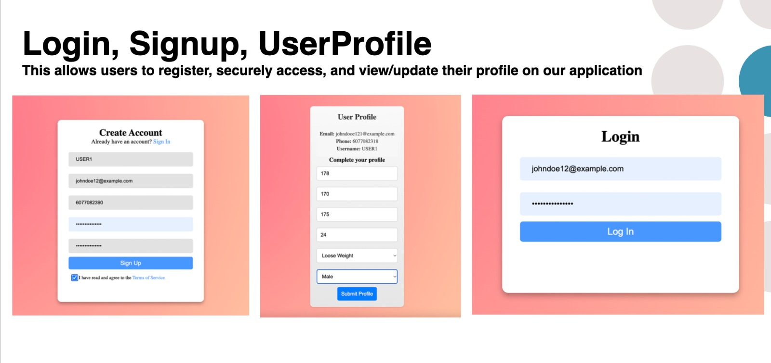

Slide 4

Let’s go through the features in the application
The applications comes with 4 major features
1. Exercises tutorial
2. Meal and workout plan generator
3. Progress Record Feature
4. Progress Tracker

Slide 5
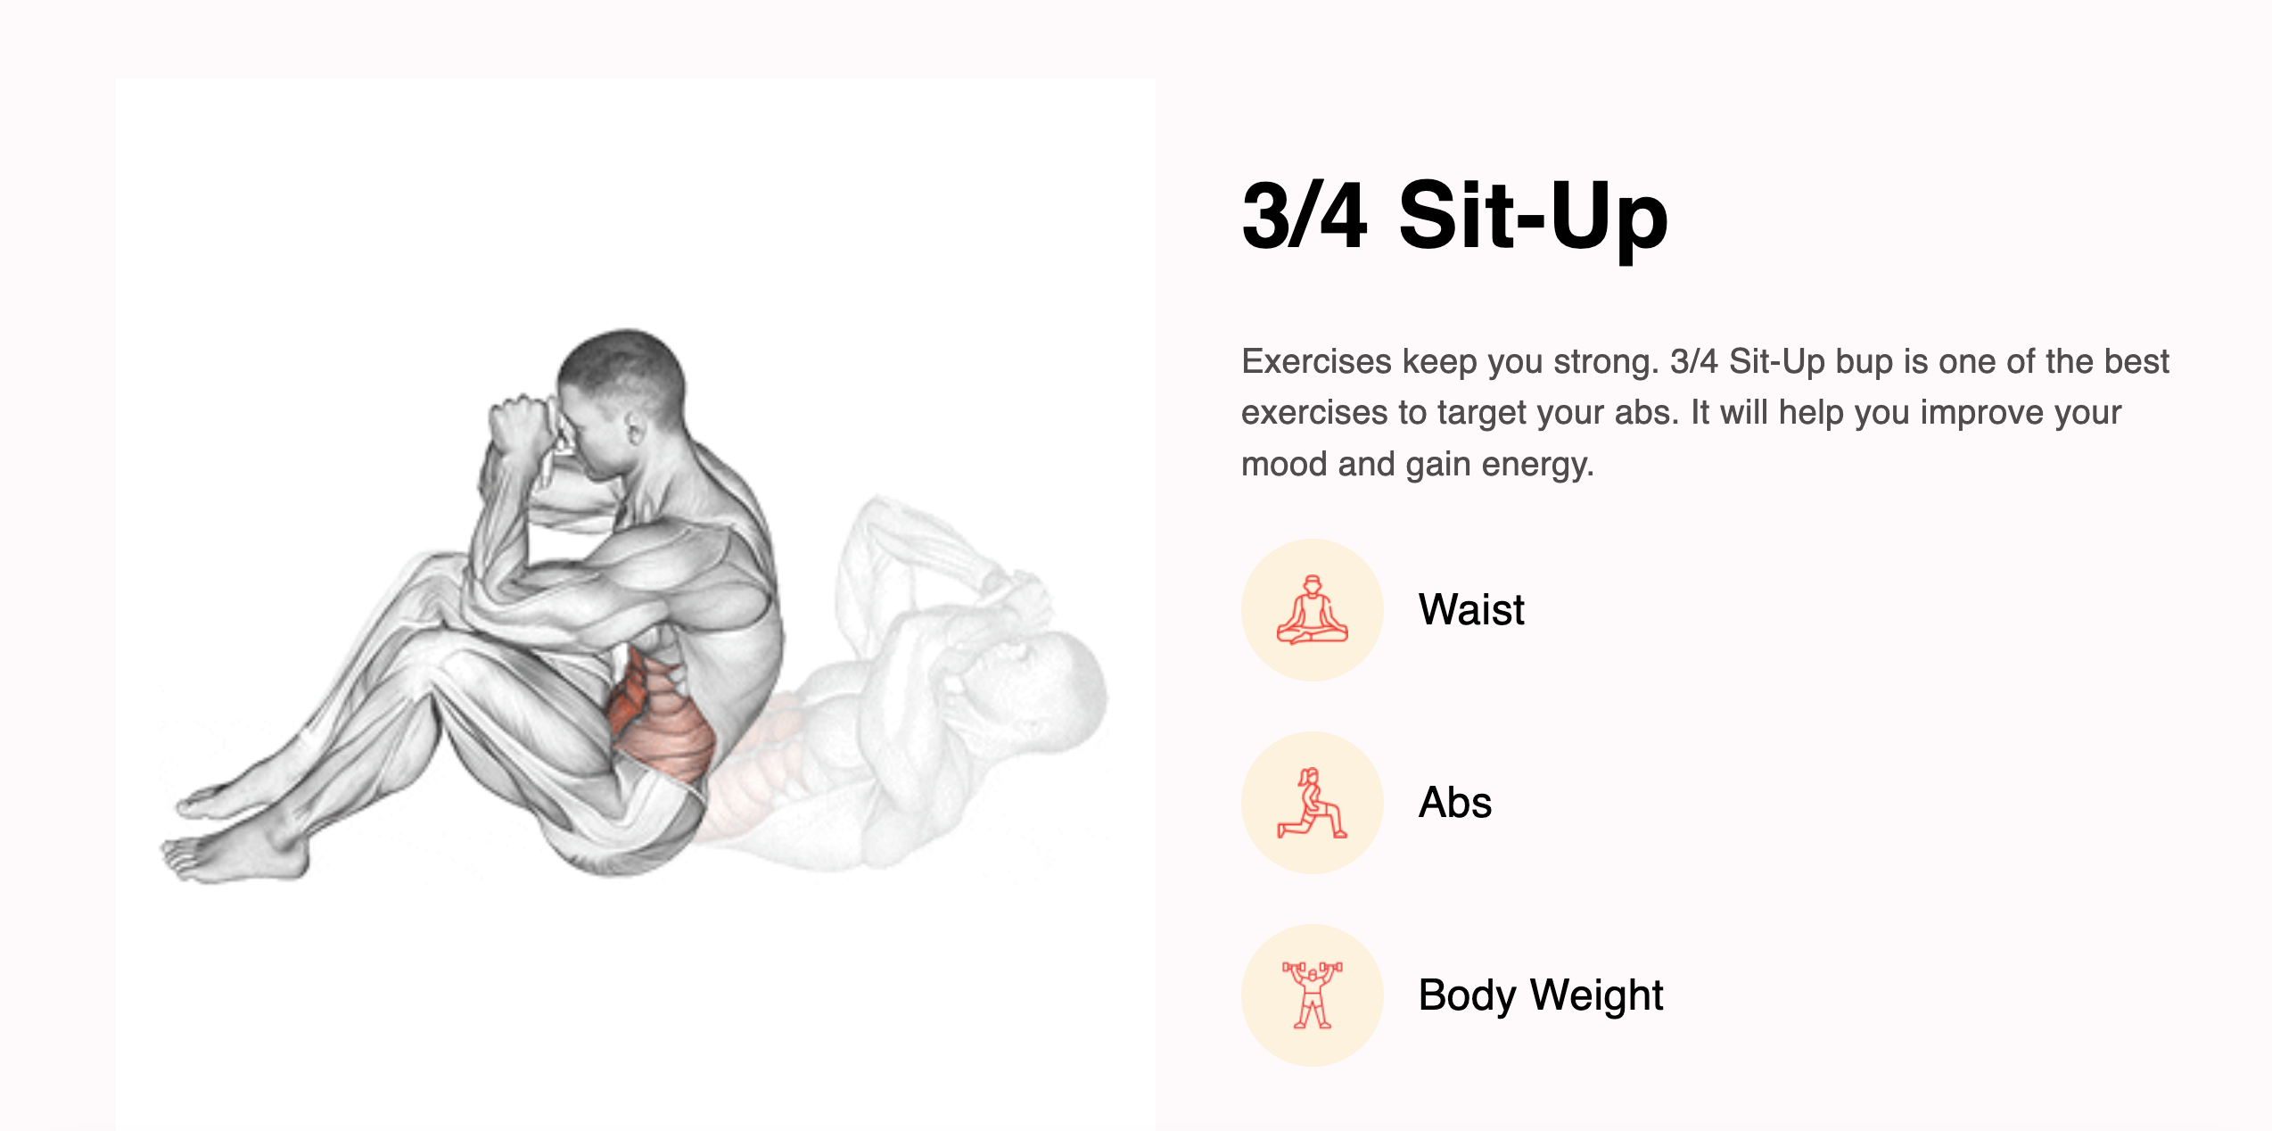
Exercises tutorial
This components enable user to learn basic exercises per muscle group by demonstrating the steps and posture for the exercises. It also helps user suggest you tube videos to learn more about a particular exercise

Slide 6
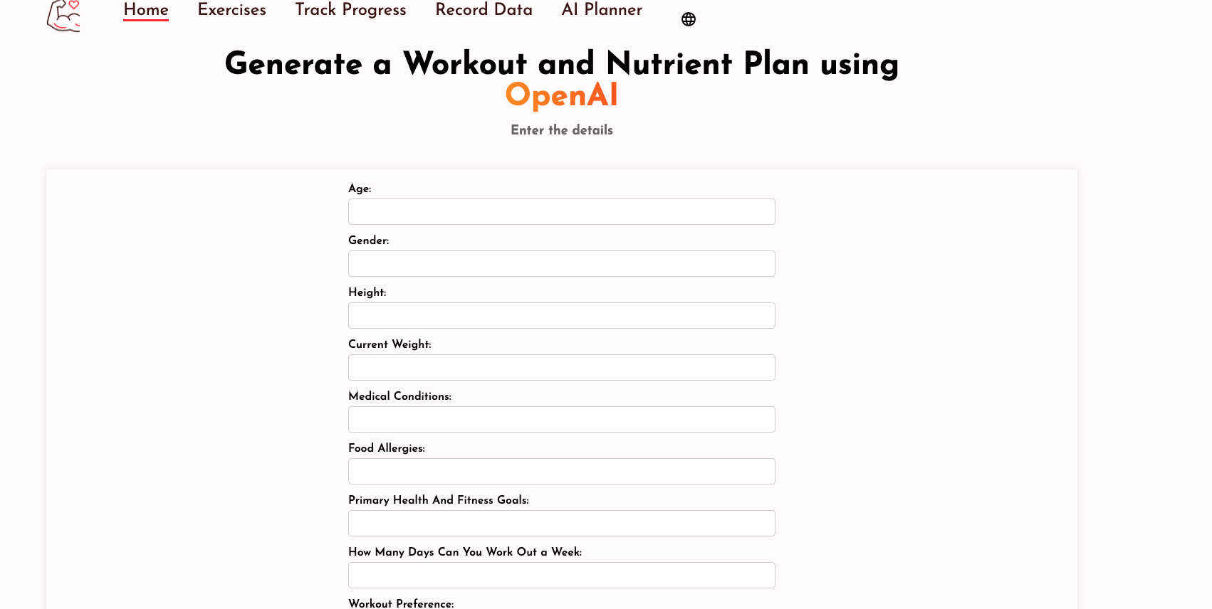
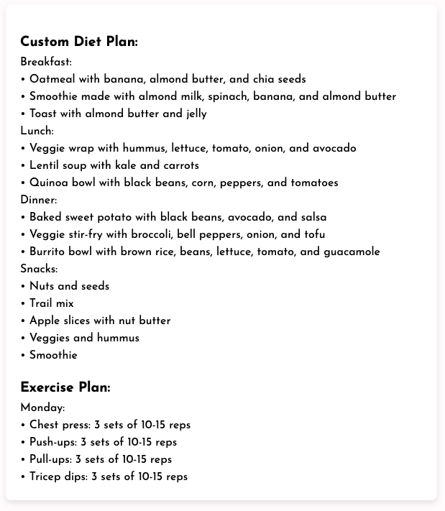
Meal and workout plan generator
Adaptive Programs: Based on the user's fitness level, goals (e.g., weight loss, muscle gain, endurance training), and any physical limitations or medical conditions, the AI suggests a tailored workout plan.
Dietary Preferences & Restrictions: The AI can generate meal plans based on user preferences, such as vegetarian, vegan, keto, or gluten-free diets, and can consider any allergies or intolerances.
Recipe Suggestions: Based on the ingredients users have on hand and their nutritional needs, the AI can suggest recipes, making meal planning easier.

Slide 7
Progress Record Feature
This feature plays the most essential role for CRUD operations in our application. The Form is responsible to prompt the user daily to enter his nutritional as well his training details.
Makes use of state management to store Nutritional Values for Breakfast, Lunch, Dinner to be stored in state till the “Calculate Total Calories” button is clicked.
Future Scope : Add a carousel for Date and a visually pleasing variation of Workout Category menu.

Slide 8
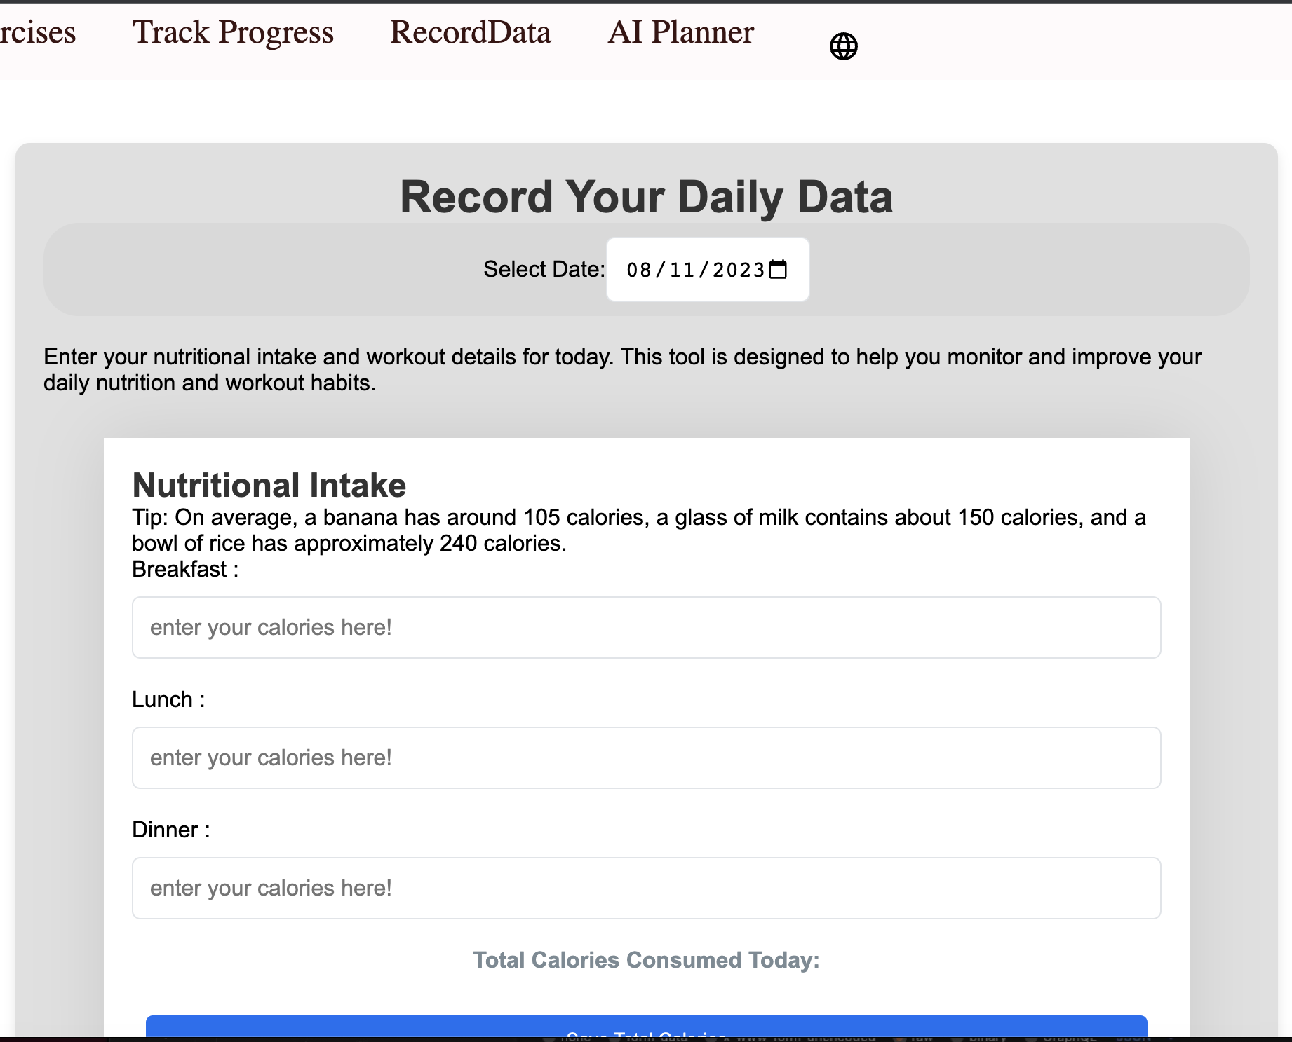
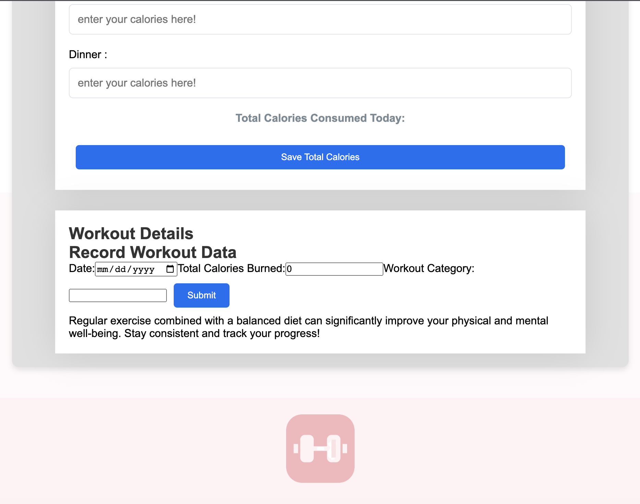
Record Data Page

Slide 9
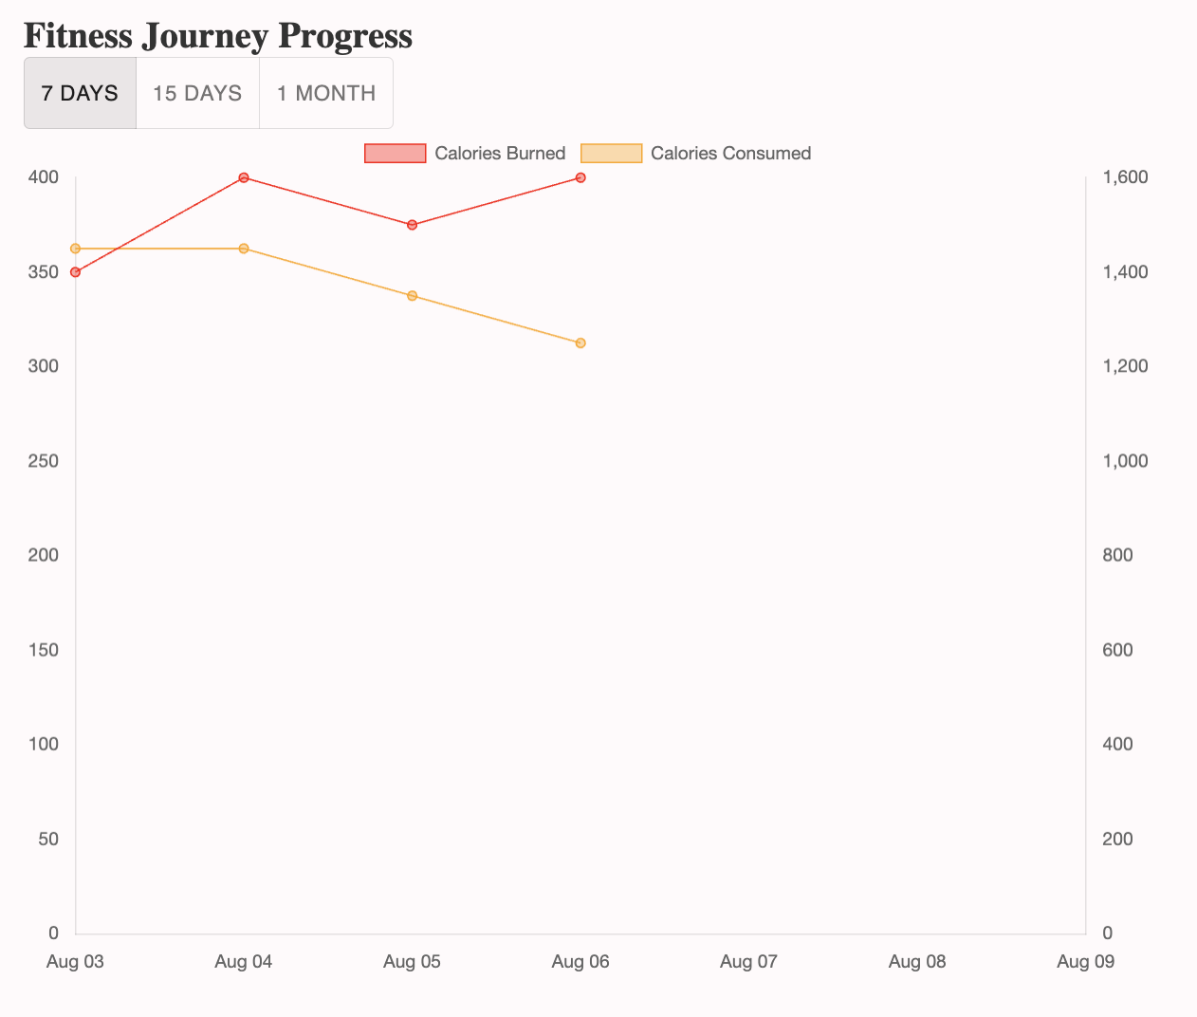
Progress Tracker
This feature lets the user have a wholistic view of his/her progress by analyzing the trend of the calorie intake and workout over a period. The user can track and monitor the progress across 3 time durations of a week, fortnight and a month so as to see if he’s moving towards his goal or not.

Slide 10
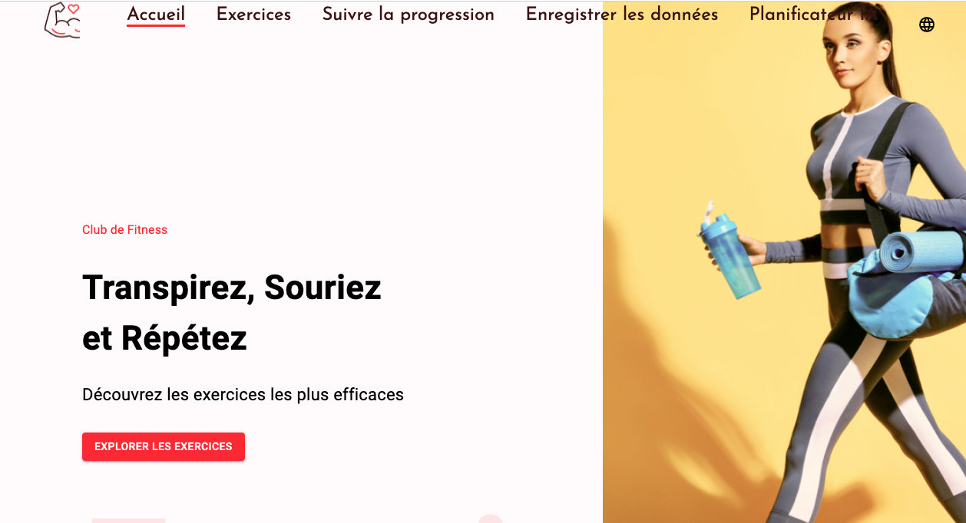

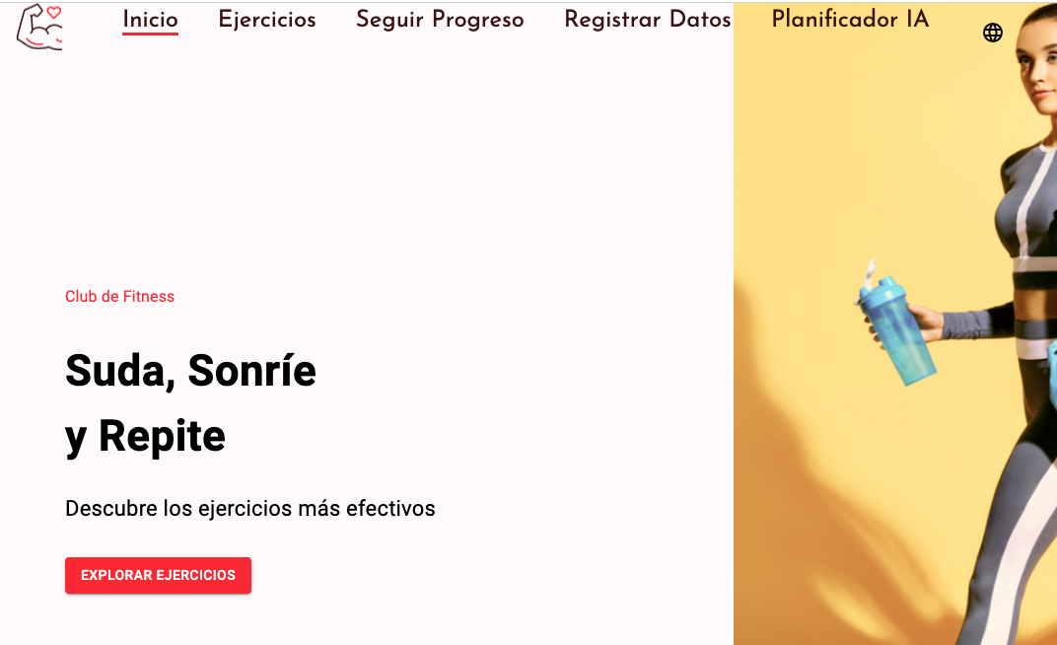
Internationalization
Language & Locale Support:
Enable support for multiple languages and regional differences, ensuring that content is accurately translated and culturally appropriate.

Slide 11
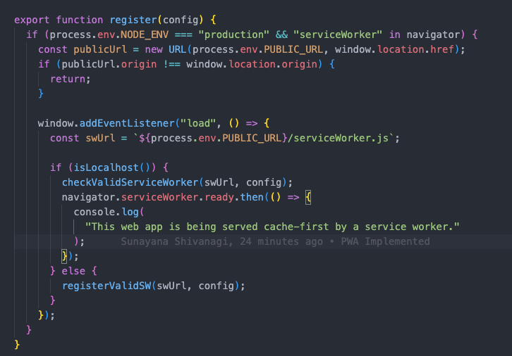
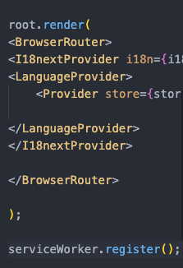
PWA
Offline Access: PWAs can work offline or with low-quality networks, thanks to service workers that cache key resources.
Responsive Design: They adapt to any device, screen size, or orientation, ensuring a consistent user experience across platforms.
Performance: PWAs are optimized for speed and reliability, often leading to faster load times and smoother interactions compared to traditional web apps.

Slide 12
Thank you for using Fittrack!
References
https://rapidapi.com/justin-WFnsXH_t6/api/exercise
https://rapidapi.com/h0p3rwe/api/youtube-search-and-download/
https://rapidapi.com/yourdevmail/api/chatgpt-ai-chat-bot

