Slide 1
Are you ready?

Slide 2



Software Tool Time

Slide 3


Slide 4
WebGL 1.0 Tutorial Lecture 08 – Clipping and Culling
Tutor
Hwanyong “Grey Bear” LEE
Objectives
Clipping and Culling with surface geometry
Preparation
Download sample code from https://github.com/hwan-ajou/webgl-1.0
May 2021 / (CC-BY-NC 4.0) Hwanyong Lee and Ajou University

Slide 5
OpenGL ES 2.0 pipeline diagram
Graphics Context
Buffer (Array, Element)
Vertex Processing
Primitive Processing
Vertex Shader
App
API
Texture
Processing
Rasterization
Texture
Fragment Shader
Fragment Processing
System SW
(Window, Web, HAL)
Framebuffer
(Color, Stencil, Depth)
Pixel
Processing

Slide 6
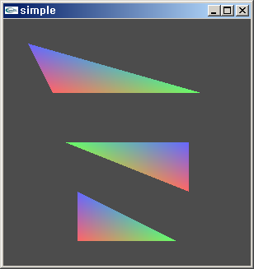
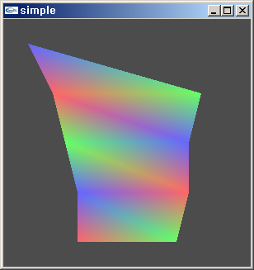
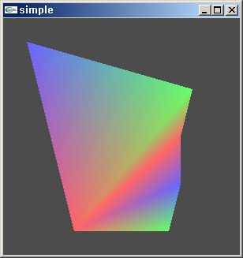
Triangles
TRIANGLES
TRIANGLES_STRIP
TRIANGLE_FAN

Slide 7
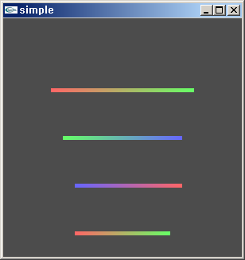
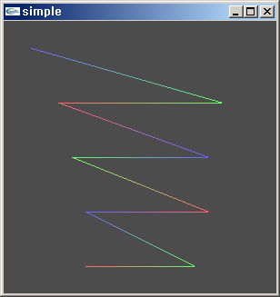
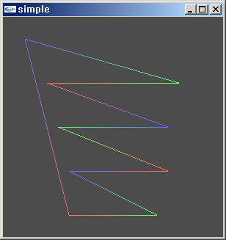
Lines
LINES
LINE_STRIP
LINE_LOOP
lineWidth(f) – set line width

Slide 8
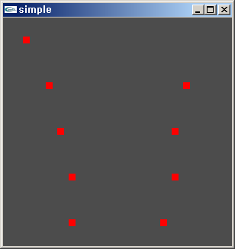
Point Sprites
POINTS
gl_PointSize – built in variable for point radius
gl_PointCoord – vec2 variable in fragment shader
PointCoord can be used as texture coordinate to draw textured point sprinte

Slide 9
Perspective Division / Viewport Tr.
Normalize with w coordinate
X_{C}/ W_{C}, Y_{C}/ W_{C,} Z_{C}/W_{C}
Viewport Transformation
void viewport(int x, int y, long w, long h)
x,y is screen coord., w,h specify width height of viewport
void depthRange(float n, float f)
n, f – 0~1

Slide 10
Primitive Processing
Primitive Processing
Vertex
Primitive Assembly
Primitive
Perspective Division
Viewport Mapping
Primitive Clipping

Slide 11
Clipping
Viewing Volume
Viewing Frustum
Clipping Triangle / Line / Point
Fully inside – no clipping
Fully outside – discard
Partially inside – modify triangle

Slide 12
Rasterization Process
Rasterization
Triangle
Facing Determination
Face Culling
Primitive
Point
Depth offset
Multisampling
Line
Fragment

Slide 13
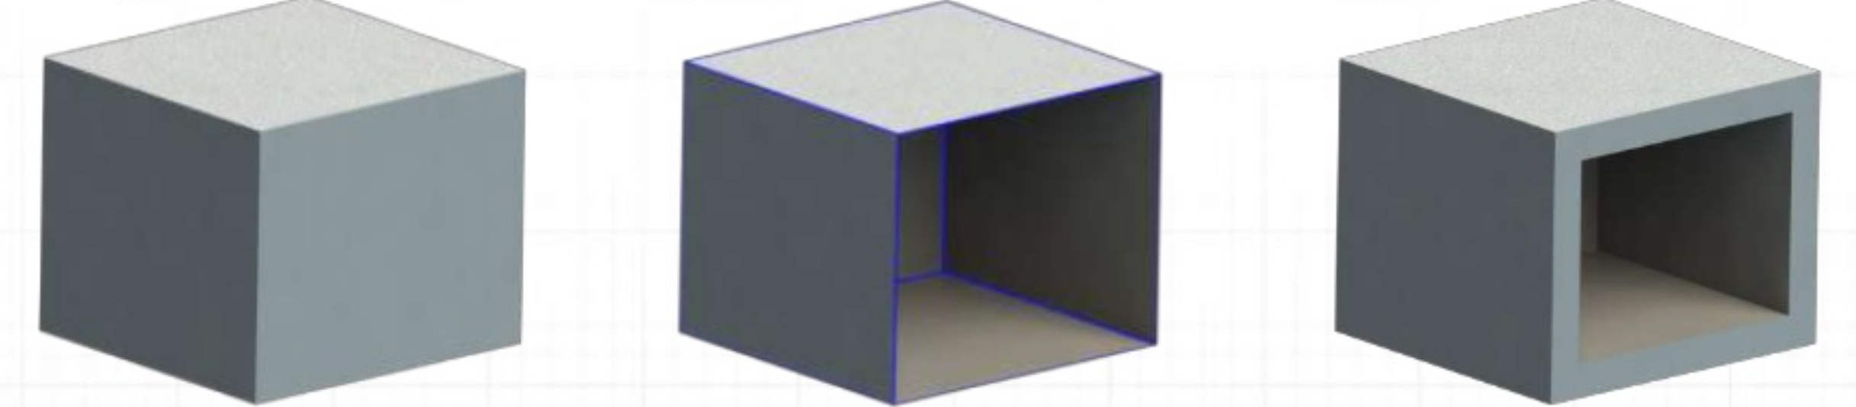

How can we define a model of “geometry”
Solid model vs Surface model

Slide 14
Culling
void frontFace(enum dir)
dir : gl.CW or gl.CCW (default)
void cullFace(enum mode)
mode: gl.FRONT, gl.BACK(default), gl.FRONT_AND_BACK
void enable/disable (CULL_FACE)
Default is disabled

Slide 16

Software Tool Time (소프트웨어 툴 타임)
(CC-BY-NC 4.0) Hwanyong Lee and Ajou University
Visit “Software Tool Time” channel in YouTube : http://goo.gl/remxrw
This video was supported by the Khronos Group
All product names, trademarks, and/or company names are used solely for identification and belong to their respective owners.
“Software Tool Time” video is licensed to the public under a Creative Commons Attribution 4.0 License (https://creativecommons.org/license/by/4.0/)
Twin Musicom’s African Drums (Sting) is licensed to the to the public under a Creative Commons Attribution 4.0 License (Artist: http://www.twinmusicom.org/)

Slide 17
Software Tool Time

Slide 19
Lab. 08 Culling

Slide 21
Software Tool Time (소프트웨어 툴 타임)
(CC-BY-NC 4.0) Hwanyong Lee and Ajou University
Visit “Software Tool Time” channel in YouTube : http://goo.gl/remxrw
This video was supported by the Khronos Group
All product names, trademarks, and/or company names are used solely for identification and belong to their respective owners.
“Software Tool Time” video is licensed to the public under a Creative Commons Attribution 4.0 License (https://creativecommons.org/license/by/4.0/)
Twin Musicom’s African Drums (Sting) is licensed to the to the public under a Creative Commons Attribution 4.0 License (Artist: http://www.twinmusicom.org/)

