Slide 1
Are you ready?

Slide 2



Software Tool Time

Slide 3


Slide 4
WebGL 1.0 Tutorial Lecture 09 – Fragment Operation
Tutor
Hwanyong “Grey Bear” LEE
Objectives
per-fragment operation – scissoring, stencil-test, depth-test
Preparation
Download sample code from https://github.com/hwan-ajou/webgl-1.0
May 2021 / (CC-BY-NC 4.0) Hwanyong Lee and Ajou University

Slide 5
OpenGL ES 2.0 pipeline diagram
Graphics Context
Buffer (Array, Element)
Vertex Processing
Primitive Processing
Vertex Shader
App
API
Texture
Processing
Rasterization
Texture
Fragment Shader
Fragment Processing
System SW
(Window, Web, HAL)
Framebuffer
(Color, Stencil, Depth)
Pixel
Processing

Slide 6
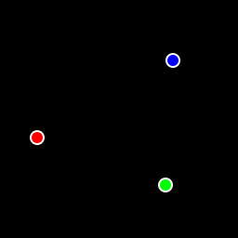
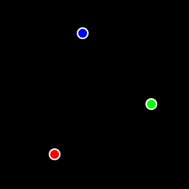
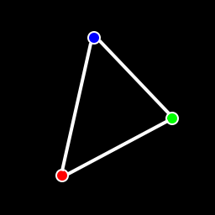
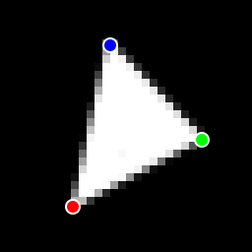
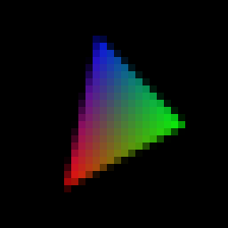
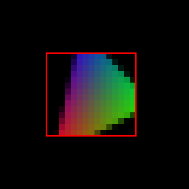
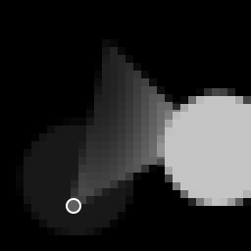



How to work
Graphics Context
Vertex Buffer (Array, Element)
Vertex Processing
Primitive Processing
Vertex Shader
App
API
Texture
Processing
Rasterization
Texture
Fragment Shader
Fragment Processing
System SW
(Window, Web, HAL)
Frame Buffer
(Stencil, Drawing, Depth, … )
Pixel Processing

Slide 7
Fragment Processing
Fragment Processing
Fragment (+ varying)
Pixel ownership
Scissor Test
Multi-sample
Frag. Op.
Texture
Fragment shader
Fragment Shading
Pixel
Depth Test
Stencil Test

Slide 8


Pixel Processing
Pixel Processing
Pixel
Blending
Dithering
Fine control of Buffer
Additional Multisampling
Frame buffer objects

Slide 9
Fragment Operation control
enable(enum token) / disable / isEnabled
DEPTH_TEST Control depth testing of fragments
STENCIL_TEST Control stencil testing of fragments
SCISSOR_TEST Control scissoring testing of fragments
BLEND Control blending of fragments
DITHER Control the dithering of fragment colors
CULL_FACE Control the culling faces
SAMPLE_COVERAGE Control the computation of sample coverage values
SAMPLE_ALPHA_TO_COVERAGE Control the use of a sample’s alpha in the computation of a sample coverage value
Some features should be provided from canvas

Slide 10
Scissoring and its API
Drawing inside rectangle
void scissor(x, y, width, height)
Screen coordinate
void enable/disable (SCISSOR_TEST)
Default is disabled
getParameter(enum pname)
SCISSOR_{BOX, TEST}

Slide 11
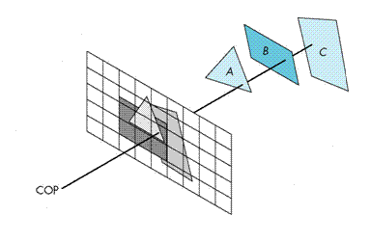
Hidden-Surface Removal
We want to see only those surfaces in front of other surfaces
OpenGL uses a hidden-surface method called the z-buffer algorithm that saves depth information as objects are rendered so that only the front objects appear in the image

Slide 12
Depth Test API
void depthRange(float near, far)
mapping near plane and far plane to windows (0.0 <= near < far <= 1.0)
void depthFunc(func)
NEVER, ALWAYS, LESS, EQUAL, LEQUAL, GREATER,
GEQUAL, NOTEQUAL
void enable/disable (DEPTH_TEST)
Default is disabled
getParameter(enum pname)
DEPTH_{BITS,CLEAR_VALUE, FUNC, RANGE, TEST, WRITEMASK}

Slide 13
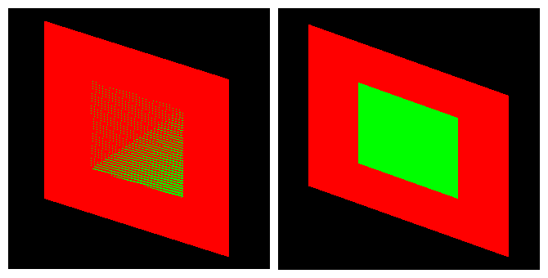
Polygon Offset
To avoid z-fight
add delta value to z-buffer test
void polygonOffset(float factor, float units)
depth offset = m * factor + r * units m = (∂z ⁄ ∂x ² + ∂z ⁄ ∂y ²)
enable(POLYGON_OFFSET_FILL) and disable(POLYGON_OFFSET_FILL)
Stored new z value is original value not delta added value.

Slide 14
Stencil
void stencilOp(enum sfail, zfail, zpass)
KEEP, ZERO, REPLACE, INCR, DECR, INCR_WRAP, DESCR_WRAP, INVERT
void stencilOpSeparate(enum sfail, zfail, zpass)
mode: FRONT, BACK(default), FRONT_AND_BACK
void stencilFunc(func, ref, mask)
func - NEVER, LESS, EQUAL, LEQUAL, GREATER, GEQUAL, NOTEQUAL, ALWAYS(default)
ref – 0 ~ 2^{n}-1 (default = 0) // Value for updating
mask – bit mask (defaut = all 1)
void enable/disable (STENCIL_TEST)
Default is disabled
getParameter(pnum)
STENCIL_{BITS, CLEAR_VALUE, TEST}, STENCIL_[BACK_]{FAIL,FUNC, REF, VALUE_MASK, WRITEMASK},
STENCIL_[BACK_]PASS_DEPTH_{FAIL, PASS}

Slide 15
Fragment Operation on/off
enable(enum token) / disable / isEnabled
DEPTH_TEST Control depth testing of fragments
STENCIL_TEST Control stencil testing of fragments
SCISSOR_TEST Control scissoring testing of fragments
BLEND Control blending of fragments
DITHER Control the dithering of fragment colors
CULL_FACE Control the culling faces
SAMPLE_COVERAGE Control the computation of sample coverage values
SAMPLE_ALPHA_TO_COVERAGE Control the use of a sample’s alpha in the computation of a sample coverage value
Some features must be provided from canvas

Slide 16
Buffers
Color buffer
Front & Back color buffer
Depth Buffer
Stencil Buffer
Clearing Buffers
clear(Glbitfield mask) – mask COLOR_BUFFER_BIT, DEPTH_BUFFER_BIT, STENCIL_BUFFER_BIT
clearColor(float r, float g, float b, float a);
clearDepth(float depth);
clearStencil (Glint s);
Maintain Buffers
gl = canvas.getContext('webgl’, {stencil:true, alpha:true, depth:true, antialias:true, preserveDrawingBuffer:true});

Slide 17
Framebuffer Writing Masks
colorMask(boolean red, boolean green, boolean blue, boolean alpha);
depthMask (Glboolean depth); // default = True
stencilMask (Gluint mask); // default = 0b111…111
stencilMaskSeparate (enum face, Gluint mask);
Example
gl.stencilMaskSeparate(gl.FRONT, 0b110101);
gl.getParameter(gl.STENCIL_WRITEMASK); // 0b110101
gl.getParameter(gl.STENCIL_BACK_WRITEMASK); // 0b110101
gl.getParameter(gl.STENCIL_BITS);

Slide 19

Software Tool Time (소프트웨어 툴 타임)
(CC-BY-NC 4.0) Hwanyong Lee and Ajou University
Visit “Software Tool Time” channel in YouTube : http://goo.gl/remxrw
This video was supported by the Khronos Group
All product names, trademarks, and/or company names are used solely for identification and belong to their respective owners.
“Software Tool Time” video is licensed to the public under a Creative Commons Attribution 4.0 License (https://creativecommons.org/license/by/4.0/)
Twin Musicom’s African Drums (Sting) is licensed to the to the public under a Creative Commons Attribution 4.0 License (Artist: http://www.twinmusicom.org/)

Slide 20
Software Tool Time

Slide 22
Lab. 09 Scissoring, Stencil, Depth-test

Slide 24
Software Tool Time (소프트웨어 툴 타임)
(CC-BY-NC 4.0) Hwanyong Lee and Ajou University
Visit “Software Tool Time” channel in YouTube : http://goo.gl/remxrw
This video was supported by the Khronos Group
All product names, trademarks, and/or company names are used solely for identification and belong to their respective owners.
“Software Tool Time” video is licensed to the public under a Creative Commons Attribution 4.0 License (https://creativecommons.org/license/by/4.0/)
Twin Musicom’s African Drums (Sting) is licensed to the to the public under a Creative Commons Attribution 4.0 License (Artist: http://www.twinmusicom.org/)

