Slide 1
Are you ready?

Slide 2



Software Tool Time

Slide 3


Slide 4
WebGL 1.0 Tutorial Lecture 10 – fragment operation (b)
Tutor
Hwanyong “Grey Bear” LEE
Contents
Understanding aliasing and anti-aliasing
Learn how to control MSAA
Blending and dithering
Preparation
Previous lectures
Copy html and js file from
https://github.com/hwan-ajou/webgl-1.0
April 2020 / (CC-BY-NC) Hwanyong Lee and Ajou University

Slide 5
OpenGL ES 2.0 pipeline diagram
Graphics Context
Buffer (Array, Element)
Vertex Processing
Primitive Processing
Vertex Shader
App
API
Texture
Processing
Rasterization
Texture
Fragment Shader
Fragment Processing
System SW
(Window, Web, HAL)
Framebuffer
(Color, Stencil, Depth)
Pixel
Processing

Slide 6
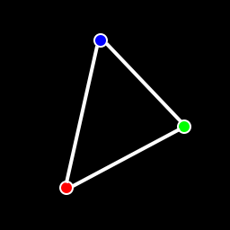
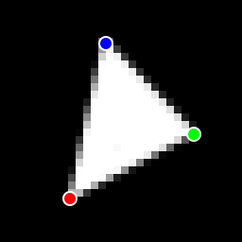
Rasterization Processing
Rasterization
Triangle
Facing Determination
Face Culling
Primitive
Point
Depth offset
Multisampling
Line
Fragment

Slide 7
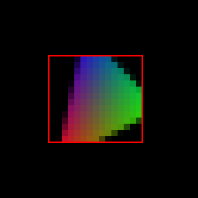
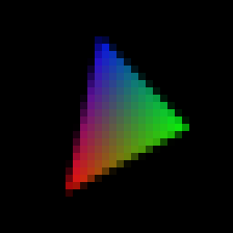
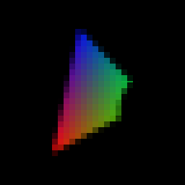
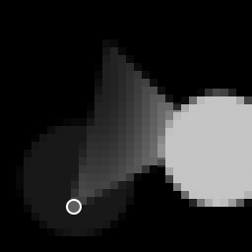
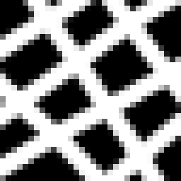

Fragment Processing
Fragment Processing
Fragment (+ varying)
Pixel ownership
Scissor Test
Multi-sample
Frag. Op.
Texture
Fragment shader
Fragment Shading
Pixel
Depth Test
Stencil Test

Slide 8
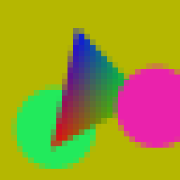

Pixel Processing
Pixel Processing
Pixel
Blending
Dithering
Fine control of Buffer
Additional Multisampling
Frame buffer objects

Slide 9
Fragment Operation control
enable(enum token) / disable / isEnabled
DEPTH_TEST Control depth testing of fragments
STENCIL_TEST Control stencil testing of fragments
SCISSOR_TEST Control scissoring testing of fragments
BLEND Control blending of fragments
DITHER Control the dithering of fragment colors
CULL_FACE Control the culling faces
SAMPLE_COVERAGE Control the computation of sample coverage values
SAMPLE_ALPHA_TO_COVERAGE Control the use of a sample’s alpha in the computation of a sample coverage value
Some features should be provided from canvas/device

Slide 10
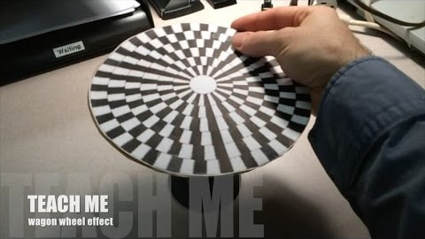
Aliasing
(CC-BY) Jesse Mason - https://www.youtube.com/watch?v=QOwzkND_ooU
Notes:
Timing aliasing

Slide 11
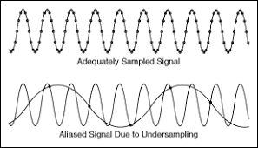
Aliasing
Sampling rate is not enough for high frequency signal

Slide 12

Aliasing in graphics
anti-aliasing is process for reducing aliasing

Slide 13
Basic Idea of AA
Increase Sampling Rate!
Quality vs Efficiency
Spatial vs Temporal
Antialiasing trade-offs
Low performance → Low refresh rate (Temporal Aliasing)
Resources → Framebuffers
Calculation of “coverage”
Area vs Sampling

Slide 14
Anti-Aliasing Methods
Spatial AA
Super sampling AA (SSAA)
Multi sampling AA (MSAA)
Fast Approximate AA (FXAA, NVIDIA)
TXAA - TXAA 2x = MSAA 2x + TAA 2x + Blur
Morphological AA (MLAA, PS3)
…
Temporal AA
Motion Blur
…

Slide 15
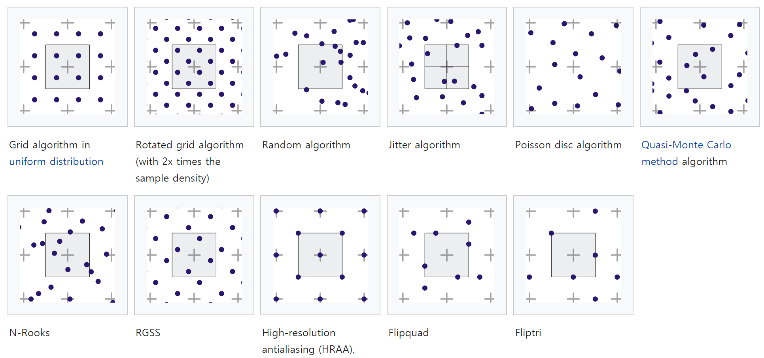
Sampling Pattern
wikipedia

Slide 16
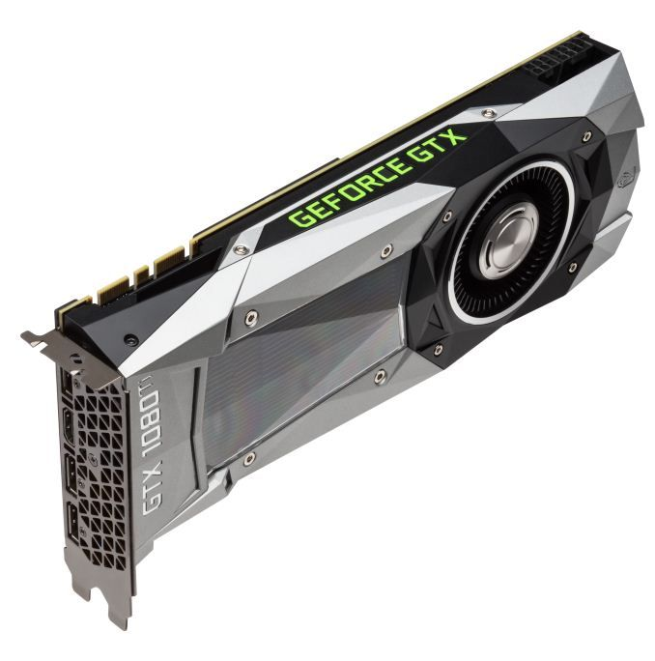
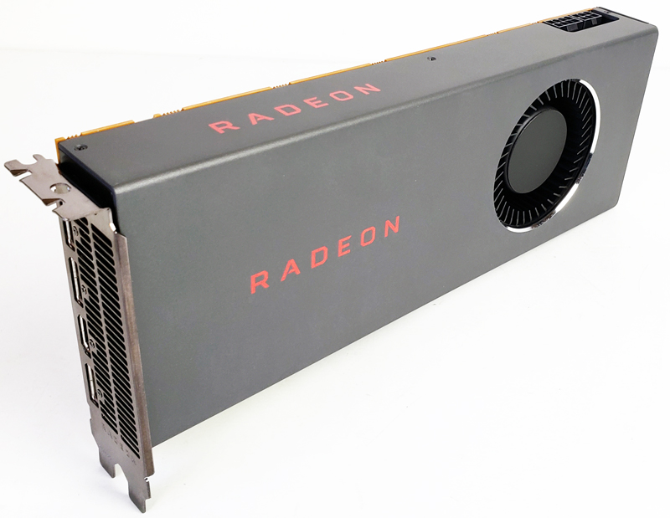



Enabling MSAA for WebGL
Hardware Support
OS/System Support
Web Browser Support
WebGL Contents Support

Slide 17
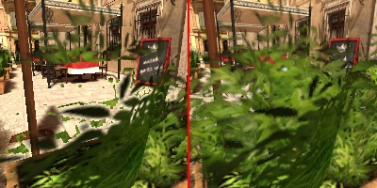
Context and Parameters for MSAA
getContext with antialias:true
enable/disable
SAMPLE_COVERAGE, SAMPLE_ALPHA_TO_COVERAGE
sampleCoverage(value, inverse)
contextStruct getContextAttributes()
any getParameter(enum pname)
pname: {SAMPLE_BUFFERS, SAMPLE_COVERAGE_{INVERT, VALUE}, SAMPLES,
https://www.worldviz.com/post/alpha-to-coverage

Slide 18
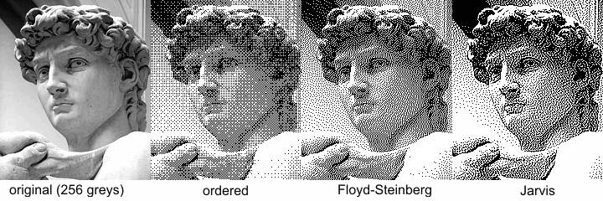
Dithering (Optional in GL ES 2.0)
enable(DITHER) and disable(DITHER)

Slide 19
Pixel Processing
Pixel Processing
Pixel
Blending
Dithering
Fine control of Buffer
Additional Multisampling
Frame buffer objects

Slide 20
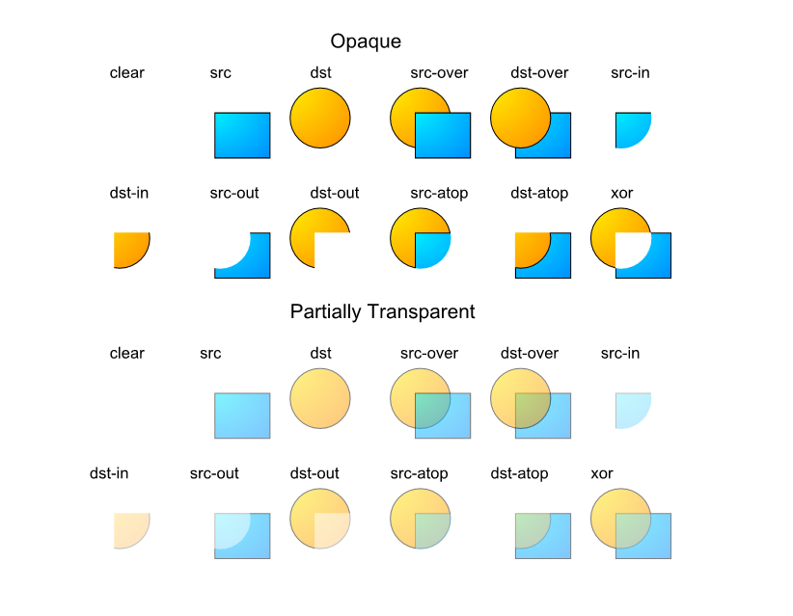
Blending - Example

Slide 21
Blending API
enable(GL_BLEND);
Output = sfactor * srcColor <mode> dfactor * dstColor
blendFunc(enum sfactor, enum dfactor);
ONE, ZERO, SRC_COLOR, SRC_ALPHA, ONE_MINUS_SRC_COLOR, ONE_MINUS_SRC_ALPHA, DST_COLOR, DST_ALPHA, ONE_MINUS_DST_COLOR, ONE_MINUS_DST_ALPHA CONSTANT_COLOR, ONE_MINUS_CONSTANT_COLOR // Only SRC or DST once.
blendFuncSeparate(enum srcRGB, dstRGB. srcAlpha, dstAlpha)
blendEquation (enum mode);
blendEquationSepatate (enum modeRGB, mode alpha)
GL_FUNC_ADD, GL_FUNC_SUBTRACT, GL_FUNC_REVERSE_SUBTRACT
blendColor (float red, green, blue, alpha)
Set Constant color – CONSTANT_COLOR, CONSTANT_ALPHA

Slide 22
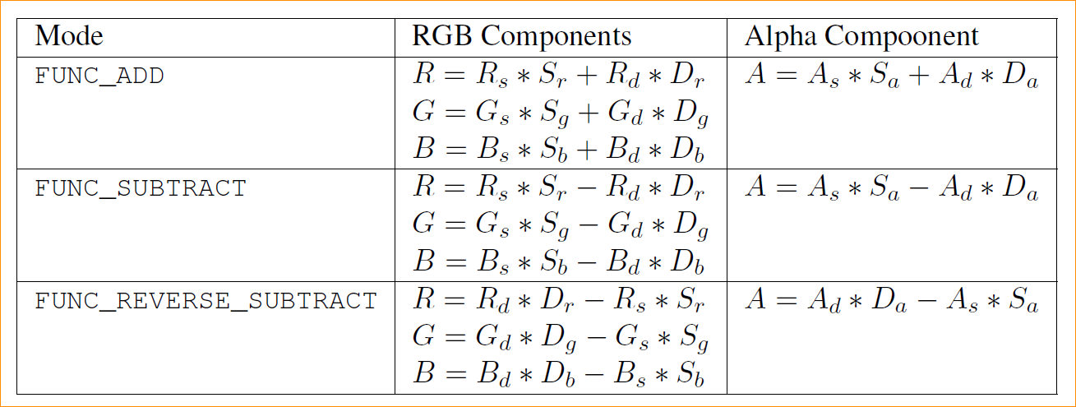
Blending Equation

Slide 23
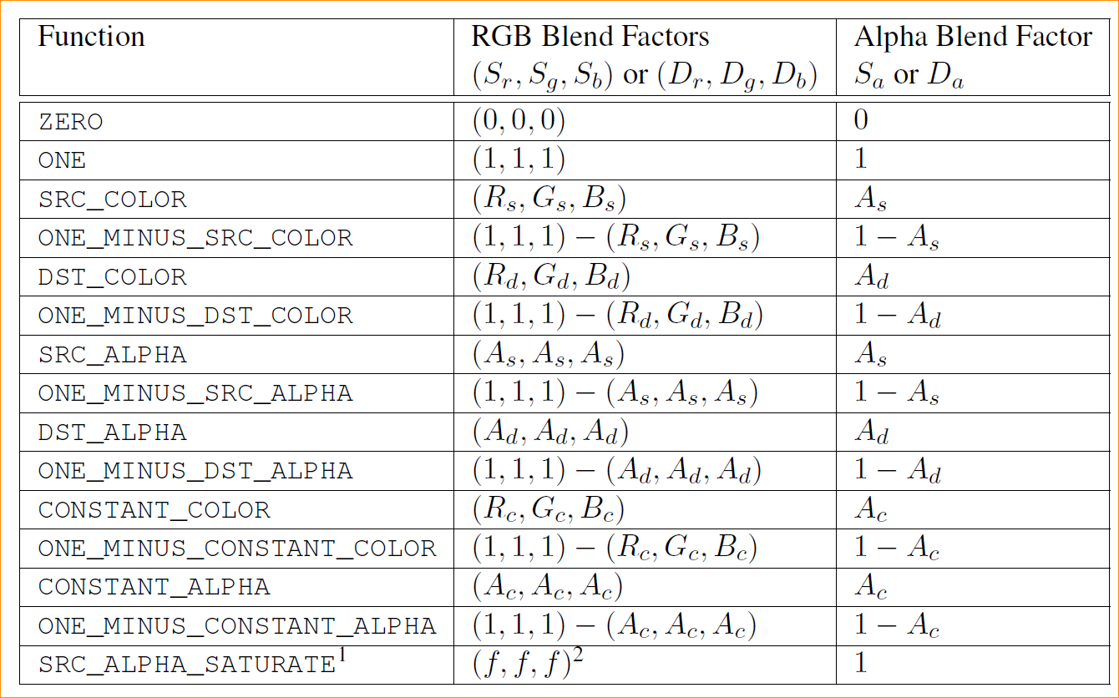
Blending Factor
SATURATE
only for SRC
min(As, 1-Ad)

Slide 25

Software Tool Time (소프트웨어 툴 타임)
(CC-BY-NC 4.0) Hwanyong Lee and Ajou University
Visit “Software Tool Time” channel in YouTube : http://goo.gl/remxrw
This video was supported by the Khronos Group
All product names, trademarks, and/or company names are used solely for identification and belong to their respective owners.
“Software Tool Time” video is licensed to the public under a Creative Commons Attribution 4.0 License (https://creativecommons.org/license/by/4.0/)
Twin Musicom’s African Drums (Sting) is licensed to the to the public under a Creative Commons Attribution 4.0 License (Artist: http://www.twinmusicom.org/)

Slide 26
Software Tool Time

Slide 28
Lab. 10 Multi-sampling and Blending

Slide 30
Software Tool Time (소프트웨어 툴 타임)
(CC-BY-NC 4.0) Hwanyong Lee and Ajou University
Visit “Software Tool Time” channel in YouTube : http://goo.gl/remxrw
This video was supported by the Khronos Group
All product names, trademarks, and/or company names are used solely for identification and belong to their respective owners.
“Software Tool Time” video is licensed to the public under a Creative Commons Attribution 4.0 License (https://creativecommons.org/license/by/4.0/)
Twin Musicom’s African Drums (Sting) is licensed to the to the public under a Creative Commons Attribution 4.0 License (Artist: http://www.twinmusicom.org/)

Slide 31
Context and Parameters
contextStruct getContextAttributes()
any getParameter(enum pname)
pname: {ALPHA, RED, GREEN, BLUE, SUBPIXEL}_BITS,, ACTIVE_TEXTURE, ALIASED_{LINE_WIDTH, POINT_SIZE}_RANGE, ARRAY_BUFFER_BINDING, BLEND_DST_{ALPHA, RGB}, BLEND_EQUATION_{ALPHA, RGB}, BLEND_SRC_{ALPHA, RGB}, BLEND[_COLOR], COLOR_{CLEAR_VALUE, WRITEMASK} NUM_]COMPRESSED_TEXTURE_FORMATS, CULL_FACE[_MODE], CURRENT_PROGRAM, DEPTH_{BITS, CLEAR_VALUE, FUNC, RANGE, TEST, WRITEMASK}, ELEMENT_ARRAY_BUFFER_BINDING, DITHER, FRAMEBUFFER_BINDING, FRONT_FACE, GENERATE_MIPMAP_HINT, LINE_WIDTH, MAX_[COMBINED_]TEXTURE_IMAGE_UNITS, MAX_{CUBE_MAP_TEXTURE, RENDERBUFFER, TEXTURE}_SIZE, MAX_VARYING_VECTORS, MAX_VERTEX_{ATTRIBS, TEXTURE_IMAGE_UNITS, UNIFORM_VECTORS}, MAX_VIEWPORT_DIMS, PACK_ALIGNMENT, POLYGON_OFFSET_{FACTOR, FILL, UNITS}, RENDERBUFFER_BINDING, RENDERER, SAMPLE_BUFFERS, SAMPLE_COVERAGE_{INVERT, VALUE}, SAMPLES, SCISSOR_{BOX, TEST}, SHADING_LANGUAGE_VERSION, STENCIL_{BITS, CLEAR_VALUE, TEST}, STENCIL_[BACK_]{FAIL, FUNC, REF,VALUE_MASK, WRITEMASK}, STENCIL_[BACK_]PASS_DEPTH_{FAIL, PASS}, TEXTURE_BINDING_{2D, CUBE_MAP}, UNPACK_ALIGNMENT, UNPACK_{COLORSPACE_CONVERSION_WEBGL, FLIP_Y_WEBGL, PREMULTIPLY_ALPHA_WEBGL}, VENDOR, VERSION, VIEWPORT

