Slide 1
Are you ready?

Slide 2



Software Tool Time

Slide 3


Slide 4
WebGL 1.0 Tutorial Lecture 12 – Shading
Tutor
Hwanyong “Grey Bear” LEE
Contents
Understanding illumination Model
How to use make rendering model – Phong,
How to programming shader
Preparation
Previous lectures
Copy html and js file from
https://github.com/hwan-ajou/webgl-1.0
June 2021 / (CC-BY-NC) Hwanyong Lee and Ajou University

Slide 5

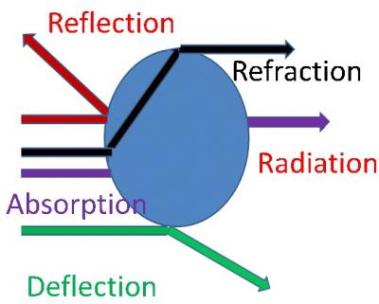
Model - Light / Material / Illumination
Rendering is ; Calculating number of photons come into camera (eye) → Change into human perception range → Change into device range (rgb)

Slide 6
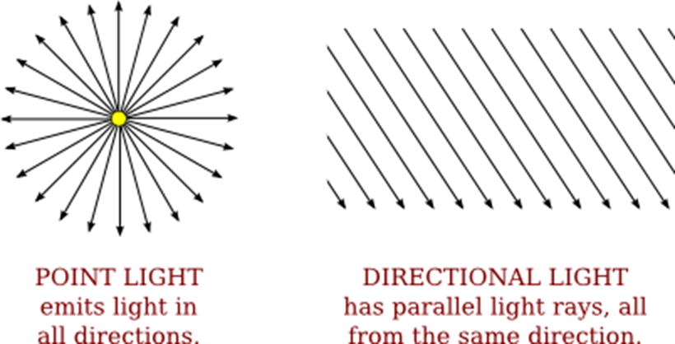
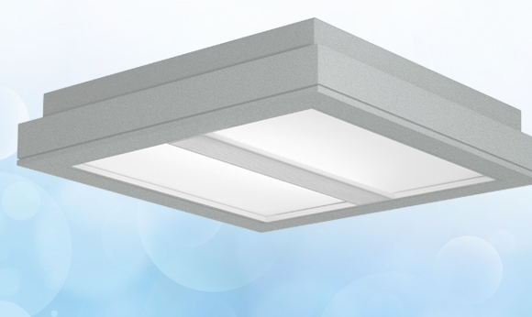
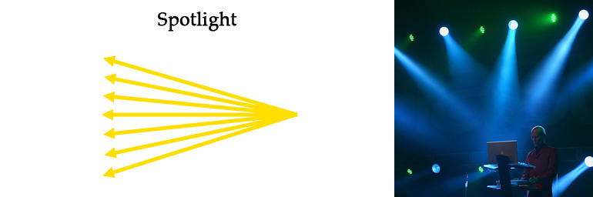
Light Source Model
Simplified Model
Point Light
Parallel Light
Surface Light
Spot Light

Slide 7
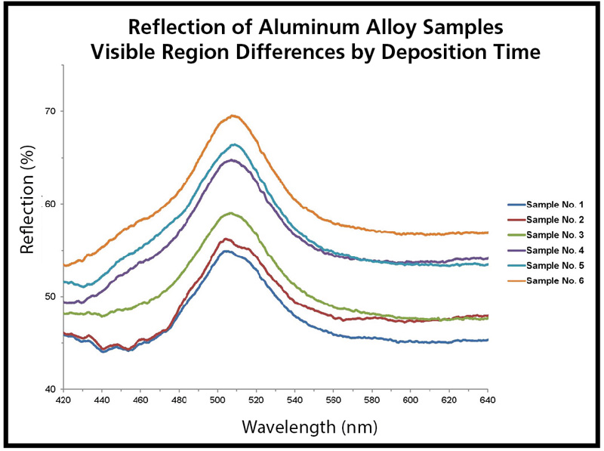
Material Model
Radiation, Reflection, Absorption, Deflection, Refraction
Surface - Simplified + Combined
Diffuse Material
Specular Material
Microscopic Model
Reflection spectrum

Slide 8

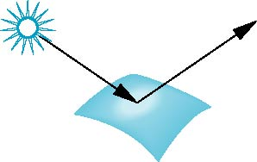
Surface Types
The smoother a surface, the more reflected light is concentrated in the direction a perfect mirror would reflected the light
A very rough surface scatters light in all directions
smooth surface
rough surface

Slide 9
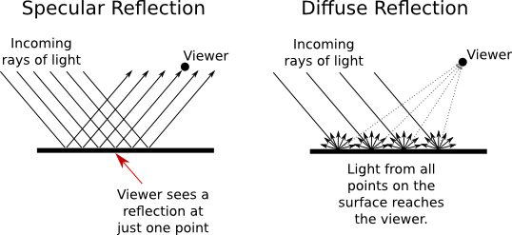
Two kind Reflection
http://math.hws.edu/graphicsbook/c4/s1.html

Slide 10
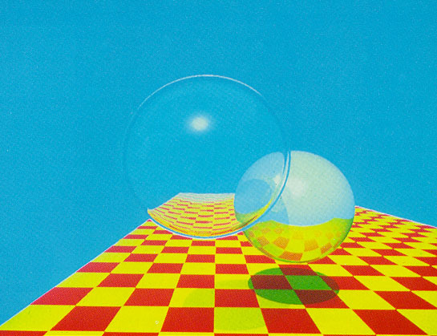
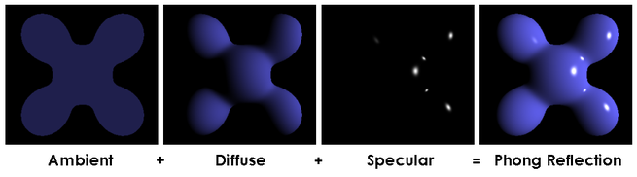
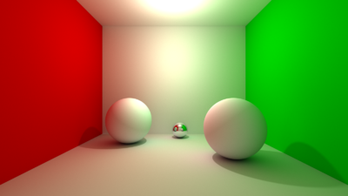
Illumination Model
Light Radiation – Neon, Sun, …
Surface Ambient
Surface Diffuse + Light
Surface Specular + Light
Transparency
Reflection
Refraction
Shadow casting
...
Global Illumination

Slide 11
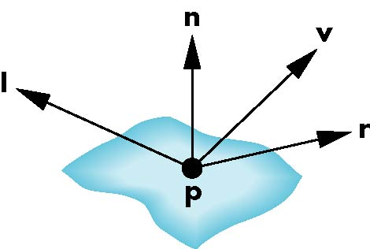
Phong Model
A simple model that can be computed rapidly
Has three components
Diffuse
Specular
Ambient
Uses four vectors
To source
To viewer
Normal
Perfect reflector

Slide 12
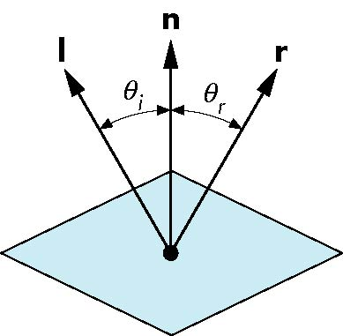
Ideal Reflector
Normal is determined by local orientation
Angle of incidence = angle of reflection
The three vectors must be coplanar
r = 2 (l · n ) n - l

Slide 13
Lambertian Surface
Perfectly diffuse reflector
Light scattered equally in all directions
Amount of light reflected is proportional to the vertical component of incoming light
reflected light ~cos θ_{i}
cos θ_{i} = l · n if vectors normalized
There are also three coefficients, k_{r}, k_{b}, k_{g} that show how much of each color component is reflected

Slide 14
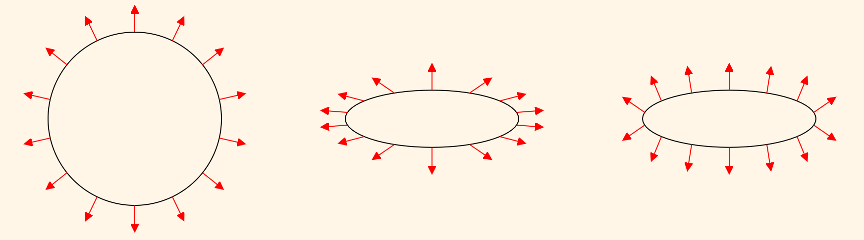
How can we calculate normal vector
Transformation of v+n

Slide 15
How can we calculate normal vector
Normal Vector Transform Matrix is Transpose of the inverse of the model view
Why?
M: model matrix, N: normal matrix
n • v = 0, v = q – r
v’ = M q – M r = M (q – r) = M v
(N n) • (M v) = 0
transpose(N n) (M v)
transpose(n) transpose (N) M v (transpose(n) * v == 0)
transpose(N) M = Identity

Slide 16

Specular Surfaces
Most surfaces are neither ideal diffusers nor perfectly specular (ideal reflectors)
Smooth surfaces show specular highlights due to incoming light being reflected in directions concentrated close to the direction of a perfect reflection
specular
highlight

Slide 17
Modeling Specular Relections
Phong proposed using a term that dropped off as the angle between the viewer and the ideal reflection increased
I_{r} ~ k_{s} I cos^{α}φ
reflected
intensity
shininess coef
incoming intensity
φ
absorption coef

Slide 18
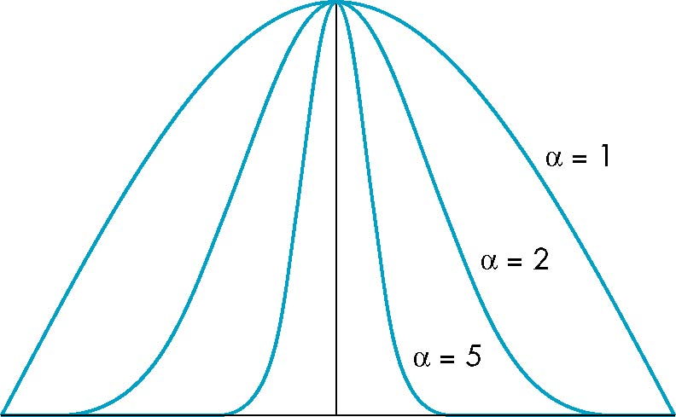
The Shininess Coefficient
Values of α between 100 and 200 correspond to metals
Values between 5 and 10 give surface that look like plastic
cos^{α} φ
-90
90
φ

Slide 19
Ambient Light
Ambient light is the result of multiple interactions between (large) light sources and the objects in the environment
Amount and color depend on both the color of the light(s) and the material properties of the object
Add k_{a} I_{a} to diffuse and specular terms
reflection coef
intensity of ambient light

Slide 20
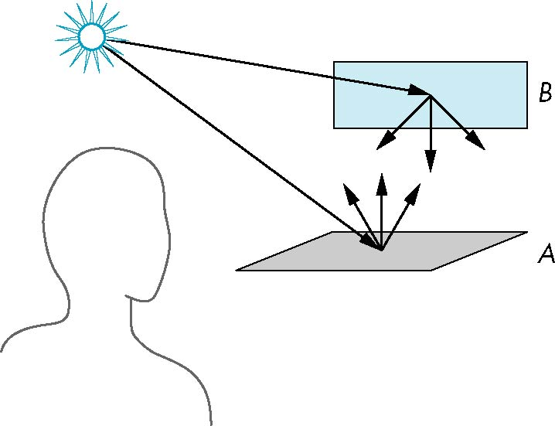
Distance Terms
The light from a point source that reaches a surface is inversely proportional to the square of the distance between them
We can add a factor of the form 1/(ad + bd +cd²) to the diffuse and specular terms
The constant and linear terms soften the effect of the point source

Slide 21
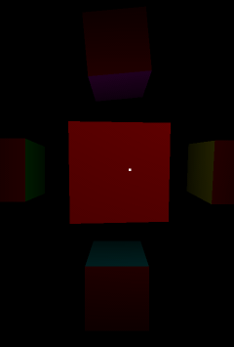
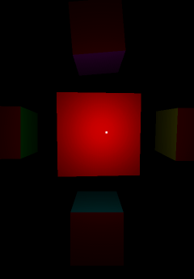
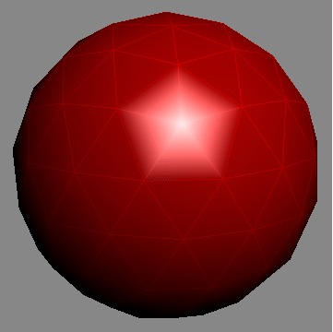
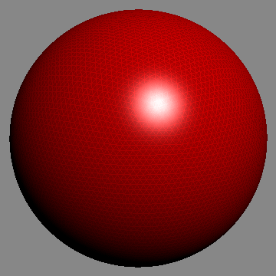
Gouraud shading vs Phong shading
Interpolate Color vs Interpolate Normal
Vertex shader vs Flagment shader

Slide 22
Light Sources
In the Phong Model, we add the results from each light source
Each light source has separate diffuse, specular, and ambient terms to allow for maximum flexibility even though this form does not have a physical justification
Separate red, green and blue components
Hence, 9 coefficients for each point source
I_{dr}, I_{dg}, I_{db}, I_{sr}, I_{sg}, I_{sb}, I_{ar}, I_{ag}, I_{ab}

Slide 23
Material Properties
Material properties match light source properties
Nine absorbtion coefficients
k_{dr}, k_{dg}, k_{db}, k_{sr}, k_{sg}, k_{sb}, k_{ar}, k_{ag}, k_{ab}
Shininess coefficient α

Slide 24
Adding up the Components
For each light source and each color component, the Phong model can be written (without the distance terms) as
I =k_{d} I_{d} l · n + k_{s} I_{s} (v · r )^{α} + k_{a} I_{a}
For each color component
we add contributions from
all sources

Slide 25
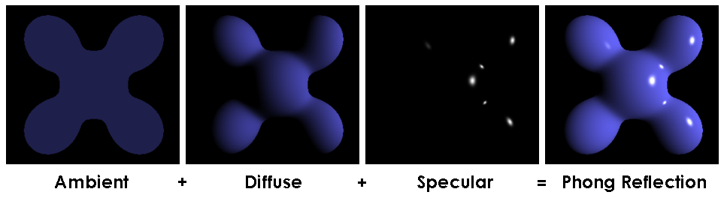
Phong

Slide 26
Modified Phong Model
The specular term in the Phong model is problematic because it requires the calculation of a new reflection vector and view vector for each vertex
Blinn suggested an approximation using the halfway vector that is more efficient

Slide 27
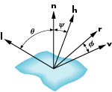
The Halfway Vector
h is normalized vector halfway between l and v
h = ( l + v )/ | l + v |

Slide 28
Using the halfway vector
Replace (v · r )^{α} by (n · h )^{β}
β is chosen to match shineness
Note that halfway angle is half of angle between r and v if vectors are coplanar
Resulting model is known as the modified Phong or Blinn lighting model
Specified in OpenGL standard

Slide 29
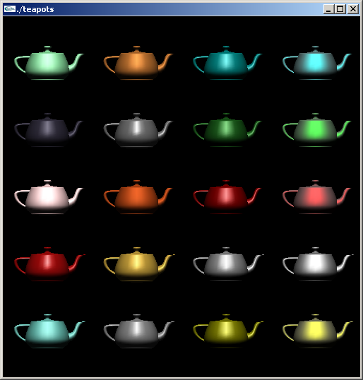
Example
Only differences in
these teapots are
the parameters
in the modified
Phong model

Slide 30
Computation of Vectors
l and v are specified by the application
Can computer r from l and n
Problem is determining n
For simple surfaces is can be determined but how we determine n differs depending on underlying representation of surface
OpenGL leaves determination of normal to application
Exception for GLU quadrics and Bezier surfaces was deprecated

Slide 31
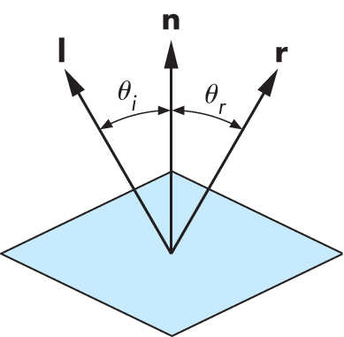
Computing Reflection Direction
Angle of incidence = angle of reflection
Normal, light direction and reflection direction are coplaner
Want all three to be unit length

Slide 32
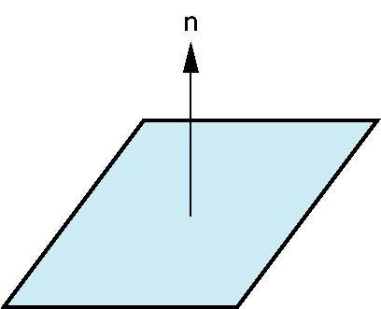
Plane Normals
Equation of plane: ax+by+cz+d = 0
From Chapter 3 we know that plane is determined by three points p₀, p₂, p₃ or normal n and p₀
Normal can be obtained by
n = (p₂-p₀) × (p₁-p₀)

Slide 33

Normal to Sphere
Implicit function f(x,y.z)=0
Normal given by gradient
Sphere f(p)=p·p-1
n = [∂f/∂x, ∂f/∂y, ∂f/∂z]^{T}=p

Slide 34
Parametric Form
For sphere
Tangent plane determined by vectors
Normal given by cross product
x=x(u,v)=cos u sin v
y=y(u,v)=cos u cos v
z= z(u,v)=sin u
∂p/∂u = [∂x/∂u, ∂y/∂u, ∂z/∂u]T
∂p/∂v = [∂x/∂v, ∂y/∂v, ∂z/∂v]T
n = ∂p/∂u × ∂p/∂v

Slide 36
Software Tool Time (소프트웨어 툴 타임)
(CC-BY-NC 4.0) Hwanyong Lee and Ajou University
Visit “Software Tool Time” channel in YouTube : http://goo.gl/remxrw
This video was supported by the Khronos Group
All product names, trademarks, and/or company names are used solely for identification and belong to their respective owners.
“Software Tool Time” video is licensed to the public under a Creative Commons Attribution 4.0 License (https://creativecommons.org/license/by/4.0/)
Twin Musicom’s African Drums (Sting) is licensed to the to the public under a Creative Commons Attribution 4.0 License (Artist: http://www.twinmusicom.org/)

Slide 37
Software Tool Time

Slide 39
Lab. 12 Shading

Slide 41
Software Tool Time (소프트웨어 툴 타임)
(CC-BY-NC 4.0) Hwanyong Lee and Ajou University
Visit “Software Tool Time” channel in YouTube : http://goo.gl/remxrw
This video was supported by the Khronos Group
All product names, trademarks, and/or company names are used solely for identification and belong to their respective owners.
“Software Tool Time” video is licensed to the public under a Creative Commons Attribution 4.0 License (https://creativecommons.org/license/by/4.0/)
Twin Musicom’s African Drums (Sting) is licensed to the to the public under a Creative Commons Attribution 4.0 License (Artist: http://www.twinmusicom.org/)

