Slide 1
Are you ready?

Slide 2



Software Tool Time

Slide 3


Slide 4
WebGL 1.0 Tutorial Lecture 00 - Preparation
Tutor
Hwanyong “Grey Bear” LEE
Objectives
Understanding WebGL 1.0 (OpenGL ES 2.0) and Graphics Pipeline
How to use WebGL API
Shading Language – OpenGL ES Shading Language Version 1.00
Drawing simple cube with texture / rotating animation
Preparation
Basic knowledge
Computer, Data structure, Geometry (Matrix and Transformation)
HTML, Javascript and C language
Hardware – PC with GPU
Software – Code editor (notepad++), Web browser (Chrome and Opera GX), local web server (mongoose)
April 2021 / (CC-BY-NC 4.0) Hwanyong Lee and Ajou University

Slide 5
Course Contents
WebGL 1.0 Tutorial
Preparation
Pipeline
Hello Triangle
VBO
Vertex Attributes
Primitive Assembly
Shading Language
Transform
glmatrix.js
View/Projection Transform
Per-fragment operations
Texture
Animation
Antialiasing
WebGL 1.0 Advanced (Future Plan)
Bump mapping
Shadow casting
NPR
Connect to web media
Advanced deformation and animation
etc.
WebGL 2.0 Tutorial and Advanced Course (Future Plan)

Slide 6
Development Tool Setup

Slide 7
Web Browser
Web Browser Support WebGL 1.0
Edge, Firefox, Chrome, Safari, Opera
https://caniuse.com/#feat=webgl
WebGL 2.0
https://caniuse.com/#feat=webgl2
WebGL Samples
https://webglsamples.org/

Slide 8
Local Web Server
For processing local file (for texture image, etc.)
is not allowed Chrome, Opera, FireFox
But Edge can
Local Webserver
Chrome – Web Server for Chrome extension program
https://chrome.google.com/webstore/detail/web-server-for-chrome/ofhbbkphhbklhfoeikjpcbhemlocgigb/related
Mongoose web server
Visual Studio
Web Server apps – MiniWeb, etc.

Slide 9
JavaScript Programming
IDE
Visual Studio, Eclipse, etc.
Code Editor
Visual Studio Code (with WebGL Extension)
Notepad++
Web Browser
Chrome, Edge, Opera GX (CPU usage)
console.log, console.error, console.info, console.warn
Recommended study material
https://www.w3schools.com/js/
https://javascript.info/
https://javascript.info/debugging-chrome

Slide 10
WebGL Reference
Quick reference card
https://www.khronos.org/files/webgl/webgl-reference-card-1_0.pdf
API Reference
https://developer.mozilla.org/ko/docs/Web/API/WebGL_API
Source code of this course
https://github.com/hwan-ajou/webgl-1.0

Slide 11
Understanding OpenGL ES 2.0 / WebGL 1.0 Pipeline

Slide 12

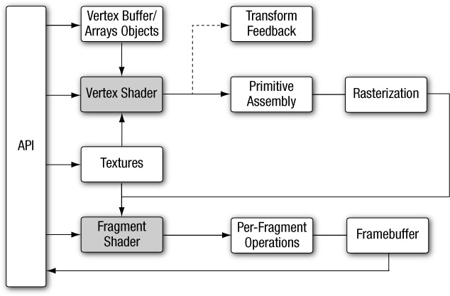
OpenGL ES 2.0 pipeline diagram
Munshi, Ginsburg and Shreiner
“OpenGL ES 2.0 Programming Guide”, Addison Wesley

Slide 13

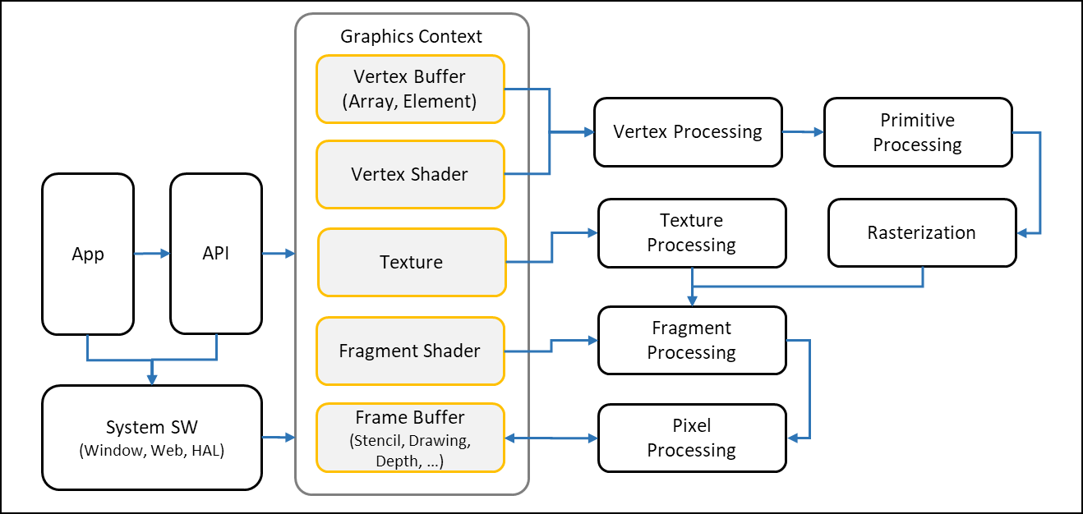
OpenGL ES 2.0 pipeline diagram
Based on the book “OpenGL Insights”,
CRC Press https://openglinsights.com/pipeline.html

Slide 14
OpenGL ES 2.0 pipeline diagram
Graphics Context
Vertex Buffer (Array, Element)
Vertex Processing
Primitive Processing
Vertex Shader
App
API
Texture
Processing
Rasterization
Texture
Fragment Shader
Fragment Processing
System SW
(Window, Web, HAL)
Frame Buffer
(Stencil, Drawing, Depth, …)
Pixel
Processing

Slide 15
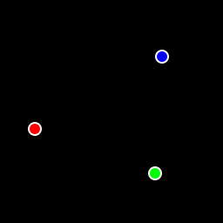
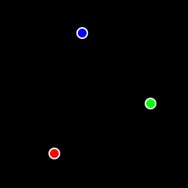

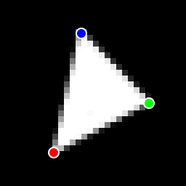
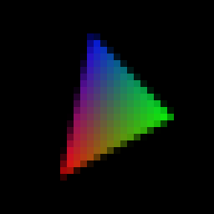
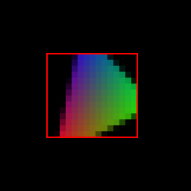

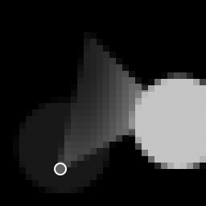



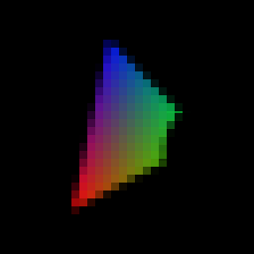
How to work
Graphics Context
Vertex Buffer (Array, Element)
Vertex Processing
Primitive Processing
Vertex Shader
App
API
Texture
Processing
Rasterization
Texture
Fragment Shader
Fragment Processing
System SW
(Window, Web, HAL)
Frame Buffer
(Stencil, Drawing, Depth, … )
Pixel Processing

Slide 17
Software Tool Time (소프트웨어 툴 타임)
(CC-BY-NC 4.0) Hwanyong Lee and Ajou University
Visit “Software Tool Time” channel in YouTube : http://goo.gl/remxrw
This video was supported by the Khronos Group
All product names, trademarks, and/or company names are used solely for identification and belong to their respective owners.
“Software Tool Time” video is licensed to the public under a Creative Commons Attribution 4.0 License (https://creativecommons.org/license/by/4.0/)
Twin Musicom’s African Drums (Sting) is licensed to the to the public under a Creative Commons Attribution 4.0 License (Artist: http://www.twinmusicom.org/)

Slide 18
NVIDIA Tegra 4 GPU Architecture

Slide 19
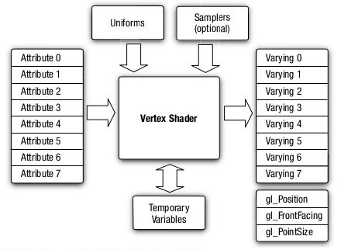
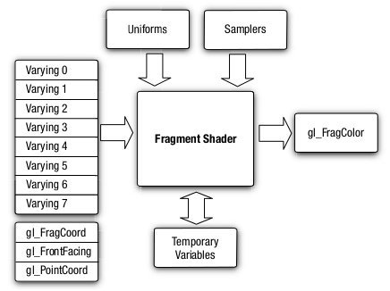
OpenGL ES 2.0 Vertex / Fragment Shader

Slide 20
OpenGL ES 2.0 pipeline block diagram
Graphics Context
Vertex Buffer (Array, Element)
Vertex Processing
Primitive Processing
Vertex Shader
App
API
Texture
Processing
Rasterization
Texture
Fragment Shader
Fragment Processing
System SW
(Window, Web, HAL)
Frame Buffer
(Stencil, Drawing, Depth, …)
Pixel
Processing

Slide 21
Graphics Context
Vertex Buffer (Array, Element)
Vertex Processing
Primitive Processing
Vertex Shader
App
API
Texture
Processing
Rasterization
Texture
Fragment Shader
Fragment Processing
System SW
(Window, Web, Canvas, HAL)
Frame Buffer
(Stencil, Drawing, Depth)
Pixel
Processing

Slide 23
Graphics Context
Vertex Buffer (Array, Element)
Vertex Processing
Primitive Processing
Vertex Shader
App
API
Texture
Processing
Rasterization
Texture
Fragment Shader
Fragment Processing
System SW
(Window, Web, Canvas, HAL)
Frame Buffer
(Stencil, Drawing, Depth)
Pixel
Processing

Slide 24
Primitive Processing
Vertex Processing
Vertex
Vertex Buffer (Array, Element)
Vertex Assembly
Vertex Shader (uniform, attribute)
Vertex shading
Primitive Assembly
Primitive
Vertex
(varying, built-in output)
Perspective Division
Viewport Mapping
Primitive Clipping

Slide 25
Texture Processing
Texture Image
LOD Processing
Coordinate Wrapping
Texel
Fetch Texel
Filtering
Notes:
Fine control (Index, Color, Depth, Stencil mask)

Slide 26
Rasterization
Triangle
Facing Determination
Face Culling
Primitive
Point
Depth offset
Multisampling
Line
Fragment

Slide 27
Fragment Processing
Fragment (+ varying)
Pixel ownership
Scissor Test
Multi-sample
Frag. Op.
Texture
Fragment shader
Fragment Shading
Pixel
Depth Test
Stencil Test

Slide 28
Pixel Processing
Pixel
Blending
Dithering
Fine control of Buffer
Additional Multisampling
Frame buffer objects

