Slide 1
Are you ready?

Slide 2



Software Tool Time

Slide 3


Slide 4
WebGL 1.0 Tutorial Lecture 02 – Buffer, View, Buffer Object
Tutor
Hwanyong “Grey Bear” LEE
Objectives
Understanding Buffer, View, Buffer Object
Preparation
Download hello triangle in https://github.com/hwan-ajou/webgl-1.0
April 2021 / (CC-BY-NC 4.0) Hwanyong Lee and Ajou University

Slide 5
OpenGL ES 2.0 pipeline diagram
Graphics Context
Buffer (Array, Element)
Vertex Processing
Primitive Processing
Vertex Shader
App
API
Texture
Processing
Rasterization
Texture
Fragment Shader
Fragment Processing
System SW
(Window, Web, HAL)
Framebuffer
(Color, Stencil, Depth)
Pixel
Processing

Slide 6
Vertex Processing
Vertex Processing
Vertex Buffer (Array, Element)
Vertex Assembly
Vertex Shader (uniform, attribute)
Vertex shading
Vertex
(varying, built-in output)

Slide 7
Vertex buffer object
Vertex Data Stored in CPU memory → GPU memory
ArrayBuffer and Typed Arrays (Javascript)
Buffers – unstructured binary data
Views – typed array
(Vertex) Buffer Objects
Cache data to graphics memory
Rendering performance, memory bandwidth, power consumption
Target
GL_ARRAY_BUFFER – for vertex attributes
GL_ELEMENT_ARRAY_BUFFER – indices of primitive for assembly
const buffer = new ArrayBuffer(8);
const view = new Int32Array(buffer);

Slide 8
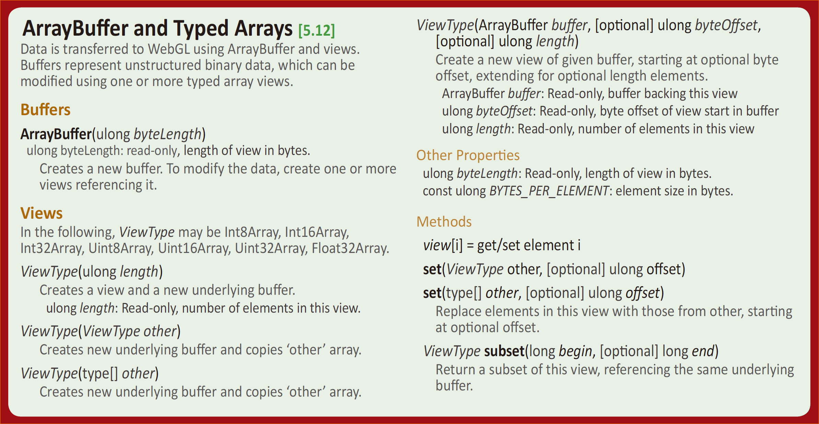
Vertex Buffer and Type Array (JS)
WebGL 1.0 reference card

Slide 9
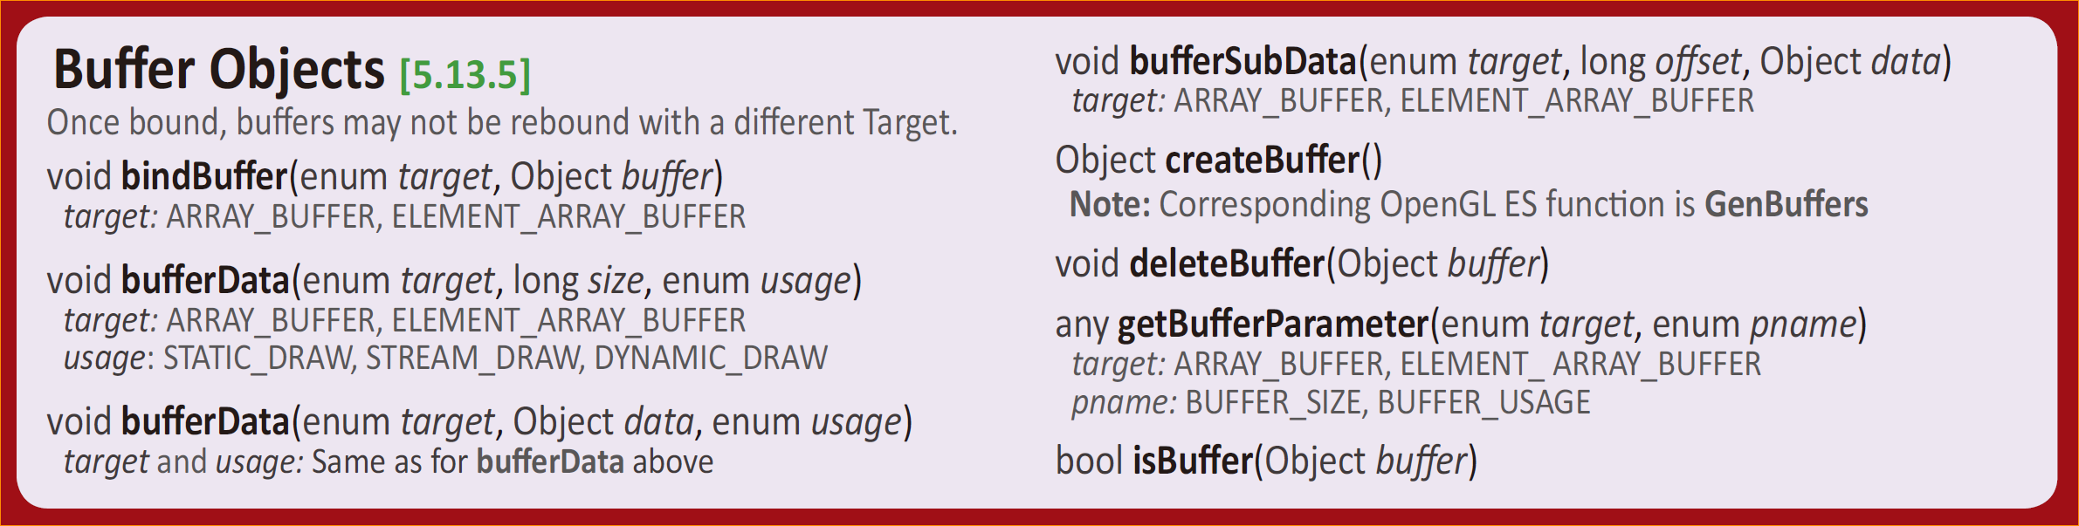
Buffer Object API
WebGL 1.0 reference card

Slide 10
Creating and Binding VBO (GL ES)
OpenGL ES - Example
void initVertexBufferObjects(vertex_t *vertexBuffer, GLushort *indices,
GLuint numVertices, GLuint numIndices, GLuint *vboIds)
{
glGenBuffers(1, vboIds);
glBindBuffer(GL_ARRAY_BUFFER, vboIds[0]);
glBufferData(GL_ARRAY_BUFFER, numVertices * sizeof(vertex_t), vertexBuffer, GL_STATIC_DRAW);
// bind buffer object for element indices
glBindBuffer(GL_ELEMENT_ARRAY_BUFFER, vboIds[1]);
glBufferData(GL_ELEMENT_ARRAY_BUFFER, numIndices * sizeof(GLushort), indices, GL_STATIC_DRAW);
}

Slide 11
Creating and Binding VBO (WebGL)
WebGL - Example
void function initialiseBuffer()
{
var vertexData = [
-0.4, -0.4, 0.0, // Bottom left
0.4, -0.4, 0.0, // Bottom right
0.0, 0.4, 0.0 // Top
]; // var vertexData = new Float32Array([…………]);
gl.vertexBuffer = gl.createBuffer(); // Generate a buffer object
gl.bindBuffer(gl.ARRAY_BUFFER, gl.vertexBuffer);
gl.bufferData(gl.ARRAY_BUFFER, new Float32Array(vertexData), gl.STATIC_DRAW);
return testGLError("initialiseBuffers");
}

Slide 12
Compare WebGL to OpenGL ES
glGenBuffers(1, vbo); // Can Generate Multiple Buffers
glBindBuffer(GL_ARRAY_BUFFER, vbo);
glBufferData(GL_ARRAY_BUFFER, numVertices * sizeof(vertex_t), vertexBuffer, GL_STATIC_DRAW);
gl.vertexBuffer = gl.createBuffer(); // Generate a buffer object
gl.bindBuffer(gl.ARRAY_BUFFER, gl.vertexBuffer);
gl.bufferData(gl.ARRAY_BUFFER, new Float32Array(vertexData), gl.STATIC_DRAW);

Slide 13
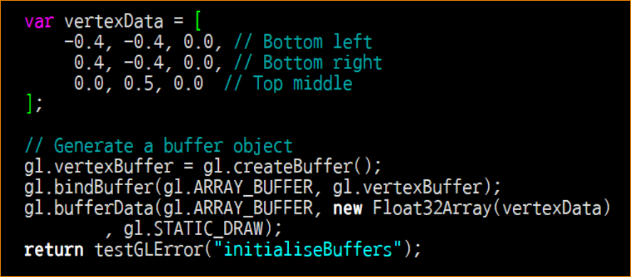
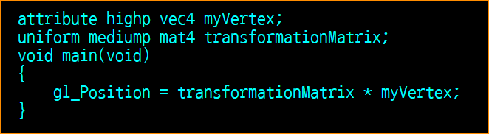
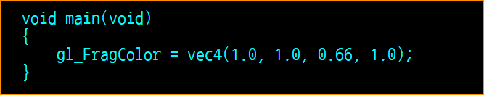
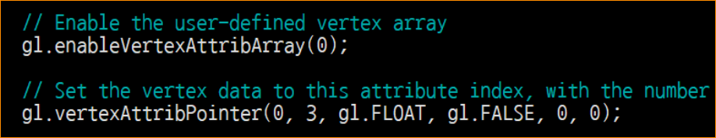
Pipeline with the code
Graphics Context
Buffer (Array, Element)
Vertex Shader
App
API
Texture
Fragment Shader
System SW
(Window, Web, HAL)
Framebuffer
(Color, Stencil, Depth)

Slide 14
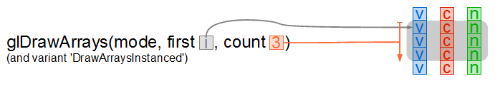
Draw Primitives (Draw Array)
void drawArrays(enum mode, int first, long count)
mode: POINTS, LINE_STRIP, LINE_LOOP, LINES, TRIANGLE_STRIP, TRIANGLE_FAN, TRIANGLES
first: vertex to draw, may not be a negative value.
count: number of vertices to draw

Slide 15
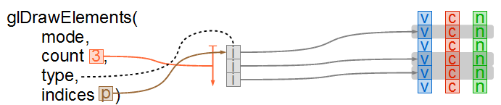
Draw Primitives (Draw Element)
void drawElements(enum mode, long count, enum type, long offset)
mode: POINTS, LINE_STRIP, LINE_LOOP, LINES, TRIANGLE_STRIP,TRIANGLE_FAN, TRIANGLES
count: number of vertices to draw
type: UNSIGNED_BYTE, UNSIGNED_SHORTvoid gl.DrawArrays(GLenum mode, GLint first, GLsizei count)
offset: start position in byte

Slide 16
Lab. 02 Draw two triangle with two buffer

Slide 18
Software Tool Time (소프트웨어 툴 타임)
(CC-BY-NC 4.0) Hwanyong Lee and Ajou University
Visit “Software Tool Time” channel in YouTube : http://goo.gl/remxrw
This video was supported by the Khronos Group
All product names, trademarks, and/or company names are used solely for identification and belong to their respective owners.
“Software Tool Time” video is licensed to the public under a Creative Commons Attribution 4.0 License (https://creativecommons.org/license/by/4.0/)
Twin Musicom’s African Drums (Sting) is licensed to the to the public under a Creative Commons Attribution 4.0 License (Artist: http://www.twinmusicom.org/)

Slide 19
Pipeline Example – NVIDIA Tegra 4

Slide 20
Two ways of making vertex attributes
Example Attributes
Position x 3, Color x 4, ST x 2, UV x 2
Array of structure
A = [x1, y1, z1, r1, g1, b1, a1, s1, t1, u1, v1, x2, y3, z2, r2, g2, b2, a2, s2, t2, u2, v2, … ]
Structure of Array
A = [x1, y1, z1, x2, y2, z2, … ]
B = [r1, g1, b1, a1, r2, g2, b2, a2, … ]
…
Recommend Array of structure
Performance, management, # of commands, etc.

Slide 21
OpenGL ES API – Vertex Attributes
Setting Vertex Arrays
void glVertexAttribPointer(GLuint index, Glint size, GLenum type, GLboolean normalized, GLsizei stride, const void *ptr)
Index – 0 ~ max-1
size – number of component (1~4)
type – GL_BYTE, GL_UNSIGNED_BYTE, GL_SHORT, GL_UNSIGNED_SHORT, GL_FLOAT, GL_FIXED, GL_HALF_FLOAT_OES
normalized - Non-floating number should be normalized or nit when converted to float
stride – delta between vertex index i and index i+1 it may be negative. ( 0 means generally packed )
*ptr feature is not in WebGL!
Notes:
In case of OpenGL ES – it is possible to use pointer of array as parameters, however in JavaScript it is not easy, and it is not recommendable.

Slide 22
NVIDIA Tegra 4 GPU Architecture

Slide 23
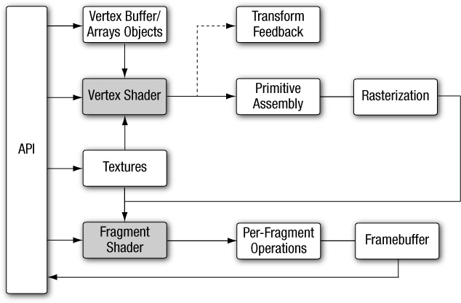
OpenGL ES 2.0 Pipeline

Slide 24
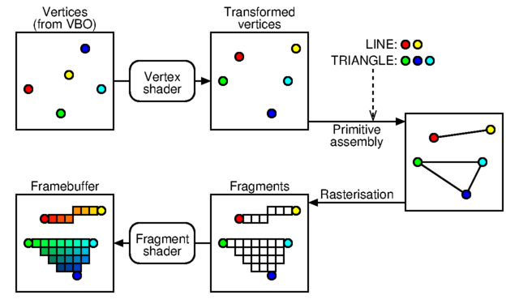
What happened

Slide 25
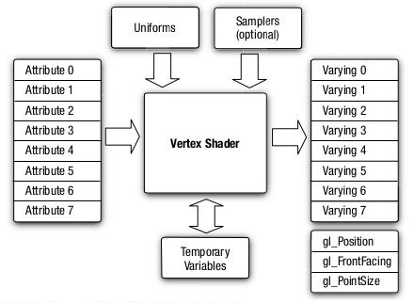
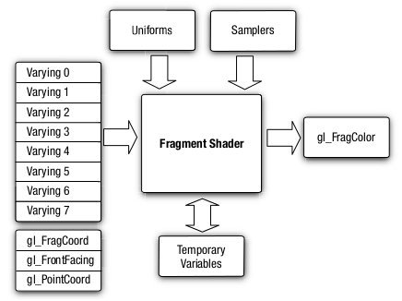
OpenGL ES 2.0 Vertex / Fragment Shader

Slide 26
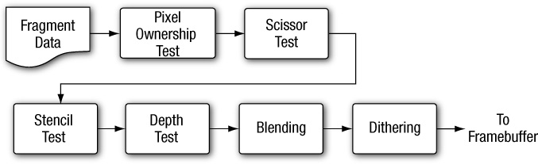
Per-Fragment Operations

