Slide 1
Are you ready?

Slide 2



Software Tool Time

Slide 3


Slide 4
WebGL 1.0 Tutorial Lecture 03 – Attributes and Uniforms
Tutor
Hwanyong “Grey Bear” LEE
Objectives
Understanding Attributes, Uniform
Preparation
Download hello triangle in https://github.com/hwan-ajou/webgl-1.0
April 2021 / (CC-BY-NC 4.0) Hwanyong Lee and Ajou University

Slide 5
OpenGL ES 2.0 pipeline diagram
Graphics Context
Buffer (Array, Element)
Vertex Processing
Primitive Processing
Vertex Shader
App
API
Texture
Processing
Rasterization
Texture
Fragment Shader
Fragment Processing
System SW
(Window, Web, HAL)
Framebuffer
(Color, Stencil, Depth)
Pixel
Processing

Slide 6
Vertex Processing & Primitive Processing
Vertex Processing
Vertex Buffer (Array, Element)
Vertex Assembly
Vertex Shader (uniform, attribute)
Vertex shading
Vertex
(varying, built-in output)

Slide 7
Vertex Shader - Fragment Shader
Per-vertex output
Per-vertex input
all vertex common input
all vertex/frag common input
Varying 0
Varying 0
Per-vertex input
Uniforms
Samplers (Option)
Uniforms
Samplers
Varying 1
Varying 1
Attribute 0
Varying 2
Varying 2
Attribute 1
Varying 3
Varying 3
Attribute 2
Varying 4
Varying 4
Vertex shading
Fragment shading
Attribute 3
Varying 5
Varying 5
gl_FragColor
Attribute 4
Varying 6
Varying 6
Pre-defined output
Attribute 5
Varying 7
Varying 7
Attribute 6
Attribute 7
gl_Position
gl_FragCoord
Temporary Variables
gl_FrontFacing
gl_FrontFacing
Temporary Variables
gl_PointSize
gl_PointSize
Pre-defined output
Pre-defined input

Slide 8
NVIDIA Tegra 4 GPU Architecture

Slide 9
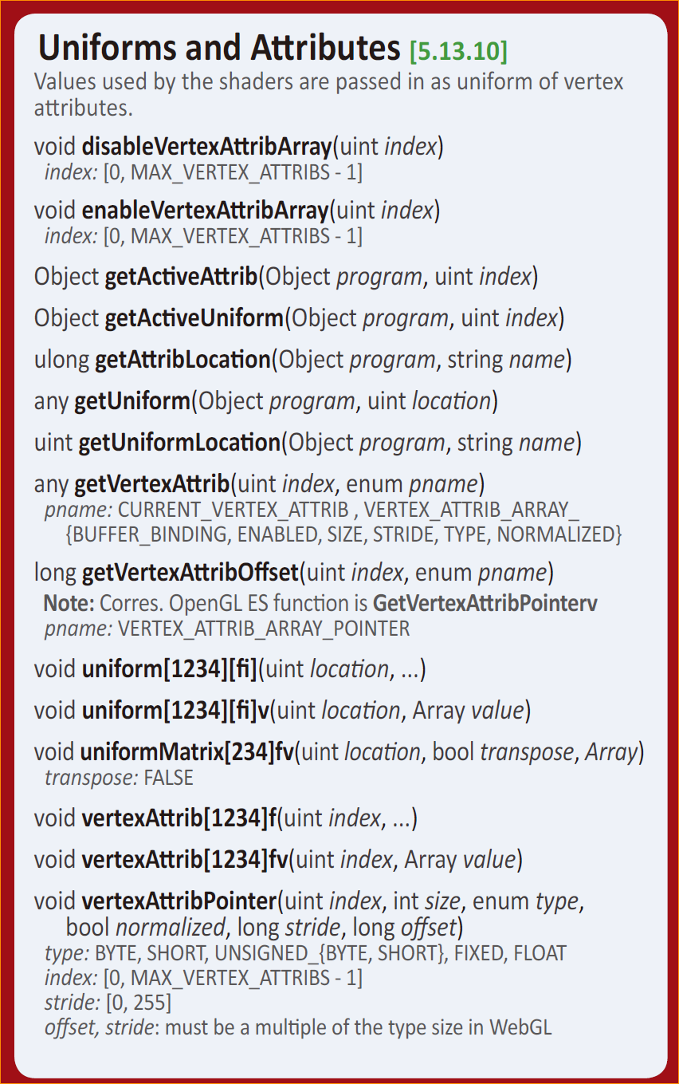
Uniforms and Attiributes
bindAttribLocation(prog,index,name) – Optional in WebGL 1.0
WebGL 1.0 reference card

Slide 10
WebGL API – Vertex Attributes
Vertex Attributes – Per-vertex data
Get max attributes
(gl.) MAX_VERTEX_ATTRIBS must be >= 8
Setting Constant Vertex Attribute – same for all vertex
gl.VertexAttrib{1234}f(GLuint index, Float x, …);
gl.VertexAttrib{1234}fv(GLuint index, Array value);
must disable VertexAttribArray! void disableVertexAttribArray(uint index) // index: [0, MAX_VERTEX_ATTRIBS - 1]
void enableVertexAttribArray(uint index)
index: [0, MAX_VERTEX_ATTRIBS - 1]

Slide 11
WebGL API – Vertex Attributes
Setting Attribute location in shader
void bindAttribLocation(Object program, uint index, string name)
Getting Attribute location in shader
ulong getAttribLocation (Object program, string name)
Setting Vertex Arrays in VBO
void vertexAttribPointer(uint index, int size,
enum type, bool normalized, long stride, long offset)
type: BYTE, SHORT, UNSIGNED_{BYTE, SHORT}, FLOAT (HALF_FLOAT in WebGL2)
index: [0, MAX_VERTEX_ATTRIBS - 1], stride: [0, 255]
normalized: True/False (e.g. BYTE – (Value+0.5)/127.5 )
Notes:
In case of OpenGL ES – it is possible to use pointer of array as parameters, however in JavaScript it is not easy, and it is not recommendable.
offset, stride: must be a multiple of the type size

Slide 12
Two ways of making vertex attributes
Example Attributes
Position x 3, Color x 4, ST x 2, UV x 2
Array of structure
A = [x1, y1, z1, r1, g1, b1, a1, s1, t1, u1, v1, x2, y3, z2, r2, g2, b2, a2, s2, t2, u2, v2, … ]
Structure of Array
A = [x1, y1, z1, x2, y3, z2, … ]
B = [r1, g1, b1, a1, r2, g2, b2, a2, … ]
…
Recommend Array of structure
Performance, management, # of commands, etc.

Slide 13
WebGL API - Uniform
Uniform – All-vertex/fragment common data
get uniform location in shader
ulong getUniformbLocation (Object program, string name)
Setting Uniform
void uniform[1234][fi](uint location, ...)
void uniform[1234][fi]v(uint location, Array value)
void uniformMatrix[234]fv(uint location, bool transpose, Array)
// transpose: FALSE

Slide 14
Get Uniform and Attribute information
Object getActiveAttrib(Object program, uint index)
Object getActiveUniform(Object program, uint index)
any getUniform(Object program, uint location)
any getVertexAttrib(uint index, enum pname)
// pname: CURRENT_VERTEX_ATTRIB , VERTEX_ATTRIB_ARRAY_
// {BUFFER_BINDING, ENABLED, SIZE, STRIDE, TYPE, NORMALIZED}
long getVertexAttribOffset(uint index, enum pname)
// Note: Corres. OpenGL ES function is GetVertexAttribPointerv
// pname: VERTEX_ATTRIB_ARRAY_POINTER
Notes:
get은 가급적 사용하지 말것 성능상의 이유

Slide 15
Software Tool Time

Slide 17
Lab. 03 two triangles with color vertices

Slide 19

Software Tool Time (소프트웨어 툴 타임)
(CC-BY-NC 4.0) Hwanyong Lee and Ajou University
Visit “Software Tool Time” channel in YouTube : http://goo.gl/remxrw
This video was supported by the Khronos Group
All product names, trademarks, and/or company names are used solely for identification and belong to their respective owners.
“Software Tool Time” video is licensed to the public under a Creative Commons Attribution 4.0 License (https://creativecommons.org/license/by/4.0/)
Twin Musicom’s African Drums (Sting) is licensed to the to the public under a Creative Commons Attribution 4.0 License (Artist: http://www.twinmusicom.org/)

Slide 20
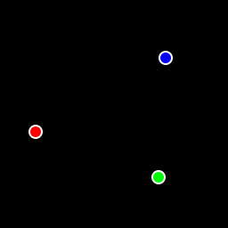
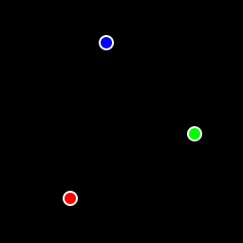
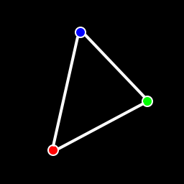
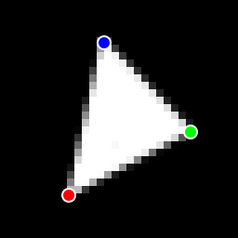
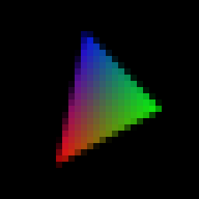
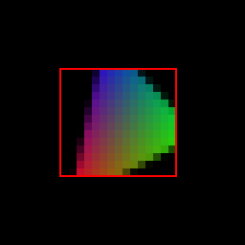
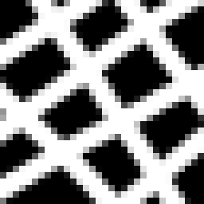
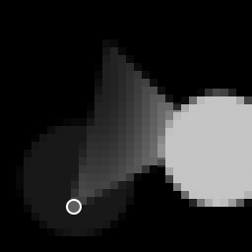



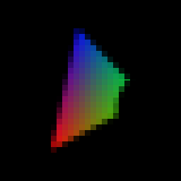
How to work
Graphics Context
Vertex Buffer (Array, Element)
Vertex Processing
Primitive Processing
Vertex Shader
App
API
Texture
Processing
Rasterization
Texture
Fragment Shader
Fragment Processing
System SW
(Window, Web, HAL)
Frame Buffer
(Stencil, Drawing, Depth, … )
Pixel Processing

Slide 21
Vertex Processing & Primitive Processing
Primitive Processing
Vertex
Vertex Processing
Vertex Buffer (Array, Element)
Vertex Assembly
Primitive Assembly
Primitive
Vertex Shader (uniform, attribute)
Vertex shading
Perspective Division
Vertex
(varying, built-in output)
Viewport Mapping
Primitive Clipping

Slide 22
Texture Processing
Texture Processing
Texture Image
LOD Processing
Coordinate Wrapping
Texel
Fetch Texel
Filtering

Slide 23
Rasterization
Triangle
Facing Determination
Face Culling
Primitive
Point
Depth offset
Multisampling
Line
Fragment

Slide 24
Fragment Processing
Fragment (+ varying)
Pixel ownership
Scissor Test
Multi-sample
Frag. Op.
Texture
Fragment shader
Fragment Shading
Pixel
Depth Test
Stencil Test

Slide 25
Pixel Processing
Pixel
Blending
Dithering
Fine control of Buffer
Additional Multisampling
Frame buffer objects

Slide 26
Graphics Context
Vertex Buffer (Array, Element)
Vertex Processing
Primitive Processing
Vertex Shader
App
API
Texture
Processing
Rasterization
Texture
Fragment Shader
Fragment Processing
System SW
(Window, Web, Canvas, HAL)
Frame Buffer
(Stencil, Drawing, Depth)
Pixel
Processing

Slide 27
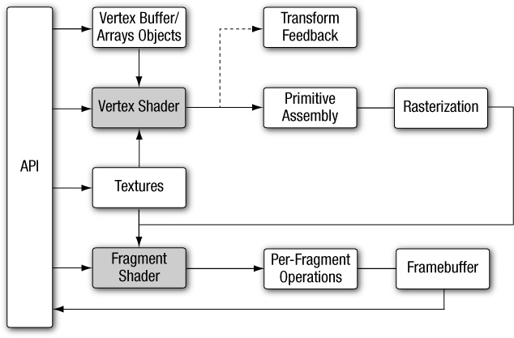

Slide 28
Graphics Context
Vertex Buffer (Array, Element)
Vertex Processing
Primitive Processing
Vertex Shader
App
API
Texture
Processing
Rasterization
Texture
Fragment Shader
Fragment Processing
System SW
(Window, Web, Canvas, HAL)
Frame Buffer
(Stencil, Drawing, Depth)
Pixel
Processing

Slide 29
Primitive Processing
Vertex Processing
Vertex
Vertex Buffer (Array, Element)
Vertex Assembly
Vertex Shader (uniform, attribute)
Vertex shading
Primitive Assembly
Primitive
Vertex
(varying, built-in output)
Perspective Division
Viewport Mapping
Primitive Clipping

Slide 30
Texture Processing
Texture Image
LOD Processing
Coordinate Wrapping
Texel
Fetch Texel
Filtering
Notes:
Fine control (Index, Color, Depth, Stencil mask)

Slide 31
Rasterization
Triangle
Facing Determination
Face Culling
Primitive
Point
Depth offset
Multisampling
Line
Fragment

Slide 32
Fragment Processing
Fragment (+ varying)
Pixel ownership
Scissor Test
Multi-sample
Frag. Op.
Texture
Fragment shader
Fragment Shading
Pixel
Depth Test
Stencil Test

Slide 33
Pixel Processing
Pixel
Blending
Dithering
Fine control of Buffer
Additional Multisampling
Frame buffer objects

