Slide 1
Are you ready?

Slide 2



Software Tool Time

Slide 3


Slide 4
WebGL 1.0 Tutorial Lecture 04 – Primitive Assembly
Tutor
Hwanyong “Grey Bear” LEE
Objectives
Understanding Primitive and its assembly
Preparation
Download hello triangle in https://github.com/hwan-ajou/webgl-1.0
April 2021 / (CC-BY-NC 4.0) Hwanyong Lee and Ajou University

Slide 5
OpenGL ES 2.0 pipeline diagram
Graphics Context
Buffer (Array, Element)
Vertex Processing
Primitive Processing
Vertex Shader
App
API
Texture
Processing
Rasterization
Texture
Fragment Shader
Fragment Processing
System SW
(Window, Web, HAL)
Framebuffer
(Color, Stencil, Depth)
Pixel
Processing

Slide 6
Vertex Processing & Primitive Processing
Primitive Processing
Vertex
Vertex Processing
Vertex Buffer (Array, Element)
Vertex Assembly
Primitive Assembly
Primitive
Vertex Shader (uniform, attribute)
Vertex shading
Perspective Division
Vertex
(varying, built-in output)
Viewport Mapping
Primitive Clipping

Slide 7
Vertex Shader - Fragment Shader
Per-vertex output
Per-vertex input
all vertex common input
all vertex/frag common input
Varying 0
Varying 0
Per-vertex input
Uniforms
Samplers (Option)
Uniforms
Samplers
Varying 1
Varying 1
Attribute 0
Varying 2
Varying 2
Attribute 1
Varying 3
Varying 3
Attribute 2
Varying 4
Varying 4
Vertex shading
Fragment shading
gl_FragData[ ]
Attribute 3
Varying 5
Varying 5
gl_FragColor
Attribute 4
Varying 6
Varying 6
Pre-defined output
Attribute 5
Varying 7
Varying 7
Attribute 6
Attribute 7
gl_Position
gl_FragCoord
Temporary Variables
gl_FrontFacing
gl_FrontFacing
Temporary Variables
gl_PointSize
gl_PointSize
Pre-defined output
gl_PointCoord
Pre-defined input

Slide 8
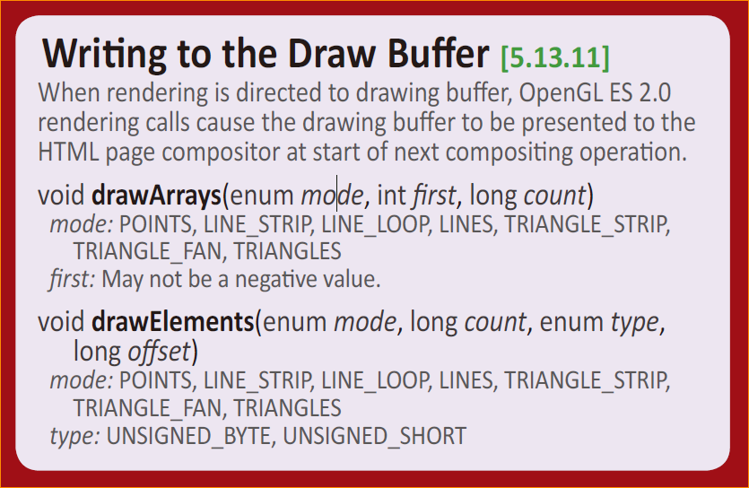
Types of Primitives
In drawArrays and drawElements
POINTS
LINES, LINE_STRIP, LINE_LOOP
TRIANGLES, TRIANGLE_STRIP, TRIANGLE_FAN

Slide 9

Points
GL_POINTS
gl_PointSize – built in variable for point radius
gl_PointCoord – vec2 variable in fragment shader
PointCoord can be used as texture coordinate to draw textured point sprite

Slide 10
Line
GL_LINES
n vertices – n/2 lines
(V₀,V₁), (V₂,V₃), (V₄,V₅)
GL_LINE_STRIP
n vertices – (n-1) lines
(V₀,V₁), (V₁,V₂), (V₂,V₃) …
GL_LINE_LOOP
n vertices – (n) lines
(V₀,V₁), (V_{1,} V₂), (V₂,V₃), (V₃,V₄)
lineWidth – set line width

Slide 11
Triangle
GL_TRIANGLES
n vertices – n/3 triangles
(V₀,V₁,V₂), (V₃,V₄,V₅)
GL_TRIANGLE_STRIP
n vertices – (n-2) triangles
(V₀,V₁,V₂), (V₂,V₁,V₃) …
GL_TRIANGLE_FAN
n vertices – (n-2) triangles
(V₀,V₁,V₂), (V₀,V₂,V₃), (V₀,V₃,V₄)

Slide 12
Primitive Assembly and coordinates
Primitive Processing
Vertex
Primitive Assembly
Primitive
Perspective Division
Viewport Mapping
Primitive Clipping

Slide 13
Lab. 04 points, lines, triangles

Slide 14
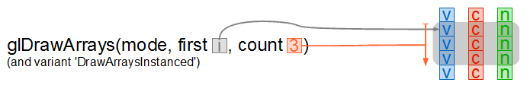
Draw Primitives (Draw Array)
void drawArrays(enum mode, int first, long count)
mode: POINTS, LINE_STRIP, LINE_LOOP, LINES, TRIANGLE_STRIP, TRIANGLE_FAN, TRIANGLES
first: vertex to draw, may not be a negative value.
count: number of vertices to draw

Slide 15
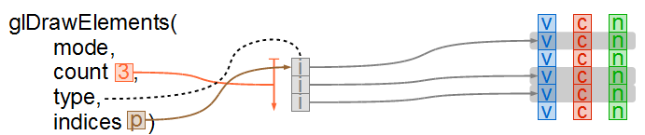
Draw Primitives (Draw Element)
void drawElements(enum mode, long count, enum type, long offset)
mode: POINTS, LINE_STRIP, LINE_LOOP, LINES, TRIANGLE_STRIP,TRIANGLE_FAN, TRIANGLES
count: number of vertices to draw
type: UNSIGNED_BYTE, UNSIGNED_SHORTvoid gl.DrawArrays(GLenum mode, GLint first, GLsizei count)
offset: start position in byte

Slide 16
Cube - Array
#define VERTEX_POS 0
vertexArray = [ …
x0, y0, z0, x1, y1, z1, x2, y2, z2,
x0, y0, z0, x2, y2, z2, x3, y3, z3,
x0, y0, z0, x3, y3, z3,
]; // (x, y, z) per vertex
…
…
gl.DrawArrays(GL_TRIANGLES, 0, 36);

Slide 17
Cube - Element
#define VERTEX_POS_INDX 0
vertices = [ … ];// (x, y, z) per vertex
indices = [ 0, 1, 2, 0, 2, 3,
0, 3, 4, 0, 4, 5,
0, 5, 6, 0, 6, 1,
7, 6, 1, 7, 1, 2,
7, 4, 5, 7, 5, 6,
7, 2, 3, 7, 3, 4 ];
…..
gl.DrawElements(GL_TRIANGLES, sizeof(indices)/sizeof(GLubyte), GL_UNSIGNED_BYTE, indices);

Slide 18
Software Tool Time

Slide 20
Lab. 04 Practice primitives

Slide 21
Homework – Make Cube (Array)
Make function with
createCube( sx, sy, sz )
vertex coordinates must be
[ sx/2, sy/2, sz/2, // V0 -sx/2, sy/2, sz/2, // V1 -sx/2, -sy/2, sz/2, // V2 sx/2, sy/2, sz/2, // V0 -sx/2, -sy/2, sz/2, // V2 sx/2, -sy/2, sz/2, // V3 … … ] // Total 36 vertices
Test with drawArrays

Slide 23

Software Tool Time (소프트웨어 툴 타임)
(CC-BY-NC 4.0) Hwanyong Lee and Ajou University
Visit “Software Tool Time” channel in YouTube : http://goo.gl/remxrw
This video was supported by the Khronos Group
All product names, trademarks, and/or company names are used solely for identification and belong to their respective owners.
“Software Tool Time” video is licensed to the public under a Creative Commons Attribution 4.0 License (https://creativecommons.org/license/by/4.0/)
Twin Musicom’s African Drums (Sting) is licensed to the to the public under a Creative Commons Attribution 4.0 License (Artist: http://www.twinmusicom.org/)

