Slide 1
Are you ready?

Slide 2



Software Tool Time

Slide 3


Slide 4
WebGL 1.0 Tutorial Lecture 05 – Shader Programming
Tutor
Hwanyong “Grey Bear” LEE
Objectives
Understanding GLES Shader Version 1.0
Preparation
Download sample codes https://github.com/hwan-ajou/webgl-1.0
April 2021 / (CC-BY-NC 4.0) Hwanyong Lee and Ajou University

Slide 5
Shader Versions
GLSL ES | OpenGL ES | WebGL | Based on GLSL | Date | Preprocessor
1.00.17 | 2.0 | 1.0 | 1.20 | 12 May 2009 | #version 100
3.00.6 | 3.0 | 2.0 | 3.30 | 29 January 2016 | #version 300 es
GLSL | OpenGL | Date | Preprocessor
1.10.59 | 2.0 | 30 April 2004 | #version 110
1.20.8 | 2.1 | 07 September 2006 | #version 120
1.30.10 | 3.0 | 22 November 2009 | #version 130
1.40.08 | 3.1 | 22 November 2009 | #version 140
1.50.11 | 3.2 | 04 December 2009 | #version 150
3.30.6 | 3.3 | 11 March 2010 | #version 330
4.00.9 | 4.0 | 24 July 2010 | #version 400
4.10.6 | 4.1 | 24 July 2010 | #version 410
4.20.11 | 4.2 | 12 December 2011 | #version 420
4.30.8 | 4.3 | 7 February 2013 | #version 430
4.40.9 | 4.4 | 16 June 2014 | #version 440
4.50.7 | 4.5 | 09 May 2017 | #version 450
4.60.5 | 4.6 | 14 June 2018 | #version 460
https://en.wikipedia.org/wiki/OpenGL_Shading_Language

Slide 6
Shading Language Overview
NVIDIA Tegra 4 GPU Architecture
C/C++ Like Programming
Parallel Programming (SIMD)
Processor
Vertex Processor
operates on one vertex at a time.
does not replace graphics operations that require knowledge of several vertices at a time.
Fragment Processor
cannot change a fragment's position.
Access to neighboring fragments is not allowed.
The values computed by the fragment shader are ultimately used to update frame-buffer memory or texture memory

Slide 7
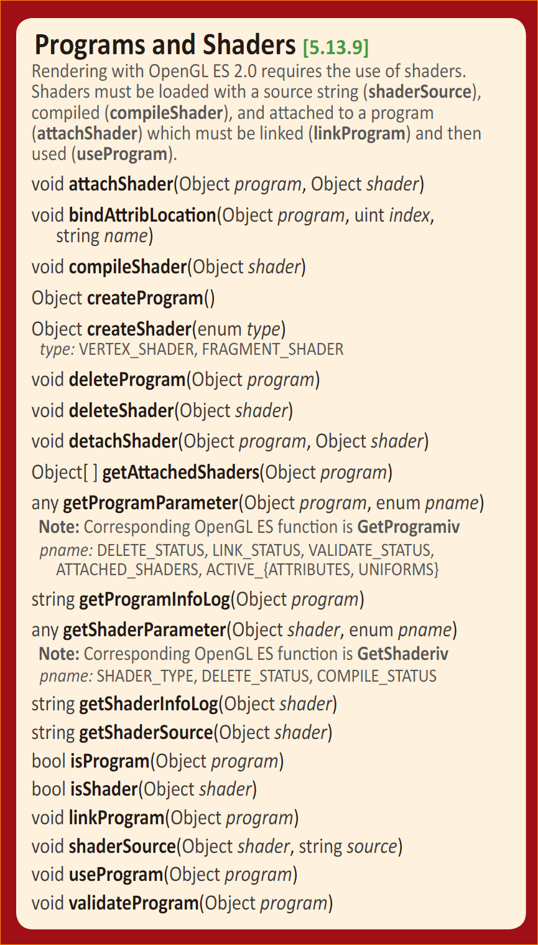
WebGL API

Slide 8
Shading Language Basic – WebGL API
Source code made with Strings (vertexShaderSource)
gl.vertexShader = gl.createShader(gl.VERTEX_SHADER);
gl.shaderSource(gl.vertexShader, vertexShaderSource);
gl.flagShader = gl.createShader(gl.FRAGMENT_SHADER);
gl.shaderSource(gl.fragShader, fragmentShaderSource);
Compile shader code
gl.compileShader(gl.vertexShader);
gl.compileShader(gl.fragShader);
Program – Create /Attach /Link / Use
gl.programObject = gl.createProgram();
gl.attachShader(gl.programObject, gl.fragShader);
gl.attachShader(gl.programObject, gl.vertexShader);
gl.linkProgram(gl.programObject);
gl.useProgram(gl.programObject);

Slide 9
GLES SL 1.00 Programming
Preprocessor
#, #define, #undef, #if, #ifdef, #ifndef, #else, #elif, #endif, #error, #pragma, #extension, #version, #line
#version 100
predefined macro
__LINE__, __FILE__, __VERSION__, GL_ES, GL_FRAGMENT_PRECISION_HIGH
operators (precedence order)
( ) + - ~ ~ * / % << >> < > <= >= & ^ | && ||
Vector components (swizzled and replicated)
{x,y,z,w}, {r,g,b,a}, {s,t,p,q}
example : gl_Position.xyzw = myVertex.xxww;

Slide 10
Language Reserved Keyword
attribute const uniform varying
break continue do for while
if else
in out inouts
float int void bool true false
lowp medium highp precision invariant
discard return
mat2 mat3 mat4
vec2 vec3 vec4 ivec2 ivec3 ivec4 bvec2 bvec3 bvec4
sampler2D samplerCube
struct

Slide 11
Basic Data Types
Basic
int, float, bool, void
Vectors
vec2, vec3, vec4 // floating point
Also int (ivec) and boolean (bvec)
Matrices (n x n)
mat2, mat3, mat4
Stored by columns (column major !)
Standard referencing m[row][column]
Texture
sampler2D, samplerCube
Arrays, Structure
C - like

Slide 12
Matrix-Vector Multiplication
in GL SL,
Matrices are column major.
mat4 m;
vec4 u, v;
u = m * v;
u = v * m;

Slide 13
Pointers
There are no pointers in GLSL
We can use C struct, which can be copied back from functions
structure can be passed by GLSL functions !
Because matrices and vectors are basic types,
they can be passed into and output from GLSL functions !
e.g. mat3 func(mat3 a);

Slide 14
Qualifiers
Storage Qualifiers
const, attribute, uniform, varying
Vertex attributes(gl_Position) and varying values are interpolated by the rasterizer into fragment attributes
Precision Qualifiers
highp, medium, lowp
Parameter
in, out, inout
Variance/Invariance
Order of qualification (strict order)
invariant-qualifier storage-qualifier precision-qualifier
storage-qualifier parameter-qualifier precision-qualifier

Slide 15
Attribute Qualifier
Attribute-qualified variables can change at most once per vertex
There are a few built in variables such as gl_Position
can be
float, vec2, vec3, vec4, mat2, mat3, and mat4
attribute float temperature

Slide 16
Uniform Qualifier
Variables that are constant for an entire primitive
Can be changed in application and sent to shaders
Cannot be changed in shader
Used to pass information to shader such as the bounding box of a primitive
uniform mat4 xform;

Slide 17
Varying Qualifier
Variables that are passed from vertex shader to fragment shader
Automatically interpolated by the rasterizer
can be - float, vec2, vec3, vec4, mat2, mat3, and mat4
ES SL 100 style used the varying qualifier
varying vec4 color;

Slide 18
Parameter Qualifiers : Passing values in Shader function
call by value-return
Variables are copied in
Returned values are copied back
Three possibilities
In (default)
out
inout
vec4 diffuse(inout float myFloat, vec3 light, in vec3 normal, out vec3 specular)
{
specular = …
return dot(normal, light);
}

Slide 19
Precision Qualifiers / Precision
highp, mediump, lowp
highp - for vertex shader
lowp – for color value
mediump – somewhere in (lowp <= precision <= highp)
Example
lowp float color;
varying mediump vec2 Coord;
lowp ivec2 foo(lowp mat3);
highp mat4 m;
Default Precision
Example
precision highp int;
precision lowp sampler2D;

Slide 20
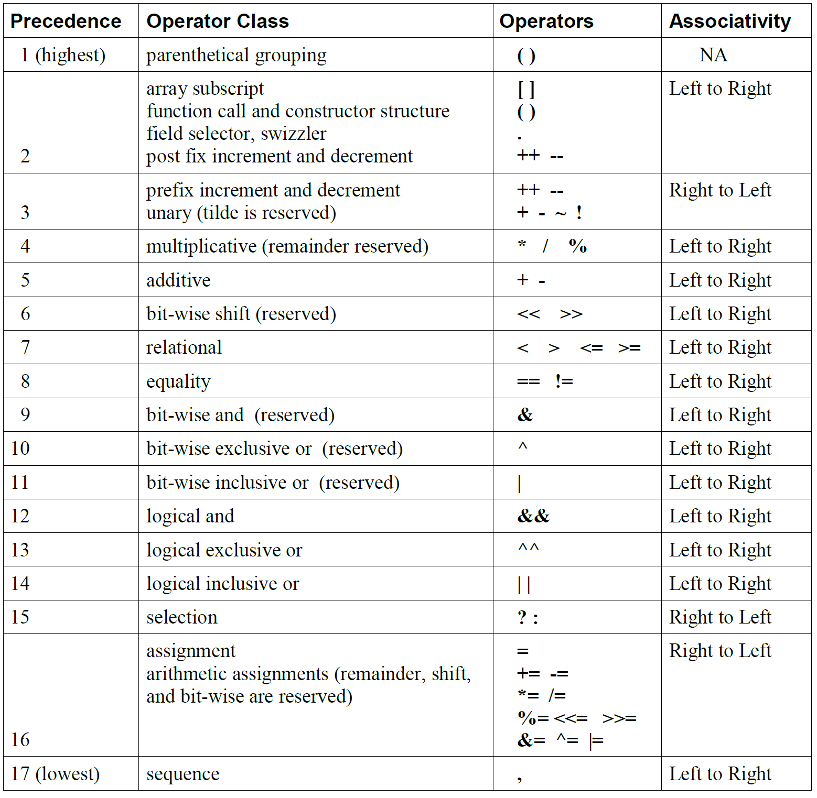
Operators

Slide 21
Constructors
Conversion and Scalar
int(bool), int(float), float(bool), float(int), bool(float), bool(int) // 0 or 0.0 are converted to false
Vector
vec3(float), vec4(ivec4), vec2(float, float), ivec3(int,int,int), bvec4(int, int, float, float) vec2(vec3), vec3(vec2, float), vec3(float, vec2)
Matrix
mat3(float) // Diagonal=float, others=0 mat2(float,float,float,float), mat3(vec3,vec3,vec3)
Struct
Similar to C

Slide 22
Component
Vector
Component
[0] [1] [2], [3] {x, y, z, w} {r, g, b, a} {s, t, p, q}
Swizzle
vec4 pos = vec4(1.0, 2.0, 3.0, 4.0);
vec4 swiz= pos.wzyx; // swiz = (4.0, 3.0, 2.0, 1.0)
vec4 dup = pos.xxyy; // dup = (1.0, 1.0, 2.0, 2.0)
Version 1.00
Matrix
Component
mat4 m;
m[1] = vec4(2.0); // sets the second column to all 2.0
m[0][0] = 1.0; // sets the upper left element to 1.0
m[2][3] = 2.0; // sets the 4th element of the third column to 2.0

Slide 23
Vector and Matrix Operations
Scalar operation
for each component : V2 = V1 * 2.0
Vector operation
component by component : V3 = V1 + V2
Matrix * Vector
u = v * m // is same as
u.x = dot(v, m[0]); // m[0] is the left column of m
u.y = dot(v, m[1]); // dot(a,b) is the inner (dot) product of a and b
u.z = dot(v, m[2]);
Precision of operation
Implementation dependent

Slide 24
Statement and Structure
Program blocks
statement, declaration, function
if-else / for / while / do-while / discard / return / break / continue
discard – only for fragment shader

Slide 25
Built-in Variables
Vertex Shader
gl_Position – homogeneous vertex position
gl_PointSize – size of point (pixel unit)
global scope
Fragment Shader
gl_FragColor – Color of fragment vertex
gl_FragData – Array
Cannot use both
gl_FragCoord – x, y, z, 1/w (Read Only, screen coordinates)
gl_PointCoord – 2D Coord of current fragment is located
gl_FrontFacing – true/false if front-facing primitives

Slide 26
Built-in Attributes
Vertex shader
Build-in Constant (value is minimum requirement)
gl_MaxVertexAttribs = 8; gl_MaxVertexUniformVectors = 128; gl_MaxVaryingVectors = 8; gl_MaxVertexTextureImageUnits = 0; gl_MaxCombinedTextureImageUnits = 8; gl_MaxTextureImageUnits = 8; gl_MaxFragmentUniformVectors = 16; gl_MaxDrawBuffers = 1;
Built-in Uniform
struct gl_DepthRangeParameters {
highp float near; // n
highp float far; // f
highp float diff; // f - n
};
uniform gl_DepthRangeParameters gl_DepthRange;

Slide 27
Built in Functions (1)
Math, Matrix, Vector
Trigonometric : radians, degrees, sin, cos, tan, asin, acos, atan(x), atan2(y,x)
Exponential : log, exp, exp2, log2, sqrt, inversesqrt
General Math : abs, sign, floor, ceil, fract, mod, min, max, clamp, mix, step, smoothstep
Geometric : length, distance, dot, cross, faceforward, reflect, refract,
Matrix : matrixCompMult
Vector Relational : lessThan, lessThanEqual, greaterThan, greaterThanEqual, equal, notEqual, any, all, not // return value is bvec
Notes:
Matrix : matrixCompMult // Component by component multiply

Slide 28
Built in Functions (2)
Texture function
Vertex shader only
vec4 texture2DLod(sampler2D sampler, vec2 coord, float lod)
vec4 texture2DProjLod(sampler2D sampler, vec3 coord, float lod)
vec4 texture2DProjLod(sampler2D sampler, vec4 coord, float lod)
vec4 textureCubeLod(samplerCube sampler, vec3 coord, float lod)
Fragment shader only
vec4 texture2D(sampler2D sampler, vec2 coord, float bias)
vec4 texture2DProj(sampler2D sampler, vec3 coord, float bias)
vec4 texture2DProj(sampler2D sampler, vec4 coord, float bias)
vec4 textureCube(samplerCube sampler, vec3 coord, float bias)
Available in both
vec4 texture2D(sampler2D sampler, vec2 coord)
vec4 texture2DProj(sampler2D sampler, vec3 coord)
vec4 texture2DProj(sampler2D sampler, vec4 coord)
vec4 textureCube(samplerCube sampler, vec3 coord)

Slide 29
Reference
GLSL ES Specification
https://www.khronos.org/files/opengles_shading_language.pdf
WebGL 1.0 Quick Reference Card
https://www.khronos.org/files/webgl/webgl-reference-card-1_0.pdf

Slide 30
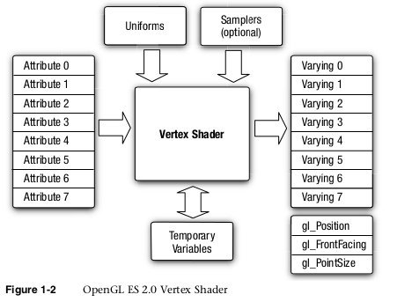
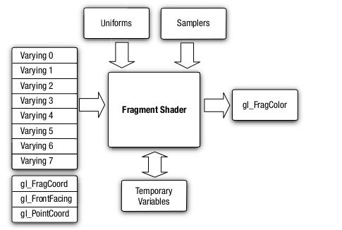
in next version
in / out rather than attribute / varying
introducing framebuffer object
now, you must bind the framebuffer to the fragment shader
attribute
→ in
varying
→ out
varying
→ in
new:
out
framebuffer

Slide 31
Software Tool Time

Slide 33
Lab. 05 Modify T05.js
two shader switching

Slide 35

Software Tool Time (소프트웨어 툴 타임)
(CC-BY-NC 4.0) Hwanyong Lee and Ajou University
Visit “Software Tool Time” channel in YouTube : http://goo.gl/remxrw
This video was supported by the Khronos Group
All product names, trademarks, and/or company names are used solely for identification and belong to their respective owners.
“Software Tool Time” video is licensed to the public under a Creative Commons Attribution 4.0 License (https://creativecommons.org/license/by/4.0/)
Twin Musicom’s African Drums (Sting) is licensed to the to the public under a Creative Commons Attribution 4.0 License (Artist: http://www.twinmusicom.org/)

