Slide 1
Are you ready?

Slide 2



Software Tool Time

Slide 3


Slide 4
WebGL 1.0 Tutorial Lecture 06 – Transformation Overview
Tutor
Hwanyong “Grey Bear” LEE
Objectives
Understanding Transformation and Matrix
Learn how to use gl-Matrix.js
Preparation
Download hello triangle from https://github.com/hwan-ajou/webgl-1.0
Download glmatrix.js https://glmatrix.net/ or github
April 2021 / (CC-BY-NC 4.0) Hwanyong Lee and Ajou University

Slide 5
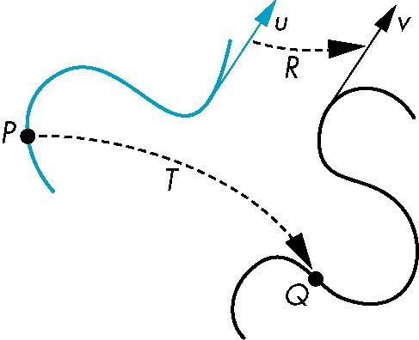
General Definition
A transformation maps points to other points and/or vectors to other vectors
v = T(u)
Q=T(P)

Slide 6
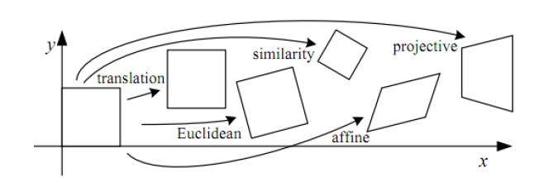
Category of Transformation: Linear, Affine, Projective,
Complex
Non-Linear
Notes:
Linear Transform의 의미는 Vertex를 이동하면 모양 전체가 유지된다는 의미

Slide 7
Linear Transformations
Line preserving
Characteristic of many physically important transformations
rotation, translation, scaling, shear
Importance in graphics is that we need only transform endpoints of line segments and let implementation draw line segment between the transformed endpoints
Can be represented with Linear Algebra equation
Matrix Multiplication with Vector

Slide 8

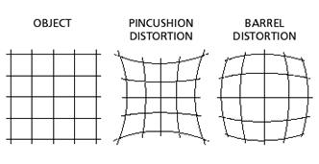
Non-linear Transformation
Example : Barrel Distortion

Slide 9
OpenGL ES 2.0 pipeline diagram
Graphics Context
Buffer (Array, Element)
Vertex Processing
Primitive Processing
Vertex Shader
App
API
Texture
Processing
Rasterization
Texture
Fragment Shader
Fragment Processing
System SW
(Window, Web, HAL)
Framebuffer
(Color, Stencil, Depth)
Pixel
Processing

Slide 10


Translate
Moving vertex with amount of [tx, ty, tz]
$$x^{′}=x+tx \\ y^{′}=y+ty \\ z^{′}=z+tz$$
$\left[\begin{matrix}x′ \\ y′ \\ z′ \\ 1\end{matrix}\right] = \left[\begin{matrix}1 & 0 & 0 & tx \\ 0 & 1 & 0 & ty \\ 0 & 0 & 1 & tz \\ 0 & 0 & 0 & 1\end{matrix}\right]$ * $\left[\begin{matrix}x \\ y \\ z \\ 1\end{matrix}\right]$
translateMat =
[1.0, 0.0, 0.0, 0.0, 0.0, 1.0, 0.0, 0.0,
0.0, 0.0, 1.0, 0.0,
tx, ty, tz, 1.0];

Slide 11


Scale
Expand or contract along each axis (with respect to Origin 0,0)
$$x^{′}=x∗sx \\ y^{′}=y∗sy \\ z^{′}=z ∗sz$$
$\left[\begin{matrix}x′ \\ y′ \\ z′ \\ 1\end{matrix}\right] = \left[\begin{matrix}sx & 0 & 0 & 0 \\ 0 & sy & 0 & 0 \\ 0 & 0 & sz & 0 \\ 0 & 0 & 0 & 1\end{matrix}\right]$ * $\left[\begin{matrix}x \\ y \\ z \\ 1\end{matrix}\right]$
scaleMat =
[ sx, 0.0, 0.0, 0.0, 0.0, sy, 0.0, 0.0,
0.0, 0.0, sz, 0.0,
0.0, 0.0, 0.0, 1.0];

Slide 12


Rotation with Z-axis
rotation with z-axis about the origin by θ degrees
$$x^{′}=x\cos{\text{q}}−y\sin{\text{q}} \\ y^{′}=x\sin{\text{q}}+y\cos{\text{q}} \\ z^{′}=z$$
$\left[\begin{matrix}x′ \\ y′ \\ z′ \\ 1\end{matrix}\right] = \left[\begin{matrix}\cos{\text{q}} & −\sin{\text{q}} & 0 & 0 \\ \sin{\text{q}} & \cos{\text{q}} & 0 & 0 \\ 0 & 0 & 1 & 0 \\ 0 & 0 & 0 & 1\end{matrix}\right]$ * $\left[\begin{matrix}x \\ y \\ z \\ 1\end{matrix}\right]$
rotZMat =
[Math.cos(th), Math.sin(th), 0.0, 0.0, -Math.sin(th), Math.cos(th), 0.0, 0.0,
0.0, 0.0, 1.0, 0.0,
0.0, 0.0, 0.0, 1.0];

Slide 13


Rotation with Y-axis and X-axis
rotation with y-axis about the origin by θ
rotation with y-axis about the origin by θ
$\left[\begin{matrix}x′ \\ y′ \\ z′ \\ 1\end{matrix}\right] = \left[\begin{matrix}\cos{\text{q}} & 0 & \sin{\text{q}} & 0 \\ 0 & 1 & 0 & 0 \\ −sin{\text{q}} & 0 & \cos{\text{q}} & 0 \\ 0 & 0 & 0 & 1\end{matrix}\right]$ * $\left[\begin{matrix}x \\ y \\ z \\ 1\end{matrix}\right]$
$\left[\begin{matrix}x′ \\ y′ \\ z′ \\ 1\end{matrix}\right] = \left[\begin{matrix}1 & 0 & 0 & 0 \\ 0 & \cos{\text{q}} & \sin{\text{q}} & 0 \\ 0 & −sin{\text{q}} & \cos{\text{q}} & 0 \\ 0 & 0 & 0 & 1\end{matrix}\right]$ * $\left[\begin{matrix}x \\ y \\ z \\ 1\end{matrix}\right]$

Slide 14
Reflection
corresponds to negative scale factors
s_{x} = 1, s_{y} = -1
s_{x} = -1, s_{y} = 1
s_{x} = -1, s_{y} = -1

Slide 15


Shear with X-axis
rotation with z-axis about the origin by θ degrees
$$x^{′}=x+y\cot{\text{q}} \\ y^{′}=y \\ z^{′}=z$$
$\left[\begin{matrix}x′ \\ y′ \\ z′ \\ 1\end{matrix}\right] = \left[\begin{matrix}1 & \cot{\text{q}} & 0 & 0 \\ 0 & 1 & 0 & 0 \\ 0 & 0 & 1 & 0 \\ 0 & 0 & 0 & 1\end{matrix}\right]$ * $\left[\begin{matrix}x \\ y \\ z \\ 1\end{matrix}\right]$
shearXMat =
[1.0, 0.0, 0.0, 0.0, Math.cot(th), 1.0, 0.0, 0.0,
0.0, 0.0, 1.0, 0.0,
0.0, 0.0, 0.0, 1.0];

Slide 16


Shear with y-axis
rotation with z-axis about the origin by θ degrees
$$x^{′}=x \\ y^{′}=x\cot{\text{q}}+y \\ z^{′}=z$$
$\left[\begin{matrix}x′ \\ y′ \\ z′ \\ 1\end{matrix}\right] = \left[\begin{matrix}1 & 1 & 0 & 0 \\ \cot{\text{q}} & 1 & 0 & 0 \\ 0 & 0 & 1 & 0 \\ 0 & 0 & 0 & 1\end{matrix}\right]$ * $\left[\begin{matrix}x \\ y \\ z \\ 1\end{matrix}\right]$
shearXMat =
[1.0, Math.cot(th), 0.0, 0.0, 0.0, 1.0, 0.0, 0.0,
0.0, 0.0, 1.0, 0.0,
0.0, 0.0, 0.0, 1.0];

Slide 17
Inverses Transform
Although we could compute inverse matrices by general formulas, we can use simple geometric observations
Translation: T⁻¹(d_{x}, d_{y}, d_{z}) = T(-d_{x}, -d_{y}, -d_{z})
Rotation: R ⁻¹(q) = R(-q)
Holds for any rotation matrix
Note that since cos(-q) = cos(q) and sin(-q)=-sin(q)
R ⁻¹(q) = R ^{T}(q)
Scaling: S⁻¹(s_{x}, s_{y}, s_{z}) = S(1/s_{x}, 1/s_{y}, 1/s_{z})

Slide 18
Order of Transformations
Note that matrix on the right is the first applied
Mathematically, the following are equivalent
vn = A * B * C * v = A * (B * (C * v))
Note many references use column matrices to represent points. In terms of column matrices
vn = v^{T *} C^{T *} B^{T *} A^{T}
Why we use “Homogeneous Coordinate”

Slide 19
General Rotation About the Origin
A rotation by θ about an arbitrary axis
can be decomposed into the concatenation
of rotations about the x, y, and z axes
R(θ) = R_{z}(θ_{z}) R_{y}(θ_{y}) R_{x}(θ_{x})
y
θ_{x} θ_{y} θ_{z} are called the Euler angles
v
θ
Note that rotations do not commute
We can use rotations in another order but
with different angles
x
z

Slide 20
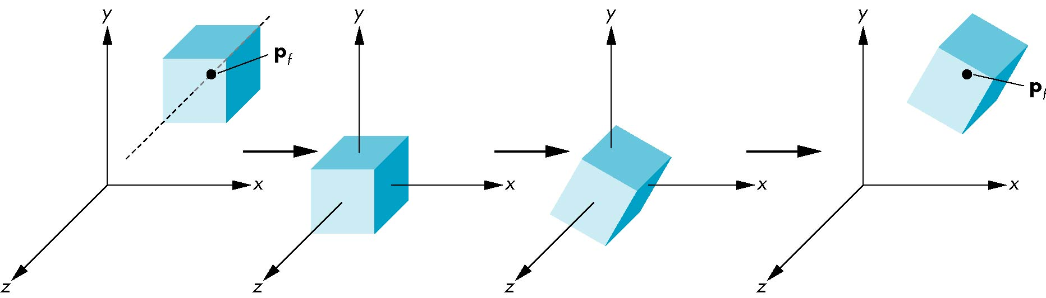
Rotation About Point (p_{f}) other than the Origin
Move point to origin
Rotate
Move point back
M * v = T(p_{f}) * R(q) * T(-p_{f}) * v

Slide 22

Software Tool Time (소프트웨어 툴 타임)
(CC-BY-NC 4.0) Hwanyong Lee and Ajou University
Visit “Software Tool Time” channel in YouTube : http://goo.gl/remxrw
This video was supported by the Khronos Group
All product names, trademarks, and/or company names are used solely for identification and belong to their respective owners.
“Software Tool Time” video is licensed to the public under a Creative Commons Attribution 4.0 License (https://creativecommons.org/license/by/4.0/)
Twin Musicom’s African Drums (Sting) is licensed to the to the public under a Creative Commons Attribution 4.0 License (Artist: http://www.twinmusicom.org/)

Slide 23
Software Tool Time

Slide 25
Lab. 06a gl-Matrix

Slide 26
gl-matrix
JavaScript open source code for gl drawing
http://glmatrix.net/
Modules
glMatrix
equals(a, b), toRadian, setMatrixArrayType(type) – default Float32Array
mat2
mat2d – 3 x 2 matrix – same as PostScript
mat3
mat4
quat
quat2
vec2
vec3
vec4

Slide 27
How to use gl-matrix
You can import in JavaScript code with import
Script in html file
<script type="text/javascript" src="gl-matrix.js"> </script>
<script>
window['mat4'] = glMatrix.mat4;
window['vec4'] = glMatrix.vec4;
window['vec3'] = glMatrix.vec4;
</script>
<script type="text/javascript" src="hello.js"> </script>

Slide 28
Start coding - Preparation
Copy gl-matrix to local work folder
Drawing Cube
Make Cube Data
Depth Test Enabled
https://git.ajou.ac.kr/hwan/cg_course/-/tree/master /WebGL/transform-coding
Start code is backup with name of _start

Slide 29
gl-matrix
vec3 (vec4)
create(), zero(out), fromValues(x, y, z), set(out, x, y, z), add(out, a, b), ceil(out, a), clone(a), copy(out, a), cross(out, a, b), distance(a, b), divide(out, a, b), dot(a, b), equals(a, b), exactEquals(a, b), floor(out, a), forEach(a, stride, offset, count, fn, arg_{opt}), inverse(out, a), length(a), max(out, a, b), min(out, a, b), multiply(out, a, b), negate(out, a), normalize(out, a), random(out, scale_{opt}), squaredDistance(a, b), squaredLength(a), str(a), sub(out, a, b),
bezier(out, a, b, c, d, t), lerp(out, a, b, t), hermite(out, a, b, c, d, t),
rotate{XYZ}(out, a, b, rad), round(out, a), scale(out, a, b), scaleAndAdd(out, a, b, scale), transformMat3(out, a, m), transformMat4(out, a, m), transformQuat(out, a, q),

Slide 30
gl-matrix
mat4
add(out, a, b), adjoint(out, a), clone(a), copy(out, a), create(), distance(a, b), determinant(a), equals(a, b), exactEquals(a, b), frob(a), fromValues(m00, … , m33), identity(out), invert(out, a), multiplyScalarAndAdd(out, a, b, scale), multiply(out, a, b), multiplyScalar(out, a, b), set(out, m00 … , m33) , str(a), subtract(out, a, b),
fromRotation(out, rad, axis), fromScaling(out, v), from{XYZ}Rotation(out, rad), getRotation(out, mat), getScaling(out, mat), getTranslation(out, mat), rotate(out, a, rad, axis), rotate{XYZ}(out, a, rad), scale(out, a, b), translate(out, a, v), transpose(out, a)
Notes:
A 역행렬 = Adjoint A / det A

Slide 31
gl-matrix
mat4 for View/Projection trasnformation
targetTo(out, eye, center, up), lookAt(out, eye, center, up)
frustum(out, left, right, bottom, top, near, far), ortho(out, left, right, bottom, top, near, far), perspective(out, fovy, aspect, near, far), perspectiveFromFieldOfView(out, fov, near, far),
mat4 for quaternion
fromQuat(out, q), fromQuat2(out, a), fromRotationTranslation(out, q, v), fromRotationTranslationScale(out, q, v, s), fromRotationTranslationScaleOrigin(out, q, v, s, o),

Slide 32
Change Transformation Code
Divide into 3 part of transformation
Model Transformation
View Transformation
Projective Transformation
Change Shader and RenderScene( )

Slide 34
Software Tool Time (소프트웨어 툴 타임)
(CC-BY-NC 4.0) Hwanyong Lee and Ajou University
Visit “Software Tool Time” channel in YouTube : http://goo.gl/remxrw
This video was supported by the Khronos Group
All product names, trademarks, and/or company names are used solely for identification and belong to their respective owners.
“Software Tool Time” video is licensed to the public under a Creative Commons Attribution 4.0 License (https://creativecommons.org/license/by/4.0/)
Twin Musicom’s African Drums (Sting) is licensed to the to the public under a Creative Commons Attribution 4.0 License (Artist: http://www.twinmusicom.org/)

Slide 35
Software Tool Time

Slide 37
Lab. 06b Model transform with using gl-matrix

Slide 39
Software Tool Time (소프트웨어 툴 타임)
(CC-BY-NC 4.0) Hwanyong Lee and Ajou University
Visit “Software Tool Time” channel in YouTube : http://goo.gl/remxrw
This video was supported by the Khronos Group
All product names, trademarks, and/or company names are used solely for identification and belong to their respective owners.
“Software Tool Time” video is licensed to the public under a Creative Commons Attribution 4.0 License (https://creativecommons.org/license/by/4.0/)
Twin Musicom’s African Drums (Sting) is licensed to the to the public under a Creative Commons Attribution 4.0 License (Artist: http://www.twinmusicom.org/)

