Slide 1
Are you ready?

Slide 2



Software Tool Time

Slide 3


Slide 4
WebGL 1.0 Tutorial Lecture 07 – View/Projection Transform
Tutor
Hwanyong “Grey Bear” LEE
Contents
view and projective transformation
How to programming shaders
Preparation
Download hello triangle from https://github.com/hwan-ajou/webgl-1.0
Download glmatrix.js https://glmatrix.net/ or github
April 2021 / (CC-BY-NC 4.0) Hwanyong Lee and Ajou University

Slide 5
OpenGL ES 2.0 pipeline diagram
Graphics Context
Buffer (Array, Element)
Vertex Processing
Primitive Processing
Vertex Shader
App
API
Texture
Processing
Rasterization
Texture
Fragment Shader
Fragment Processing
System SW
(Window, Web, HAL)
Framebuffer
(Color, Stencil, Depth)
Pixel
Processing

Slide 6
Vertex Processing & Primitive Processing
Primitive Processing
Vertex
Vertex Processing
Vertex Buffer (Array, Element)
Vertex Assembly
Primitive Assembly
Primitive
Vertex Shader (uniform, attribute)
Vertex shading
Perspective Division
Vertex
(varying, built-in output)
Viewport Mapping
Primitive Clipping

Slide 7
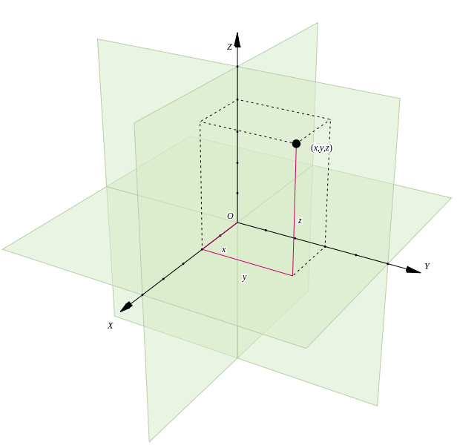
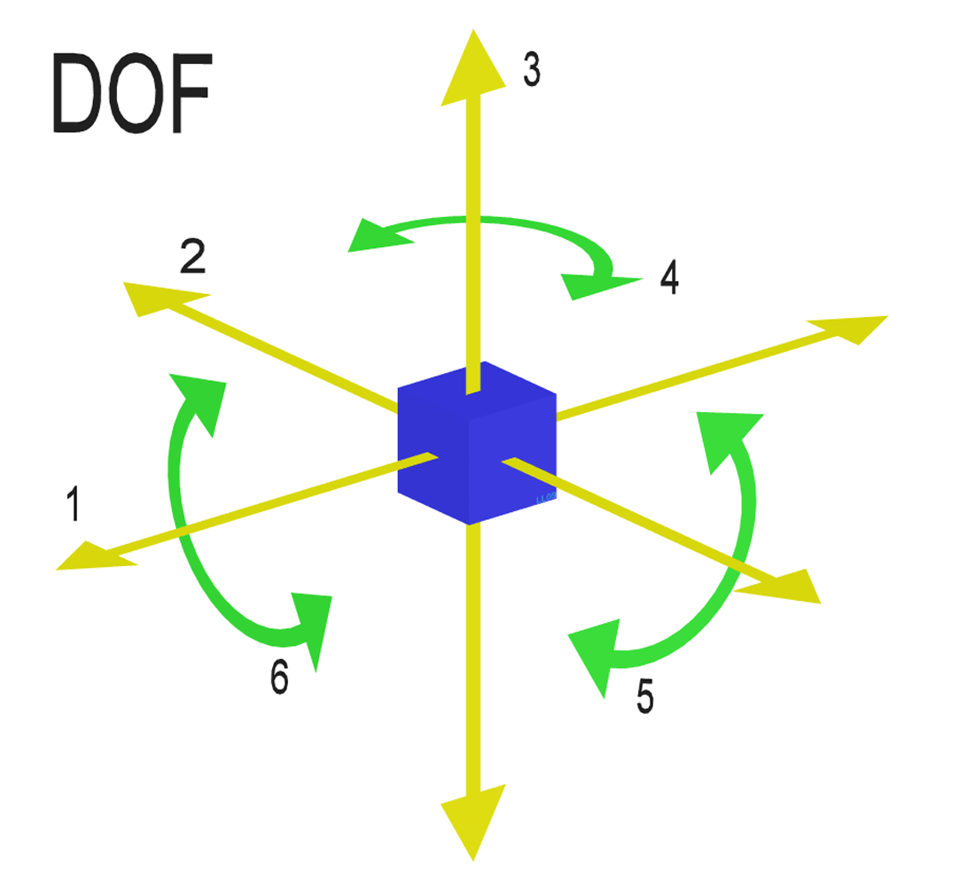
Coordinate System & Degree of Freedom
Cartesian Coordinate System
Define Position with coordinate
Degree of Freedom

Slide 8
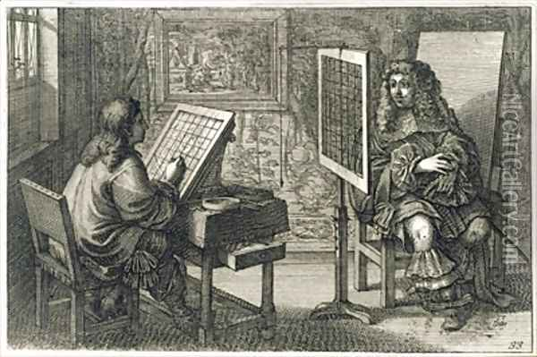
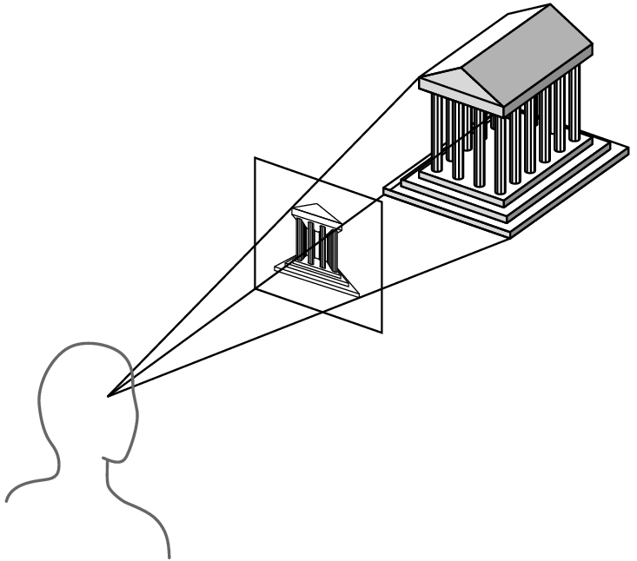

Classical (Perspective) Projection
Realism (1850 ~ 1880)
introducing vanishing point (소실점)

Slide 9
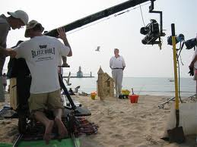
Introducing View Matrix
model matrix : you located the objects (or actors)
view matrix : now, you move the camera (or view)

Slide 10
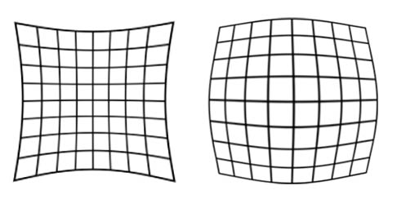

Camera Parameters
Camera Position
3 DOF Coordinate
Camera Direction
3 DOF Angle
Optical Parameters
Focal Length – Field of View
Focus Position
Iris
Lens Distortion
We will deal with only
LINEAR!
Pin-hole camera

Slide 11
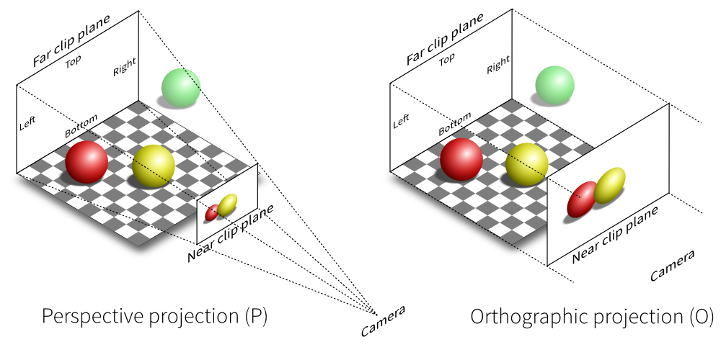
Kind of Projections
parallel projection
infinite COP = DOP
direction of projection
perspective viewing
finite COP
center of projection

Slide 12
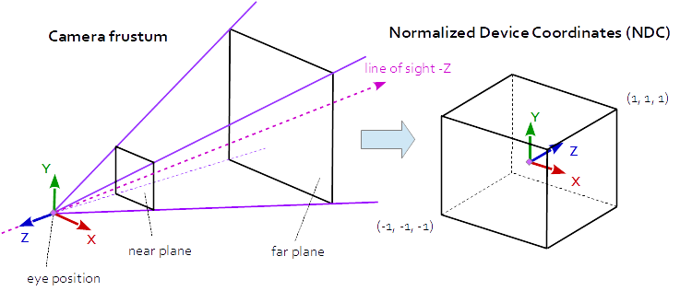
Final Target to make

Slide 13
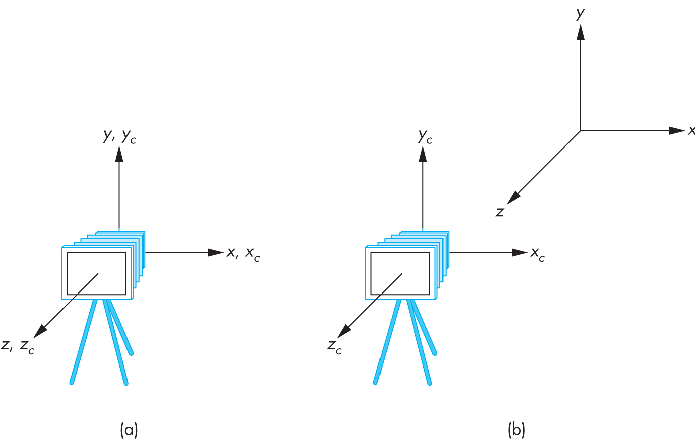
Camera Positioning
initial camera position in OpenGL
at the origin of the world frame, to –z direction
camera movement = reverse movement of the objects
Translatef(0.0, 0.0, –100);

Slide 14
Viewing API’s
general viewing API
PHIGS, GKS-3D : famous graphics library
camera setting?
VRP (view reference point)
VPN (view plane normal)
VUP (view up vector)
view-up vector V
view reference point
view-plane normal vector N

Slide 15
Calculation Viewing Matrix
M_{view} : viewing matrix
Transform from Point q in World Coordinate to Camera Coordinate
p : VRP, n : (normalized) VPN, v : (normalized) VUP
in world frame

Slide 16
Computation of Viewing Matrix
Condition
View Plane
view coordinate system
View Reference Point

Slide 17
Viewing Matrix의 계산

Slide 18
Look-At Approach

Slide 19
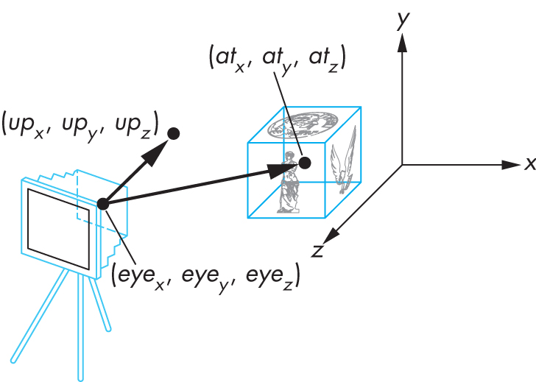
Look-At Interface
camera position + camera orientation
look-at approach
At the Position (eye_{x}, eye_{y}, eye_{z}), Look at the Point (at_{x}, at_{y}, at_{z})
Define Up Vector or Rotation Angle (up_{x}, up_{y}, up_{z})

Slide 20
Look-At Approach
user input:
in the world frame,
eye position: (eye_{x}, eye_{y}, eye_{z})
at position: (at_{x}, at_{y}, at_{z})
up vector: : (up_{x}, up_{y}, up_{z})
VRP = (eye_{x}, eye_{y}, eye_{z})
VPN = (at_{x}, at_{y}, at_{z}) – (eye_{x}, eye_{y}, eye_{z})
VUP : (up_{x}, up_{y}, up_{z})의 방향 보정
normalization

Slide 21
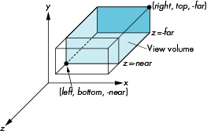
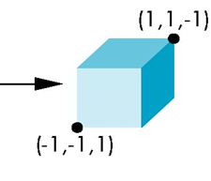
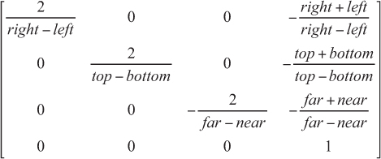
Orthographic Projection Matrix
–

Slide 22
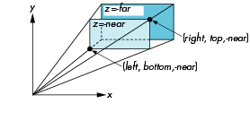
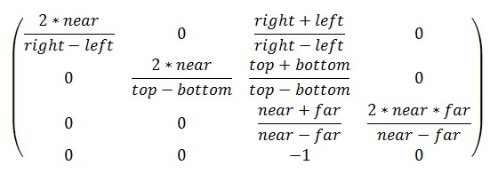
Perspective Projection Matrix

Slide 23
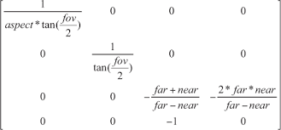
Perspective using Field of View

Slide 24
view/projection in gl-matrix
mat4 for View Transformation
lookAt(out, eye, center, up)
Projective Transformation
ortho(out, left, right, bottom, top, near, far),
frustum(out, left, right, bottom, top, near, far),
perspective(out, fovy, aspect, near, far),
perspectiveFromFieldOfView(out, fov, near, far),

Slide 25
Software Tool Time

Slide 27
Lab. 07 view/projection transform with using gl-matrix

Slide 29

Software Tool Time (소프트웨어 툴 타임)
(CC-BY-NC 4.0) Hwanyong Lee and Ajou University
Visit “Software Tool Time” channel in YouTube : http://goo.gl/remxrw
This video was supported by the Khronos Group
All product names, trademarks, and/or company names are used solely for identification and belong to their respective owners.
“Software Tool Time” video is licensed to the public under a Creative Commons Attribution 4.0 License (https://creativecommons.org/license/by/4.0/)
Twin Musicom’s African Drums (Sting) is licensed to the to the public under a Creative Commons Attribution 4.0 License (Artist: http://www.twinmusicom.org/)

