Slide 1
3장 Getting started with neural networks
“기회와 준비가 만났을 때 … ”

Slide 2
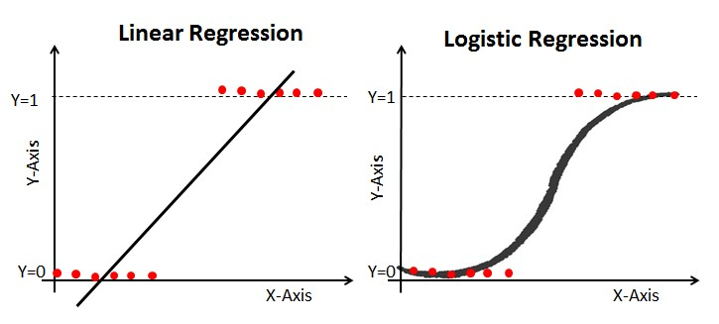
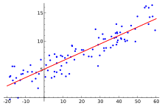
6. Predicting house prices: a regression example
The two previous examples - predict a single discrete label of an input data point.
Another common type of machine-learning problem is regression - predicting a continuous value: temperature tomorrow, time, or price
NOTE Don’t confuse regression and the algorithm logistic regression. Confusingly, logistic regression isn’t a regression algorithm—it’s a classification algorithm.

Slide 3
6. Predicting house prices: a regression example
3.6.1 The Boston Housing Price dataset
predict the median price of homes in a given Boston suburb in the mid-1970s
only 506 samples - 404 training samples and 102 test samples.
And each feature in the input data (for example, the crime rate, the local property tax rate) has a different scale. For instance, some values are proportions, which take values between 0 and 1; others take values between 1 and 12, others between 0 and 100, and so on.
Listing 3.24 Loading the Boston housing dataset
from keras.datasets import boston_housing
(train_data, train_targets), (test_data, test_targets) =boston_housing.load_data()
Let’s look at the data:
>>> train_data.shape
(404, 13) # 13 features
>>> test_data.shape
(102, 13)

Slide 4
6. Predicting house prices: a regression example
3.6.1 The Boston Housing Price dataset
As you can see, you have 404 training samples and 102 test samples, each with 13 numerical features - capita crime rate, average number of rooms per dwelling, accessibility to highways, and so on.
The targets are prices of owner-occupied homes, in thousands of dollars:
>>> train_targets
[15.2, 42.3, 50. ... 19.4, 19.4, 29.1] # 404 in $(*1000)
The prices are typically between $10,000 and $50,000

Slide 5
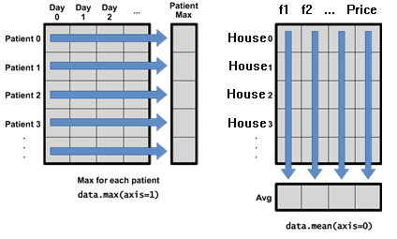
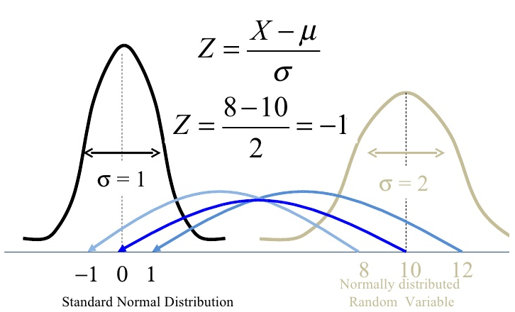
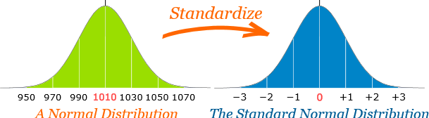
6. Predicting house prices: a regression example
3.6.2 Preparing the data
feature-wise normalization: feature is centered
around 0 and has a unit standard deviation.
Listing 3.25 Normalizing the data
mean = train_data.mean(axis=0)#(404,13)
std = train_data.std(axis=0) #(102,13)
train_data -= mean
train_data /= std
test_data -= mean
test_data /= std
Note that the quantities used for normalizing the test data are computed using the training data.

Slide 6
6. Predicting house prices: a regression example
3.6.3 Building your network
small samples - small network with two hidden layers, each with 64 units.
less training data - worse overfitting
a small network is one way to mitigate overfitting.
Listing 3.26 Model definition
from keras import models
from keras import layers
def build_model():
model = models.Sequential()
model.add(layers.Dense(64, activation='relu',
input_shape=(train_data.shape[1],)))
model.add(layers.Dense(64, activation='relu'))
model.add(layers.Dense(1))
model.compile(optimizer='rmsprop', loss='mse', metrics=['mae'])
return model
output - a single unit and no activation (it will be a linear layer) for scalar regression to predict a single continuous value, free to learn to predict values in any range
sigmoid activation function - predict values between 0 and 1
mean absolute error (MAE) loss function for regression problems - 0.5 → off by $500 on average.

Slide 7
6. Predicting house prices: a regression example
3.6.4 Validating your approach using K-fold validation
very small validation set (for instance, about 100 examples) - high variance with regard to the validation split
k-fold cross-validation (see figure) - splitting the available data into K partitions (typically K = 4 or 5), instantiating K identical models, and training each one on K – 1 partitions while evaluating on the remaining partition.
The validation score for the model - average of the K validation scores
3-fold cross-validation

Slide 8
6. Predicting house prices: a regression example
3.6.4 Validating your approach using K-fold validation
Listing 3.27 K-fold validation
import numpy as np
k=4
num_val_samples = len(train_data) // k # 나눗셈의 몫 – 404//4 → 101…0
num_epochs = 100
all_scores = []
for i in range(k): # i = 0,1,2,3
print('processing fold #', i)
val_data = train_data[i * num_val_samples: (i + 1) * num_val_samples]
val_targets = train_targets[i * num_val_samples: (i + 1) * num_val_samples]
partial_train_data = np.concatenate( [train_data[:i* num_val_samples],
train_data[(i + 1) * num_val_samples:]],
axis=0)
partial_train_targets = np.concatenate( [train_targets[:i * num_val_samples],
train_targets[(i + 1) * num_val_samples:]],
axis=0)
model = build_model()
model.fit(partial_train_data, partial_train_targets,
epochs=num_epochs, batch_size=1, verbose=0)
val_mse, val_mae = model.evaluate(val_data, val_targets, verbose=0)
all_scores.append(val_mae)

Slide 9
6. Predicting house prices: a regression example
3.6.4 Validating your approach using K-fold validation
Running this with num_epochs = 100 yields the following results:
>>> all_scores
[2.588258957792037, 3.1289568449719116, 3.1856116051248984, 3.0763342615401386]
>>> np.mean(all_scores)
2.9947904173572462
different validation scores, from 2.6 to 3.2.
The average (3.0) is a much more reliable metric K-fold cross-validation
$3,000 on average - significant considering with $10,000 to $50,000.

Slide 10
6. Predicting house prices: a regression example
3.6.4 Validating your approach using K-fold validation
Let’s try training the network a bit longer: 500 epochs. To keep a record of how well the model does at each epoch, you’ll modify the training loop to save the per-epoch validation score log.
Listing 3.28 Saving the validation logs at each fold
num_epochs = 500
all_mae_histories = []
for i in range(k):
print('처리중인 폴드 #', i)
val_data = train_data[i * num_val_samples: (i + 1) * num_val_samples]
val_targets = train_targets[i * num_val_samples: (i + 1) * num_val_samples]
partial_train_data = np.concatenate(
[train_data[:i * num_val_samples],
train_data[(i + 1) * num_val_samples:]],
axis=0)
partial_train_targets = np.concatenate(
[train_targets[:i * num_val_samples],
train_targets[(i + 1) * num_val_samples:]],
axis=0)
model = build_model()
history = model.fit(partial_train_data, partial_train_targets,
validation_data=(val_data, val_targets),
epochs=num_epochs, batch_size=1, verbose=0)
mae_history = history.history['val_mean_absolute_error'] # 500
all_mae_histories.append(mae_history) # (k, 500)

Slide 11
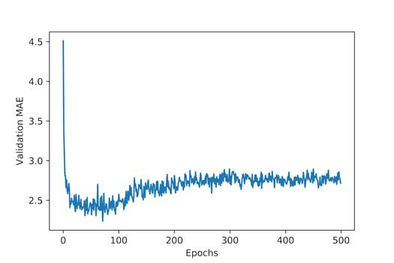
6. Predicting house prices: a regression example
3.6.4 Validating your approach using K-fold validation
the average of the per-epoch MAE scores for all folds.i successive mean K-fold validation scores
Listing 3.29 Building the history of successive mean K-fold validation scoresat
average_mae_history = [np.mean([x[i] for x in all_mae_histories])
for i in range(num_epochs)]
Let’s plot this; see figure 3.12.tin
Listing 3.30 Plotting validation scoresg 30 Plotting validation scores
import matplotlib.pyplot as plt
plt.plot(range(1,len(average_mae_history)+1),
average_mae_history)
plt.xlabel('Epochs')
plt.ylabel('Validation MAE')
plt.show()
Figure 3.12 Validation MAE by epoch

Slide 12
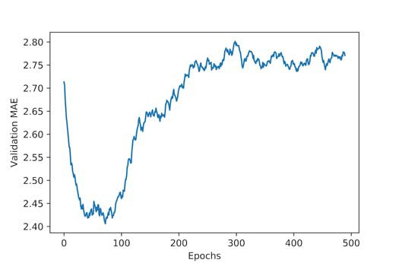
6. Predicting house prices: a regression example
3.6.4 Validating your approach using K-fold validation
Omit the first 10 data points, which are on a different scale than the rest of the curve.
Replace each point with an exponential moving average of the previous points, to obtain a smooth curve.ssive tion scores
Listing 3.31 Plotting validation scores, excluding the first 10 data points mean K-fold
def smooth_curve(points, factor=0.9):
smoothed_points = []
for point in points:
if smoothed_points:
previous = smoothed_points[-1]
smoothed_points.append
(previous * factor + point * (1 - factor))
else:
smoothed_points.append(point)
return smoothed_points
smooth_mae_history = smooth_curve(average_mae_history[10:])
plt.plot(range(1, len(smooth_mae_history) + 1), smooth_mae_history)
plt.xlabel('Epochs')
plt.ylabel('Validation MAE')
plt.show()
test = [3, 5, 4, 6, 7, 3]
smooth_curve(test)
Figure 3.13 Validation MAE by epoch,
excluding the first 10 data points

Slide 13
6. Predicting house prices: a regression example
validation MAE stops improving significantly after 80 epochs.
adjust the size of the hidden layers, and then look at its performance on the test data.
-fold validation scores
Listing 3.32 Training the final model
model = build_model()
model.fit(train_data, train_targets,epochs=80, batch_size=16, verbose=0)
test_mse_score, test_mae_score = model.evaluate(test_data, test_targets)
Here’s the final result:
>>> test_mae_score 2.5532484335057877
You’re still off by about $2,550

Slide 14
6. Predicting house prices: a regression example
3.6.5 Wrapping up
Here’s what you should take away from this example:
Mean squared error (MSE) is a loss function commonly used for regression.
The concept of accuracy doesn’t apply for regression. A common regression metric is mean absolute error (MAE).
When features in the input data have values in different ranges, each feature should be scaled independently as a preprocessing step.
When there is little data available, using k-fold validation is a great way to reliably evaluate a model.
When little training data is available, it’s preferable to use a small network with few hidden layers (typically only 1 or 2), in order to avoid severe overfitting.

Slide 15
6. Predicting house prices: a regression example
Chapter summary
binary classification, multiclass classification, and scalar regression
preprocess raw data before feeding it into a neural network.
features with different ranges, scale each feature independently
As training progresses, neural networks eventually begin to overfit on never-before-seen data.
If you have small training data, use a small network with only one or two hidden layers, to avoid severe overfitting.
If your data is divided into many categories, you may cause information bottlenecks if you make the intermediate layers too small.
Regression uses different loss functions and different evaluation metrics than classification.
When you’re working with little data, k-fold validation can help reliably evaluate your model.

