Slide 1
Brexit
Brexit and the news

Slide 2
Content
Introduction
Previous work
Data collection
Data cleaning
Data visualization
Trend and Date
Most common words in NY Time
The opinion of NY Times toward Brexit *
Difference between different type of article *
The results and future work

Slide 3
Introduction
What is Brexit?
Why does it matter?
Global repercussion
Global response
Personal interest
Our Focus
How the press react to the brexit?
Focus on a single newspaper
Focus on New York Times
Non-British paper
English paper
Notes:
Blogs
Briefings
News

Slide 4

Initial plan and how it evolved
To tell the tale of Brexit with emojis but Twitter said
Then we decided to understand the evolution of responses to Brexit from three news sites. -
One British
One American
And a Chinese.
Then , settled on the American one only. (We speak of the limitations of this at the end)

Slide 5
Previous work
The Emojis of Brexit
Focus on two days (the day before the vote and the day after the vote)
Social factor that may have influenced “Brexit”
Predicting Brexit
Mining Twitter
Natural Language Processing

Slide 6
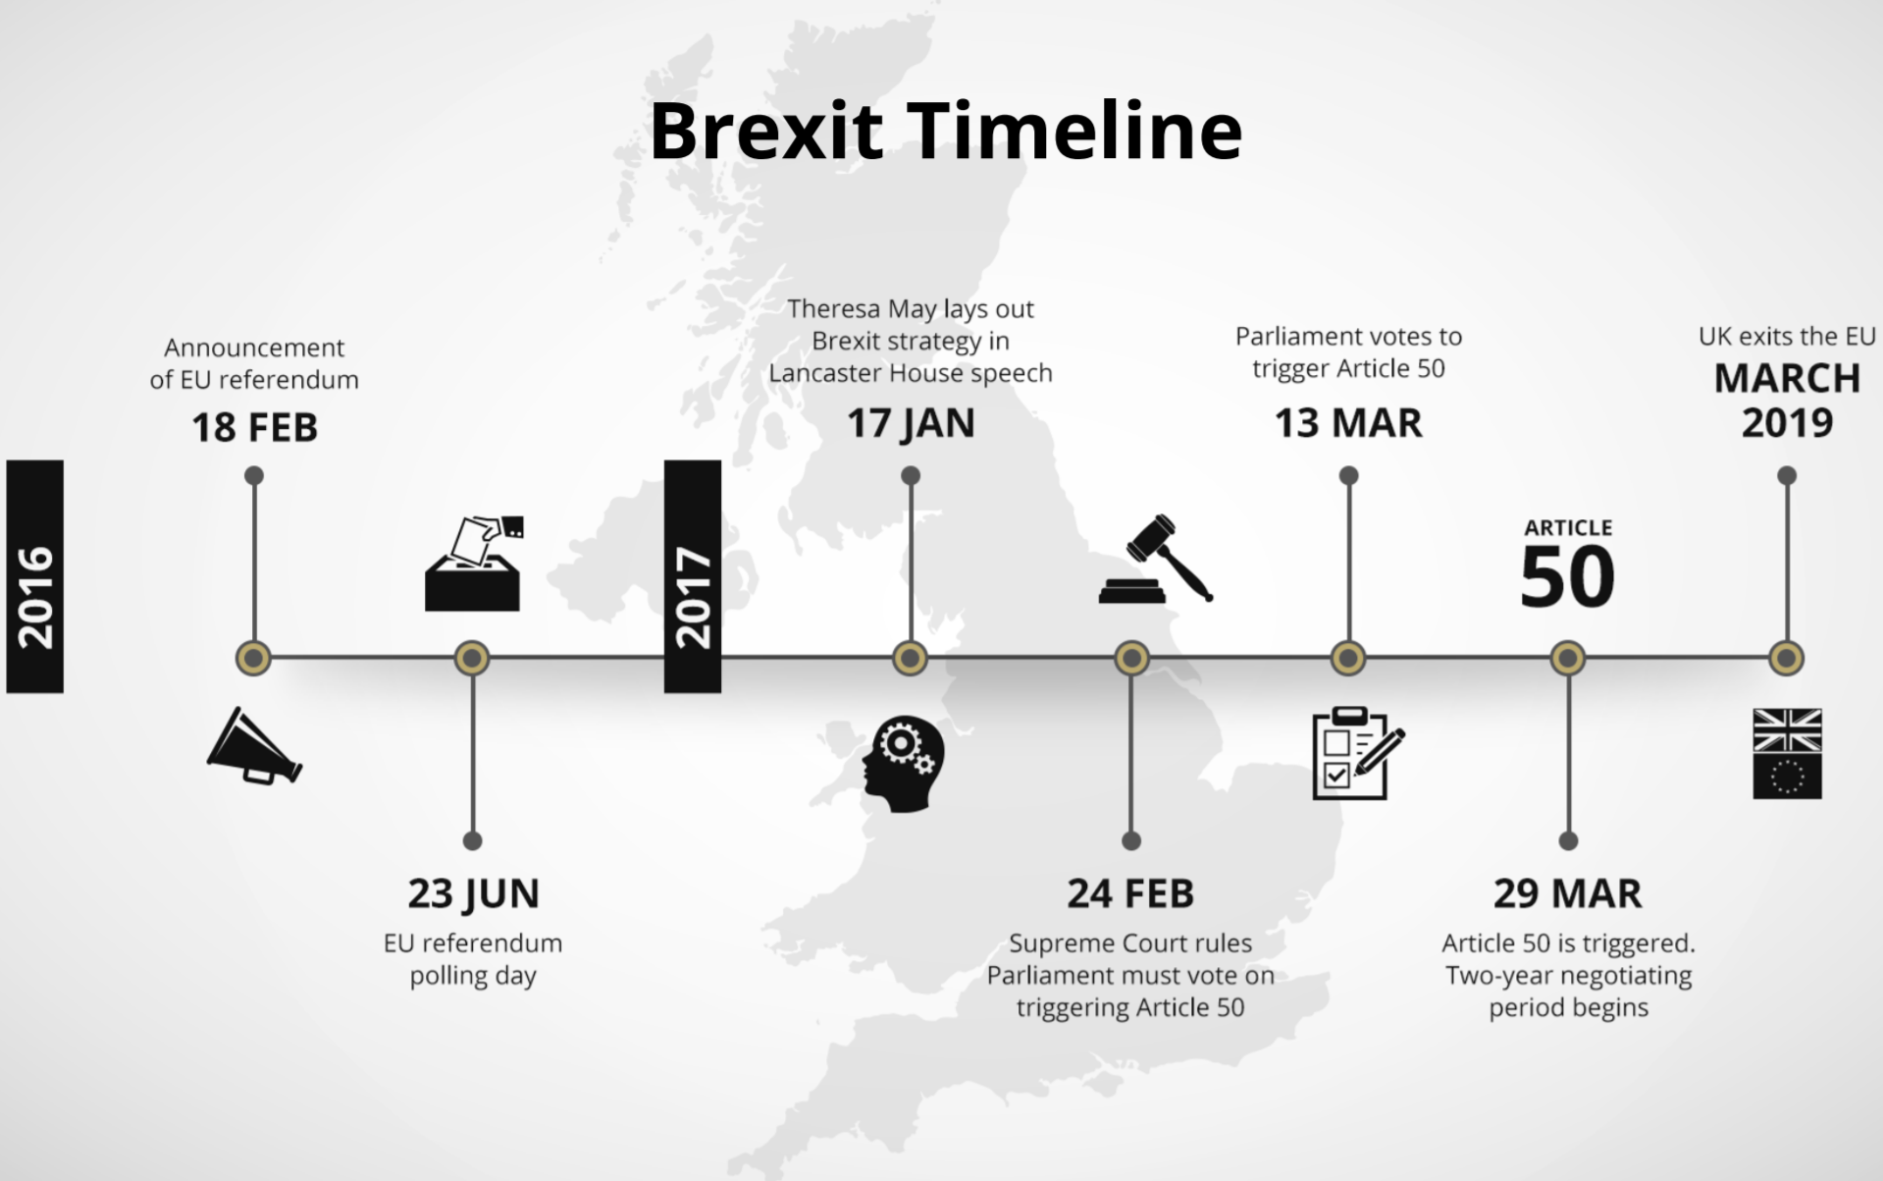
Source: Financial Trading (Brexit: Trading Opportunities)

Slide 7
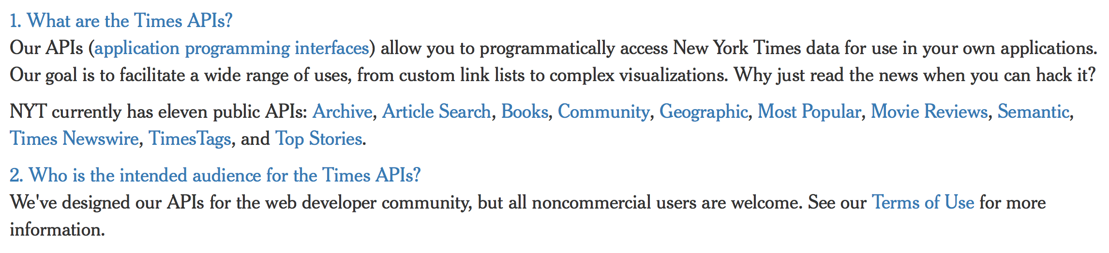
Data Collection
NY Time API

Slide 8
Data Collection
Difficulties
No existing and useful code
Unlike Twitter API which we learned from Assignment 2
API Call Limit
The Article Search API is rate limited to 1,000 calls per day, and 1 call per second.

Slide 9
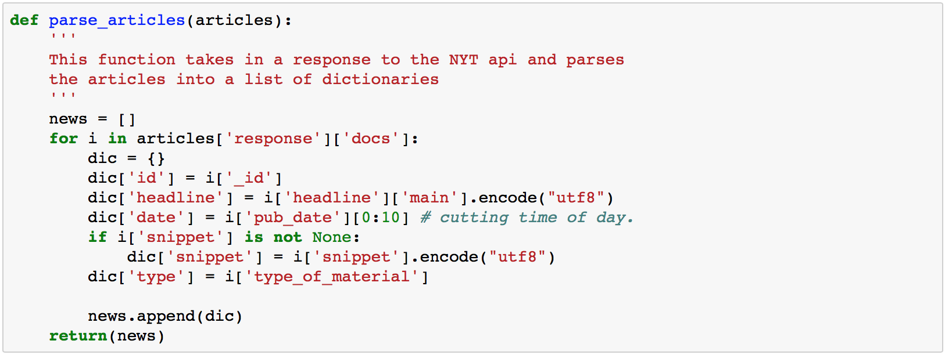
Data Collection
Demo

Slide 10
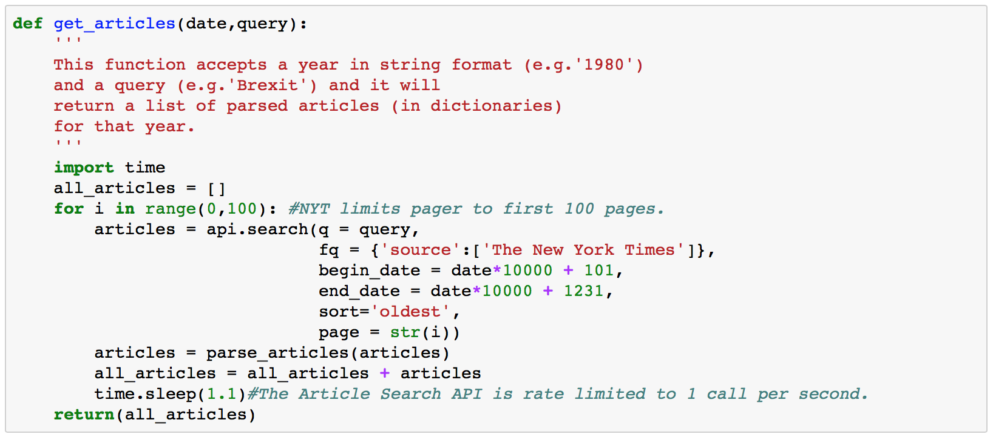
Data Collection
Demo

Slide 11
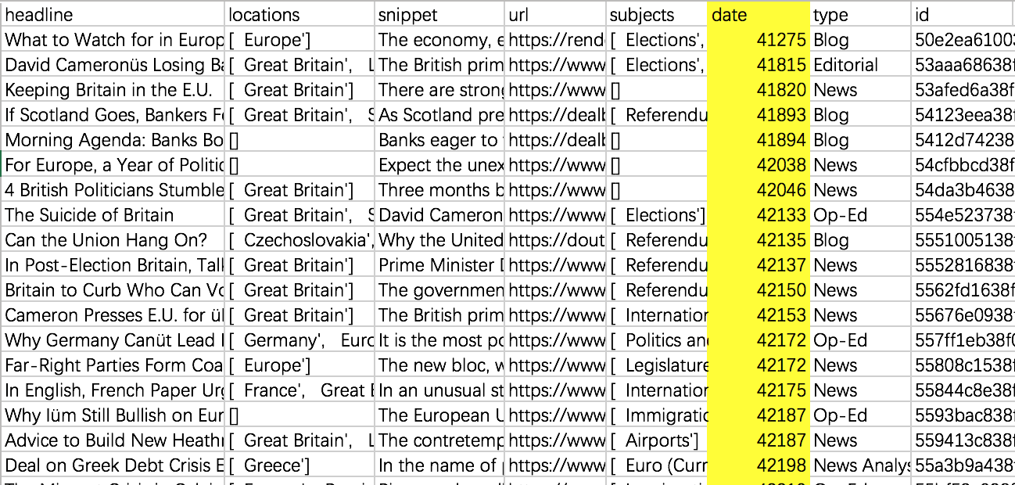
Data cleaning
Date

Slide 12
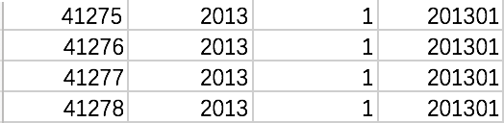
Data cleaning
Date
In the Excel, 1900-01-01 in date format equals to 1 in number format; 2013-01-01 in date format equals to 41275 in number format.
According to this rule, we make a new table.
And use Table.join() function to convert number to date format.

Slide 13
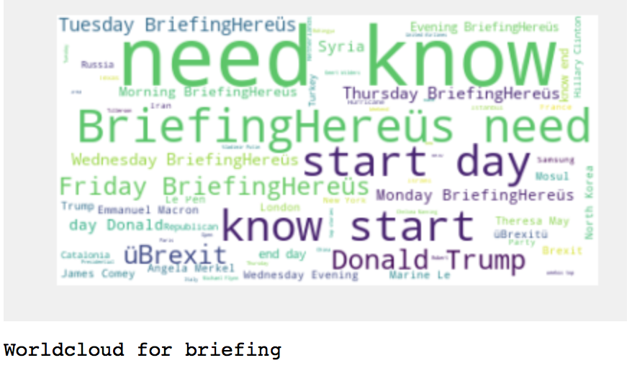
Data cleaning
Type (briefing)

Slide 14
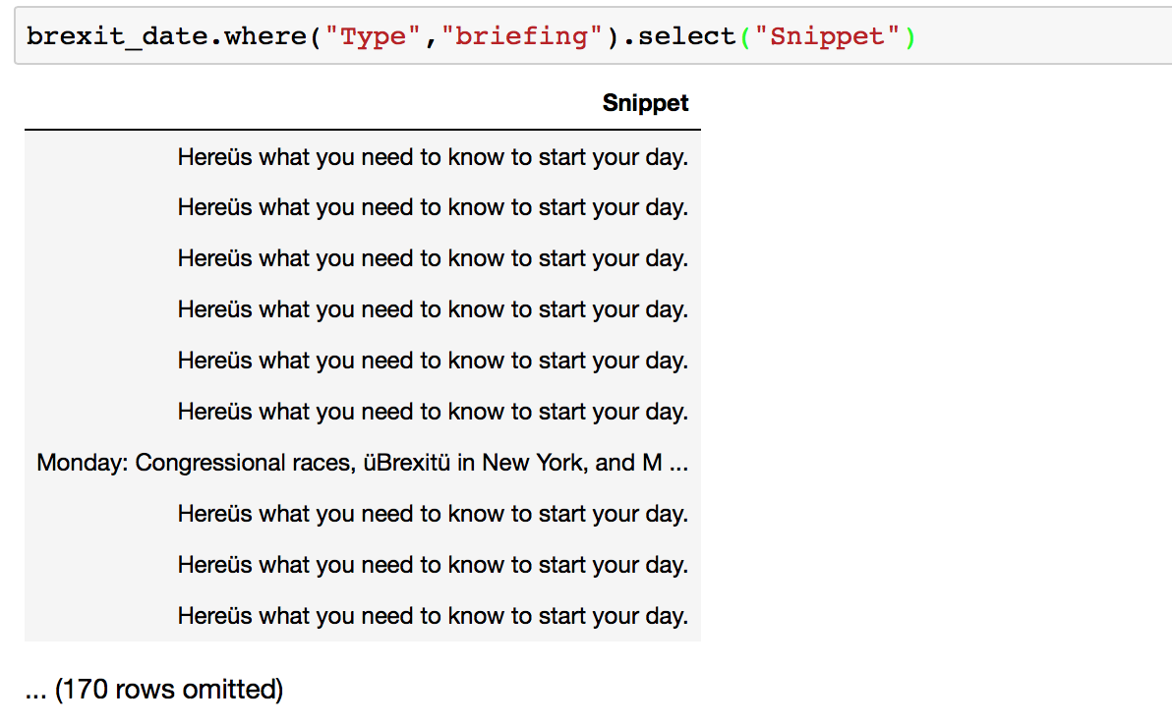
Data cleaning
Type (briefing)

Slide 15
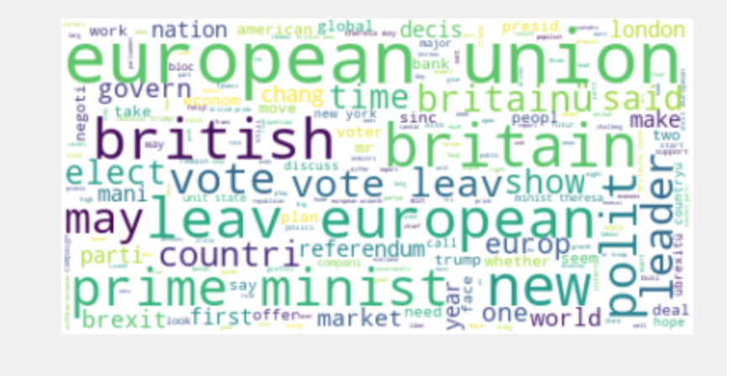
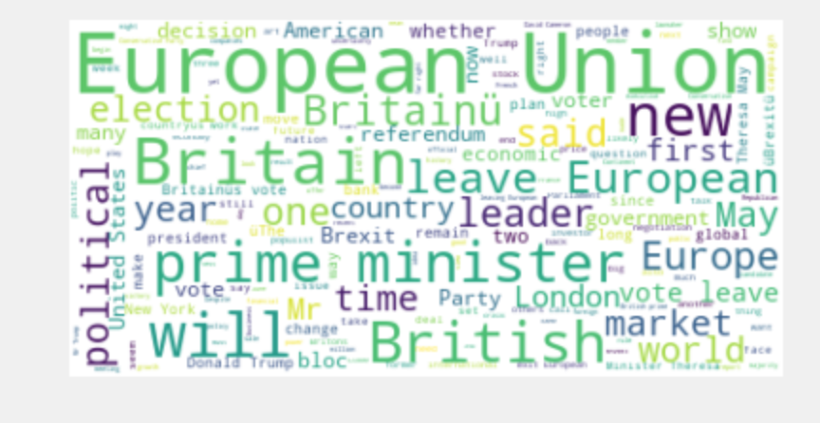
Data cleaning
Tokenization, Removing Punctuation & Stopwords, and Stemming
After Before

Slide 16
Data visualization
Tools: Python, Tableau
Topics:
Trend and Date (Python and Tableau)
Most common words in NY Time (Python, WordCloud)
The Prediction of opinion NY Times held toward Brexit (Python, WorldCloud)
Difference between different type of article (Python, WorldCloud)

Slide 17
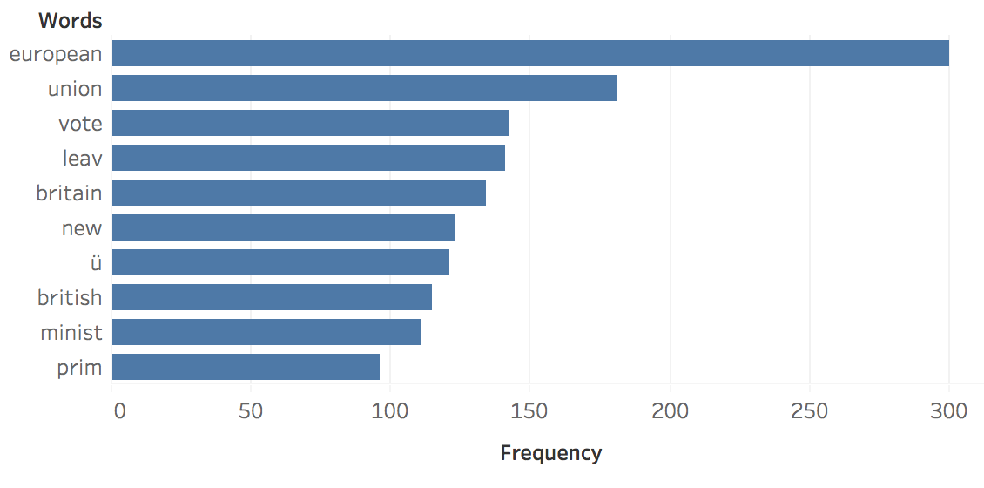
Data visualisation

Slide 18
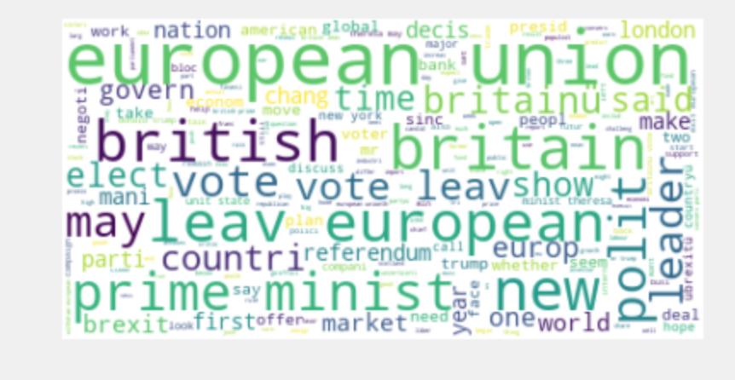
Data Visualization
Most Common Words

Slide 19
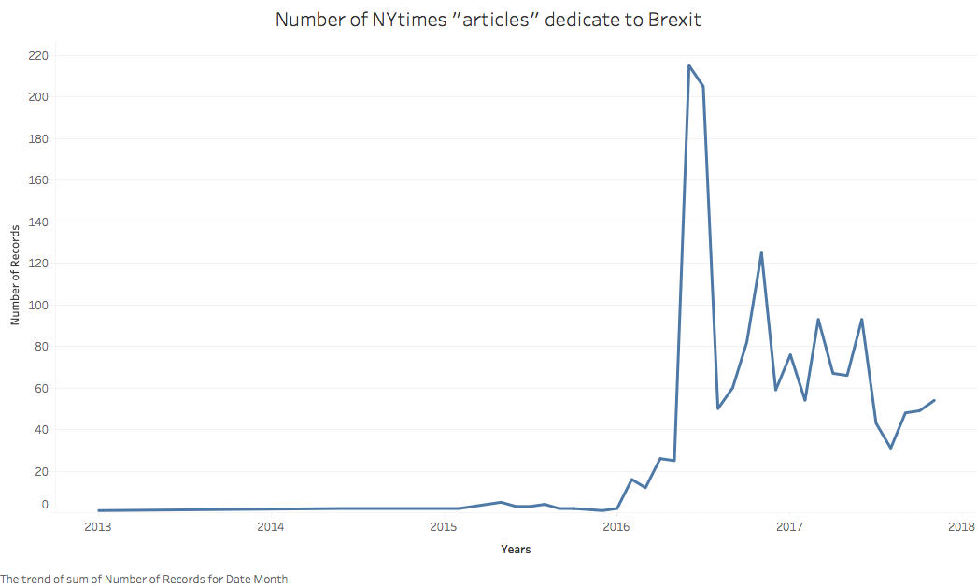
Data Visualization
Trend and Date

Slide 20
Brexit Vote began
Brexit vote needs to go through parliament
3/29 - final submission to leaving EU
Date for Brexit referendum finalized
Cameron first mentioned the possibility of Brexit
Brexit vote pushed early on agenda
Parliament gives permission for Brexit
Brexit negotiations begin

Slide 21
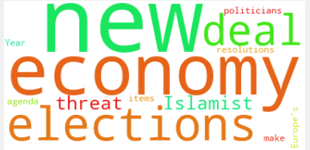
Data Visualization
2013

Slide 22
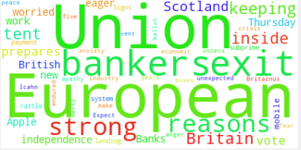
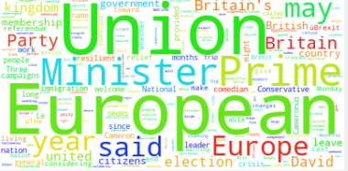
Data Visualization
2014
2015

Slide 23
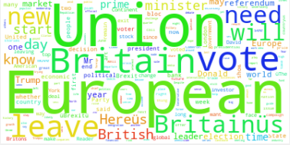
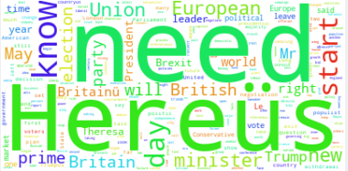
Data Visualization
2016
2017

Slide 24
Limits
Data cleaning is an iterative process
Brexit is a neologism and does not represent the beginning of the talk on UK leaving Europe
Stemming and Lemmatization are still work in progress
Limited amount of times of usage
Most APIs call rate limited to 1,000 calls per day, and 5 calls per second. The Article Search API is rate limited to 1,000 calls per day, and 1 call per second.
Focus on a larger amount of data will have result in a more accurate result.

Slide 25
Results
The articles highlight the main concerns around the time of Brexit
We can see words such as Bankers, Leave, Start, Need , Europe and Britain a lot
The main thematics are not static and evolve through time

Slide 26
Difficulties
Struggle with data gathering
Date conversion (different format)
Miscommunication in our process to seek help

Slide 27
How to improve?
Better communication in terms of seeking help
Determining a wider range of sources to collect from
We need more practice on gathering data

Slide 28
Work citation
Celli, F., Stepanov, E., Poesio, M., & Riccardi, G. (2016). Predicting Brexit: Classifying agreement is better than sentiment and pollsters. In Proceedings of the Workshop on Computational Modeling of People's Opinions, Personality, and Emotions in Social Media (PEOPLES) (pp. 110-118).
Prismoji. (2016, June 30). Https://prismoji.com/2016/07/01/brexit-emojis/. Retrieved November 30, 2017, from https://prismoji.com/2016/07/01/brexit-emojis/
New York Times (n.d.). The New York Times Developer Network. Retrieved November 24, 2017, from http://developer.nytimes.com/
Financial Trading (2017, March 31). Brexit: Trading Opportunities. Retrieved December 01, 2017, from http://www.financialtrading.com/brexit-trading-opportunities/
Seaton, J. (2016). Brexit and the media. The Political Quarterly, 87(3), 333-337.
The Guardian (2016, April 22). Barack Obama: Brexit would put UK 'back of the queue' for trade talks . Retrieved December 01, 2017, from https://www.theguardian.com/politics/2016/apr/22/barack-obama-brexit-uk-back-of-queue-for-trade-talks
The Guardian. (2017, January 16). Donald Trump's first UK post-election interview: Brexit a 'great thing' . Retrieved from https://www.theguardian.com/us-news/2017/jan/15/trumps-first-uk-post-election-interview-brexit-a-great-thing

