Slide 1
컴퓨터 시스템 기초설계
11조
2010136143 황 동현
2013136040 박 순영

Slide 2
Purpose
기존의 CCTV의 정적인 움직임을 탈피하는 동적인 움직임 구현
CCTV의 Dead zone을 최소화
전원, 네트워크 문제시에도 신뢰성 유지
감시 담당 인력 최소화
Cost down

Slide 3
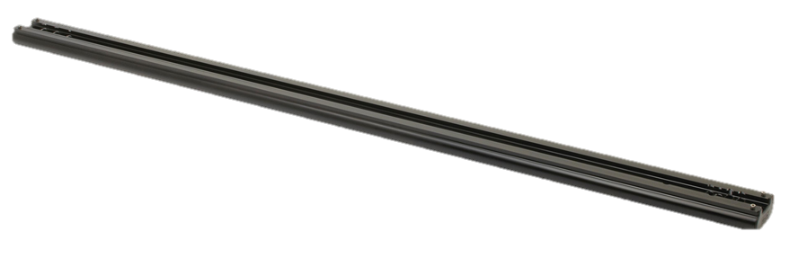

Idea
동적인 움직임을 위한 Rail System 채용
레일 위를 움직이게 함으로 사각지대를 예방

Slide 4

Idea
기존의 정적인 PTZ CCTV의 제한된 탐지 범위를 확대가능
적은 CCTV로 넓은 영역을 커버 가능

Slide 5
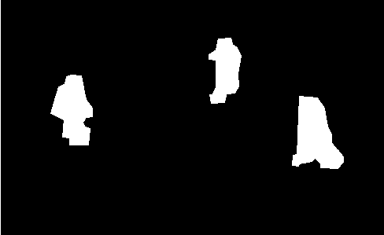
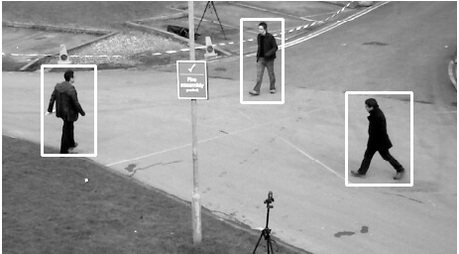
Idea
차영상을 이용하여 움직이는 물체 탐지 및 추적
스스로 적의 움직임을 탐색 및 운용병사의 수동조작 감소
IR 카메라를 통해 야간 감시 가능

Slide 6
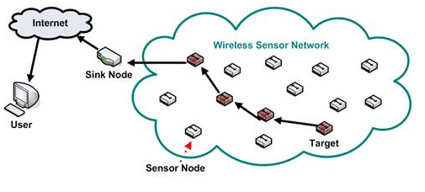
Idea
LTE 등의 일반 통신망 마비 시 -이상상황 미 발생 시 : Delay-Tolerant Network -이상상황 발생 시 : Wireless Sensor Network를 통한 이상상황 보고
Radio Interference Area

Slide 7

System Function
Motor Control (Scheduled, Manual)
Image Process (Finding Moving object)
& Transfer
Reliable Data Transfer
Urgent Signal Transfer
Video Playback

Slide 8
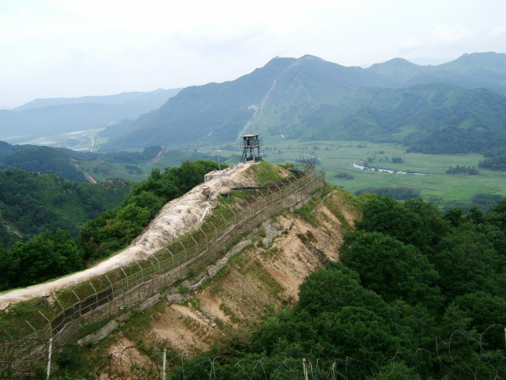



Wireless Sensor Network
(not data, only signal)
Radio Interference Area
Main Server
Rail system
video and signal data
Client

Slide 9
System Block Diagram
SERVER
Video Streaming
Status Signal Transfer
Manual Control Signal Transfer
Data Save
Other node’s Status Signal
Processed Video Data(Live, Saved)
Status Signal(Oneself, others)
CCTV NODE
Image Capture, Processing (Moving Object Tracking)
Data Transfer
Motor Control
Manual Control Signal
Video Stream
(Live, Saved)
Status Signal
Manual
Control Signal
Request Saved
Video Data
CLIENT
Video Play
Sound Alarm (if signal be received)
Manual Control
Own node’s Status Signal

Slide 10
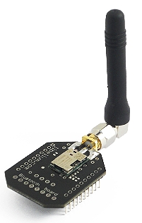
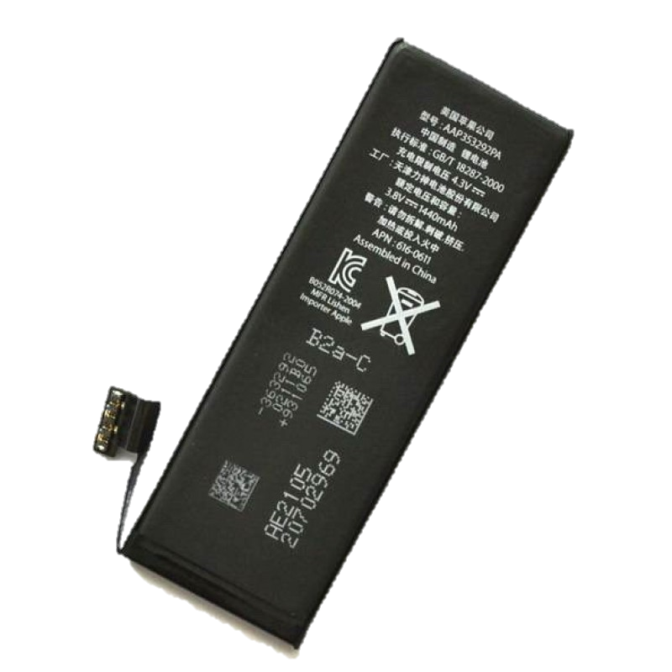

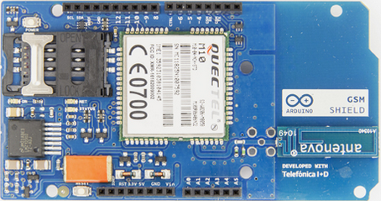
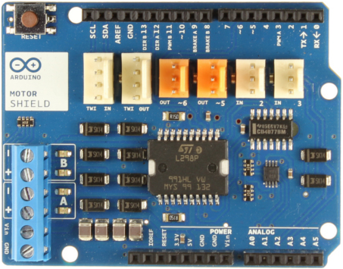
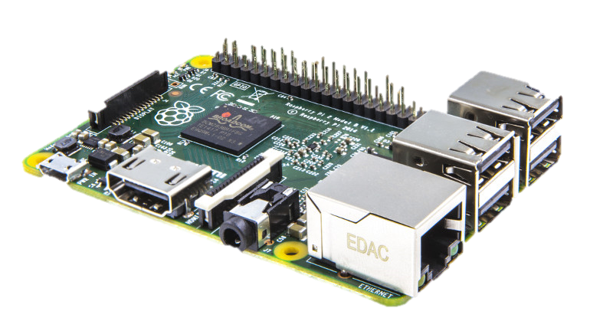
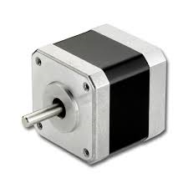
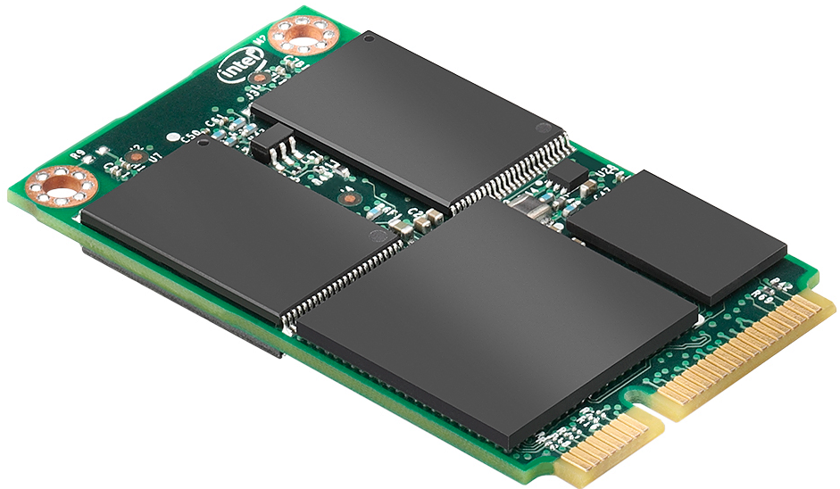
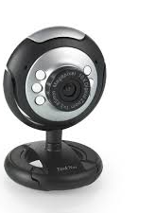
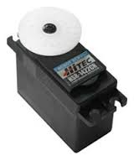
CCTV Node Model
power
network
step motor
PWM circuit
microprocessor
storage
servo motor
camera
IR LED

Slide 11
CCTV NODE Function, I/O
Function
CCTV NODE
Image Capture, Processing (Moving Object Tracking)
Data Transfer
Motor Control
Input
Output
Other node’s Status Signal
Processed Video Data(Live, Saved)
Status Signal(Oneself, others)
Manual Control Signal

Slide 12
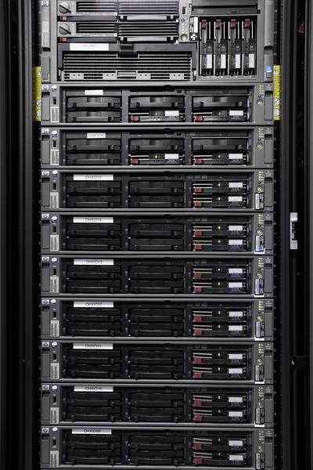
Server Model
Blade Server
Linux or Windows Server OS Based (Windows’s Streaming performance is better than Linux)

Slide 13
Server Function, I/O
Function
SERVER
Video Streaming
Status Signal Transfer
Manual Control Signal Transfer
Data Save
Input
Output
Processed Video Data(Live, Saved)
Status Signal(Oneself, others)
Request Saved Video Data
Video Stream (Live, Saved)
Status Signal
Manual Control Signal

Slide 14

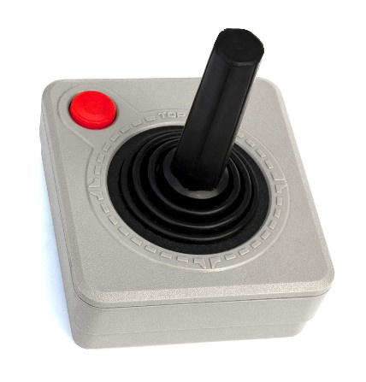
Client Model
Standard PC
Windows Operating System
Include Special Input Device

Slide 15
Client Function, I/O
Function
Input
CLIENT
Video Play
Sound Alarm (if signal be received)
Manual Control
Output
Video Stream (Live, Saved)
Status Signal
Manual Control Signal
Request Saved Video Data

Slide 16
Motor Control
CCTV NODE
SERVER
Client
Manual Control Signal
Manual Control Signal
Data Transfer Module
Manual Control
Signal Transfer
Manual Control
Scheduled
Signal
Manual Control Signal
Step Motor Control Signal
Motor Control Module
Step Motor
Servo Motor PWM Signal
Servo Motor

Slide 17


Image Process & Transfer
Data
Base
CCTV NODE
Source Image
Image Capture & Processing
Processed Video Data
Status Signal
SERVER
Video,
Status
Processed Video
Status Signal
Data Save
Data Transfer
Module
Video
Streaming
Status
Signal Transfer
Video Stream
Status Signal
Video Play
Sound
Alarm
CLIENT

Slide 18
Reliable Data Transfer
CCTV NODE
Data
Base
Source Image
Image Capture & Processing
Processed Video
Status Signal
SERVER
Video,
Status
Internal
Storage
Data Save
Processed Video Data(Live, Saved)
Status Signal
Video
Streaming
Status
Signal Transfer
Processed Video
Status Signal
Video Stream
Status Signal
(If network condition
recovered)
Data Transfer
Module
Video Play
Sound
Alarm
CLIENT

Slide 19
Urgent Signal Transfer
Out of Main Network Area
CCTV NODE
Source Image
Image Capture & Processing
Processed Video
Status Signal
SERVER
Status Signal
If object detected
Data Save
Internal
Storage
Video
Streaming
Status
Signal Transfer
Data Transfer
Module
Status Signal
Status Signal
Status Signal
Other CCTV NODE
Video Play
Sound
Alarm
Data Transfer
Module
CLIENT

Slide 20
Video Playback
Data
Base
SERVER
Saved Video, Status
Data Save
Video
Streaming
Status
Signal Transfer
Request
Saved Video
Stream
Saved
Video Stream
Video Play
Sound
Alarm
CLIENT

Slide 21
Thank You!

