Slide 1
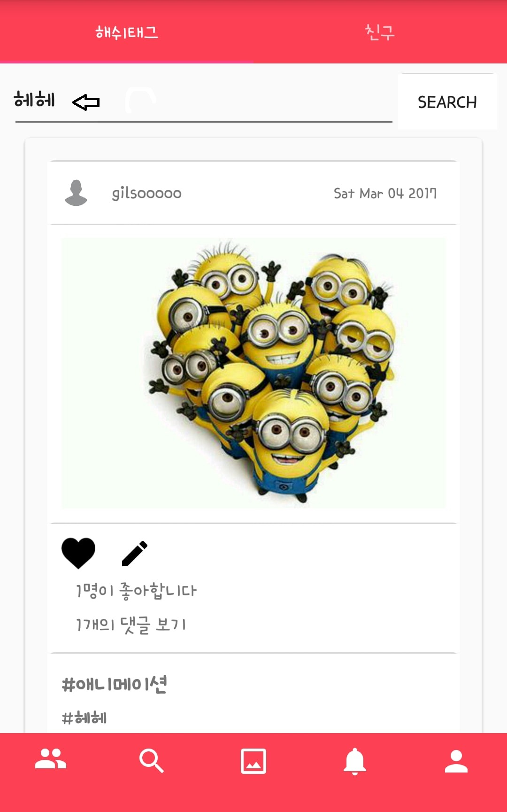
Searched!!
Searched!!

