Slide 1
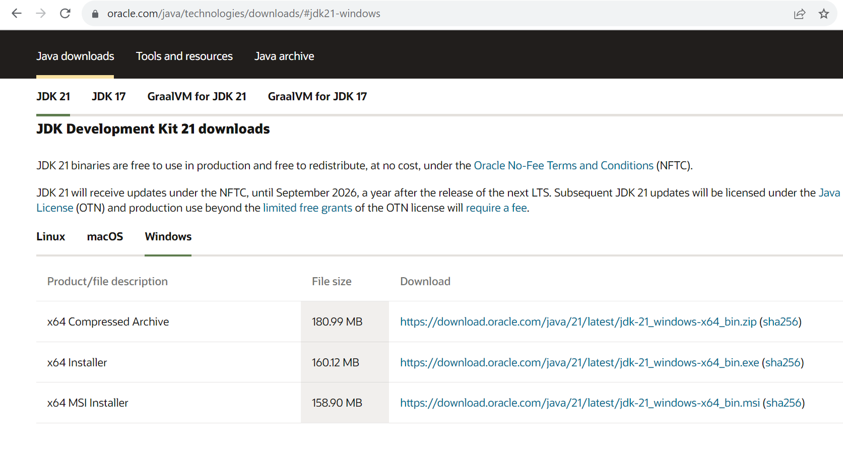
1) Install JDK
https://www.oracle.com/java/technologies/downloads/

Slide 2
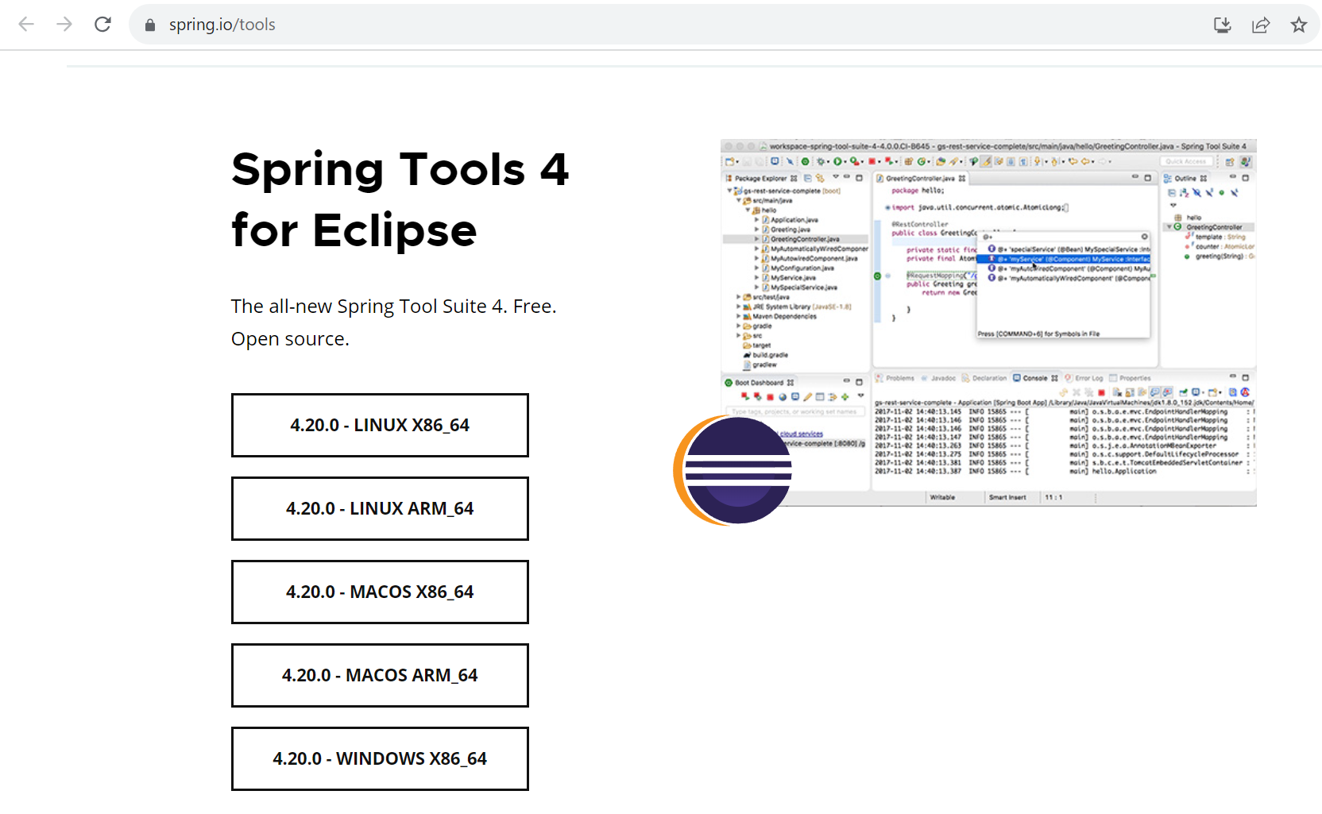
2) Install STS(SpringTools 4)
https://spring.io/tools

Slide 3
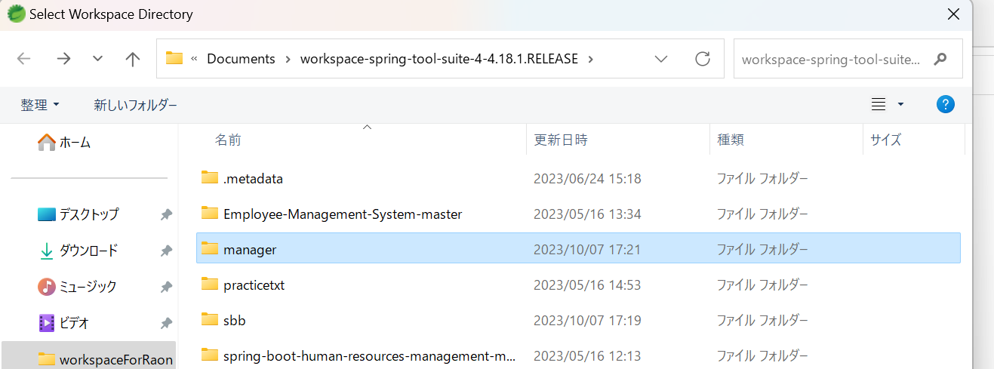
4) ImportProject
ワークスペース内にプロジェクトフォルダが正確に位置する必要

Slide 4
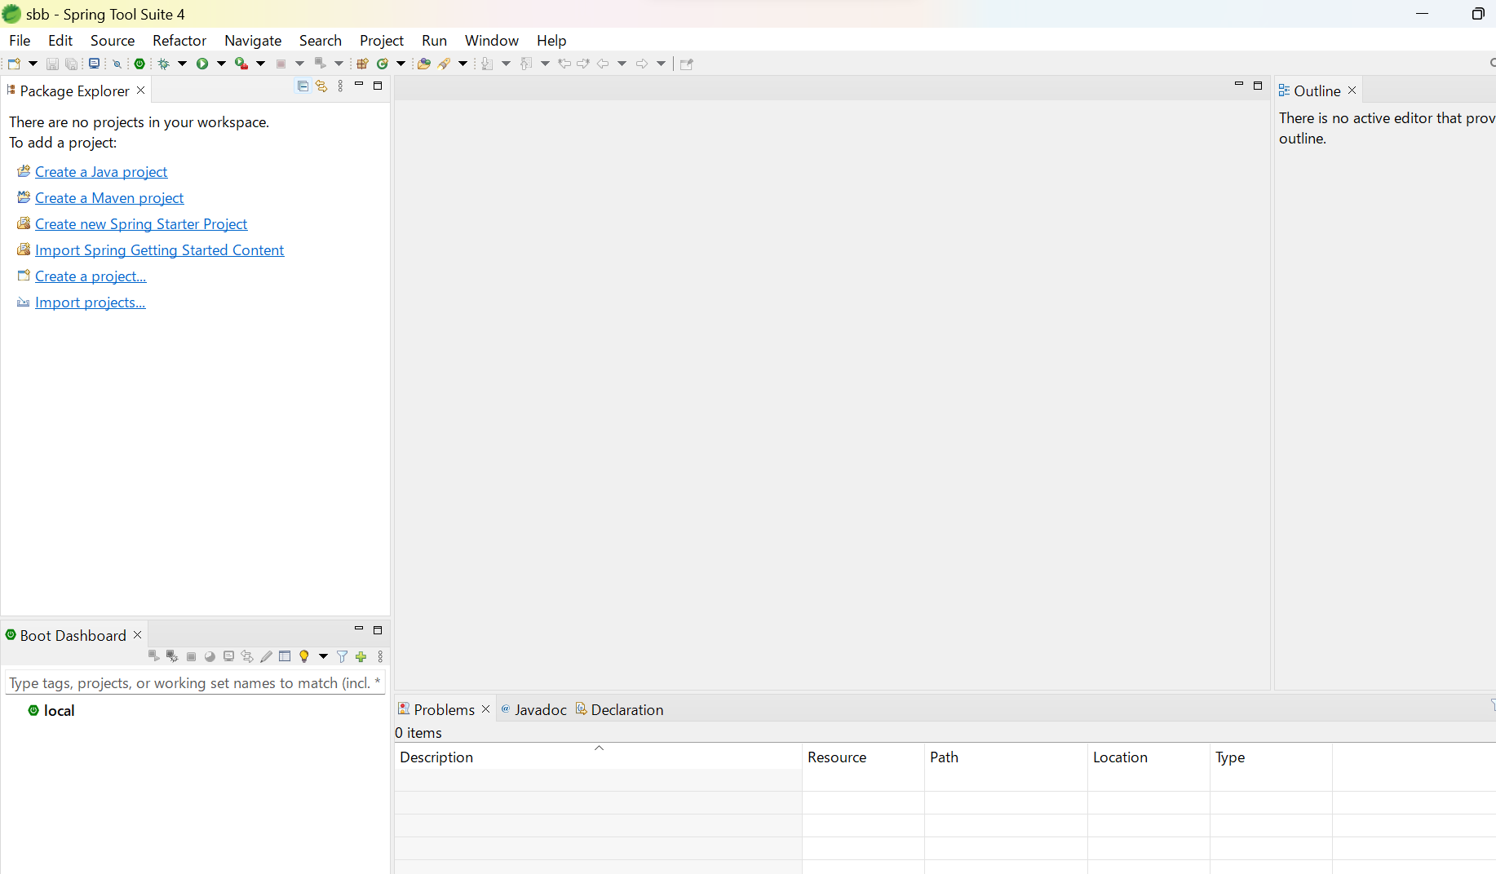
4) ImportProject
Improt Project Gradle > Exist Gradle Project

Slide 5
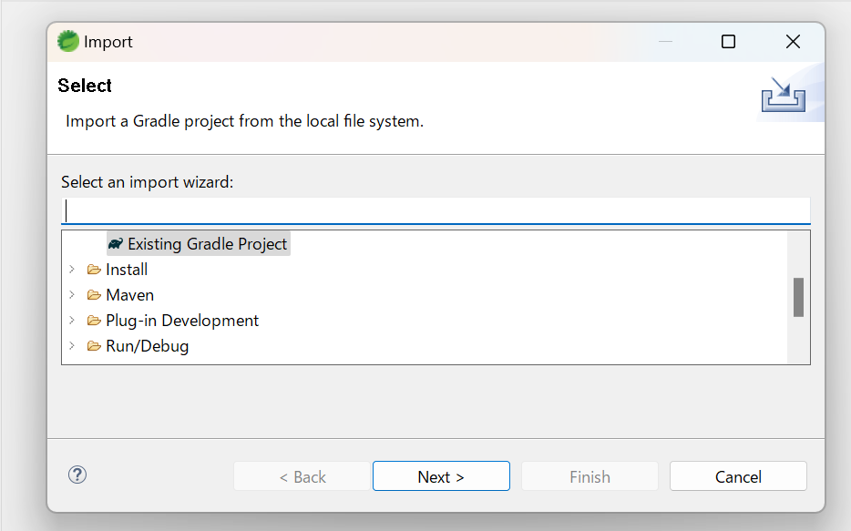
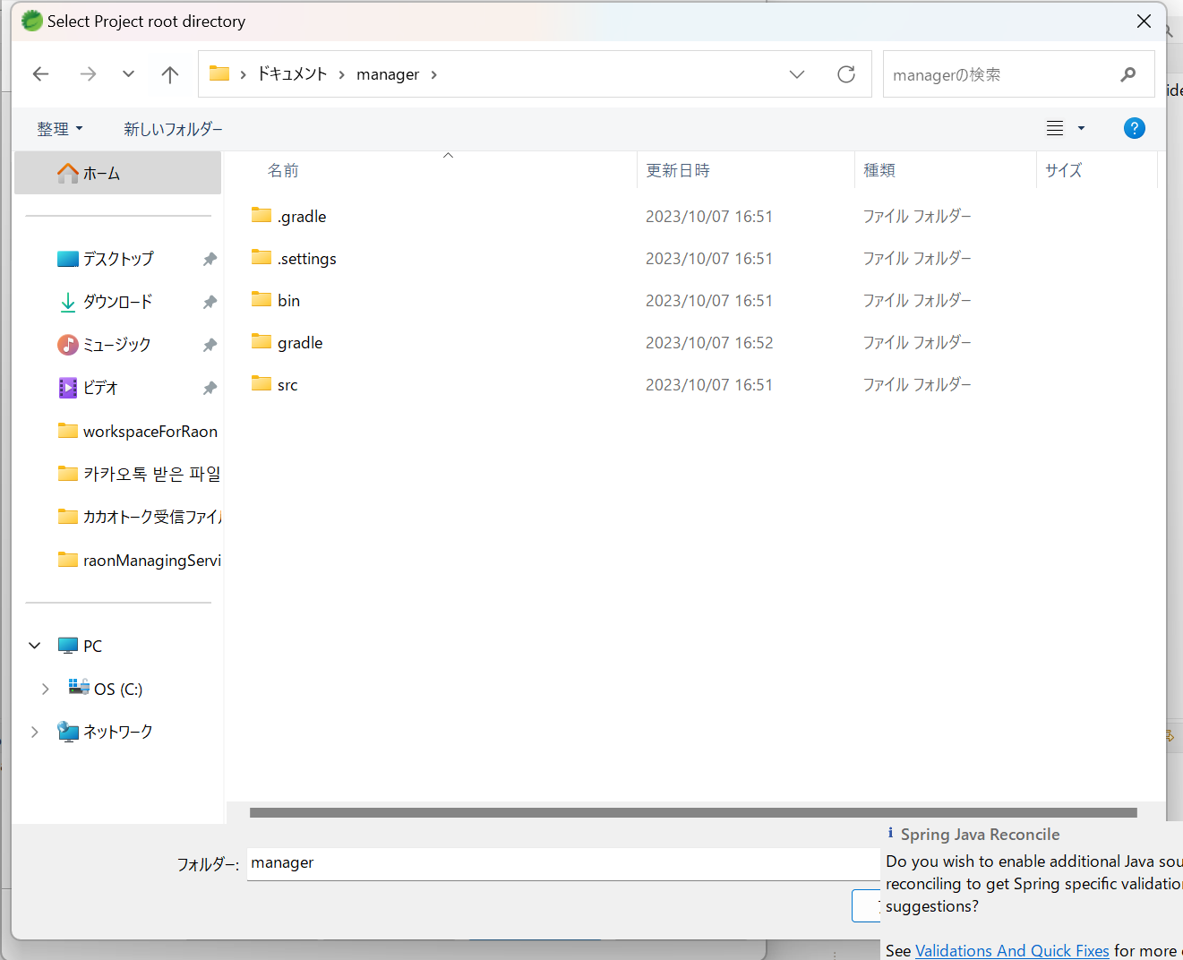
4) ImportProject
Improt Project Gradle > Exist Gradle Project

Slide 6
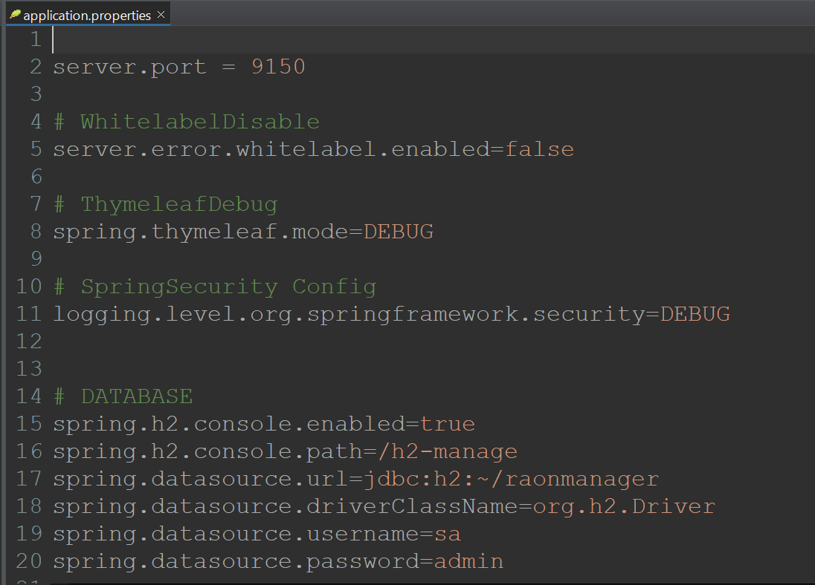
How to Run Project
localhost:9150
localhost:9150/h2-manage ID : sa
PW : admin

Slide 7
