Slide 1




RAON
RAONManager
Ver1.0

Slide 2


How To Install

Slide 3
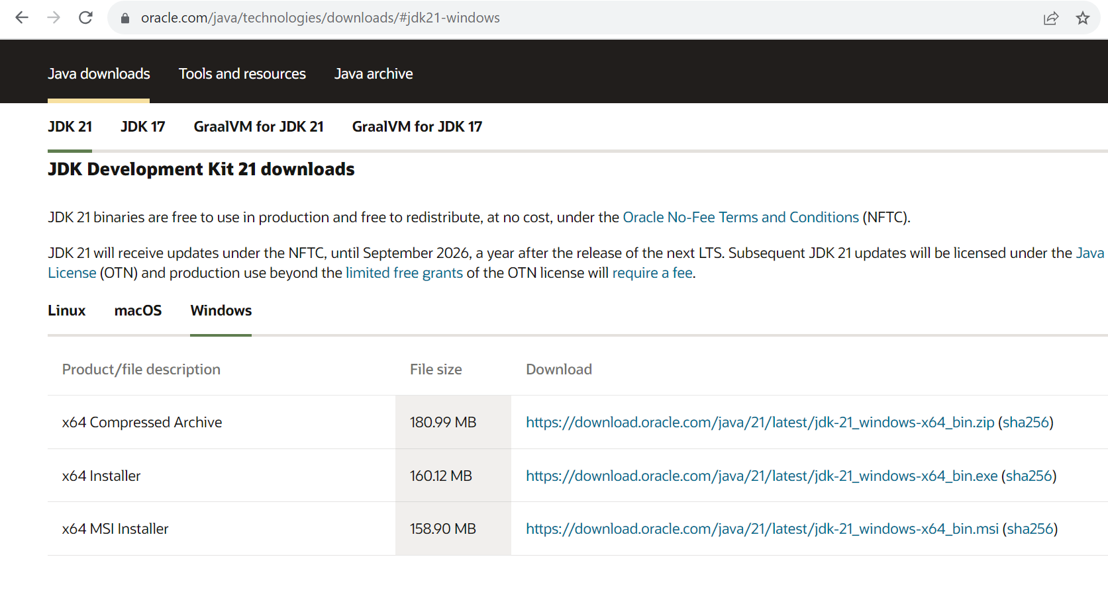
1) Install JDK
https://www.oracle.com/java/technologies/downloads/

Slide 4
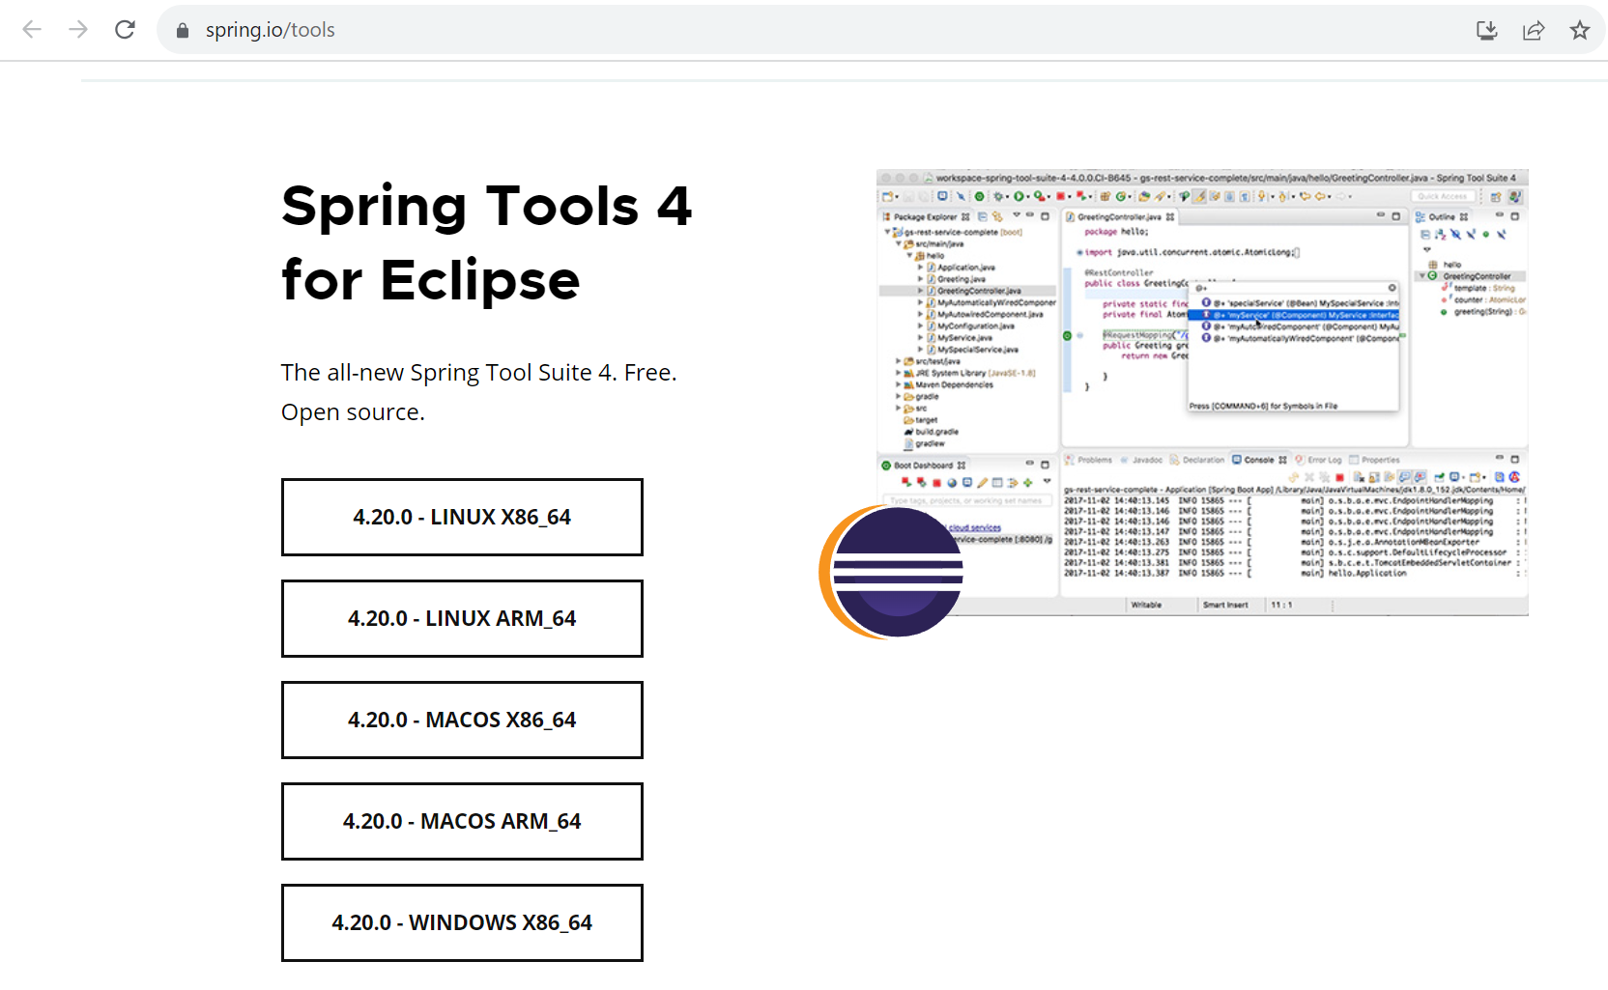
2) Install STS(SpringTools 4)
https://spring.io/tools

Slide 5
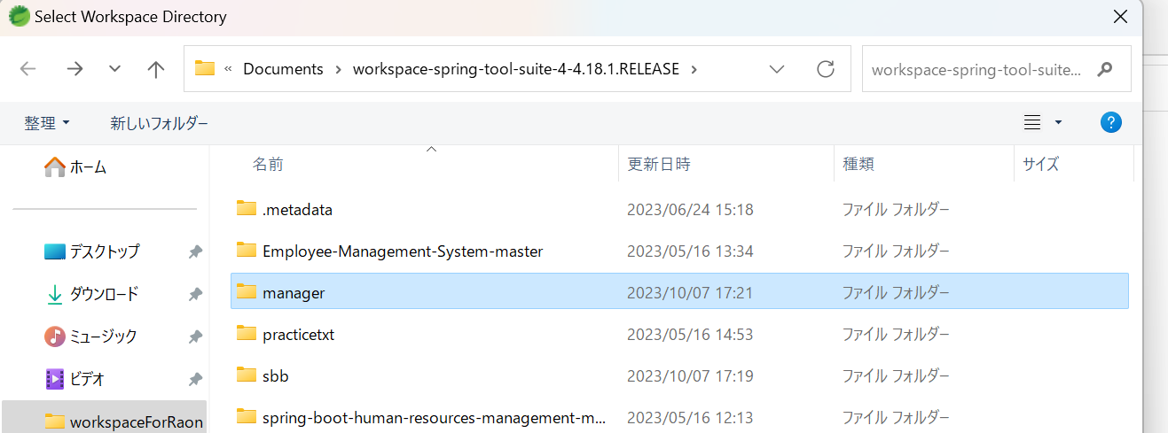
3) ImportProject
Downloaded Files Have To Enter the Workspace

Slide 6
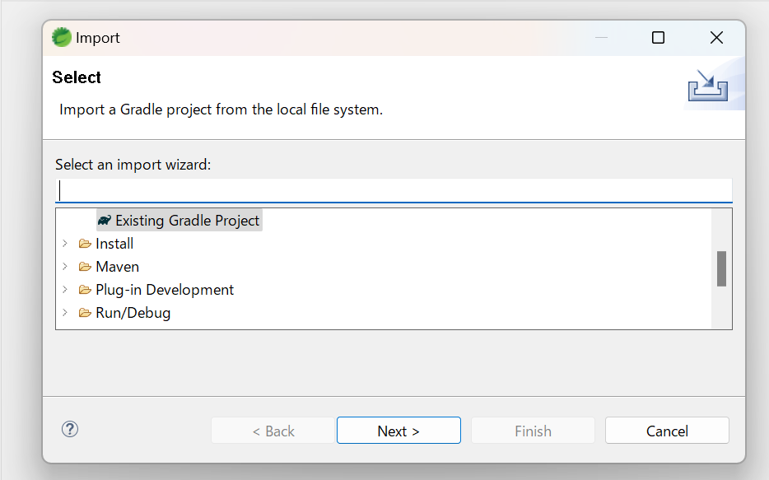
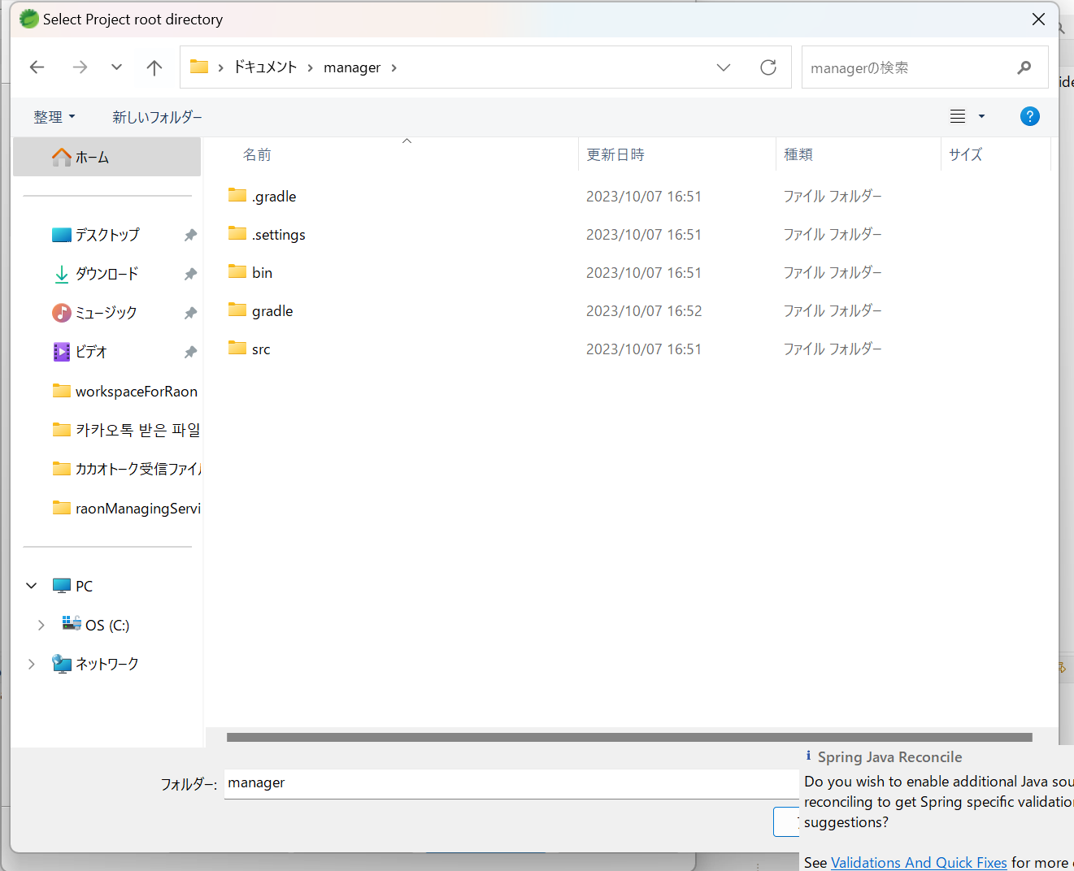
3) ImportProject
Improt Project Gradle -> Exist Gradle Project

Slide 7

How Run Project

Slide 8
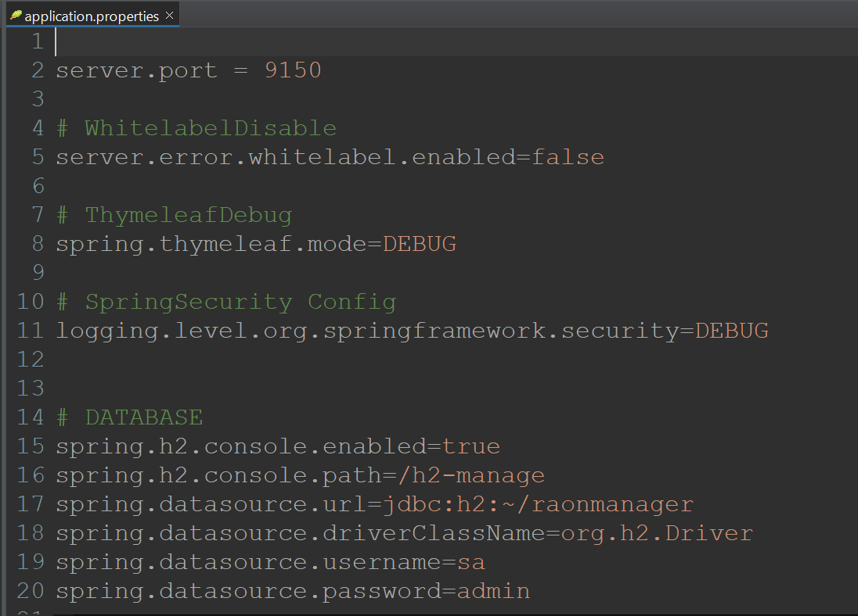
localhost:9150
localhost:9150/h2-manage ID : sa
PW : admin

Slide 9
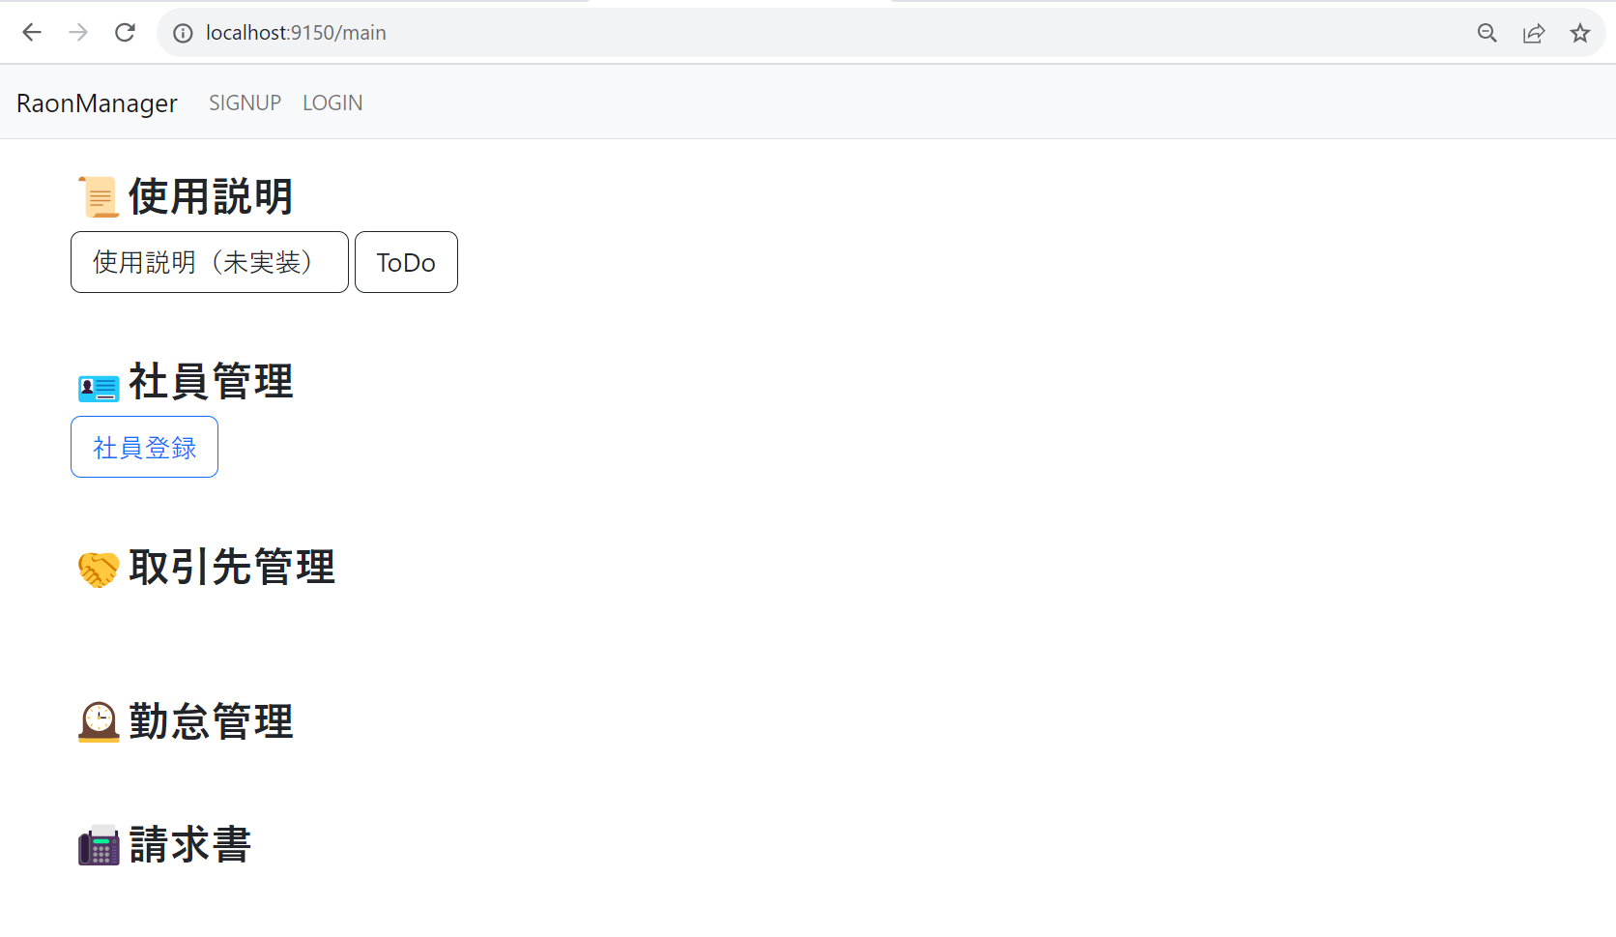

Slide 10
PW RESET
LOG IN
CUSTOMER
ENROLL
EMPLOYEE ENROLL
CUSTOMER
LIST
MAIN
EMPLOYEE
LIST
INVOICE
WRITE
ATTENDANCE
WRIITE
INVOICE
LIST
ATTENDANCE
LIST
SIGN IN

