Slide 1
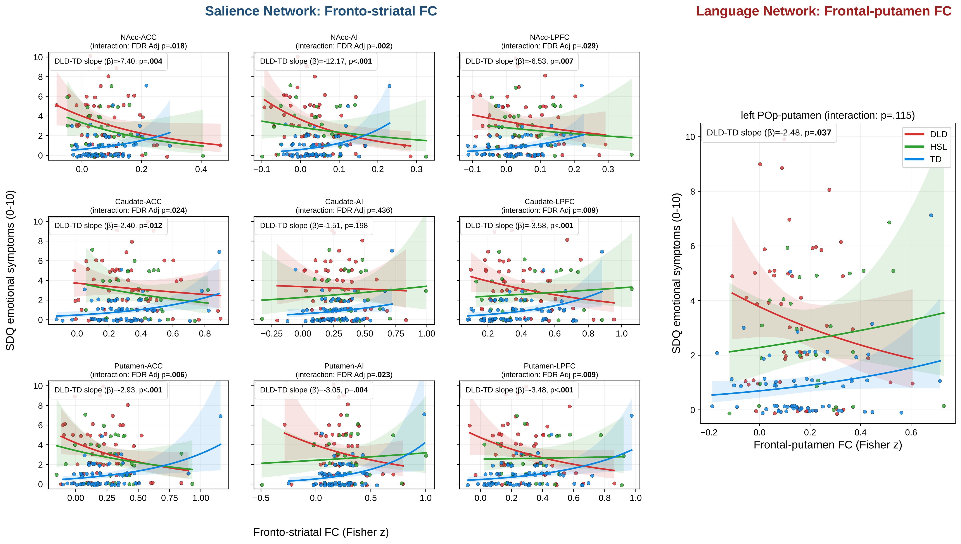
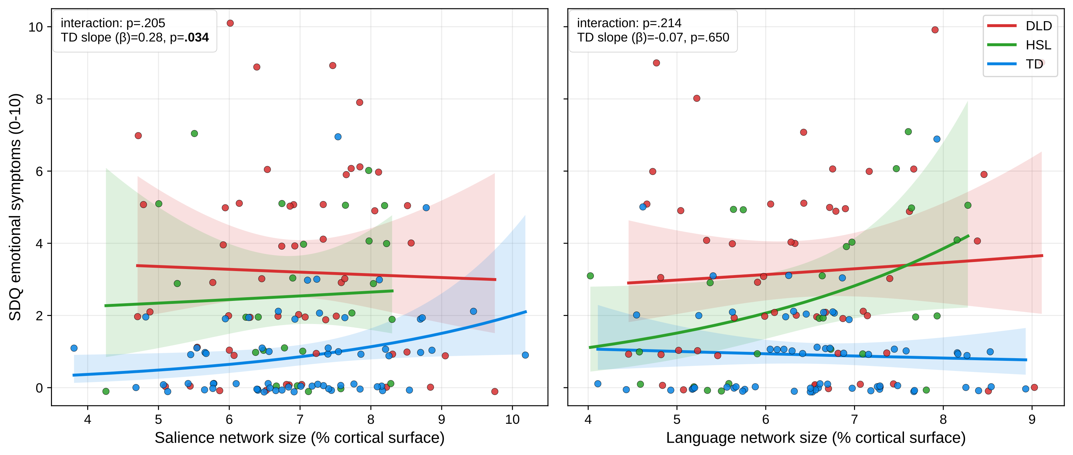
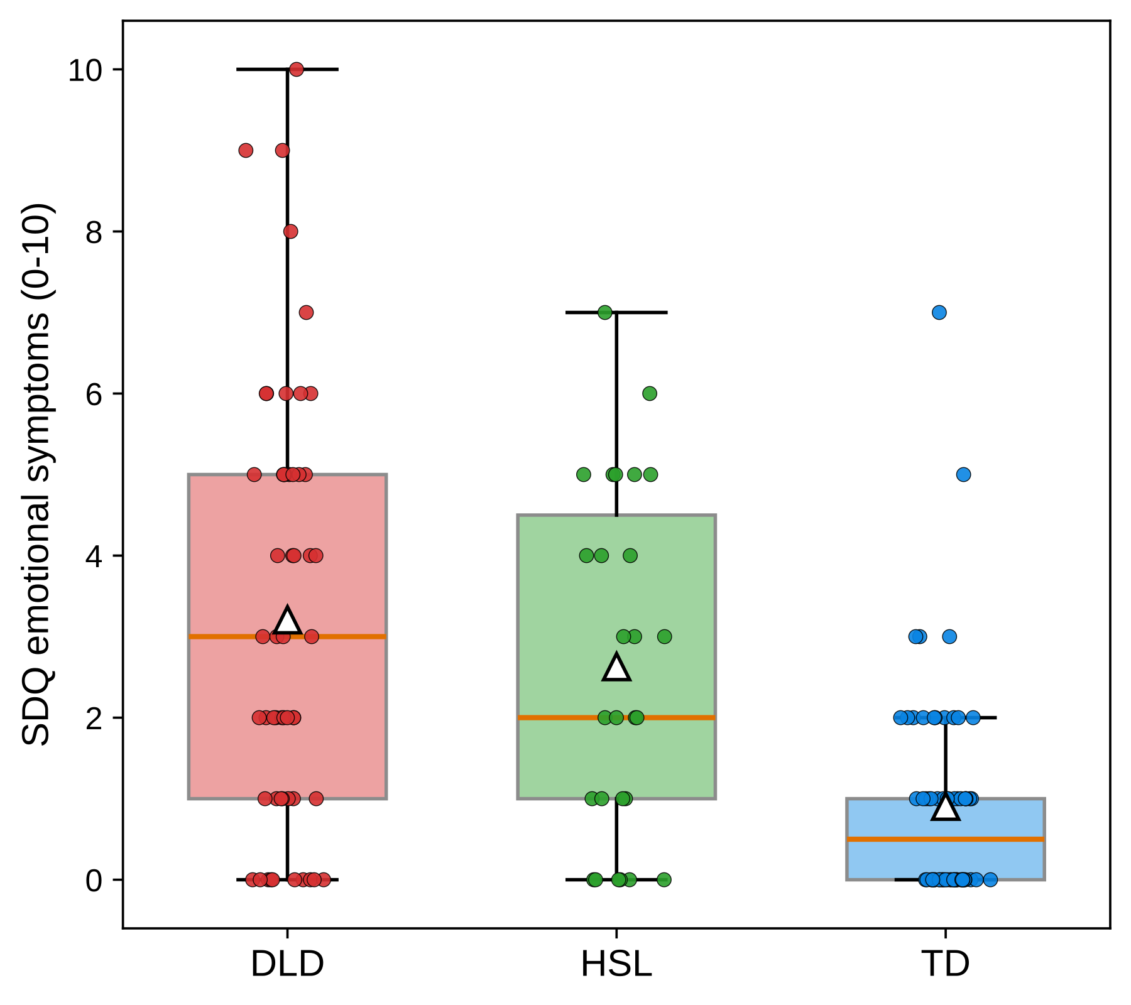
[Poster title] Person-specific salience and language-network connectivity and emotional symptoms in Developmental Language Disorder
[Author names]
[Affiliations · contact email]
Background & Aims
Methods
Developmental Language Disorder (DLD) carries a markedly elevated risk of emotional difficulties; the brain basis is unclear.
The salience network and a left fronto-striatal / language circuit are candidate substrates for mood regulation.
Aim: test whether person-specific network size and connectivity relate to SDQ emotional symptoms, and whether that coupling differs by group.
[Edit: add 1–2 references or a hypothesis statement here.]
Sample: n = 144 (DLD = 53, HSL = 27, TD = 64); icafix MS-HBM set n = 142.
Individualised cortical networks via MS-HBM; salience & language network size as % cortical surface.
Fronto-striatal FC (9 tiles) and a left pars-opercularis–putamen language edge (CAB-NP), Fisher-z.
Negative-binomial models of SDQ-emotional on group × predictor (TD reference); joint-interaction LR + Freedman–Lane permutation.
[Edit: scanner/sequence, preprocessing, exclusions.]
Results
Figure 2. FC → SDQ-emotional by group. Salience fronto-striatal grid (blue title) and the language frontal–putamen edge (red title); NB fits ± 95% CI.
Figure 3. SDQ-emotional vs salience / language network size (NB mean ± 95% CI).
Figure 1. SDQ-emotional by group.
Conclusions
[Key finding 1] Clinical groups show elevated emotional symptoms (large group main effects).
[Key finding 2] The FC → mood slope differs between DLD and TD for several fronto-striatal tiles and the language edge (interaction), though single-group slopes are mostly non-significant.
[Key finding 3 / take-home message — edit.]
References & Acknowledgements
[1] … [2] … [3] Gordon et al. 2021, Cereb Cortex. Funding / acknowledgements: […]. Contact: [email].

