Slide 1
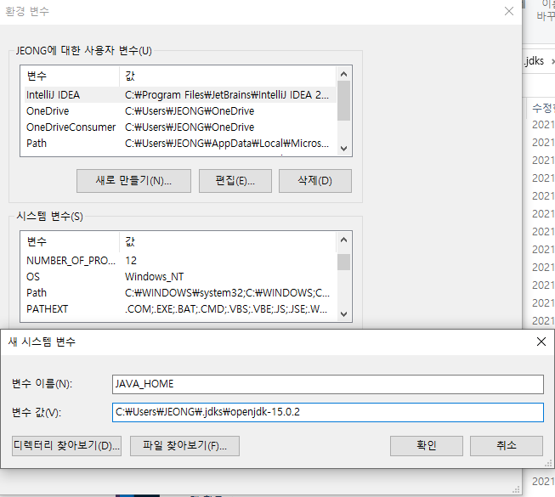

Slide 2


Slide 3
jdbc:h2:~/jpashop

Slide 4

