Slide 1
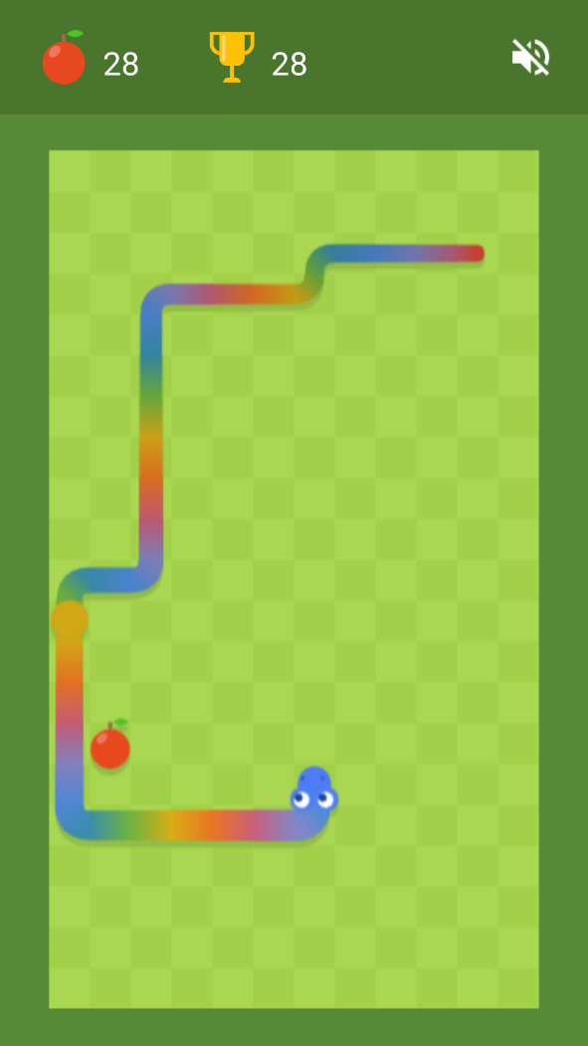
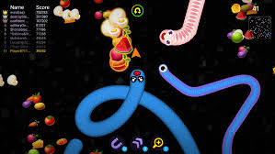
게임제작 Unity3D

Slide 2
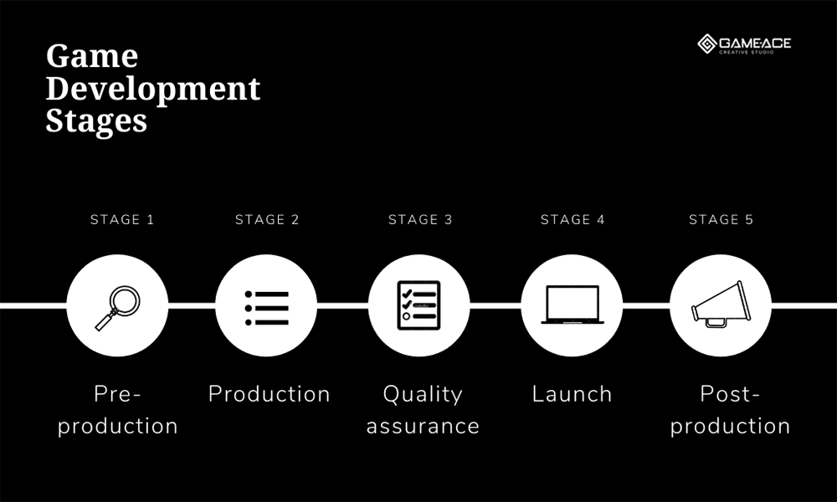
5 Key Game Development Stages
Game Development Stages
Notes:
Market and competitor analysis. It is necessary to determine what is now at peak popularity in the gaming industry and brings the most significant profit.
The target audience. It is important to determine who will be interested in your product to advance the game’s development according to their preferences.
Choosing a platform. The choice of a platform is usually based on the popularity of use, as well as the company’s coding capabilities.
Allocation of resources. It is necessary to establish the number of required specialists, equipment, as well as the video game development process timeline that will be required for the execution of a project.
Concept art. Concept artists design characters, environments, props, and other game assets.
Type of monetization. Make money from ads, in-game purchases, or sell a product at a fixed cost?
Risk analysis. It involves calculating all possible risks in advance and determining the methods of damage mitigation.
Marketing strategy. It is necessary to think about how to make the game appeal to as many users as possible.

Slide 3
Production
2단계 : 생산
여러 내부 단계로 나눠 개발 진행
Prototyping
Visual Content
Creation
Game Level Design
Development
Audio Design &
Voice Acting
Coding

Slide 4
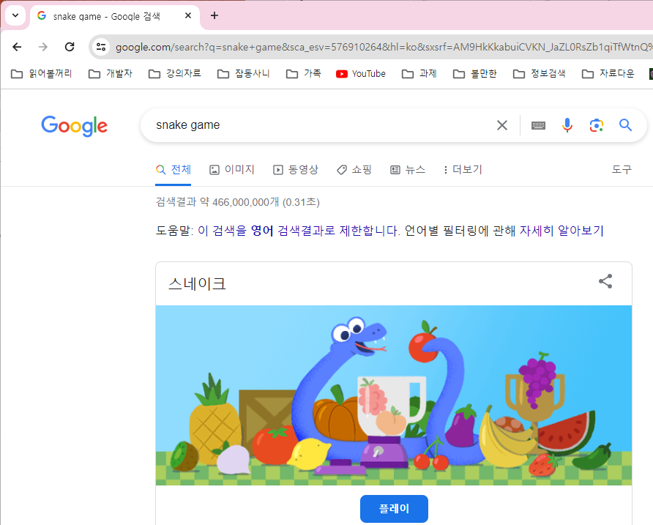
Google 검색

Slide 5
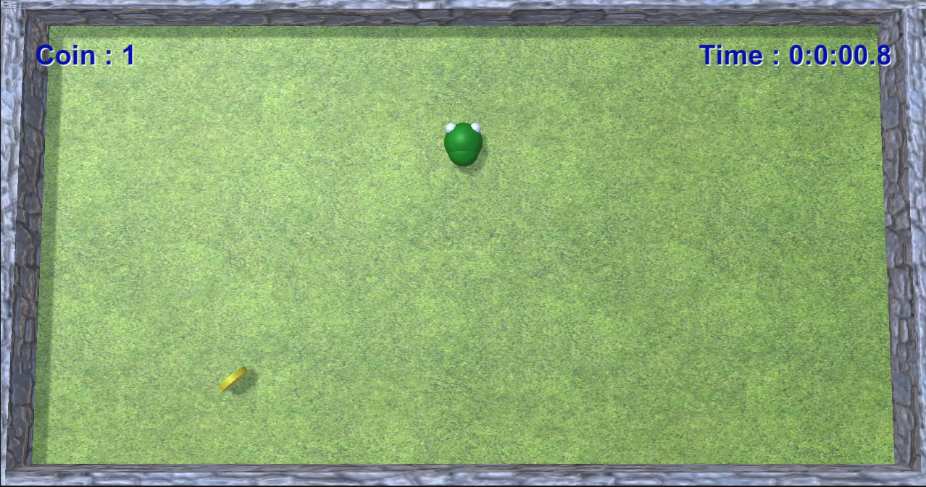
Snake game
A sub-genre of action video games where the player maneuvers the end of a growing line, often themed as a snake. The player must keep the snake from colliding with both other obstacles and itself, which gets harder as the snake lengthens.
게임방법
뱀이 움직임을 제어하면서 아이템을 획득
장애물 또는 플레이 오브젝트와 충돌하면 게임 오버
Click the image to start a game
https://www.google.com/fbx?fbx=snake_arcade

Slide 6
P.241
게임 요구사항
화면의 뱀은 일정한 속도로 이동하며, 플레이어는 뱀의 이동 방향만 제어할 수 있다
뱀이 화면의 동전을 획득하면 마디가 하나씩 추가된다
뱀의 마디는 3개 단위로 색이 반복된다
화면의 위에 획득한 동전의 수와 게임의 경과 시간을 표시한다
뱀이 좌우의 벽이나 자신의 몸통과 충돌하면 게임 오버
게임 오버가 되면, 다시 플레이할 것인지를 묻는 메시지와 선택 버튼을 표시한다
PC와 WebGL은 키보드로 조작하고, 모바일 단말기는 가상의 조이스틱을 만들어서 제어한다

Slide 7
Final Results

Slide 8
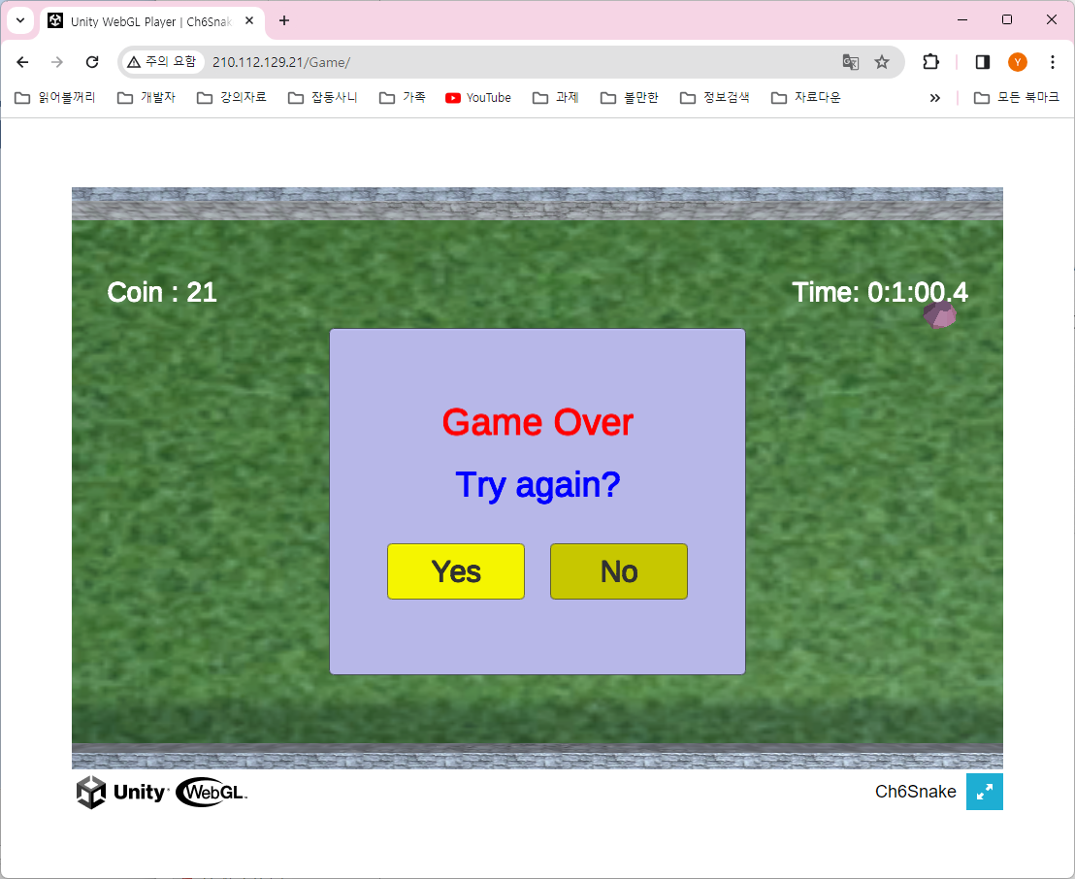

Slide 9
