Slide 1
Sentiment and Topic in the British Parliamentary Debates
Hani Warith

Slide 2
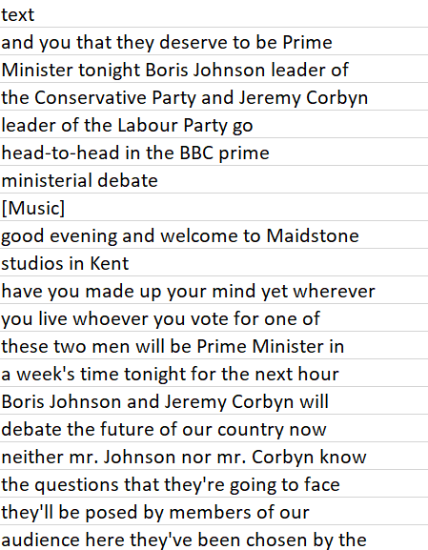
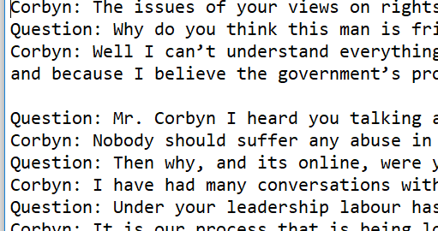
Original Data
Original Scraped Data
Plain text Transcript

Slide 3
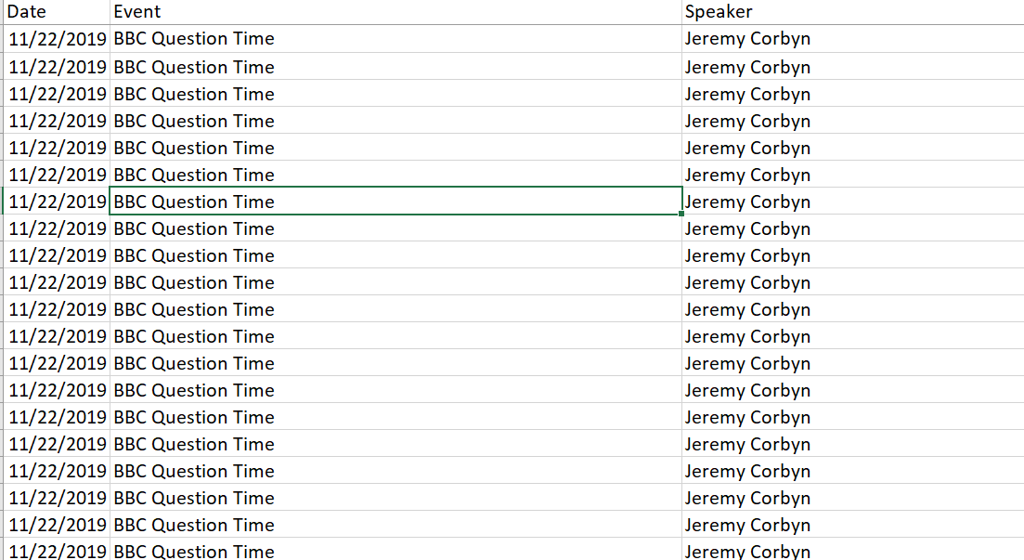
Final Spreadsheet

Slide 4
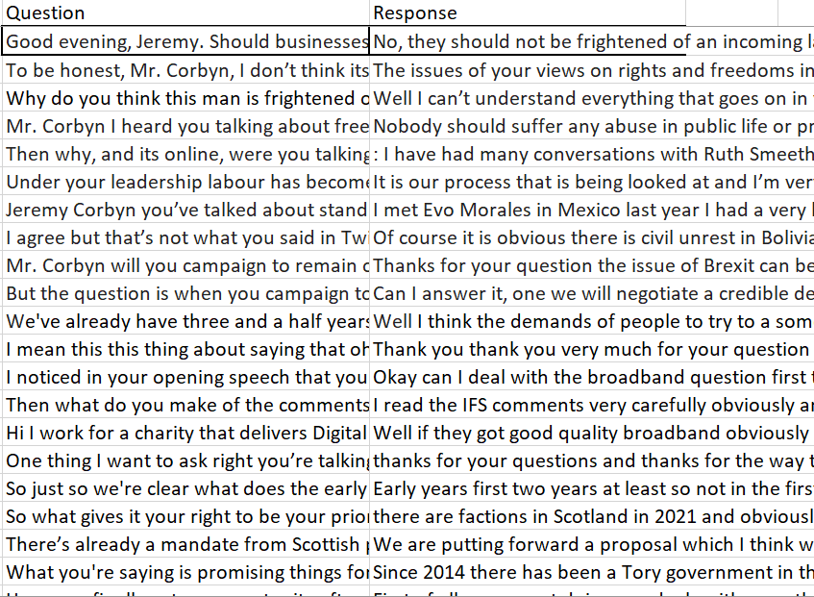
Final Spreadsheet

Slide 5
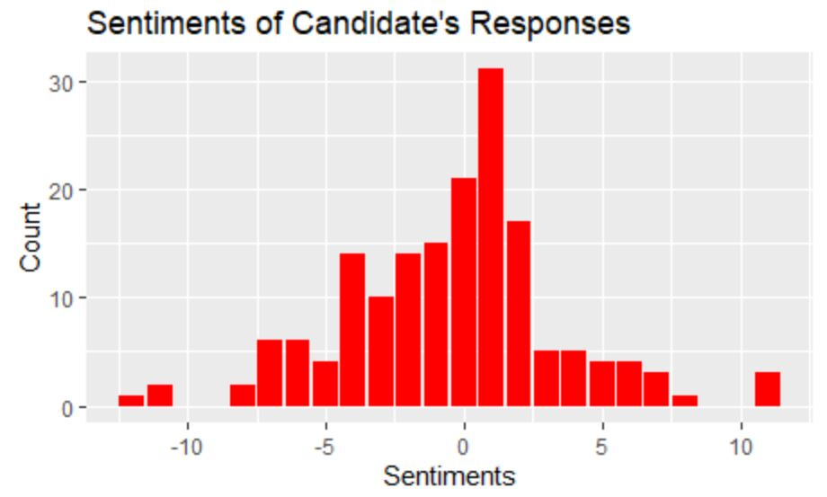
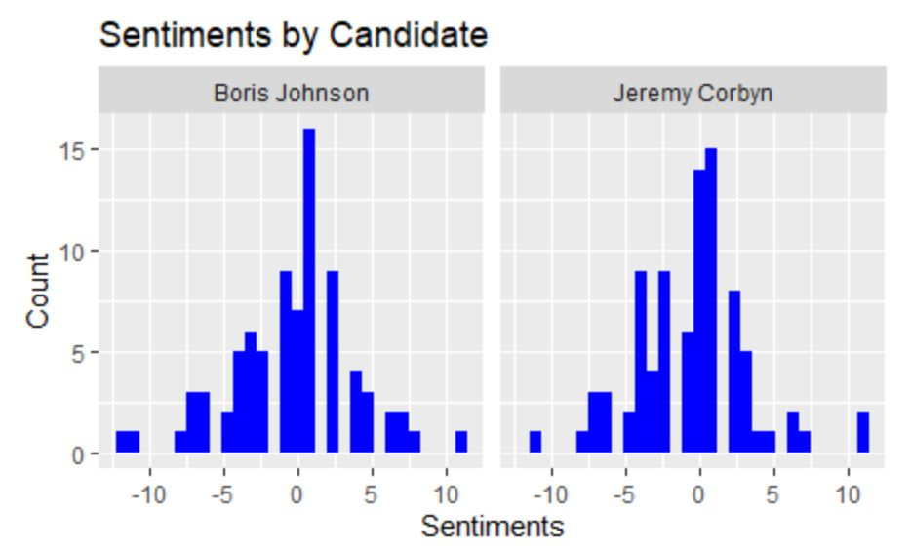
Sentiment Analysis

Slide 6
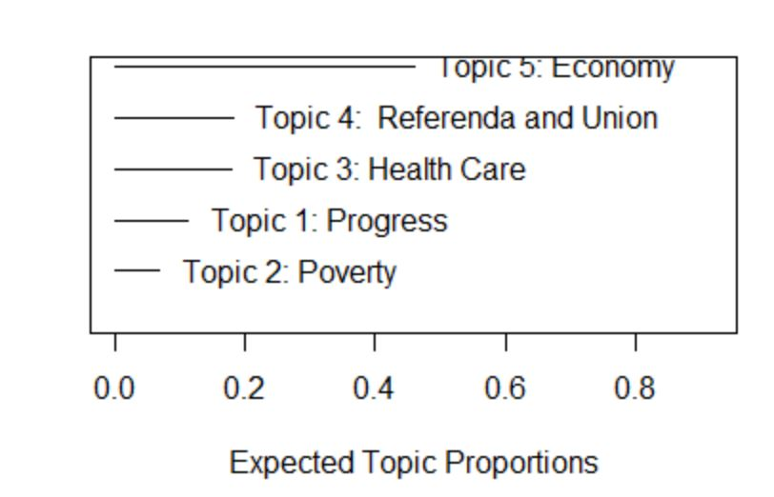
Topic Model

