Slide 1
Use and Testing of Pseudo-random Number Generators (PRNGs)
A. Matthew Amthor
Senior Project 2003

Slide 2
Topical Summary
PRNGs, Linear Congruential Generators to Combined Hybrid Generators
Tests for Randomness, Knuth to Marsaglia
Applications for PRNGs
Notes:
Making, Testing, Using

Slide 3
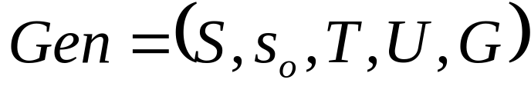

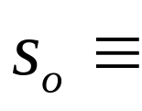



Definition of Generator
From L’Ecuyer
A structure, , with
A finite number of states
An initial state or seed
(The transition function)
A finite number of outputs
(The output function)

Slide 4
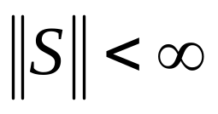
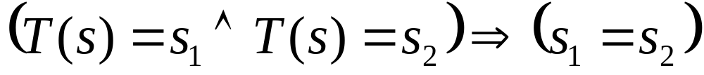

Definition of Period
The Period, p, for a given generator is the minimum value of k for which the n^{th} state of the generator is equal to the (n+k)^{th} state of the generator.
A finite period is required by the finite number of states and the function T.

Slide 5
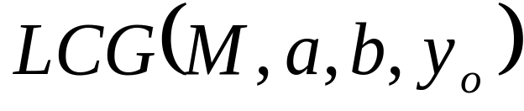
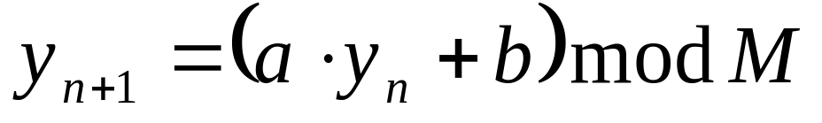
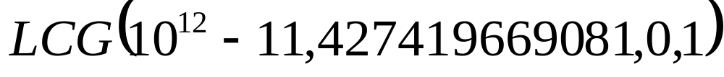
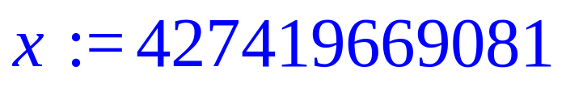
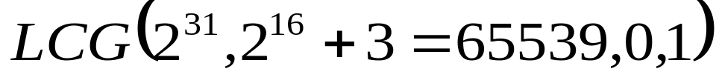
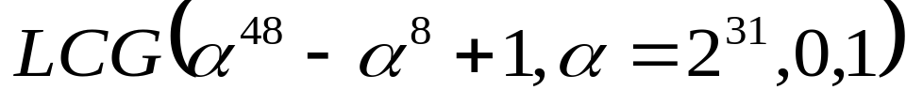
Linear Congruential Generator (LCG)
Some Popular/Infamous LCGs
Maple
> x:=rand();
RANDU
Mathematica
Notes:
Four input parameters define a recursion relation
Define the period of a PRNG and discuss its relation to modulus M
This is the most commonly used PRNG
Show Maple PRNG

Slide 6
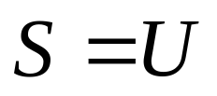
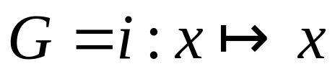
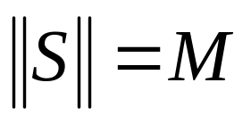
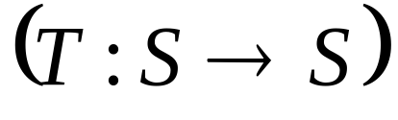
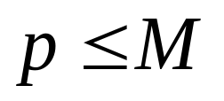
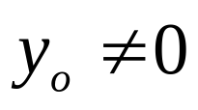
Properties of the LCG
Because and
defines a function, T, such that a state, s, uniquely determines the following state, we can easily say that .
In fact, it has been shown that the maximum is p=m-1 only if m is prime, the multiplier a is a primitive root mod M and .
Notes:
Define the period of a PRNG and discuss its relation to modulus M
This is the most commonly used PRNG

Slide 7
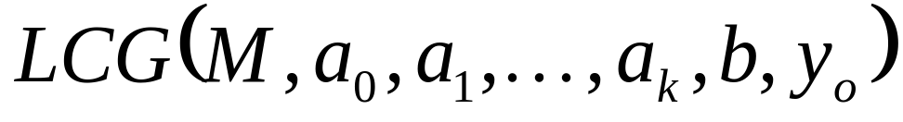

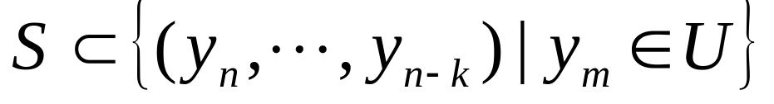
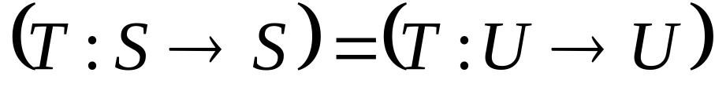
Extended Linear Congruential Generator (ELCG aka RG)
Also referred to as Recursive Generator (RG). Note that but rather:
And therefore it is no longer true that:
, or that
NOT TRUE!
Notes:
Compare to LCG
Compare (set of states) equality to (set of outputs)
Note that all coefficients a_n need not be non-zero

Slide 8
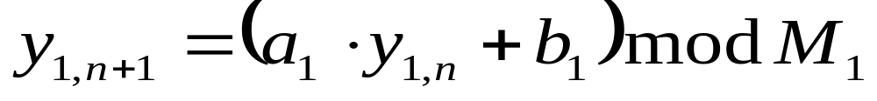
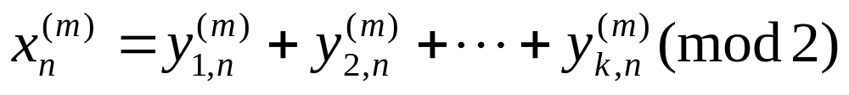
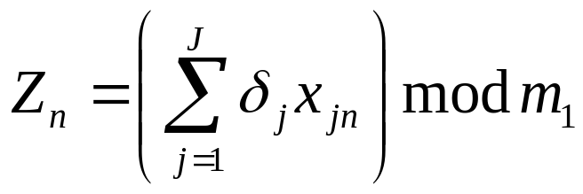
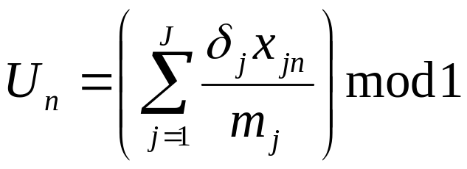
Combined Linear Congruential Generator (cLCG)
As before,
Methods of Combination
Bit wise XOR
L’Ecuyer
Wichmann & Hill
Notes:
Explain the process
L’Ecuyer gives integers and uses generators with distinct prime moduli
Wichmann & Hill gives Uniform [0,1)

Slide 9
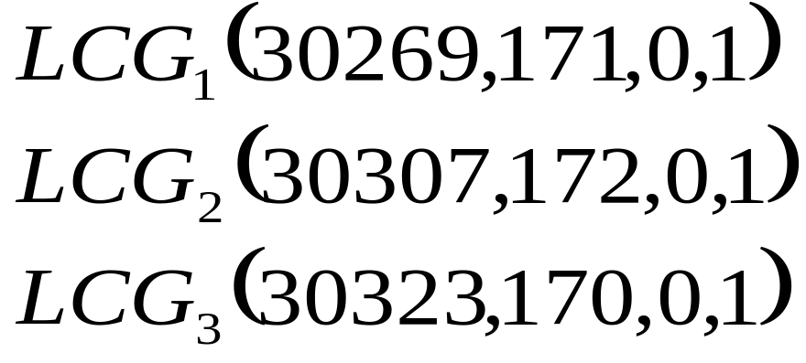
Wichman and Hill cLCG
Combined Linear Congruential Generators are equivalent to generators with larger moduli.
Notes:
Zeisl in the Journal of Applied Statistics 1986 showed the equivalent LCG.
State why the cLCG is good: fast with effectively large modulus

Slide 10


Multiple Recursive Generator (MRG)
Produced by a combination of RGs of the form:
MRG designed by Grube for .
Uses 3 generators
Note: definition of indices for coefficients, a, is off by one from my definition.

Slide 11

Shuffling Outputs,
The Bays-Durham Shuffle
Time to Use the Whiteboard

Slide 12
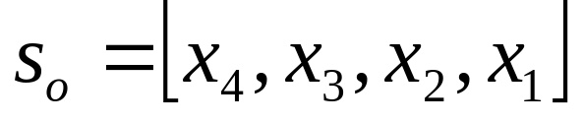
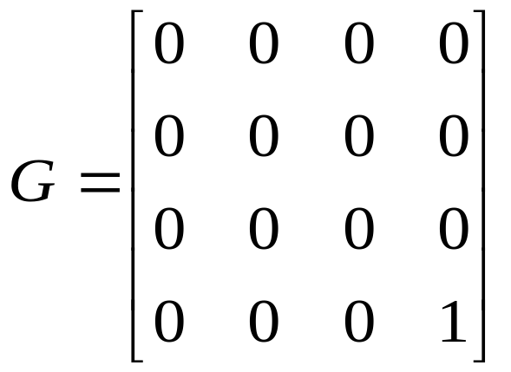
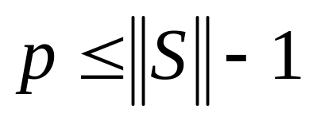
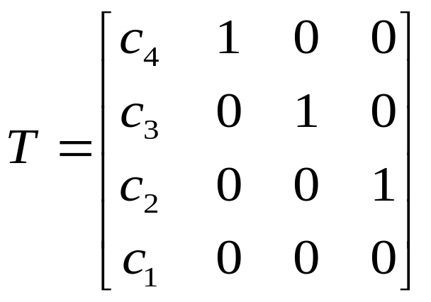
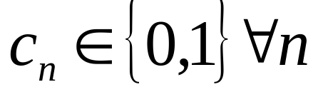
Feedback Shift Register (FSR or LFSR)
Output is a stream of bits.
The period is limited by the number of states.
Note:
Notes:
For word length n
Rightmost term is x1 and is output bit
2^n possible values
2^n –1 maximum size state space and maximum period

Slide 13

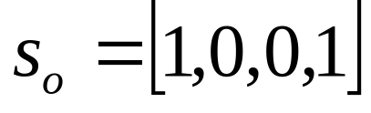

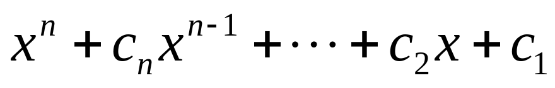
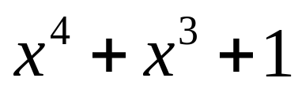
Full Period LFSR
Hmm…
For Example,
<-monic irreducable?
is monic irreducable for this n.
The period then is the smallest m so that f(x) divides x^{m} + 1. In this case m=15.
Notes:
There are also generalized feedback shift registers

Slide 14
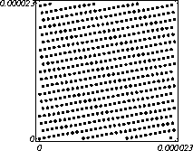
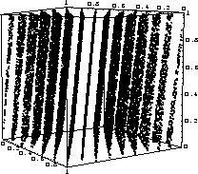
That Doesn’t Look Random
Lattice structure exhibited by any generator based on multiplicative linear-congruential methods.
(LCG, cLCG, ELCG, MRG, as well as FSR, and Fibonacci)
Source: pLab website
Lattice structure exists in all dimensions. (3-d lattice at right)
Notes:
Discuss construction of the lattice diagram.
Generated numbers are normalized to the unit n-dimensional hypercube and overlapping consecutive sets of outputs are used as components in n-dimensional vectors

Slide 15

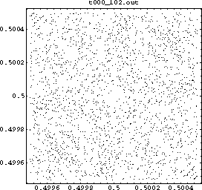
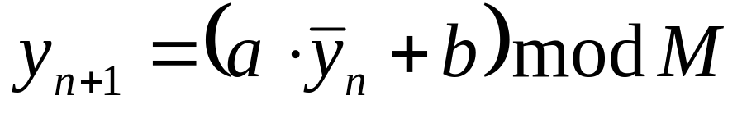
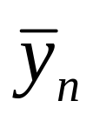
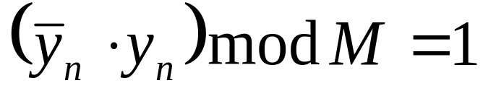
Inverse Congruential Generator (ICG)
with such that,
The ICG shows no lattice structure, though some symmetries are evident.
Notes:
Neat idea but has poor statistical performance.

Slide 16
Tests for Randomness
Uniform distribution in k-dim space
Monte Carlo value for pi
Rank permutation distribution
Characteristics of spectral lattice
Selected tests from DIEHARD by Marsaglia
  GCD, value and iterations necessary
  Birthday spacings repeated

Slide 17
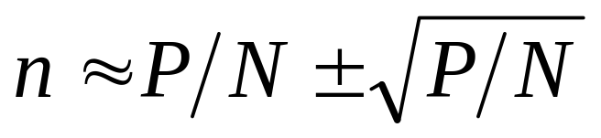
Uniform Distribution in k-dimensions
Divide the space into N bins of equal size.
Form a number, P, of k-tuples from the random numbers.
Count the number, n, of k-dimensional vectors in each bin.
?
Notes:
Sample size should be much less than generator period.
Can be used to find serial or parallel correlation for generators.

Slide 18
Rank Permutation Distribution
Generate n sets with m random numbers in each set
Replace the numbers in each set with their rank within that set (1..m).
Check for a uniform distribution of each of the m! possible orderings

Slide 19
Monte Carlo Value for Pi
See Maple worksheet: MonteCPi.mws
Notes:
Why not use truly random numbers for Monte Carlo Simulations?

Slide 20
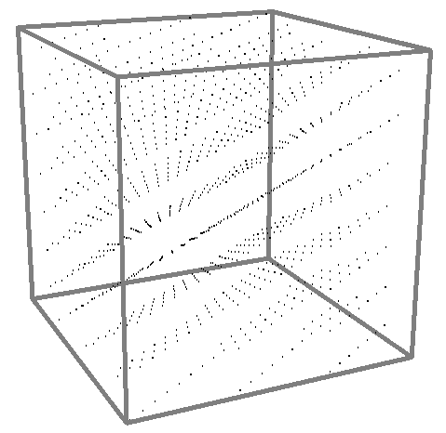
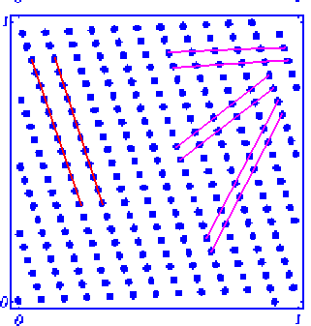
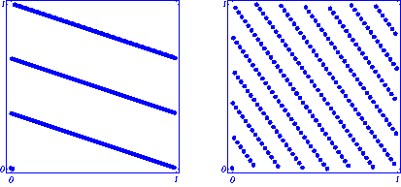
Spectral Test in s-Dimensions
Considers the maximal distance between adjacent parallel hyperplanes in the s-dimensional lattice. The maximum of these values over all families is d_{s}
(poor 2-d lattice structures)
Images from pLab website; K. Entacher, P. Hallekalek

Slide 21
GCD Test from DIEHARD
a b
366 = 1*297 + 69
297 = 4*69 + 21
69 = 3*21 + 6
21 = 3*6 + 3
6 = 2*3 + 0 (k=5 iterations)
GCD(a,b) = 6
Applying Euclid’s algorithm to two integers will produce several quantities to examine.
The distributions of k and GCD(a,b) have been studied extensively.
Notes:
These are more rigorous tests
LCGs all fail the DIEHARD tests

Slide 22
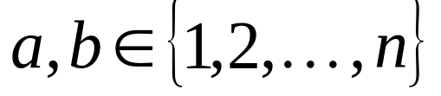
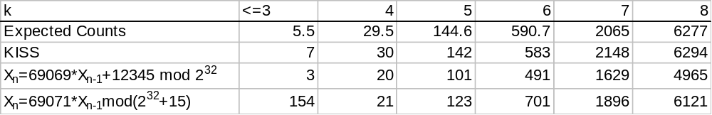
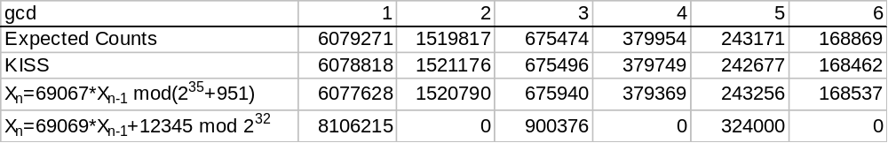
Results from GCD Test
For ,
The distribution of GCD(a,b) was found by extensive simulation.
Notes:
KISS is a combined hybrid generator incl. LCG FSR and RG created by Marsaglia

Slide 23
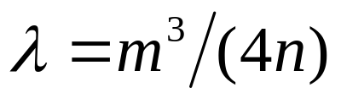

Birthday Spacings Test from DIEHARD
Generate m birthdays in a year of length n using PRNG outputs.
Poisson distribution approximates the number of duplicated values among ordered birthday spacings asymptotically with .
Diehard uses an especially rigerous n=2³² and m=2¹², such that .

Slide 24
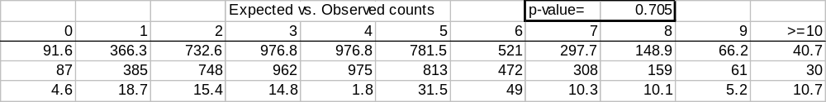
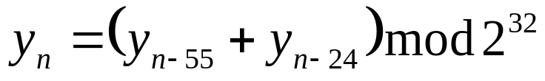
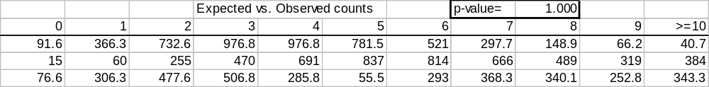
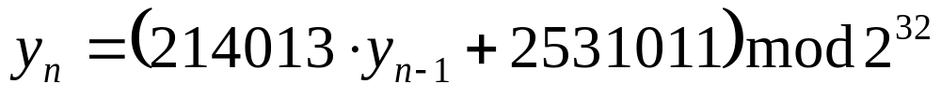

Results from B’day Test
KISS Generator
Notes:
Counts >=10 are combined

Slide 25
Selected Applications
Monte Carlo simulations
Cryptography
Computational number theory

Slide 26
Monte Carlo Simulations
For Radioactive Decay Simulation
See Maple worksheet: MonteCDecay.mws
Notes:
Discuss more complicated nuclear physics simulations
Also used in business simulations, environmental simulations, etc.

Slide 27


Cryptography
Public Key:
Used to encrypt info sent to you
Private Key:
Decrypts info encrypted with the public key
PRNGs are used to generate secret keys.
Emphasis is on unpredictability.
Notes:
Uniformity and other geometric properties are not too important.
Discuss weakness of short period single LCG method

Slide 28

What to Look for in a Cryptographic PRNG
Assume attackers will know your generator algorithm.
Very large number of states
Strong separation between the state value and the output value
Reseeding process or other means of adding entropy continuously to the state
Notes:
Must fear your own programmers and decompilers in the public
The State determines everything and should not be easily determined either by brute force or by studying the output
Reseeding guards against State Compromise Extension Attacks.

Slide 29




Cryptographic Generator:
DSA PRNG
(least states used in DSA)
Optional Input
(state is “hidden” in output)
(new state incorporates optional input)

Slide 30

Computational Number Theory
Additional properties of purely random numbers are required beyond uniform distribution.
Outputs should have prime factorizations and relative GCDs consistent with a purely random generator.

Slide 31
References
J. Woods, personal communication.
E. Green, personal communication.
P. Patten personal communication.
G. Marsaglia and W. Tsang, 2002, Some Difficult-to-pass Tests of Randomness, Journal of Statistical Software, Volume 7, Issue 3.
C. C. Klimasauskas, 2002, Not Knowing Your Random Number Generator Could Be Costly: Random Generators – Why Are They Important , PCAI, Volume 16, Number 3.
Pierre L’Ecuyer, 1994, Uniform Random Number Generators, Annals of Operations Research.
J. Kelsey, B. Schneier, D. Wagner, and C. Hall, Cryptanalytic Attacks on Pseudorandom Number Generators, http://www.counterpane.com/pseudorandom_number.pdf

Slide 32
References (cont.)
Diehard Program and Associated Documentation by G. Marsaglia, http://stat.fsu.edu/pub/diehard/
D. M. Ceperley, 2000, Random Number Generation, http://web.mse.uiuc.edu/matse390/lnotes/PRNG.ppt
Spectral Test Server, K. Entacher, P. Hellekalek, http://random.mat.sbg.ac.at/results/karl/spectraltest/, http://random.mat.sbg.ac.at/~charly/server/node1.html,
W. Cherowitzo, Linear Feedback Shift Registers, 2000, http://www-math.cudenver.edu/~wcherowi/courses/m5410/m5410fsr.html
Sieve of Eritosthenes, http://www.math.utah.edu/~alfeld/images/sieve.gif

Slide 33

References (cont.)
C. E. Praeger, Linear Feedback Shift Registers, 2001, http://www.maths.uwa.edu.au/~praeger/teaching/3CC/WWW/chapter4.html
Unknown Author, Statistical Tests, http://sprng.cs.fsu.edu/Version2.0/statistical-tests.html
Unknown Author, Teaching Notes for the
Probabilistic Number Theory Problem, http://www2.edc.org/makingmath/mathprojects/pNumberTheory/pNumberTheory_teach.asp
Unknown Author, Linear Feedback Shift Registers, http://homepage.mac.com/afj/lfsr.html
And a very special thanks goes to Mr.&Mrs.

