Slide 1
HPCA Tutorial: Memory Failure Prediction
Qiao Yu
Technical University of Berlin

Slide 2
Outline
Introduction
Related Work
Our Work
Exploring error bits for memory failure prediction: An in-depth correlative study (ICCAD’23)
HiMFP: Hierarchical intelligent memory failure prediction for cloud service reliability (DSN’23)
Investigating Memory Failure Prediction Across CPU Architectures (DSN’24)
Conclusion and Future Work
Notes:
This is the outline of our work. We first introduce the background.

Slide 3
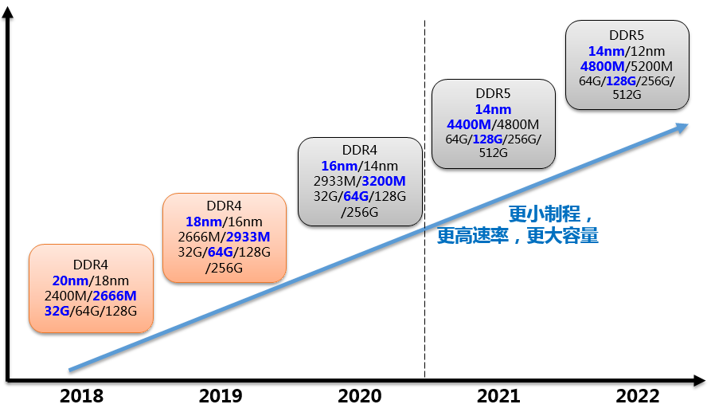
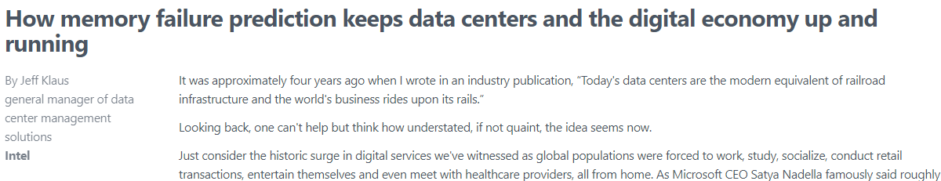
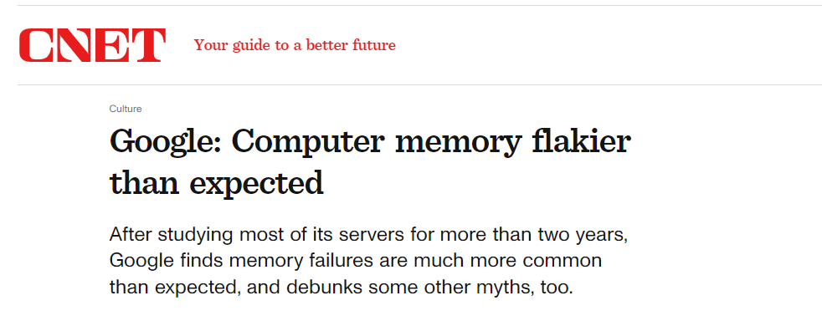
Memory Failure
Background: With the increasing demand for cloud computing, DRAM (Dynamic random access memory) failure is one of leading causes of server crashes. DRAM failure rate has increased each generation as the density and speed increase.
Notes:
Memory or DRAM (Dynamic random access memory) is one of leading causes of server crashes in the datacenter. It has been increasing as the process, density and speed of DRAM increase.
Here is the distribution of hardware failure from Intel report, as you can see, memory failure is the major failure, and accounts for 37% in datacenters.
There are some headlines from google as well, memory failure is always a problem in cloud providers. It has a direct impact on server reliability and will cause enormous economic losses.
So the industry has started to use memory failure prediction to predict failures ahead of time, for example, Intel has provided commercial solution of memory failure prediction for cloud providers.

Slide 4

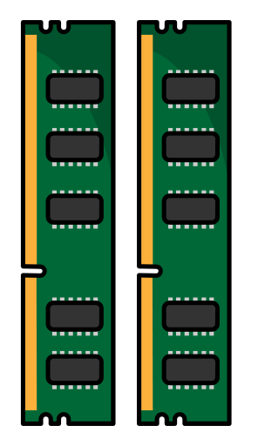


How Memory Failure Causes Server Crashes?
Processor
Task Execution
Data Operation
MOTIVATION
To avoid server crashes, Machine Learning (ML) are introduced to predict memory failures and reduce VM interruptions.
.
Task Failed
Erroneous Data
Memory Controller
Server
Processor
Main Memory
(DRAM)
Error Correction Code (ECC) Mechanism (e.g., SEC-DED, ChipKill) detects and corrects errors.
✕
Problem: ECC is unable to correct all errors.
Notes:
how memory failure causes server crashes, here is an example.
This is the server.
This is the Processor, the processor often referred to as the “brain” to execute tasks for computer.
And memory often stores currently used data, and fetches the data to processor.
So when DIMM encounters failures, erroneous data will be fetched to CPU, eventually causes tasks failed. So servers are crashed immediately, often if it happens in the kernel space of server.
To alleviate this problem, modern server-grade CPUs including memory controllers are often equipped with ECC mechanism to detect and correct memory errors correspondingly. However, the problem is ECC is unable to correct all errors and provide fully coverage for memory reliability.
This motivates us to use machine learning techniques to predict memory failures and reduce VM interruptions.

Slide 5
Memory Faults, Errors and Failures
Memory Faults:
The underlying causes of an error in DRAM.
Soft Faults: particle impacts, cosmic rays. --recoverable
Hard Faults: ware-out, manufacture defect. --repeatable
Memory Errors:
Correctable Error (CE): Errors that can be corrected by ECC mechanism.
Uncorrectable error (UE): uncorrected by ECC mechanism.
Sudden UE: UEs that instantly corrupt data.
Predictable UE: UEs that start as correctable errors and evolve to severe UEs.
As-yet-unconsumed (AYU) UCE: UCEs that have been detected but not yet consumed by the system or processors, e.g., Intel’s UCNA, Patrol Scrubbing UCE.
Critical UCE: UCEs that typically lead to service interruptions.
Memory Failures:
A critical event in which the delivered service deviates from the correct service. UEs typically lead to catastrophic failures, resulting in a crash.
Logging
Predicting
Faults
Errors
UE/Failure
Notes:
Here is the terminology of memory faults, errors and failures.
Memory Fault is the underlying reason of DRAM error including soft fault.
Memory Error includes Correctable Error (CE) and Uncorrectable error (UE). Errors that can be corrected by ECC are CE, while uncorrected by ECC mechanism is UE.
There are also sudden UE and predictable UE happened in the datacenter. Sudden UE: UEs that instantly corrupt data,. Since sudden UE is without CE preceding, we don’t have enough signals to predict UCE, So we focus on Predictable UE: UEs that start as correctable errors and evolve to severe UEs.
Memory failure is a critical event in which the delivered service deviates from the correct service, like UE.

Slide 6
Outline
Introduction
Related Work
Our Work
Exploring error bits for memory failure prediction: An in-depth correlative study (ICCAD’23)
HiMFP: Hierarchical intelligent memory failure prediction for cloud service reliability (DSN’23)
Investigating Memory Failure Prediction Across CPU Architectures (DSN’24)
Conclusion and Future Work
Notes:
This is the outline of our work. We first introduce the background.

Slide 7
Related Work
Recent works of memory failure prediction have been discussed as below:
Giurgiu et al. [IBM, Middleware’17] proposed the first predictive model for DRAM failure prediction utilizing correctable errors, event logs, and sensor metrics.
Boixaderas et al. [BSC, SC’20] presented Random Forest model with CE features at the DIMM, socket, and node levels, and evaluated their UE prediction using a cost-aware method.
Zhang et al. [SJTU, DSN’22] and Cheng et al. [CUHK, SRDS’22] proposed to predict server failures, considering both UE-driven and CE-driven failures from the Alibaba datacenter.
Li et al. [Intel&ByteDance, SC’22] presented an empirical study correlating CEs and UEs using error bit patterns and DIMM part numbers.
However, none of existing literature reveals latent correlations of error bits, specifically in DQ and Beat. Additionally, a comprehensive hierarchical framework is necessary for adapting different levels of memory recovery techniques.
Notes:
Memory failure prediction is not new, there are many recent works of Memory Failure Prediction have been discussed as below:
a study of Barcelona supercomputing center presented Random Forest with CE features at DIMM socket and node levels to predict UEs.
Zhang and Cheng proposed sever-level of failure prediction considering bother UE-driven and CE-driven failure from Alibaba datacenter.
Li from Intel together with ByteDance presented empirical study correlating CE and UE using error bit patterns and part numbers to predict UEs.
And in our previous work, we also established a hierarchical framework called Hi MFP for memory failure prediction, combining the bit-level features and as yet unconsumed UE, and the memory recovery techniques. However, UEs is influenced not just by DRAM faults but also by differences across CPU architectures, due to the diverse ECC mechanisms in use.

Slide 8
Outline
Introduction
Related Work
Our Work
Exploring error bits for memory failure prediction: An in-depth correlative study (ICCAD’23)
HiMFP: Hierarchical intelligent memory failure prediction for cloud service reliability (DSN’23)
Investigating Memory Failure Prediction Across CPU Architectures (DSN’24)
Conclusion and Future Work
Notes:
This is the outline of our work. We first introduce the background.

Slide 9
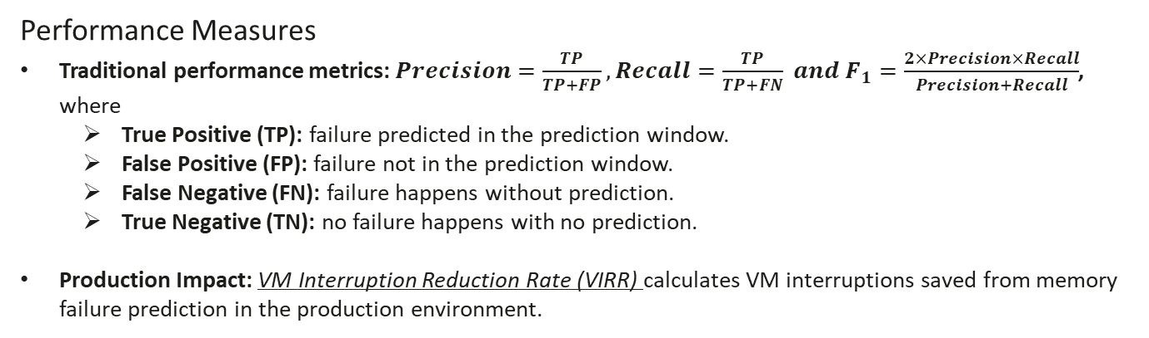
Dataset and Performance Measures
Large-Scale dataset from Huawei Cloud datacenters
We collected datasets across CPU architectures including Intel Skylake/Cascade Lake, Icelake and Huawei ARM K920 architectures servers.
Error logs w/ static configuration, MCE log and memory events.
Over 90,000 DDR4 DIMMs (Samsung, Hynix, Micron, etc) are examined.
Performance Measures
Traditional performance metrics: $Precision=\frac{TP}{TP+FP}, Recall=\frac{TP}{TP+FN} and F_{1}=\frac{2×Precision×Recall}{Precision+Recall}$, where
True Positive (TP): failure predicted in the prediction window.
False Positive (FP): failure not in the prediction window.
False Negative (FN): failure happens without prediction.
True Negative (TN): no failure happens with no prediction.
Production Impact: VM Interruption Reduction Rate (VIRR) calculates VM interruptions saved from memory failure prediction in the production environment.
Notes:
We collect the large-scale datasets from Huawei Cloud Data Center including the latest Intel architecture servers.
Error logs are with static configuration, MCE log and memory events are collected.
Over 90,000 DDR4 DIMMs from the major manufacturers are examined.
We use traditional performance metrics from precision, recall, and F1-score.
We also consider the production impact.
The virtual machine interruption reduction rate calculates the VMs saved from the memory failure prediction in the production environment.
Failures predicted in the prediction window are considered as the TP. Otherwise is a FP and failures happen without the prediction are false negative.
True Negative refers to No failure happens with no prediction

Slide 10
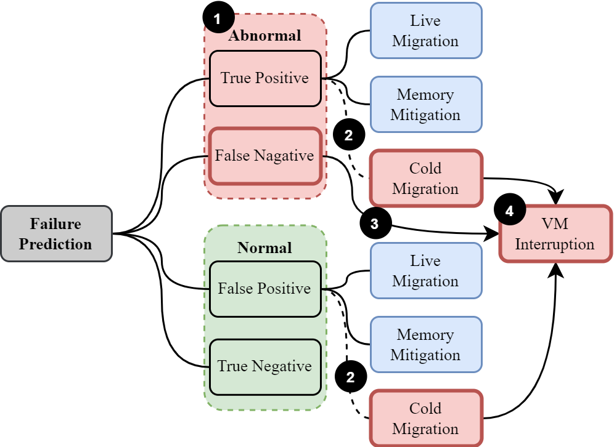
Dataset and Performance Measures
Virtual Machine Interruption Rate
Production Impact: VM Interruption Reduction Rate (VIRR) calculates VM interruptions saved from memory failure prediction in the production environment.
Notes:
Here is an example of how traditional machine learning metrics relates to VIRR. When memory is predicted to be abnormal, corresponding measures are triggered, such as live migration and page offlining, to prevent VM interruptions due to memory failures. If these failures go unpredicted, they will lead to VM interruptions. Additionally, in cases of prediction errors, such as false positives, incorrect VM migrations may occur, which can also result in VM interruptions. This metric allows us to translate machine learning metrics like precision and recall into production metrics, specifically VM Interruption Reduction Rate (VIRR).

Slide 11
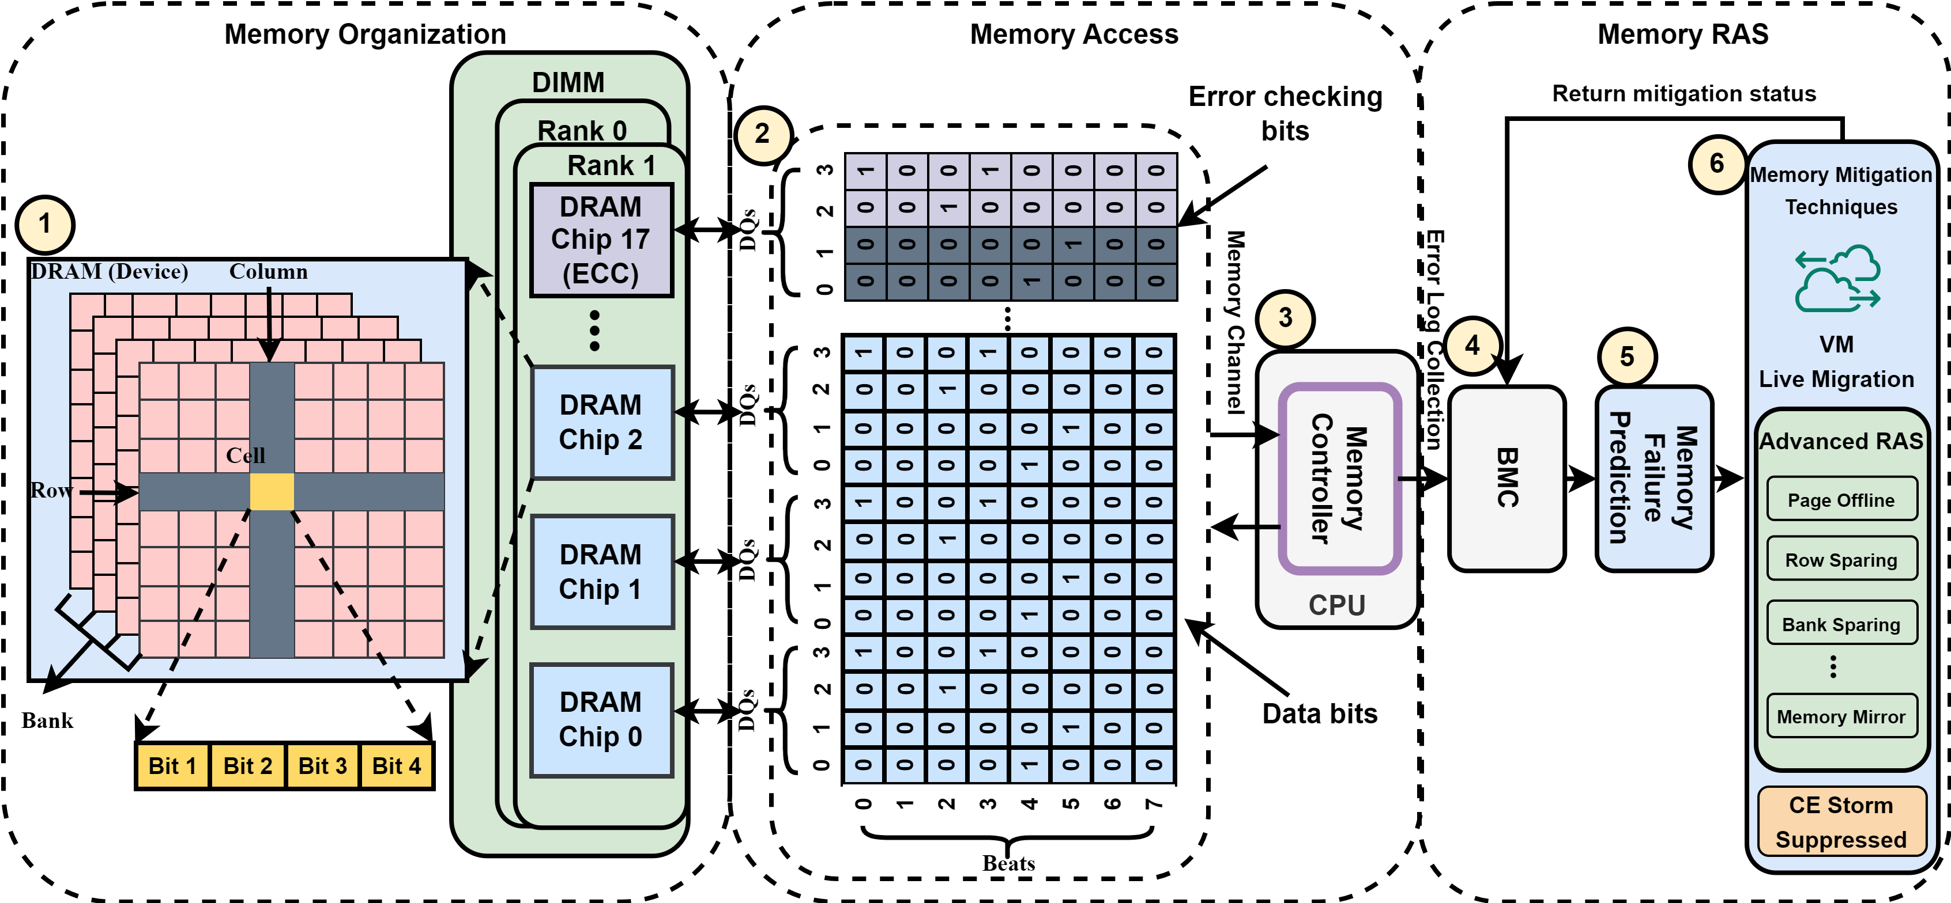
Framework
Notes:
This is the framework. We first discuss the memory organization. The DIMM can contain the multiple DRAMs. In the organization of each DRAM, it contains the multiple banks and each bank is indexed by the column and row. And their intersection is the cell which contains the data bits. So, once the data request is initialized, data bits are transferred via DQs and beats to the memory controller in CPU. And data bits are always together with the error-checking bits, which are used to detect and correct the erroneous data bits. And the UE and CE information will be stored in the BMC, which is a specialized processor to monitor the hardware status. And then, the memory failure prediction will use the error logs from BMC to predict the failures.
And correspondingly, the memory mitigation techniques will be triggered, like the virtual machine live migration and other advanced techniques, like the page offlining, row sparing, and the CE storm suppressed.

Slide 12
Framework
1
1
1
1
Bit 2
Bit 3
Notes:
Once a fault happens in a DRAM, the erroneous bits will be transferred via DQs and beats to the memory controller. Error checking bits are used to detect and correct these erroneous bits. In the previous studies, if the error-checking bits in the specific patterns, the ECC in memory controller cannot correct them. The underlying reason is that a certain number of the ECC bits are reallocated for other uses. And this also will be the trend in the future in modern Intel platform.

Slide 13
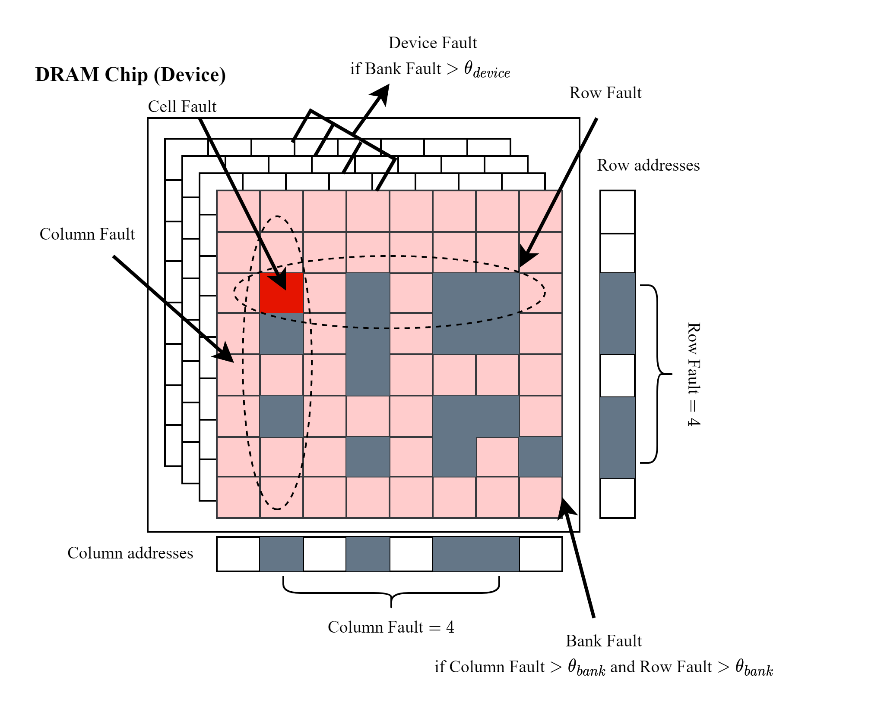
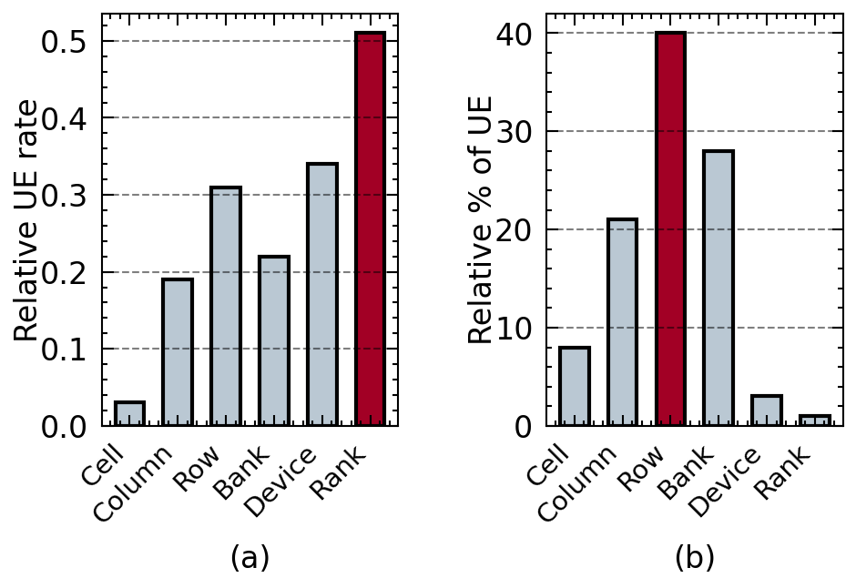
Component Fault Analysis
FINGDING
While higher-level faults may have a higher likelihood of causing UEs, Row and Bank faults account for the majority of UEs in the system.
Notes:
Then, we move to the component for the analysis. In this figure, the higher level faults in the DRAM architecture generally lead to the higher relative UE rate, but we observe that the most UEs happen in the row and the bank level. This leads us to the finding 4. While the higher level faults may have the higher likelihood of causing UE, but the row and bank faults account for the majority of UEs in the system.

Slide 14
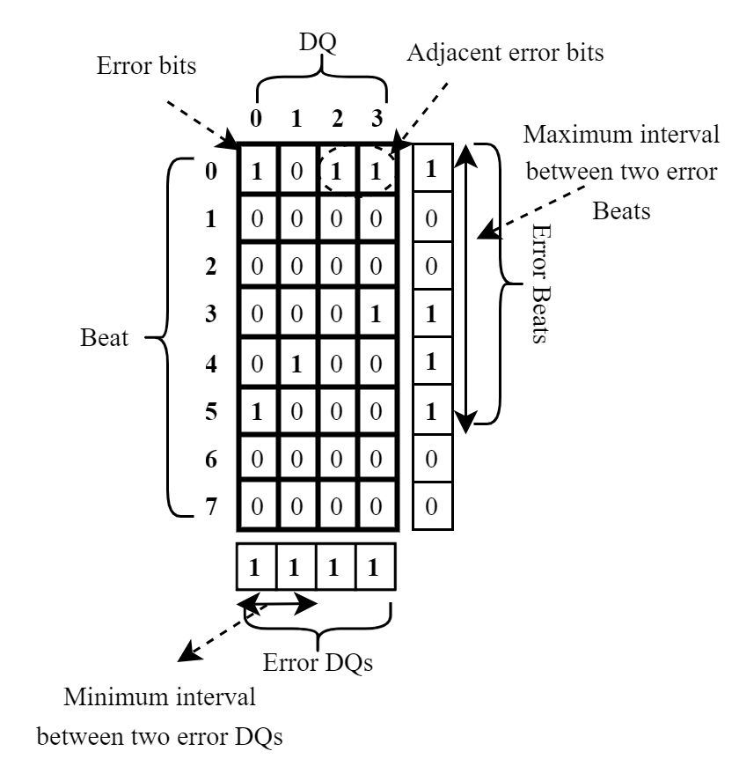
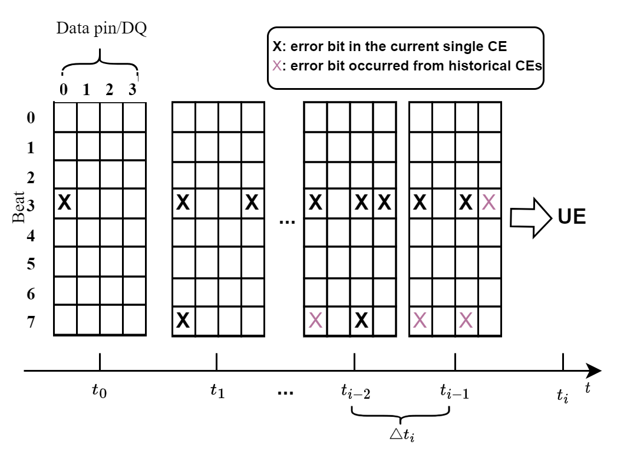
Error Bit Distribution
Notes:
In the error-bit distribution, we will investigate the bit distributions in spatial location of the check bits.
For example, we examine adjacent error bits, the maximum interval between two error beats, etc. Then, we add the temporal information into the spatial error bit information to correlate with the UE occurrences. The historical information including the error bits from the past.

Slide 15
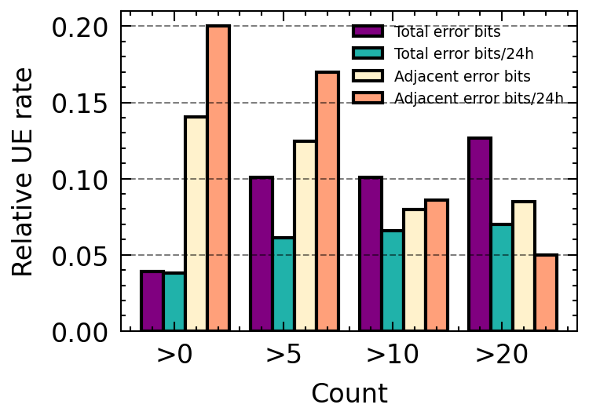
Error Bit Analysis
FINDING
The total number of error bits exhibits weaker correlation of UE compared to adjacent error bits. Even a small number of adjacent bits can lead to UE occurrence.
Notes:
In the error-bit analysis, we observe the total number of error bits exhibits the weaker correlation of UE compared to the adjacent error bits. Even a small number of adjacent bits can lead to UE occurrence.

Slide 16
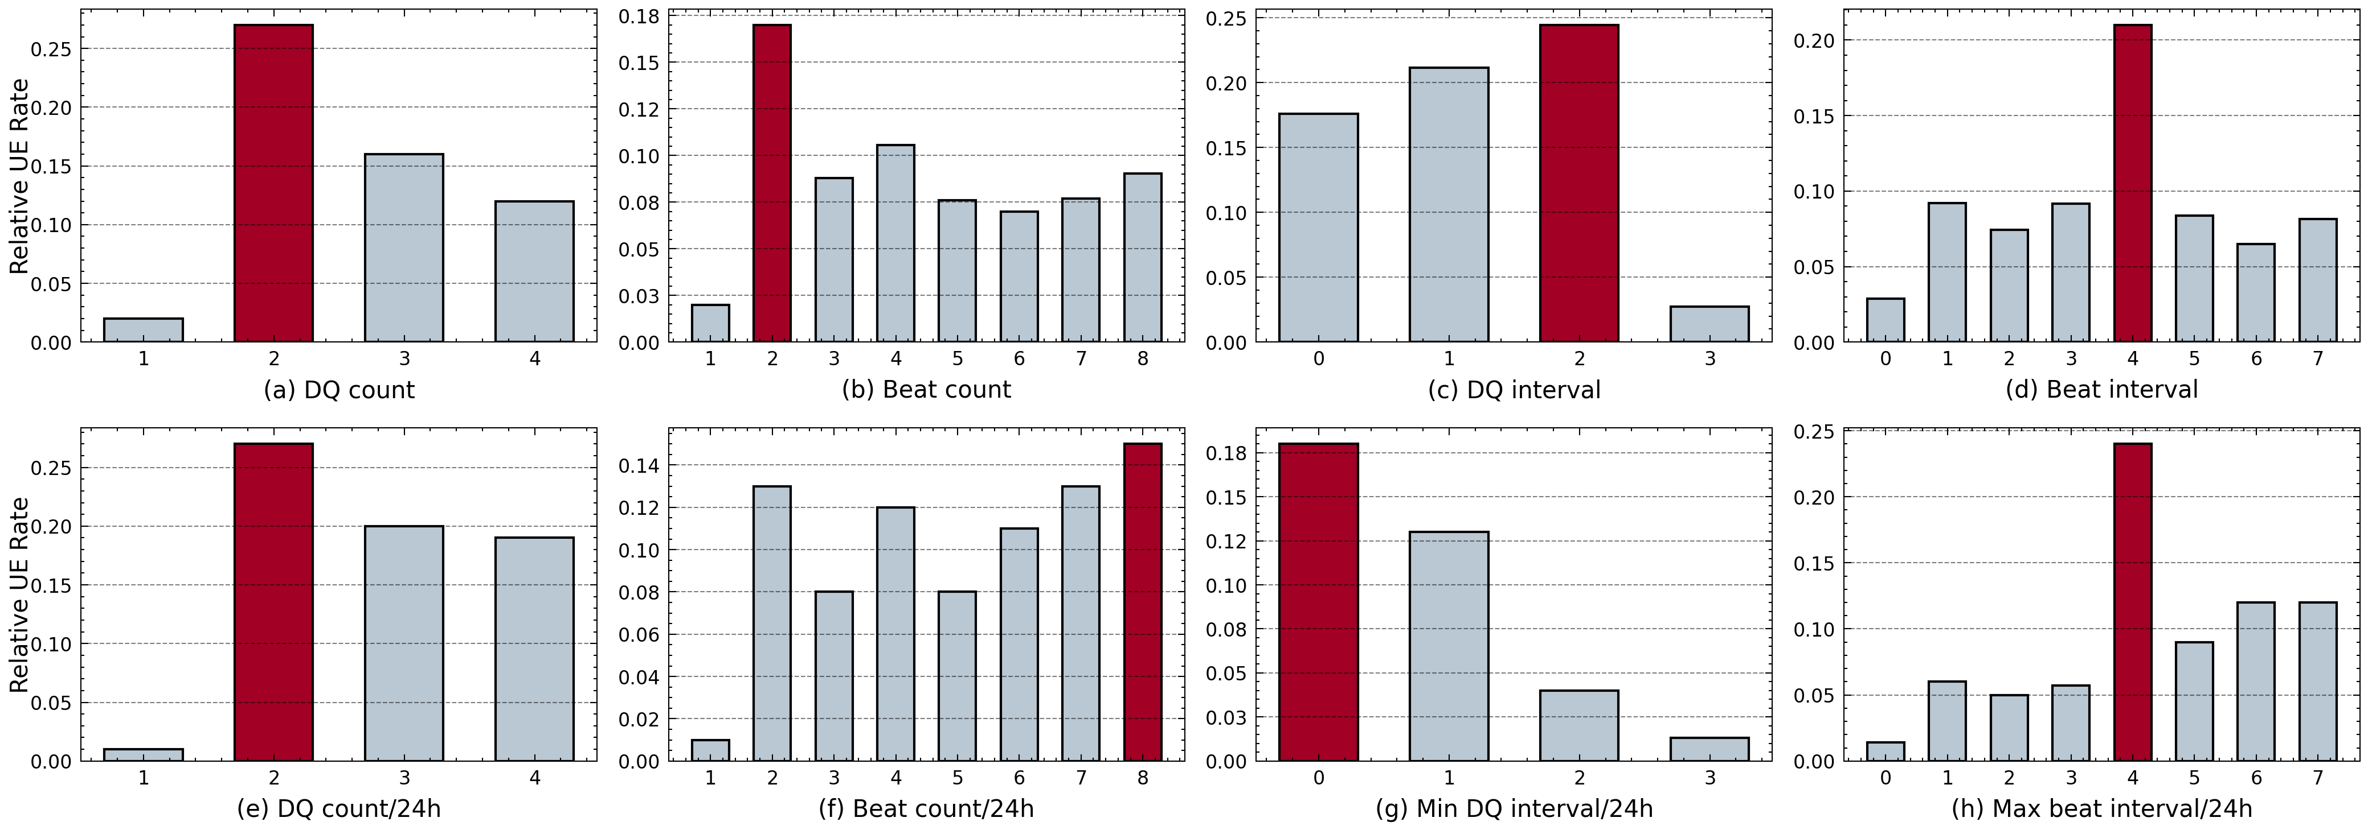
Error Bit Analysis
FINDING
Our analyses reveal that both spatial and temporal error bits in DQs and beats play a significant role in distinguishing UE occurrences.
Notes:
Then, we observe the error bits in DQ and beat. If error bits happens in two DQs or the multiple beats, they generally have the higher relative UE rate than the one DQ and one beat. Another interesting observation is once the beat interval is 4, they are most likely to encounter the UE.
In finding 3, our analysis revealed that both spatial and temporal error bits in DQ and bits are important for UE occurrences.

Slide 17
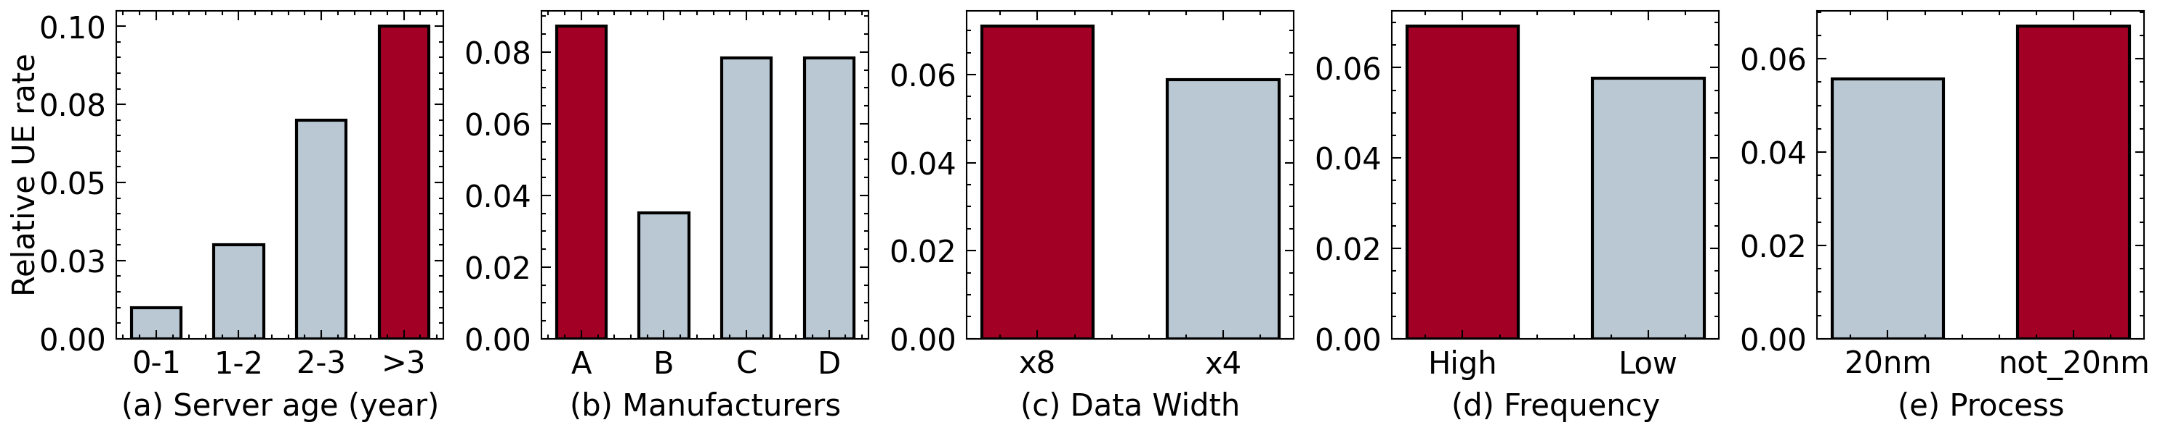
System Configuration Analysis
FINDING
The UE rate varies across server age, manufacturers, data width, frequency and process, while we did not observe significant differences in the capacity of the DIMM.
Notes:
We analyze the system configuration as well from the server age, manufacturers, data width, frequencies, and process.
In our finding 5, the UE rate varies across these system configurations. While we did not observe the significant differences in the capacity of DRAM.

Slide 18
Outline
Introduction
Related Work
Our Work
Exploring error bits for memory failure prediction: An in-depth correlative study (ICCAD’23)
HiMFP: Hierarchical intelligent memory failure prediction for cloud service reliability (DSN’23)
Investigating Memory Failure Prediction Across CPU Architectures (DSN’24)
Conclusion and Future Work
Notes:
This is the outline of our work. We first introduce the background.

Slide 19
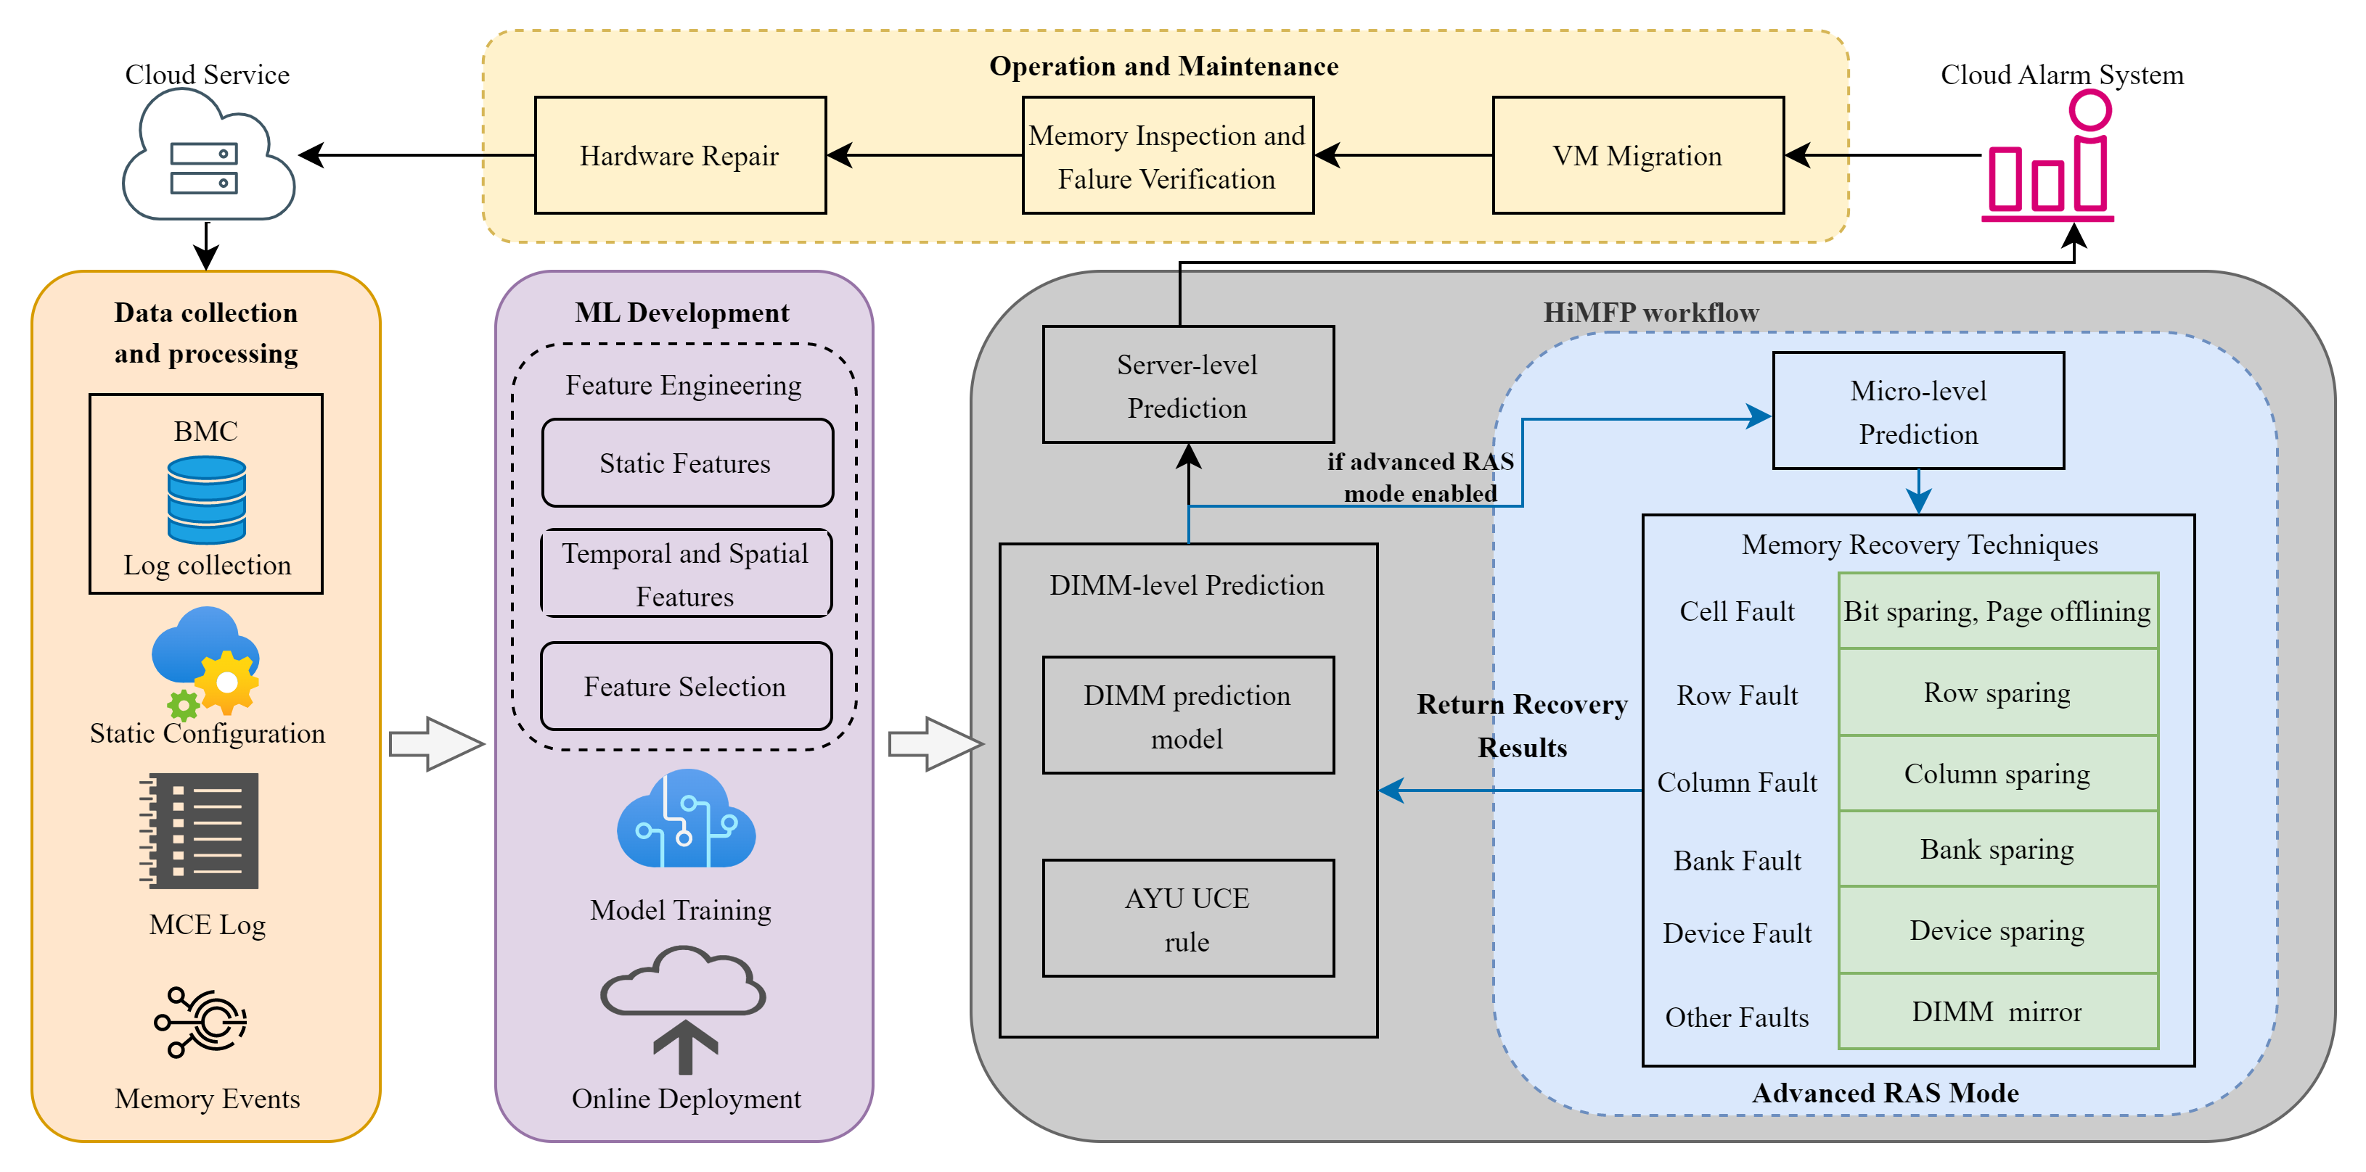
Framework
Notes:
This the framework of HiMFP,
As you see, data is collected via BMC and categorize into static configuration, MCE log, memory events
And these data will be utilized for ML Development operation including feature engineering and model training and online deployment,
Specifically in HiMFP workflow, we first

Slide 20
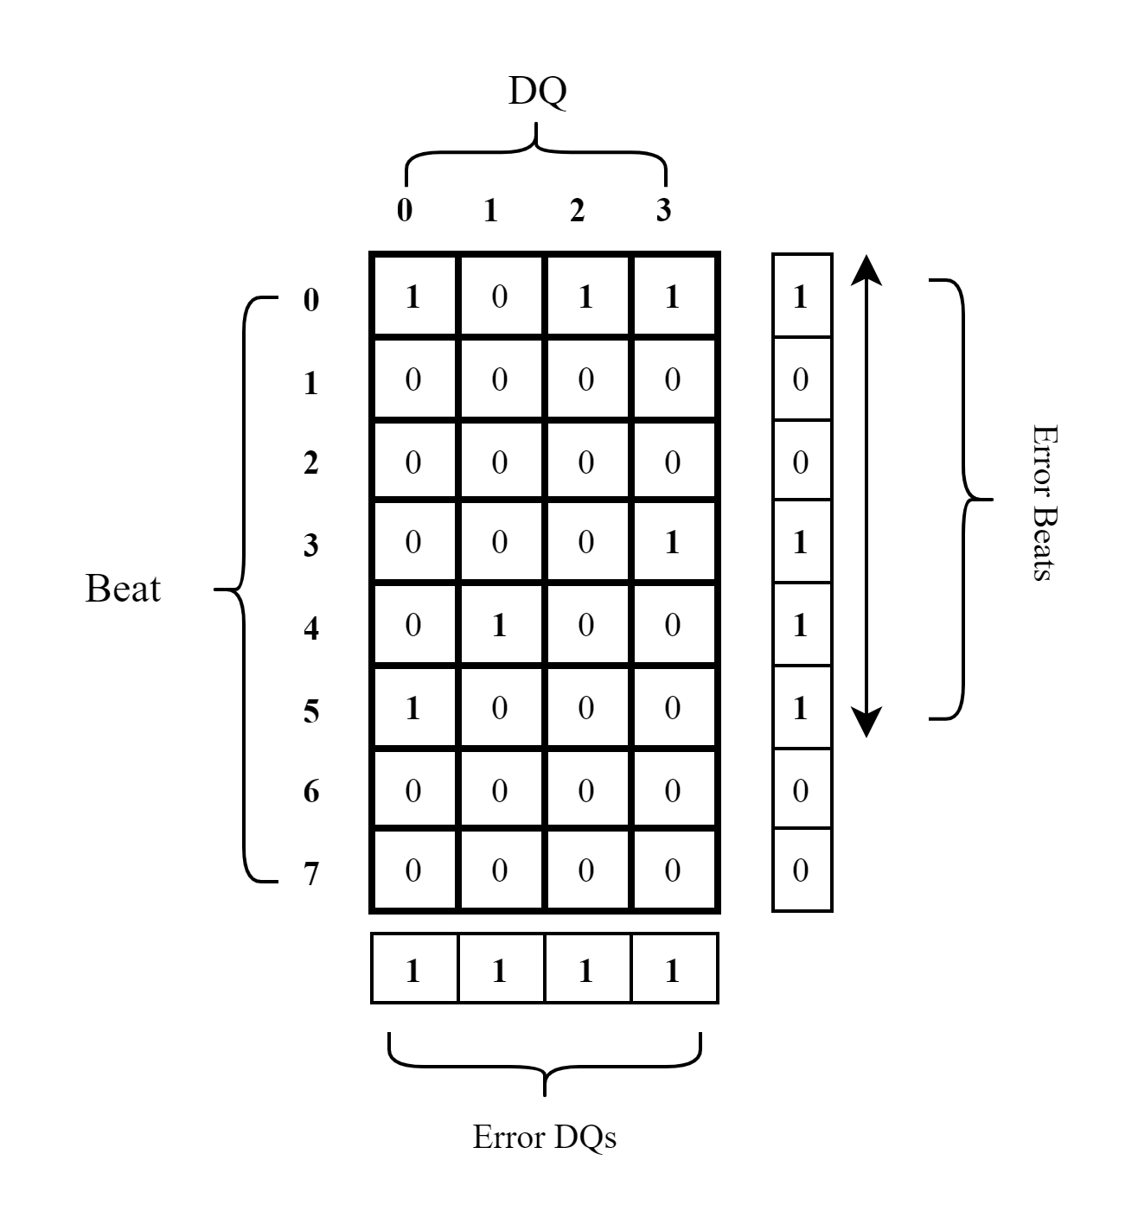
Micro-level Prediction
Multi-DQ-Beat Fault

Slide 21
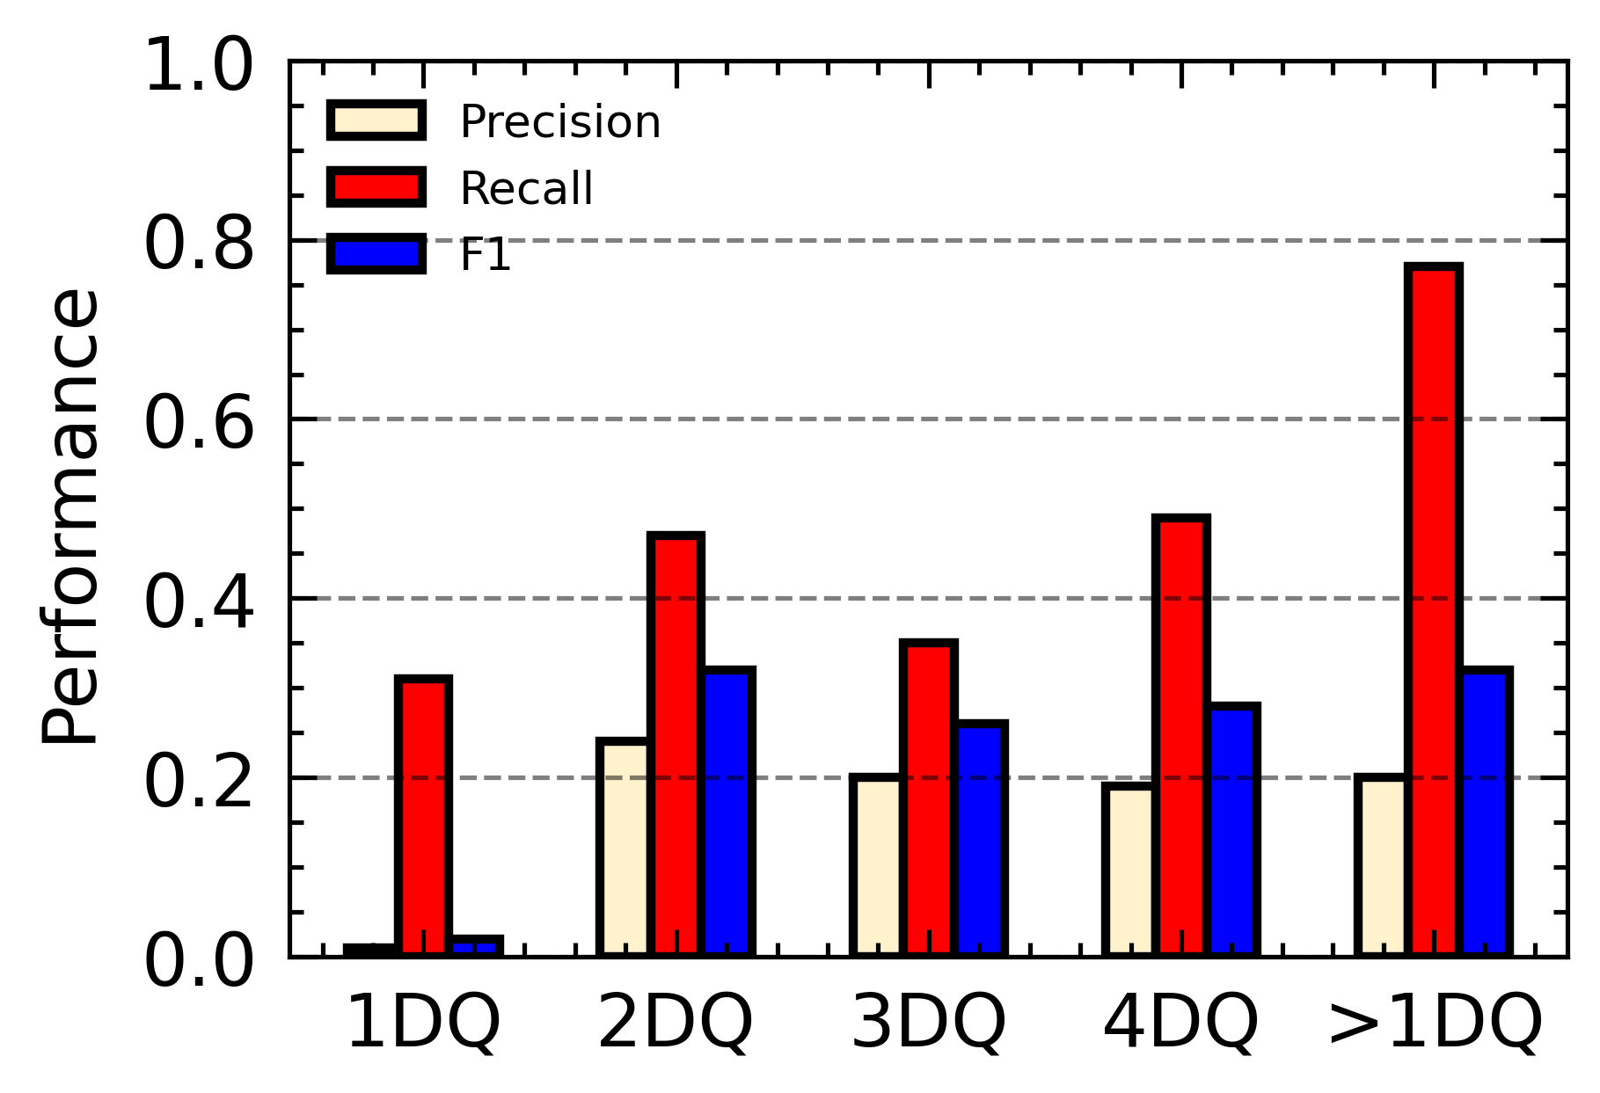
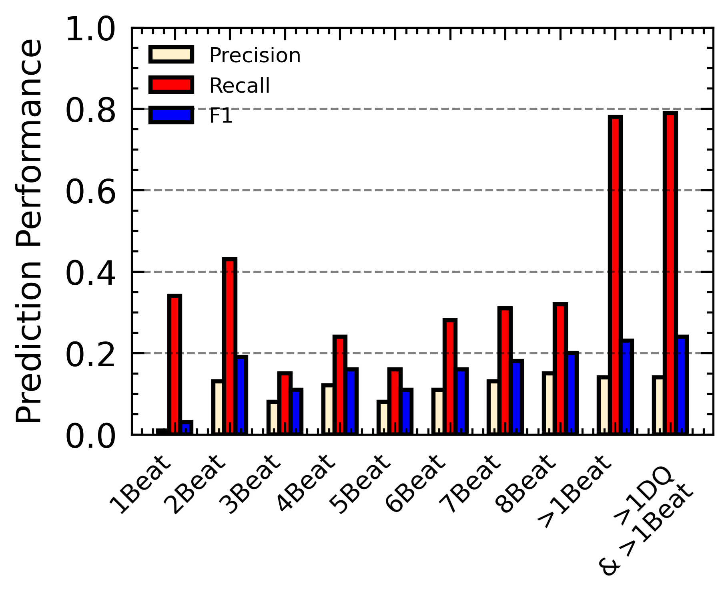
Micro-level Evaluation
Multi DQs and beats errors prone to higher UCE prediction performance
KEY OBSERVATION
Error DQ and beats play significant role in distinguishing UE occurrences.
Performance Analysis
The superiority of Multi DQs and beats predictors

Slide 22
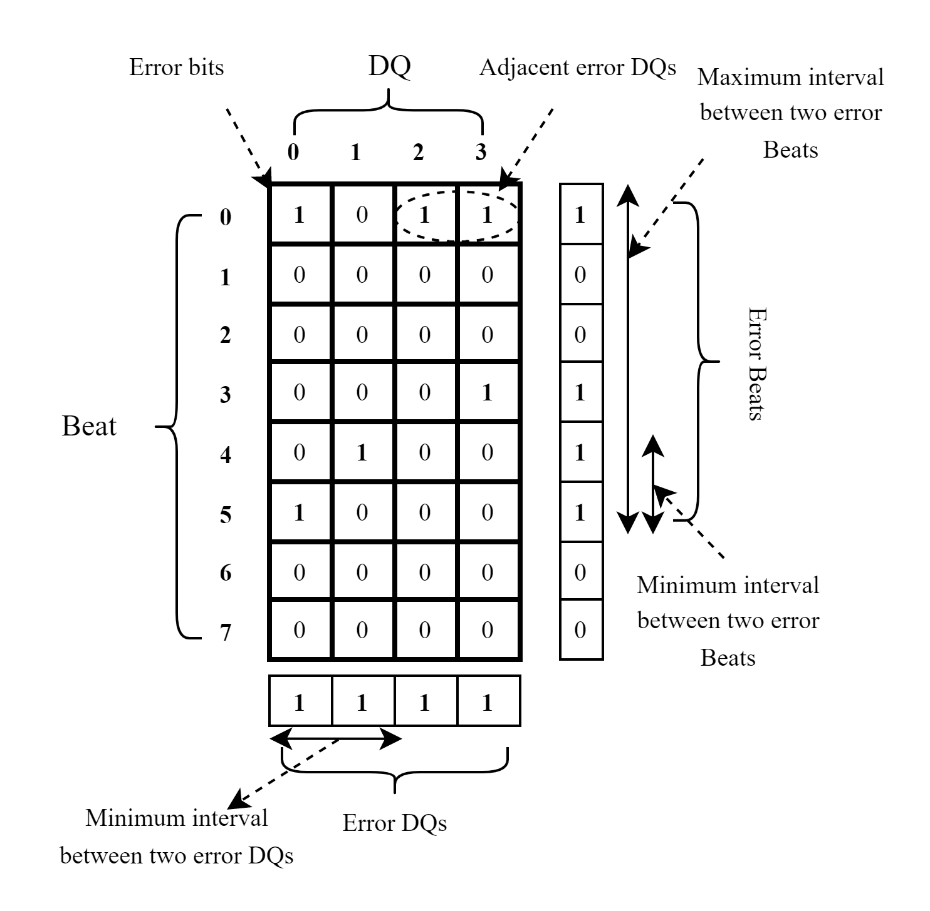
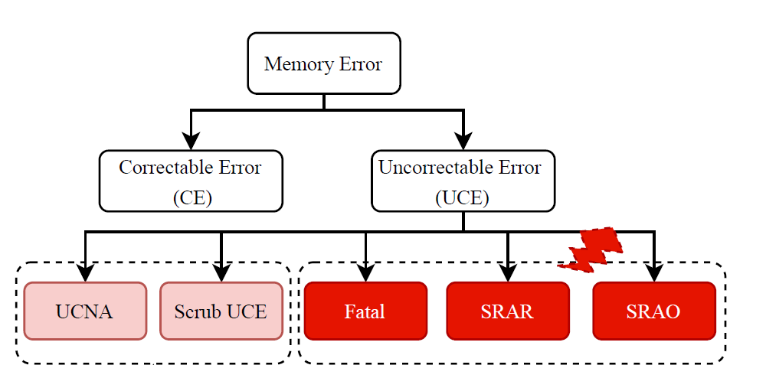
DIMM-level Features
Seven groups of spatio-temporal features are characterized for DIMM-level prediction.
1. Static Features: DIMM characteristics including Manufacturer, Data width, Frequency and Chip process.
2. CE Error Rate: the number of CEs and their occurrence frequency.
3. Fault Counts: cumulative number of micro-level faults (cell, row, column, bank and device).
4. Memory Events: CE storm, CE storm suppressed notification, CE overflow, etc.
5. DQ-Beat Error Bits Features: the spatial and temporal distribution of error bits in DQs and Beats.
6. Error bits pattern features: error-bit patterns which are more likely to encounter UCE.
7. AYU UCE rule: As-yet-unconsumed UCEs (e.g., UCNA, Patrol Scrub UCE) for UCE-caused failure prediction.
Notes:
Erroneous data bits are occurred in different DQs and beats, we investigate their spatical and temporal distribution for example adjacent DQs and distance between error DQs and beats. We also collected error bits pattern features as previous work for algorithm prediction.

Slide 23
DIMM-level Evaluation
The best performance
UCE
Prediction
UCE-caused
Failure Prediction
SUMMARY
Proposed Bit-level features and AYU UCE demonstrate significant generality across all algorithms, while LightGBM stands out as the best performance.

Slide 24
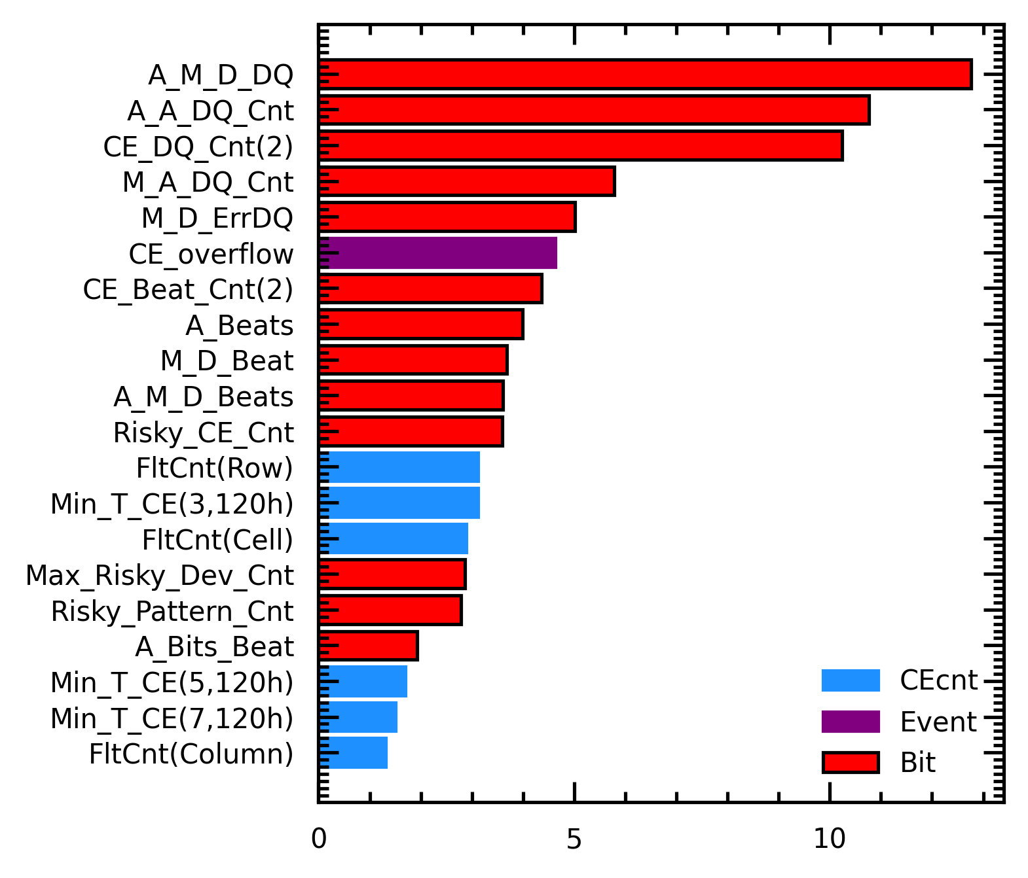
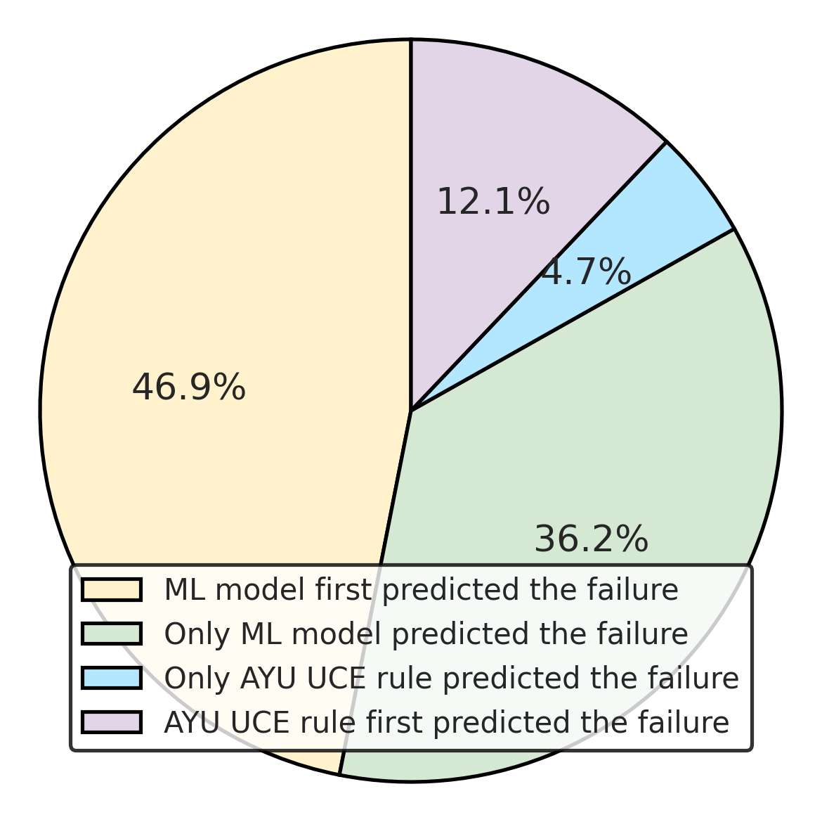
Model Analysis
Error DQs features
Micro-faults and CE frequency features
83%
17%
Feature Importance
Prediction timeliness
KEY OBSERVATION
Bit-level ones hold predominant importance among all features, while the combination of the ML model and AYU UCE showcases the best timeliness.

Slide 25
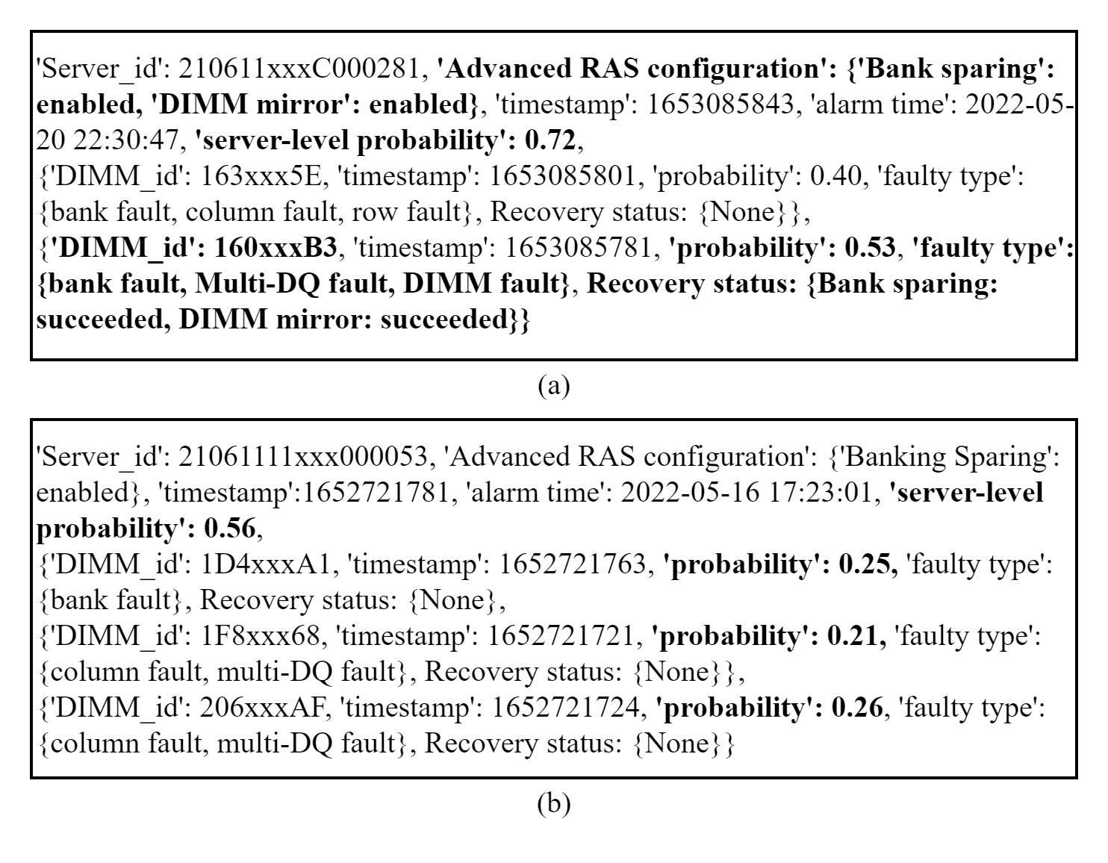

Server-level Prediction
Server-level memory failure prediction provides a comprehensive health assessment for all DIMMs in the server.
Server-level prediction
Server1
P1
P_server1
P2
P3
Data
DIMM-level Prediction
…
Server2
P4
P_server2
P5
P6

Slide 26
Performance in Server-level Prediction
The ALOR approach performs better in the 5-minute lead time, while achieving similar results to the MaxFailPro prediction in the 1 hour lead time.

Slide 27
Outline
Introduction
Related Work
Our Work
Exploring error bits for memory failure prediction: An in-depth correlative study (ICCAD’23)
HiMFP: Hierarchical intelligent memory failure prediction for cloud service reliability (DSN’23)
Investigating Memory Failure Prediction Across CPU Architectures (DSN’24)
Conclusion and Future Work
Notes:
This is the outline of our work. We first introduce the background.

Slide 28
Contribution
We present the first memory failure study between X86 and ARM systems in large-scale datacenters.
We develop ML-based algorithms for predicting memory failures, leveraging identified DRAM fault modes to anticipate UEs on these platforms.
We establish an MLOps framework of failure prediction, to facilitate the collaboration across teams and help manage production ML algorithms lifecycle.

Slide 29
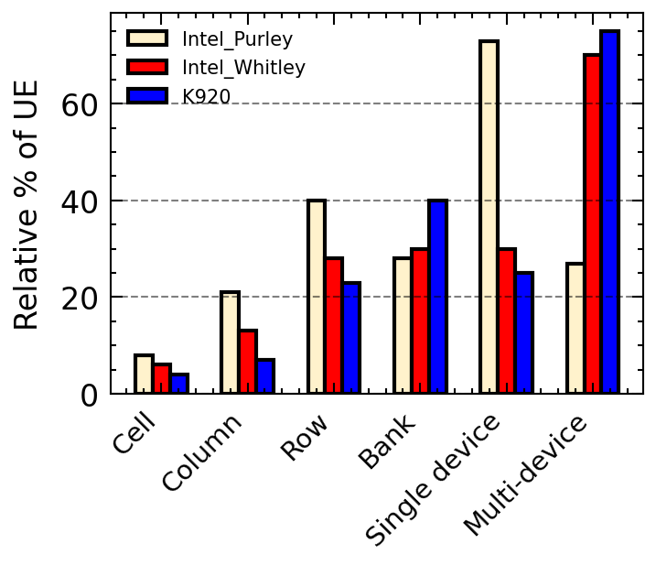
Component Fault Analysis
FINDING
The Intel Purley platform primarily experiences UEs due to single device faults. Meanwhile, the K920 and Intel whitley platforms exhibit fewer single device faults.
Notes:
We classify DRAM faults at a micro-level. For example, a cell fault refers to a repeatable CE (Correctable Error) in the same DRAM address. If these faults align within the same row or column, they are classified as row and column faults, respectively. If they span multiple devices, they are considered multi-device faults. The figure on the right-hand side shows the percentage of UEs (Uncorrectable Errors) associated with different micro-level faults across various CPUs. For instance, the Intel Purley platform exhibits more single-device faults compared to the Whitley and ARM K920 platforms. Our analysis reveals that different CPU architectures display distinct fault patterns.

Slide 30
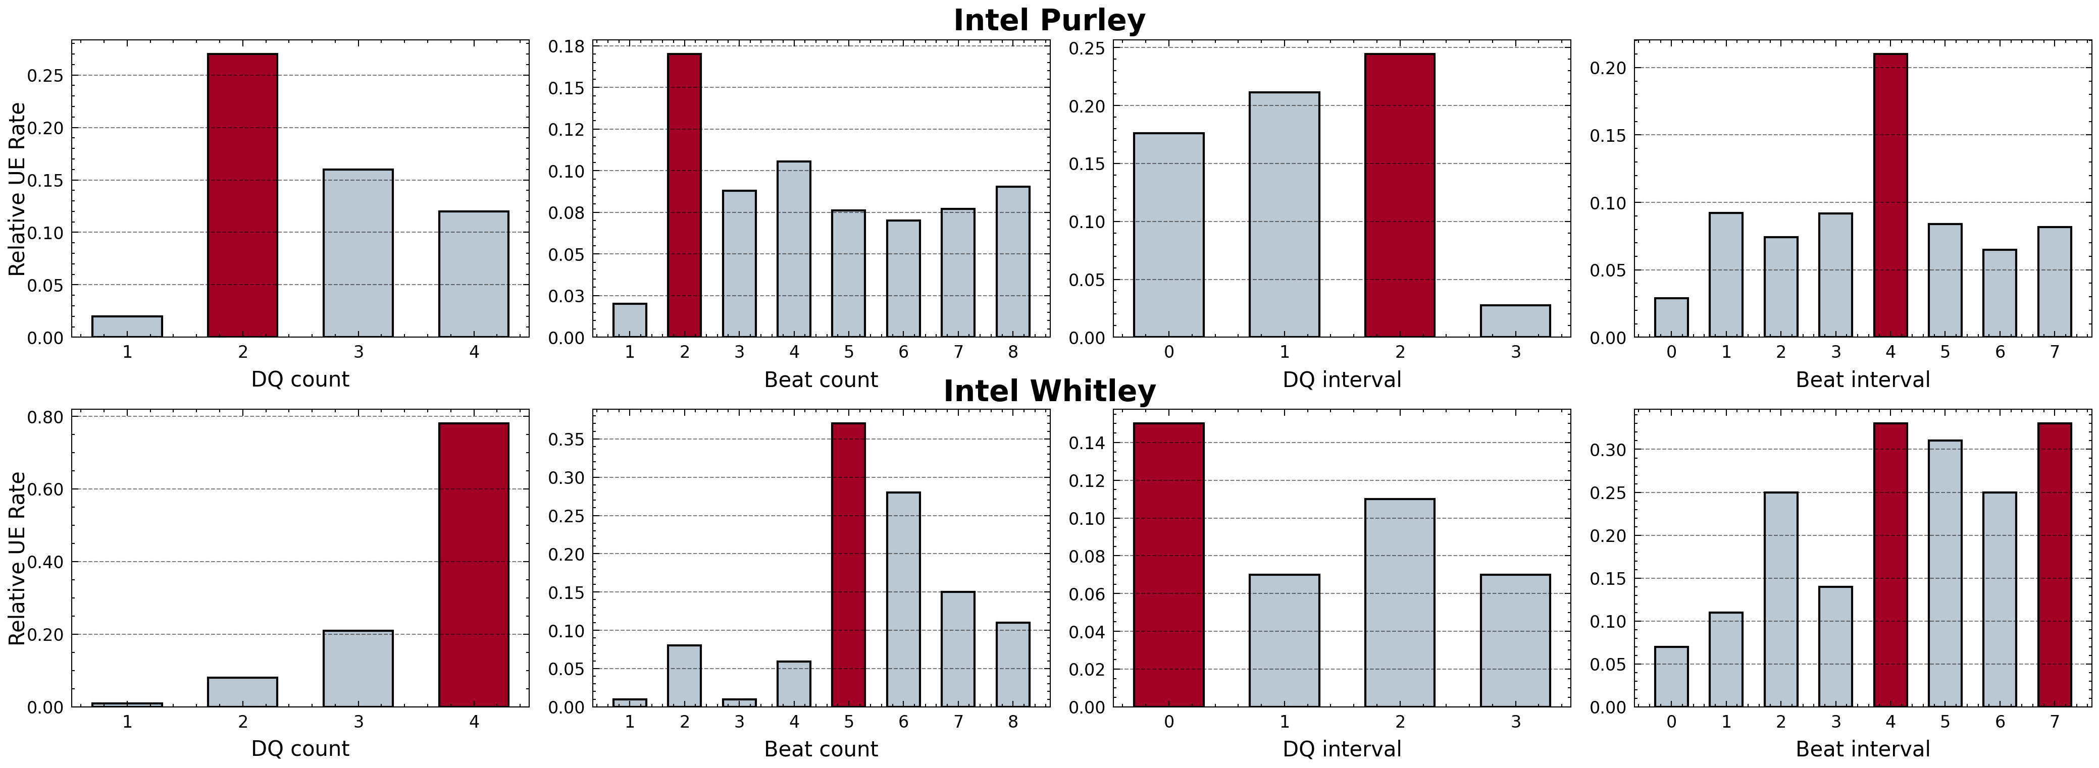
Error Bit Analysis
Relative UE rate: The fraction of DIMMs experiencing UEs based on specific characteristics, including
FINDING
At the bit-level within Intel architecture, distinct DQ and beat patterns emerge.
Notes:
Then, we analyze the error bits in DQ and beat by correlating them with UE rate. In Purley platform, error bits happened in two DQs or the multiple beats are more likely to encounter UE, Another observation is once the beat interval is 4, they have higher UE rate. By contrast, the Intel Whitley platform exhibited higher UE rates with 4 error DQs and 5 error beats counts.
In finding 3, At the bit-level within Intel architecture, distinct DQ and beat patterns emerge, highlighting the importance of formulating failure patterns designed to specific platforms

Slide 31
Performance in Different CPUs
Finding
Prediction efficacy varies across platforms; the Intel Whitley and K920 platform demonstrates comparatively weaker predictive performance.
Notes:
Then, we discuss the performance in different platforms. We are able to predict the most failures in Intel Purley platform, while less failures are predicted in Intel whitley and K920 platform.

Slide 32
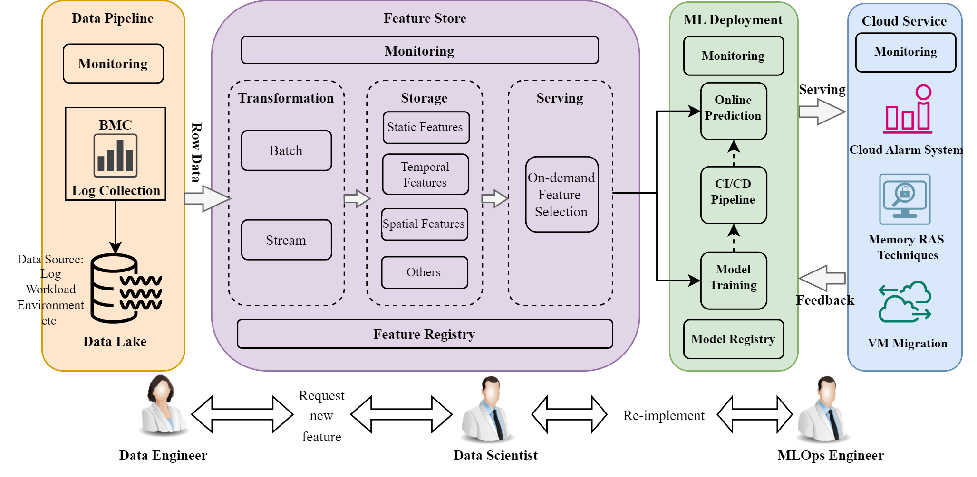
MLOps for Failure Prediction
Notes:
After developing machine learning (ML) algorithms, it is crucial to both maintain and enhance them. This engineering effort is essential for the fast iteration of algorithms online. Therefore, we need MLOps for memory failure prediction. We collect data from various sources, including logs, workloads, environmental data, and temperature, into the datalake. The raw data is then transformed, stored, and monitored in a feature store. Once models are trained and demonstrate significant improvements in benchmark evaluations, they are deployed in the production environment. The Cloud Alarm System triggers an alarm based on predicted memory failures. Depending on the use case, memory RAS (Reliability, Availability, and Serviceability) techniques are implemented to mitigate these failures. This pipeline requires collaboration across different teams in various departments, enhancing overall teamwork.

Slide 33
MLOps for Failure Prediction
Notes:
After developing machine learning (ML) algorithms, it is crucial to both maintain and enhance them. This engineering effort is essential for the fast iteration of algorithms online. Therefore, we need MLOps for memory failure prediction. We collect data from various sources, including logs, workloads, environmental data, and temperature, into the datalake. The raw data is then transformed, stored, and monitored in a feature store. Once models are trained and demonstrate significant improvements in benchmark evaluations, they are deployed in the production environment. The Cloud Alarm System triggers an alarm based on predicted memory failures. Depending on the use case, memory RAS (Reliability, Availability, and Serviceability) techniques are implemented to mitigate these failures. This pipeline requires collaboration across different teams in various departments, enhancing overall teamwork.

Slide 34
Impact of MLOps on The Production
Aspect | Without MLOps | With MLOps
Deployment Speed | Around 6 Months | ~Monthly
Algorithms | 1 | 4 in the production and >10 in test environment
Collaboration | Few teams and less communications | Various teams, closely collaboration
Monitoring | None | >3 main dashboards, >10 different analysis
Data Quality | 1 source, poor data quality and timeliness | 4 data sources, data quality monitoring.

Slide 35
Outline
Introduction
Related Work
Our Work
Exploring error bits for memory failure prediction: An in-depth correlative study (ICCAD’23)
HiMFP: Hierarchical intelligent memory failure prediction for cloud service reliability (DSN’23)
Investigating Memory Failure Prediction Across CPU Architectures (DSN’24)
Conclusion and Future Work
Notes:
This is the outline of our work. We first introduce the background.

Slide 36
Conclusion and Future Work
Conclusion:
We conduct the first in-depth bit-level analysis between error bits and UE. In addition, micro-level faults and system configurations are correlated with UE occurrences.
Combining different levels of predictors, As-yet-unconsumed (AYU) UCEs for predicting UCE-caused failures, and HiMFP framework is established to predict hierarchical levels of memory failure.
We investigate memory failure prediction across different CPU architectures in large-scale datacenters, and an MLOps framework is established to continue improving memory failure prediction.
Future Work:
Extend our algorithm to CE-driven failure Prediction include emerging memory technology, DDR5, HBM.

Slide 37
Thank You!
Q & A

