Slide 1

WWW 2025 SmartMem Competition
Team: NOVA
Member: Aibin Wang¹, Jiaxing Qi¹, Wentao Feng¹
Instructor: Zhongzhi Luan¹
¹Sino-German Joint Software Institute,Beihang University
28th April, 2025

Slide 2
Introduction
Background
Problem Definition

Slide 3



Background
Processor
Task
Execution
Data
Operation
Goal
In this Competition,Our goal is to predict whether each DRAM module will experience an Uncorrectable Error (UE) failure within the next k days.Which can avoid server crashes and reduce VM interruptions.
.
Task Failed
Detect&
Correct
Erroneous
Data
Main Memory(DRAM)
Server
Processor
IMC
Error Correction Code (ECC) Mechanism (e.g., SEC-DED, ChipKill) detects and corrects errors.
Problem:ECC is unable to correct all errors and Uncorrectable Errors(UEs) is one of primary causes of server failures and cluster downtime
[1]Reference:HPCA Tutorial: Memory Failure Prediction.Qiao Yu,Technical University of Berlin
Notes:
This competition provided datasets of three cities.
For each city, given a directed road graph, including the sets of nodes, edges and super-segments.
Here each super-segment is composed of a set of adjacent nodes.
The main data is vehicle counter data, which aggregates the traffic volume of each node during 15-minutes timeslot.
The extreme sparsity of this data is one of the difficulties of this competition.
Some static attributes of nodes and edges are also provided.

Slide 4
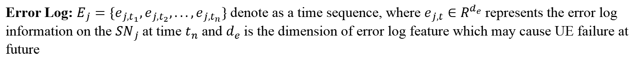
Problem Definition
The competition collected DIMM data from multiple servers via MCElog, and each DIMM is identiffed by its unique Serial Number (SN).
Memory Configuration: Denoted as $C_{j}∈R^{d_{c}}$, where the $d_{c}$ is the dimension of configuration feature,which include maunfacturter memory type, size, cpu’s model and etc.
Error Log: $E_{j}=\{e_{j,t_{1}},e_{j,t_{2}},...,e_{j,t_{n}}\}$ denote as a time sequence, where $e_{j,t}∈R^{d_{e}}$ represents the error log information on the $SN_{j}$ at time $t_{n}$ and $d_{e}$ is the dimension of error log feature which may cause UE failure at future
Error Label: Denoted as $y_{j}∈\{0,1\}$ , where $y_{j}=1$ indicating DIMM suffers the Uncorrectable Error (UE), otherwise it is Correctable Error (CE).
Our goal is to estimate the probability that DIMM will experience a UE within the prediction window (7days in competition),it can formalized as:
$$P(y_{j}=1|C_{j},E_{j})=f(C_{j},E_{j};θ^{∗})$$
Where $θ$ is the learnable parameters and $θ^{∗}$ is the optimal parameters.And the problem can be transformed into a minimization problem between the predicted probability distribution and the true probability distribution.
Notes:
This competition provided datasets of three cities.
For each city, given a directed road graph, including the sets of nodes, edges and super-segments.
Here each super-segment is composed of a set of adjacent nodes.
The main data is vehicle counter data, which aggregates the traffic volume of each node during 15-minutes timeslot.
The extreme sparsity of this data is one of the difficulties of this competition.
Some static attributes of nodes and edges are also provided.

Slide 5
Methodology
Prediction Framework
Feature Generation
Data Grouping
Training and Inference

Slide 6
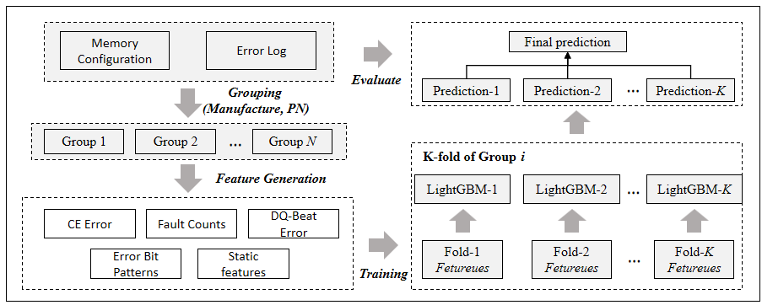
Prediction Framework
Grouping
Feature Generation
Training
Prediction
Evaluate
Notes:
This competition provided datasets of three cities.
For each city, given a directed road graph, including the sets of nodes, edges and super-segments.
Here each super-segment is composed of a set of adjacent nodes.
The main data is vehicle counter data, which aggregates the traffic volume of each node during 15-minutes timeslot.
The extreme sparsity of this data is one of the difficulties of this competition.
Some static attributes of nodes and edges are also provided.

Slide 7
Feature Generation
CE Error features refer to the number of CE and their occurrence frequency.Most features are similar to those in Work A[2].However,we have proposed our own features, which are described as below:
Max_Unique_CE_Error_Frequency ($t_{i}$): maximum frequency of consecutive identical CEs (Same location and ECC error code) within $t_{i}$ , Where $t_{i}$ is time interval.
Min_Unique_CE_Error_Frequency($t_{i}$): minimum frequency of consecutive identical CEs within $t_{i}$
Max_Unique_CE_Error_Count($t_{i}$): maximum number of all consecutive identical CEs within $t_{i}$
Identical CEs
Different color means CEs happen in Different location
[2]Yu, Qiao, et al. "Himfp: Hierarchical intelligent memory failure prediction forcloud service reliability." 2023 53rd Annual IEEE/IFIP International Conferenceon Dependable Systems and Networks (DSN). IEEE, 2023.
Notes:
This competition provided datasets of three cities.
For each city, given a directed road graph, including the sets of nodes, edges and super-segments.
Here each super-segment is composed of a set of adjacent nodes.
The main data is vehicle counter data, which aggregates the traffic volume of each node during 15-minutes timeslot.
The extreme sparsity of this data is one of the difficulties of this competition.
Some static attributes of nodes and edges are also provided.

Slide 8
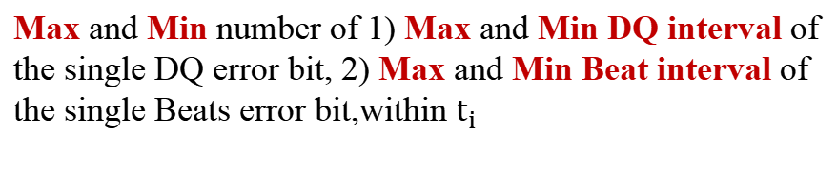
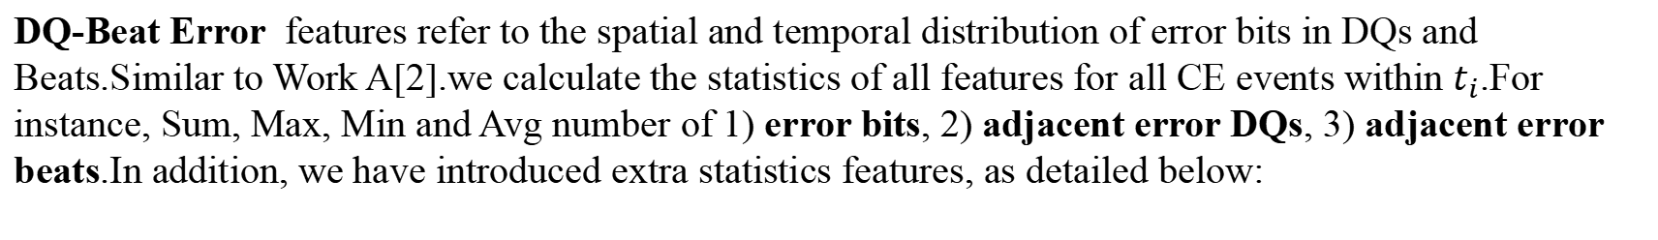
Feature Generation
DQ-Beat Error features refer to the spatial and temporal distribution of error bits in DQs and Beats.Similar to Work A[2].we calculate the statistics of all features for all CE events within $t_{i}$.For instance, Sum, Max, Min and Avg number of 1) error bits, 2) adjacent error DQs, 3) adjacent error beats.In addition, we have introduced extra statistics features, as detailed below:
Adjacent Error Beats
ErrorBeats
Max and Min number of 1) Max and Min DQ interval of the single DQ error bit, 2) Max and Min Beat interval of the single Beats error bit,within $t_{i}$
1
0
0
1
1
1
0
0
0
1
0
0
0
0
1
0
0
1
1
0
0
0
0
1
0
0
0
1
DQ
2
1
0
0
0
0
0
0
0
1
Maximun of Maximun intervals
3
1
0
0
1
0
0
0
0
1
Different Error Beats
1
0
0
1
1
1
0
0
0
1
2
3
4
5
6
7
ErrorDQs
Error
Bit
1
0
1
1
1
1
0
1
Minimum of Minimum intervals
Beat
[2]Yu, Qiao, et al. "Himfp: Hierarchical intelligent memory failure prediction forcloud service reliability." 2023 53rd Annual IEEE/IFIP International Conferenceon Dependable Systems and Networks (DSN). IEEE, 2023.
Notes:
This competition provided datasets of three cities.
For each city, given a directed road graph, including the sets of nodes, edges and super-segments.
Here each super-segment is composed of a set of adjacent nodes.
The main data is vehicle counter data, which aggregates the traffic volume of each node during 15-minutes timeslot.
The extreme sparsity of this data is one of the difficulties of this competition.
Some static attributes of nodes and edges are also provided.

Slide 9
Feature Generation
Fault Counts features refers to cumulative number of microlevel faults (cell, row, column, bank and device) within $t_{i}$.
Error Bit Patterns features refer to risky CE occurrence in terms of guaranteed coverage by ECC[3].
Static Features describe DIMM characteristics. including manufacturer, data width, and chip procedure, which are transformed into one-hot encoding features in our approach.
0
0
0
0
0
x
0
0
0
0
0
0
0
0
0
0
0
0
0
0
0
x
0
0
0
0
0
0
x
0
0
0
0
0
0
0
0
0
0
0
0
0
0
0
x
0
0
0
0
0
0
0
0
0
0
0
x
0
0
0
0
0
0
0
x
0
0
0
0
0
0
0
0
0
0
0
0
0
0
0
x
0
0
x
0
0
0
0
x
0
0
x
0
0
0
0
(a) a fully correctable error-bit pattern
(b) another fully correctable error-bit pattern
(c) an actual error-bit pattern from a risky CE
[3]Li, Cong, et al. "From correctable memory errors to uncorrectable memory errors:What error bits tell." SC22: International Conference for High Performance Computing, Networking, Storage and Analysis. IEEE, 2022.
Notes:
This competition provided datasets of three cities.
For each city, given a directed road graph, including the sets of nodes, edges and super-segments.
Here each super-segment is composed of a set of adjacent nodes.
The main data is vehicle counter data, which aggregates the traffic volume of each node during 15-minutes timeslot.
The extreme sparsity of this data is one of the difficulties of this competition.
Some static attributes of nodes and edges are also provided.

Slide 10
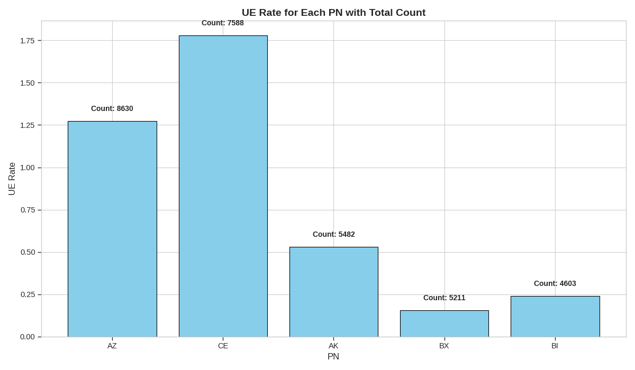
Data Grouping
Data Grouping: In system services, DIMM modules from various vendors have diverse hardware architectures and characteristics. WorkB[3] finds that UE-prone faults are speciffc to certain DIMM part numbers and can be generic to certain manufacturers. WorkC[4] also points out that different manufacturers show different UE rates, which may result from DIMM process differences.
[3]Li, Cong, et al. "From correctable memory errors to uncorrectable memory errors:What error bits tell." SC22: International Conference for High Performance Computing, Networking, Storage and Analysis. IEEE, 2022.
[4]Yu, Qiao, et al. "Investigating Memory Failure Prediction Across CPU Architectures."2024 54th Annual IEEE/IFIP International Conference on Dependable Systems and Networks-Supplemental Volume (DSN-S). IEEE, 2024.
Notes:
This competition provided datasets of three cities.
For each city, given a directed road graph, including the sets of nodes, edges and super-segments.
Here each super-segment is composed of a set of adjacent nodes.
The main data is vehicle counter data, which aggregates the traffic volume of each node during 15-minutes timeslot.
The extreme sparsity of this data is one of the difficulties of this competition.
Some static attributes of nodes and edges are also provided.

Slide 11
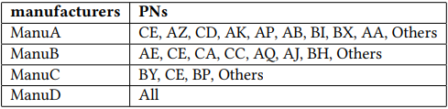
Data Grouping
Data Grouping: Our work groups different PNs across various manufacturers,enabling the model to learn distinct hardware characteristics in later stages. The speciffc grouping is shown in the table below:
[3]Li, Cong, et al. "From correctable memory errors to uncorrectable memory errors:What error bits tell." SC22: International Conference for High Performance Computing, Networking, Storage and Analysis. IEEE, 2022.
[4]Yu, Qiao, et al. "Investigating Memory Failure Prediction Across CPU Architectures."2024 54th Annual IEEE/IFIP International Conference on Dependable Systems and Networks-Supplemental Volume (DSN-S). IEEE, 2024.
Notes:
This competition provided datasets of three cities.
For each city, given a directed road graph, including the sets of nodes, edges and super-segments.
Here each super-segment is composed of a set of adjacent nodes.
The main data is vehicle counter data, which aggregates the traffic volume of each node during 15-minutes timeslot.
The extreme sparsity of this data is one of the difficulties of this competition.
Some static attributes of nodes and edges are also provided.

Slide 12
Training and Inference
Label Method: We score positive samples using soft labels, with scores ranging from 0.5 to 1. A smaller time interval between a CE event in the positive sample and the ffrst UCE occurrence results in a score
closer to 1; otherwise, it approaches 0.5.
Model: In our work, we tackle the failure prediction problem through regression rather than binary classiffcation. We employ LightGBM, a tree - based machine learning algorithm, for DIMM - level prediction.
Prediction: we utilize a voting system among multiple models to determine the ffnal result.The final result undergoes post - processing. If its score is below the threshold, UE is deemed not to occur; otherwise, UE is expected to happen
Notes:
This competition provided datasets of three cities.
For each city, given a directed road graph, including the sets of nodes, edges and super-segments.
Here each super-segment is composed of a set of adjacent nodes.
The main data is vehicle counter data, which aggregates the traffic volume of each node during 15-minutes timeslot.
The extreme sparsity of this data is one of the difficulties of this competition.
Some static attributes of nodes and edges are also provided.

Slide 13
Experiments
Hyperparameter Settings
Feature Importance
Classification Performance

Slide 14
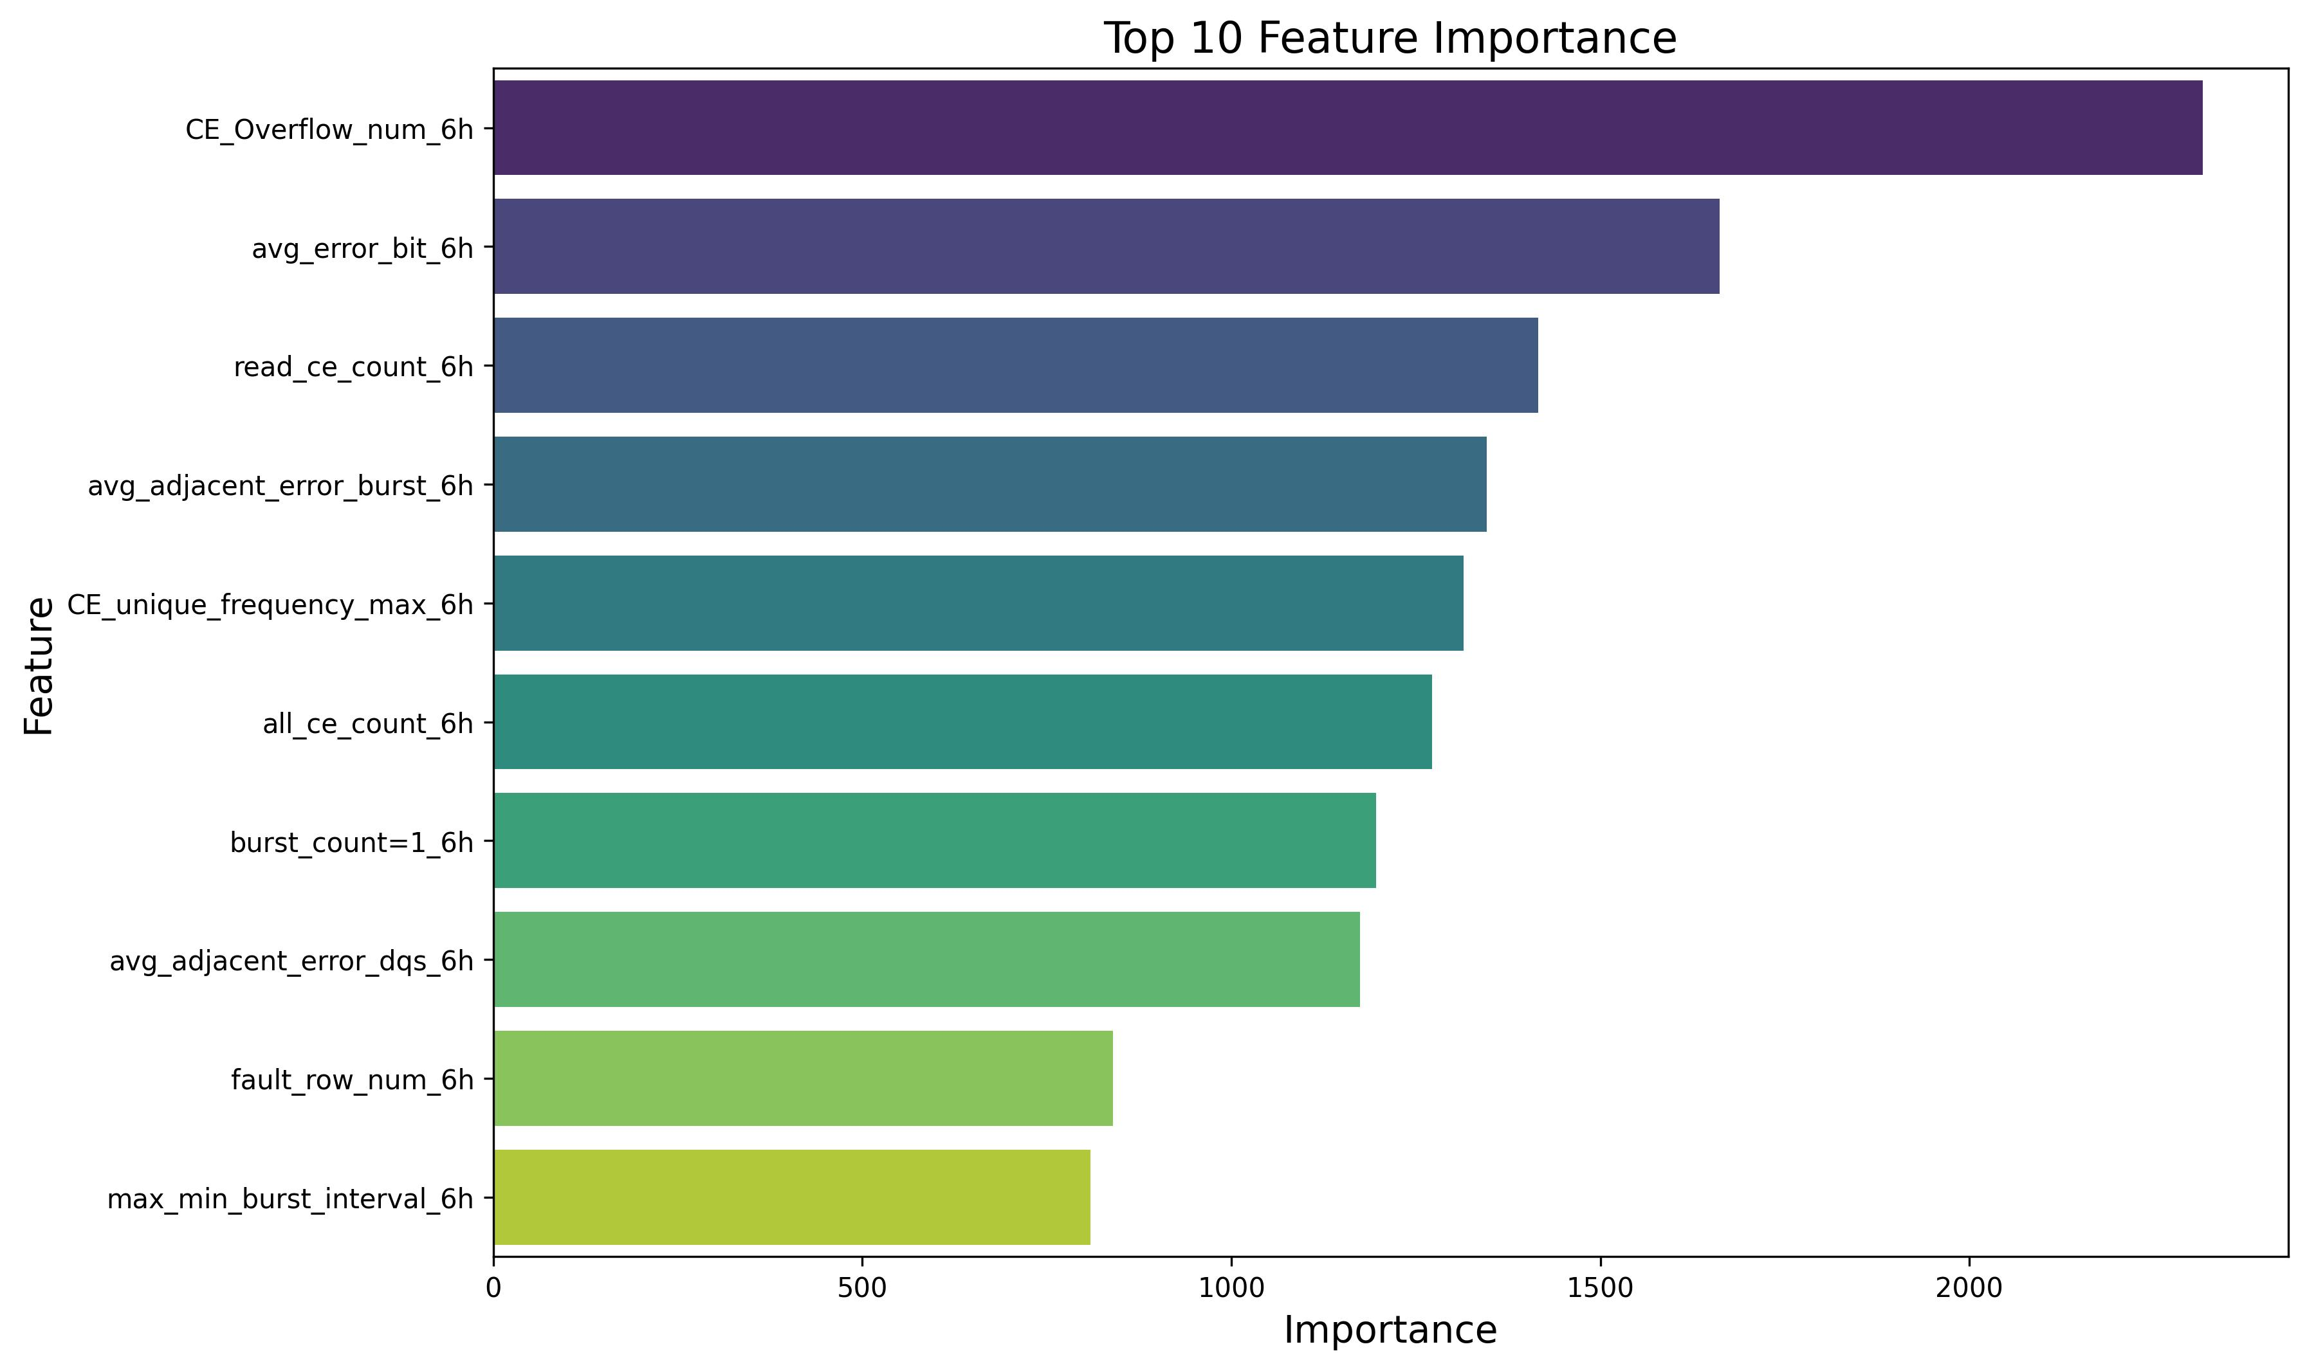
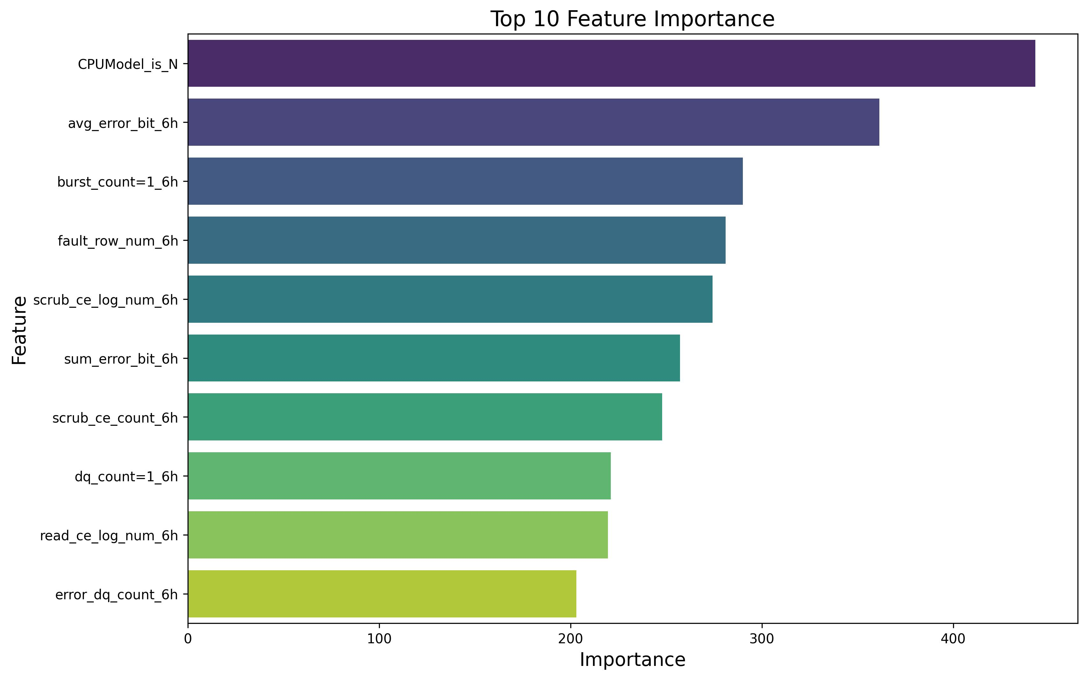
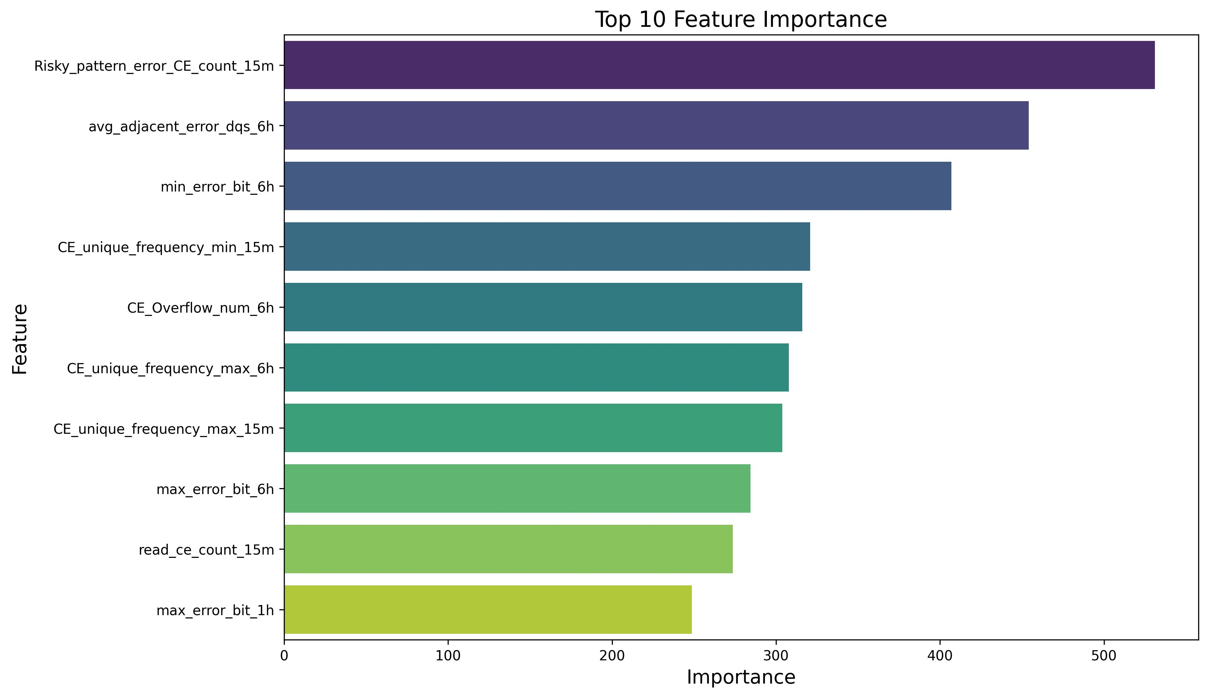
Experiments
Hyperparameter Settings
Model | max_depth | num_leaves | min_child_samples | n_estimators | learning_rate | verbose | n_jobs
LightGBM | 8 | 64 | 64 | 500 | 0.1 | -1 | -1
Feature Importance
（a）
（b）
（c）
Our feature rank Top
Some groups were less sensitive to CE
Risky feature still important
Notes:
This competition provided datasets of three cities.
For each city, given a directed road graph, including the sets of nodes, edges and super-segments.
Here each super-segment is composed of a set of adjacent nodes.
The main data is vehicle counter data, which aggregates the traffic volume of each node during 15-minutes timeslot.
The extreme sparsity of this data is one of the difficulties of this competition.
Some static attributes of nodes and edges are also provided.

Slide 15
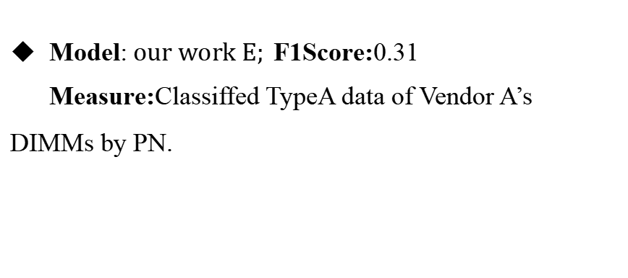

Classification Performance
Model:$our work E;$F1Score:0.31
Measure:Classiffed TypeA data of Vendor A’s DIMMs by PN.
Model:$baseline ;$F1Score:0.207
Model:$our work baseline;$F1Score:0.21
Measure:Adjusted the observation window and time interval.
Model:$our work A ;$F1Score:0.23
Measure:Added DQ-Beat Errors features.
Model:$our work B ;$F1Score:0.25
Measure:Added Risky Pattern features.
Model:$our work C ;$F1Score:0.27
Measure:Applied k-fold cross - validation, switched the task to regression, and modiffed the positive sample labeling method.
Model:$our work D ;$F1Score:0.29
Measure:Used data grouping for sampling, classifying DIMMs by manufacturer and training/inferencing with separate models for each manufacturer.
Notes:
This competition provided datasets of three cities.
For each city, given a directed road graph, including the sets of nodes, edges and super-segments.
Here each super-segment is composed of a set of adjacent nodes.
The main data is vehicle counter data, which aggregates the traffic volume of each node during 15-minutes timeslot.
The extreme sparsity of this data is one of the difficulties of this competition.
Some static attributes of nodes and edges are also provided.

Slide 16
Conclusions

Slide 17
CONCLUSION
Group modeling-based solution
To predict these failures in advance, we propose a group modeling-based solution to overcome the distribution complexity and distribution shift problems of existing methods.
Feature Engineering
our work adds new features to CE Error and DQ-Beat Error based on prior research. And totally extract five features including CE Error, DQ-Beat Error, Fault Counts, Error Bit Patterns, Static Features.
Ensemble Voting Mechanism
we apply k - fold cross - validation and leverage an ensemble voting mechanism across multiple models to boost result validity.
Notes:
This competition provided datasets of three cities.
For each city, given a directed road graph, including the sets of nodes, edges and super-segments.
Here each super-segment is composed of a set of adjacent nodes.
The main data is vehicle counter data, which aggregates the traffic volume of each node during 15-minutes timeslot.
The extreme sparsity of this data is one of the difficulties of this competition.
Some static attributes of nodes and edges are also provided.

Slide 18


