Slide 1

WWW 2025 SmartMem Competition
Team: Choosing a name is such a headache
Member: Qianli Ma¹, Xinyi Peng¹, Congcong Gu²
¹East China Normal University
²Pingan
28th April, 2025

Slide 2
Introduction
Team Introduction
Problem Definition

Slide 3




Team Introduction
Xinyi Peng
Specialized in recommendation algorithms, responsible for algorithm design.
2024 Tianchi-AFAC LLM Contest
2024 IJCAI-Voice DeepFake Detection
2023 Tsinghua-China Collegiate Computing Contest
2023 Tianchi-AFAC TimeSeries Contest
2023 Tianchi-IEEE-AICAS RecSys Contest
2023 Tianchi-Imagine Computing Contest
Qianli Ma
Specialized in RL, responsible for engineering optimization.
Congcong Gu
Specialized in recommendation algorithms.
Notes:
This competition provided datasets of three cities.
For each city, given a directed road graph, including the sets of nodes, edges and super-segments.
Here each super-segment is composed of a set of adjacent nodes.
The main data is vehicle counter data, which aggregates the traffic volume of each node during 15-minutes timeslot.
The extreme sparsity of this data is one of the difficulties of this competition.
Some static attributes of nodes and edges are also provided.

Slide 4
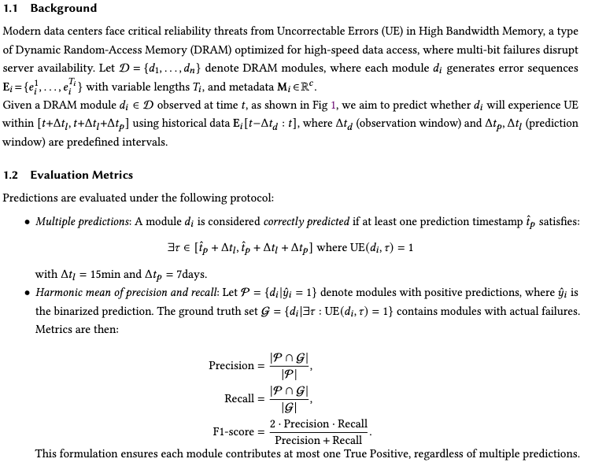
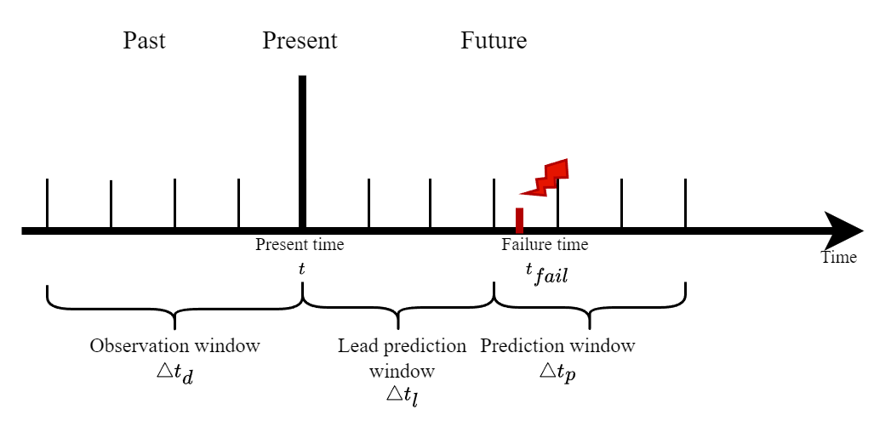
Problem Definition
Notes:
This competition provided datasets of three cities.
For each city, given a directed road graph, including the sets of nodes, edges and super-segments.
Here each super-segment is composed of a set of adjacent nodes.
The main data is vehicle counter data, which aggregates the traffic volume of each node during 15-minutes timeslot.
The extreme sparsity of this data is one of the difficulties of this competition.
Some static attributes of nodes and edges are also provided.

Slide 5
Methodology
Challenge 1: Severe Class Imbalance
Challenge 2: Information-Sparse Samples
Challenge 3: Extreme Data Skewness
Challenge 4: High Noise and Missing Data in Raw Logs

Slide 6
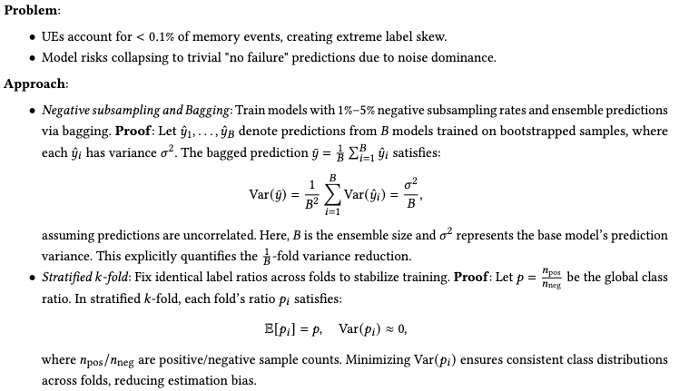
Challenge 1: Severe Class Imbalance
Notes:
This competition provided datasets of three cities.
For each city, given a directed road graph, including the sets of nodes, edges and super-segments.
Here each super-segment is composed of a set of adjacent nodes.
The main data is vehicle counter data, which aggregates the traffic volume of each node during 15-minutes timeslot.
The extreme sparsity of this data is one of the difficulties of this competition.
Some static attributes of nodes and edges are also provided.

Slide 7
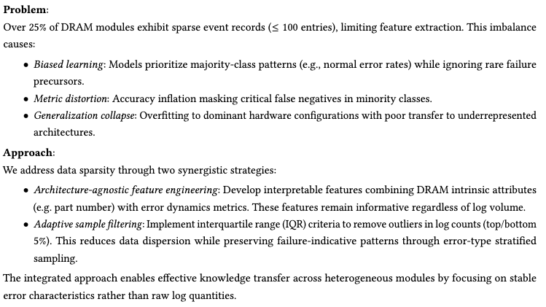
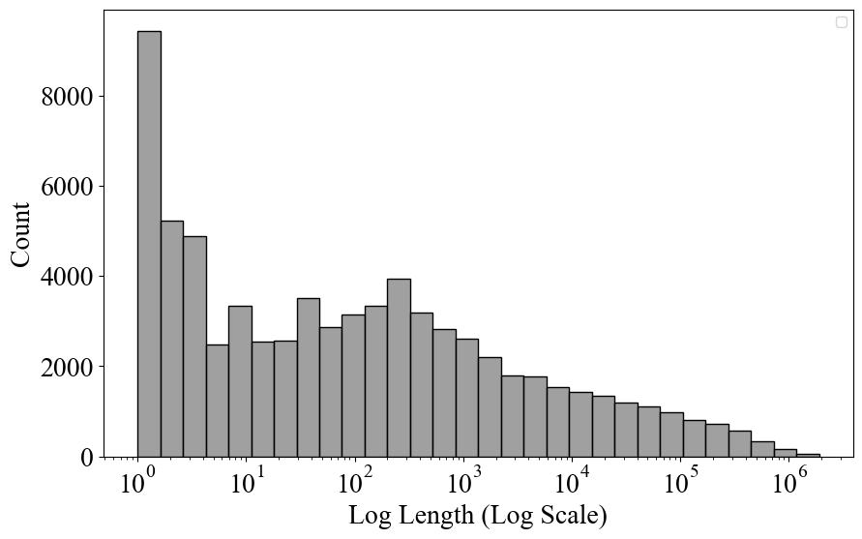
Challenge 2: Information-Sparse Samples
Notes:
This competition provided datasets of three cities.
For each city, given a directed road graph, including the sets of nodes, edges and super-segments.
Here each super-segment is composed of a set of adjacent nodes.
The main data is vehicle counter data, which aggregates the traffic volume of each node during 15-minutes timeslot.
The extreme sparsity of this data is one of the difficulties of this competition.
Some static attributes of nodes and edges are also provided.

Slide 8
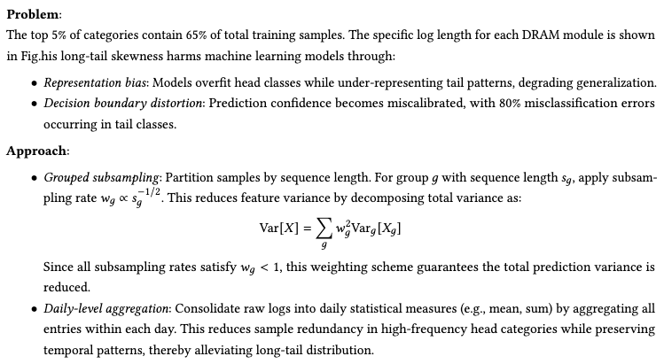
Challenge 3: Extreme Data Skewness
Notes:
This competition provided datasets of three cities.
For each city, given a directed road graph, including the sets of nodes, edges and super-segments.
Here each super-segment is composed of a set of adjacent nodes.
The main data is vehicle counter data, which aggregates the traffic volume of each node during 15-minutes timeslot.
The extreme sparsity of this data is one of the difficulties of this competition.
Some static attributes of nodes and edges are also provided.

Slide 9
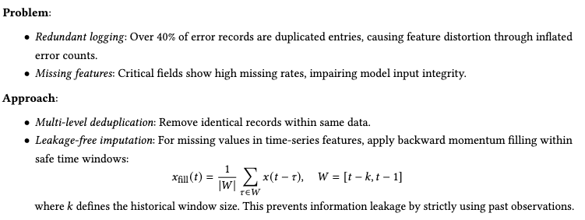
Challenge 4: High Noise and Missing Data in Raw Logs
Notes:
This competition provided datasets of three cities.
For each city, given a directed road graph, including the sets of nodes, edges and super-segments.
Here each super-segment is composed of a set of adjacent nodes.
The main data is vehicle counter data, which aggregates the traffic volume of each node during 15-minutes timeslot.
The extreme sparsity of this data is one of the difficulties of this competition.
Some static attributes of nodes and edges are also provided.

Slide 10
Experiments
Label Construction Study
Sample Selection Study
Model Validation Study

Slide 11
Label Construction Study
We label a DRAM module as positive if it experiences UE within 7 days after the observation window (excluding the immediate 15-minute buffer). We experimented with various labeling windows and found longer windows caused distribution shift. Using the last two months as validation data with fixed parameters
Window Length | F1-Score
1days | 0.21
3days | 0.25
7days | 0.30
14days | 0.25
Notes:
This competition provided datasets of three cities.
For each city, given a directed road graph, including the sets of nodes, edges and super-segments.
Here each super-segment is composed of a set of adjacent nodes.
The main data is vehicle counter data, which aggregates the traffic volume of each node during 15-minutes timeslot.
The extreme sparsity of this data is one of the difficulties of this competition.
Some static attributes of nodes and edges are also provided.

Slide 12
Sample Selection Study
To address data imbalance and sparsity, we implemented various sampling strategies. Using the last two months as validation data with fixed labeling.
Method | F1-Score
Baseline | 0.21
Negative Sampling (0.01) | 0.27
Negative Sampling (0.1) | 0.30
Negative Sampling (0.2) | 0.30
Adaptive Sample Filtering | 0.29
Grouped Subsampling | 0.29
Notes:
This competition provided datasets of three cities.
For each city, given a directed road graph, including the sets of nodes, edges and super-segments.
Here each super-segment is composed of a set of adjacent nodes.
The main data is vehicle counter data, which aggregates the traffic volume of each node during 15-minutes timeslot.
The extreme sparsity of this data is one of the difficulties of this competition.
Some static attributes of nodes and edges are also provided.

Slide 13
Model Validation Study
We evaluated different validation strategies while maintaining optimal sampling and labeling configurations. Our final approach used temporal split validation with 2-month windows.
Validation Method | Params | F1-Score
Random split | valid_ratio=0.3 | 0.24
Full Training | Round=Best | 0.23
Temporal split | K=5 | 0.23
K-fold | K=5 | 0.22
Group K-fold | Group=sn_name | 0.25
Stratified K-fold | K=5 | 0.30
Notes:
This competition provided datasets of three cities.
For each city, given a directed road graph, including the sets of nodes, edges and super-segments.
Here each super-segment is composed of a set of adjacent nodes.
The main data is vehicle counter data, which aggregates the traffic volume of each node during 15-minutes timeslot.
The extreme sparsity of this data is one of the difficulties of this competition.
Some static attributes of nodes and edges are also provided.

Slide 14
Conclusions

Slide 15
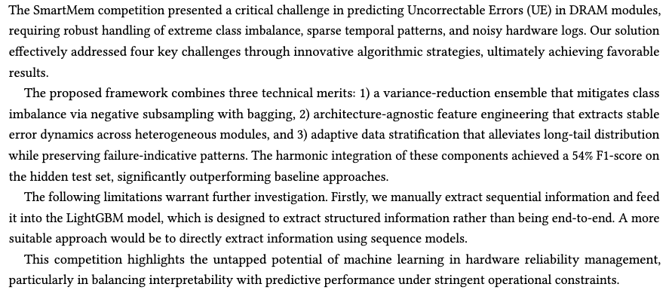
Conclusions
Notes:
This competition provided datasets of three cities.
For each city, given a directed road graph, including the sets of nodes, edges and super-segments.
Here each super-segment is composed of a set of adjacent nodes.
The main data is vehicle counter data, which aggregates the traffic volume of each node during 15-minutes timeslot.
The extreme sparsity of this data is one of the difficulties of this competition.
Some static attributes of nodes and edges are also provided.

Slide 16


