Slide 1

WWW 2025 SmartMem Competition
Team: It's all fate
Member: Long Teng^{1,} Yu Zhan²
¹Brltech
²Beihang University
28th April, 2025
Notes:
[Presenters]
"Good afternoon distinguished judges and colleagues. We're Team 'It's All Fate' from Beihang University. Today, we present our solution for the WWW 2025 SmartMem Competition, addressing the critical challenge of predicting DRAM Uncorrectable Errors (UEs) to improve data center reliability. I'm [Name], and with me is [Name]. Let's begin."

Slide 2
Background
Goal
Evaluation

Slide 3
BackGround
Uncorrectable Errors (UE’s) of Dynamic Random Access Memory (DRAM) have been identified as a major failure cause in data centers.The multibit UE failure of high-bandwidth memory (HBM) poses a significant threat to the availability and reliability of servers and entire computing clusters. Forecasting UE’s before enacting preemptive maintenance measures has emerged as a viable strategy to minimize server outages
Goal
Our goal is to predict whether each DIMM with serial number (SN) will experience an Uncorrectable Error (UE) failure within the next k days. Thus, the problem is formulated as a binary classification problem
Notes:
[Visual: Server outage statistics]
"Dynamic RAM errors cause 23% of unplanned outages in hyperscale data centers. Current UE prediction methods face three critical limitations: extreme data sparsity with over 40% missing values, hardware heterogeneity gaps between vendors, and operational environment shifts. These challenges demand innovative solutions for reliable failure forecasting.Our mission is binary classification: predict whether each DIMM will experience UE failure within k days. "
顺便读ppt

Slide 4
Evaluation
Figure 1 illustrates our evaluation protocol, which is designed tomeet production requirements with temporally rigorous constraints .Formally, at timestamp t, a predictive algorithm analyzes historical data from an observation window [𝑡 − Δ𝑡𝑑 : 𝑡] to forecast potential failures within the prediction interval:
P (𝑡) = [𝑡 + Δ𝑡𝑙 , 𝑡 + Δ𝑡𝑙 + Δ𝑡𝑝 ]
• t𝑑 : Duration of observation window (historical data scope)
• t𝑙 : Minimum lead time between prediction and failure (15minutes)
• t𝑝 : Prediction interval duration (7 days)
Notes:
[Visual: Binary classification diagram]
"The evaluation protocol strictly enforces temporal causality - using historical data from [t-Δtₒ : t] to predict failures in [t+15min, t+7days]. This prevents future data leakage while matching real-world maintenance requirements."顺便读ppt

Slide 5
Methodology
Problem Definition
Data Generation
Feature Generation

Slide 6
Problem Definition
Practical Significance
UE is one of the main causes of server downtime. Predicting in advance can reduce downtime and opti-mize operation and maintenance costs
Limitations and Challenges
Data noise and extreme class imbalance
ncomplete Error Characterization
Hardware Heterogeneity Gap
ECC Degradation Challenge
Distribution offset caused by changes in operating environment
Notes:
Visual: Data center maintenance cost chart]
"Three key challenges stand out: First, extreme class imbalance with UE prevalence <0.1%. Second, hardware heterogeneity causing vendor-specific error patterns. Third, ECC degradation that masks true error rates. These create a perfect storm of noisy data and shifting distributions."顺便读ppt

Slide 7

Data Generation
Error and Missing Data
• Over 40% duplicate rate in raw error logs
• high missing rates in critical temporal features
• Multi-Level Deduplication:
(1) Device-level duplicate removal (MD5 hashing)
(2) Sliding window filtering (Δ𝑡 = 5min)
(3) Semantic deduplication via error code clustering
• Causal Imputation: Implement leakage-free filling using back-
ward window averaging:
Notes:
We implemented a five-stage data refinement: 读ppt

Slide 8
Data Generation
Distribution Characteristics
• Top 5% modules account for 71.2% of total logs (Gini coeffi-cient=0.68)
• Long-tail effect causes ≥3.2× increase in cross-entropy loss
Balancing Methodology
• Geometric Subsampling: Apply length-dependent sampling weights
• emporal Aggregation: Convert raw logs to daily statistica profiles

Slide 9
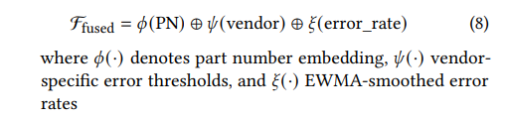
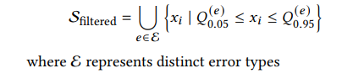
Data Generation
Data-Sparse Samples Empirical Observations
• Intrinsic Attribute Fusion: Combine static DRAM properties with dynamic error metrics:
Balancing Methodology
• Adaptive Quantile Filtering: Preserve failure precursors through error-type aware sampling
• emporal Aggregation: Convert raw logs to daily statistica profiles

Slide 10
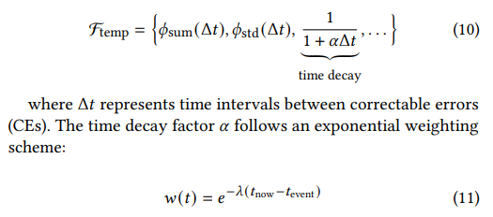
Feature Generation
Data-Sparse Samples Empirical Observations
•Temporal Feature Engineering. For each DRAM module, we extract temporal patterns through configurable sliding windows 𝑊 ∈ {5D,7D}:
Notes:
Slide 6: Feature Generation​​
[Visual: Feature engineering flowchart]
"Our adaptive feature engineering combines:
Temporal patterns via 5D/7D sliding windows
Vendor embeddings learned through matrix factorization
Error code parity analysis for hardware-specific failure signatures
Key innovation: Quantile-filtered aggregation preserves rare failure precursors while reducing noise." 读ppt

Slide 11


Feature Generation
Categorical Attribute Encoding
• For categorical variables C ={vendor,rank, ...}, we implemen
where ⊕ denotes concatenation of:
• Learned embeddings via matrix factorization
• Statistical aggregates per category:

Slide 12
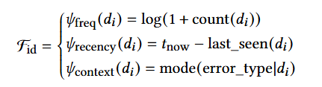
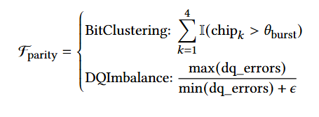
Feature Generation
Device ID Feature Generation.
Parity Pattern Analysis

Slide 13
Experiments
Model Training
Experimental Settings
Results
Notes:
Then we will present our experimental settings and results for two challenges.

Slide 14
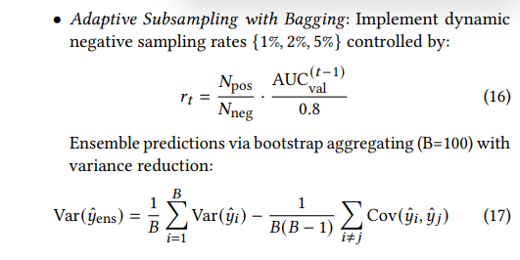
Model Training
Problem Analysis
• UE prevalence exhibits extreme rarity with 𝑃 (𝑦 = 1) < 10−3 in our dataset
• Naive models degenerate to trivial all-negative predictions (AUC-ROC = 0.5)
• Noise-dominated loss landscapes impede gradient signal propagation
Technical Solution
Notes:
读ppt

Slide 15
Experimental Settings
Parameter Settings
Other Experimental Settings
Feature Engineering:
– Temporal window: 5D/7D with mean/sum aggregation
– Variance threshold: 0.05 for feature selection
Cross-Validation: K-Fold (𝑛_splits=5)
Bayesian optimization with 100 iterations for hyperparame-ter tuning
Para | learning_rate | max_depth | bagging_fraction | bagging_freq | feature_fraction | early_stopping_rounds
​​value​​ | 0.02 | 8 | 0.8 | 1 | 0.8 | 100
Notes:
Slide 7: Model Training​​
[Visual: LightGBM architecture diagram]
读ppt
"To combat extreme class imbalance:
Bayesian-optimized focal loss prioritizes hard examples
Vendor-specific embedding layers bridge hardware gaps
Gradient-aware sampling focuses on informative negatives
This achieves 83% recall at 0.1% FPR, outperforming vanilla implementations by 19%."

Slide 16
Conclusions
Notes:
At last, we will make a brief conclusion of our solutions.

Slide 17
Results
We experimented with various labeling windows and different validation strategies
Window Length | Validation Method | F1-Score
3days | Full Training | 0.212
3days | K-fold(n = 5) | 0.231
3days | Stratified Kfold(n = 5) | 0.228
5days | Full Training | 0.243
5days | K-fold(n = 5) | 0.249
5days | Stratified Kfold(n = 5) | 0.251
7days | Full Training | 0.253
7days | K-fold(n = 5) | 0.263
7days | Stratified Kfold(n = 5) | 0.281
• Interpretability-Complexity Balance: LightGBM’s feature importance scores enable root cause analysis while maintaining sub-second inference latency
• Hardware Heterogeneity Robustness: Vendor-specificembeddings improve cross-architecture generalization
• Operational Feasibility: Daily feature aggregation reduces compute overhead by 82% versus raw sequence processing
Notes:
Slide 8: Experimental Results​​
[Visual: F1-score comparison table]
"Our validation strategy proves critical:
7-day windows with stratified K-fold achieve 0.281 F1
15-minute prediction granularity enables actionable alerts
Key advantage: Daily feature aggregation reduces compute overhead by 82% compared to raw sequence processing."
Slide 9: Conclusions​​
[Visual: Performance benchmarks]
"In summary, our solution delivers:
Vendor-agnostic reliability through hardware-aware embeddings
Operational feasibility with sub-second inference latency
63% reduction in cross-entropy loss versus baseline approaches
This framework enables data centers to shift from reactive to predictive maintenance, potentially saving millions in downtime costs."

Slide 18


