Slide 1

WWW 2025 SmartMem Competition
Team: first_wewillwin
Member: Jiacheng Lin^{1,} Yulin Xiao^{1,} Dong Zheng^{1,}
Instructor:Wenjun Li^{1,} Jun Liu¹
¹Hangzhou Dianzi University
28th April, 2025

Slide 2
Introduction
Team member Introduction
Introduction to the Competition
Difficulty of the competition

Slide 3

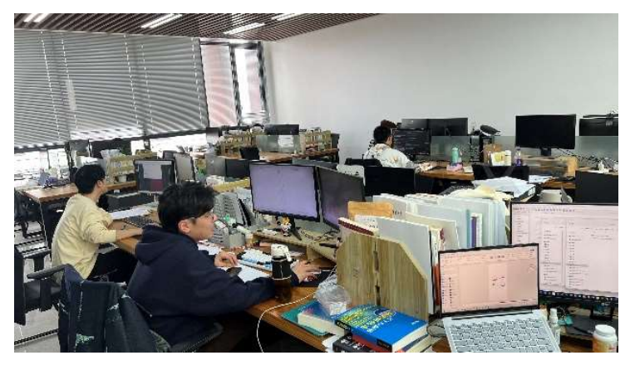
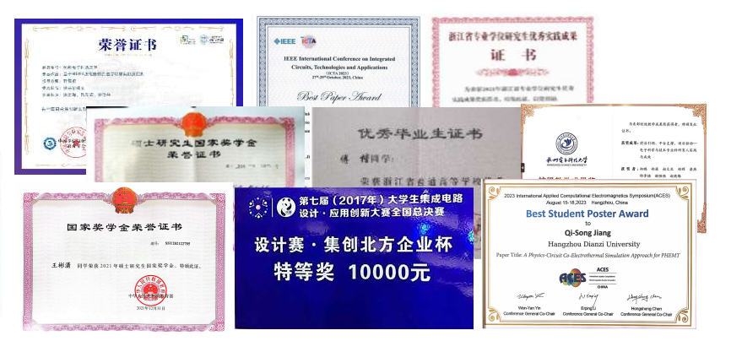




Team member Introduction
Team member Introduction: Lin Jiacheng, Xiao Yulin, Zheng Dong
EDA Technology Innovation Center
Jiacheng Lin
Master's degree
Yulin Xiao
Master's degree
Dong Zheng
Master's degree
EDA basic commonality and cutting-edge technology research (optimization, synthesis, place and route, MBSE technology roadmap)
JG-specific chip design simulation technology R&D (chip feature extraction, macro model, modeling tool development)
Large language model training and agent design in the vertical field of RF/MMIC
Research Interests: AI and Big Data, Multi-modal Recognition, Image Segmentation

Slide 4
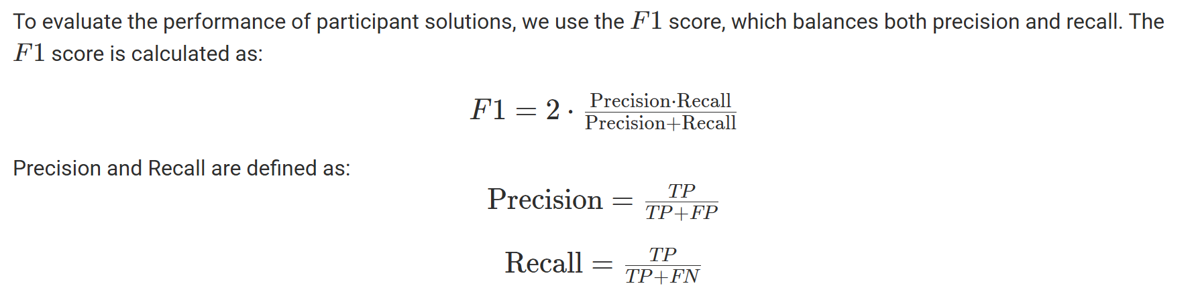
Introduction to the Competition
Introduction to the Competition
Data Introduction
1. Hardware Dimensions
Cpuid: CPU ID
Channelid: Channel ID (each CPU has multiple channels)
Dimmid: DIMM ID (each channel connects multiple DIMMs)
Rankid: Rank ID (each DIMM has 1 or 2 Ranks)
Deviceid: Device ID (each DIMM has multiple devices)
2. Error and Log Dimensions
Retryrderrlogparity: Retry read error log parity information
Retryrderrlog: Retry log, records error type and check (parity/ECC)
Burst_info: Memory DQ and burst error parity bits
Error_type: Error type (read or scrub/erase)
Log_time: Error occurrence timestamp
3. System and Configuration Dimensions
manufacturer: Server manufacturer
model: CPU model
PN: DIMM part number
Capacity: DIMM capacity
memory_type: DIMM type (e.g., DDR4)
Dynamic memory failure timing prediction
Based on the memory and kernel log data of large-scale servers (with a total of hundreds of millions of logs and tens of thousands of servers), a machine learning model is trained to detect online whether a server will experience memory failure within the next 7 days. (Classification problem)
Evaluation Index

Slide 5
Difficulty of the competition
Difficulty of the competition
Task Difficulties
Highly Imbalanced Data: Out of a total of 72,959 machines in the training data, only 673 experienced memory failures (0.9%).
Difficult Feature Engineering: The vast majority of the original features are Categorical features.
Key Constraint - Prediction Window:
Predictions must occur before the actual failure alarm_time and need to meet specific lead time requirements. t_pred + 15 minutes <= alarm_time <= t_pred + 15 minutes + 7 days.
DIMM 1
DIMM 1
DIMM 1
DIMM 1
DIMM 1
DIMM 1
Channel 0
Channel 1
Channel 2
Channel 0
Channel 1
Channel 2
rank 0
rank 1
DIMM 0
DIMM 0
DIMM 0
DIMM 0
DIMM 0
DIMM 0
bank 0
bank 0
IMC 2
IMC 0
bank 1
bank 1
CPU 1
CPU 0
…
…
IMC 3
IMC 1
bank 14
bank 14
bank 15
bank 15
DIMM 0
DIMM 0
DIMM 0
DIMM 0
DIMM 0
DIMM 0
Channel 0
Channel 1
Channel 2
Channel 0
Channel 1
Channel 2
DIMM 1
DIMM 1
DIMM 1
DIMM 1
DIMM 1
DIMM 1

Slide 6
Methodology
Feature Engineering
Multi-window Fusion

Slide 7
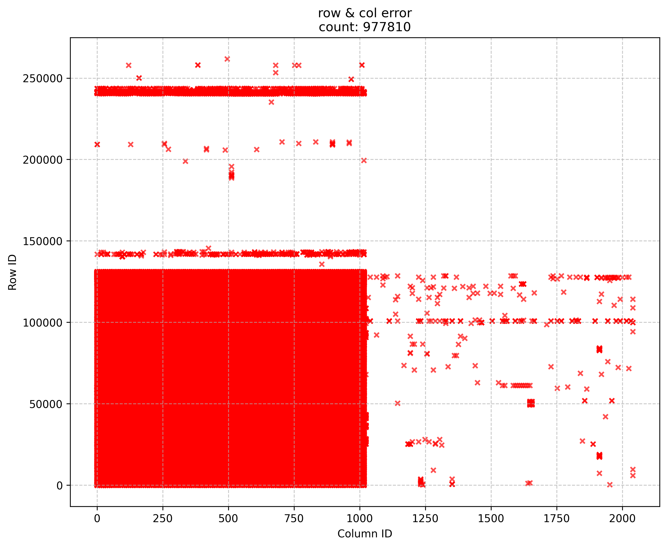
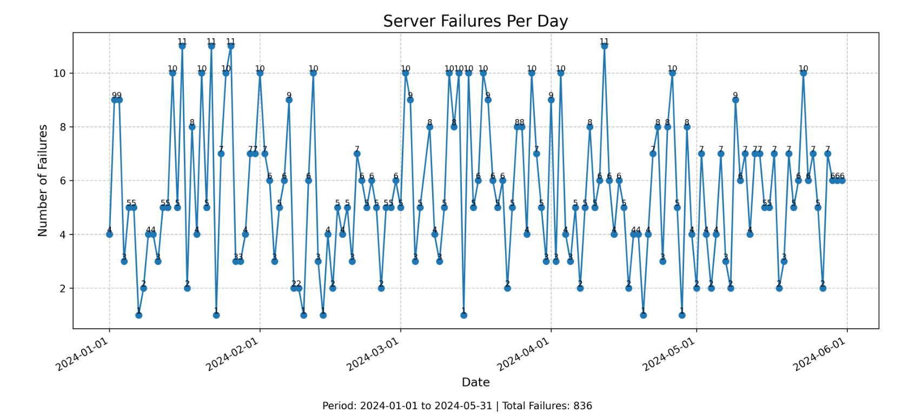
Feature Engineering
Visual Charts
Feature Engineering
serial_number | ChannelId | rankid | bankid | row | col | LogTime | manufacturer | region
sn_1 | 2 | 1 | 2 | 129329 | 744 | 1705898605 | B | 0
sn_1 | 2 | 1 | 2 | 129329 | 744 | 1705898729 | B | 0
Time
Key Observation:
The error distribution exhibits significant clustering rather than random scattering.
There are clearly concentrated areas of row/column/regional errors.
Error logs form a time series, requiring capture of dynamic patterns within sliding windows.
Observation window
Machine Learning

Slide 8
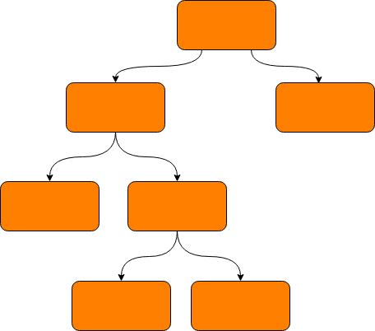
Feature Engineering
Statistical correlation characteristics
Label construction
Comparison and Testing
From logs to predictable signals
Label construction
Comparison and Testing
Identifying Positive Sample Windows: The positive sample window preceding a failure is identified, with the window closest to the failure event labeled as 1.
Linear Decay: Starting from the window labeled as 1, we trace back in time, and for earlier feature windows, their label values decrease linearly, with the label linearly decaying to a minimum of 0.5.
Negative Sample Labels: All other feature windows that do not fall into the above positive sample windows (including all windows from SNs that never experienced a failure, and windows from failing SNs that are far removed in time from the failure event) are assigned a label of 0.
Internal Structure: Implemented through the development of a LightGBM model.
Statistical Features
(Window Aggregation)
Intra-Window Dynamic Features
(First Order/Change)
Error Count & Types: Total logs & CE/SCRUB counts (Reflects Error Activity).
Underlying Error Severity: Total/Max Burst/DQ (Measures Error Severity).
Hardware Location Concentration (Nunique): Unique ID counts per level (Identifies Fault Localization)
Automated Fault Mode Recognition: Bank/Row/Cell level modes (Aids Diagnosis Type).
1. Error Frequency Change: Stats on time diffs between logs (Captures Frequency Fluctuation/Acceleration).
Error Severity Change Rate: Stats on Burst/DQ count diffs (Indicates Error Severity Deterioration).
……
After testing on the dataset and continuously optimizing the features and parameters used by the model, as well as employing five-fold cross-validation, (stage 1 score: 0.21)

Slide 9
Multi-window Fusion
Memory Address Log
Serial Number | Fault Time
sn_32644 | 1722945465
sn_53527 | 1725607371
.... | ....
sn_65571 | 1723834531
MCE Log
Feature Engineering
Voting
Moudle
LGMB Model
多窗口
融合
Kernel Log
Stage 0(Feature Engineering Stage): Real-time extraction of frequency statistics and principle-based features from logs to form the training/testing data.
Stage 1(Machine Learnning):
Using a regression model, based on the information within a machine's specified window and historical log data, we determine the probability of the machine experiencing a failure within the next 7 days following that window.
Stage 2( Multi-window fusion Stage):
Further utilize the regression model to derive judgment results across multiple windows. Achieve the fusion of multi-perspective results across different sliding windows.

Slide 10
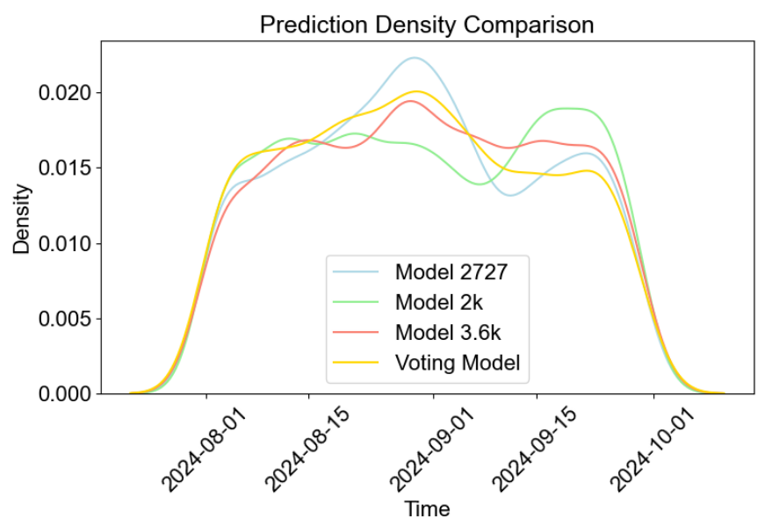
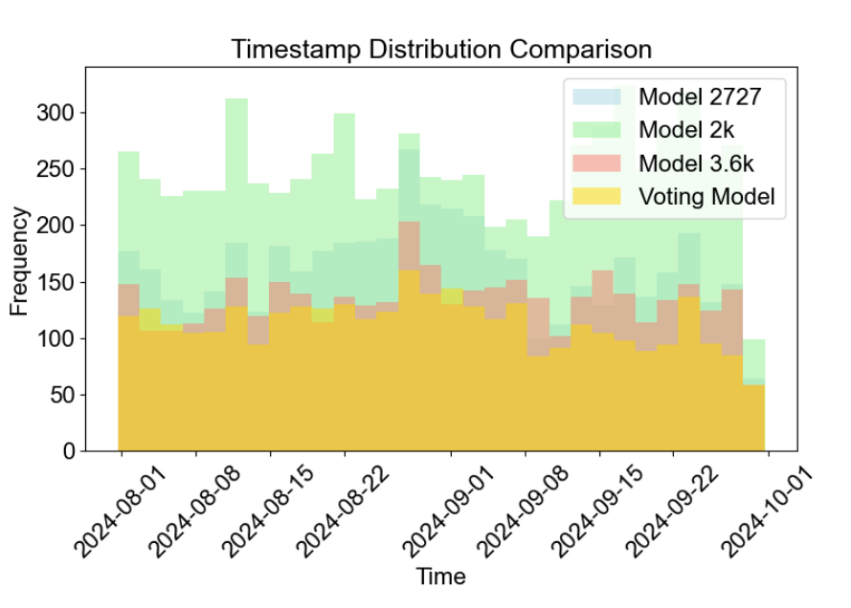
Multi-window Fusion
Multi-window Fusion
Voting
Moudle
LGMB Model
Sliding Windows2000S
Capture different scale patterns: Using multiple sliding Windows of different lengths (such as the 2727s, 2000s, 3600s you are using) is to attempt to capture event patterns at different time scales. Short Windows may capture sudden anomalies, while long Windows may capture slowly accumulating trends.
Sliding Windows2727S
Sliding Windows3600S

Slide 11
Experiments
Voting Model Design
Final Score Variation Results

Slide 12
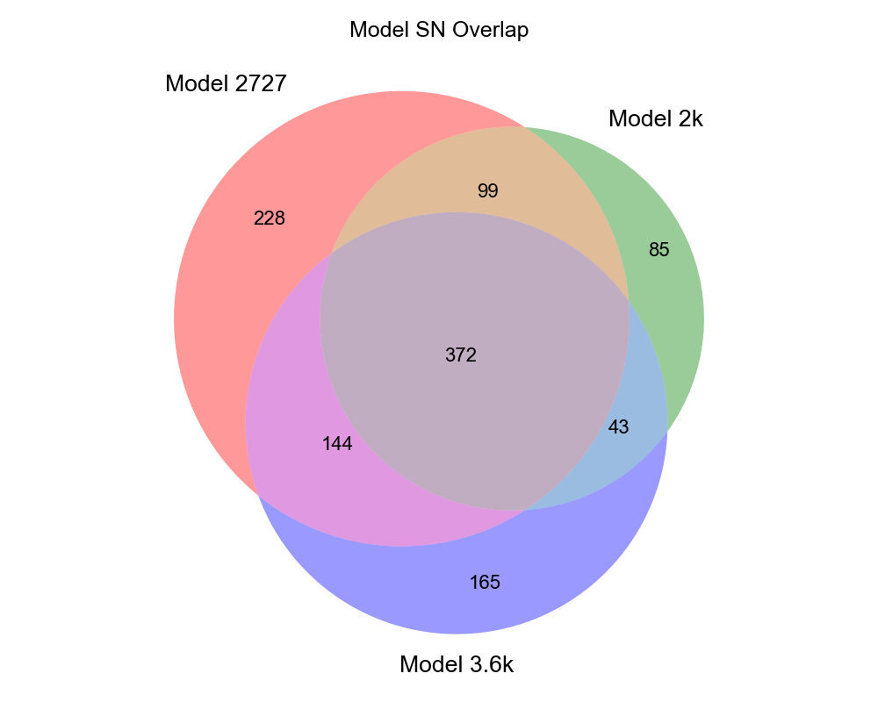
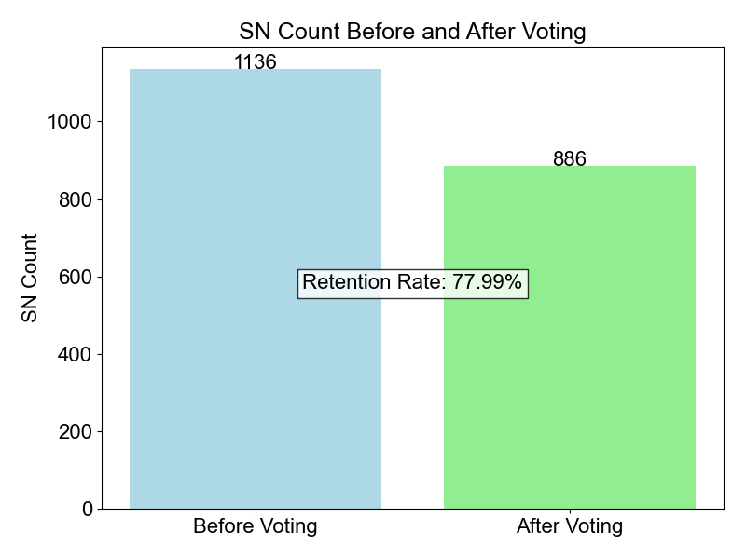
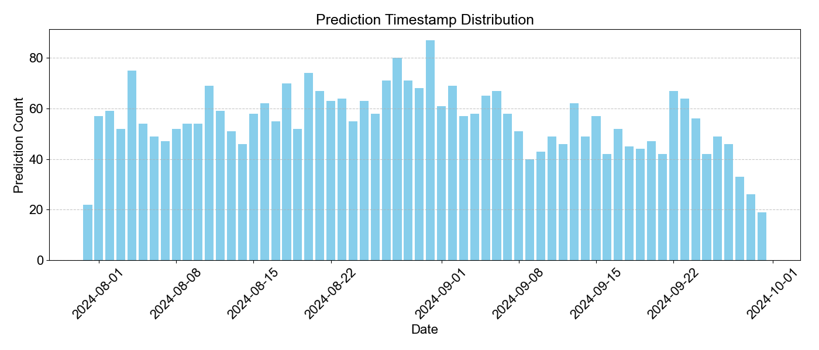
Voting Model Design
Voting Model Design
Correlation Analysis Chart
Phase 1: Candidate SN Screening:
Initially screen likely failing SNs. Calculate cumulative weighted votes per SN from base models. This significantly cuts candidate SNs (around 78% retention), focusing on higher-probability failures and filtering low-confidence predictions.
Phase 2: Timestamp Clustering and Voting:
Merge similar predictions and find initial failure time. Collect all models' predicted timestamps per SN, cluster them, select the highest-scoring cluster. The median timestamp of this best cluster is the SN's preliminary predicted time, fusing models and initially locating failure.
Phase 3: Timestamp Refinement:
Refine initial time using original model predictions. Using Phase 2's median time as a reference, find nearby predictions (within +/- 3600s) from all original models (used 93.1% of the time). If no nearby predictions exist, use a weighted average to calculate the final timestamp.

Slide 13
Final Score Variation Results
Final Score Variation Results
Effectiveness of the Approach
Hybrid Correction of Multi-Time Phase and Multi-Model Strategies for Fund Prediction
Experiment Strategies | Stage 1 Results
lgbm+3600s window | 0.236
lgbm+2727s window | 0.251
lgbm+2000s window | 0.205
Baseline prediction | 0.207
Multi-window voting | 0.260
Restructured Feature Engineering: Rebuilt feature engineering, reformulating the labels for a regression task.
1
Improve0.019 stage_1
Restructured Observation Window: Explored more potential first-order, second-order, statistically correlated, and trend-related features to improve model accuracy and correct baseline version prediction results.
Score Trend of Different Strategies
2
Experiment Strategies | Stage 1 Results
lgbm+3600s window | 0.188
lgbm+2727s window | 0.190
lgbm+2000s window | 0.186
Baseline prediction | NAN
Multi-window voting | 0.191
Improve 0.015 stage_1
Improve 0.002 stage_2
Model Voting ResultsM: Increased model robustness through multi-window model fusion voting.
3
Improve 0.009 stage_1
Improve 0.001 stage_2

Slide 14
Conclusions

Slide 15
Conclusions
Attempted but ineffective approaches
Exploration and Outlook
Regression Label Exploration: Employed a [1.0, 0.5] linearly decaying label, but there is a disconnect between the regression target and the final SN-level F1 metric.
Validation Strategy Upgrade: Explore time-based cross-validation to better reflect real-world deployment scenarios.
1
1
Window Aggregation Features: The model heavily relies on window statistical features (count, Nunique, difference), without deeply exploring sequence models.
Target Alignment Optimization: Optimize the labels/loss function to more directly align with the SN-level F1 metric.
2
2
Core Feature Engineering: Focuses on bit-level analysis (burst/dq) and hardware-level Nunique (fault_mode), potentially with redundancy or insufficient interaction exploration.
Model Feature Deepening:
Model: Attempted multi-model ensembling/fusion.
Features: Refined/expanded features (cross-window, global).
3
3
Static Sampling Strategy: Employed coarse file-level sampling with sample number limits, without attempting dynamic or hard sample mining.
External Information Fusion: Consider incorporating system-level information such as server load and temperature.
4
4

Slide 16


