Slide 1

WWW 2025 SmartMem Competition
Team: TimeSeries Star
Member: Xinci Liu, Wei Zhang
Instructor: Xinyue Li
Institute: City University of Hong Kong
28th April, 2025

Slide 2
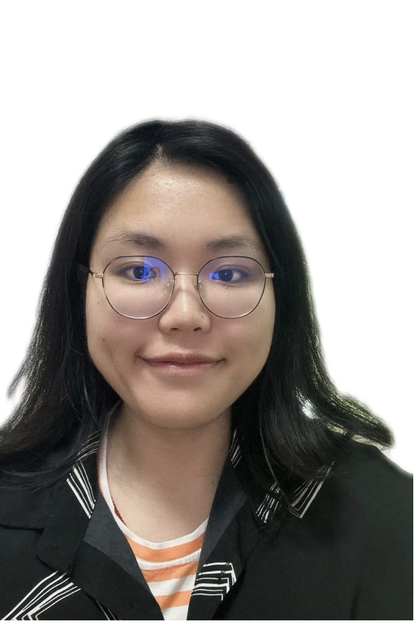
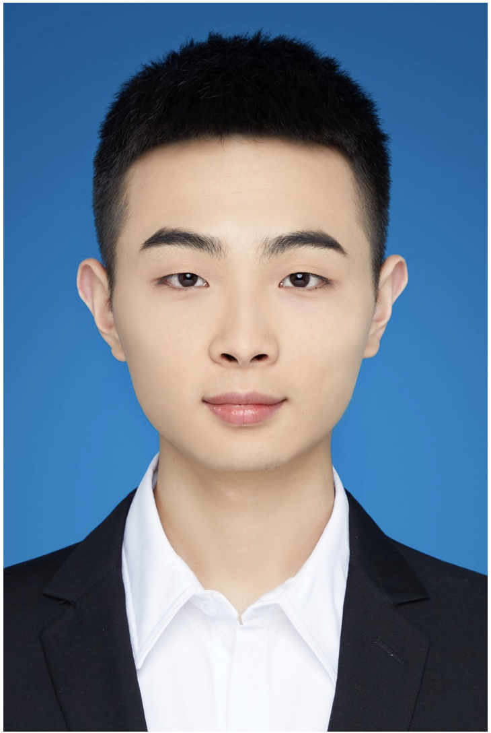

Team Member Introduction
Xinci Liu
PHD student in City University of Hong Kong.
Research Interests:
Multi-model learning, time-series prediction and
deep learning in health-care datasets.
Wei Zhang
PHD student in City University of Hong Kong.
Research Interests: medical imaging and multi-modal learning.

Slide 3
Introduction
Problem Definition
Summary for baseline solution
Our improvements to baseline solution

Slide 4
Problem Definition
Dynamic random-access memory (DRAM) module occasionally encounter Uncorrectable Error(UE) failure, which are among the primary causes of failures in data centers. Our Project aims to forecast whether DRAM module will experience an UE failure with in the next K days.
Past
Present
Future
historical data
lead
prediction
window
15min
prediction window 7 days

Slide 5
Summary of Baseline Introduction
Feature Engineering
Training Data Generation
LightGBM model
Result Generation
Positive label:
range 30 days before the ticket time.
Negative label:
continuous 30 days without failure ticket.
temporal features
spatial features
parity features
Tested to be outperformed random forest, XGB and Catboost
default threshold: 0.5

Slide 6
Improvements to the Baseline Method
Feature Engineering
Training Data Generation
LightGBM model
Result Generation
Positive Label:
Range 3/7 days before the ticket time.
Negative Label:
Continuous 3/7 days in SN without failure tickets(random choice)
XGB Model
Single Threshold
Prediction values larger than another threshold appears in a continuous window.

Slide 7
Methodology
Overview of Methodology
Training Data Generation and Feature Engineering
XGB Model

Slide 8
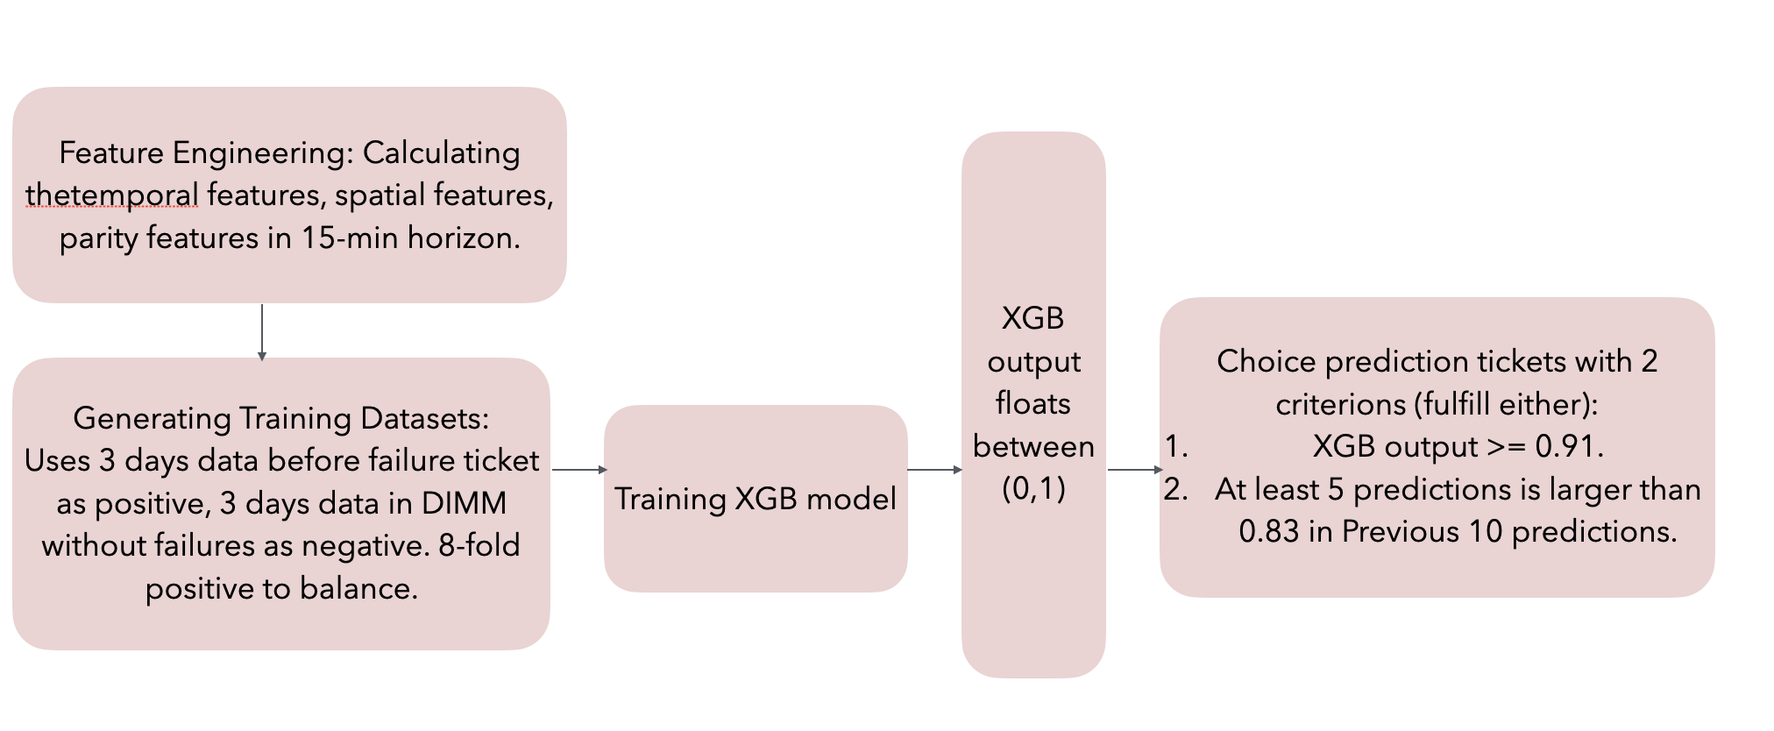
Overview of Methodology

Slide 9
Training Data Generation and Feature Engineering
Feature Generation
Training Data Generation
Spatial Features
fault_mode_others
fault_mode_device
fault_mode_bank
fault_mode_row
fault_mode_column
fault_mode_cell
fault_row_num
fault_column_num
Positive Datasets: within 3 days datasets before the failure ticket.
Negative Datasets: Continuous 3 day datasets in DRAM module without failure tickets.
Balance the Positive and Negative Data:
multiple the positive data until
positive:negative = 1:10
Temporal Features
read_ce_log_num, read_ce_count
scrub_ce_log_num
scrub_ce_count
all_ce_log_num
all_ce_count
ce_storm_count…
Parity Features
error_bit_count
error_dq_count
error_burst_count
max_dq_interval
max_burst_interval
dq_count=n
burst_count=n
Time Window Size: 15m, 1h, 6h

Slide 10
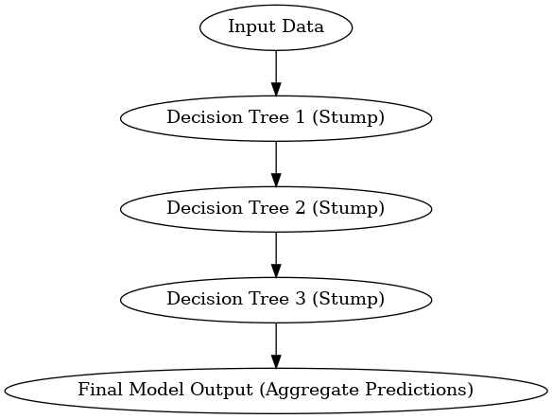
XGB Model Introduction
XGBoost (eXtreme Gradient Boosting) is a powerful, scalable machine learning algorithm based on gradient boosting.
Key Points
Hyper-parameters
Gradient Boosting Framework | XGBoost builds an ensemble of weak learners (decision trees) sequentially
Objective Function | loss function: log loss for binary classification regularization: l2 regularization to prevent overfitting
Tree Construction | Uses a greedy algorithm to split nodes
max_depth | 6
learning rate | 0.1
early_stopping_rounds | 10
objective | binary:logistic
eval_metric | logloss

Slide 11
Experiments
Threshold selection & Performance evaluation
Threshold modification

Slide 12

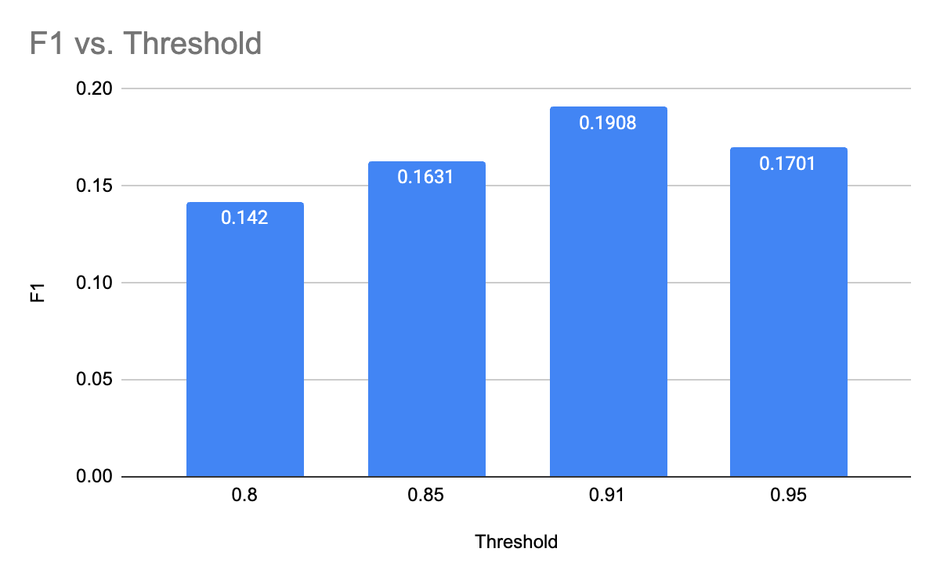
Threshold selection & Performance Evaluation
Threshold selection:
To find out the Threshold of XGB model with best performance, we used datasets for Jan to April as training dataset, and datasets from March as validation dataset, and tried to do several experiments to find out the best threshold for prediction.
Performance Evaluation:
The F1 Score was used to evaluate the performance. We have
Threshold | F1
0.80 | 0.1420
0.85 | 0.1631
0.91 | 0.1908
0.95 | 0.1701

Slide 13
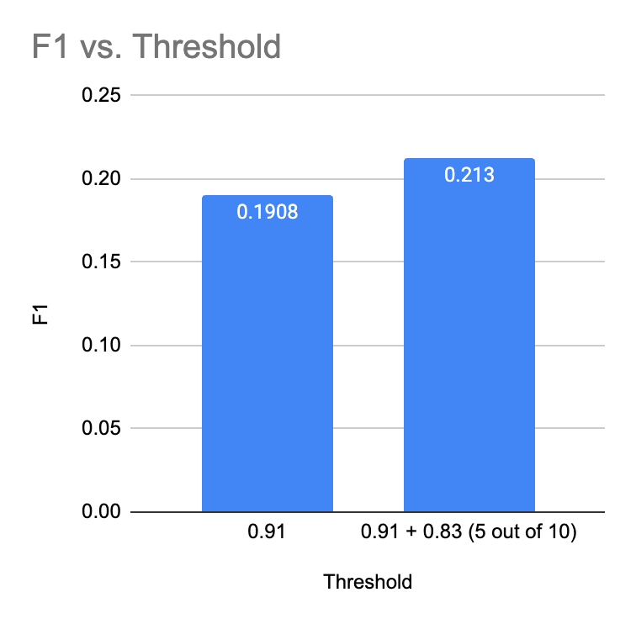
TimeStamp XGB_output
Threshold Modification
15:15
15:30
15:45
16:00
16:15
16:30
16:45
17:00
17:15
17:30
0.45
0.56
0.68
0.75
0.80
0.83
0.84
0.88
0.88
0.89
Since the threshold we choice were relatively high, and we noticed that the probability of UE always changes gradually over time without human intervention. Specifically, if a DIMM is in a poor state, the probability of a UE occurring increase over time. As a result, In addition to the initial threshold of 0.91, if a DIMM has been predicted to have a probability of experiencing an Uncorrectable Error (UE) higher than 0.83 in 5 out of the 10 feature statistics within the previous 150 minutes of the log, we will also flag this DIMM as being on the verge of experiencing a UE.
Failure ticket flag
Threshold | F1
0.91 | 0.1908
0.91 + 0.83 (5 out of 10) | 0.213

Slide 14
Conclusions & Future Work
Rooms of improvements
Future Work

Slide 15
Conclusion & Future work
The main improvements we made compare to the baseline are in the training data selection and the threshold selection process.
We reused the features in the baseline methods, it would be meaningful to do more research in feature selection.
We didn’t compare the performance of different traditional machine learning models, it will be valuable to compare more ML models.
It would be valuable to try more deep learning networks.

Slide 16


