Slide 1

Memory Failure Prediction in Huawei Cloud
28th April, 2025
Min Zhou ^{[1]}, Hongyi Xie ^{[1,2]} ,Qiao Yu ^{[3]}, Jialing Yu ^{[1]}, Ping Liu ^{[1]}, Zhengli Sheng ^{[1]}
^{[1]} Huawei
^{[2]} University of Science and Technology of China
^{[3]} Technical University of Berlin
Notes:
Good afternoon, everyone!
I'm Xie Hongyi, a Master's student at the School of Artificial Intelligence and Data Science at USTC, and right now, I'm interning at Huawei Cloud. It's a real pleasure to be here today and have the chance to share with you some of the latest work and explorations that Huawei Cloud has been doing in the area of memory failure prediction.

Slide 2
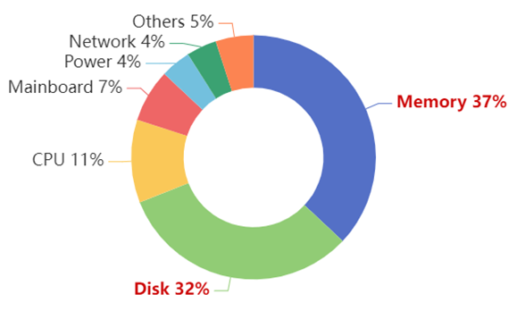
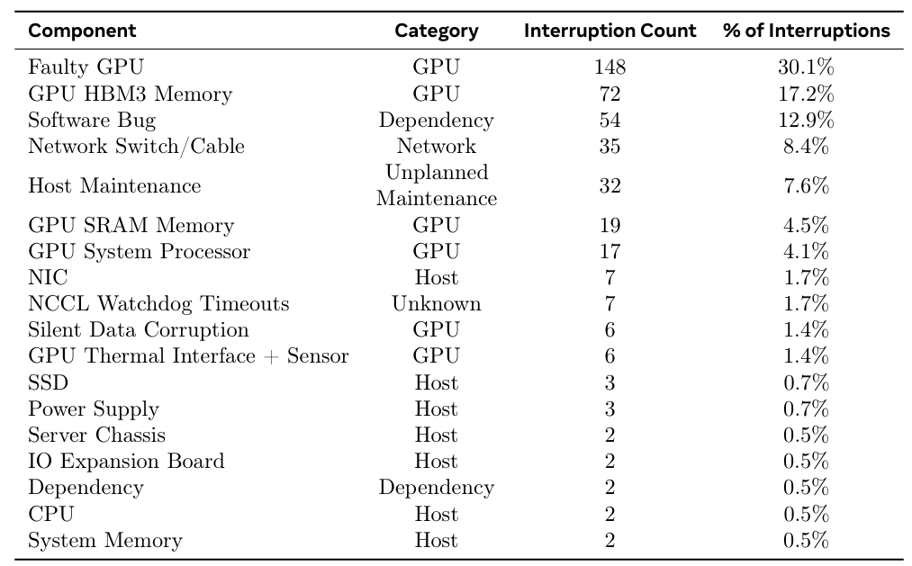




Background – Cloud Infrastructure Reliability in the AI Era
PCLS
DRAM
Speed and Density
PPR
ADDDC
SDDC
Page Offline
DRAM Reliability
ECC/SDDC
DDR2
2006~2011
DDR3
2011~2016
DDR4
2016~2021
DDR5
2021~2026
Hardware Failure Distribution in Data Centers
(Intel’s report)
Analysis of Causes for Large Model Training Interruptions
(Meta’s report)
Trends in DRAM Performance Development
(Huawei’s report)
Cloud
Infrastructure
Hardware Fault
software bugs
unstable network
$$⋯$$
Services
AI / LLM
Reliability Challenges
Background: In the AI era, cloud infrastructure reliability has become a key focus, with hardware failures as the biggest threat.
Current Situation: (Left chart) Hardware failures account for nearly 70% of data center hardware issues, drawing strong attention from SRE engineers.
Impact: (Middle chart) Hardware failures are the main cause of AI training failures, affecting service continuity and model stability.
Trend: (Right chart) Hardware failure risks are rising yearly, making reliability a core requirement for cloud infrastructure.
Notes:
In recent years, industry reports from companies like Intel, Meta, and Huawei have highlighted that as cloud computing and AI technologies develop rapidly, ensuring the reliability of cloud infrastructure has become a key focus. Among the biggest challenges is hardware failure, which accounts for nearly 70% of data center issues.
Hardware failures are also the leading cause of AI training failures, impacting both service continuity and model stability. As we can see, the risk of hardware failures is rising each year, making infrastructure reliability more important than ever. This is why predicting and diagnosing hardware failures is crucial to maintaining the availability and stability of cloud services.

Slide 3
Background – Memory Faults, Errors and Failures
Memory Faults:
The underlying causes of an error in DRAM.
Soft Faults: particle impacts, cosmic rays. --recoverable
Hard Faults: ware-out, manufacture defect. --repeatable
Memory Errors:
Correctable Error (CE): Errors that can be corrected by ECC mechanism.
Uncorrectable error (UE): uncorrected by ECC mechanism.
Sudden UE: UEs that instantly corrupt data.
Predictable UE: UEs that start as correctable errors and evolve to severe UEs.
Memory Failures:
A critical event in which the delivered service deviates from the correct service. UEs typically lead to catastrophic failures, resulting in a crash.
Logging
Predicting
Faults
Errors
UE/Failure
Notes:
Memory failures are a key component of hardware failures. The terminology related to memory faults, errors, and failures are shown below.
A memory fault refers to the underlying cause of DRAM errors, including soft faults.
A memory error can either be a Correctable Error (CE) or an Uncorrectable Error (UE). CEs are errors that can be corrected by the ECC mechanism, while UEs are errors that cannot be corrected by ECC.
In data centers, we encounter both sudden UEs and predictable UEs. Sudden UEs are those that immediately corrupt data, and since they don’t have preceding CEs, there are not enough signals to predict them.
Therefore, we focus on predictable UEs caused memory failures, which start as CEs and evolve into more severe UEs.
Finally, a memory failure is a critical event where the delivered service deviates from the expected correct service, such as in the case of a UE.

Slide 4












Data – Event Sequence-Driven Hardware Failure Prediction
Event Sequence-Driven Failure Prediction: Based on historical event sequences, this approach predicts whether a failure will occur within a future time window.
Observation Window
Lead Window
Prediction Window
Event sequence
Memory Failure
Time
Past
Present
Future
Prediction interval
$$Δt_{pred_int}$$
ith CE
$$t_{i}$$
Failure time
$$t_{fail}$$
$$SN_s$$
Lead prediction
$$Δt_{lead}$$
Valid prediction
$$Δt_{valid}$$
Prediction interval
$$Δt_{pred_int}$$
Inference Time
Prediction interval
$$Δt_{pred_int}$$
Inference Time
Memory Errors
System Alerts
User Behavior
(Logs)
Disk Metrics
System KPIs
Traffic Records
(Metrics)
Short term $Δt_{s}=15min$
Short term $Δt_{s}=15min$
Long term $Δt_{l}=60min$
Long term $Δt_{l}=60min$
Non-Uniformly Spaced Event Sequences
Uniformly Spaced Event Sequences
Notes:
Our task can be formally described as predicting future hardware failures based on correctable memory errors, such as memory crashes caused by uncorrectable errors. Correctable errors in memory can be represented as an event sequence. We are addressing the problem of hardware failure prediction driven by event sequences, where we use historical event sequence data to predict whether a failure will occur in the near future.
These event sequences can be divided into two types: Uniformly Spaced Event Sequences and Non-Uniformly Spaced Event Sequences, depending on the sampling interval. In the case of Huawei Cloud’s log data flow, memory correctable errors form an Non-Uniformly Spaced event sequence, which presents a more complex challenge.

Slide 5

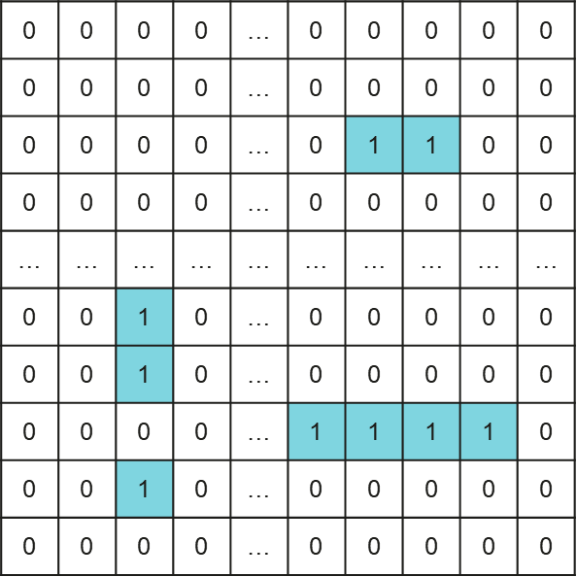
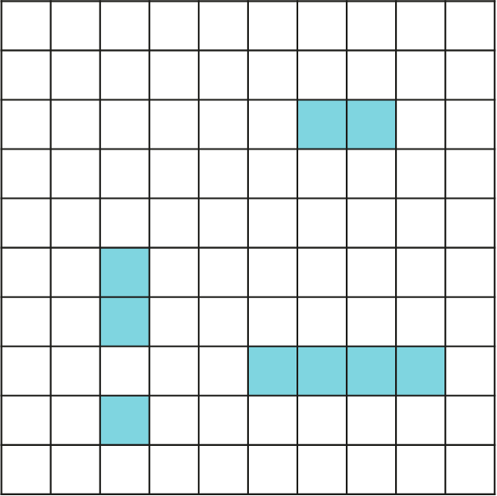
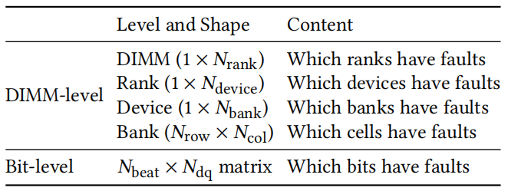


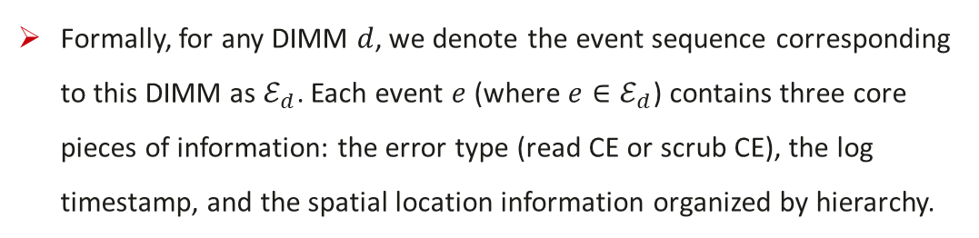



Data – Multi-Level Memory Fault Logs (CE logs)
Server
DIMM
Memory Access
CPU 0
Rank 0
DIMM > Rank > Device > Bank > Row/Column > Cell
IMC of CPU
CPU 1
Device 0
$$⋯$$
Rank
Device 0
Device 1
$$⋯$$
Device ECC
DQs
$$⋯$$
0
1
2
3
Device
1 | 0 | 1 | 1
0 | 1 | 0 | 0
0 | 0 | 0 | 1
0 | 0 | 1 | 0
0 | 0 | 0 | 0
0 | 0 | 0 | 0
0 | 0 | 0 | 0
1 | 0 | 0 | 0
1
Bank 0
Column
CPU
Bank
Bank 1
2
DIMM 0
DIMM 1
$$⋯$$
Row
Beats
Channel 0
Cell
3
4
$$⋯$$
5
DIMM 0
DIMM 1
6
Channel 1
Bank
4
$$⋯$$
3
7
2
8
1
5
Ⅰ. Server-level Info
Ⅱ. DIMM-level Info
Ⅲ. Bit-level Info
Formally, for any DIMM $d$, we denote the event sequence corresponding to this DIMM as $ℰ_{d}$​. Each event $e$ (where $e∈ℰ_{d}$​) contains three core pieces of information: the error type (read CE or scrub CE), the log timestamp, and the spatial location information organized by hierarchy.
Notes:
For memory fault prediction, the input consists of event sequences derived from memory error logs. These logs include multimodal information, such as numerical, textual, and multi-level alarm spatial data. At a server level, this includes static configuration parameters like the CPU model, frequencies, and DIMM-specific properties. At the DIMM level, we focus on identifying the specific failed memory cell, recording the fault location using hierarchical coordinates, such as rank ID, device ID, bank ID, row ID, and column ID. Finally, at the bit level, we capture the error bits during memory access as a 32-bit binary sequence, representing the error state across the DQ-Beat Matrix.

Slide 6
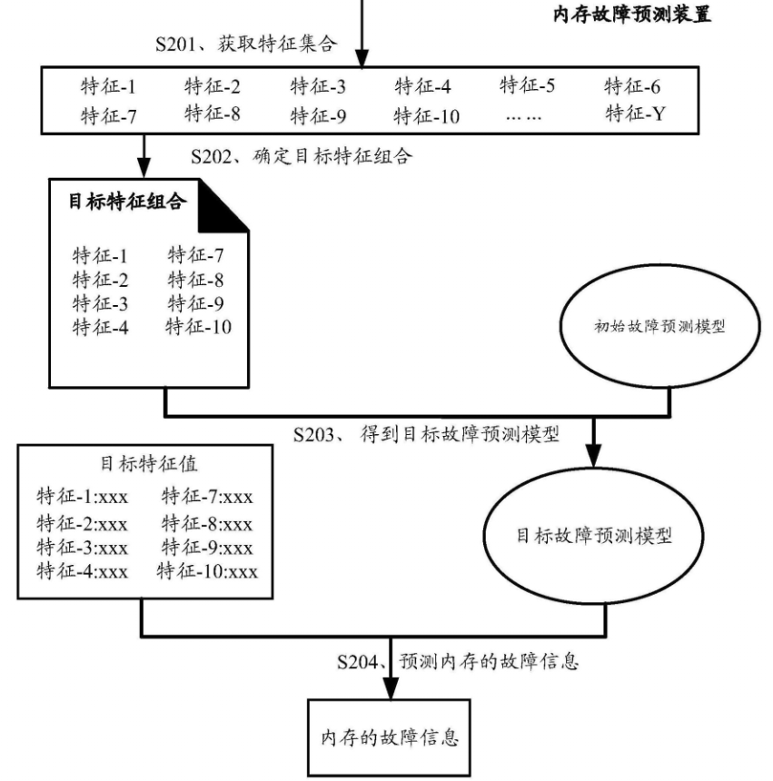
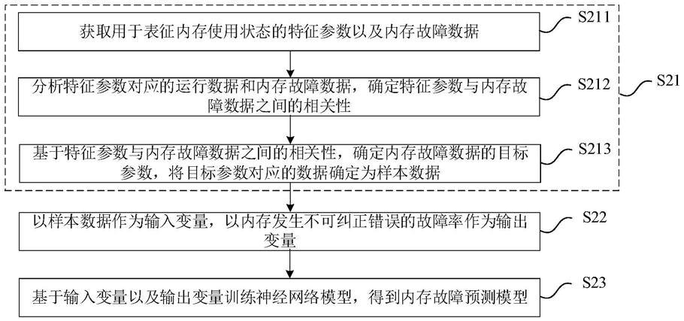
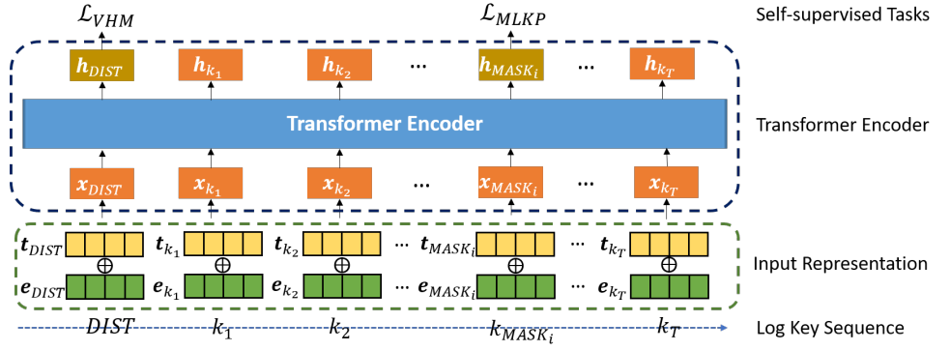
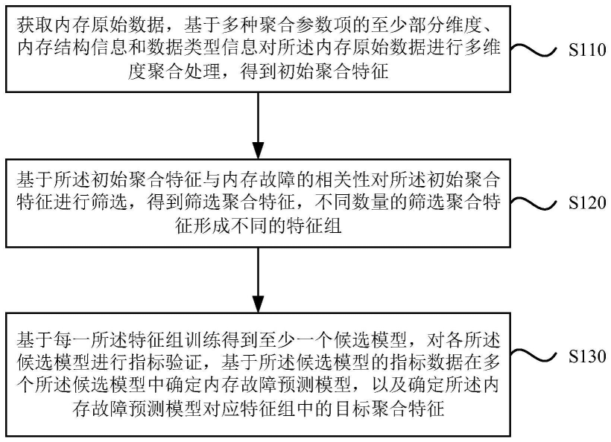
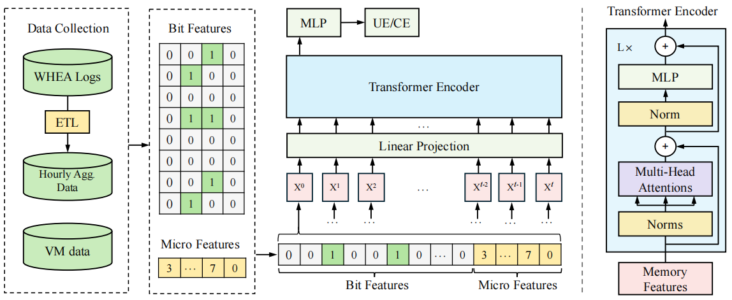
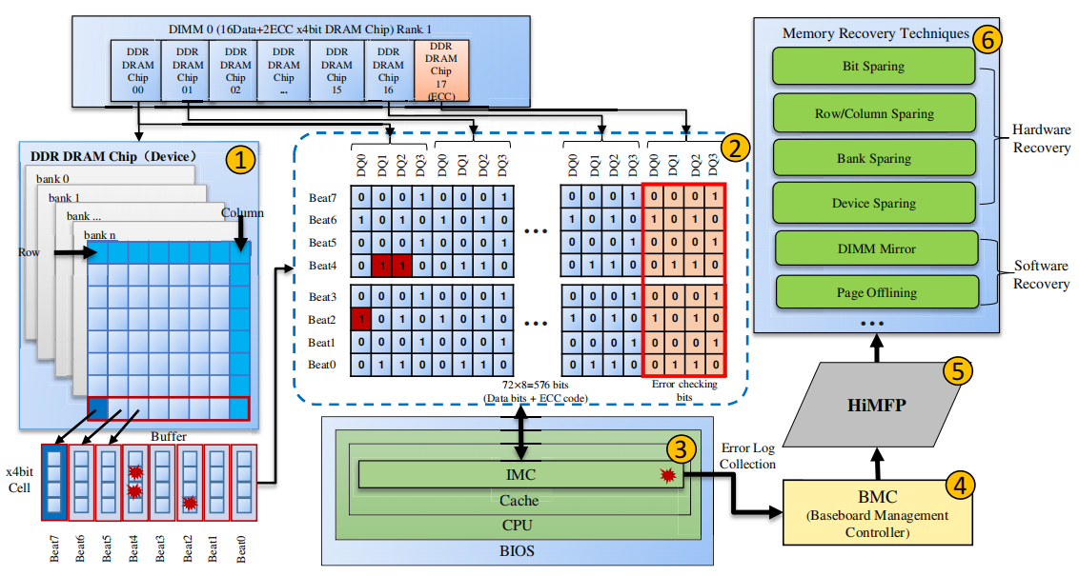
Current Situation – Limitations of Existing Methods
Classifier Based on Raw Event Sequence Features
1. Only uses raw event sequence features
2. Generates higher-order features by simple combinations of raw features
Issues: The features are too simple, not considering the characteristics of memory failure data, and fail to explore features related to abnormal patterns.
Classifier Based on Event Sequence Statistical Features
1. Manually selects failure prediction features and uses aggregated features to train the classifier
2. Uses aggregated spatial features and employs transformers to capture the association between aggregated features and failures
Issues: Only aggregated features are used, with no consideration of how features at different granularities and scales affect model performance.
Classifier Using Expert Knowledge to Design Features
1. Leverages extensive expert knowledge to design spatial features at different levels and trains machine learning models for failure prediction
Issues: Requires a large amount of expert knowledge, the feature design process is complex.
Notes:
Existing research methods have three main limitations.
First, classifiers based on raw event sequence features only use simple combinations of raw features, which don’t capture the unique patterns of memory failures and fail to explore abnormal data patterns.
Second, classifiers based on statistical features rely on aggregated data and transformers to predict failures, but they overlook how features at different granularities and scales affect performance.
Finally, expert knowledge-based classifiers use domain-specific features, but they require a lot of expert input, and designing these features is a complex and time-consuming process.

Slide 7
Framework – Heterogeneous Event Sequence Analysis and Failure Prediction Framework
Event Sequence Analysis
Timestamp Modeling
Event Content Analysis
Temporal Dimension
Spatial Dimension
Data
Event Sequence Analysis
Temporal & Spatial
Data support
Model
Memory Failure Prediction
Memory Failure Prediction
3 models for MFP
Time-aware Model
Model support
Time-patch scale Model
Application
MFP System Deployment
Time-point scale Model
MFP System Deployment
Offline Training & Online Validation
Notes:
To address these issues, we have designed a event sequence analysis and failure prediction framework, with the core focus on event sequence analysis and memory failure prediction. Finally, we will deploy it onto the AIOps system for use in the Huawei Cloud’s production environment.

Slide 8
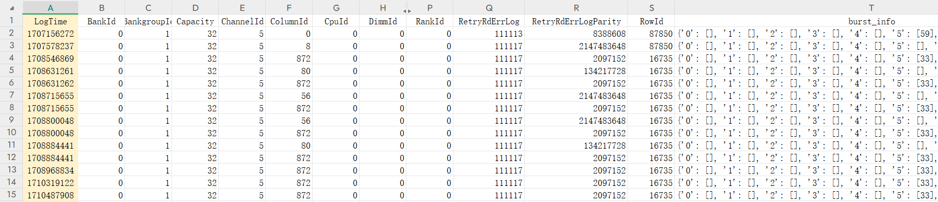








Research Topic 1: Event Sequence Analysis
：Not considering CE content
Generation Time of a Sample: $T$
：Considering CE content
CE Sequence of a Specific Analysis
Sample interval $Δt_{pred}$
$$事件序列 ℰ_{d}$$
（1）Temporal：Timestamp Analysis
时间戳表征 ${Za}_{d}^{T}∈ℝ^{L×d_{z}}$
统计特征 ${Fa}_{d}^{T}∈ℝ^{d_{a}}$
（2）Spatial：Event Content Analysis
$$⋯$$
事件空间特征 ${Fb}_{d}^{T}∈ℝ^{L×d_{b}}$
（3）Spatiotemporal：Multilevel Analysis
多层级时空特征 ${Fc}_{d}^{T}∈ℝ^{d_{c}}$
Research Topic 1: Event Sequence Analysis
Notes:
The first research topic focus on event sequence analysis. For the temporal and spatial aspects of event sequences, we have designed event feature and representation extractors across three dimensions: temporal, spatial, and spatiotemporal.
The temporal dimension is specifically used to analyze timestamp sequences, the spatial dimension considers only the information of each event itself while ignoring its time-related data, and finally the spatiotemporal dimension combines both time and space information of CE.

Slide 9
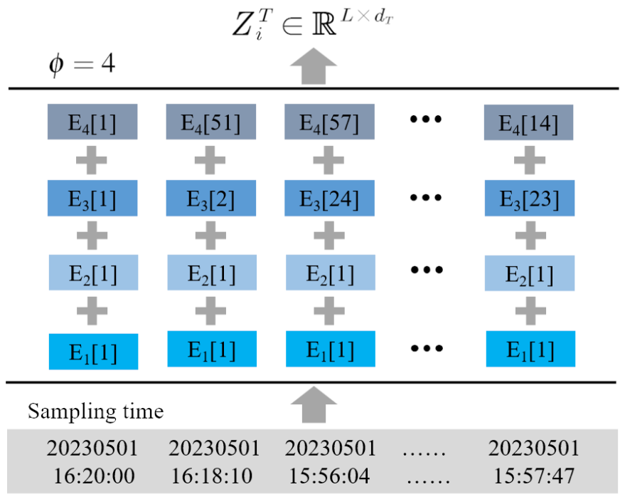

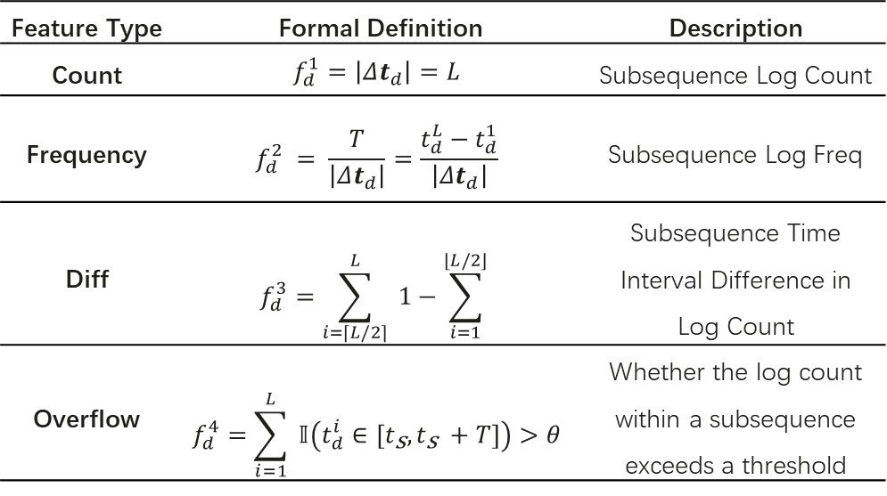
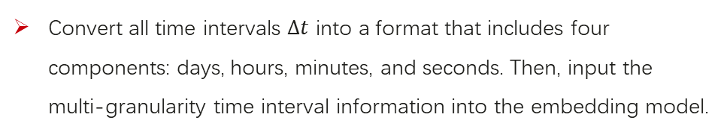

1.1 Event Timestamp Analysis
1.1 Timestamp Representation ${Za}_{d}^{T}∈ℝ^{L×d_{z}}$
1.1 Statistical Features ${Fa}_{d}^{T}∈ℝ^{d_{a}}$
Feature Type | Formal Definition | Description
Count | $$f_{d}^{1}=\left|Δt_{d}\right|=L$$ | Subsequence Log Count
Frequency | $$f_{d}^{2} = \frac{T}{\left|Δt_{d}\right|}=\frac{t_{d}^{L}−t_{d}^{1}}{\left|Δt_{d}\right|}$$ | Subsequence Log Freq
Diff | $$f_{d}^{3}=\sum_{i=⌈L/2⌉}^{L}{ }1−\sum_{i=1}^{⌊L/2⌋}{ }$$ | Subsequence Time Interval Difference in Log Count
Overflow | $$f_{d}^{4}=\sum_{i=1}^{L}{ }𝕀\left(t_{d}^{i}∈\left[t_{\text{s}},t_{\text{s} }+T\right]\right)>θ$$ | Whether the log count within a subsequence exceeds a threshold
Convert all time intervals $Δt$ into a format that includes four components: days, hours, minutes, and seconds. Then, input the multi-granularity time interval information into the embedding model.
In addition, we also consider statistical features such as counts, frequencies, and differences, which are determined by memory mechanisms or statistical analysis.
Notes:
First, for the temporal dimension, we focus on breaking down each event’s /relative time to the first alarm/ into multiple granularities. This allows us to input the multigranularity time interval information into an embedding model, which will help us build the relationship between time and events later on. Additionally, we also consider features such as counts, frequencies, and differences, which are determined by memory mechanisms or statistical analysis, and we categorize these as statistical features. This combination of time and statistical features helps provide a more comprehensive understanding of the event sequences.

Slide 10

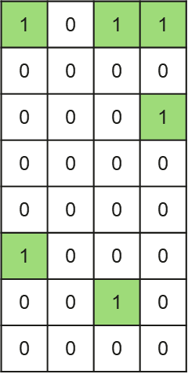
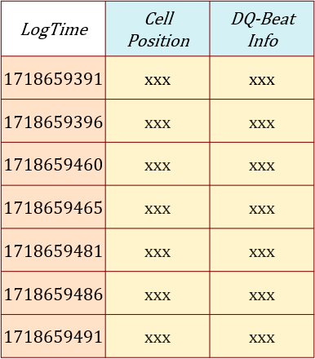
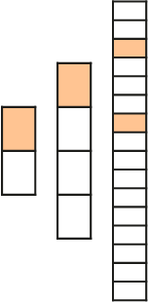

1.2 Event Content Analysis
Multi-level
DIMM>Rank>Device>Bank
Bank
DQ-Beat Matrix
Multi-scale
A DIMM generates a large number of event records, with each event corresponding to one blue cell and one green matrix.
M²-MFP: A Multi-Scale and Multi-Level MFP Framework. This framework automatically extracts and aggregates multi-level features to establish a MFP model across multiple scales, achieving high performance, high efficiency, and strong generalization ability.
We need a Multi-scale & Multi-Level MFP Framework!
Notes:
For the spatial dimension, we abstract the memory's spatial information by associating each event with a blue grid and a green matrix.
The blue grid represents coarse-grained spatial information at the DIMM level, which includes the location of the error unit.
The green matrix represents fine-grained information at the bit level, which includes bit flip data from retry registers.

Slide 11
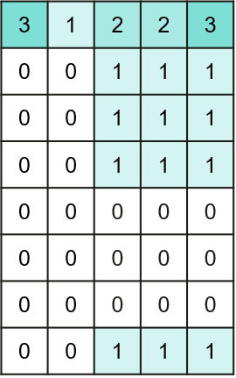
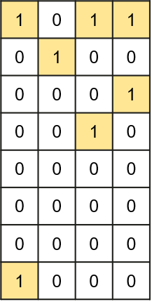






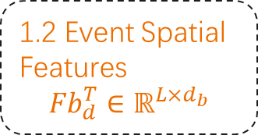















1.2 Event Content Analysis
Column
2d-Binary Spatial Feature Extractor ($BSFE^{2d}$)
Reduction-then-Aggregation
1.2 Event Spatial Features
$${Fb}_{d}^{T}∈ℝ^{L×d_{b}}$$
Composed by 2 paths
Reduction-then-Aggregation
Aggregation-then-Reduction
$$Reduction$$
$$G_{r}\left(X\right)$$
Row
$$Max Pooling$$
$$Avg Pooling$$
$$G_{rp}\left(X\right)$$
Aggregation Across Hierarchies
Low-level
High-Level
Guided by 3 principles
Symmetry Generality Sensitivity
Aggregation-then-Reduction
$$Max Pooling$$
$$G_{p}\left(X\right)$$
$$Reduction$$
$$G_{pr}\left(X\right)$$
$$X^{1d}∈{\left\{0, 1\right\}}^{1×10}$$
（1）max distance = 7
Multi-Binary Spatial Feature Extractor (Multi-BSFE)
（2）min distance = 1
$$e_{1}$$
$$B(e_{1})$$
2d-BSFE
$$F_{bit}(e_{1})$$
Pooling
$$max\left(⋯\right)$$
$$sum(⋯)$$
$$avg(⋯)$$
$$⋯$$
Higher levels BSFE
（3）max consecutive length = 3
$$e_{2}$$
$$B(e_{2})$$
2d-BSFE
$$F_{bit}(e_{2})$$
（4）group count = 3
$$⋯$$
$$⋯$$
（5）element count = 5
$$e_{l}$$
$$B(e_{l})$$
$$F_{bit}(e_{l})$$
Bank-level features
1d-Binary Spatial Feature Extractor ($BSFE^{1d}$)
2d-BSFE
$$⋯$$
$$M_{b}^{agg}$$
$$F_{bank}(ℰ_{b})$$
1D-BSFE effectively extracts potential fault information from events.
2D-BSFE efficiently accomplishes feature aggregation.
Multi-BSFE implements aggregation operations across hierarchies.
2d-BSFE
Combine
In the same bank $b$
1.3 Multilevel Spatiotemporal Features ${Fc}_{d}^{T}∈ℝ^{d_{c}}$
Notes:
Specifically, we have designed a 0-1 matrix space feature extractor to capture features from two-dimensional matrix information. This is done by first designing a one-dimensional BSFE (Bit-Level Space Feature Extractor) based on three principles: symmetry, generality, and sensitivity. We then extend this to two dimensions using two approaches: first reduction then aggregation, and first aggregation then reduction. Finally, we define an inter-level aggregation operation to extract features from multiple event aggregations.
The BSFE method /proves effective/ by extracting patterns related to fault mechanisms. The 2D-BSFE extracts correctable error (CE) patterns from bit-level information, while ensuring the three principles are satisfied: symmetry (which avoids naive methods), generality (which differentiates it from approaches like DQ-Beat Predictor or Himfp), and sensitivity (which sets it apart from CNN, ViT, and STIM-based methods). Ablation studies confirm its strong performance. Additionally, the Multi-BSFE captures spatial-temporal features, such as the number of faulty columns per bank, through hierarchical aggregation, and its effectiveness is further validated by feature importance analysis and ablation tests.

Slide 12




Research Topic 2: Memory Fault Prediction
时间戳表征 ${Za}_{d}^{T}∈ℝ^{L×d_{z}}$
Time-aware Model
SRE Engineer Inspection
统计特征 ${Fa}_{d}^{T}∈ℝ^{d_{a}}$
Time-patch scale Model
Post-hoc Interpretability Tools
事件空间特征 ${Fb}_{d}^{T}∈ℝ^{L×d_{b}}$
多层级时空特征 ${Fc}_{d}^{T}∈ℝ^{d_{c}}$
Time-point scale Model
Model Interpretability
Representations
MFP model
Analysis
Research Topic 2: Memory Fault Prediction
 | Training Input | Model | Object | Inference Input
Time-aware Model | Time Window Time Point Features | Dual-path Transformer | Minimize Cross-Entropy | The same as during training
Time-patch scale Model | Time Window Time Patch Features | Any classifier, such as LGBM | Minimize Cross-Entropy | The same as during training
Time-point scale Model | All History Time Point Features | Custom Decision Tree | Minimize Gini Index | Single time point features
Notes:
The second research topic focus on memory fault prediction. Building on the four sets of features and representations derived from the first topic of our research, we have designed three models that capture the relationship between historical events and memory faults from different perspectives.
By using the interpretability of the models or post-hoc interpretability tools, we can then perform fault diagnosis, helping us better understand the causes and patterns of memory failures.

Slide 13









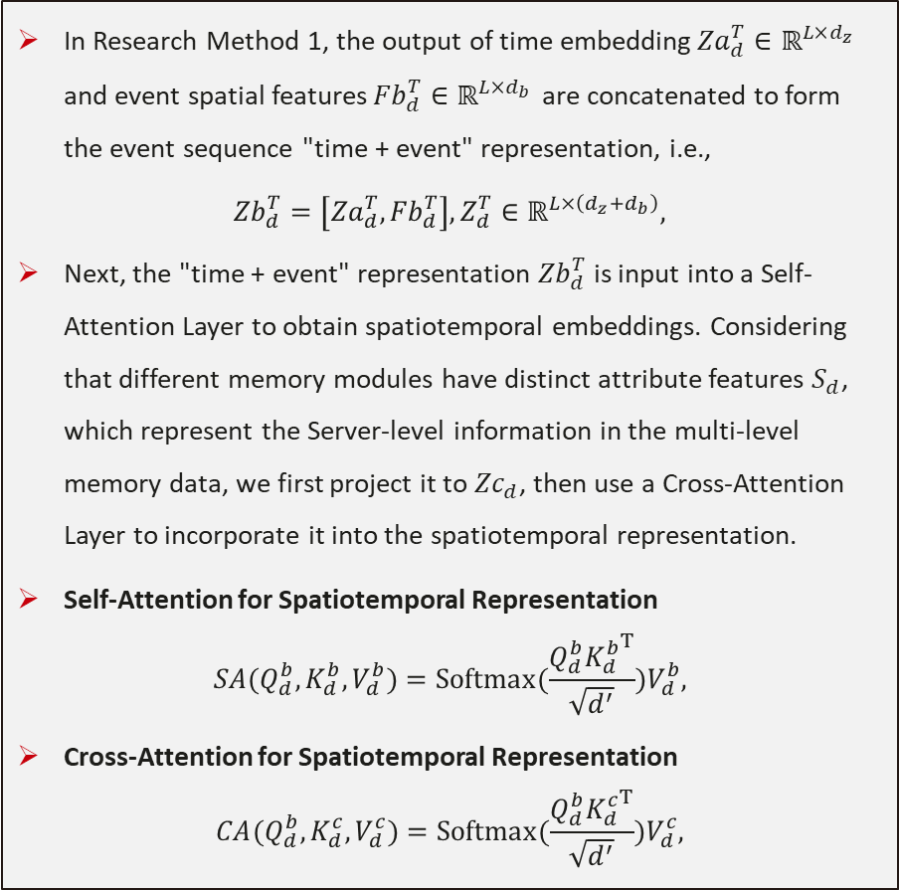








2.1 Time-aware model
Time-aware Prediction Module
In Research Method 1, the output of time embedding${Za}_{d}^{T}∈ℝ^{L×d_{z}}$ and event spatial features${Fb}_{d}^{T}∈ℝ^{L×d_{b}}$ are concatenated to form the event sequence "time + event" representation, i.e.,
$$\begin{aligned}{Zb}_{d}^{T}=\left[{Za}_{d}^{T},{Fb}_{d}^{T}\right],Z_{d}^{T}∈ℝ^{L×\left(d_{z}+d_{b}\right)},\end{aligned}$$
Next, the "time + event" representation ${Zb}_{d}^{T}$​ is input into a Self-Attention Layer to obtain spatiotemporal embeddings. Considering that different memory modules have distinct attribute features $S_{d}$​, which represent the Server-level information in the multi-level memory data, we first project it to ${Zc}_{d}$​, then use a Cross-Attention Layer to incorporate it into the spatiotemporal representation.
Self-Attention for Spatiotemporal Representation
$$SA(Q_{d}^{b}, K_{d}^{b}, V_{d}^{b})=Softmax(\frac{Q_{d}^{b}{K_{d}^{b}}^{T}}{\sqrt{d^{′}}})V_{d}^{b},$$
Cross-Attention for Spatiotemporal Representation
$$CA(Q_{d}^{b}, K_{d}^{c}, V_{d}^{c})=Softmax(\frac{Q_{d}^{b}{K_{d}^{c}}^{T}}{\sqrt{d^{′}}})V_{d}^{c},$$
时间戳表征 ${Za}_{d}^{T}$
事件空间特征 ${Fb}_{d}^{T}$
属性特征 $S_{d}$
Combine
Project
“时间+事件”表征 ${Zb}_{d}^{T}$
属性表征 ${Zc}_{d}$
Shared weights
Projection
$$\text{Projection}$$
$$Q_{d}^{b}$$
$$K_{d}^{b}$$
$$V_{d}^{b}$$
$$Q_{d}^{b}$$
$$K_{d}^{c}$$
$$V_{d}^{c}$$
Self-Attention
Cross-Attention
Shared weights
Dense
$$\text{Dense}$$
Add
Norm
FFN
$$⋯$$
Add
Norm
FFN
$$⋯$$
Integration
时空嵌入表征 $Z_{d}^{T}$
Classifier
Notes:
We combine the time and event spatial information to create a unified representation. First, we take the time embedding and the event spatial features and merge them together. This combined representation helps us capture both the time-related and event-related aspects of the data. Then, we input this combined "time + event" representation into a Self-Attention Layer, which allows us to understand the spatiotemporal relationships between the events and their timings.
Additionally, we recognize that different memory modules have distinct server-level information. We project this server-level data into a new representation and then use a Cross-Attention Layer to integrate it with the spatiotemporal representation. This way, we can combine both the event and server-level information to better capture the full context of memory failures.

Slide 14







2.2 Time-patch scale model
Past
Present
Future
Prediction interval
$$Δt_{pred_int}$$
ith CE
$$t_{i}$$
SN_s
Observation Window $Δt_{obs}$
RowId | ColumnId | RetryRdErrLogParity | LogTime | xxx | … | xxx
68876 | 136 | 65536 | 1717193965 | xxx | … | xxx
68876 | 136 | 65536 | 1717193992 | xxx | … | xxx
68876 | 136 | 65536 | 1717194030 | xxx | … | xxx
68876 | 136 | 4096 | 1717199247 | xxx | … | xxx
68876 | 136 | 4096 | 1717199279 | xxx | … | xxx
Time-patch Scale Prediction Module
统计特征 ${Fa}_{d}^{T}∈ℝ^{d_{a}}$
多层级时空特征 ${Fc}_{d}^{T}∈ℝ^{d_{c}}$
属性特征 $S_{d}$
Classifier
SN_s
Notes:
For the Time-patch scale model, during training, we aggregate historical correctable errors (CEs) using a sliding window. Then, we apply multiple levels of the BSFE to extract multi-level spatial features from the time-patch scale data. The final time-patch feature vector is created by combining the outputs of the Multi-BSFE with the counting features we derived. These features are then fed into a classifier, such as LightGBM, to train a failure prediction model.
Throughout both training and inference, features are generated at regular intervals using CE logs from the previous observation window. This process ensures that the predictions remain consistent over time, maintaining temporal accuracy.

Slide 15
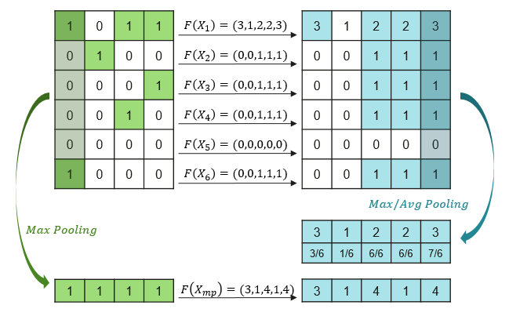
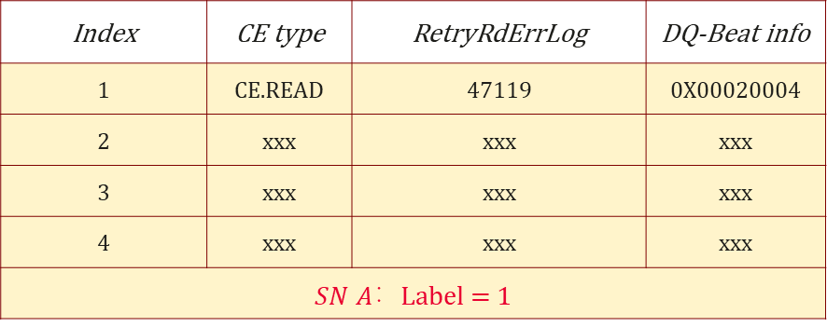

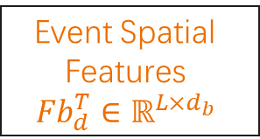
2.3 Time-point scale model
Index | CE type | RetryRdErrLog | DQ-Beat info
1 | CE.READ | 47119 | 0X00020004
2 | xxx | xxx | xxx
3 | xxx | xxx | xxx
4 | xxx | xxx | xxx
$SN A$：Label = 1 | xxx | xxx | xxx
4 Burst Rule
Risky CE Rule
Others
Event Spatial Features
$${Fb}_{d}^{T}∈ℝ^{L×d_{b}}$$
Rules
Results
A: Burst max dist=4
B: Burst min dist=4
C: RetryRdErrlog = UE
Rule：A & B & C
A: dq[0,1] exist error
B: dq[2,3] exist error
Rule：A & B
A: XXX
B: XXX
$$⋯$$
Rule：$∩(⋯)$
Existing research and experiments on our dataset demonstrate that proposing high-precision rules for time fine-grained features helps improve the overall performance of memory fault prediction.
The recall ability of manually designed rules is limited. How to use data-driven methods to design learnable rules has become an important direction for memory fault prediction.
Notes:
Finally, we have the Time-point scale model. Our existing research and experiments on this dataset show that creating high-precision rules for time fine-grained features significantly improves the overall performance of memory fault prediction. However, the recall ability of manually designed rules is limited. This limitation highlights the importance of finding ways to use data-driven methods to design learnable rules. Developing such methods has become a key direction for improving memory fault prediction.

Slide 16


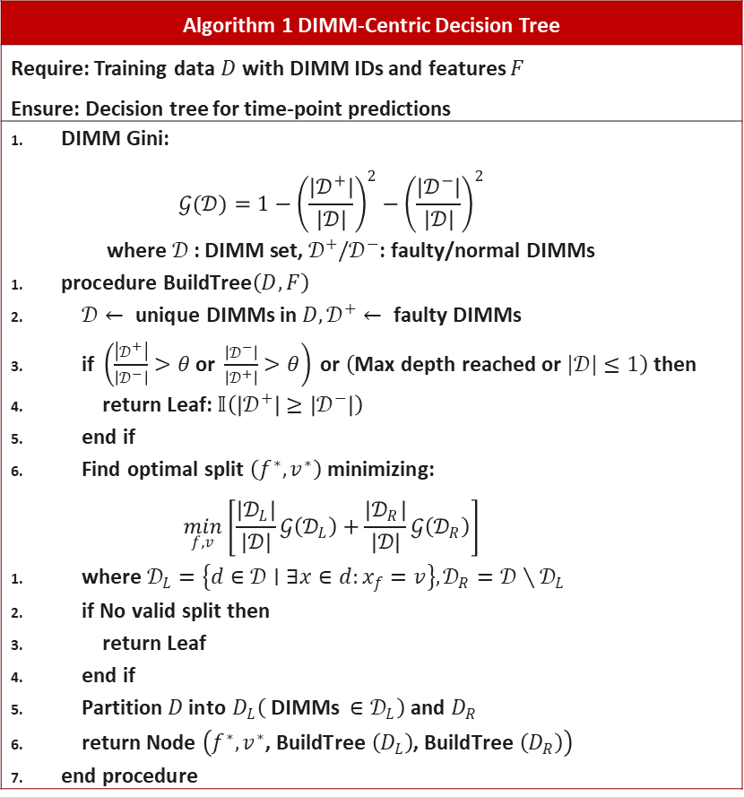









2.3 Time-point scale model
Algorithm 1 DIMM-Centric Decision Tree
Require: Training data $D$ with DIMM IDs and features $F$ Ensure: Decision tree for time-point predictions
$\text{DIMM} \text{Gini}\text{:}$ $$𝒢(𝒟)=1−{\left(\frac{\left|𝒟^{+}\right|}{|𝒟|}\right)}^{2}−{\left(\frac{\left|𝒟^{−}\right|}{|𝒟|}\right)}^{2}$$ $$\text{where} 𝒟\text{ : }\text{DIMM} \text{set}\text{, }𝒟^{+}/𝒟^{−}\text{: }\text{faulty}\text{/}\text{normal} \text{DIMMs}$$ $\text{procedure} \text{BuildTree}\left(D,F\right)$ $𝒟← \text{unique} \text{DIMMs} \text{in} D,𝒟^{+}← \text{faulty} \text{DIMMs}$ i$\text{f} \left(\frac{\left|𝒟^{+}\right|}{\left|𝒟^{−}\right|}>θ \text{or} \frac{\left|𝒟^{−}\right|}{\left|𝒟^{+}\right|}>θ\right) \text{or} \left(\text{Max} \text{depth} \text{reached} \text{or} |𝒟|≤1\right) \text{then}$ r$\text{eturn} \text{Leaf}\text{: }𝕀\left(\left|𝒟^{+}\right|≥\left|𝒟^{−}\right|\right)$ $\text{end} \text{if}$ $\text{Find} \text{optimal} \text{split} \left(f^{∗},v^{∗}\right) \text{minimizing}\text{: }$ $$\min_{f,v} \left[\frac{\left|𝒟_{L}\right|}{|𝒟|}𝒢\left(𝒟_{L}\right)+\frac{\left|𝒟_{R}\right|}{|𝒟|}𝒢\left(𝒟_{R}\right)\right]$$ w$\text{here} 𝒟_{L}=\left\{d∈𝒟∣∃x∈d:x_{f}=v\right\},𝒟_{R}=𝒟∖𝒟_{L}$ i$\text{f} \text{No} \text{valid} \text{split} \text{then}$ $\text{return} \text{Leaf}$ $\text{end} \text{if}$ $\text{Partition} D \text{into} D_{L}\left( \text{DIMMs} ∈𝒟_{L}\right) \text{and} D_{R}$ r$\text{eturn} \text{Node} \left(f^{∗},v^{∗}\text{, }\text{BuildTree} \left(D_{L}\right)\text{, }\text{BuildTree} \left(D_{R}\right)\right)$ $\text{end} \text{procedure}$
SN | id | Feature_X Gini | DIMM-Centric Gini | Truth
A | 0 | 0 | Max(0, 0, 1, 1, 1) = 1 | 1
 | 1 | 0
 | 2 | 1
 | 3 | 1
 | 4 | 1
B | 0 | 0 | Max(0, 0, 1) = 1 | 0
 | 1 | 0
 | 2 | 1
Time-point Scale Prediction Module
$$f_{1}$$
$Rule 1:(f_{1}=a)∧(f_{2}=b)$ $Rule 2: ⋯$
$$⋯$$
$$f_{1}=a$$
$$f_{1}≠a$$
$$f_{2}$$
$$f_{3}$$
$$f_{2}=b$$
$$f_{2}≠b$$
$$f_{4}$$
$$f_{5}$$
$$⋯$$
DIMM-level Decision Tree
Rule Set
Notes:
We designed a customized Gini decision tree based on bit-space features and CE type to achieve fault prediction at the time-point granularity. The key innovation in our approach is the use of DIMM-level Gini gain, instead of traditional sample-level impurity metrics. This allows for more precise fault prediction. The algorithm works by extracting all branches of the DIMM-Centric Decision Tree that result in a fault prediction (indicated by a result of 1) and then storing these branches in a rule base.
During inference, when new CE data comes in from the data stream, we evaluate it against the rule base. If a record matches any of the rules, the corresponding DIMM is predicted to experience a fault in the future. This approach allows for real-time prediction based on previously learned patterns.

Slide 17




























Research Topic 2: Three Memory Fault Prediction Models
Time-aware Prediction Module
Time-patch Scale Prediction Module
时间戳表征 ${Za}_{d}^{T}$
事件空间特征 ${Fb}_{d}^{T}$
属性特征 $S_{d}$
统计特征 ${Fa}_{d}^{T}∈ℝ^{d_{a}}$
多层级时空特征 ${Fc}_{d}^{T}∈ℝ^{d_{c}}$
Combine
Project
属性特征 $S_{d}$
Classifier
“时间+事件”表征 ${Zb}_{d}^{T}$
属性表征 ${Zc}_{d}$
Shared weights
Projection
$$\text{Projection}$$
$$Q_{d}^{b}$$
$$K_{d}^{b}$$
$$V_{d}^{b}$$
$$Q_{d}^{b}$$
$$K_{d}^{c}$$
$$V_{d}^{c}$$
Time-point Scale Prediction Module
$$f_{1}$$
$Rule 1:(f_{1}=a)∧(f_{2}=b)$ $Rule 2: ⋯$
$$⋯$$
$$f_{1}=a$$
$$f_{1}≠a$$
Self-Attention
Cross-Attention
$$f_{2}$$
$$f_{3}$$
$$f_{2}=b$$
$$f_{2}≠b$$
Shared weights
$$f_{4}$$
$$⋯$$
Dense
$$\text{Dense}$$
$$f_{5}$$
Add
Norm
FFN
$$⋯$$
Add
Norm
FFN
$$⋯$$
DIMM-level Decision Tree
Rule Set
Integration
Time-aware model: Models timestamps and spatial features using deep learning.
Time-patch scale model: Aggregates events across time scales to generate spatiotemporal features.
Time-point scale model: Uses spatial features and a decision tree for rule generation.
时空嵌入表征 $Z_{d}^{T}$
Classifier
Notes:
To summarize, we have developed three models for memory fault prediction. The Time-aware model focuses on modeling the timestamp representations of all events within the time window, along with event spatial features, using deep learning methods. The Time-patch scale model aggregates all events within the time window across multiple time scales to generate multi-level spatiotemporal features. These features are then combined with statistical features for modeling. Finally, the Time-point scale model uses event spatial features from all historical events and a custom decision tree to generate a set of rules for fault prediction.

Slide 18
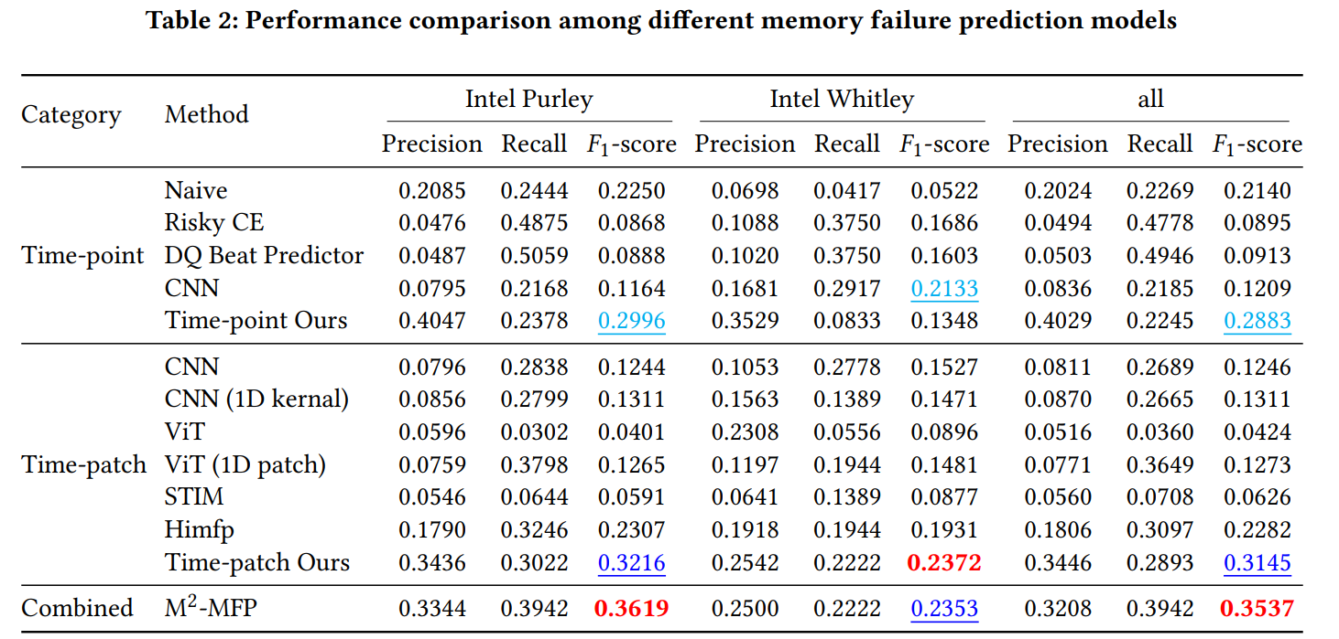
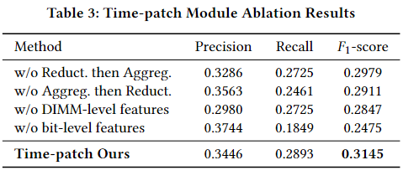
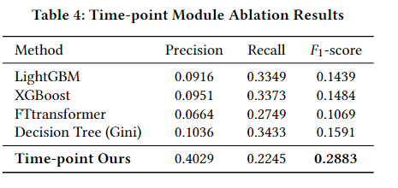
Research Topic 3: MFP System Deployment
M²-MFP achieves sota performance by effectively leveraging its multi-scale hierarchical architecture for enhanced predictive capability.
Dual-path feature extraction and multi-level feature integration are necessary.
Rule-based methods exhibit high false positive rates in the results.
Deep learning methods struggle to extract features effectively, resulting in poor performance.
The Time-point and Time-patch modules outperform their counterparts.
M²-MFP achieves state-of-the-art performance by leveraging its multi-scale hierarchical architecture.
DIMM-level Decision Tree achieves the best performance compared to these alternatives.
Notes:
The first two research components together form an end-to-end event sequence-driven fault prediction and diagnosis module. We’ve successfully deployed this module in Huawei Cloud's production environment, achieving state-of-the-art performance. Additionally, we’ve verified that both modules contribute to improving the overall performance. Looking ahead, our future work will focus on continuously improving fault prediction capabilities, expanding the fault diagnosis scenarios, and ultimately extending these solutions to provide intelligent operations and maintenance services across various cloud infrastructure use cases.

Slide 19



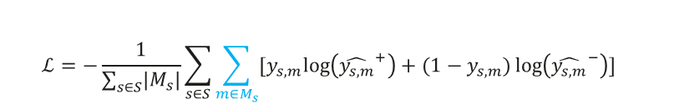
Future Work – Loss Function
MFP aims to forecast DIMM failures, but since a DIMM maps to multiple samples during inference, sample-level loss functions fail to accurately represent DIMM-level predictions.
Let the set of DIMMs be $S$. For $s∈S$，the sample set of $s$ in the training set is $M_{s}$.
DIMM-level Loss
Sample-level Loss
$$ℒ=−\frac{1}{\left|S\right|}\sum_{s∈S}{[y_{s}log\left({\hat{y_{s}}}^{+}\right)+(1−y_{s})\log\left({\hat{y_{s}}}^{−}\right)]}$$
$$ℒ=−\frac{1}{\sum_{s∈S}{\left|M_{s}\right|}}\sum_{s∈S}{\sum_{m∈M_{s}}{[y_{s,m}log\left({\hat{y_{s,m}}}^{+}\right)+(1−y_{s,m})\log\left({\hat{y_{s,m}}}^{−}\right)]}}$$
Samples
1
2
3
4
Failure time
$$t_{fail}$$
Prediction interval
5
$$SN_s$$
Positive Training Window
Sample Index | 1 | 2 | 3 | 4 | 5
Label | 0 | 0 | 1 | 0 | 1
If Failure | TP = 2, FP = 3
No Failure | TP = 3, FP = 2
DIMM Index | s
Label | 1
If Failure | TP = 1, FP = 0
No Failure | TP = 0, FP = 1
How to apply DIMM-level loss in a Sample-level prediction scenario becomes a problem, and Multi-Instance Learning (MIL) may be applicable in this context.
Notes:
In addition, we have several areas for future work. The first one involves the loss function. Currently, MFP aims to forecast DIMM failures, but since a DIMM corresponds to multiple samples during inference, the sample-level loss functions do not accurately reflect DIMM-level predictions. This is an issue we plan to address in our future work to improve the accuracy of our model’s predictions at the DIMM level.

Slide 20
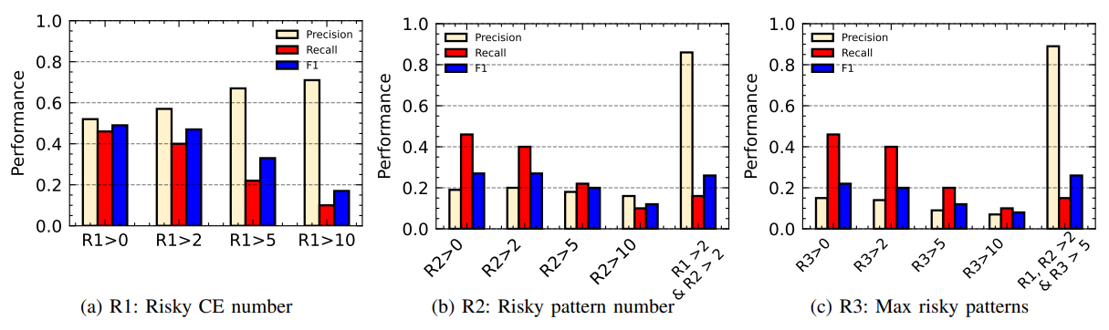
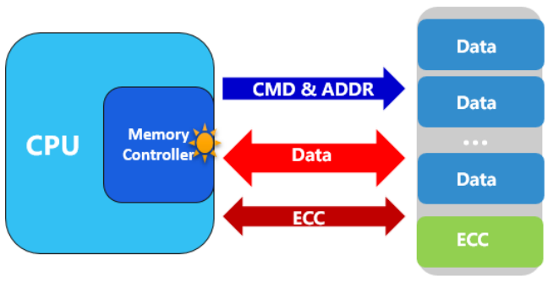
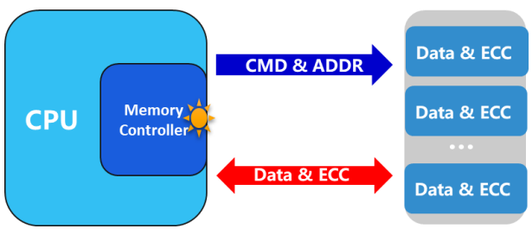
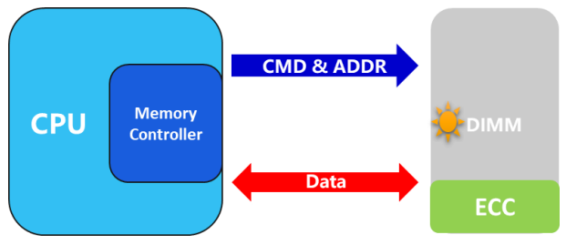











Future Work – Risky Parity Pattern
Statistical analysis to find risky CE patterns
1 | 0 | 1 | 1
0 | 0 | 0 | 0
0 | 0 | 0 | 1
0 | 0 | 0 | 0
0 | 0 | 0 | 0
1 | 0 | 0 | 0
0 | 0 | 1 | 0
0 | 0 | 0 | 0
Side-band ECC
Is it Risky Parity?
Custom Decision Tree to find risky CE patterns
$$f_{1}$$
$Rule 1:(f_{1}=a)∧(f_{2}=b)$ $Rule 2: ⋯$
$$⋯$$
$$f_{1}=a$$
$$f_{1}≠a$$
High-ordered features
$$f_{2}$$
$$f_{3}$$
$$f_{2}=b$$
$$f_{2}≠b$$
$$f_{4}$$
$$f_{5}$$
$$⋯$$
DIMM-level Decision Tree
Rule Set
Inline ECC
Stage 1(2023)：Design rules based on expert knowledge according to the mechanism of specific ECC.
Stage 2(2024)：Design rules based on experience according to statistical laws.
Stage 3(2025)：Utilize general models to mine general-purpose models applicable to universal datasets.
On-die ECC
Notes:
The second area of future work is the Risky Parity Pattern. This approach consists of three stages. In Stage 1, we design rules based on expert knowledge, focusing on the mechanisms of specific ECC (Error Correcting Code). In Stage 2, we design rules based on experience, using statistical laws to guide the process. Finally, in Stage 3, we aim to use general models to discover universal models that can be applied to a wide range of datasets, making the approach more adaptable and scalable.

Slide 21

Resources
Our repositories
WWW competition baseline
Code for M2-MFP
Resources for our HPCA 2025 tutorial
Resources for our WWW 2025 competition
……
Notes:
In addition to the work we've discussed today, we also have several resources available. These include the baseline code for the WWW competition, the code for M2-MFP, and materials for our HPCA 2025 tutorial and WWW 2025 and competitions.
We encourage you to explore these resources, and we’re excited to continue advancing in this field.
Thank you for your attention, and I look forward to any questions or further discussions!

