Slide 1
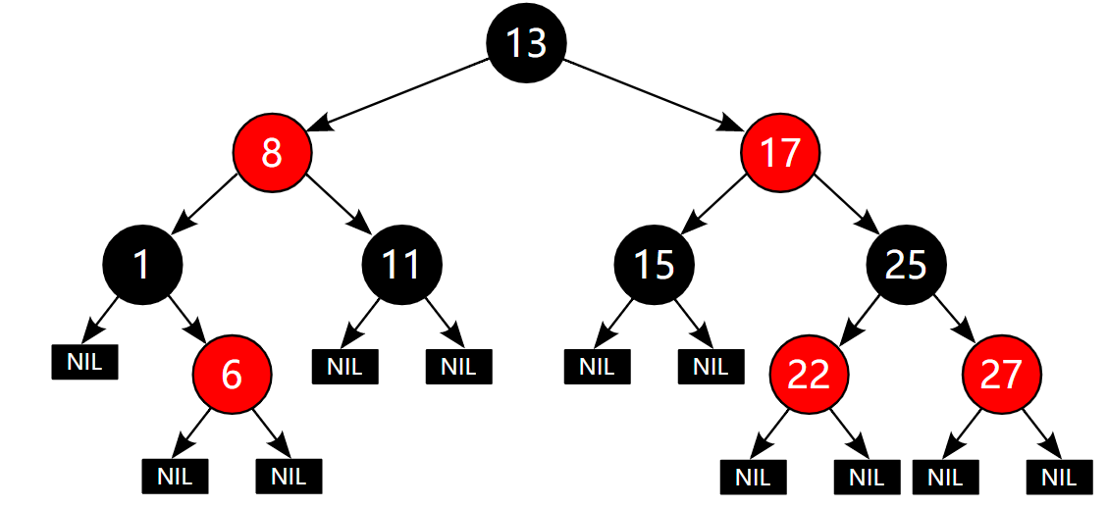
红 黑 树
Red black tree(RBT)
YouTube:
hwdong

Slide 2
Red black tree(RBT)

Slide 3
Search

Slide 4

Search
Search is an important operation for finding info in data collection.

Slide 5

Search
Search in your computer

Slide 6

Search
Search on internet

Slide 7

Search
Search database

Slide 8
sequential search

Slide 9
sequential search
Linear search： one-by-one comparison
compare with each element
Search: 4
（8, 3, 10, 1, 6, 4, 7, 13）

Slide 10
sequential search
Linear search： one-by-one comparison
compare with each element
Search: 4
（8, 3, 10, 1, 6, 4, 7, 13）

Slide 11
sequential search
Linear search： one-by-one comparison
compare with each element
Search: 4
（8, 3, 10, 1, 6, 4, 7, 13）

Slide 12
sequential search
Linear search： one-by-one comparison
compare with each element
Search: 4
（8, 3, 10, 1, 6, 4, 7, 13）

Slide 13
sequential search
Linear search： one-by-one comparison
compare with each element
Search: 4
（8, 3, 10, 1, 6, 4, 7, 13）

Slide 14
sequential search
Linear search： one-by-one comparison
compare with each element
Search: 4
（8, 3, 10, 1, 6, 4, 7, 13）

Slide 15
sequential search顺序搜索
Linear search线性搜索： one-by-one comparison
compare with each element
Search: 5
（8, 3, 10, 1, 6, 4, 7, 13）

Slide 16
sequential search
Linear search： one-by-one comparison
compare with each element
Search: 5
（8, 3, 10, 1, 6, 4, 7, 13）

Slide 17
sequential search
Linear search： one-by-one comparison
compare with each element
Search: 5
（8, 3, 10, 1, 6, 4, 7, 13）

Slide 18
sequential search
Linear search： one-by-one comparison
compare with each element
Search: 5
（8, 3, 10, 1, 6, 4, 7, 13）

Slide 19
sequential search
Linear search： one-by-one comparison
compare with each element
Search: 5
（8, 3, 10, 1, 6, 4, 7, 13）

Slide 20
sequential search
Linear search： one-by-one comparison
compare with each element
Search: 5
（8, 3, 10, 1, 6, 4, 7, 13）

Slide 21
sequential search
Linear search： one-by-one comparison
compare with each element
Search: 5
（8, 3, 10, 1, 6, 4, 7, 13）

Slide 22
sequential search
Linear search： one-by-one comparison
compare with each element
Search: 5
（8, 3, 10, 1, 6, 4, 7, 13）

Slide 23
sequential search
Linear search： one-by-one comparison
compare with each element
Search: 5
（8, 3, 10, 1, 6, 4, 7, 13）

Slide 24
sequential search
Linear search： one-by-one comparison
compare with each element
Search: 4
Time：Very slow O(n)
（8, 3, 10, 1, 6, 4, 7, 13）

Slide 25
binary search

Slide 26
Binary Search
For Ordered Sequence :
Search: 4
（1, 3, 4, 6, 7, 8, 10, 13）

Slide 27
Binary Search
For Ordered Sequence :
Search: 4
（1, 3, 4, 6, 7, 8, 10, 13）

Slide 28
Binary Search
For Ordered Sequence :
Search: 4
（1, 3, 4, 6, 7, 8, 10, 13）

Slide 29
Binary Search
For Ordered Sequence :
Search: 5
（1, 3, 4, 6, 7, 8, 10, 13）

Slide 30
Binary Search
For Ordered Sequence :
Search: 5
（1, 3, 4, 6, 7, 8, 10, 13）

Slide 31
Binary Search
For Ordered Sequence :
Search: 5
Not found
（1, 3, 4, 6, 7, 8, 10, 13）

Slide 32
Binary Search
For Ordered Sequence :
Search: 5
Very fast: O(log₂n)
n
n/2
n/2²
…
n/2^{k}<=1
（1, 3, 4, 6, 7, 8, 10, 13）
2^{k}>=n
k>=log₂n

Slide 33
sorted Sequence
Insert/delete 插入/删除:
Insert: 5
（1, 3, 4, 6, 7, 8, 10, 13）

Slide 34
sorted Sequence
Insert/delete 插入/删除:
Insert: 5
（1, 3, 4, 6, 7, 8, 10, , 13）

Slide 35
sorted Sequence
Insert/delete 插入/删除:
Insert: 5
（1, 3, 4, 6, 7, 8, , 10 , 13）

Slide 36
sorted Sequence
Insert/delete 插入/删除:
Insert: 5
（1, 3, 4, 6, 7, , 8 , 10 , 13）

Slide 37
sorted Sequence
Insert/delete 插入/删除:
Insert: 5
（1, 3, 4, 6, , 7 , 8 , 10 , 13）

Slide 38
sorted Sequence
Insert/delete 插入/删除:
Insert: 5
（1, 3, 4, , 6 , 7 , 8 , 10 , 13）

Slide 39
sorted Sequence
Insert/delete 插入/删除:
Insert: 5
need to move many elements
Delete is similar
（1, 3, 4, 5 , 6 , 7 , 8 , 10 , 13）

Slide 40
binary search tree(BST)

Slide 41
binary search tree(BST)
Same search efficiency as binary search on sorted sequence.
Need not move many elements for insert/delete operations.

Slide 42
binary search tree(BST)
It is a binary tree.
Each Node:
- Left tree smaller than the node

Slide 43
binary search tree(BST)
It is a binary tree.
Each Node:
- Left tree smaller than the node
- Right tree larger than the node

Slide 44
binary search tree(BST)
Each Node:
- Left tree smaller than the node

Slide 45
binary search tree(BST)
Each Node:
- Left tree smaller than the node
- Right tree larger than the node

Slide 46
binary search tree
Search: 4
4<8
Go left

Slide 47
binary search tree
Search: 4
4>3
Go right

Slide 48
binary search tree
Search: 4
4<6
Go left

Slide 49
binary search tree
Search: 4
4==4
Found!

Slide 50
binary search tree
Search: 5
5<8
Go left

Slide 51
binary search tree
Search: 5
5>3
Go right

Slide 52
binary search tree
Search: 5
5<6
Go left

Slide 53
binary search tree
Search: 5
5>4
Go right

Slide 54
binary search tree
Search: 5
5>4
Not found

Slide 55
binary search tree
1
Search: go from root, at most to the leaf
Time： O(h)
2
h=4
3
4

Slide 56
Insert in BST
Search the location to insert,
then insert
Insert: 5
Insert is fast and
need not move many elements
5

Slide 57
Insert an element
8
Insert: 8

Slide 58
8
10
Insert:10

Slide 59
8
10
Insert:14
14

Slide 60
8
3
10
Insert: 3
14

Slide 61
8
3
10
Insert: 6
14
6

Slide 62
8
3
10
Insert: 1
14
1
6

Slide 63
8
3
10
Insert: 7
14
1
6
7

Slide 64
8
3
10
Insert: 13
14
1
6
7
13

Slide 65
8
3
10
Insert: 4
14
1
6
4
7
13

Slide 66
Balance
h = ⎣log₂n⎦ +1
1+2+…+ 2^{h-1} = 2^{h}-1

Slide 67
Balance or not?
Good!
Bad!
h = ⎣log₂n⎦ +1 h = n

Slide 68
AVL tree

Slide 69
AVL tree
(named after inventors Adelson-Velsky and Landis)
Balanced binary search tree.
For any node:
|Height(LeftTree) – Height(RightTree)| <=1

Slide 70
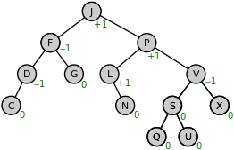
For any node:
|Height(RightTree) – Height(LeftTree)| <=1
balance factor
h = ⎣log₂n⎦ +1

Slide 71
Insert in AVL Tree
0
13
－1
13
－2
13
0
24
－1
24
0
37
Inserted a leaf node,
make some ancestor node not balanced!

Slide 72
R
－2
13
0
24
R
rotate
－1
24
0
13
0
37
0
37
Inserted node(37) is the Right child of Right child of non-balanced ancestor node (13).
The case for the unbalanced tree (rooted at 13) is called: RR

Slide 73
－2
13
0
24
rotate
－1
24
0
13
0
37
0
37
Insert 90
－2
24
－1
24
Insert 53
0
13
－2
37
0
13
－1
37
1
90
0
90
0
53

Slide 74
－2
24
0
13
－2
37
R
1
90
0
53
L
Inserted node(37) is the Left child of Right child of non-balanced ancestor node (13).
The case for the unbalanced tree (rooted at 13) is called: RL

Slide 75
－2
24
－2
24
0
13
－2
37
0
13
－2
37
1
90
－1
53
0
53
0
90
－1
24
0
13
0
53
0
37
0
90

Slide 76
Four Cases: LL,RR, LR,RL
LL: left node of left tree
L
0
B
2
A
Right rotation
L
1
B
0
A
A_{R}
B_{L}
B_{L}
h-1
B_{R}
B_{R}
A_{R}
h-1
The right subtree of B become the left subtree of A

Slide 77
RR: right node of right tree
R
0
B
2
A
R
Left rotation
1
B
0
A
A_{L}
B_{R}
h-1
B_{R}
B_{L}
B_{L}
A_{L}
h-1
The left subtree of B become the right subtree of A

Slide 78
LR: right subtree of left child
Need two rotations
2
A
-1
B
A_{R}
1
C
B_{L}
h-1
C_{L}
C_{R}
h-2

Slide 79
LR: right subtree of left child
Left rotation first
-1
A
2
A
0
C
A_{R}
-1
B
A_{R}
h-1
1
C
0
B
C_{R}
B_{L}
h-1
C_{L}
C_{R}
B_{L}
C_{L}
h-2

Slide 80
LR: right subtree of left child
Then Right rotation
-1
A
0
C
0
C
A_{R}
0
B
-1
A
0
B
C_{R}
B_{L}
C_{L}
C_{R}
A_{R}
B_{L}
C_{L}

Slide 81
RL: left subtree of right node
-2
A
1
B
A_{L}
h-1
1
C
B_{R}
h-1
C_{L}
C_{R}
h-2

Slide 82
RL: left subtree of right node
Right rotation first
0
A
-2
A
0
C
1
B
A_{L}
A_{L}
h-1
1
C
-1
B
B_{R}
C_{L}
h-1
C_{L}
C_{R}
C_{R}
B_{R}
h-2

Slide 83
RL: left subtree of right node
Then Left rotation
0
A
0
C
0
C
A_{L}
0
A
-1
B
-1
B
C_{L}
A_{L}
C_{L}
C_{R}
B_{R}
C_{R}
B_{R}

Slide 84
Red-Black Tree (RBT)

Slide 85
A red-black tree (RBT) is a binary search tree in which
each node has a color (red or black) associated with it

Slide 86
Leaf node are different in BST and RBT
leaf nodes in RBT are empty nodes, but leaf nodes in BST are data nodes.
6
Internal node
6
Internal node
3
7
3
7
Internal node
Leaf node
BST tree
Leaf node
RBT tree

Slide 87
Red-Black Tree (RBT) need less rotations during insertion and deletion than AVL tree. RBT trees are less balanced compared to AVL Trees.
if the insertions and deletions are less frequent and search is a more frequent operation, then AVL tree should be preferred over Red-Black Tree.

Slide 88
RBT tree use color rules to keep tree balanced!

Slide 89
(root property) The root of the red-black tree is black

Slide 90
2. (leaf property) The color of a leaf node is black

Slide 91
3. (red property) The children of a red node are black.
A Parent and its child should not both Red

Slide 92
3. (black property) For each node, all simple paths from the node to descendant leaves contain the same number of black nodes.
2 black nodes

Slide 93

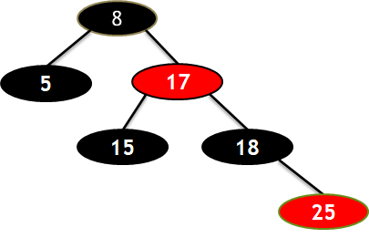
4. The height of the red-black tree is at most
n=6
h(8)=4
h(17)=3
h(18)=2
h(25)=1
h(8)=4<=2log₂(n+1)= 2log₂(6+1)

Slide 94
To Proof
The height of the red-black tree is at most

Slide 95
Black Height : the number of black nodes on any simple path from a node x (not including it) to a leaf
bh=2
bh=1
bh=1
bh=1
bh=1
bh=1
bh=1
bh=0
bh=0
bh=0
bh=0

Slide 96
We can similarly define similar red-height. Then:
h(x) = bh(x)+rh(x)
Any path from x to leaf node, the number of black nodes >= the number of red nodes, so:
rh(x)<=bh(x)
So:
h(x)<=2bh(x)

Slide 97

prove by induction
when bh(x)=0, at least 2 ^{bh(x)} -1 = 0 internal node
when bh(x)>0, if the color of its child is red, then bh(child) = bh(x) ,else bh(child) = bh(x) -1
x
x
c
c

Slide 98
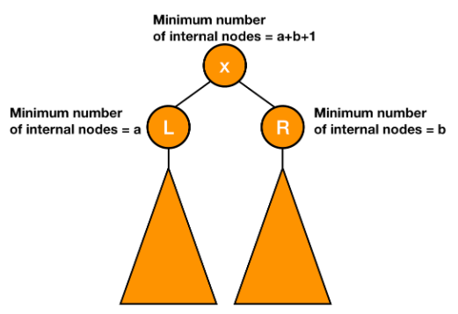
Internal nodes of x>=2(2^{bh(x)-1} - 1)+1 = 2^{bh(x)} - 2+1
= 2^{bh(x)} - 1

Slide 99




Like AVL ,the search time for BRT = O(h) = O(log₂n)

Slide 100
insert
How to insert newNode in Red Black Tree

Slide 101
insert
1. If tree is empty:
insert newNode with black color to be root
Else:
2. use BST insert to add it to the tree and color the node Red
3. recolor, rotation to restore RBT properities.
3.1 uncle is red
3.2 uncle is black

Slide 102
If tree is Empty then insert the newNode as Root node with color Black .
8

Slide 103
2. If tree is not Empty then insert the newNode as leaf node with color Red.
3. If the parent of newNode is Black then exit from the operation.
8
18
Notes:
http://pages.cs.wisc.edu/~skrentny/cs367-common/readings/Red-Black-Trees/

Slide 104
2. If tree is not Empty then insert the newNode as leaf node with color Red.
3. If the parent of newNode is Black then exit from the operation.
8
5
18

Slide 105
4. If the parent of newNode is Red then check the color of uncle node.
4.1 If uncle is colored Red then perform Recolor and also check parent’s parent of new node if its not root node than recolor it. Repeat the same until tree becomes Red Black Tree.
8
5
18
15

Slide 106
4. If the parent of newNode is Red then check the color of uncle node.
4.1 If uncle is colored Red then perform Recolor and also check parent’s parent of new node if its not root node than recolor it. Repeat the same until tree becomes Red Black Tree.
8
5
18
15

Slide 107
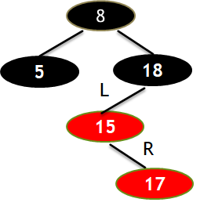
4.2 If uncle is colored Black or NULL then make suitable Rotation and Recolor it.
Uncle is Null(black leaf node)
Need LR rotation

Slide 108
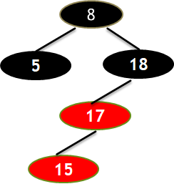
3.2 If it is colored Black or NULL then make suitable Rotation and Recolor it.
Left rotation
Need LR rotation

Slide 109
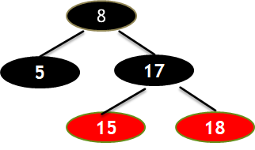
3.2 If it is colored Black or NULL then make suitable Rotation and Recolor it.
Left rotation
Right rotation
Need LR rotation

Slide 110
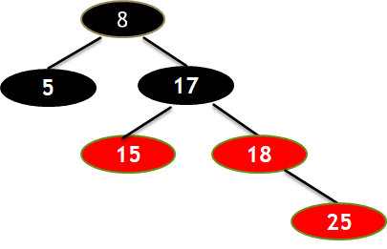
4.1 Parent is red and uncle is red, then recolor and check grandparent if its not root node than recolor it.

Slide 111
4.1 Parent is red and uncle is red, then recolor and check grandparent if its not root node than recolor it.
Repeat the same until tree becomes Red Black Tree.
grandparent

Slide 112
if T is empty:
X.color = black; T= X; return;
X.Color = red;
While(X.parent.color==red):
if X.uncle.color==red:
X.parent.color=X.uncle.color = black
if X. parent. Parent is not root:
X. parent. Parent.color==red; x = X.parent. Parent;
else:
break
else:
rotate and recolor；
Recolor, rotation

Slide 113
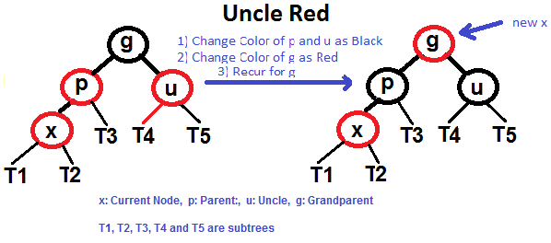
Case 1: uncle is red
Notes:
https://www.geeksforgeeks.org/c-program-red-black-tree-insertion/

Slide 114
Case 2: uncle is black
Rotate (LL, RR, LR, RR) and recolor

Slide 115
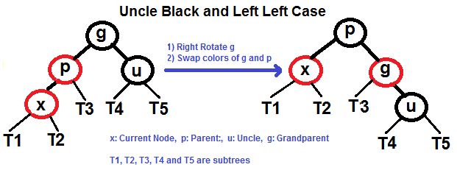

Slide 116
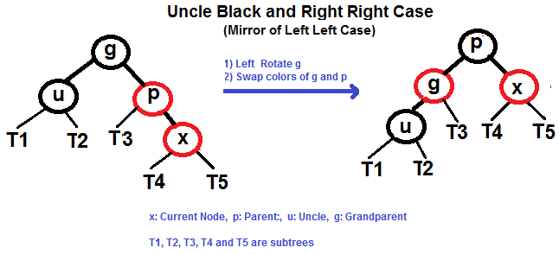

Slide 117
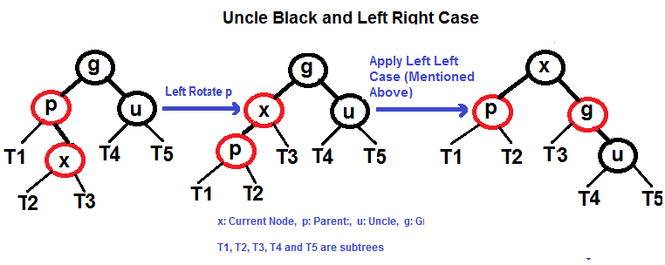

Slide 118
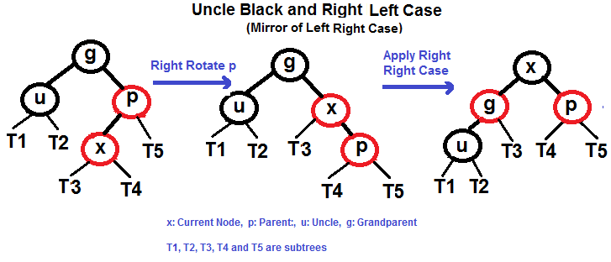

Slide 119

关注我
https://hwdong-net.github.io
Youtube频道:hwdong

