Slide 1

Advanced Oracle Features
When, why and how to use them in your Java programs
Harald Westphal / 2012-01-23

Slide 2


Agenda
Introduction to Abstract Data Types
Oracle as a Message Broker
Storing and finding Spatial Data

Slide 3
Agenda
Introduction to Abstract Data Types
Oracle as a Message Broker
Storing and finding Spatial Data

Slide 4


Abstract Data Types
User Data Types
  Extending the built-in type system
Object oriented extension of SQL
Storing and retrieving of structured, nested values in a single column

Slide 5
Creating types
CREATE OR REPLACE TYPE foobar AS OBJECT (
name VARCHAR2(100),
flag NUMBER(3),
creation_date TIMESTAMP,
tags string_collection
)
CREATE OR REPLACE TYPE string_collection AS TABLE OF VARCHAR2(100)
CREATE OR REPLACE TYPE foobar_array AS VARRAY(1000) OF foobar

Slide 6
Deleting types
-- types must be dropped in correct order
DROP TYPE foobar_array;
DROP TYPE foobar;
-- alternative
DROP TYPE foobar FORCE;
DROP TYPE foobar_array;

Slide 7
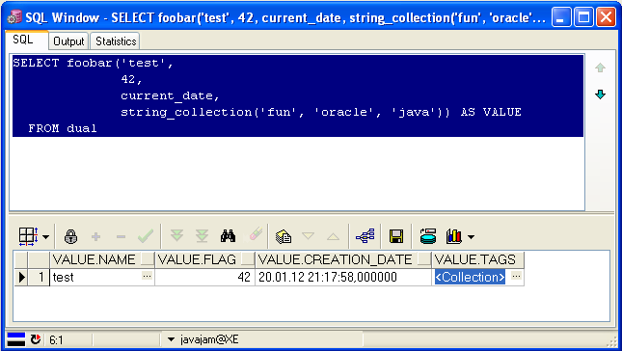
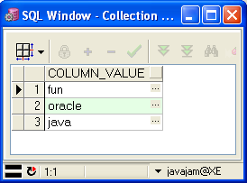
Creating a value in SQL

Slide 8
Usage types
As column type in a table
  ADT must be based on OBJECT and VARRAY
  When using TABLE type, nested tables must be maintained
    CREATE TABLE t_foobar (fc foobar) NESTED TABLE fc.tags STORE AS t_foobar_tags
As parameter type (in/out) for stored procedures
As column type in a view
  store data in relations
  return joined columns as collections

Slide 9
ADTs in views
CREATE TABLE tagged(id NUMBER(38));
CREATE TABLE tag(tagged_id NUMBER(38), value VARCHAR2(100));
SELECT t1.*,
CAST(MULTISET
(SELECT t2.value FROM tag t2
WHERE t2.tagged_id = t1.id) AS
string_collection) AS tags
FROM tagged t1

Slide 10
ADTs in Java
OBJECT → java.sql.Struct
TABLE, VARRAY → java.sql.Array
Creating ADT instances is vendor specific
  Oracle API must be used
  java.sql.Connection must be unwrapped to native oracle.jdbc.OracleConnection

Slide 11
Creating a value in Java
PreparedStatement stmt = ...;
OracleConnection orclConn =
stmt.getConnection().unwrap(OracleConnection.class);
ArrayDescriptor arrayDescriptor =
ArrayDescriptor.createDescriptor("foobar_array", orclConn);
Struct[] values = new Struct[...];
StructDescriptor structDescriptor =
StructDescriptor.createDescriptor("foobar", orclConn);
for (int i = 0; i < values.size(); i++) {
Struct struct = new STRUCT(structDescriptor,
orclConn, new Object[] { ... });
values[i] = struct;
}
Array array = new ARRAY(arrayDescriptor, orclConn, values);
stmt.setArray(0, array);

Slide 12

Creating a value in Java

Slide 13
Use frameworks!
Spring Framework
  NativeJdbcExtractor
  JDBC Extensions for Oracle
OSTM
  Bean annotations
  Usable with Mybatis
    Lightweight O-R mapper
  Usable with Hibernate
    Generic UserType implementation

Slide 14
Why should you care?
Performance
  Load resp. store complex objects (and collections) with a single (join-less) select resp. update statement
  No hidden roundtrips
Simplified O-R mapping
Suitable for non-cyclic trees of value objects
Database understands structure of complex values

Slide 15

ADT References
PL/SQL Language Reference
http://bit.ly/tnGa6y
MyBatis
http://mybatis.googlecode.com/
Spring Data JDBC Extensions for Oracle
http://bit.ly/ulVUuC
Oracle SQL Type Mapper
http://ostm.googlecode.com/

Slide 16
Agenda
Introduction to Abstract Data Types
Oracle as a Message Broker
Storing and finding Spatial Data

Slide 17
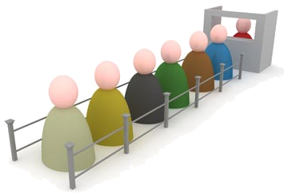
Advanced Queuing
Database-integrated message queuing
Build on top of standard database technology
  Messages are stored in tables
  Payload types are defined as ADTs
  SQL for querying messages and monitoring of queues
Available in all Oracle editions

Slide 18
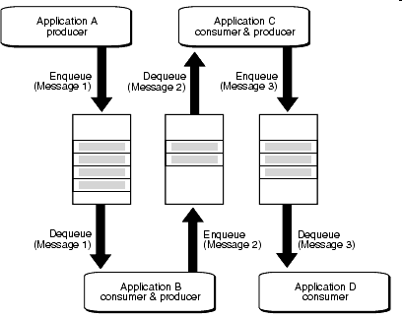
Usage Scenario

Slide 19
Creating a queue
dbms_aqadm.create_queue_table(
queue_table => 'foo_qt',
queue_payload_type => 'foo');
dbms_aqadm.create_queue(
queue_name => 'foo_q',
queue_table => 'foo_qt');
dbms_aqadm.start_queue(
queue_name => 'foo_q‘);

Slide 20
Enqueing and dequeing
DECLARE
msgid RAW(16);
eopt dbms_aq.enqueue_options_t;
mprop dbms_aq.message_properties_t;
payload foo;
BEGIN
payload := foo(…);
dbms_aq.enqueue('foo_q', eopt, mprop, payload, msgid);
END;
DECLARE
msgid RAW(16);
dopt dbms_aq.dequeue_options_t;
mprop dbms_aq.message_properties_t;
payload foo;
BEGIN
dbms_aq.dequeue('foo_q', dopt, mprop, payload, msgid);
END;

Slide 21
Queue types and options (1)
Enqueing and dequeing is transactional
  Number of retries is configurable
  Delay is configurable
  Failed messages are moved to a configurable exception queue
Expiration time is configurable
Dequeing order is configurable
  Enqueue time, priority
Dequeue wait time is configurable
User-defined dequeue condition (WHERE clause)

Slide 22
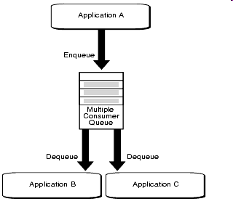
Queue types and options (2)
Multi consumer queues (“topics”)
Consumer must subscribe to queue
Identified by name and address
Message remains in queue until it is consumed by all consumers which where subscribed when the message was enqueued

Slide 23
Java usage
Native AQ API
  Part of the JDBC API (since 11g)
JMS API implementation
  can be found in aqapi.jar
  support of ADT and standard JMS messages
    Predefined types
    Try to get along with TextMessage and BytesMessage

Slide 24
Java example (1)
dbms_aqadm.create_queue_table(
queue_table => 'java_qt',
queue_payload_type => 'sys.aq$_jms_text_message');
dbms_aqadm.create_queue(
queue_name => 'java_q',
queue_table => 'java_qt');
dbms_aqadm.start_queue(
queue_name => 'java_q');

Slide 25
Java example (2)
// must return OracleConnection!
javax.sql.DataSource dataSource = ...;
javax.jms.ConnectionFactory conFactory =
AQjmsFactory.getConnectionFactory(dataSource);
javax.jms.Connection con = conFactory.createConnection();
javax.jms.Session session = con.createSession(...);
javax.jms.Destination queue = session.createQueue("java_q");
javax.jms.MessageProducer sender = session.createProducer(queue);
javax.jms.Message message = session.createTextMessage("foobar");
sender.send(message);
javax.jms.MessageConsumer receiver =
session.createConsumer(queue);
javax.jms.Message message = receiver.receive();

Slide 26
Why should you care?
Persistent and transactional message queuing
Distributed JMS/JDBC transaction without XA
Reuse of existing infrastructure and tools
Database understands structure of message payloads
Polling of database tables can be avoided

Slide 27
AQ References
Advanced Queuing User's Guide
http://bit.ly/vTGWcw
Spring Data JDBC Extensions for Oracle
http://bit.ly/ryZM75

Slide 28
Agenda
Introduction to Abstract Data Types
Oracle as a Message Broker
Storing and finding Spatial Data

Slide 29

Oracle Spatial
Oracle offers built-in features for storing and retrieving spatial data
Formerly known as Spatial Data Option (SDO)
We are using Oracle Locator
  available in all Oracle editions
  Oracle Spatial is an option for Oracle EE
Basically consists of
  a spatial datatype
  a domain specific index
  bunch of PL/SQL packages

Slide 30
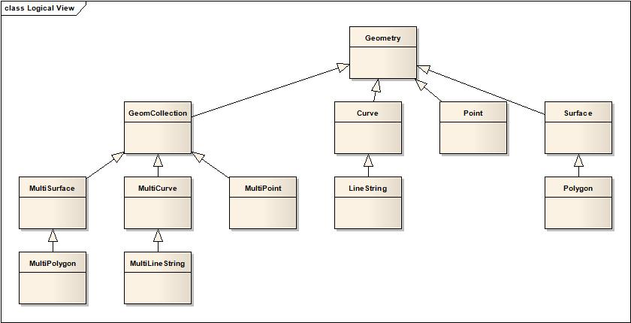
Data Type Hierarchy

Slide 31
Spatial Reference Systems
A geometry consists of its coordinates plus a spatial reference system identifier (SRID)
SRID defines how to interpretate the coordinates
  Example: x = longitude, y = latitude, unit = decimal degrees
Common SRIDs
  8307 (WGS84 Oracle)
  4326 (WGS84 EPSG),
  3857 (Web/Spherical Mercator)
List of all SRIDs: CS_SRS

Slide 32
Creating a spatial table
CREATE TABLE country (
code VARCHAR2(2),
name VARCHAR2(100),
geometry sdo_geometry);
INSERT INTO user_sdo_geom_metadata
(table_name, column_name, diminfo, srid)
VALUES
('country',
'geometry',
sdo_dim_array(sdo_dim_element('X',
-180, 180, 0.005),
sdo_dim_element('Y',
-90, 90, 0.005)), 8307);

Slide 33
Creating a spatial index
CREATE INDEX
country_geometry_idx
ON country(geometry)
INDEXTYPE IS
mdsys.spatial_index;

Slide 34
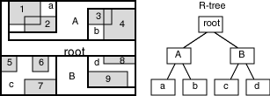

Spatial Queries (1)
Spatial index is a multi-dimensional index (R-tree index)

Slide 35
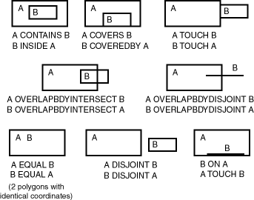
Spatial Queries (2)
Topological relationships

Slide 36
Spatial Queries (3)
Find neighbours of country X
  SELECT c0.*
  FROM country c0, country c1
  WHERE c1.code = 'X'
  AND sdo_relate(c0.geometry,
  c1.geometry,
  'mask=touch') = 'TRUE'

Slide 37
Spatial Queries (4)
Find countries within a distance of a point
  SELECT c0.*
  FROM country c0
  WHERE
  sdo_within_distance(c0.geometry,
  sdo_geometry(2001, 8307,
  sdo_point_type(10.0, 53.55,
  NULL),
  NULL, NULL),
  'distance=1000000') = 'TRUE'

Slide 38
Java usage
Construct SDO_GEOMETRY objects by hand
  SQL (consider maximum statement length)
  STRUCT
Oracle’s sdoapi.jar
  oracle.spatial.geometry.JGeometry
GeoTools / JTS
  org.geotools.data.oracle.sdo.GeometryConverter
  converts from and to JTS geometries (i.e. the OGC reference model)

Slide 39
Live Demo

Slide 40
Why should you care?
Location based services become mainstream
Naive storage of spatial data will not scale
Efficient spatial queries are essential

Slide 41
Spatial References
Spatial Developer’s Guide
http://bit.ly/tDrn5X
JTS
http://www.vividsolutions.com/jts
GeoTools
http://geotools.org/

Slide 42

<EOF>
Thank you for your attention!
Please ask your questions!

