Slide 1
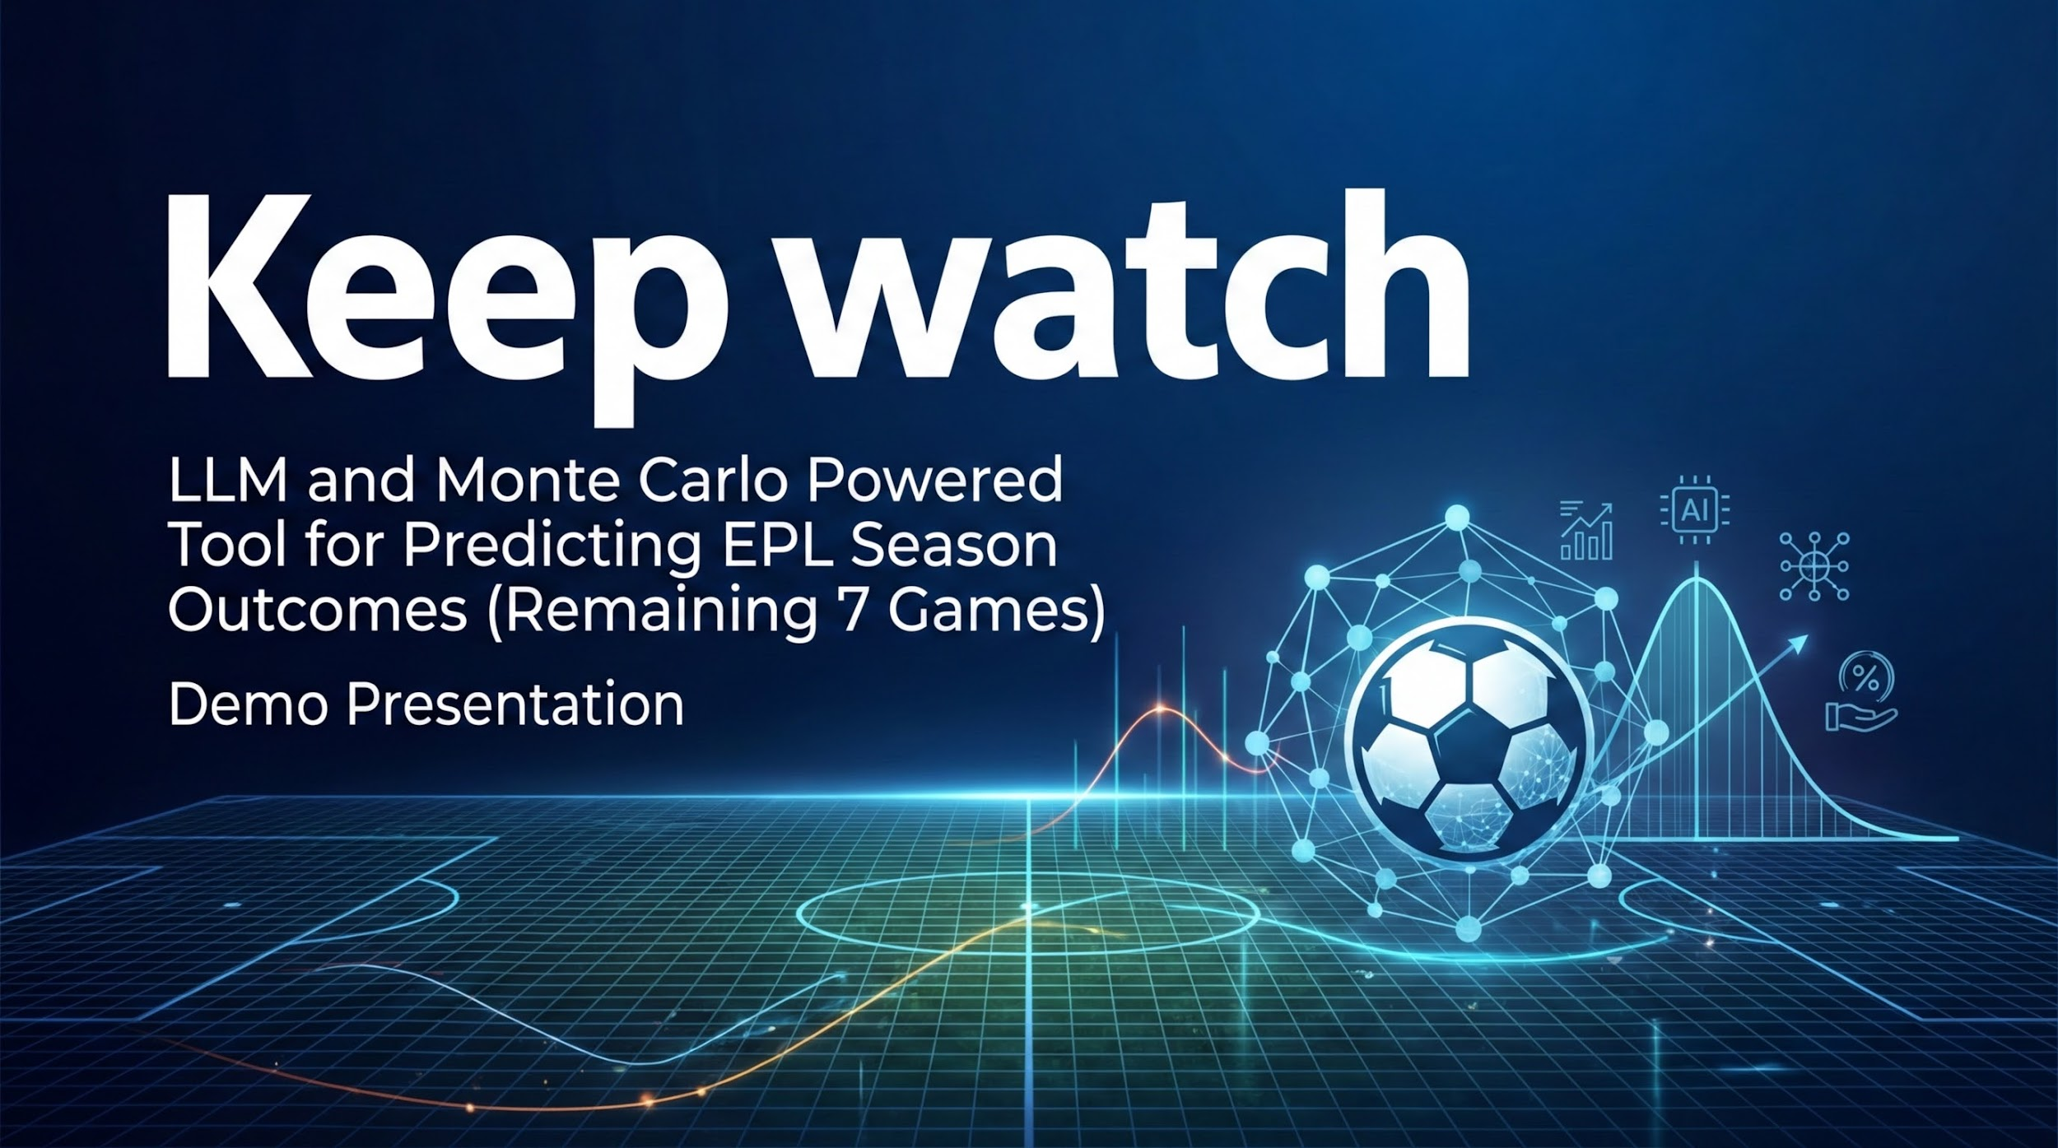

Slide 2
How the EPL Works
STRUCTURE
20 clubs — every team plays every other team, Home and Away (38 games each).
SCORING
3
1
0
pts
Win
Draw
Loss
AT THE END OF THE SEASON, THERE ARE 4 POSSIBLE OUTCOMES:
1st
Top 4
5th – 7th
18th–20th
Champion
Champions League
Europa / Conf.
Relegated
League title — the best possible outcome.
European football the following season.
Continental football. Decent, but not the dream.
Drop to the Championship. Catastrophic.

Slide 3
The Questions I Was Trying to Answer
With 7 games left, fans and analysts face the same impossible questions:
Outcome Odds
What are the real, quantified odds that Team X wins the title, qualifies for Europe, or gets relegated?
Game Importance
Of the remaining 7 fixtures, which are the highest leverage? Where should a team focus its energy?
Scenario Testing
If Team X wins Game A but loses Game B — how do outcome probabilities shift? Calculated instantly.
Multi-Scenario View
Test several scenarios side by side and compare their impact on final standings at a glance.
Hindsight Analysis
Knowing what we know now — how could Team X have acted differently 12 months ago to change their fate?

Slide 4
What the Ideal App Looks Like
Four escalating layers of insight — from facts to strategy:
THE WHAT
THE SO WHAT
Current Probabilities
Scenario Explorer
A live, real-time snapshot: the odds of every outcome for every club — right now, based on this week's actual results and fixtures.
What if Newcastle beat Arsenal but lose to Palace? What if they lose their goalkeeper to injury? Play with any scenario and instantly see probabilities shift.
THE WHAT NOW
THE WHAT IF
Deep Dive Analysis
Impossible Scenarios
Pick a team and a valid scenario. Keepwatch deep-dives: given these constraints, what ACTUALLY matters in the remaining 7 games? Where is the highest leverage?
Beyond today's mathematical reality — if you could go back 12 months, which paths or decisions could have unlocked a route to success that no longer exists?

Slide 5
How Keepwatch Is Built — The Inputs
Six data and intelligence layers working in combination:
1
Monte Carlo Simulation
2
Live Betting Odds API
3
Live Results API
Simulates the remaining season 10,000 times. Outcome probabilities emerge from the distribution across all runs.
Win/draw/loss probabilities sourced from live sportsbook odds. ELO ratings serve as an accurate fallback.
Current standings and match results fetched in real time — every simulation starts from today's actual league state.
4
LLM Probability Adjustment
5
Serper Web Research
6
FIFA 26 Player Scores
Interprets natural-language scenarios and adjusts match odds accordingly before re-running 10k simulations.
Fast, cheap web search via Serper API — surfaces news, injury updates, and context to enrich any scenario analysis.
Player ratings quantify individual quality and squad depth, enabling analysis of how key injuries shift win probability.

Slide 6
Live Demo
Keepwatch in action
Outcome Probabilities · Game Importance · Scenario Testing · Deep Dive

Slide 7
Key Learnings — Beyond Football
What Keepwatch taught us that applies far beyond the EPL:
Serper beats traditional web search
Fast, cheap, and highly relevant. For any tool that needs real-world context, Serper is the clear winner — and this applies directly to Gorilla.
LLM + Math is the combination that matters
Language models alone give you language. Simulation alone gives you numbers. Together they produce insight — and that pattern is worth repeating everywhere.
Digital Twinning IS possible
Running 10,000 simulations of a complex real-world system in seconds is a proof of concept. The lessons from that scale far beyond a football league.
Chat is critical — but UI matters too
The conversational interface is powerful, but a simple UI layer on top of it would dramatically improve adoption and usability of the Innovera tool.
Crush complexity into a single number
Betting odds are price signals — they encode real-world judgment into one actionable figure. We need an equivalent signal layer for the Innovera Platform.

Slide 8
Thank You
Questions?
Keepwatch | LLM + Monte Carlo EPL Probability Calculator
Powered by LLM + Monte Carlo Simulation

