Slide 1
Clinical decision support system: Hypertension
CPBMI 1조

Slide 2
1. ATHENA DSS
Assessment and Treatment of Hypertension: EvideNce-based Automation (ATHENA)
초창기의 decision support system
Developed at Stanford Medical Informatics
Two components
Knowledge Base (KB): risk stratification, BP targets, comorbidity, preferred drug, clinical message 등을 담고 있음
Guideline interpreter: patient-specific treatment를 recommend 함
Based on JNC6
M.K. Goldstein et al., Proc AMIA Symp. 2000:300-4.

Slide 3
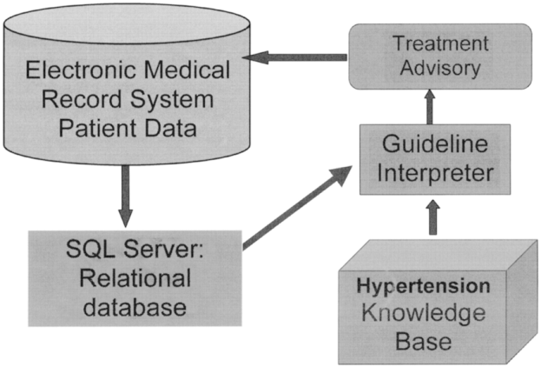
ATHENA - DSS architecture

Slide 4
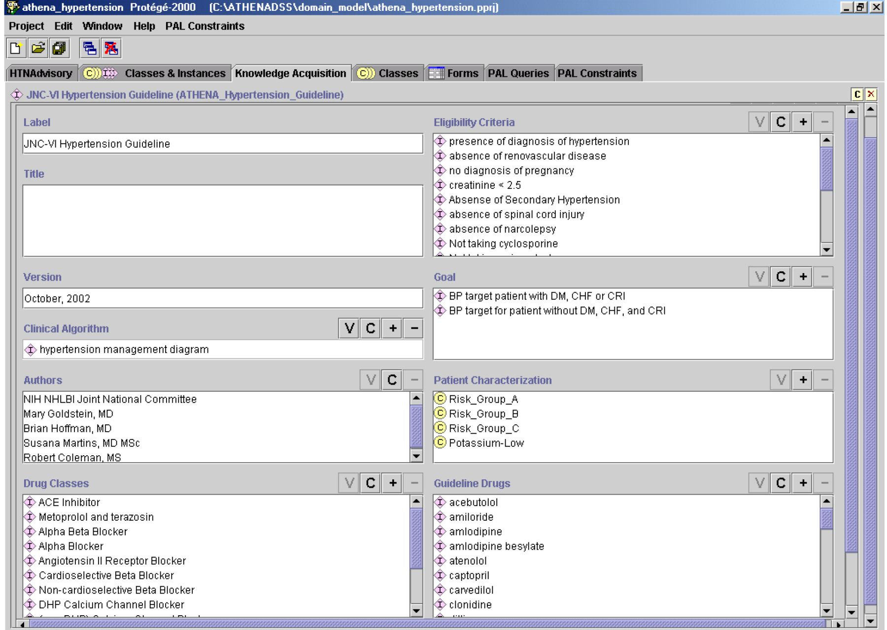
Knowledge Base Screen

Slide 5
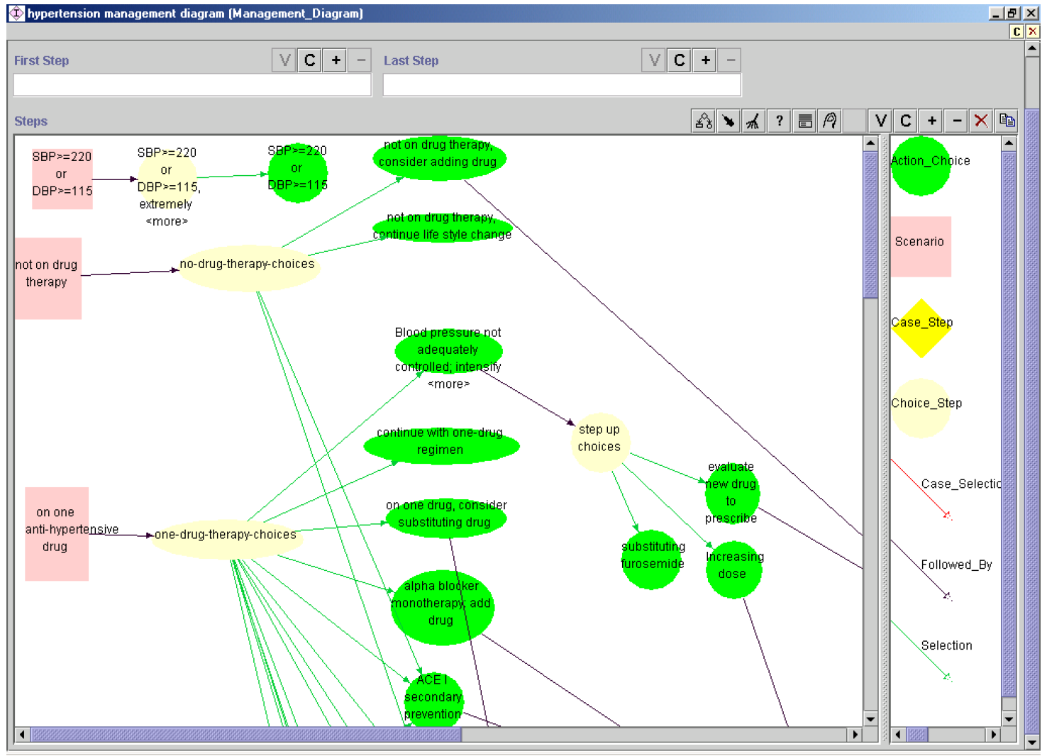
Guideline Model

Slide 6
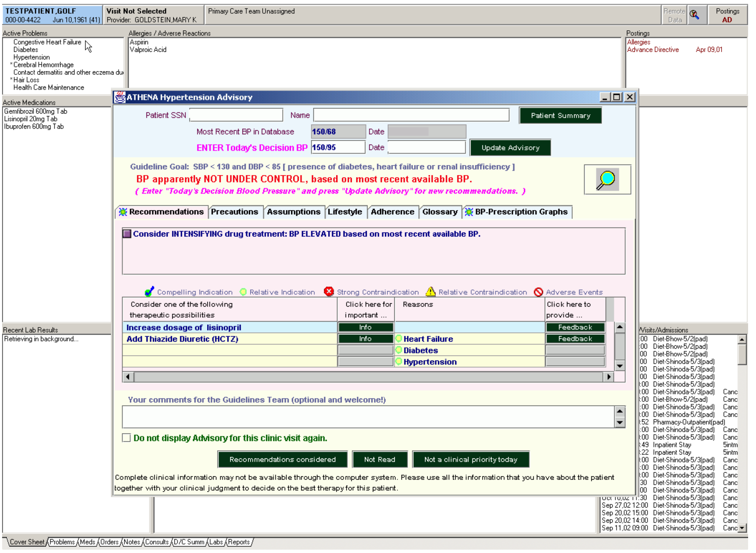
Recommendation Screen

Slide 7
2. DSS-HTN
Clinical and Computerized Decision Support System for Management of Hypertension
Algorithmic approach for
Evaluation of a patient
Risk stratification
Drug management
Lifestyle intervention
Based on Indian Guidelines for Hypertension II (2007)
R. Anchala et al., PLoS One. 2013 Nov 5;8(11)

Slide 8
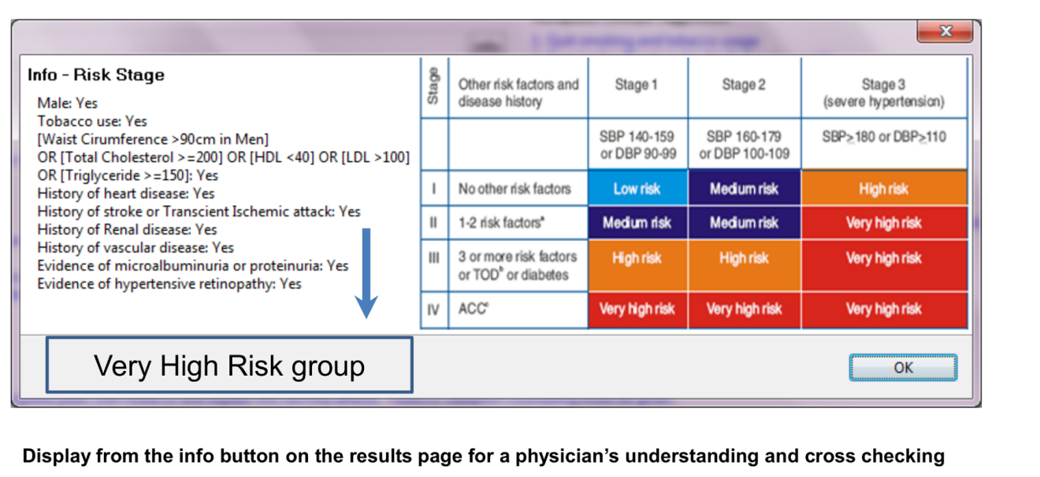
Risk staging

Slide 9
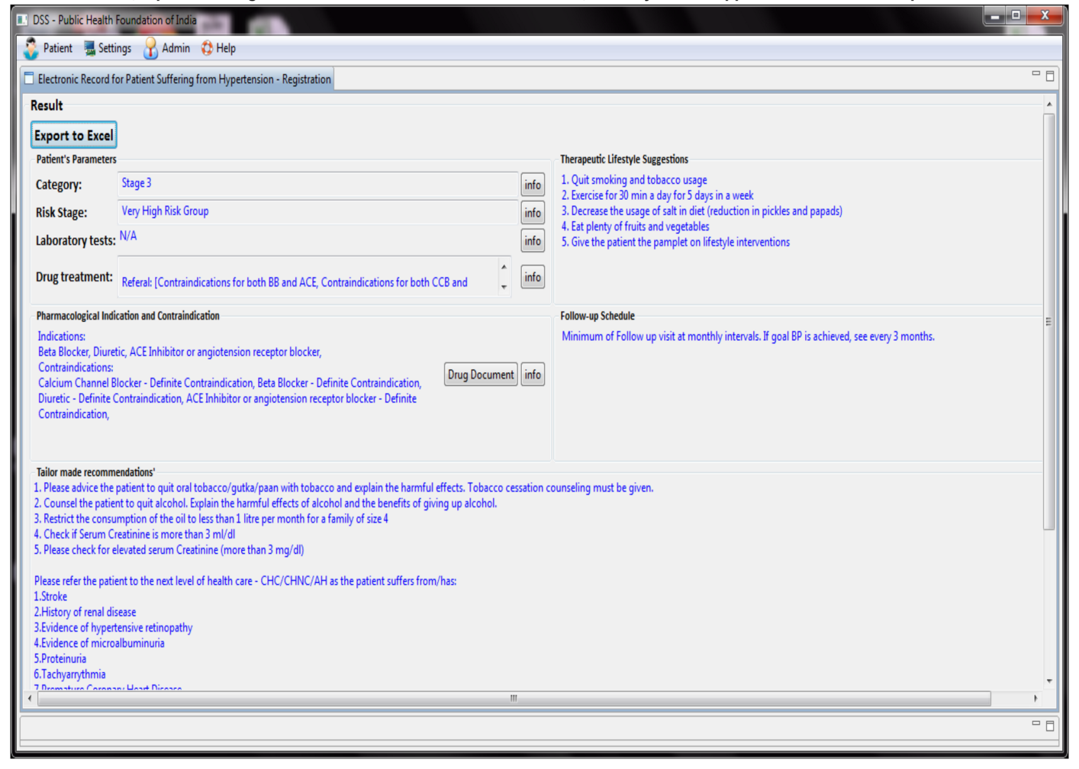
Recommendations and Advice

Slide 10
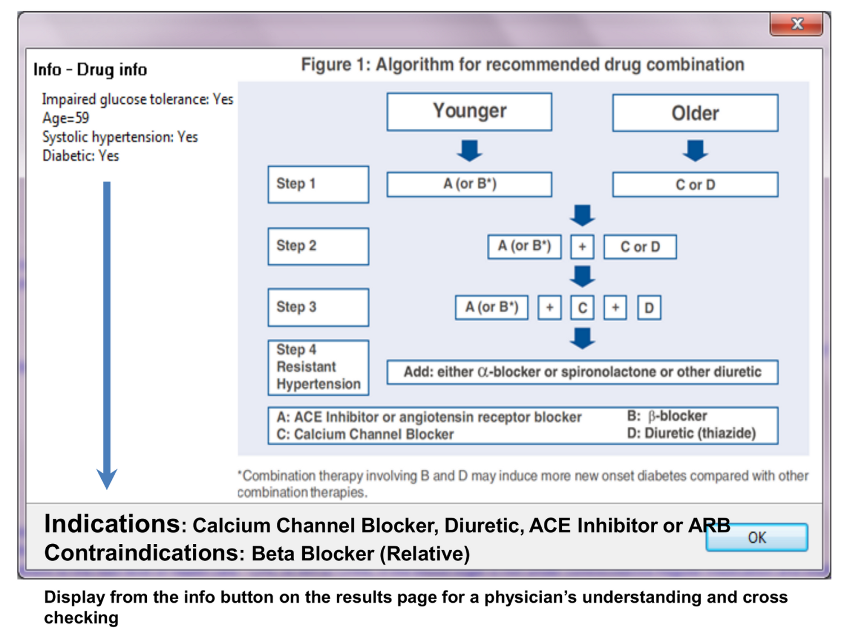
Drug information

