Slide 1
Small scale project management
LITA National Forum 2005
Frank Cervone
f-cervone@northwestern.edu
Assistant University Librarian for Information Technology
Northwestern University
Friday September 30, 2005

Slide 2
Agenda
An overview of what project management is
The contexts of project management
Project management model applied to small projects
Why projects fail – ensuring project success

Slide 3
Why are information technology projects so hard?
Complex series of inter-related activities
Many skills are involved
  Software development, design production
  Creativity, planning
Cross-functional communication
  Up, down, sideways, outside
Defining what is a project
  Operational activities
  On-going maintenance

Slide 4
Which do you think is a project?
  Web site redesign
  Implementation of reference chat service
  Auditing software usage
  Installing server patches
  Improve web site response time
  Web page content update
  Selection of a new information resource
  Selection of a new library management system
  Upgrading the server operating system

Slide 5

A formal definition
A project is a temporary sequence of unique, complex, and connected activities having one goal or purpose and that must be completed by a specific time, within budget, and according to specification.
        Effective Project Management by Wysocki, Beck, and Crane.

Slide 6
So, what is a project?
Temporary
    Does not necessarily mean “short duration”
    Have a definite beginning
    Ends with a measurable outcome
      Objectives have been achieved
      Becomes clear the objective cannot/will not be met
      Need no longer exists
      The project is terminated
Unique
    Something that has not been done before
    Repeating elements do not change the fundamental uniqueness of project work

Slide 7

What is project management?
Project management is the process of
  defining the extent (scoping),
  planning,
  staffing,
  organizing,
  directing, and
  controlling
    the development of an acceptable system at a minimum cost within a specified time frame

Slide 8
Why is it so complicated?
Project management originated in engineering
Base of knowledge emphasizes large-scale projects
  Designing Hoover Dam, Space Shuttle
PM emphasis tends to be on things and procedure, not people and process
PM for IT issues are different than “classic” PM
  Building a bridge vs. building a LMS system

Slide 9
PMBOK
PMBOK
  Project Management Body of Knowledge
  Theoretical Framework
    Context
    Processes
  Knowledge Areas
Integration | Scope
Time | Cost
Quality | Human Resources
Communications | Risk
Procurement

Slide 10
The project management context
The project phases and project life cycle
Stakeholders
General Management Skills
Organizational Influences

Slide 11
What is the project manager responsible for?
Knowledge
  About the organization
  Skills required for project
Communications
  Up, down, across organization
Documentation
Quality control
Development
  Staff
  Working practices

Slide 12
Project dimensions
Budget
Schedule
Quality

Slide 13
If you change one…
Schedule
Budget
Quality
you automatically change the others

Slide 14
The “formal” project life cycle
These are the most
frequently overlooked
phases in
most projects
Define (initiation)
Plan
Execute
  Leading, team building, motivating
Control
Close
Are projects formally organized at your organization?

Slide 15
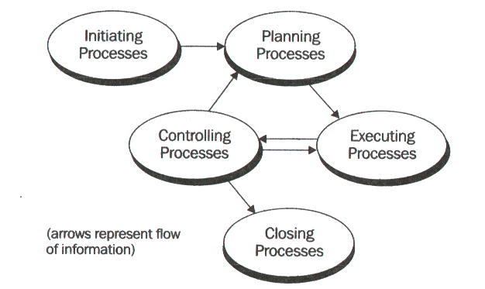
Project activity interrelationships

Slide 16
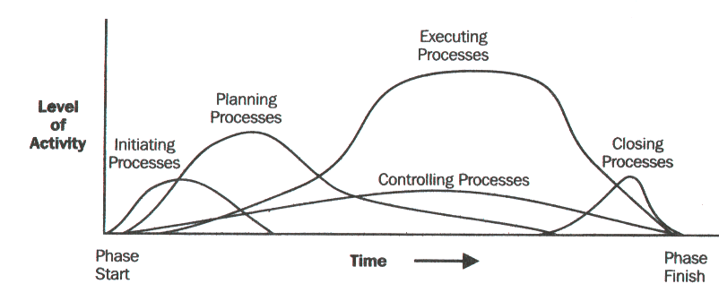
Resource usage within the project lifecycle

Slide 17
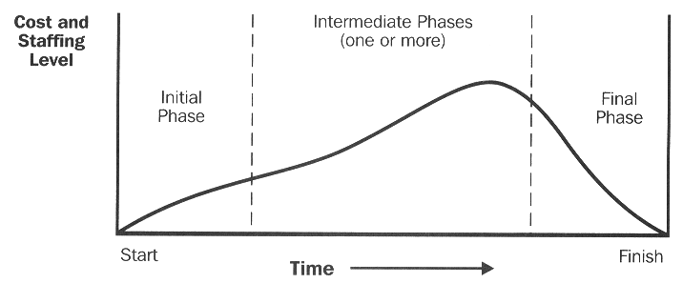
Project phases
Each stage consists of multiple phases
Characteristics of a phase
Specific function
Specific deliverables
Phase exit/kill point

Slide 18
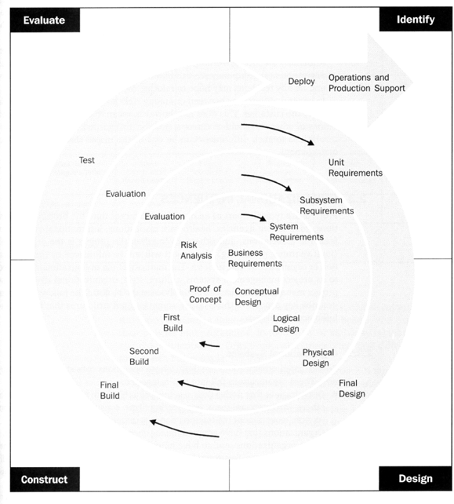

Slide 19
Project management model
Define
  Clarification, definition
Plan
  Specification
Coordinate and control
  Content, design, construction, testing, launch
Close
  Maintenance, evaluation

Slide 20
Outcomes
Definition
  Project brief
  Preliminary budget, schedule, & recommendations
Plan
  Project specifications document
Sometimes these are combined into a single activity

Slide 21
Outcomes, cont.
Scheduling and control
  Content
    Gathering and delivery plan, tracking mechanism
  Design
    Storyboards
    Project milestones
  Construction
    Change control
    Testing
  Launch –
    Handover briefing, documentation

Slide 22

Outcomes, cont.
Close
  Training and development
  Project review
  Site performance analysis

Slide 23
Define
Confirm the purpose
  Understand problems and issues
  What are the benefits?
Start defining clear objectives
  What are the deliverables?
Explain the project methodology
Agree to next steps
Ask the right questions

Slide 24
Stakeholders
Key stakeholders on every project:
  Sponsor
  Project manager
  Project team members
External
  Funders, contractors, government agencies, larger organization
Who are your stakeholders?

Slide 25
Planning elements
  Start date
  Background
  Objectives
  Benefits
  Scope and boundaries of work
Always record project objectives
in terms of the requestor
  Constraints
  Assumptions
  Deliverables
  Activity time chart
  Reporting
  Financial aspects
Notes:
Scope creep

Slide 26
Why planning is necessary
A plan is a map of the terrain, not
the terrain itself
Planning generates “buy-in”
Corrective action is not possible if there is nothing to refer to
Planning save time and money and improves overall quality
Do you encounter resistance to planning?
What is its root cause?

Slide 27
Planning Q&A
Question/statement
Planning requires a lot of work and time, time that can be spent on completing tasks required by the project
Planning is not productive, nothing is really produced except maybe a pretty chart
The original plan is fixed and cannot be changed anyway
Answer/response
Studies show planning saves time in the long term
The plan contains the detailed information that explains what needs to be done, by whom, and by when
The plan is a fluid document that is adjusted as the situation warrants

Slide 28
Planning elements
Creating the work breakdown structure (WBS)
  Define tasks
Create the team structure and individual responsibilities
Estimate effort and duration for each task
Prepare overall schedule
Allocate resources to tasks
Determine costs
Risk analysis and contingency
The level of detail in these will depend on the size of the project

Slide 29
Creating the WBS/ define tasks
Hierarchical arrangement
Descriptions of tasks
  Brief and easily understood
Not all tasks are subdivided to the same lowest level
  On small project, tasks are divided into small components
Does not show interdependencies, yet
Time estimates
  Big project, yes
  Small project, no

Slide 30
Team structure and responsibilities
Presented as an organization chart
Identify the function
  Not the person
Authority and responsibility
  Four types
    Approver
    Must be informed
    Must be consulted
    Must prepare

Slide 31
Estimating effort and duration
Effort
  The time the task will take to complete
  Assumes no interruptions, breaks, lost, or wasted time
Duration
  The time the task actually takes to complete
  Includes all lost, wasted, and waiting time
The distinction between these two things is very important

Slide 32
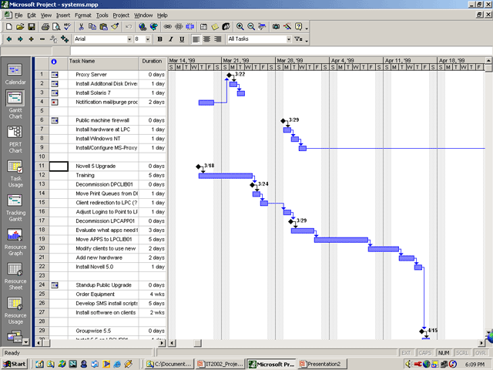

Slide 33
Create your own project chart in a spreadsheet program
One sheet for each major job category
  Job/task id
  Who
  Projected effort time
  Actual effort (updated as work is done)
  Projected start date
  Projected end date
  Actual start date
  Actual end date
  Total each column
Summary sheet at the beginning which shows totals from all sheets

Slide 34
Allocating resources to tasks
Assigning personnel to tasks
Reconfirm estimates of work and durations
  Resources available
    Part-time
    Not as experienced
Resource leveling
  Checking and resolving over allocation of resources
In a small project, consider using generic estimates

Slide 35
Risk analysis and contingency
How much contingency has been included?
Where is the contingency included?
The problem of contingency cuts
  Padding - doesn’t work
Risk analysis provides justification
  Work that must be done to reduce risk of project failure
  Work that might be needed if things go wrong

Slide 36
Measuring risk
Identify high-risk tasks
  Determine the probability of failure using a high-low-medium or 1 to 5 scale
  Determine the impact on the project using the same scale
  Multiply probability by impact to get the total impact factor
  High risk tasks have an impact factor of 12 or greater
Prepare contingency tasks
On a small project, try to find someone else in your organization you can work with
These tasks should be performed by the entire team not just the project manager

Slide 37
Problem risk template
Task | Probability of failure | Impact on project | Total impact factor

Slide 38
Project review
Project effectiveness
  Were the project objectives achieved?
  Has the problem been solved or addressed?
Process effectiveness
  What could have been done better?
Customer satisfaction
  Will the project sponsor recommend working with the project team members in the future?
Additional requests

Slide 39
Why failure occurs
Failing to establish commitment
  Quick win – long loss
  Transforming a culture is a major undertaking
Poor expectations management
  Scope creep
  Feature creep
  “guestimation”
The project is simply not necessary or seriously misguided
  Over ambitious in scope
Premature commitment to a fixed budget or schedule
Adding resources to overcome schedule slippages
Inadequate people management skills

Slide 40
Situational leadership
Directing/telling
Coaching/selling
Supporting/participating
Delegating
If no one seems to be in charge,
then no one is

Slide 41
Keys to web development success
Define the objectives clearly
Communication often
Get management support
Allocate adequate time and resources
Plan and then control
  Resist unrealistic directives/expectations
Make sure users are involved
Use pilot programs
Learn to say no

Slide 42
Thank you
Frank Cervone
  Assistant University Librarian for Information Technology
  Northwestern University
  f-cervone@northwestern.edu
  www.cervone.com

