Slide 1
Regression
Materials: https://bit.ly/34NV4Ej
Sign in: https://bit.ly/32EzHUg

Slide 2
1) Introduction
2) Theory
3) Hands-on Coding
What is regression and why do we care?
How does linear regression work? What “types” exist?
Analysing life expectancy dataset from World Health Organization (WHO)

Slide 3



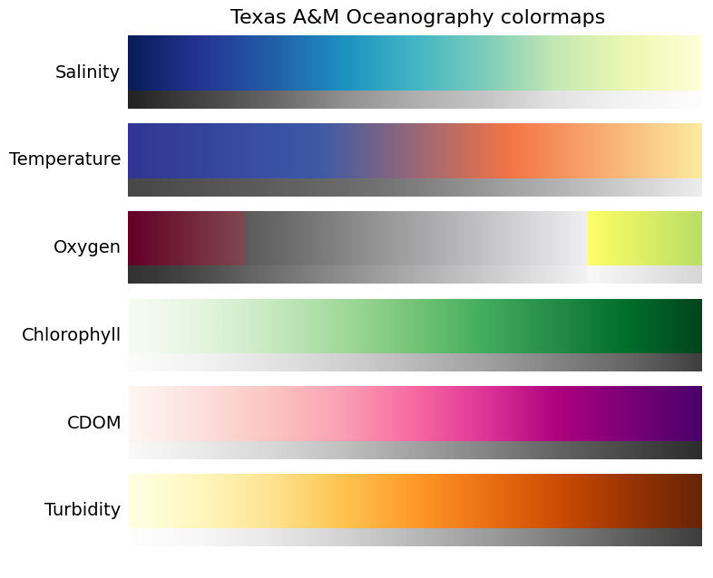


Classification vs. Regression
Input
Input
Continuous
Discrete

Slide 4
Regression
y
f(x)
x
Estimating a function (f)
that maps inputs (x)
to a continuous output (y)
Input

Slide 5
Regression Applications
Classification or regression?
Is this email spam or not spam?
What is the price of a house given its specs?
What genre of this movie given the audio?
What animal is present in this picture?
What is the MPG of a car given engine specs?
**What is someone’s life expectancy given their country’s health stats?**

Slide 6

Linear Regression

Slide 7

Linear Regression

Slide 8
Linear Regression Graphically
 | Hours Spent Outside/Day | Happiness Score
Bob | 8 | 9.43
Dylan | 6.5 | 7.87
Susan | 0 | 3.32
Maggie | 2 | 6.43
Notes:
\hat y = \theta_1 x_1 + b

Slide 9

Linear Regression Graphically
 | Hours Spent Outside/Day | Happiness Score
Bob | 8 | 9.43
Dylan | 6.5 | 7.87
Susan | 0 | 3.32
Maggie | 2 | 6.43

Slide 10
Multiple LR Graphically
 | Hours Spent Outside/Day | Number of Pets | Happiness Score
Bob | 8 | 5 | 9.43
Dylan | 6.5 | 2 | 7.87
Susan | 0 | 1 | 3.32
Maggie | 2 | 3 | 6.43
Notes:
\hat y = \theta_1 x_1 + \theta_2 x_2 + ... \theta_n x_n+ b

Slide 11

Multiple LR Graphically
 | Hours Spent Outside/Day | Number of Pets | Happiness Score
Bob | 8 | 5 | 9.43
Dylan | 6.5 | 2 | 7.87
Susan | 0 | 1 | 3.32
Maggie | 2 | 3 | 6.43
Defines a plane

Slide 12
Multiple LR Graphically
Defines a plane

Slide 13
Linear Regression: Understanding Error
What makes a good fit?
Distance of Y Component

Slide 14
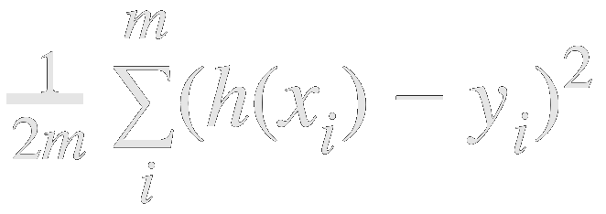
Linear Regression: Understanding Error
What makes a good fit?
Distance of Y Component
Sum of Squared Distances
Penalizes larger errors
Goal: Find theta1 theta2 that minimize the error

Slide 15
How to we get an “ideal” model?
Update parameters

Slide 16

Case 1: Direct Solution
For simple linear regression
Directly solve for slope
Then solve for intercept
Notes:
\theta_1 = \frac{\sum_{i=1}^{s} (x_i - \bar x)(y_i = \bar y)}{\sum_{i=1}^{s} (x_i - \bar x)^2}

Slide 17


Multiple LR: Ordinary Least Squares
For Multiple LR
Use linear algebra approach
Inverses, matrix multiplication, etc
Formulate Problem As:
Solve Using:
Notes:
\hat \beta= (XX')^{-1}X'y

Slide 18
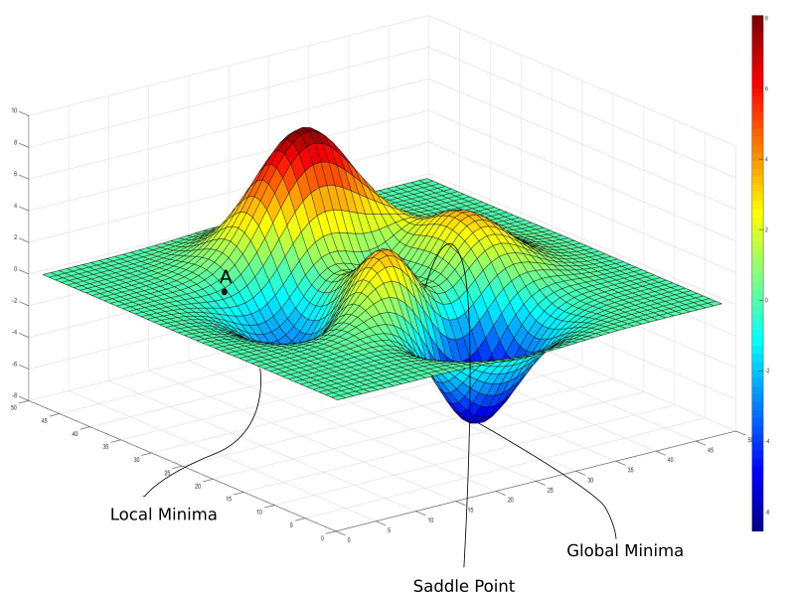

Case 3: Gradient Descent
For Multiple LR
Optimizing in high dimensional space
Steps:
Initialize
Run model
Compute error
Adjust parameters
Output model
Cost function
Sum of squared error

Slide 19
Solution Methods
Simple Linear
Least Squares
Gradient Descent
Directly estimate intercept and slope
Usable only with one feature
Linear Algebra Approach
Slow on large datasets
Optimizer approach
Better for large datasets

Slide 20
Polynomial Linear Regression
Notes:
\hat y = \theta_1 x+ \theta_2x^2 + \theta_1x^3 +b
http://latex2png.com/

Slide 21




Other Non-Linear Regression

Slide 22
Questions?
If not, it’s time for coding!

