Slide 1
Support Vector Machine
Data Science at GT
Materials: http://bit.ly/2l9ErSj
Attendance: http://bit.ly/2meXuur
PIN: 230919

Slide 2
An Example?

Slide 3
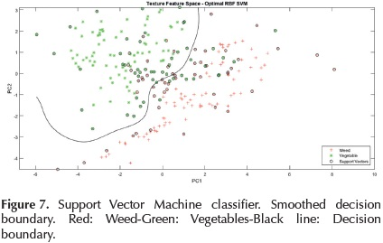
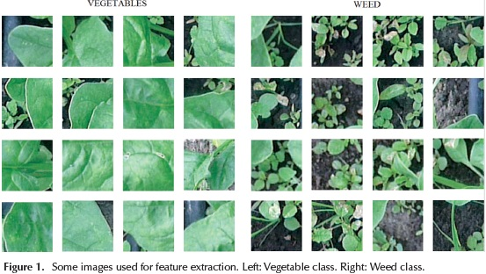
Real World Image Classification Example
Classification between weed and vegetable crop images
Pulido, Camilo, Solaque, Leonardo, & Velasco, Nelson. (2017). Weed recognition by SVM texture feature classification in outdoor vegetable crop images. Ingeniería e Investigación, 37(1), 68-74. http://www.scielo.org.co/scielo.php?script=sci_arttext&pid=S0120-56092017000100009

Slide 4
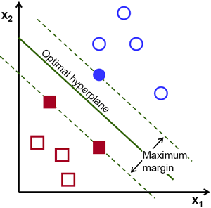
What is SVM (Support Vector Machine)?
Supervised Learning
Separation of classes
Maximal margin

Slide 5
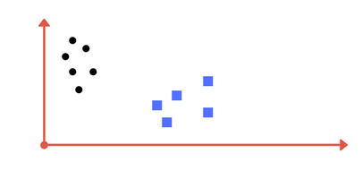
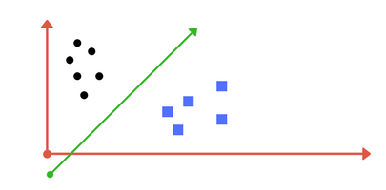
How would you separate the data
Easy. Separate with a line.

Slide 6
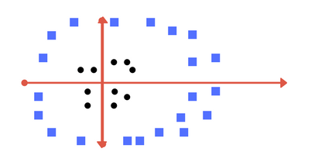
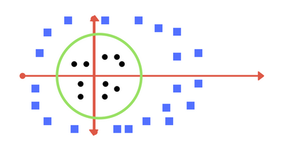
And this?
Separate with a circular boundary
Maybe?

Slide 7
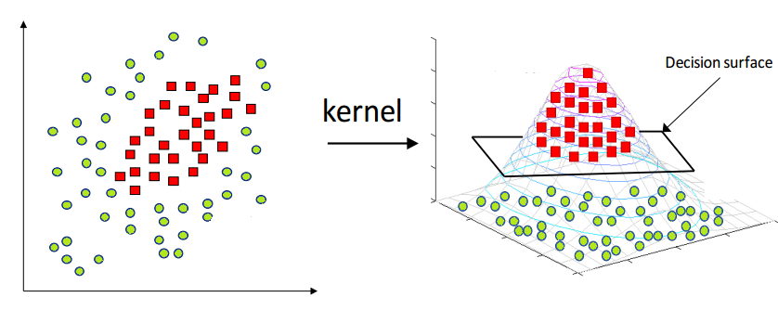
And this?
Or look at the data from another perspective?

Slide 8
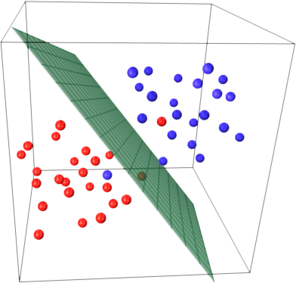
Hyperplane
1-dimensional
Point
2-dimensional
Line
3-dimensional
Plane
Higher dimension
Hyperplane

Slide 9
How do I find the OPTIMAL

Slide 10
How do I find the OPTIMAL

Slide 11
How do I find the OPTIMAL
All seem to work?

Slide 12
How do I find the OPTIMAL

Slide 13
How do I find the OPTIMAL
Support Vectors
(vectors closest to the boundary)

Slide 14
How do I find the OPTIMAL
As far as possible from the Support Vectors

Slide 15
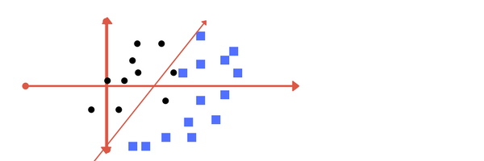
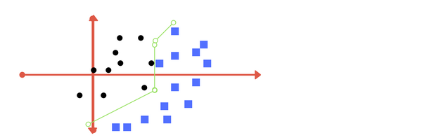
How do I find the OPTIMAL

Slide 16
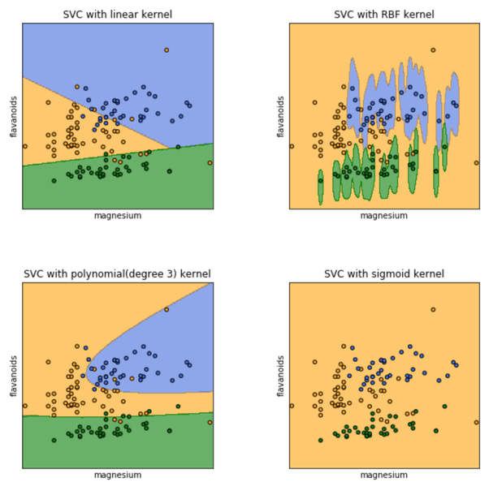
Kernel
Transform data into another space where it is separable by hyperplane
Linear kernel
Radial Base Function (rbf) kernel
Polynomial kernel
Sigmoid kernel And more…

Slide 17
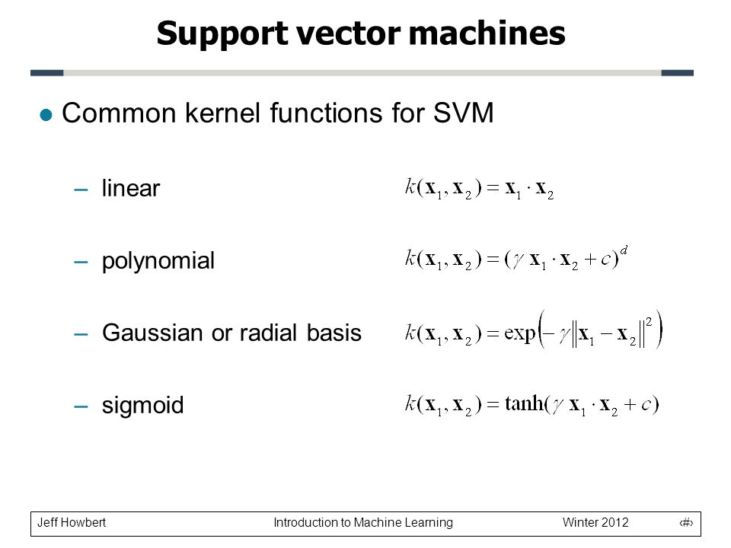
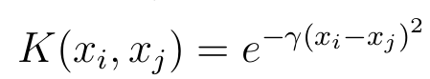
Kernel
Transform data into another space where it is separable by hyperplane
Linear kernel
Radial Base Function (rbf) kernel
Polynomial kernel
Sigmoid kernel And more…

Slide 18
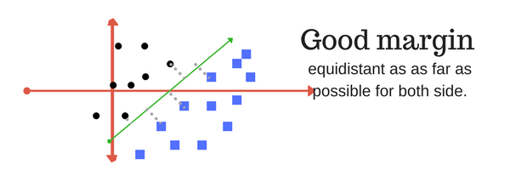
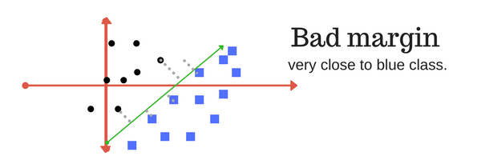
Margin

Slide 19
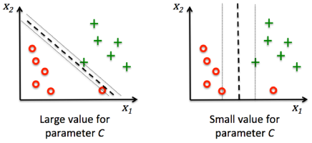
Regularizer / Penalty / C
How much we want to avoid (or penalize) misclassification
Large C
Prioritize smaller-margin hyperplane
Even if boundary is more complicated.
Small C
Look for a larger-margin hyperplane
Even if it mis-classifies more points

Slide 20
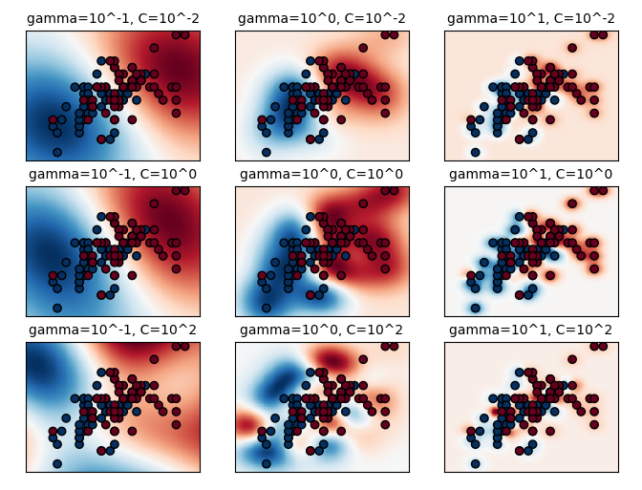
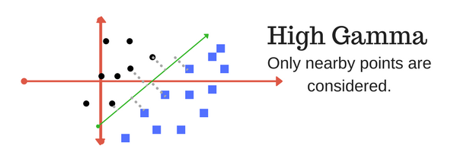
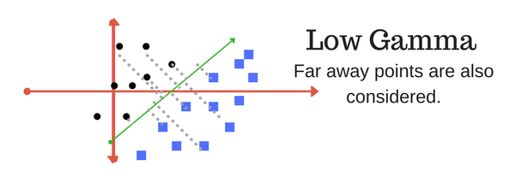
Gamma
How far can a single point influence our boundary calculation

Slide 21
Pros Cons
Classify well if class divisions are obvious
The idea of support vector
Minimize impact of outliers
Effective in high dimension
Effective when number of data points are more than number of features
Cannot perform well with too much overlapping classes
Calculation can get heavy when the dataset is large
May not generalize well if there are more features than data points

Slide 22
Pros Cons
Classify well if class divisions are obvious
The idea of support vector
Minimize impact of outliers
Effective in high dimension
Effective when number of data points are more than number of features
Cannot perform well with too much overlapping classes
Calculation can get heavy when the dataset is large
May not generalize well if there are more features than data points
How can we reduce our features?

Slide 23
Dimensionality Reduction
PCA - Principal Component Analysis (linear transformation)
Autoencoder (non-linear transformation)
Feature 1
Feature 2
Feature 3
Feature 4
Feature 5
Feature 6
Feature 7
Dimensionality Reduction
NEW Feature 1
NEW Feature 2
NEW Feature 3

Slide 24
Big Idea
Generate new but fewer features (compressed)
PCA
Projects to another dimension using linear transformation e.g. 2D to 3D space
Autoencoder
Yields compressed features with non-linear transformation
Able to learn better generalization of input features

Slide 25
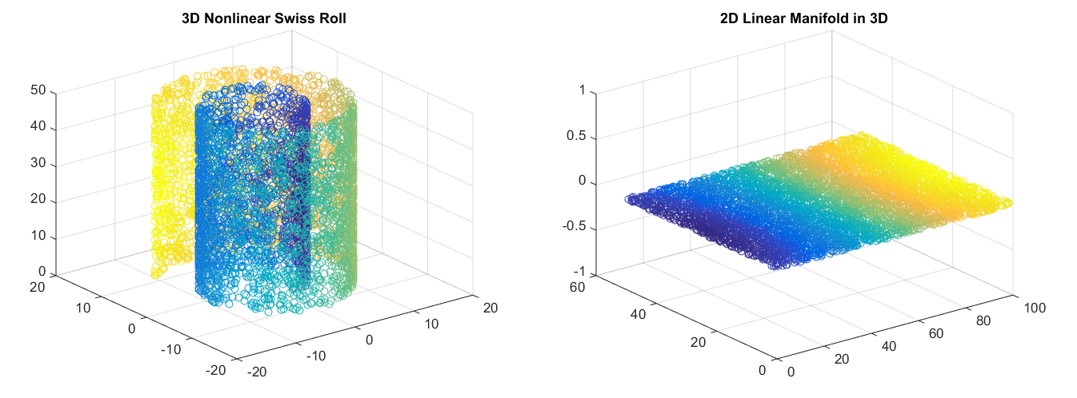
Autoencoder

Slide 26
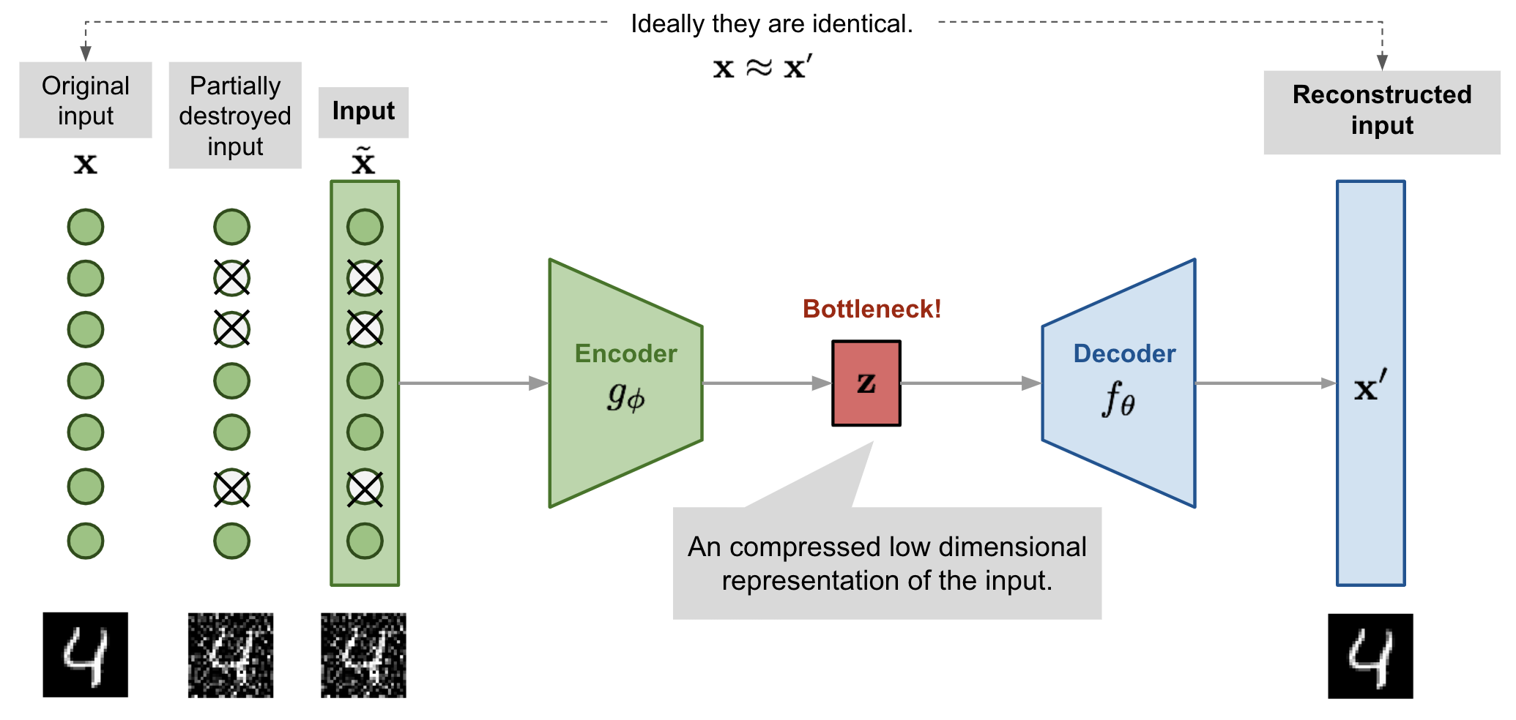
Autoencoder

Slide 27
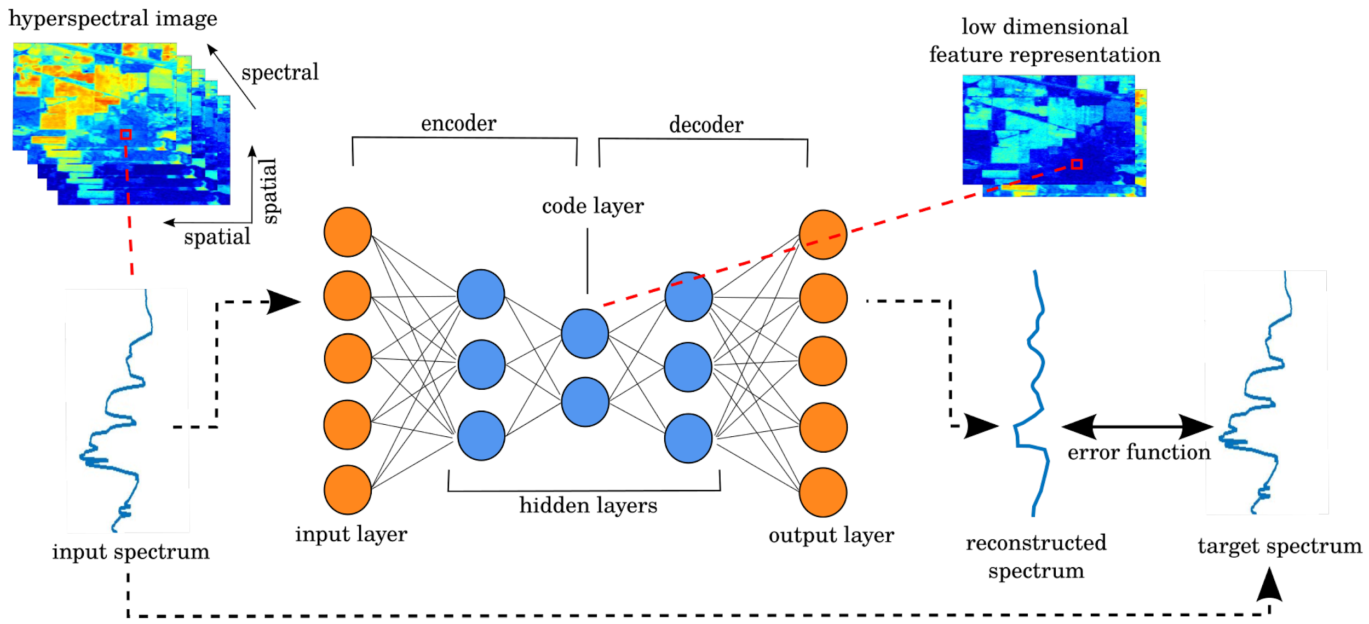
Autoencoder

Slide 28
Autoencoder
Discard the Decoder and keep the Encoder

Slide 29
Autoencoder
Use the Encoder to reduce our dimensionality before SVM
Discard the Decoder and keep the Encoder

Slide 30
Question?

