Slide 2
Example of an Optimization Problem

Slide 3
Example of an Optimization Problem

Slide 4
Example of an Optimization Problem

Slide 5
Example of an Optimization Problem

Slide 6
Example of an Optimization Problem

Slide 7
Example of an Optimization Problem

Slide 8
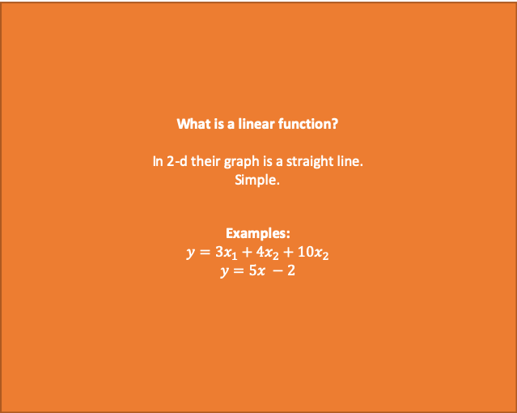
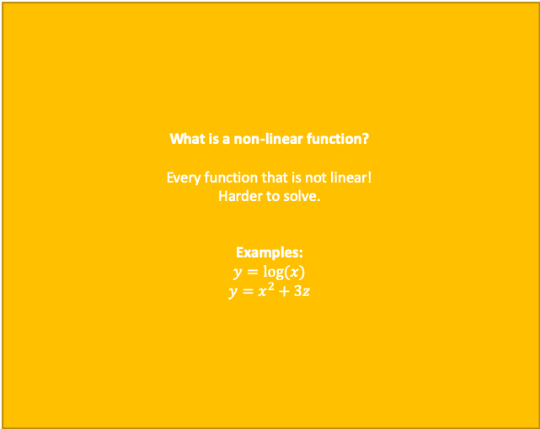
Linear vs. Integer Optimization
We assume that our problem objective and constraints can be written as linear functions of the decision variables.
What is a linear function?
In 2-d their graph is a straight line.
Simple.
Examples:
$$y={3x}_{1}+{4x}_{2}+10x_{2}$$
$$y=5x −2$$
What is a non-linear function?
Every function that is not linear!
Harder to solve.
Examples:
$$y=log⁡(x)$$
$$y=x^{2}+3z$$

Slide 9
Linear vs. Integer Optimization
We assume that our problem objective and constraints can be written as linear functions of the decision variables.
Examples of Linear Functions
Examples of Non-Linear Functions

