Slide 1
Insights into induced neurons from RNA co-expression
Heather Wick, PhD
Talkowski Lab Meeting 12.14.22

Slide 2
Co-expression analysis for biological insight
Expectations and Applications:
Find robust baseline modules of co-expressed genes in control group
Modules NOT associated with biological or technical variation
Evaluate robustness of modules
How consistent is gene-module assignment?
Can we improve outcomes from small sample sizes?
Pipeline can be applied to other data sets
Can Weighted Correlation Network Analysis (WGCNA) performed on datasets resampled from a larger pool of gene expression data give us more robust modules?

Slide 3
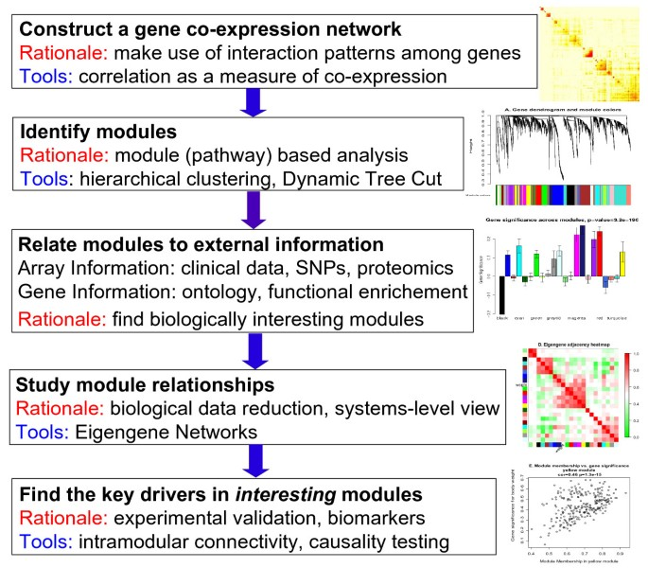
WGCNA
Weighted Correlation Network Analysis
Goal: find clusters (modules) of correlated genes, infer biological meaning
Langfelder & Horvath, 2008

Slide 4
PWS data set, background, QC
Goal:
1) find modules NOT associated with biological or technical variation
Baseline clusters of genes associated with “WT” biology/phenotype
2) statistically evaluate resampling/boot-strapping method
Data structure:
WT iNs only
Background
GM: 50
MGH: 49
Clone split at iPSC stage (yes vs no)
Exposure to gRNA (no exposure vs exposure to gRNA to various genes)
QC:
cpm cutoff 0.5 in 50% of samples (n genes = 16,769)
Outlier detection: PCA after library size normalization (1 removed)
ComBat on raw to correct for background
Prep for WGCNA:
Library size normalization, log2 transformation
Final n samples = 99

Slide 5
ComBat
Batch correction for background
2 “outliers” have large library sizes
sizeFactor normalization makes them blend in
Johnson et al. 2007

Slide 6
WGCNA:
Individual 99
PWS₀ data
99 samples
Individual WGCNA
One-step module detection
without replacement
Individual gene network
Individual modules
QC

Slide 7
rWGCNA:
Consensus 99
WGCNA:
Individual 99
PWS₀ data
99 samples
PWS data
65 samples
without replacement
PWS data
65 samples
without replacement
PWS data
65 samples
without replacement
PWS data
65 samples
without replacement
PWS data
65 samples
without replacement
PWS_{n}
65 samples
without replacement
X 100
Individual WGCNA
Consensus WGCNA
One-step module detection
without replacement
One-step consensus module detection
without replacement
PWS data
65 sampl
ement
Individual gene network
PWS data
65 sampl
ement
PWS data
65 sampl
ement
PWS data
65 sampl
ement
Individual gene networks (x100)
Individual modules
Consensus gene network (1)
Consensus modules
QC comparisons

Slide 8
WGCNA
more realistic scenario:
Individual 26
Consensus 26
PWS₀ data
26 samples
PWS data
65 samples
without replacement
PWS data
65 samples
without replacement
PWS data
65 samples
without replacement
PWS data
65 samples
without replacement
PWS data
65 samples
without replacement
PWS_{n}
17 samples
without replacement
X 100
Individual WGCNA
Consensus WGCNA
One-step module detection
without replacement
One-step consensus module detection
without replacement
PWS data
65 sampl
ement
Individual gene network
PWS data
65 sampl
ement
PWS data
65 sampl
ement
PWS data
65 sampl
ement
Individual gene networks (x100)
Individual modules
Consensus gene network (1)
Consensus modules
QC comparisons

Slide 9
PWS₀ data
99 samples
PWS₀ data
26 samples
PWS data
65 samples
without replacement
PWS data
65 samples
without replacement
PWS data
65 samples
without replacement
PWS data
65 samples
without replacement
PWS data
65 samples
without replacement
PWS data
65 samples
without replacement
PWS data
65 samples
without replacement
PWS data
65 samples
without replacement
PWS data
65 samples
without replacement
PWS data
65 samples
without replacement
PWS_{n}
65 samples
without replacement
X 100
PWS_{n}
17 samples
without replacement
X 100
Consensus WGCNA
Individual WGCNA
Consensus WGCNA
One-step consensus module detection
without replacement
One-step module detection
without replacement
One-step consensus module detection
without replacement
PWS data
65 sampl
ement
PWS data
65 sampl
ement
PWS data
65 sampl
ement
Individual gene network
PWS data
65 sampl
ement
PWS data
65 sampl
ement
PWS data
65 sampl
ement
PWS data
65 sampl
ement
PWS data
65 sampl
ement
Individual gene networks (x100)
Individual gene networks (x100)
Individual modules
Consensus gene network (1)
Consensus gene network (1)
Consensus modules
Consensus modules
QC comparisons
Notes:
3-way comparisons

Slide 10
WGCNA: 4 experiments
Analysis name | Individual99 | Consensus99 | Individual26 | Consensus26
Analysis type | Individual | Consensus | Individual | Consensus
# samples total | 99 | 99 | 26 | 26
# resamples | - | 100 | - | 100
Resample fraction (n) | - | 0.66 (65) | - | 0.66 (17)
Soft power threshold | 19 | 18 | 21 | 20
Network type | Signed | Signed | Signed | Signed
Block size | 17k | 17k | 17k | 17k
Min. module size | 30 | 30 | 30 | 30
Module merge threshold | 0.25 | 0.25 | 0.25 | 0.25
# modules | 28 | 32 | 29 | 38
# assigned genes | 14,576 | 10,504 | 15,697 | 9,536
# unassigned genes (grey) | 2,193 | 6,265 | 1,072 | 7,233
Notes:
Except for the number of samples and whether the analyses were consensus on resampled, or individual, tried to make analyses otherwise similar
Using a signed network type, same block size that encompassed all genes, same minimum module size, and module merge threshold
Soft power threshold was calculated on individual experiments to choose best for each one, but were similar
Consensus rWGCNA tends to have more modules, which are a little smaller
Individual analyses tend to have fewer genes in grey.
All genes assigned to grey in individual analysis were assigned to grey in consensus analysis
-possibly, consensus analysis is more stringent about gene assignment
--smaller individual sample sizes, have more weakly co-expressed genes which are separated into unassigned category
The soft thresholding, is a value used to power the correlation of the genes to that threshold. The assumption on that by raising the correlation to a power will reduce the noise of the correlations in the adjacency matrix. To pick up one threshold use the pickSoftThreshold function, which calculates for each power if the network resembles to a scale-free graph. The power which produce a higher similarity with a scale-free network is the one you should use.

Slide 11
Consensus has more modules, more unassigned genes (grey)
Notes:
As an example
Module sizes for 3 experiments: consensus 99, consensus 26, and individual 26
Both consensus experiments have much larger grey modules
Indiv26 doesn’t even have grey as the largest module

Slide 12
Individual and consensus modules are enriched for each other
-log10 p
Individual 99-sample
WGCNA modules
Reciprocal modules: 22
Reciprocal == Modules in one analysis whose most significantly enriched module in the other analysis also claims that module as its most significant hit
Consensus 99-sample WGCNA modules
Notes:
With all this data, first, I wanted to see how robust our modules from our large experiments were
Enrichment plot of consensus 99 (x) vs individual 99
Most modules have one other module which they are very significantly enriched for, which also has at least 50% of the same genes; some modules are more split
We refer to module pairs between these analyses which claim each other to be their most significant hit as reciprocal modules
NOT SHOWN: enrichment for cons26 vs indiv26, cons99 vs cons26, etc. These relationships are not quite as clear, but there are some reciprocal modules

Slide 13
Individual and consensus modules are enriched for each other
-log10 p
Individual 99-sample
WGCNA modules
Reciprocal modules: 22
Reciprocal == Modules in one analysis whose most significantly enriched module in the other analysis also claims that module as its most significant hit
Consensus 99-sample WGCNA modules
Notes:
Highlighted by the blue boxes is one example of a reciprocal pair of modules
Turquoise consensus 99 and blue individual 99 are each other’s most significant hit, and they also share the majority of the same genes
Overall, there are 22 reciprocal module pairs out of 28 individual modules and 32 consensus modules
I won’t show the tables, but I also used enrichment to determines reciprocal module pairs between
Consensus99 and individual 26
Consensus99 and consensus26

Slide 14



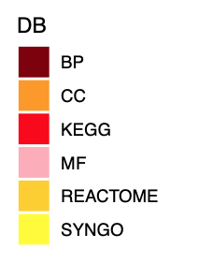
Reciprocal modules in Individual99 and Consensus99 share function
Analysis/Module | # genes | # genes overlap Consesnsus99 | Enrichment p value Consensus99 | # terms FDR < 0.1 | # terms overlap Consensus99
Consensus 99 Turquoise | 1327 | - | - | 430 | -
Individual 99 Blue | 1418 | 871 | <1.2e-315 | 313 | 207
p < 1.2e-315
-log10(FDR)
-log10(FDR)
Notes:
Gene set enrichment of those two modules: they share a lot of the same functional terms
Plots: top 20 terms from each from GO, Reactome, KEGG, and SYNGO
Generally speaking, these reciprocal modules tend to be fairly consistent in these larger data sets

Slide 15
Reciprocal module in individual 26 does not share function
Analysis/Module | # genes | # genes overlap Consensus99 | Enrichment p value Consensus99 | # terms FDR < 0.1 | # terms overlap Consensus99
Consensus 99 Turquoise | 1327 | - | - | 430 | -
Individual 26 Greenyellow | 613 | 387 | 2.1e-284 | 2 | 2
-log10(FDR)
-log10(FDR)
Notes:
Individual 26 WGCNA’s reciprocal module does not share the same function
This module, greenyellow, is reciprocal with turquoise consensus 99, and over half of its genes are in common with turquoise, but only has 2 significant terms
These terms do appear in cons99 analysis

Slide 16
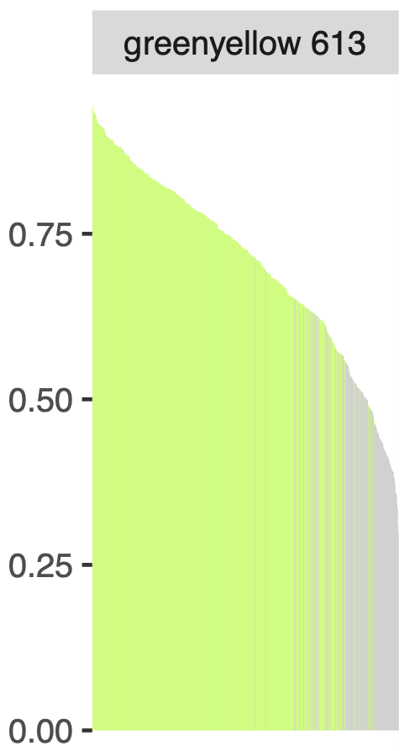
Can we improve biological interpretation of small data sets with a module membership cutoff?
Module membership = correlation (-1 to 1) of a gene with module eigengene
Module eigengene = representation of the gene expression profiles in a module (1st PCA)
Genes with low module memberships calculated in individual WGCNA tend to be unassigned (grey) in consensus WGCA
Calculated in Individual26
－ assigned in consensus
－ unassigned in consensus
Genes in greenyellow
module in individual26
Notes:
A potential simple solution: use module membership cutoff to reassign genes to grey
Module membership value represents the strength of that gene’s relationship with the module eigengene
The closer to 1, the stronger the relationship
Genes with lower module membership were unassigned in consensus
L: module membership of genes from greenyellow in individual26,
---colored by whether they are assigned or unassigned in consensus
Roughly, if you were to set a cutoff at 0.5, you could exclude most of those unassigned genes

Slide 17
Genes with module memberships < 0.5 (calculated in individual) tend to be assigned grey in consensus
Notes:
Module membership values for modules in indiv26; grey indicates unassigned in cons26
Many of these modules look like a 0.5 cutoff would be removing weak genes from the modules
Some modules have a lot of grey genes interspersed throughout

Slide 18
Module membership cutoff does not necessarily improve biological insight
Analysis/Module | # genes | # genes overlap Consensus99 | Enrichment p value Consensus99 | # terms FDR < 0.1 | # terms overlap Consensus99
Consensus 99 Turquoise | 1327 | - | - | 430 | -
Individual 26 Greenyellow | 613 | 387 | 2.1e-284 | 2 | 2
Individual 26 mod Greenyellow | 549 | 374 | 5.2e-293 | 1 | 1
-log10(FDR)
-log10(FDR)
-log10(FDR)
Notes:
In this example, removing those genes does not produce better functional results

Slide 19
Can we improve biological interpretation of small data sets with consensus WGCNA?
Reciprocal modules: mutually most significantly enriched module pairs
p value calculated on gene membership
Consensus99 is our baseline for reciprocal modules:
Consensus99 <-> Individual26 (17 modules)
Consensus99 <-> Consensus26 (18 modules)
Consensus99 <-> [Individual26 AND Consensus26] (14 modules)
Assessment of improvement of biological interpretation of reciprocal modules:
Jaccard index calculated on functional terms in reciprocal module pairs
Jaccard index = intersection(terms in Consensus99 and x26)
union(Consensus99 terms, x26 terms)
Notes:
Module membership cutoff didn’t work, but what about consensus rWGCNA on our resampled datasets?
Using cons99 as baseline, found reciprocal modules in both the smaller data sets based on gene enrichment pvalues:
-17 in indiv26
-18 in cons26
-overlap those: 14 total
Then, assess whether the biological insight from the smaller experiments are closer to baseline by
calculating Jaccard index on the significant gene set enrichment terms from the experiments
The intersection of terms in 2 given experiments divided by the union of terms in those experiments
Calculated two sets of Jaccard indices:
-cons99 vs indiv26
-cons99 vs cons26
Larger JI means closer to baseline (cons99)

Slide 20
Can we improve biological interpretation of small data sets with consensus WGCNA?
consensus99 | Consensus99 # genes | individual26 | Individual26# genes | Pval cons99 vs indiv26 | # genes overlap cons99 vs indiv26 | consensus26 | consensus26# genes | Pval cons99 vs cons26 | # genes overlap cons99 vs cons26 | Jaccard terms FDR <0.1 cons99 vs indiv26 | Jaccard terms FDR <0.1 cons99 vs cons26 | Jaccard difference
turquoise | 1327 | greenyellow | 613 | 2.07e-284 | 387 | brown | 568 | 2.20e-284 | 374 | 0.00061293 | 0.13140037 | 0.13078744
black | 468 | green | 1201 | 2.55e-199 | 276 | tan | 377 | 3.74e-268 | 224 | 0.00337113 | 0.01233806 | 0.00896693
blue | 1062 | yellow | 1221 | 0 | 547 | black | 500 | 1.36e-261 | 315 | 0.0064358 | 0.01480568 | 0.00836988
brown | 1041 | blue | 1338 | 0 | 549 | green | 536 | 6.62e-294 | 343 | 0.0009194 | 0.00246761 | 0.00154821
grey | 6265 | grey | 1072 | 0 | 1011 | grey | 7233 | 0 | 4985 | 0 | 0 | 0
midnightblue | 237 | pink | 868 | 8.10e-102 | 128 | yellow | 544 | 4.01e-150 | 140 | 0 | 0 | 0
white | 68 | midnightblue | 376 | 1.26e-115 | 68 | darkorange | 92 | 2.25e-56 | 32 | 0 | 0 | 0
red | 610 | black | 947 | 0 | 392 | turquoise | 678 | 0 | 341 | 0.00153233 | 0.00123381 | -0.0002985
pink | 434 | lightgreen | 315 | 4.67e-166 | 154 | midnightblue | 296 | 4.77e-161 | 148 | 0.0036776 | 0.00308452 | -0.0005931
green | 650 | magenta | 728 | 1.44e-197 | 263 | greenyellow | 435 | 8.68e-179 | 205 | 0.02819491 | 0.01233806 | -0.0158568
yellow | 761 | turquoise | 1703 | 2.04e-239 | 431 | blue | 627 | 1.67e-297 | 331 | 0.03616304 | 0.019124 | -0.017039
Notes:
These are our 14 modules which are reciprocal between consensus99 and both individual26 and consensus26
This table shows the module names in cons99 and indiv26, the number of in each, incl overlapping genes, and their enrichment p-value
-all significant
17
18
14

Slide 21
Can we improve biological interpretation of small data sets with consensus WGCNA?
consensus99 | Consensus99 # genes | individual26 | Individual26# genes | Pval cons99 vs indiv26 | # genes overlap cons99 vs indiv26 | consensus26 | consensus26# genes | Pval cons99 vs cons26 | # genes overlap cons99 vs cons26 | Jaccard terms FDR <0.1 cons99 vs indiv26 | Jaccard terms FDR <0.1 cons99 vs cons26 | Jaccard difference
turquoise | 1327 | greenyellow | 613 | 2.07e-284 | 387 | brown | 568 | 2.20e-284 | 374 | 0.00061293 | 0.13140037 | 0.13078744
black | 468 | green | 1201 | 2.55e-199 | 276 | tan | 377 | 3.74e-268 | 224 | 0.00337113 | 0.01233806 | 0.00896693
blue | 1062 | yellow | 1221 | 0 | 547 | black | 500 | 1.36e-261 | 315 | 0.0064358 | 0.01480568 | 0.00836988
brown | 1041 | blue | 1338 | 0 | 549 | green | 536 | 6.62e-294 | 343 | 0.0009194 | 0.00246761 | 0.00154821
grey | 6265 | grey | 1072 | 0 | 1011 | grey | 7233 | 0 | 4985 | 0 | 0 | 0
midnightblue | 237 | pink | 868 | 8.10e-102 | 128 | yellow | 544 | 4.01e-150 | 140 | 0 | 0 | 0
white | 68 | midnightblue | 376 | 1.26e-115 | 68 | darkorange | 92 | 2.25e-56 | 32 | 0 | 0 | 0
red | 610 | black | 947 | 0 | 392 | turquoise | 678 | 0 | 341 | 0.00153233 | 0.00123381 | -0.0002985
pink | 434 | lightgreen | 315 | 4.67e-166 | 154 | midnightblue | 296 | 4.77e-161 | 148 | 0.0036776 | 0.00308452 | -0.0005931
green | 650 | magenta | 728 | 1.44e-197 | 263 | greenyellow | 435 | 8.68e-179 | 205 | 0.02819491 | 0.01233806 | -0.0158568
yellow | 761 | turquoise | 1703 | 2.04e-239 | 431 | blue | 627 | 1.67e-297 | 331 | 0.03616304 | 0.019124 | -0.017039
Notes:
Added to this now are the module names for cons26,
# genes in those modules, and overlapping genes with cons99 and enrichment p value
-again significant
17
18
14

Slide 22
Can we improve biological interpretation of small data sets with consensus WGCNA?
consensus99 | Consensus99 # genes | individual26 | Individual26# genes | Pval cons99 vs indiv26 | # genes overlap cons99 vs indiv26 | consensus26 | consensus26# genes | Pval cons99 vs cons26 | # genes overlap cons99 vs cons26 | Jaccard terms FDR <0.1 cons99 vs indiv26 | Jaccard terms FDR <0.1 cons99 vs cons26 | Jaccard difference
turquoise | 1327 | greenyellow | 613 | 2.07e-284 | 387 | brown | 568 | 2.20e-284 | 374 | 0.00061 | 0.13 | 0.13
black | 468 | green | 1201 | 2.55e-199 | 276 | tan | 377 | 3.74e-268 | 224 | 0.0034 | 0.012 | 0.0090
blue | 1062 | yellow | 1221 | 0 | 547 | black | 500 | 1.36e-261 | 315 | 0.0064 | 0.015 | 0.0084
brown | 1041 | blue | 1338 | 0 | 549 | green | 536 | 6.62e-294 | 343 | 0.00092 | 0.0025 | 0.0015
grey | 6265 | grey | 1072 | 0 | 1011 | grey | 7233 | 0 | 4985 | 0 | 0 | 0
midnightblue | 237 | pink | 868 | 8.10e-102 | 128 | yellow | 544 | 4.01e-150 | 140 | 0 | 0 | 0
white | 68 | midnightblue | 376 | 1.26e-115 | 68 | darkorange | 92 | 2.25e-56 | 32 | 0 | 0 | 0
red | 610 | black | 947 | 0 | 392 | turquoise | 678 | 0 | 341 | 0.0015 | 0.0012 | -0.00030
pink | 434 | lightgreen | 315 | 4.67e-166 | 154 | midnightblue | 296 | 4.77e-161 | 148 | 0.0037 | 0.0031 | -0.00060
green | 650 | magenta | 728 | 1.44e-197 | 263 | greenyellow | 435 | 8.68e-179 | 205 | 0.028 | 0.012 | -0.016
yellow | 761 | turquoise | 1703 | 2.04e-239 | 431 | blue | 627 | 1.67e-297 | 331 | 0.036 | 0.019 | -0.017
Notes:
Now added tthe Jaccard index calculated on significant functional terms in the modules, not the genes
Between cons99 and indiv26
And between cons99 and cons26
And the difference in JI values which is just to see which modules are closest to baseline of cons99
Not included the actual numbers of terms and number of overlapping terms, for simplicity
17
18
14

Slide 23
Can we improve biological interpretation of small data sets with consensus WGCNA?
consensus99 | Consensus99 # genes | individual26 | Individual26# genes | Pval cons99 vs indiv26 | # genes overlap cons99 vs indiv26 | consensus26 | consensus26# genes | Pval cons99 vs cons26 | # genes overlap cons99 vs cons26 | Jaccard terms FDR <0.1 cons99 vs indiv26 | Jaccard terms FDR <0.1 cons99 vs cons26 | Jaccard difference
turquoise | 1327 | greenyellow | 613 | 2.07e-284 | 387 | brown | 568 | 2.20e-284 | 374 | 0.00061 | 0.13 | 0.13
black | 468 | green | 1201 | 2.55e-199 | 276 | tan | 377 | 3.74e-268 | 224 | 0.0034 | 0.012 | 0.0090
blue | 1062 | yellow | 1221 | 0 | 547 | black | 500 | 1.36e-261 | 315 | 0.0064 | 0.015 | 0.0084
brown | 1041 | blue | 1338 | 0 | 549 | green | 536 | 6.62e-294 | 343 | 0.00092 | 0.0025 | 0.0015
grey | 6265 | grey | 1072 | 0 | 1011 | grey | 7233 | 0 | 4985 | 0 | 0 | 0
midnightblue | 237 | pink | 868 | 8.10e-102 | 128 | yellow | 544 | 4.01e-150 | 140 | 0 | 0 | 0
white | 68 | midnightblue | 376 | 1.26e-115 | 68 | darkorange | 92 | 2.25e-56 | 32 | 0 | 0 | 0
red | 610 | black | 947 | 0 | 392 | turquoise | 678 | 0 | 341 | 0.0015 | 0.0012 | -0.00030
pink | 434 | lightgreen | 315 | 4.67e-166 | 154 | midnightblue | 296 | 4.77e-161 | 148 | 0.0037 | 0.0031 | -0.00060
green | 650 | magenta | 728 | 1.44e-197 | 263 | greenyellow | 435 | 8.68e-179 | 205 | 0.028 | 0.012 | -0.016
yellow | 761 | turquoise | 1703 | 2.04e-239 | 431 | blue | 627 | 1.67e-297 | 331 | 0.036 | 0.019 | -0.017
Notes:
“Favorite” module example, Turquoise to greenyellow, also includes brown consensus 26 as a reciprocal module,
Which happens to have the highest JI
17
18
14

Slide 24
Consensus WGCNA improves biological insight: turquoise/greenyellow/brown
Analysis/Module | # genes | # genes overlap Consesnsus99 | Enrichment p value Consensus99 | # terms FDR < 0.1 | # terms overlap Consensus99
Consensus 99 Turquoise | 1327 | - | - | 430 | -
Individual 26 Greenyellow | 613 | 387 | 2.1e-284 | 2 | 2
Consensus 26 Brown | 568 | 374 | 2.2e-284 | 363 | 313
*
-log10(FDR)
All top20 terms in cons26
-log10(FDR)
*= not in cons99
-log10(FDR)
Notes:
Indeed, this reciprocal consus26 module, brown, has 363 significant terms, 313 of which are in common with the 430 terms significant in turquoise cons99
all top 20 terms here in cons99 are shared by these cons99 and cons26, all but one of the top20 cons26 is shared with cons99

Slide 25
Consensus WGCNA improves biological insight: black/green/tan
Analysis/Module | # genes | # genes overlap Consesnsus99 | Enrichment p value Consensus99 | # terms FDR < 0.1 | # terms overlap Consensus99
Consensus 99 Black | 468 | - | - | 125 | -
Individual 26 Green | 1201 | 276 | 2.6e-199 | 25 | 11
Consensus 26 Tan | 377 | 224 | 3.8e-268 | 23 | 20
*
*
**
*
**
*
*
**
*
*
*
*
*
*
*
*
*
*
*
*
*
*
*
*
*= in cons26
*
*= in indiv26
-log10(FDR)
*= not in cons99
-log10(FDR)
-log10(FDR)
Notes:
Here’s another, less extreme example
Black cons99, reciprocal with green indiv26, and tan cons26
Despite green being such a large module, 1200 genes, only about ¼ of its genes are in common with black,
-only has 25 terms to black’s 125; only 11 of these terms are in common
Tan cons26 only has 377 genes, but ~60% of them are in common with black.
-only 23 sig terms, but 20 of those overlap with indiv99
Top 20 cons99 terms, only 3 are in indiv26 green, but majority are in cons26 tan
Top20 indiv26 terms, majority are not in cons99
Top20 cons26 term, all but 2 are in cons99

Slide 26
Module membership cutoff: black/green/tan
Analysis/Module | # genes | # genes overlap Consesnsus99 | Enrichment p value Consensus99 | # terms FDR < 0.1 | # terms overlap Consensus99
Consensus 99 Black | 468 | - | - | 125 | -
Individual 26 Green | 1201 | 276 | 2.6e-199 | 25 | 11
Consensus 26 mod Green | 833 | 273 | 7.0e-236 | 18 | 18
**
*
**
*
*
*
*
*
*
*
*
*
*
*
*= in indiv26
*
*= in indiv26mod
-log10(FDR)
*= not in cons99
-log10(FDR)
All top terms in cons99
-log10(FDR)
Notes:
Out of curiosity, looking at how our module membership cutoff might have affected green indiv26
We see that it actually has a similar number of genes in common with cons99 as unmodified indiv26 module,
Fewer sig terms, 18 but all of which are in common with black
The top term is at least preserved
So a module membership cutoff is not necessarily detrimental as a strategy at least

Slide 27
Can we improve biological interpretation of small data sets with consensus WGCNA?
consensus99 | Consensus99 # genes | individual26 | Individual26# genes | Pval cons99 vs indiv26 | # genes overlap cons99 vs indiv26 | consensus26 | consensus26# genes | Pval cons99 vs cons26 | # genes overlap cons99 vs cons26 | Jaccard terms FDR <0.1 cons99 vs indiv26 | Jaccard terms FDR <0.1 cons99 vs cons26 | Jaccard difference
turquoise | 1327 | greenyellow | 613 | 2.07e-284 | 387 | brown | 568 | 2.20e-284 | 374 | 0.00061 | 0.13 | 0.13
black | 468 | green | 1201 | 2.55e-199 | 276 | tan | 377 | 3.74e-268 | 224 | 0.0034 | 0.012 | 0.0090
blue | 1062 | yellow | 1221 | 0 | 547 | black | 500 | 1.36e-261 | 315 | 0.0064 | 0.015 | 0.0084
brown | 1041 | blue | 1338 | 0 | 549 | green | 536 | 6.62e-294 | 343 | 0.00092 | 0.0025 | 0.0015
grey | 6265 | grey | 1072 | 0 | 1011 | grey | 7233 | 0 | 4985 | 0 | 0 | 0
midnightblue | 237 | pink | 868 | 8.10e-102 | 128 | yellow | 544 | 4.01e-150 | 140 | 0 | 0 | 0
white | 68 | midnightblue | 376 | 1.26e-115 | 68 | darkorange | 92 | 2.25e-56 | 32 | 0 | 0 | 0
red | 610 | black | 947 | 0 | 392 | turquoise | 678 | 0 | 341 | 0.0015 | 0.0012 | -0.00030
pink | 434 | lightgreen | 315 | 4.67e-166 | 154 | midnightblue | 296 | 4.77e-161 | 148 | 0.0037 | 0.0031 | -0.00060
green | 650 | magenta | 728 | 1.44e-197 | 263 | greenyellow | 435 | 8.68e-179 | 205 | 0.028 | 0.012 | -0.016
yellow | 761 | turquoise | 1703 | 2.04e-239 | 431 | blue | 627 | 1.67e-297 | 331 | 0.036 | 0.019 | -0.017
Notes:
Now, I also want to show you what a module where consensus on resampled 26 samples did worse than individual 26
Highlighted in blue is a set of reciprocal modules where cons26 did worse relative to indiv26
17
18
14

Slide 28
Room for improvement: yellow/turquoise/blue
Analysis/Module | # genes | # genes overlap Consesnsus99 | Enrichment p value Consensus99 | # terms FDR < 0.1 | # terms overlap Consensus99
Consensus 99 Black | 761 | - | - | 171 | -
Individual 26 turquoise | 1703 | 431 | 2.0e-239 | 465 | 118
Consensus 26 blue | 627 | 331 | 1.7e-297 | 36 | 31
*
*
*
*
*
*
*
*
*
**
*
*
*
All top 20 in indiv26
* = in cons26
-log10(FDR)
All top 20 indiv26 in cons99
-log10(FDR)
*= not in cons99
-log10(FDR)
Notes:
In this case, yellow cons99 reciprocal with the much larger turquoise in indiv26 and smaller blue in cons26
Both smaller analyses have similar numbers of overlap with cons99 but a larger proportion of cons26 mod is overlapping.
Many more significant terms in indiv26 than cons26, but has 118 terms in common with cons99’s 171 terms
Cons26 has a very modest 36 terms, though 31 of those are in common with cons99, so they are at least similar, just not very numerous
Please excuse ggplot accidentally stacking terms with same name

Slide 29
What biological insights can be gained?
Fu et al., Nat Genet, 2022
Perikshak et al., Cell, 2013
Li et al., Science, 2018
Consensus 99-sample WGCNA modules
Notes:
Biological insights from these modules in baseline cons99 modules
Compared to pre-existing ASD, NDD, DDD, Brainspan, and Psychencode modules
Some of our modules are significantly enriched for these
I’ve highlighted several of these to take a closer look at
Brown/black similar patterns of enrichment, also blue/cyan.
////////////////
asd and ndd from Fu et al Nat Genet 2022, Brainspan from Perikshak et al Cell 2013, Psychencode Li et al Science 2018
LOF Blue is enriched for LOF genes
Also LOF important: MEF2C
When we do perturbations, genes are changing and coregulated; but if there is baseline coreg, what does that mean?

Slide 30
brown/black: chromatin modifiers, NDD, ASD, DDD, LOF constrained, Brainspan M2/M3 (transcriptional regulation, DNA binding), FMRP targets
-log10(FDR)
-log10(FDR)
Notes:
Brown/black enriched for NDD, ASD, DDD, LOF constrained, FMRP, and especially transcriptional regulation and chromatin modifiers
/////
Brown and black,
iNeuron, seeing chromatin
Blue enriched known for LOF genes from gnomad

Slide 31
blue/cyan: chromatin modifiers, NDD, ASD, DDD, LOF constrained, Brainspan M2/M3 (transcriptional regulation, DNA binding)
-log10(FDR)
-log10(FDR)
Notes:
Blue/cyan similarly enriched for these modules (not FMRP targets)
Blue enriched known for LOF genes from gnomad

Slide 32
turquoise/tan/lightcyan: synaptic
turquoise/tan: LOF constrained, FMRP targets
-log10(FDR)
-log10(FDR)
-log10(FDR)
Notes:
Turquoise,/tan/ lightcyan synaptic, reflected in their top terms
Lightcyan
All syngo
ribosomal

Slide 33
Conclusions
Technical:
Larger sample sizes are always better
Consensus rWGCNA *may* facilitate biological findings when sample size is limited
However, needs more testing
Biological:
Consensus99 modules can be used as baseline for other experiments
PWS WT modules differentiate for:
Chromatin activity
Transcriptional regulation
Synaptic and ribosomal

Slide 34
Supplemental

Slide 35
Module-trait correlations, consensus
Notes:
remove
Module eigengenes calculated for consensus modules across all 99 samples instead of 100 times individually
(this differs slightly from consensus recommendation, but their example is only 2 samples)
All variables expanded
Pval > 0.01 and abs(cor) < 0.75 across all variables

Slide 36
Experimental design
PWS
Background, PCA
Correction of variation
What type of analysis:
WGCNA: 99 samples
Consensus rWGCNA: 99 samples
WGCNA: 26 samples
Module membership cutoff
Consensus rWGCNA: 26 samples
What are functional consequences?
Goals:
Technical: can we improve application of WGCNA to improve biological insight?
Biological: what baseline modules/biological insight can we gain from large set of normal samples?

Slide 37
Considerations for bootstrapped/consensus WGCNA
Soft power threshold calculation
Default vs calculate on full data set vs calculate on sampled data sets (then what?)
Computational resources
Memory and time
Stepwise vs automated functions
Adapt python WGCNA? (turns out pyWGCNA takes longer, at least on individual sets, when compared to automated function)
Notes:
-stepwise is untenable (both time and memory)
-adapt pyWGCNA – turns out it might take longer, at least compared to automated functions

Slide 38
Resource usage depends on number of iterations (and genes, not shown)
Notes:
Put gene size
Experiment to see computational resources used based on:
# iterations
-# genes
-max block size
-power threshold (calculated individually vs default value)
Surprising: calculating power somehow does not take longer???
Also: using default power may even use more memory? Hard to tell
Some jobs failed:
Because R^2 did not reach 0.8 for one iteration, so median power could not be found (fixable bug!)
5 17k calc
75 5k calc
75 17k calc
Appears_to_have_saved/tried_to_load_an_empty_block_data_file_during_consensus_building?
100 17k default
“Probable cause: Disk quota exceeded”:
100 5k calc

Slide 39
Notes:
Labeled by gene, it’s possible some clustering by gene?
WT cas9 exposed but not gRNA exposed
Others are gRNA + Cas9
SPA is big deletion
////
Mike: break down by granularity: background

Slide 40
Individual 26-sample
WGCNA modules
Reciprocal modules: 17
Reciprocal == Modules in one analysis whose most significantly enriched module in the other analysis also claims that module as its most significant hit
Consensus 26-sample WGCNA modules
Notes:
Genes in smaller individual modules tend to be mostly assigned to grey in consensus; even larger modules have more genes in grey than other modules in most cases
As with the 99-sample analysis, all grey genes in the individual analysis are in grey in consensus
17 modules

Slide 41
Consensus 99-sample
WGCNA modules
Reciprocal modules: 18
Reciprocal == Modules in one analysis whose most significantly enriched module in the other analysis also claims that module as its most significant hit
Consensus 26-sample WGCNA modules
Notes:
18 reciprocal

Slide 42
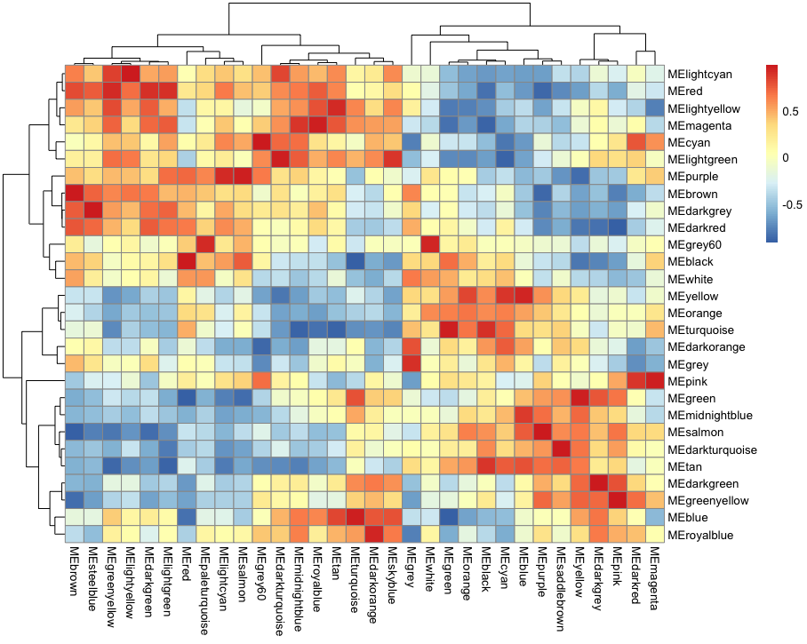
Individual WGCNA modules
Consensus WGCNA modules
Notes:
#12.12.22: apply correlation order to to previous figure
#correlate module eigengenes
MEs_both_cor<-cor(MEs_bsModuleColors_individual$eigengenes, MEs_bsModuleColors_cons_all100$eigengenes)
#Calculate dissimilarity of module-module eigengenes correlation values (cor(MEs))
MEDiss_cons = 1-cor(MEs_cons_cor);
MEDiss_indiv = 1-cor(MEs_indiv_cor);
#Generate module tree dendrograms
METree_cons = hclust(as.dist(MEDiss_cons), method = "average");
METree_indiv = hclust(as.dist(MEDiss_indiv), method = "average");
#plot heatmap, rows clustered by individual, columns clustered by consensus
pheatmap(MEs_both_cor, cluster_rows = METree_indiv, cluster_cols = METree_cons)
one of the examples we looked at earlier this week, where green module in individual which enriched for yellow and turquoise in consensus, you can see green is correlated well with those two modules, but those modules belong to different clusters in consensus, so they are perhaps not just closely related modules in the consensus analysis.

Slide 45
Genes assigned to grey in consensus99 tend to have lower module membership values in individual99 than genes which are retained in a module
Notes:
Module membership in individual, colored by top hit in consensus
Module membership value closer to 1 is stronger

Slide 46
Notes:
Module membership calculated in individual99, then colored by whether or not the module is in grey in consensus99 or not; color is the module color in individual (does not account for genes which are assigned to other modules by consensus99
Can we use this information to improve individual analysis, such as applying a module membership threshold?

Slide 47
– Size in individual (99 samples)
– Size in consensus (65 samples * 100)
– Size in individual (26 samples)

Slide 48
– Size in individual (99 samples)
– Size in consensus (65 samples * 100)
– Size in individual (26 samples)

Slide 50
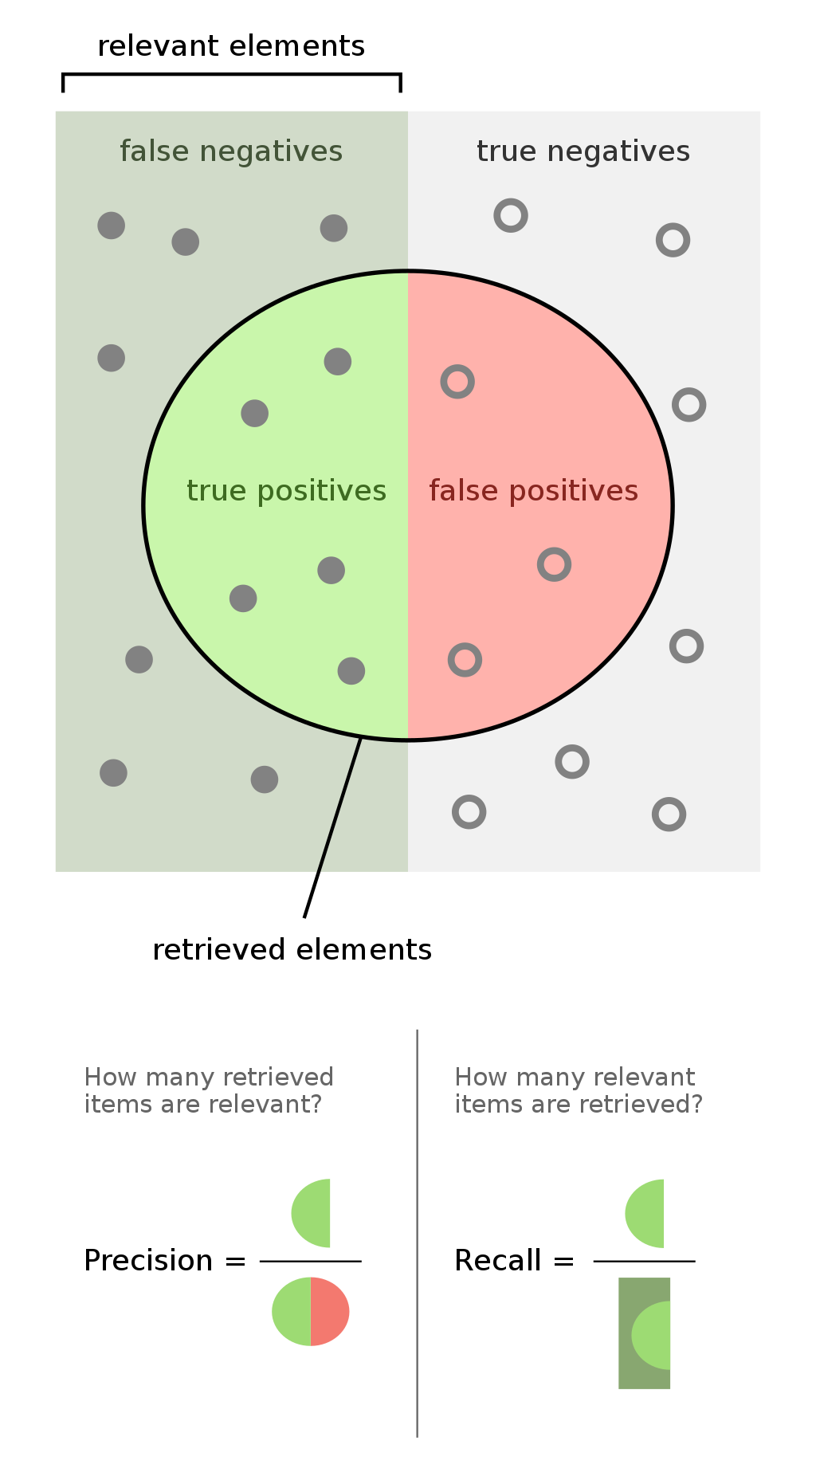
Assessing module gene membership: precision and recall in bootstrapping
Consensus WGCNA
Module_{C} A
G₁
G₂
…
G_{n}
Bootstrapped WGCNA
Module_{I} 1 is significantly
enriched for genes in
Module_{B} A
Module_{C} A
G₁
G₂
…
G_{n}
Module_{C} A
G₁
G₂
…
G_{n}
Module_{I} 1
G₁
G₂
…
G_{n}
Module_{C} A
G₁
G₂
…
G_{n}
Module_{B} A
G₁
G₂
…
G_{n}
True Positive
Precision = TP s
(TP+FP)
Recall = TP s
(TP+FN)
False Positive
Module_{C} B
G₁
G₂
…
G_{n}
Module_{C} B
G₁
G₂
…
G_{n}
Module_{C} B
G₁
G₂
…
G_{n}
Module_{I} 2
G₁
G₂
…
G_{n}
Module_{C} B
G₁
G₂
…
G_{n}
Module_{B} B
G₁
G₂
…
G_{n}
False Negative
X 100
…
…
…
…
…
Module_{C} “grey”
G₁
G₂
…
G_{n}
…
Module_{C} “grey”
G₁
G₂
…
G_{n}
Module_{C} “grey”
G₁
G₂
…
G_{n}
Module_{I} “grey”
G₁
G₂
…
G_{n}
Module_{C} “grey”
G₁
G₂
…
G_{n}
True Negative
Module_{B} “grey”
G₁
G₂
…
G_{n}

Slide 51
Precision/recall with bootstrapping; Two examples
– Precision in individual
– Recall in individual
Module individual: brown, 1331
Module consensus: brown, 1041
Enrichment p value: < 1.0e-199
Count overlap: 724
Jaccard Index: 0.44
Precision: 0.84
Recall: 0.61
Module individual: black, 1010
Module consensus: red, 610
Enrichment p value: < 1.0e-315
Count overlap: 532
Jaccard Index: 0.49
Precision: 0.81
Recall: 0.60

