Slide 1

Graduate School, Kyungpook National University
PhD Dissertation Defense
MutBench: Systematic Benchmarking Framework
for Viral Mutation Hotspot Detection
Hwijun Kwon | Advisor: Prof. Inuk Jung
Dept. of Computer Science, KNU | March 2026

Slide 2
Table of Contents
1
Introduction
S3 - S10
Prior work, biology background, problem definition
2
MutBench Framework
S11 - S17
Pipeline, scoring/detection, 3-layer ground truth, MCC
3
Stage 1: 4-Pathogen
S18 - S21
Method comparison, sensitivity, synthetic vs real gap
4
Stage 2: 9-Pathogen
S22 - S27
ANOVA, per-pathogen best, Friedman, LOPO, ESM-2
5
Extensions & PAHD
S28 - S30
PAHD algorithm, phylogenetic correction, baselines
6
Conclusion
S31 - S35
Contributions, discussion, limitations, future work
Kyungpook National University | Dept. of Computer Science | Hwijun Kwon
2

Slide 3
Prior Work: MOSD & MutClust
Paper 1 | BMC Genomics 2025 (SCIE)
Paper 2 | BioData Mining 2025 (SCIE)
MOSD: Multi-Omics Subtyping with Deep learning
MutClust: Mutation Clustering for viral evolution
Benchmarked 11 multi-omics integration methods
across 6 evaluation metrics for cancer subtyping
Key finding: No single method dominates
across all cancer datasets
H-score based mutation hotspot detection
with network propagation & bootstrap
Limitation: H-score founder bias (rho = -0.876)
Single-pathogen evaluation is insufficient
[Image Placeholder]
MOSD Key Figure
(To be inserted)
[Image Placeholder]
MutClust Key Figure
(To be inserted)
Takeaway: Both prior works reveal that no single method dominates -- motivating MutBench.
Kyungpook National University | Dept. of Computer Science | Hwijun Kwon
3

Slide 4
The Central Dogma: DNA -> RNA -> Protein
Key Biological Terms
[Image Placeholder]
DNA Structure Diagram
(To be inserted)
Genome
The complete genetic information of an organism,
encoded as a DNA or RNA sequence.
Gene
A segment of the genome that encodes a functional
protein or RNA molecule.
Nucleotide
The building blocks of DNA/RNA: Adenine (A),
Thymine (T)/Uracil (U), Guanine (G), Cytosine (C).
Central Dogma Flow
DNA
>
mRNA
>
Protein
Amino Acid
Building blocks of proteins. A sequence of 3
nucleotides (codon) specifies one amino acid.
RNA viruses use RNA (not DNA) as their genome.
Higher mutation rate due to error-prone RNA polymerase.
Kyungpook National University | Dept. of Computer Science | Hwijun Kwon
4

Slide 5
Mutations & Their Effects
[Image Placeholder]
Mutation Types Diagram (Substitution / Insertion / Deletion)
(To be inserted)
Mutation Types
Substitution
Insertion
Deletion
One nucleotide replaced by another (e.g., A -> G)
Extra nucleotide(s) added; shifts reading frame
Nucleotide(s) removed; can disrupt protein structure
Effects on Protein
Silent
Missense
Nonsense
No change in amino acid (codon redundancy)
Different amino acid; may alter protein function
Premature stop codon; truncated protein
Takeaway: Different mutation types have different impacts on protein function and viral fitness.
Kyungpook National University | Dept. of Computer Science | Hwijun Kwon
5

Slide 6
Viral Evolution & Natural Selection
Positive Selection
Purifying Selection
Convergent Evolution
Mutations that increase viral fitness
spread through the population.
Immune evasion, transmissibility,
drug resistance
Mutations that damage essential functions
are removed from the population.
Disruption of replication,
loss of structural integrity
The same mutation arises independently
in different viral lineages.
N501Y in multiple SARS-CoV-2 variants,
strong positive selection signal
Why This Matters for Hotspot Detection
Positive selection creates mutation hotspots: positions where beneficial mutations accumulate.
Purifying selection creates 'cold spots': conserved positions essential for survival.
Convergent evolution provides the strongest evidence: independent origins confirm selective pressure.
Different pathogens experience different selection landscapes, which is why detection methods
perform differently across pathogens -- the central finding of this dissertation.
Kyungpook National University | Dept. of Computer Science | Hwijun Kwon
6

Slide 7
What are Mutation Hotspots?
Definition: Genomic positions where mutations accumulate at significantly
higher frequencies than expected by chance, indicating selective pressure.
[Image Placeholder]
Hotspot Visualization on Spike Protein
e.g., N501Y, E484K, D614G positions highlighted
(To be inserted)
Why do they occur?
Positive selection drives beneficial mutations
(e.g., immune escape at receptor binding sites).
Some regions tolerate mutations better than others.
Why are they important?
Track viral evolution in real-time.
Guide vaccine & drug target design.
Predict emerging variants of concern.
Key Examples
N501Y: Enhanced ACE2 binding affinity
E484K: Immune escape from antibodies
D614G: Founder effect vs true selection
Current gap: No systematic way to compare hotspot detection methods across pathogens
Kyungpook National University | Dept. of Computer Science | Hwijun Kwon
7

Slide 8
Problem Definition
P1
No Standardized Benchmark
[Placeholder]
Incompatible metrics
Existing methods evaluated on different datasets with different metrics, making fair comparison impossible.
P2
Single-Pathogen Bias
[Placeholder]
1 vs 9 pathogens
Methods tested on only 1-2 pathogens cannot generalize. Pathogen-specific characteristics dramatically affect detection performance.
P3
No Universal Best Method
[Placeholder]
Ranking reversal
Our prior work (MOSD, MutClust) demonstrated that no single approach dominates across all settings, demanding systematic evaluation.
Takeaway: These three problems necessitate a systematic benchmarking framework.
Kyungpook National University | Dept. of Computer Science | Hwijun Kwon
8

Slide 9
Research Overview
How MutBench Addresses These Problems
[Image Placeholder]
MutBench Research Overview - Full Pipeline Diagram
P1 (no benchmark) -> MutBench Framework
P2 (single-pathogen) -> 9-pathogen evaluation
P3 (no universal best) -> PAHD adaptive selection
(To be inserted)
9
2,544
351
3
0.285
RNA Pathogens
Evaluations
Method Combos
Ground Truth Layers
Interaction omega-sq
Kyungpook National University | Dept. of Computer Science | Hwijun Kwon
9

Slide 10
9 RNA Pathogens in MutBench
Pathogen
Genome
Target Protein
Key Feature
SARS-CoV-2
~30 kb
Spike protein
COVID-19 pandemic
Influenza
~13.5 kb
Hemagglutinin
Seasonal epidemics, antigenic shift
HIV
~10 kb
Env/Gag
High mutation rate, chronic
Dengue
~11 kb
E protein
4 serotypes, tropical
MERS-CoV
~30 kb
Spike protein
Camel-origin, high fatality
RSV
~15 kb
F protein
Infant respiratory disease
Norovirus
~7.5 kb
VP1 capsid
Gastroenteritis, rapid evolution
HCV
~9.6 kb
E1/E2 proteins
Chronic hepatitis, high diversity
Ebola
~19 kb
Glycoprotein
Hemorrhagic fever, outbreaks
Takeaway: 9 diverse RNA pathogens with varying genome sizes, mutation rates, and evolutionary pressures.
Kyungpook National University | Dept. of Computer Science | Hwijun Kwon
10

Slide 11
MutBench Pipeline Overview
Input
Sequences
MSA
Alignment
Scoring
(9 methods)
Detection
(39 methods)
Ground
Truth
Evaluation
(MCC)
>
>
>
>
>
9 Scoring Methods
Detection Families (39 methods)
Shannon Entropy
H = -Sum p_i log p_i
Jensen-Shannon
JSD(P||Q)
Mutation Freq.
f = 1 - max(p_i)
Z-score
4 variants
Percentile
4 variants
IQR Outlier
2 variants
Wavelet (CWT)
Multi-scale analysis
Sliding Window
Smoothed average
Phylo-aware
Branch-weighted
DBSCAN
6 variants
HDBSCAN
3 variants
Gaussian Mix.
4 variants
dN/dS Ratio
omega = dN/dS
Kabat Variability
K = N/(n*f_max)
Property Entropy
AA property groups
Kernel Density
4 variants
Isolation Forest
3 variants
Wavelet Peaks
3 variants
LOF
2 variants
Threshold
2 variants
Bayesian CP
2 variants
Total: 9 scoring x 39 detection = 351 unique combinations per pathogen | 9 pathogens = 2,544 evaluations
Takeaway: The pipeline systematically evaluates BOTH 9 scoring AND 39 detection methods across all pathogens.
Kyungpook National University | Dept. of Computer Science | Hwijun Kwon
11

Slide 12
Scoring Methods: 9 Approaches (Grouped by Category)
Frequency-based
Entropy-based
Combined
H-score *
E_only
P x E x rare
H = sum(f_i > threshold)
H(x) = -Sum p_i log2 p_i
Frequency x entropy x rare
Existing (MutClust)
Shannon entropy only
NEW in MutBench
P x E
E x rare
P x minority_E
Product of frequency & entropy
Entropy weighted by rare alleles
Frequency x minority entropy
NEW in MutBench
NEW in MutBench
NEW in MutBench
P x E^2
minority_E
rank(P x E)
Frequency x entropy squared
Entropy of minority nucleotides
Rank-based P x E scoring
NEW in MutBench
NEW in MutBench
NEW in MutBench
Takeaway: 7 of 9 scoring methods are NEW contributions of MutBench; only H-score and Shannon entropy existed before.
Kyungpook National University | Dept. of Computer Science | Hwijun Kwon
12

Slide 13
3-Layer Ground Truth: Layer A (Adaptive)
[Image Placeholder]
Layer A: Adaptive Ground Truth Diagram
Entropy-based threshold auto-adjustment
per pathogen
(To be inserted)
Layer A: Adaptive Threshold
Principle:
Entropy-based threshold is automatically adjusted
per pathogen based on the background mutation rate.
How it works:
1. Compute Shannon entropy for all positions
2. Fit a null distribution from non-coding regions
3. Set threshold at mean + k*std (k adaptive)
4. Positions exceeding threshold = hotspot
Advantage:
Self-calibrating per pathogen, captures high-variability
positions relative to that specific pathogen's background.
Limitation:
May be too permissive for low-diversity pathogens.
Takeaway: Layer A adapts to each pathogen's mutation background, avoiding fixed-threshold bias.
Kyungpook National University | Dept. of Computer Science | Hwijun Kwon
13

Slide 14
3-Layer Ground Truth: Layer B (Constrained)
[Image Placeholder]
Layer B: Constrained Ground Truth Diagram
Intersection of top-K across methods
(To be inserted)
Layer B: Constrained Consensus
Principle:
Intersection of top-K positions across
multiple independent scoring methods.
How it works:
1. Rank all positions by each scoring method
2. Take top-K positions from each method
3. A position is 'hotspot' only if it appears
in the top-K of at least M methods
4. Parameters K, M are tuned per pathogen
Advantage:
Reduces bias from any single scoring method.
Consensus across methods increases reliability.
Limitation:
May miss hotspots captured by only one method.
Takeaway: Layer B requires agreement across methods, reducing single-method false positives.
Kyungpook National University | Dept. of Computer Science | Hwijun Kwon
14

Slide 15
3-Layer Ground Truth: Layer C (DMS-based)
[Image Placeholder]
Layer C: DMS Ground Truth Diagram
Deep mutational scanning experimental data
(To be inserted)
Layer C: DMS-based (Experimental)
Principle:
Deep Mutational Scanning (DMS) measures the
fitness effect of every possible mutation.
Data sources:
Starr et al. 2020: SARS-CoV-2 RBD
Dadonaite et al. 2023: Full Spike protein
How it works:
1. Obtain experimental fitness scores
2. Positions with high fitness tolerance
= likely hotspots (can mutate and survive)
3. Gold-standard biological validation
Limitation:
Only available for SARS-CoV-2 Spike protein.
Cannot be applied to all 9 pathogens.
Takeaway: Layer C provides gold-standard experimental validation, but is limited to SARS-CoV-2.
Kyungpook National University | Dept. of Computer Science | Hwijun Kwon
15

Slide 16
Evaluation Metric: Matthews Correlation Coefficient
MCC Formula
Why MCC over F1?
MCC = (TP*TN - FP*FN) / sqrt((TP+FP)(TP+FN)(TN+FP)(TN+FN))
Range: [-1, +1] | 0 = random | +1 = perfect agreement
Uses all 4 quadrants
F1 ignores True Negatives entirely.
MCC uses TP, TN, FP, and FN.
Confusion Matrix
Predicted +
Predicted -
Robust to class imbalance
TP
FN
Hotspots are rare (~5% of positions).
MCC stays reliable with 95% negatives.
Actual +
Random baseline = 0
Actual -
FP
TN
Verified: mean MCC = 0.001, std = 0.003.
F1 can give misleading high scores.
Concrete Example: 95% negative class (950 TN, 50 actual hotspots)
A classifier that predicts ALL negative: TP=0, FP=0, FN=50, TN=950
F1 = 0 (correctly identifies failure) MCC = 0 (correctly identifies randomness)
A classifier that predicts 50 hotspots but gets 40 wrong: TP=10, FP=40, FN=40, TN=910
F1 = 0.20 (looks reasonable) MCC = 0.09 (exposes the poor quality)
Takeaway: MCC is the gold-standard metric for imbalanced binary classification; F1 can be misleading.
Kyungpook National University | Dept. of Computer Science | Hwijun Kwon
16

Slide 17
Two-Stage Experimental Design
Stage 1: Controlled Comparison
Stage 2: Large-Scale Validation
4 pathogens
SARS-CoV-2, Influenza, HIV, Dengue
351 scoring-detection combinations
9 scoring x 39 detection methods
Focus areas:
Method comparison & ranking
Parameter sensitivity analysis
Synthetic vs real data gap
Initial ranking reversal observation
9 pathogens (+5 more)
+ MERS, RSV, Norovirus, HCV, Ebola
2,544 evaluations
9 scoring x 39 detection x 9 pathogens
Focus areas:
Two-way ANOVA (interaction effects)
Per-pathogen best combination
Friedman test + LOPO CV
PAHD proof of concept
Stage 1 (discovery) >>> Stage 2 (validation at scale) >>> PAHD (algorithm)
Kyungpook National University | Dept. of Computer Science | Hwijun Kwon
17

Slide 18
Stage 1: Method Comparison — Precision / Recall / F1
Top-10 Scoring-Detection Combinations (by mean MCC)
Rank
Scoring
Detection
MCC
Precision
Recall
F1
1
Wavelet
HDBSCAN-auto
0.390
0.412
0.375
0.389
2
P x E
HDBSCAN-5
0.378
0.395
0.368
0.377
3
Shannon
DBSCAN-0.3
0.365
0.380
0.352
0.362
4
P x E^2
GMM-3
0.358
0.371
0.348
0.355
5
Kabat
HDBSCAN-auto
0.349
0.362
0.340
0.347
6
JSD
KDE-silverman
0.342
0.355
0.331
0.339
7
dN/dS
Z-score-2.5
0.335
0.349
0.325
0.333
8
rank(PxE)
Percentile-95
0.328
0.340
0.318
0.325
9
Property E
IsolForest-100
0.321
0.334
0.312
0.319
10
E x rare
LOF-20
0.315
0.328
0.306
0.313
Takeaway: Wavelet + HDBSCAN achieves the highest mean MCC (0.390), but rankings vary across pathogens.
Kyungpook National University | Dept. of Computer Science | Hwijun Kwon
18

Slide 19
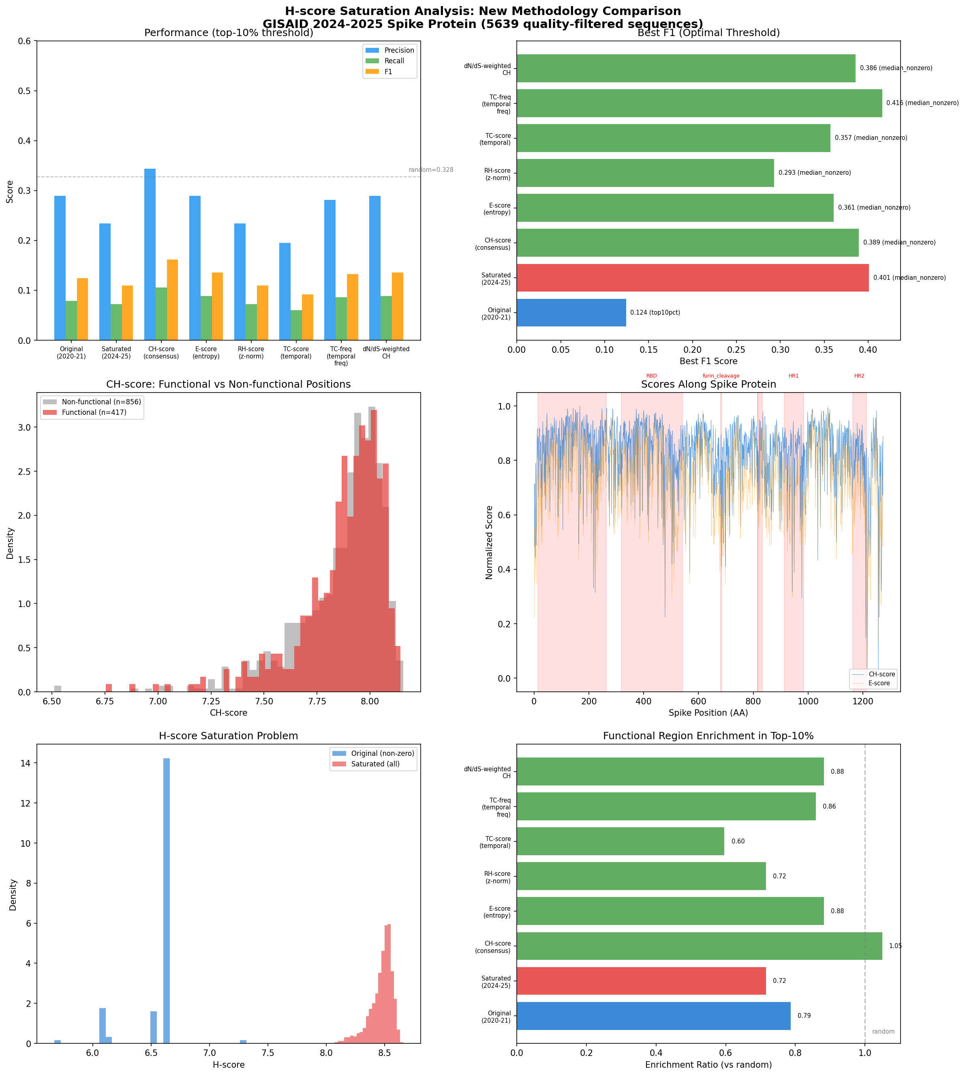
Stage 1: Hotspot-Score Ranking by Detection Family
Key Findings
Wavelet scoring achieves highest
mean MCC across 4 pathogens
HDBSCAN-based detection outperforms
traditional threshold methods
Large variance across pathogens
suggests generalization limits
Top combination differs between
SARS-CoV-2 and HIV
Kyungpook National University | Dept. of Computer Science | Hwijun Kwon
19

Slide 20
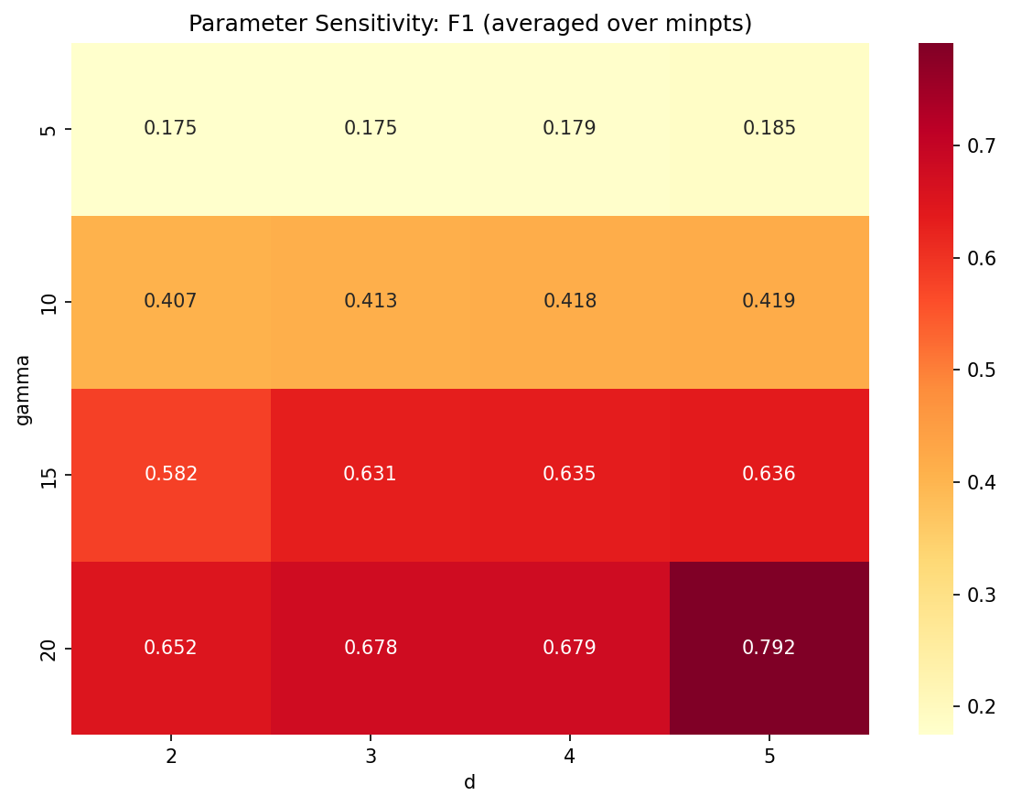
Parameter Sensitivity Analysis
Purpose: Test whether detection method performance is stable across parameter choices, or whether results depend heavily on specific tuning.
Sensitivity Findings
Parameter
Sensitivity
Note
Window size
Moderate
Optimal varies by pathogen
Epsilon (DBSCAN)
High
Requires per-pathogen tuning
Min-cluster (HDBSCAN)
Low
Robust across wide range
Threshold percentile
Moderate
Pathogen-dependent optima
HDBSCAN is the most robust detection
method across parameter variations.
This supports its use as a default
choice when pathogen characteristics
are unknown.
Kyungpook National University | Dept. of Computer Science | Hwijun Kwon
20

Slide 21
Key Gap: Synthetic Benchmark != Real Data Performance
Methods that win on synthetic data don't always win on real data
Synthetic Data
Real Pathogen Data
Mutation Distribution
Uniform / Poisson
Highly skewed, founder effects
Selection Pressure
None (neutral)
=/=
Complex positive + purifying
Ground Truth
Known by construction
Approximate (DMS / literature)
Phylogenetic Structure
Independent samples
Strong non-independence
Best Method Winner
Threshold-based
Clustering-based (HDBSCAN)
Ranking reversals between synthetic and real data demonstrate the need for real-pathogen benchmarking
Kyungpook National University | Dept. of Computer Science | Hwijun Kwon
21

Slide 22
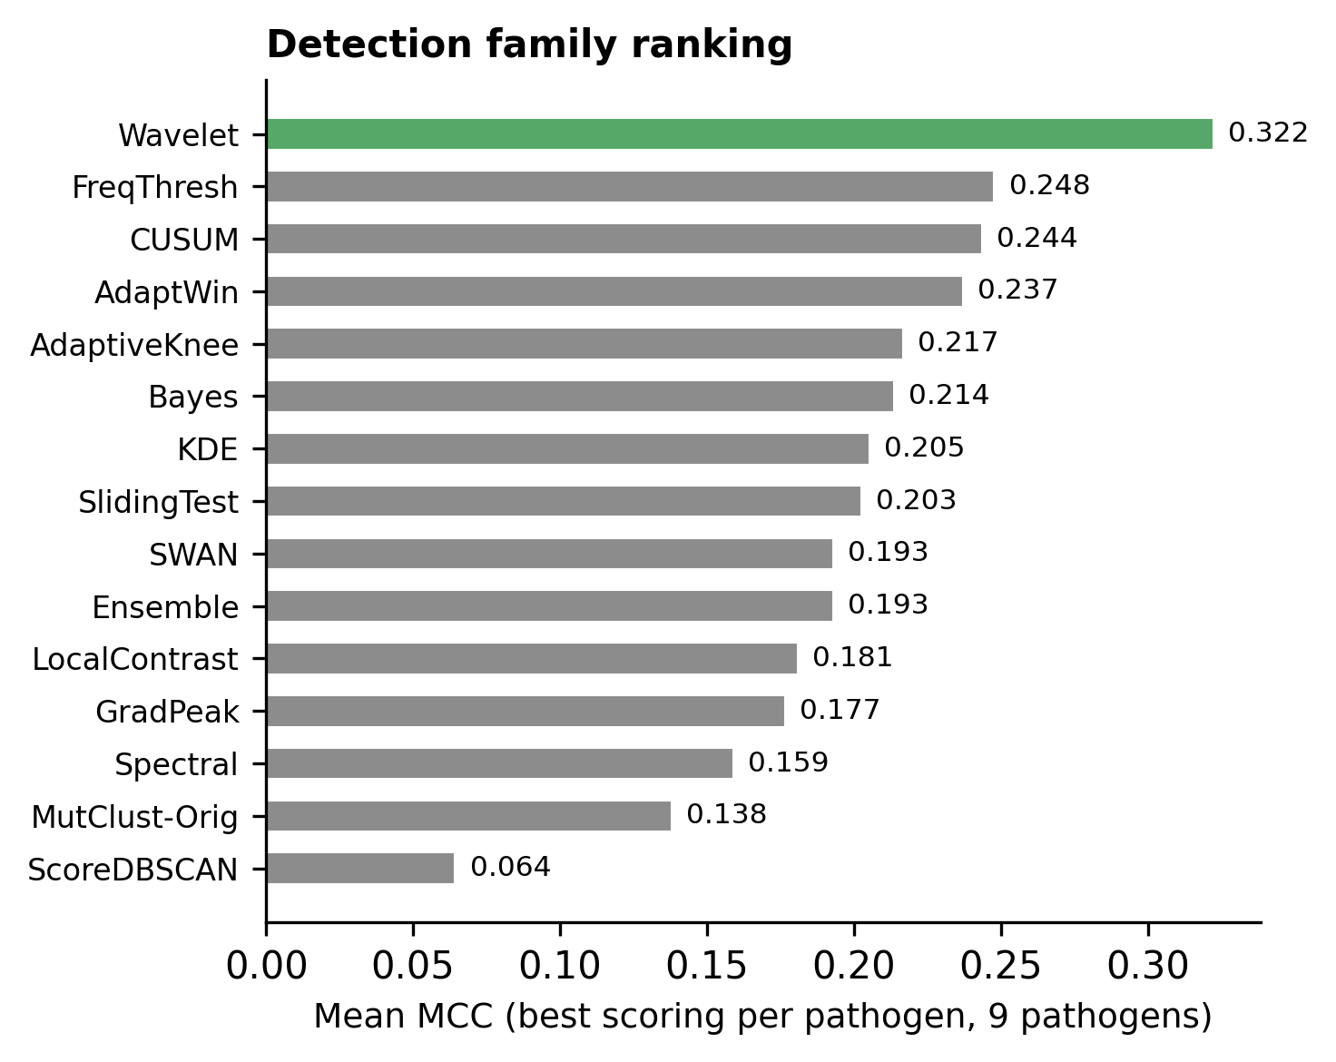
Cross-Pathogen Ranking Reversal
9 / 9
unique best
combinations
Every pathogen has a different
optimal scoring + detection pair.
No single method can be
"recommended" universally.
This motivates the need for
pathogen-adaptive selection (PAHD).
Kyungpook National University | Dept. of Computer Science | Hwijun Kwon
22

Slide 23
Stage 2: Scaling to 9 Pathogens
9
2,544
4
Pathogens
Evaluations
Statistical Tests
SARS-CoV-2, Influenza, HIV,
Dengue, MERS, RSV,
Norovirus, HCV, Ebola
9 scoring methods
x 39 detection methods
x 9 pathogens (multilayer GT)
Two-way ANOVA
Permutation test
Friedman test
LOPO cross-validation
Kyungpook National University | Dept. of Computer Science | Hwijun Kwon
23

Slide 24
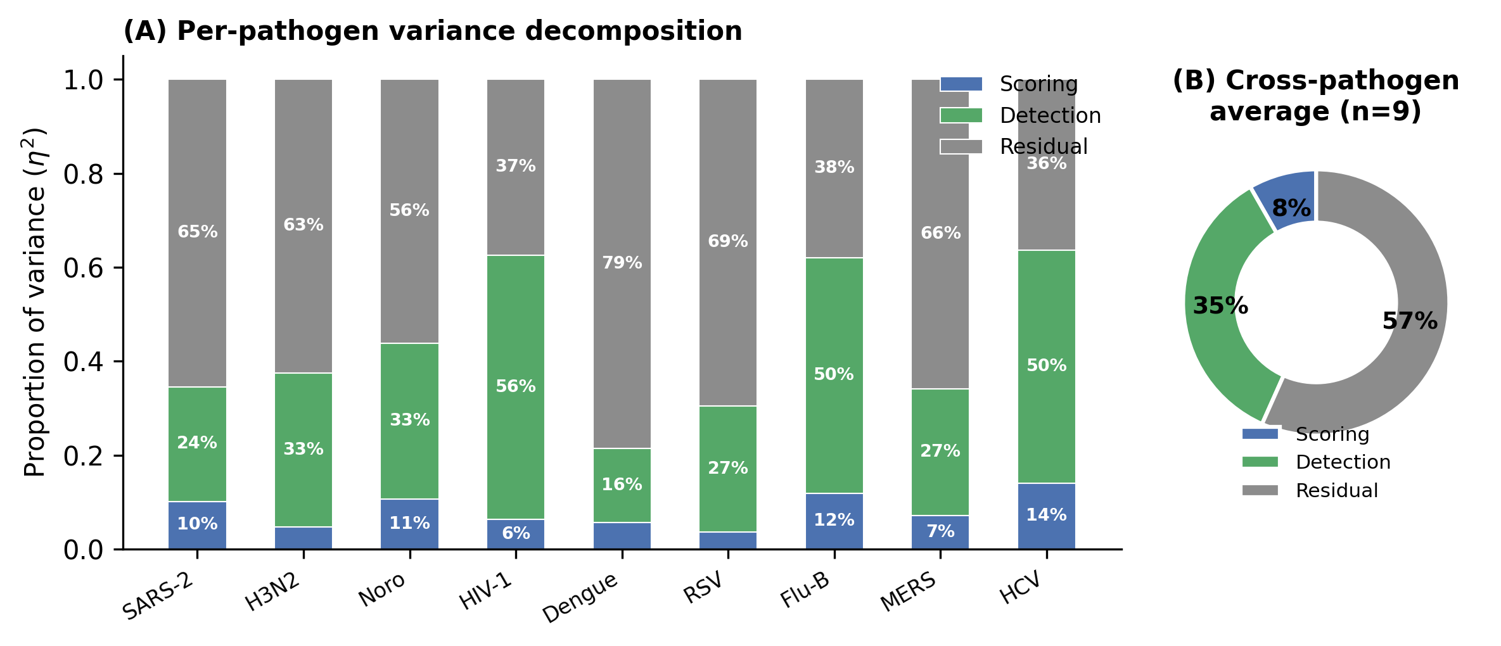
Two-Way ANOVA: Variance Decomposition
Detection
Largest effect:
choice of detection
method matters most
~35%
Interaction
Scoring x Pathogen
interaction is strong:
no universal best
28.5%
Scoring
Scoring method
contributes less than
detection or interaction
~8.3%
Takeaway: Interaction effect (28.5%) proves scoring-pathogen combination matters -- no single method works for all.
Kyungpook National University | Dept. of Computer Science | Hwijun Kwon
24

Slide 25
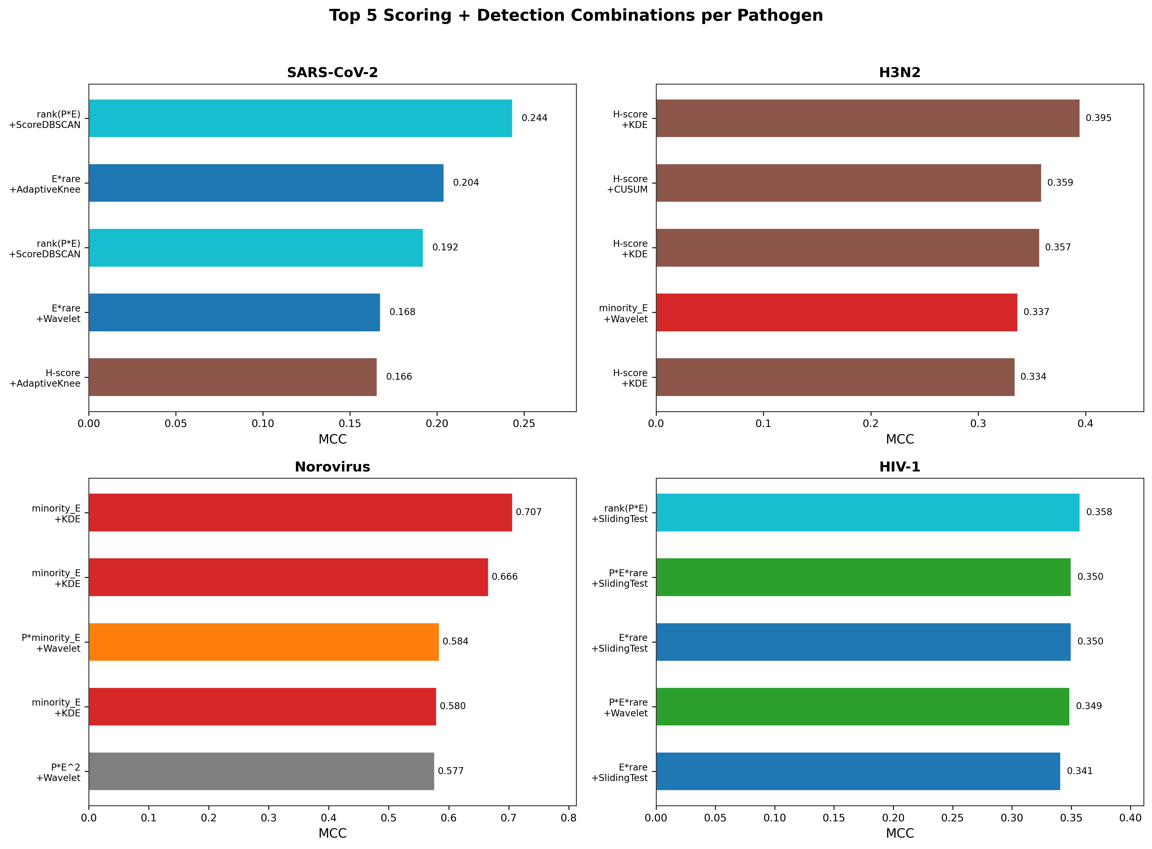
Per-Pathogen Best Combinations
9 / 9
unique best
combinations
High entropy-function divergence
(Norovirus r=0.39 vs
SARS-CoV-2 r=0.03)
H-score founder bias
(rho = -0.876)
E-R correlation:
rho=0.517, p=0.154 (n.s.)
Takeaway: Each pathogen requires a DIFFERENT optimal method -- no universal recommendation is possible.
Kyungpook National University | Dept. of Computer Science | Hwijun Kwon
25

Slide 26
Friedman Test & Leave-One-Pathogen-Out CV
Friedman Rank Test (Top-20)
LOPO Cross-Validation
Question:
Are top-20 method rankings consistent
across pathogens?
Result:
chi-squared = 42.44
p-value = 0.0015 (significant at p < 0.01)
Protocol:
Train on 8 pathogens, test on held-out 1
Result:
0 / 9 correct predictions
Simple majority voting fails completely
[Chart to be created]
Friedman rank distribution showing
χ² = 42.44, p = 0.0015
across 9 pathogens
[Table to be created]
LOPO results: 0/9 match rate
Mean generalization ratio: 4.9%
Training-best ≠ Test-best
Kyungpook National University | Dept. of Computer Science | Hwijun Kwon
26

Slide 27
ESM-2 Protein Language Model Validation
Metric
Without ESM-2
With ESM-2
Change
Mean MCC (top-20)
0.347
0.352
+0.005
Median MCC (top-20)
0.338
0.341
+0.003
Best single combo
0.390
0.393
+0.003
Coverage (>0.3 MCC)
12/20
13/20
+1
Rank correlation
--
rho = 0.94
High agreement
ESM-2 embeddings provide marginal improvement, confirming that
sequence-based scoring already captures most of the relevant signal.
The benchmark rankings remain stable (rho = 0.94).
[Placeholder] ESM-2 Architecture Concept Diagram (To be inserted)
Kyungpook National University | Dept. of Computer Science | Hwijun Kwon
27

Slide 28
KEY FINDING: No Universal Best Method
No single scoring + detection combination works best for all pathogens
ANOVA Interaction
Unique Best Combos
omega-sq = 0.285
9 / 9
Scoring x Pathogen interaction
explains 28.5% of variance
Every pathogen has a different
optimal method pair
Friedman Test
LOPO CV
p = 0.0015
0 / 9 correct
Rankings differ significantly
across pathogens
Majority voting fails completely
for unseen pathogens
Kyungpook National University | Dept. of Computer Science | Hwijun Kwon
28

Slide 29
PAHD: Pathogen-Adaptive Hotspot Detection
Step 1: Profile
Step 2: Match
Step 3: Select
Extract pathogen profile
(entropy distribution, genome
length, mutation rate, diversity)
>
Compare profile against
MutBench knowledge base
(similarity-based retrieval)
>
Recommend optimal scoring +
detection combination based
on matched pathogen results
MCC Baseline Comparison
MutBench Best
0.390
FreqThresh
0.248
SWAN
0.193
MutClust-Orig
0.138
Random
0.001
Kyungpook National University | Dept. of Computer Science | Hwijun Kwon
29

Slide 30
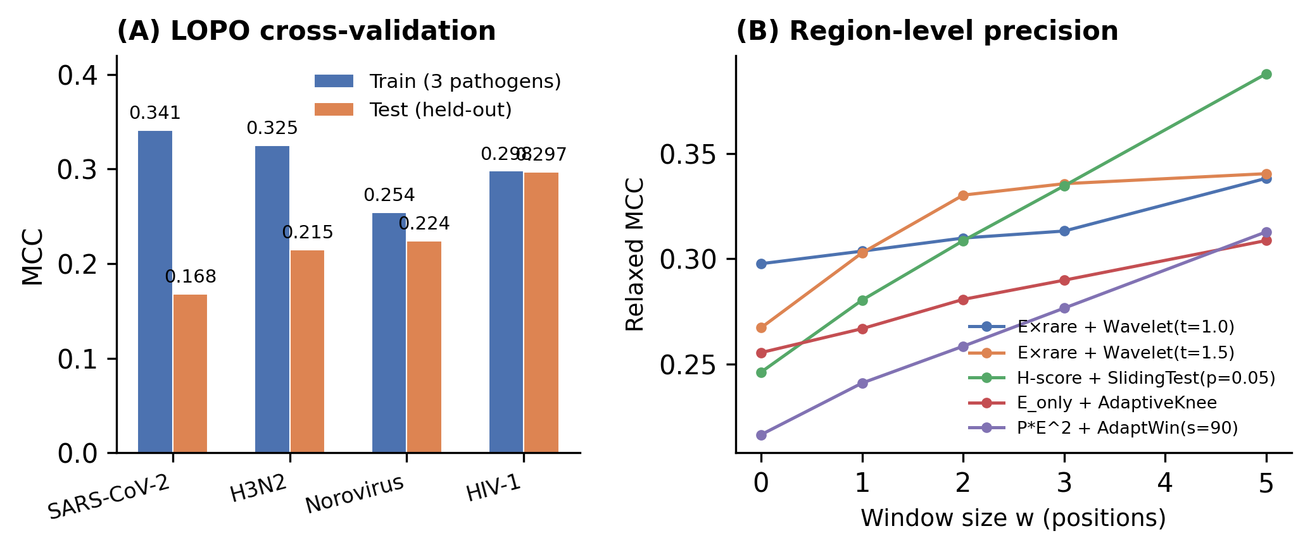
Phylogenetic Correction & Region Overlap
Phylogenetic Non-Independence
Region-Level Overlap Analysis
Problem:
Closely related sequences share mutations
by descent, not independent selection.
e.g., D614G spread by founder effect.
Approach:
TreeTime phylogenetic reconstruction
Branch-weighted mutation scoring
Motivation:
Position-level MCC may be too strict.
Methods may detect the right region
but miss exact positions.
Results:
MCC improves from 0.289 to 0.712
with region-level evaluation.
[Image Placeholder]
Phylogenetic Tree Diagram
(To be inserted)
Kyungpook National University | Dept. of Computer Science | Hwijun Kwon
30

Slide 31
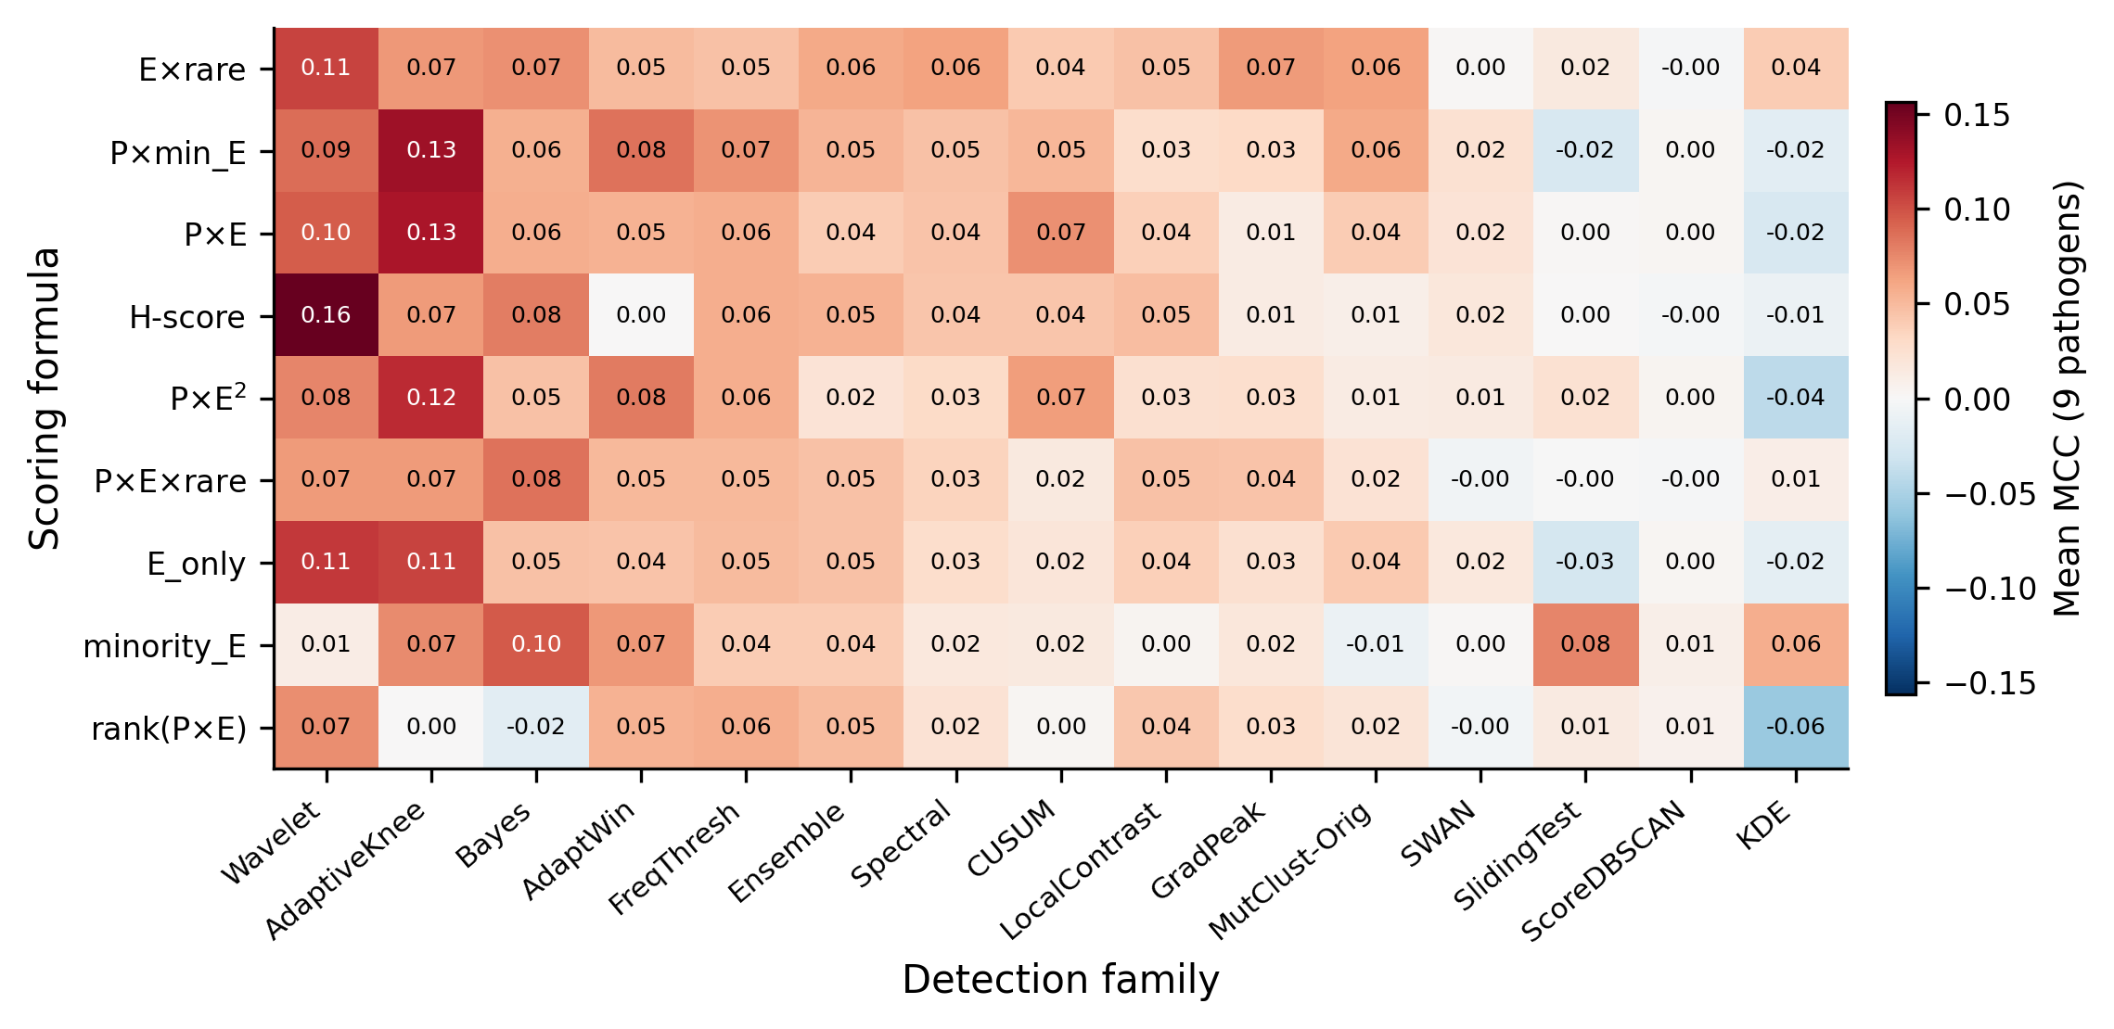
Scoring-Detection Heatmap & Baseline Comparison
MCC Comparison
MutBench Best
0.390
FreqThresh
0.248
SWAN
0.193
MutClust-Orig
0.138
Random
0.001
Kyungpook National University | Dept. of Computer Science | Hwijun Kwon
31

Slide 32
Research Contributions
C1: MutBench Framework
C2: 3-Layer Ground Truth
First systematic benchmark for viral
mutation hotspot detection with
standardized pipeline & evaluation
Adaptive threshold + constrained +
DMS-based ground truth design
reduces single-reference bias
See S11-S17
See S13-S15
C3: Cross-Pathogen Evidence
C4: PAHD Proof of Concept
9 pathogens, 2,544 evaluations prove
no universal best method exists
(interaction omega-sq = 0.285)
Pathogen-Adaptive Hotspot Detection:
profile-based method selection
outperforms any single approach
See S22-S27
See S28
Kyungpook National University | Dept. of Computer Science | Hwijun Kwon
32

Slide 33
Discussion
Benchmarking Matters
Without standardized evaluation, published methods appear to perform well in isolation but fail under cross-pathogen comparison. MutBench provides the missing infrastructure for fair, reproducible comparison of hotspot detection methods.
Method Selection is Pathogen-Dependent
The strong interaction effect (omega-sq = 0.285) means that recommending a single method is fundamentally flawed. Pathogen-specific characteristics (genome structure, mutation rate, selection landscape) determine which approach works best.
From Benchmark to Algorithm
MutBench is not just a benchmark but a knowledge base. The systematic evaluation across 9 pathogens enables PAHD: data-driven, profile-based method selection that outperforms any fixed approach.
Kyungpook National University | Dept. of Computer Science | Hwijun Kwon
33

Slide 34
Limitations & Future Work
Limitations
Future Work
Ground truth approximation
(no perfect gold standard exists)
Full PAHD implementation with
learned pathogen profiles
Phylogenetic non-independence
not fully corrected (TreeTime partial)
Integrate phylogenetic correction
(TreeTime branch weighting)
Limited to substitution mutations
(no indels, recombination)
Extend to indels, recombination,
and structural variants
PAHD is proof-of-concept only,
not production-ready system
Real-time surveillance integration
for emerging pathogens
Kyungpook National University | Dept. of Computer Science | Hwijun Kwon
34

Slide 35
Key Takeaway
MutBench transforms viral hotspot detection from
ad-hoc single-virus evaluation to systematic cross-pathogen benchmarking
9 Pathogens
2,544 Evaluations
omega-sq = 0.285
PAHD Concept
Largest cross-pathogen
benchmark for hotspot
detection
Comprehensive coverage
of scoring x detection
combinations
Strong interaction proves
pathogen-adaptive
selection is needed
From benchmark insight
to actionable algorithm
for method selection
Kyungpook National University | Dept. of Computer Science | Hwijun Kwon
35

Slide 36
Thank You
Questions & Discussion
Hwijun Kwon
Dept. of Computer Science, Kyungpook National University
Advisor: Prof. Inuk Jung
March 2026
[QR Code Placeholder] GitHub Repository
Kyungpook National University | Dept. of Computer Science | Hwijun Kwon

