Slide 1

Graduate School, Kyungpook National University
PhD Comprehensive Oral Examination
Multi-Omics Integration Analysis and Viral Mutation Hotspot Detection
From MOSD study design framework to COVID-19 severity analysis
Hwijun Kwon | Advisor: Prof. Inuk Jung
Dept. of Computer Science, KNU | March 9, 2026
BMC Genomics 2025 (SCIE)
BioData Mining 2025 (SCIE)
A review on multi-omics integration for aiding
study design of large scale TCGA cancer datasets
Identification of severity related mutation hotspots in SARS-CoV-2 using a density-based clustering approach
Kyungpook National University | Dept. of Computer Science | Hwijun Kwon

Slide 2
Table of Contents
I. Paper 1: MOSD
Multi-Omics Study Design
• Background, Prior Work, Framework,
Benchmark, Results, Guidelines
Slides 4–11
II. Paper 2: MutClust
Mutation Hotspot Detection
• Background, Prior Work, H-score,
Algorithm, Results, Validation
Slides 12–20
III. Conclusion
Research Contributions
• Unified contributions, common
themes, future directions
Slides 21–22
Kyungpook National University | Dept. of Computer Science | Hwijun Kwon
2/22

Slide 3
Key Terminology
Paper 1 — Multi-Omics (MOSD)
GE (Gene Expression)
mRNA abundance; reflects active gene transcription levels.
ME (DNA Methylation)
Epigenetic modification; CpG site methylation affects gene regulation.
MI (miRNA Expression)
Small non-coding RNA; post-transcriptional regulators of gene expression.
CNV (Copy Number Variation)
Gain or loss of genomic segments; alters gene dosage.
MOI (Multi-Omics Integration)
Combining two or more omics layers for unified analysis.
Cluster-score
Metric evaluating clustering quality across integration methods.
Paper 2 — Mutation Hotspot (MutClust)
Nucleotide
Basic unit of DNA/RNA (A, T/U, G, C); mutation target.
Mutation Hotspot
Genomic region with statistically significant mutation clustering.
Epitope
Protein region recognized by immune receptors; key for immune response.
HLA (Human Leukocyte Antigen)
Cell-surface proteins presenting antigens to T cells.
NK Cell (Natural Killer Cell)
Innate immune lymphocyte; kills virus-infected cells without prior sensitization.
Cytokine
Signaling proteins mediating immune/inflammatory responses.
Kyungpook National University | Dept. of Computer Science | Hwijun Kwon
3/22

Slide 4
Paper 1
A review on multi-omics integration for aiding study design of large scale TCGA cancer datasets
BMC Genomics 2025 (SCIE)
A review on multi-omics integration for aiding
study design of large scale TCGA cancer datasets
Kyungpook National University | Dept. of Computer Science | Hwijun Kwon
4/22

Slide 5
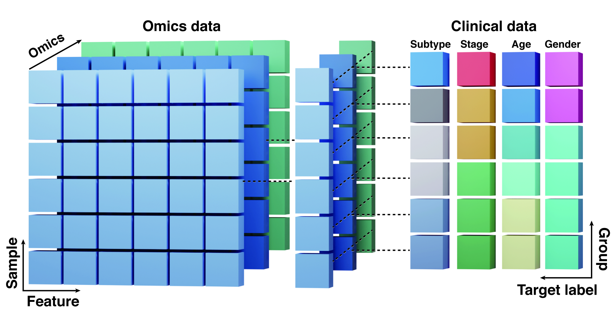
Paper 1: The Challenge of Multi-Omics Integration
Four TCGA Omics Data Types
• GE (Gene Expression) ~17,000 features
• ME (DNA Methylation) ~396,000 features
• MI (miRNA Expression) ~2,200 features
• CNV (Copy Number Variation) ~22,000 features
Combined: ~437,000 features
• Core challenges: different scales, high
dimensionality, no systematic guidelines
“How to systematically design MOI analysis?”
Benchmarked
Tested
Goal
10 TCGA cancers, 3,988 patients
10 integration methods
MOSD quantitative guidelines
Kyungpook National University | Dept. of Computer Science | Hwijun Kwon
5/22

Slide 6
Paper 1: Prior Work and Research Gap
Study | Data | Methods | Comp (of 6) | Bio (of 3) | Key Limitation
Rappoport & Shamir 2018 | TCGA (10 cancers) | SNF, LRA, COCA, Spectrum, PINS, etc. | 0 / 6 | 2 / 3 | No computational design factors
Tini et al. 2019 | TCGA breast cancer | SNF, iClusterPlus, MOFA | 1 / 6 | 1 / 3 | Single cancer type, few methods
Chauvel et al. 2020 | Simulated + real data | MOFA, NMF, CC, iCluster, SNF | 2 / 6 | 0 / 3 | No biological factor analysis
Pierre-Jean et al. 2020 | TCGA (4 cancers) | SNF, CIMLR, PINS, MoCluster | 1 / 6 | 1 / 3 | No feature selection or noise tests
Duan et al. 2021 | TCGA (33 cancers) | SNF, Spectrum, PINS, NEMO, etc. | 0 / 6 | 3 / 3 | No computational design factors
MOSD (Ours) | TCGA (10 cancers) | SNF, Spectrum, PINS+, COCA, LRA, CC, MOFA, NEMO, IntNMF, iCl+ | 6 / 6 | 3 / 3 | First unified benchmark
Research Gap
No study covers all 6 computational + 3 biological factors with specific method details
→ MOSD: Our Contribution
10 cancers | 10 methods | 6/6 computational + 3/3 biological factors | First unified benchmark
Kyungpook National University | Dept. of Computer Science | Hwijun Kwon
6/22

Slide 7
Paper 1: MOSD — 9-Factor Benchmark Framework
Computational Factors (6)
1 Sample Size
2 Feature Selection
3 Preprocessing
≥26 per class required
Top 1–10% recommended
RAW / NORM / GL modes
4 Noise Tolerance
5 Class Balance
6 Number of Classes
<30% recommended
<3:1 ratio threshold
Subtype count effect
Biological Factors (3)
7 Cancer Subtype Combination
8 Omics Combination
9 Clinical Features
Subtype pairing matters
GE-ME most effective
Subtype > Gender > Stage > Age
Single-factor isolation: vary one factor, fix all others, 10 repetitions
Kyungpook National University | Dept. of Computer Science | Hwijun Kwon
7/22

Slide 8
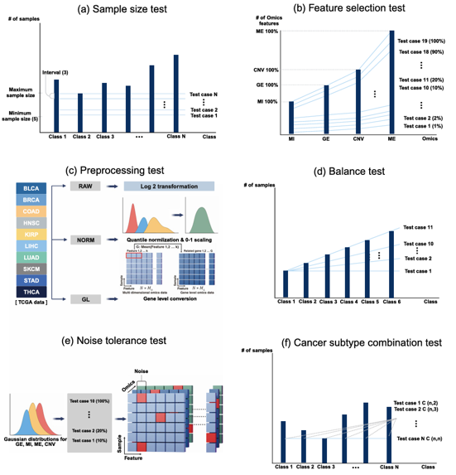
Paper 1: Data and Benchmark Design
Data Overview
• 10 TCGA cancer types
• 3,988 patients across all cohorts
• 4 omics modalities (~437K features)
• 10 MOI methods evaluated
• Cluster-score-based evaluation
10 MOI Methods
• SNF, Spectrum, PINSPlus, COCA, LRAcluster
• CC, MOFA, NEMO, IntNMF, iClusterPlus
• Selection criteria: R/Python availability, broad adoption,
• multi-omics input support, reproducibility
Kyungpook National University | Dept. of Computer Science | Hwijun Kwon
8/22

Slide 9
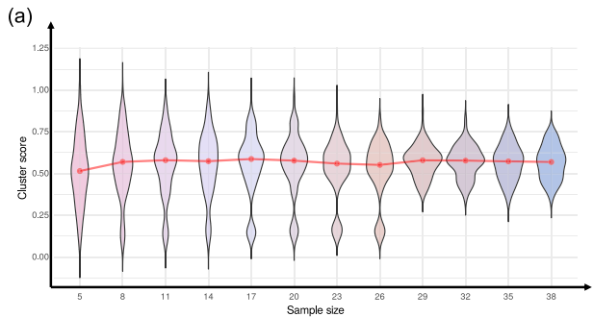
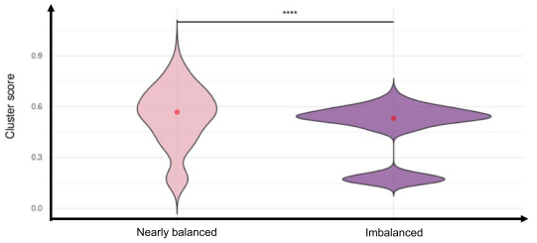
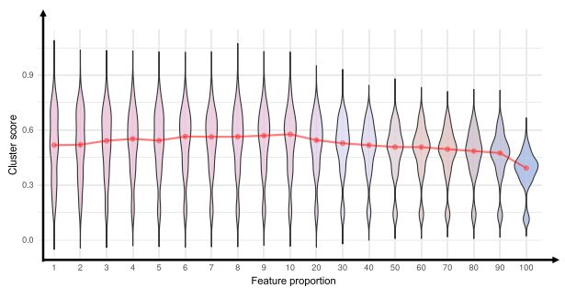
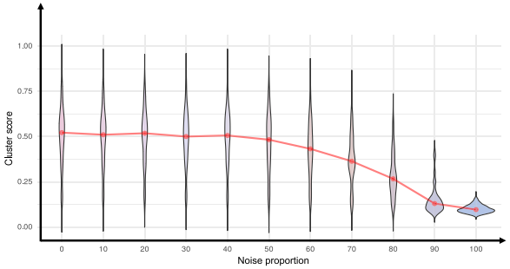
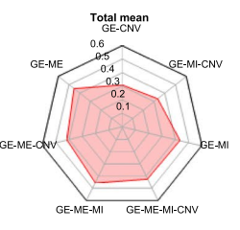
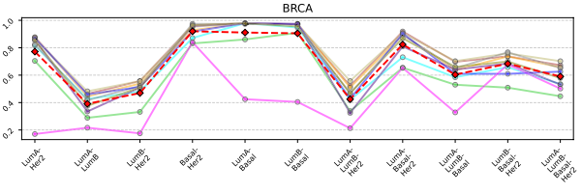
Paper 1: Benchmark Results
Evaluation Metric: Cluster-score = ( ARI + NMI + F-measure ) / 3 — Combines chance-corrected, information-theoretic, and set-based perspectives to avoid single-metric bias
1. Sample Size
≥ 26 per class
2. Class Balance
< 3:1 ratio
3. Feature Selection
1–10% optimal
[Figure]
[Figure]
[Figure]
Variance stabilizes at 26; below → catastrophic failure
Imbalance >3:1 → bimodal distribution (p<0.0001)
Peak at 1–10%; using 100% → system failure
4. Noise Tolerance
< 30% threshold
5. Omics Combination
GE-ME preferred
6. Subtype Distinctness
Molecular > clinical
[Figure]
[Figure]
[Figure]
30% cliff; >80% → total failure (score <0.10)
Gene Expression + Methylation best across 10 cancers
Molecularly distinct pairs → high score (>0.90)
Kyungpook National University | Dept. of Computer Science | Hwijun Kwon
9/22

Slide 10
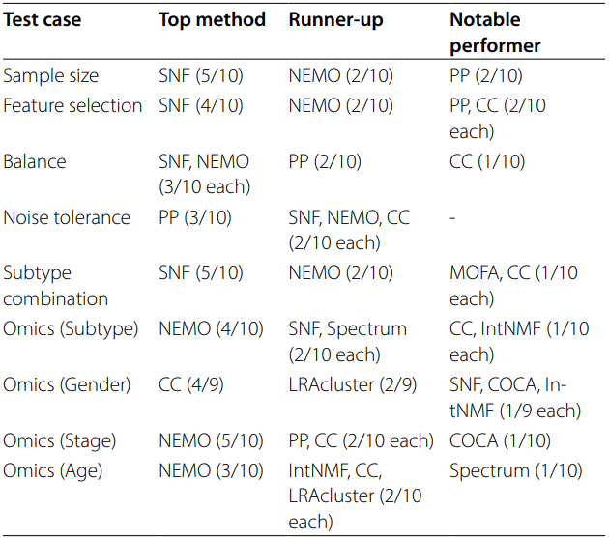
Paper 1: MOSD Guidelines & Method Profiles
Top Performing Methods
MOSD Checklist
SNF
NEMO
PINSPlus
CC
✓ ≥ 26 samples per class
Computational
Clinical / Bio
Noise Robust
Gender
Minimum for stable clustering results
✓ ≤ 10% feature selection
Top features reduce noise significantly
✓ < 3:1 class balance ratio
Avoid imbalance-driven artifacts
✓ GE-ME omics preferred
Gene expression + methylation most effective
✓ < 30% noise level
Keep below threshold for reliability
✓ Molecularly distinct subtypes
Choose subtypes with clear biological signal
Kyungpook National University | Dept. of Computer Science | Hwijun Kwon
10/22

Slide 11
Paper 1 Summary: MOSD Framework
Key Contributions
• First unified 9-factor benchmark framework for multi-omics integration
• 10 methods × 10 cancers × 3,988 patients — systematic evaluation
• Actionable guidelines with statistical thresholds for practitioners
BMC Genomics (2025, SCIE) | github.com/cobi-git/MOPARAM
Limitations & Future Directions
• TCGA-specific results — external cohort validation needed
• Single-cell multi-omics extension planned as next step
• Factor interaction effects to be explored in future work
Kyungpook National University | Dept. of Computer Science | Hwijun Kwon
11/22

Slide 12

Paper 2
Identification of severity related mutation hotspots in SARS-CoV-2 using a density-based clustering approach
BioData Mining 2025 (SCIE)
Identification of severity related mutation hotspots in SARS-CoV-2 using a density-based clustering approach
Kyungpook National University | Dept. of Computer Science | Hwijun Kwon
12/22

Slide 13
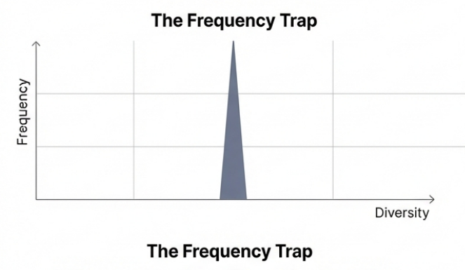
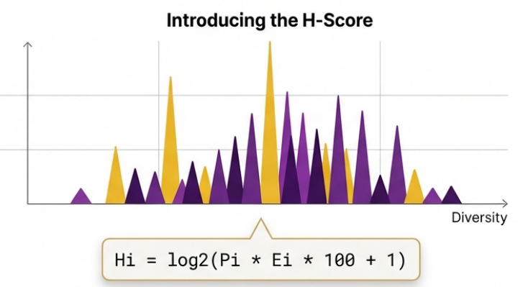
Paper 2: The Frequency Trap in Viral Mutation Tracking
Traditional frequency-based tracking misses rare but clinically critical immune-evasion mutations.
Limitation (Traditional)
• Frequency-only or entropy-only approaches
Mullick et al. (2021):
• Spike protein region only
• K-means with pre-specified K
• No whole-genome analysis
Innovation (The H-score)
• Unifies mutation probability and diversity
into a single density-aware metric.
H-score = Probability × Entropy
Kyungpook National University | Dept. of Computer Science | Hwijun Kwon
13/22

Slide 14
Paper 2: Three Approaches Compared
Frequency-Based
Entropy-Based
H-score (This Work)
"Frequent = important?"
• ✘ Lineage bias
• D614G >90% frequency
but low diversity
High frequency does not imply
clinical significance.
"Diverse = important?"
• ✘ Ignores frequency
• Rare positions inflated
when diversity is high
Diversity alone misleads
without frequency context.
"Frequency × Diversity = Severity"
• ✓ c315: high P, low E
• Detected via density clustering
not simple thresholding
Combines both signals into
a unified severity metric.
DBSCAN direct: 4 clusters, 99.76% in one mega-cluster → Adaptive density clustering needed
Kyungpook National University | Dept. of Computer Science | Hwijun Kwon
14/22

Slide 15
Paper 2: H-score — Unifying Frequency and Diversity
Why Mutation Entropy?
H-score Formula
Hᵢ = log₂( Pᵢ · Eᵢ · 100 + 1 )
Nucleotide Entropy
• Measures all uncertainty
including the dominant base
• c315: P = 0.97
→ 99.8th percentile ✘
Step 1 Nucleotide Ratios
• Count A, T, G, C at each position across all sequences
Step 2 Mutation Probability Pᵢ
• Pᵢ = 1 − (dominant nucleotide fraction)
Step 3 Mutation Entropy Eᵢ
• Shannon entropy over non-dominant nucleotides only
Step 4 Scaling & Log Transform
• Multiply P×E×100, then log₂(x+1) for normalization
Mutation Entropy (This Work)
• Conditional diversity only
excludes the dominant base
c315: → 2.3rd percentile ✓
224,318 GISAID sequences 29,409 positions scored
High H-score = frequent AND diverse mutations
*GISAID (the Global Initiative on Sharing All Influenza Data) is a massive, international database that allows scientists around the world to share the genetic "blueprints" (genomic sequences) of viruses in real-time
Kyungpook National University | Dept. of Computer Science | Hwijun Kwon
15/22

Slide 16
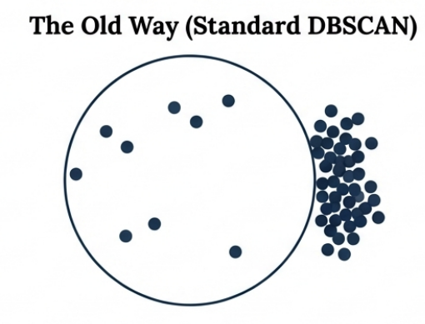
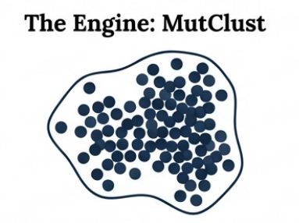
Paper 2: MutClust — Adaptive Density-Based Clustering
1. Beyond Global ε
• DBSCAN uses a fixed radius ε
for all points in the dataset.
Problem:
• 99.76% of positions fall into
a single mega-cluster.
• Only 4 clusters total.
A global radius cannot capture
local density variations in
mutation score distributions.
2. H-score Driven Local ε
Adaptive neighborhood size:
Deps = ⌈γ · Hᵢ⌉
(γ = 10)
Decay factor:
∂ = 3
Higher H-score → larger
neighborhood; decay controls
influence fall-off rate.
3. Hotspot Detection
477 hotspots identified
from 224,318 sequences.
CCM 4 Conditions:
• H > 0.03 (individual)
• Mean H > 0.01 (cluster avg)
• Sum H > 0.05 (cluster total)
• Mutations > 5 (min size)
Key Innovations:
Local Epsilon Adjustment: Expands or shrinks search boundaries dynamically based on the local H-score (y=10).
Diminishing Factor: Boundary edges dynamically attenuate (2=3) to drop low H-score bases and cleanly isolate biological hotspots.
Parameters: 5-dist plot valley = 500 → γ = 10, ∂ = 3 | Whole-genome, data-driven
Kyungpook National University | Dept. of Computer Science | Hwijun Kwon
16/22

Slide 17
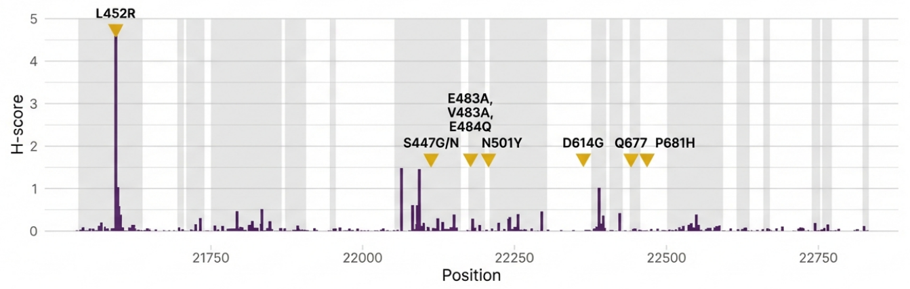
Paper 2: Hotspot Detection Results & Validation
Detection Summary
477 hotspots identified across 9/10 genes
• D614G, N501Y, E484K, K417N/T, P681H/R, L452R, etc.
• DBSCAN: 4 clusters (99.76% in one)
• MutClust: 477 meaningful hotspots
Bootstrap Validation
• 1,000 random same-size regions tested
• 3 metrics: mean H, max H, mutation count
• Benjamini–Hochberg (BH) correction applied
Kyungpook National University | Dept. of Computer Science | Hwijun Kwon
17/22

Slide 18
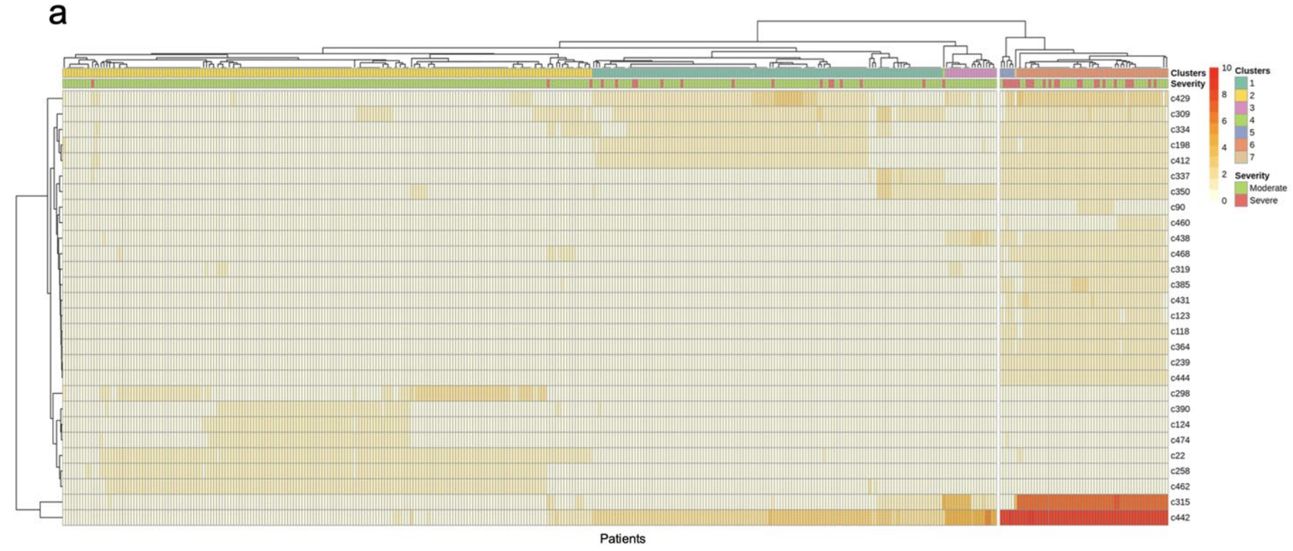
Paper 2: Severity & Biological Significance
Dominant Signatures in Severe Patients
SMS = Severe Mutation Signature
MMS = Moderate Mutation Signature
Hotspot c315 (Spike)
SMS avg 7.04 vs MMS avg 0.24
~30× difference
Hotspot c442 (ORF8/N)
SMS avg 9.04 vs MMS avg 1.23
~7× difference
Biological Implication
• c315 → immune recognition disruption
• c442 → NK cell overactivation
⚠ In silico; experimental validation needed
Kyungpook National University | Dept. of Computer Science | Hwijun Kwon
18/22

Slide 19
Paper 2: Influenza Cross-Validation
MutClust applied to 3 influenza strains with zero parameter changes — validating cross-virus generalizability.
A / H1N1 (26,703 sequences)
A / H3N2 (52,734 sequences)
B / Victoria (197,473 sequences)
• D222G (HA segment)
• 2009 pandemic high-mortality variant
• Captured without parameter tuning
• Up to 39 hotspots per segment
• All 8 gene segments analyzed
• Consistent hotspot detection
• across all 8 gene segments
• Validates mid-scale performance
• No predefined cluster count needed
• Same γ=10, ∂=3 parameters
• E627K (PB2 segment)
• Avian → human adaptation marker
• Captured at ~200K sequence scale
• Largest dataset tested
• Demonstrates robustness at scale
Cross-Virus Generalizability Confirmed
• Same parameters (γ=10, ∂=3) applied to SARS-CoV-2 and all 3 influenza strains without any modification
• Known functional mutations (D222G, E627K) successfully captured → MutClust is a universal viral surveillance tool
Kyungpook National University | Dept. of Computer Science | Hwijun Kwon
19/22

Slide 20
Paper 2 Summary
Paper 2 Key Contributions
• H-score unified metric
• MutClust 477 hotspots across 9/10 genes
• 28 severity hotspots + NK hypothesis
BioData Mining (2025, SCIE) | github.com/cobi-git/mutclust
Acknowledged Limitations
• In silico → experimental validation needed
• γ=10 SARS-CoV-2 specific
• Future: HIV, HBV, somatic mutations,
real-time surveillance
Kyungpook National University | Dept. of Computer Science | Hwijun Kwon
20/22

Slide 21
Conclusion: Computational Frameworks for Precision Medicine
1. Evaluating Methods (MOSD)
• How to design multi-omics integration studies?
• 9-factor benchmark → data-driven thresholds (26 samples, 10% features, 3:1 ratio)
• 10 methods evaluated → method selection guidelines per research context
2. Creating Methods (MutClust)
• How to extract clinical insights from viral mutations?
• H-score + adaptive clustering → data-driven hotspot detection (γ from 5-dist plot)
• 477 hotspots, 28 severity-linked → NK cell immune evasion hypothesis
3. Unifying Theme: Data-Driven Discovery
• Paper 1 evaluates existing methods → Paper 2 creates a new one (evaluator → creator)
• Both discover quantitative thresholds from data, not arbitrary cutoffs
• Unsupervised clustering + rigorous validation → biological insight, open source
Kyungpook National University | Dept. of Computer Science | Hwijun Kwon
21/22

Slide 22
Thank You
Q & A
Hwijun Kwon | Advisor: Prof. Inuk Jung
Dept. of Computer Science, KNU
BMC Genomics (2025, SCIE) | BioData Mining (2025, SCIE)
github.com/cobi-git/mosd | github.com/cobi-git/mutclust
Kyungpook National University | Dept. of Computer Science | Hwijun Kwon
22/22

